Slide 1
Solar Probe Plus Requirements Plan & Context
Dan Kelly
SPP Requirements & Verification Engineer

Slide 2
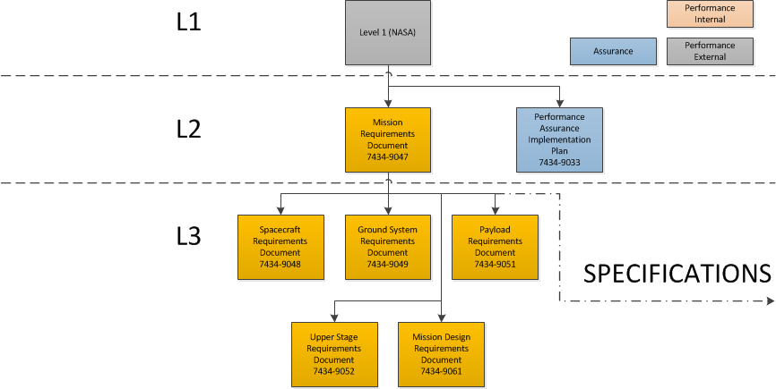
Level 2 – Mission (MRD)

Slide 3
Level 3 – Payload (PAY)

Slide 4
Allocation & Traceability
Performance Document in question (i.e. PAY) is central verification document for subject
Requirements traceable to parent performance document
Requirements allocated to documents one level below
Functional leads given oversight into many or all documents (tracking enabled by DOORS)
Timekeeping
Fault Management
I&T
Links traceable between sibling documents in certain cases
Specifications referenced via “compliance” requirements (liens)
Non-verifiable documents (i.e. plans) handled case-by-case (derived requirements, verification by inspection)

Slide 5
Requirement Subjects
The name of an investigation refers to any or all parts of the team, including flight components (sensors, boards), ground components (SOCs) or the team entity
FIELDS
SWEAP
WISPR
ISIS
A particular sensor or instrument refers only to specific flight components. All measurement requirements are at the instrument/sensor level
FIELDS: MAG, SCM, EFI
SWEAP: SPC, SPAN-A+, SPAN-B
WISPR: WISPR
ISIS: EPI-Lo, EPI-Hi
“All instruments” refers to all flight components
“All Science Operations Centers” refers to all SOCs

Slide 6
Verification Method
SPP Requirements track Verification Method and Activity
Methods: Test, Analysis, Demonstration, Inspection
Activity specifies type of T, A, I, or D to fulfill verification
Majority of all PAY document requirements are verified at Level 3 by ‘Inspection’
Traditional T A I D methods implemented at Level 4 (instrument teams top-level)
Level 3 requirements ‘Inspect’ verified Level 4 requirements flowed down from Level 3

Slide 7
Compliance Requirements
Nomenclature of document types
Payload Requirements Document – ‘Performance’ Requirements Document
‘Specification’ Documents comprised of Environmental documents and ICDs – contain verifiable information relevant to multiple elements or subsystems
PAY document section dedicated to compliance with various specification documents
Relevant requirements developed, validated, tracked, and verified within Specification document
Verification of ‘Compliance’ requirements within PAY ensure full verification of relevant requirements held in Specifications
“Placeholder” requirements currently held in PAY that will likely migrate to Specifications noted as such – in backup slides

Slide 8
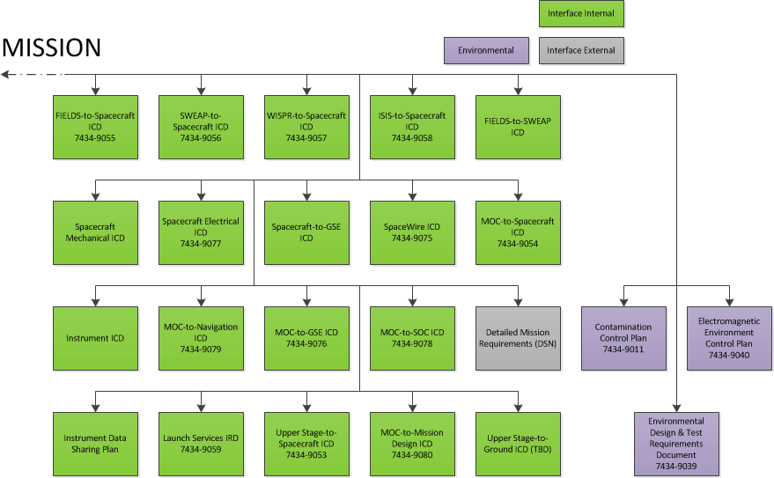
Specification Documents

Slide 9
Presentation Sample
ID Number – Requirement Title
Requirement Text. Description/Clarification Additional information used to help interpret the intended meaning of the requirement (if necessary)
Rationale | Requirement Allocation
Used to describe why requirement is necessary (explanation or linking to upper-level requirement). This section is mandatory for requirement validation. | List of planned allocated documents for this requirement.
Parent Traceability | Functional Allocation
If applicable, the upper-level requirement to which this requirement is traceable. | If applicable, list of “flagged” functions for cross-functional analysis. Fault Protection Timekeeping I&T

Slide 10
PAY Schedule
5/24: Payload Requirements Document Peer Review
5/27 – 6/7: Incorporate feedback & action items
6/24: Baseline document distributed for signature
8/30 : PDR Deliverables Due

