Slide 1
Solar Probe Plus
Introduction (payload focus)
Jim Kinnison
SPP Mission System Engineer
Jim.Kinnison@jhuapl.edu

Slide 2
Science Questions Addressed by Solar Probe Plus
Overarching Science Objective
  To determine the structure and dynamics of the Sun’s coronal magnetic field, understand how the solar corona and wind are heated and accelerated, and determine what mechanisms accelerate and transport energetic particles.
Detailed Science Objectives
  Trace the flow of energy that heats and accelerates the solar corona and solar wind.
  Determine the structure and dynamics of the plasma and magnetic fields at the sources of the solar wind.
  Explore mechanisms that accelerate and transport energetic particles.

Slide 3
Level 1 Objectives & Processes require high quality, integrated measurements
L1 Science Objectives | Sample Processes | Needed Measurements | Instruments
1. Trace the flow of energy that heats and accelerates the solar corona and solar wind. 2. Determine the structure and dynamics of the plasma and magnetic fields at the sources of the solar wind. 3. Explore mechanisms that accelerate and transport energetic particles. | - heating mechanisms of the corona and the solar wind; - environmental control of plasma and fields; - connection of the solar corona to the inner heliosphere. - particle energization and transport across the corona | - electric & magnetic fields and waves, Poynting flux, absolute plasma density & electron temperature, spacecraft floating potential & density fluctuations, & radio emissions - energetic electrons, protons and heavy ions - velocity, density, and temperature of solar wind e-, H+, He++ - solar wind structures and shocks | FIELDS Magnetic Field Electric Field Electric/Mag Wave ISIS Energetic electrons Energetic protons and heavy ions (10s of keV to ~100 MeV) SWEAP Plasma e-, H+, He++ SW velocity & temperature WISPR - White light measurements of solar wind structures

Slide 4
SPP Investigations to Answer the Science Questions
Investigation | Instruments | Measurements
Fields Experiment (FIELDS) – S. Bale, Univ. of California, Berkeley | 4 x Electric Antennas 2 x Fluxgate Magnetometers (MAG) 1 x Search Coil Magnetometer (SCM) | electric & magnetic fields and waves, Poynting flux, absolute plasma density & electron temperature, spacecraft floating potential & density fluctuations, & radio emissions
Integrated Science Investigation of the Sun (ISIS) – D. McComas, Southwest Research Institute | High energy Energetic Particle Instrument (EPI-Hi) Low energy Energetic Particle Instrument (EPI-Lo) | energetic electrons, protons and heavy ions (10s of keV to ~100 MeV)
Solar Wind Electrons Alphas and Protons (SWEAP) - J. Kasper, Smithsonian Astrophysical Observatory | Solar Probe Cup (SPC) 2 Solar Probe ANalyzers (SPAN) | velocity, density, and temperature of solar wind electrons, protons and helium ions
Wide-field Imager for Solar PRobe (WISPR) – R. Howard, Naval Research Laboratiry | White light imager | images the solar wind, shocks and other structures in the solar corona and inner heliosphere
Heliospheric Origins with Solar Probe Plus (HeliOSPP) – M. Velli, Jet Propulsion Laborar | Observatory Scientist | addresses SPP science objectives via multi-instrument data analysis and provides independent advice to optimize the scientific productivity of the mission

Slide 5
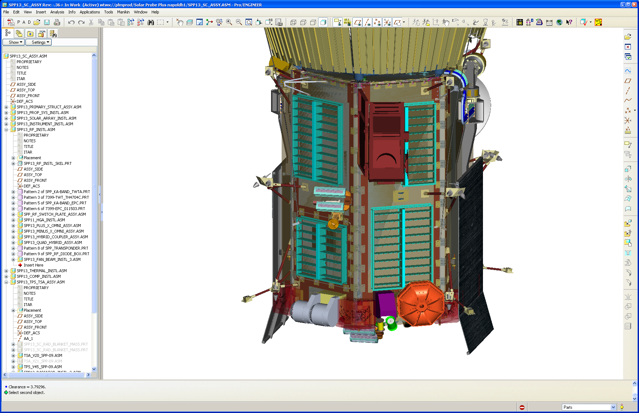
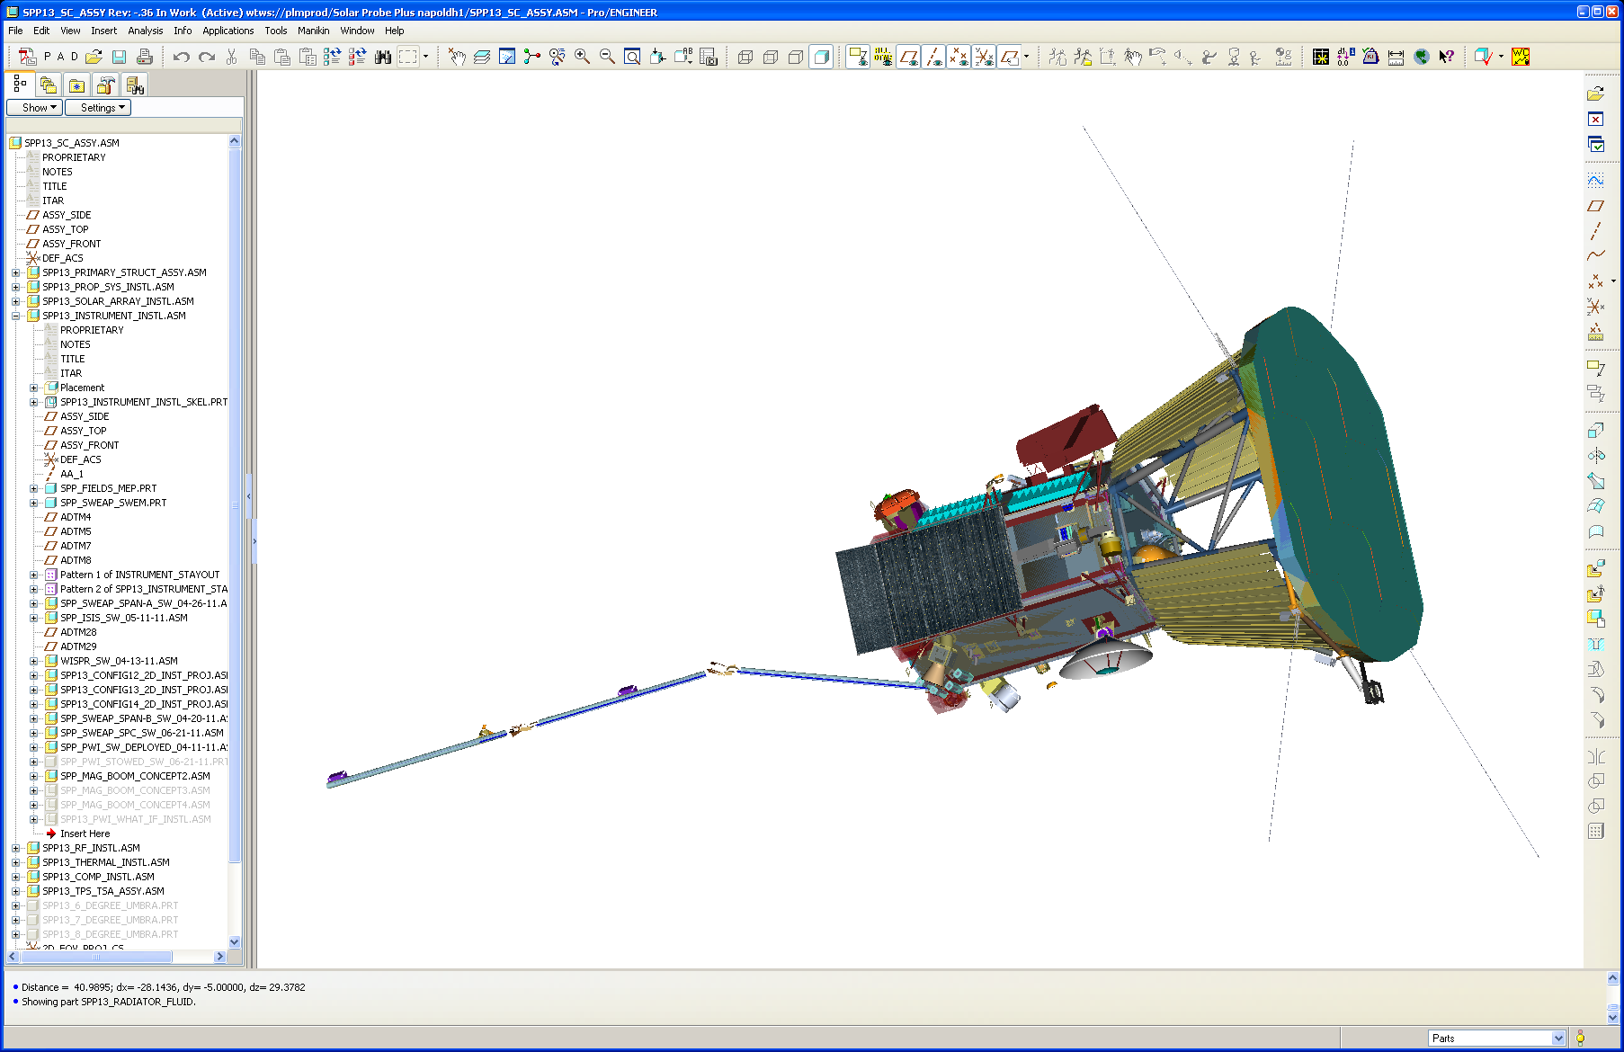
Solar Probe: Science Payload
FIELDS:
  PI: Stuart Bale, UC Berkeley SSL
  PWI (Plasma Waves Instrument)
  MAG (Magnetometer)
SWEAP (Solar Winds Electrons Alphas and Protons):
  PI: Justin Kasper, Smithsonian CFA
  SPC (Solar Probe Cup)
  SPAN (A & B)
ISIS (Integrated Science Investigation of the Sun)
  PI: Dave McComas, SWRI
  EPI-Hi
  EPI-Lo
WISPR (Wide-field Imager for Solar Probe)
  PI, Russell Howard, NRL
WISPR
EPI-Lo
EPI-Hi
SPAN-A
PWI Whips
MAG
FGMs
MAG
SCM
SPAN-B
SPC
PWI Whips

Slide 6
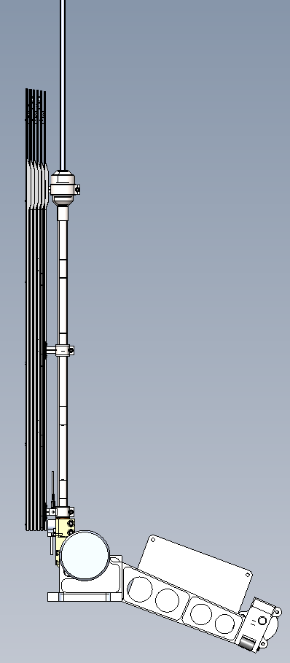

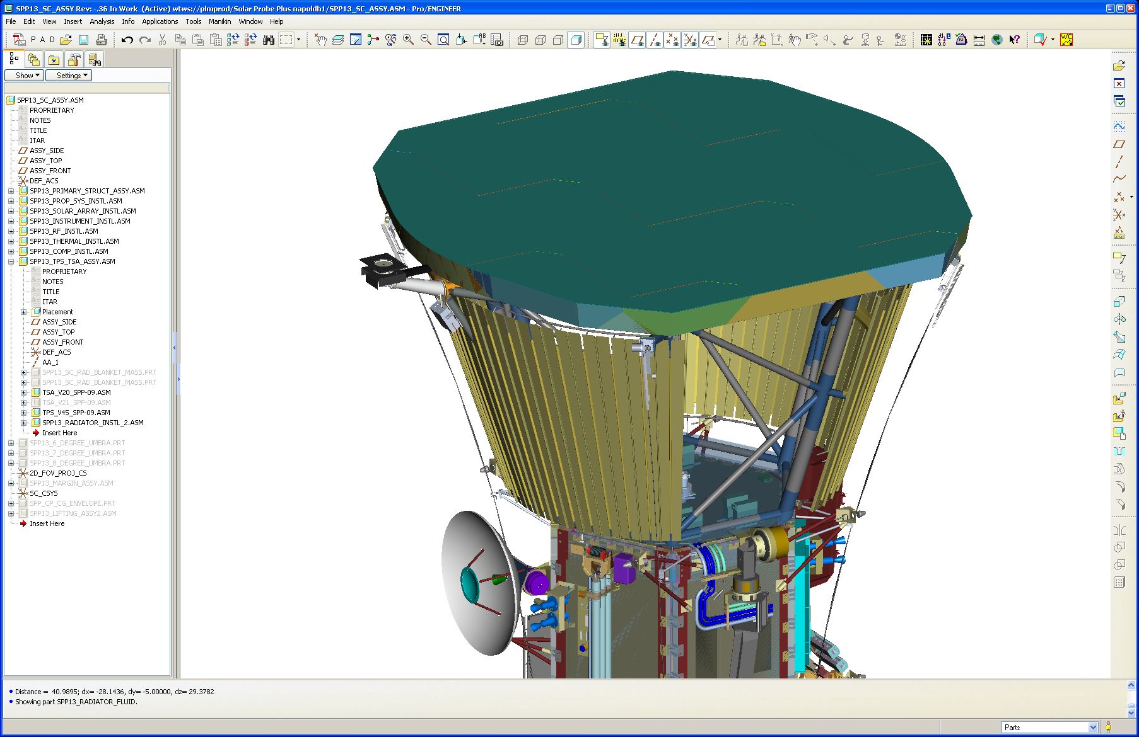
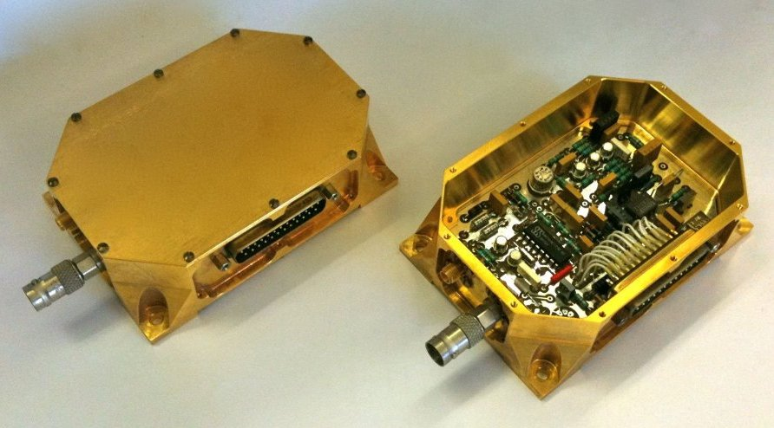
FIELDS PWI (Plasma Waves Instrument)
Measures DC & AC electric fields
2.3 m electric field antennas:
  4 whips (2 co-linear pairs) exposed beyond umbra: Niobium C-103 tube
  Canted 5º from orthogonal (for WISPR FOV reasons)
  Mounted on TSA (coplanar) behind TPS
  Heat shield: layers of Niobium sheet
  Whips stowed back along S/C
  P5 Pin-puller actuators (two per antenna: whip cage & hinge)
  Dampers control deployment speed
FIELDS Instrument Control Unit (ICU) provides internal processing, buffers data & controls both PWI and MAG
Institutions: UC Berkeley, Univ. of Minnesota, LASP (CU, Boulder), LESIA (Obs de Meudon, France)
Whip
Thermal
Isolator
PWI
Whips
Heat
shield
Stub
Hinge
Release
Mechanism
PWI
Whips
Hinge/damper
Preamp
Stowed PWI Whips

Slide 7
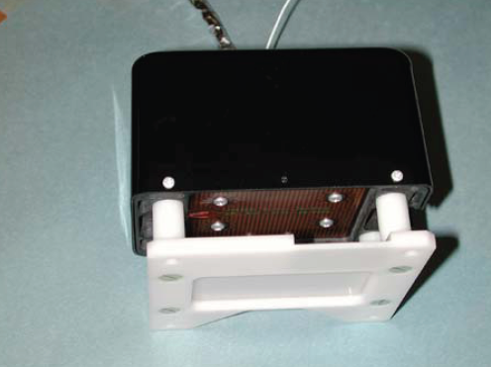
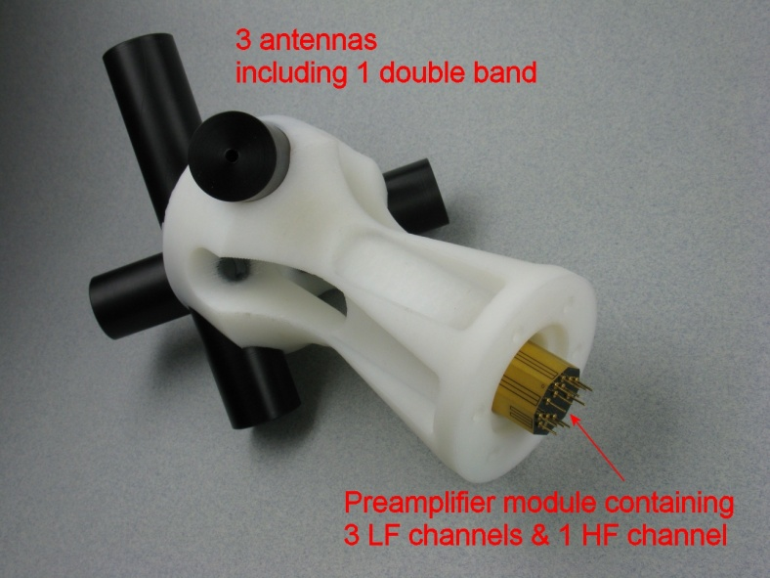
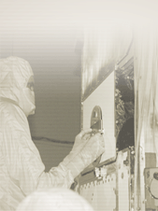
FIELDS MAG (Magnetometer)
2 fluxgate magnetometers (FGMs, inboard and outboard) for DC magnetic field
1 vector search-coil magnetometer (SCM) for AC magnetic fluctuations
SCM and FGMs aligned on centerline (z-axis) of S/C
Mounted on a ~4-m boom (APL-provided)
FIELDS Instrument Control Unit (ICU) provides internal processing, buffers data & controls both PWI and MAG
Institutions: UC Berkeley, NASA/Goddard Space Flight Center, Laboratoire de Physique et Chimie de l’Environnment et de l’Espace (LPC2E, France)
FIELDS FGMs
FIELDS SCM
7

Slide 8
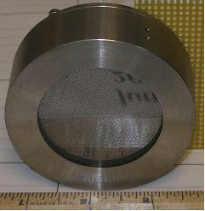
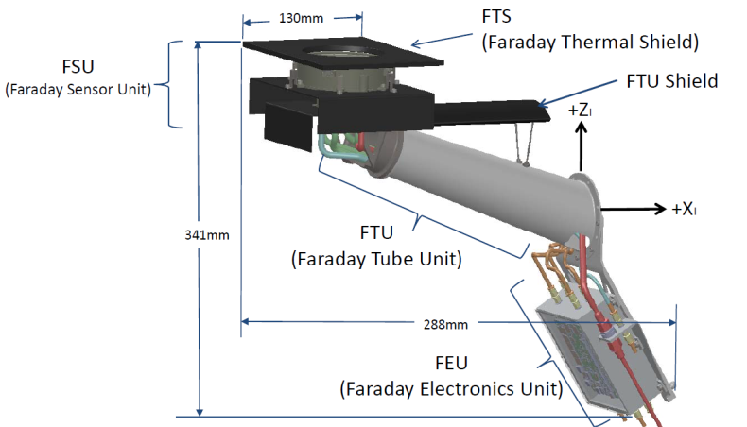
SWEAP SPC (Solar Probe Cup)
Solar Probe Cup (SPC)
  Sensor in direct sunlight
  Faraday Cup faces Sun for high cadence bulk ion & electron measurements
Uses same SWEM (SWEAP Electronics Module) as SPAN-A and –B (UC, Berkeley)
  Electrical interface to spacecraft
  Controls SPC & SPAN, formats data products, buffers data
  Includes SAO boards:
    Analog Processing Board (APB): analyzes analog signals from SPC
    High Voltage Modulator Board (HMB): produces high voltage signal for SPC’s modulator grid
Smithsonian Astrophysical Observatory (SAO)
Above right: SPC mounted on TSA
Above left: SPC prototype
Above: SPC details

Slide 9
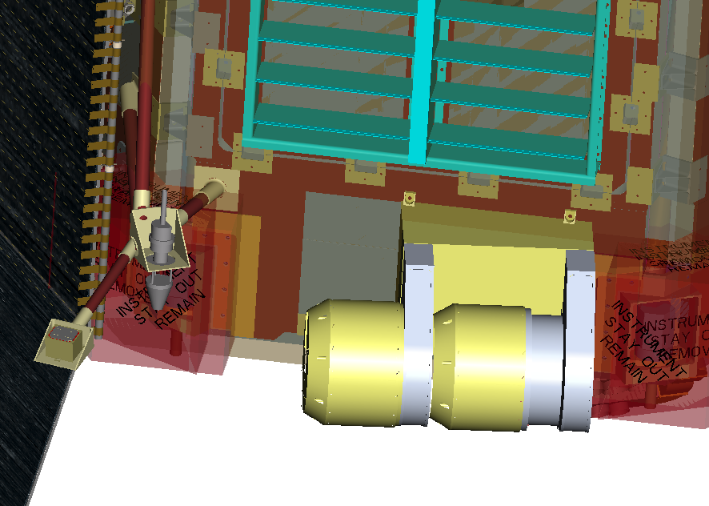
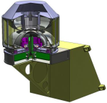
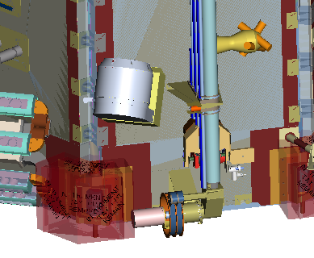
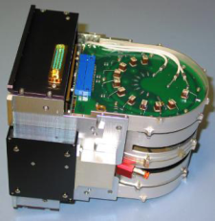
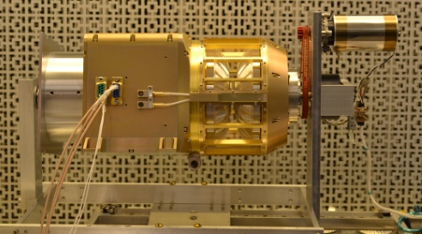
SWEAP: SPAN-A and –B (Solar Probe Analyzers)
Solar Probe Analyzers (SPAN)
  Electrostatic analyzers (ESAs) in shadow at back of spacecraft on RAM (SPAN-A) & anti-RAM (SPAN-B) sides
  Detailed measurements of 3D ion & electron velocity distribution functions
  SPAN-A Plus enhancement:
    Added time of flight (TOF) section to provide mass per charge resolution.
    Separates minor ion species, enabling distinct proton & alpha velocity distribution functions.
Uses SWEM (SWEAP Electronics Module) interface, along with SPC
  Electrical interface to spacecraft
  Controls SPC & SPAN, formats data products, buffers data
UC, Berkeley, Space Sciences Lab (SSL), as part of SAO SWEAP Investigation
Above: SPAN-A-Plus on Ram-side
Above: SPAN-B: Anti-ram: observes electrons
Above left: THEMIS ESA (heritage)
Above right: MAVEN Solar Wind Ion Analyzer (SWIA)

Slide 10
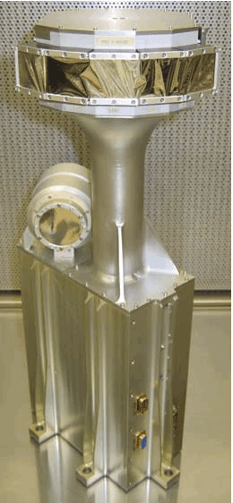
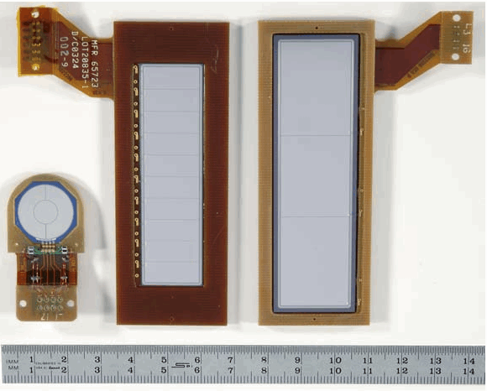
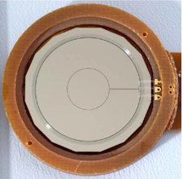
ISIS-EPI-Hi Summary
Measures energetic particle spectra, composition, and angular distributions using the dE/dx vs. E technique in a sensor system consisting of:
  Double-ended High Energy Telescope (HET)
  Two Low Energy Telescopes (LETs), one of which is double-ended (LET1) and one of which is single-ended (LET2)
Together they cover ~1 to >100 MeV/ nuc for protons and heavy elements and ~0.5 to 6 MeV for electrons
EPI-Hi has its own internal data buffering and processing capability
Caltech/JPL/SWRI
LET
HET
PEDESTAL
EPI-Hi
ELECTRONICS BOX
Above: STEREO/IMPACT LET & HET
(EPI-Hi heritage)
Above: STEREO LET & HET Si Detectors

Slide 11

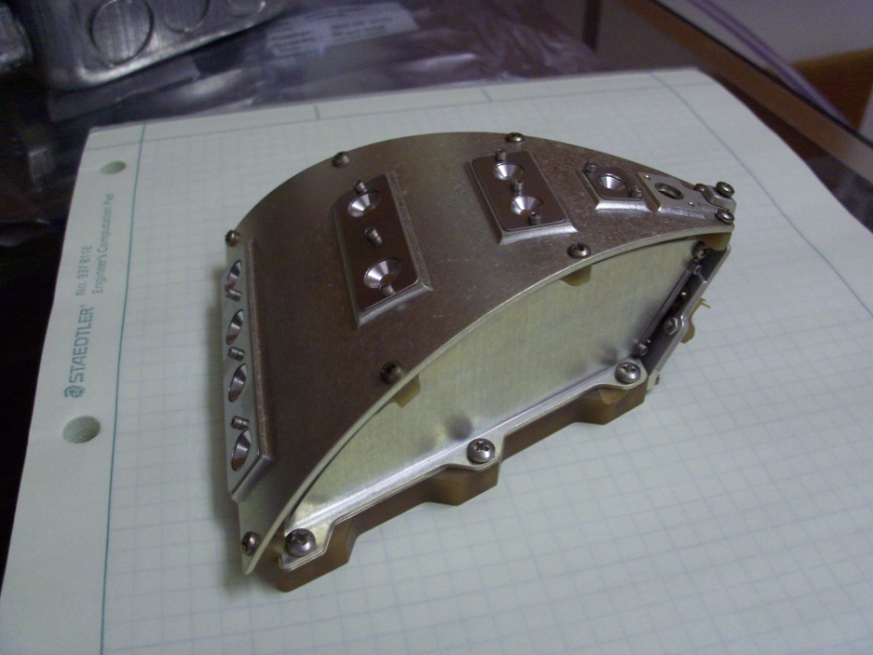
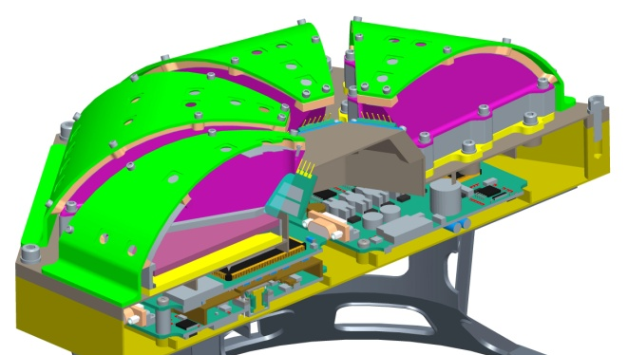
ISIS-EPI-Lo Summary
High-heritage TOF-based mass spectrometer that measures:
  energetic electron (25-500 keV)
  ion spectra (~0.02-7 MeV protons & 0.02-2 MeV/nuc heavier ions)
  Resolves all major heavy ion species and ³He and ⁴He over much of this energy range in multiple directions.
  ³He measured as a key indicator of impulsive events.
Covers the critical energy range from suprathermal energies (~20 keV/nuc) up to the lower portion of EPI-Hi energy range with a single instrument
EPI-Lo has its own internal data buffering and processing capability
APL/SWRI
EPI-Lo
10 Look Directions
per Wedge
Above: EPI-Lo PIDDP single-wedge prototype
EPI-Lo Wedge

Slide 12
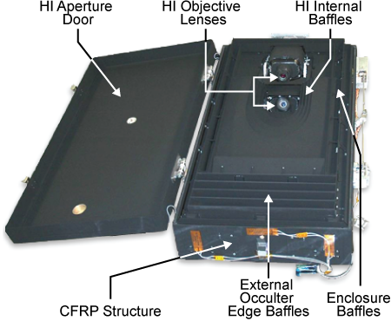
WISPR (Wide field Imager for Solar Probe)
Wide-Field Imager of the Heliosphere
Visible light observations (500-700 nm)
Only mechanism is a one-shot door (Starsys paraffin actuator with LED/photodiode encoders)
2 telescope design, with 2 next-generation 2K x 2K APS sensors
Heritage from SECCHI/HI (STEREO)
Images of coronal structures when they are close to the Sun, as they approach, and as they pass over the spacecraft
Varying viewpoint supports fine-scale 3D reconstructions
Image slow and fast solar wind structures and fluctuations directly
Image CMEs and Shocks
Provides the links between the solar wind structure and SPP in-situ instruments.
APL provides WISPR DPU (Data Processing Unit)
Naval Research Lab (NRL)
WISPR
SECCHI/HI Heritage

Slide 13
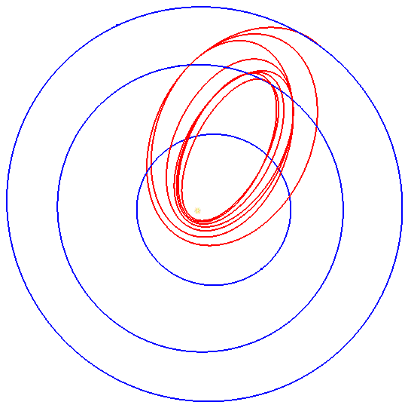
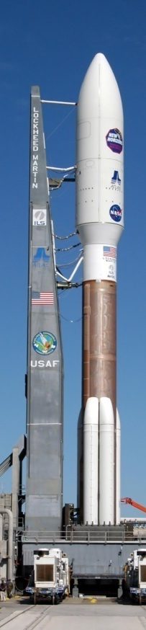
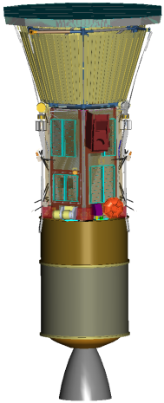
Reference Mission: Launch and Mission Design Overview
Launch
  Dates: Jul 31 – Aug 19, 2018 (20 days)
  Max. Launch C3: 154 km²/s²
  Requires Atlas V 551 class with Upper Stage
Trajectory Design
  7 Venus gravity assist flybys
Final Solar Orbits
  Perihelion: 9.86 R_{S}
  Aphelion: 0.73 AU
  Inclination: 3.4 deg from ecliptic
  Orbit period: 88 days
Mission duration: 7 years
1st Min Perihelion
at 9.86 R_{S}
12/19/2024
Launch
7/31/2018
Sun
Mercury
Venus
Earth
1st Perihelion
at 35.7 R_{S}
11/1/2018

Slide 14
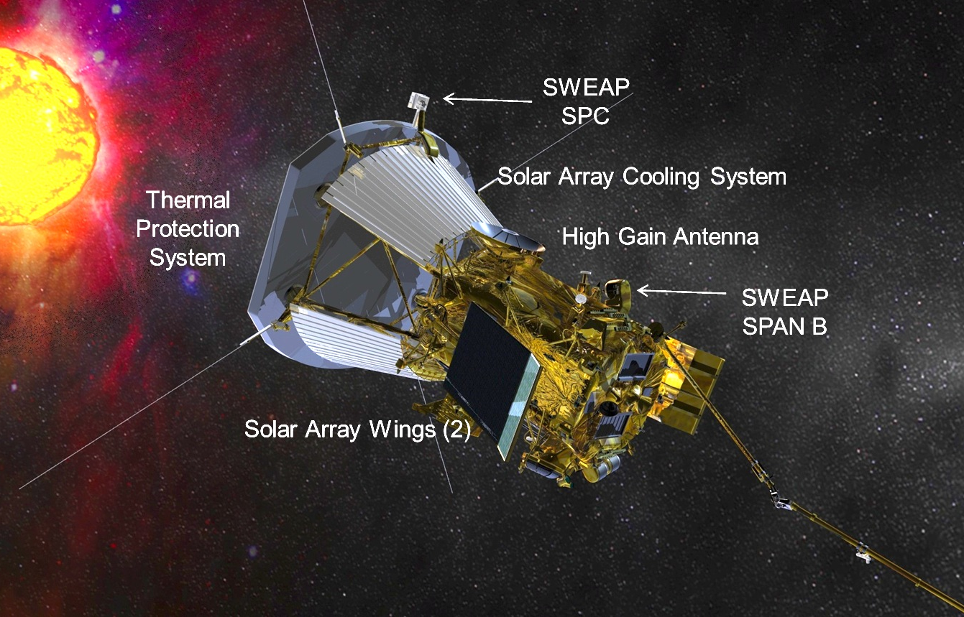
Reference Vehicle:
Anti-Ram Facing View

Slide 15
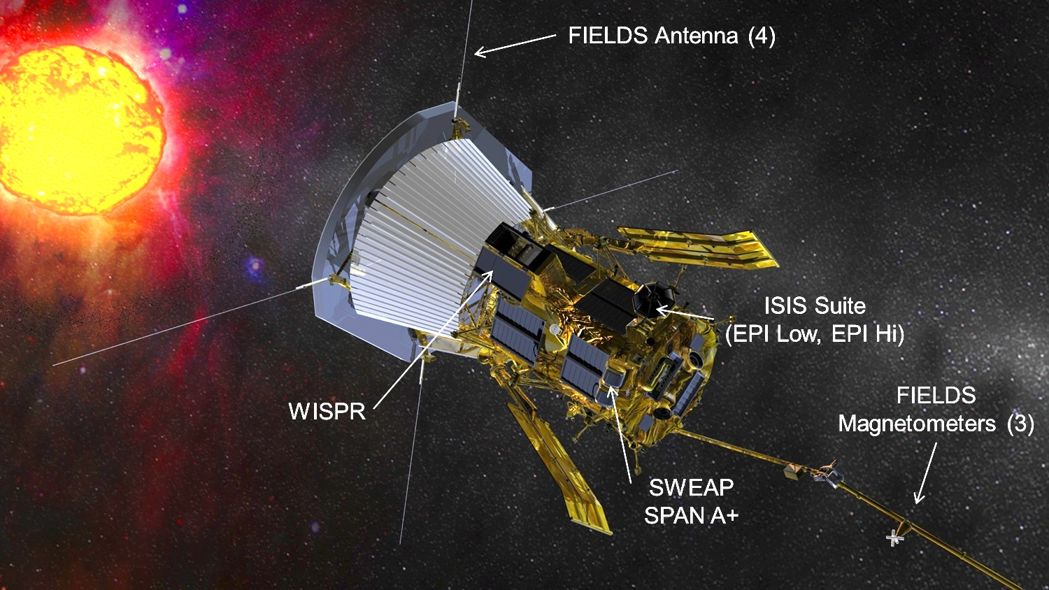
Reference Vehicle:
Ram Facing View

Slide 16
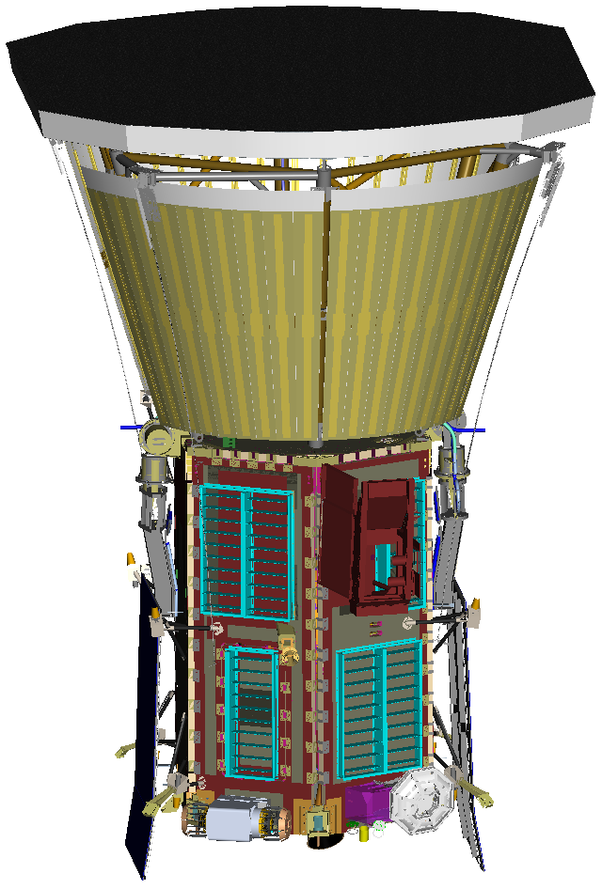
Spacecraft Overview
NASA selected instrument suites
665 kg max launch wet mass
Reference Dimensions:
  S/C height: 3m (TBR)
  TPS max diameter:2.3m (TBR)
  S/C bus diameter: 1m (TBR)
C-C Thermal protection system
Hexagonal prism s/c bus configuration
Actively cooled solar arrays
  364W (TBR) electrical power at encounter
  Solar array total area: 1.54m² (TBR)
  Radiator area under TPS: 4.4m² (TBR)
0.6m HGA, 34W TWTA Ka-band science DL
Science downlink rate: 163kb/s (TBR) at 1AU
Blowdown monoprop hydrazine propulsion
Wheels for attitude control

Slide 17
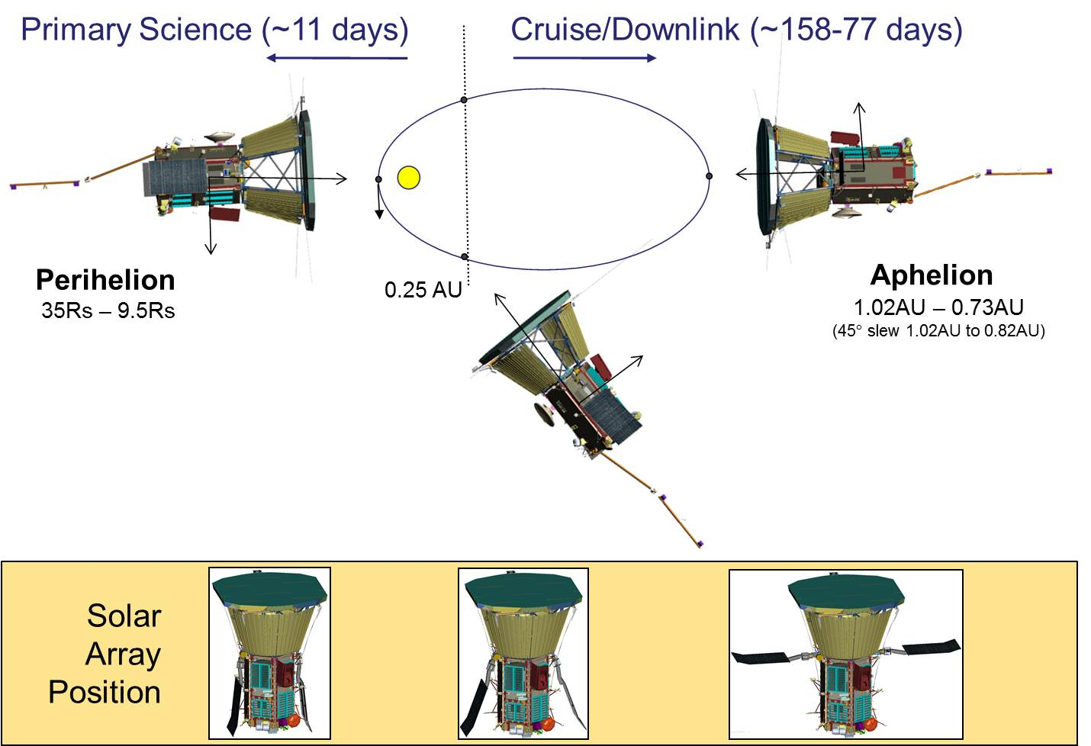
Reference Vehicle:
Concept of Operations

Slide 18
Backup

Slide 19
Block Diagram
February Baseline

Slide 20
Solar Probe Plus Organizational Chart
NASA
Science Mission Directorate
Heliophysics Division
Acting Director: V. Elsbernd
Program Scientist: M. Guhathakurta
Program Executive: J. Lee
GSFC LWS Program Office
Program Manager: N. Chrissotimos
PM for APL Projects: M. Goans
Mission Scientist: A. Szabo
SD Management
EPO
TBD
Solar Probe Plus Project Office
Project Manager: A. Driesman
Deputy Project Manager: E. Reynolds
Deputy PM for Instruments: P. Hill
Project SAM: L. Becker
Planning Manager: C. Battista
Financial Manager: J. Rodgers
Obs Scientist – JPL
M. Velli*
ISIS – SwRI
PI: D. McComas
PM: S. Weidner
Mission System Engineer
MSE: J. Kinnison
DMSE: M. Lockwood
Project Scientist
N. Fox
Upper Stage Project
PjM: C. Engelbrecht
WISPR – NRL*
PI: R. Howard
PM: S. Plunkett
FIELDS – UCB
PI: S. Bale
PM: P. Harvey
SWEAP – SAO
PI: J. Kasper
PM: J. Bookbinder
* Funded directly by NASA

Slide 21
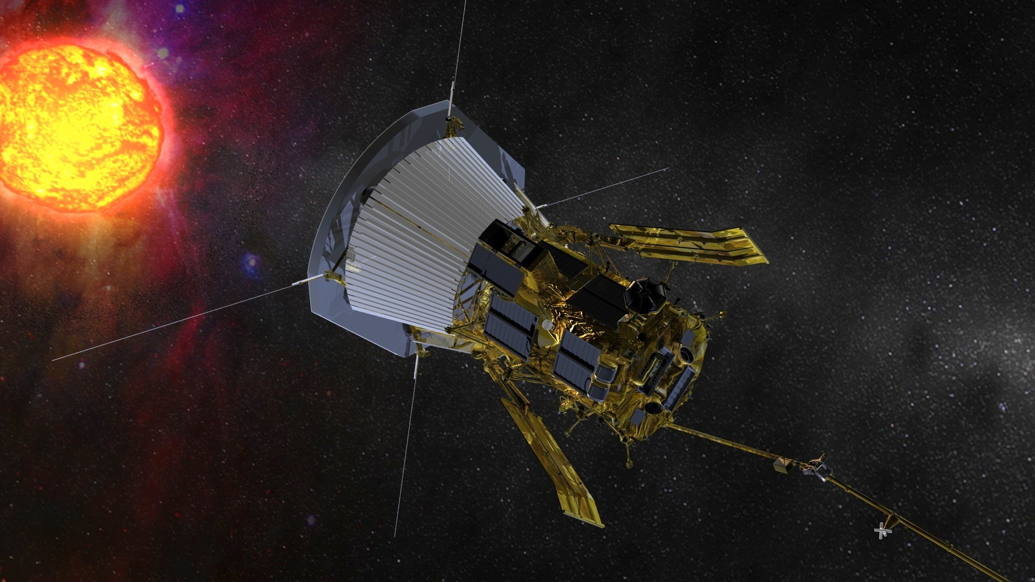
Solar Probe Plus Quad Chart
Overview
Using in-situ measurements made closer to the Sun than by any previous spacecraft, SPP will determine the mechanisms that produce the fast and slow solar winds, coronal heating, and the transport of energetic particles.
Solar Probe Plus will fly to less than 10 solar radii (Rs) of the Sun, having “walked in” from 35 Rs over 24 orbits.
Preliminary Mission Milestones
(Assuming 2018 Launch)
Pre-Phase A: 07/2008 – 11/2009
Phase A: 12/2009 – 01/2012
Phase B: 02/2012 – 03/2014
Phase C/D: 03/2014 – 08/2018
Phase E: 09/2018 – 09/2025
Sponsor: NASA SMD/Heliophysics Div
  Program Office – GSFC/LWS
  Project Scientist - APL
  Project Management - APL
  S/C Development & Operations – APL
  Science Investigations selected by AO:
    SWEAP - Smithsonian Astrophysical Observatory
    FIELDS - UC Berkeley
    WISPR - Naval Research Laboratory
    ISIS – Southwest Research Institute
    HelioOrigins – Jet Propulsion Laboratory

Slide 22
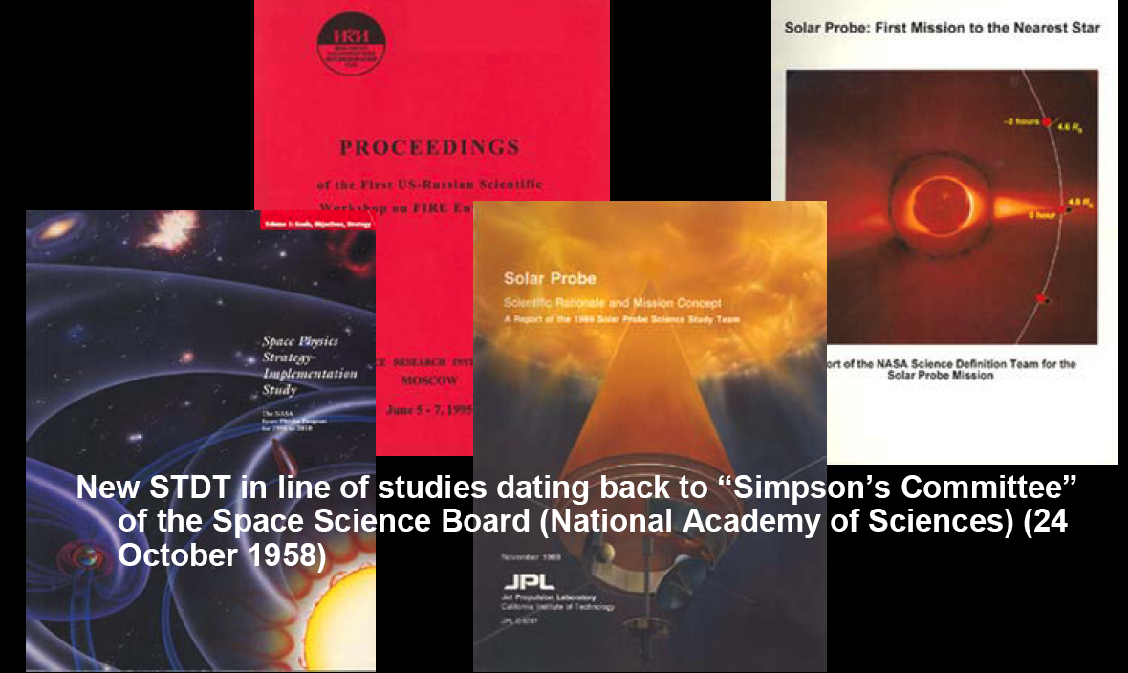
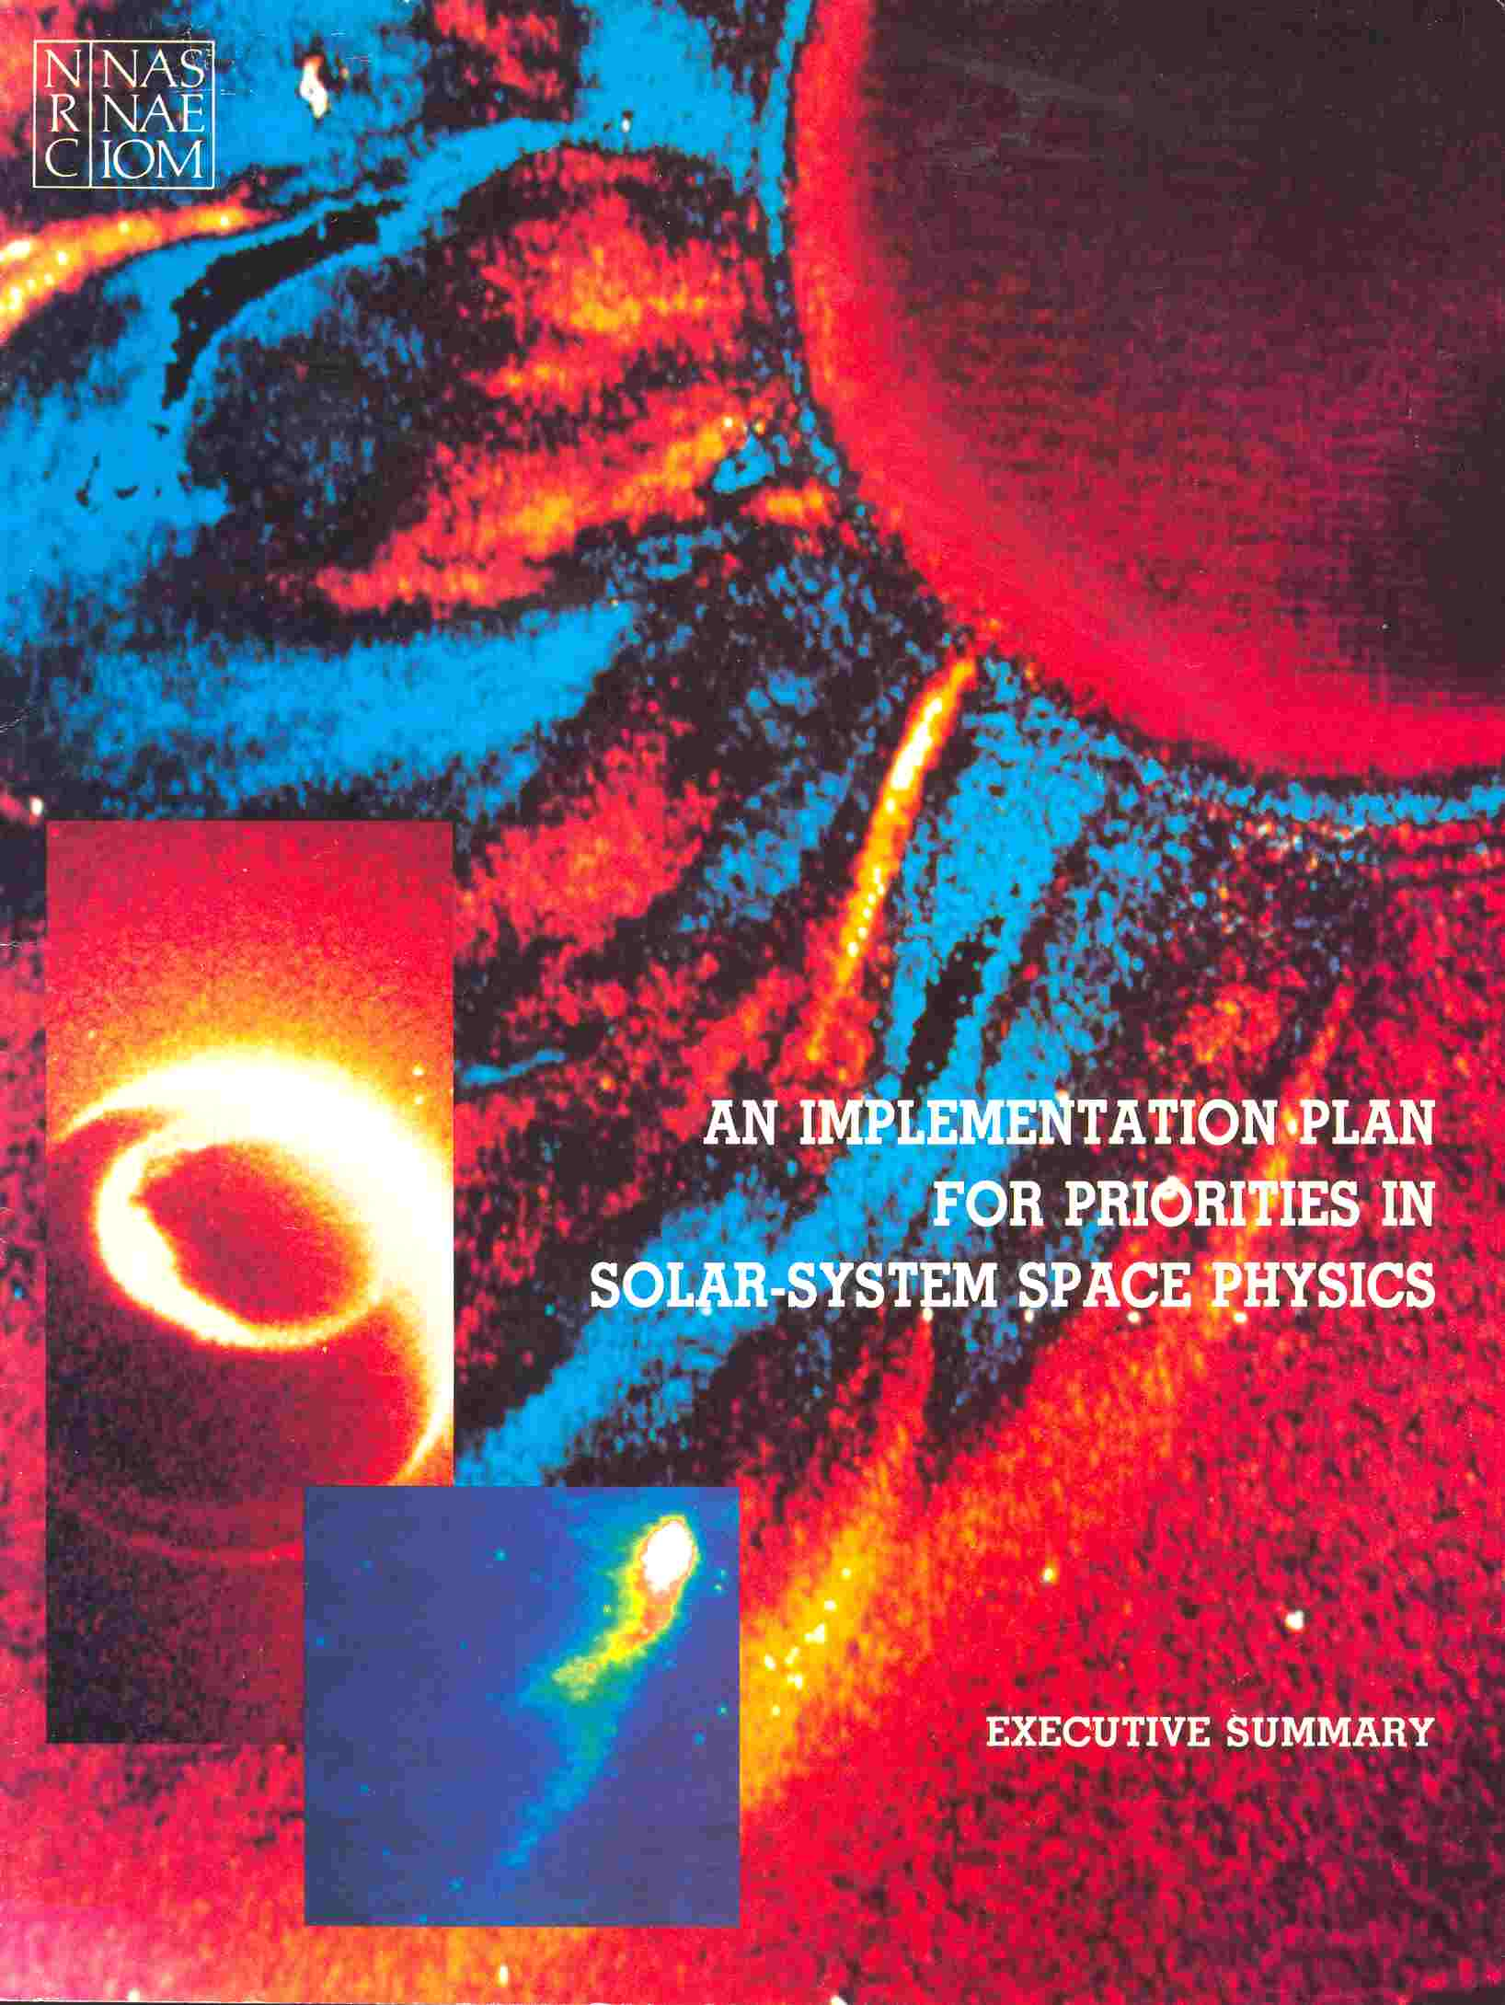
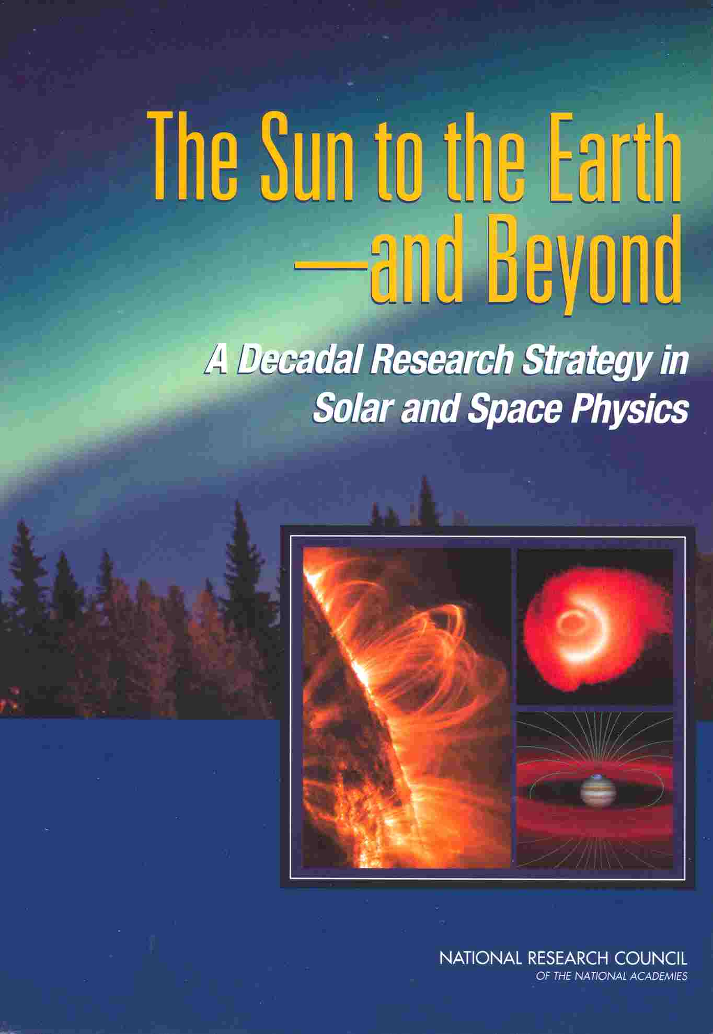
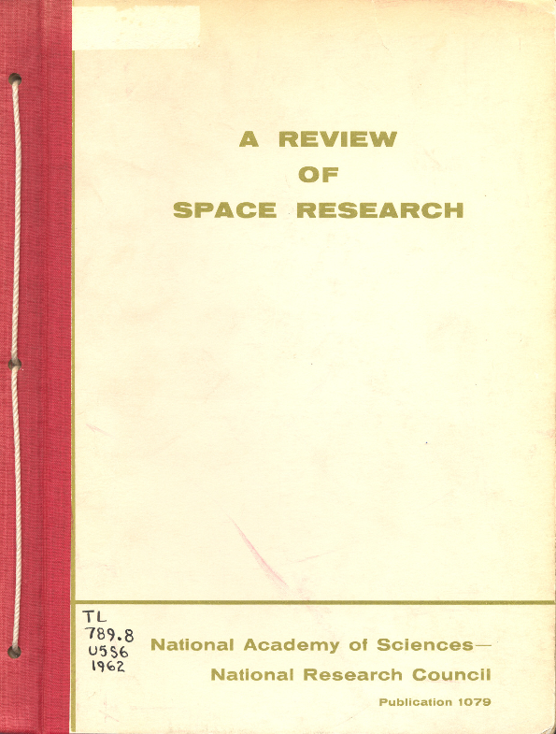
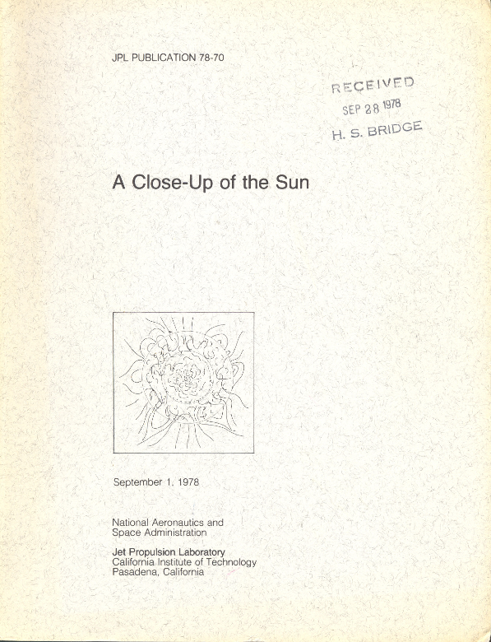
Solar Probe History (1958 - present)
Solar Probe studies, reports; NAS: 1962, 1985, 1995, 2003
Notes:
22
Opportunity to talk for a moment on the long history of an SPP-like mission

Slide 23
System Engineering
Organization
Mission System Engineer
Jim Kinnison
Mary Kae Lockwood (Deputy)
Fault Management
Sanae Kubota
EMI/EMC
Carl Herrmann
Parts
David Bonner
Requirements
Dan Kelly
Contamination Control
John Nichols
Materials and Processes
Tyler Langley
Reliability
Clay Smith
Radiation
Dave Roth
Data System Engineer
Alan Mick
Charging
Michelle Donegan
Mission Design/Navigation
Yanping Guo
Integration & Test
Mike Colby
Spacecraft SE
Mary Kae Lockwood
Rich Conde (Deputy)
Payload SE
John Boynton
Ground System HW
Walter Mitnick
Upper Stage SE
Rich Anderson
Mission Software SE
Mike Furrow
Mission Operations
Nick Pinkine
Launch Vehicle Integration Manager
Steve Vernon

Slide 24
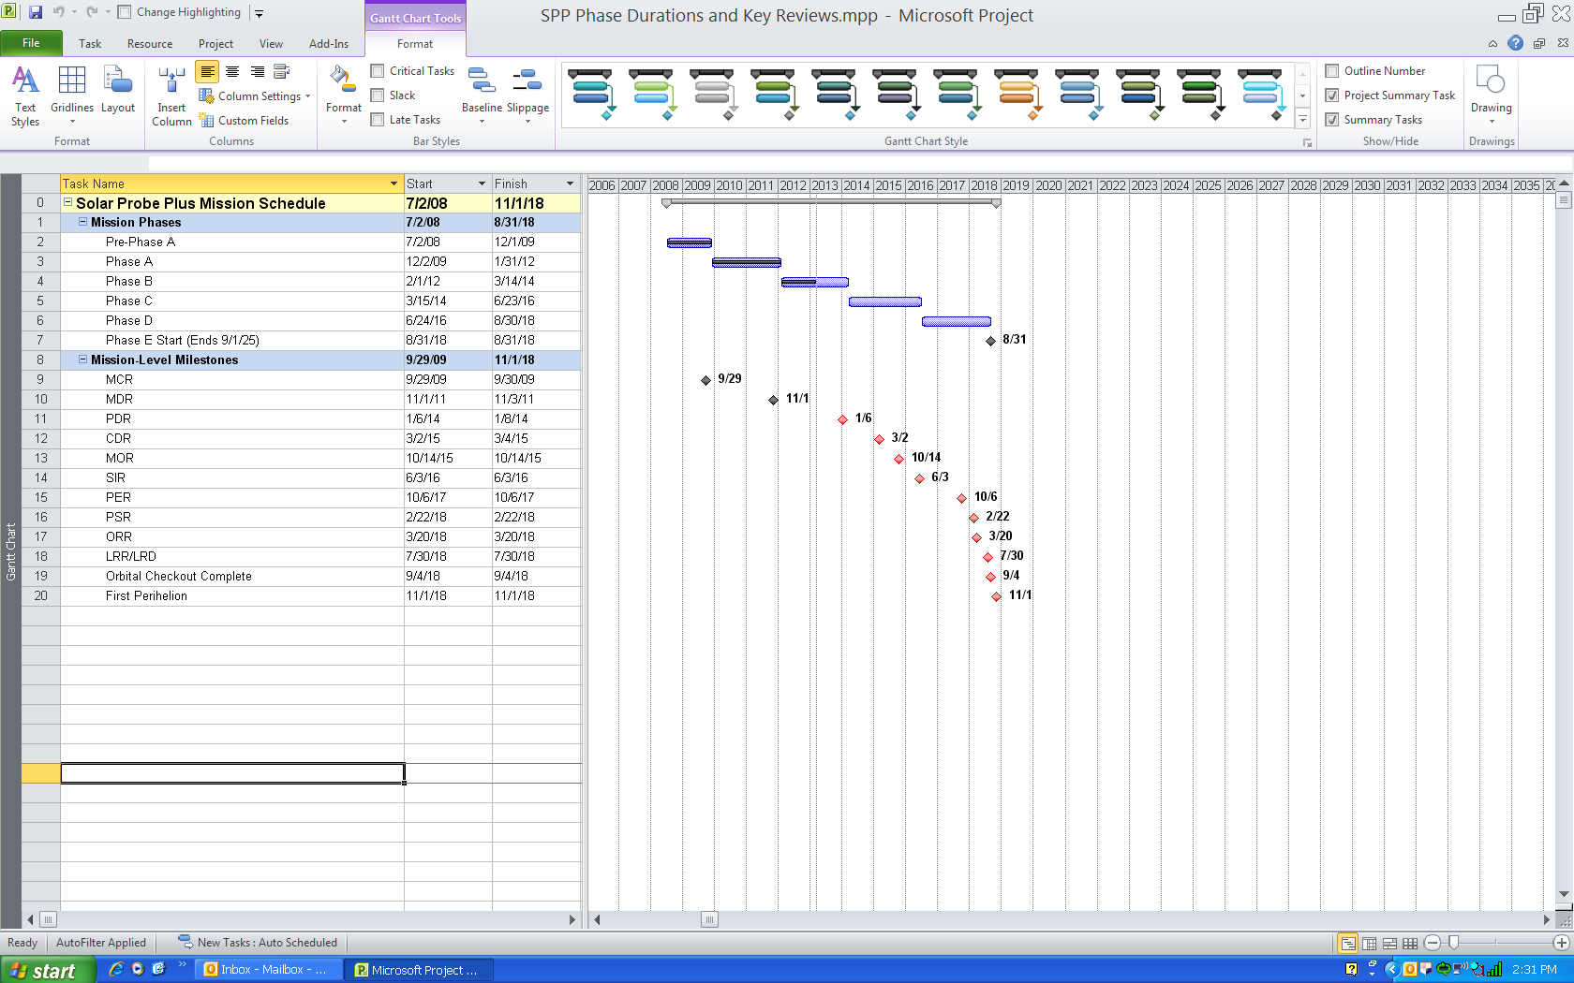
Phase Duration and Key Reviews

Slide 25
Spacecraft Technology Development
Subsystem | Description | Development Plan
Thermal Protection System (TPS) | Lightweight, non-ablative insulating layer. Provides umbra to protect spacecraft from near-Sun environment. Shaped to provide “knife edges” for solar array wings and “chamfers” for Solar Limb Sensors. | Significant materials and coatings testing. Full-scale mechanical prototype tested in the launch environment. Subscale prototype used in thermal testing in perihelion environment.
Solar Array Cooling System | Pumped-water cooling system for thermal control of the solar cell wings. Dissipates ~6000 W of heat at perihelion and is designed and operated to prevent freezing at aphelion. | Additional wing and radiator fabricated and structurally tested for launch environment. Full-scale “1/2” cooling system prototype in fabrication to include one wing, two radiators and pump. Testing includes thermal and hydraulic performance.
Solar cells | Primary and secondary sections with fixed cant angle between sections. Secondary section uses a thermally optimized cell stack illuminated to about 25 Suns at perihelion. | Full size secondary section in fabrication, including water-cooled substrate and flight-like cell assemblies to be tested at high solar irradiance, high temperature conditions.
Solar Limb Sensor | Positioned in umbra so that sensors are illuminated before any other item in the umbra. Provides early warning of umbra violation. | Prototype sensor fabrication and testing in penumbra environment.

Slide 26
Payload Technology Development
Instrument | Description | Development Plan
FIELDS | Four niobium whip antennas extend beyond TPS for electric field measurements. Each mounted to TSA through thermal choke to prevent heat transfer into structure. | Significant materials testing in realistic solar environment. Fabrication and test of thermal choke prototype to validate thermal modeling.
SWEAP Solar Probe Cup | Faraday cup using a series of high voltage and ground grids to measure energy of incoming solar wind ions. Mounted on arm that extends beyond TPS for direct observation of radial solar wind flow. | Significant materials and coatings tests performed to develop characteristics over temperature. Mechanical and thermal tests of grid prototypes have been done Prototypes will be used in thermal and mechanical tests to prove concept and validate modeling.

Slide 27
Protecting Solar Probe Plus
SPP Design
TPS coating, foam thickness provides standard spacecraft thermal environment.
All spacecraft components are packaged within an 8° packaging umbra, from nominal TPS, providing at least 2° margin against 6° umbra at 9.5Rs. Spacecraft pointing accuracy is 6 arcmin (0.1deg), well within umbra margin.
Solar cell laydown designed for higher thermal conductivity, higher temperature tolerance. Solar array angle autonomously controlled, meets power load with minimum thermal load. Solar array cooling system sized for additional margin above margined power loads.
Designed to meet radiation environments.
Dust environment, impact analysis, design guidelines – s/c and instruments. Solar arrays oriented parallel to ram to minimize dust environment on arrays.
Spacecraft is designed to be single fault tolerant and to minimize fault management response time. Fault management designed for autonomous safing and recovery.
Solar Limb Sensors provide an additional sensor to warn of a nearing umbra violation. Solar array current and voltage sensors provide additional sensors to warn of high irradiance or over-temperature on the wings.
Mission design “walk-in” provides calibration opportunity in less severe environment

Slide 28
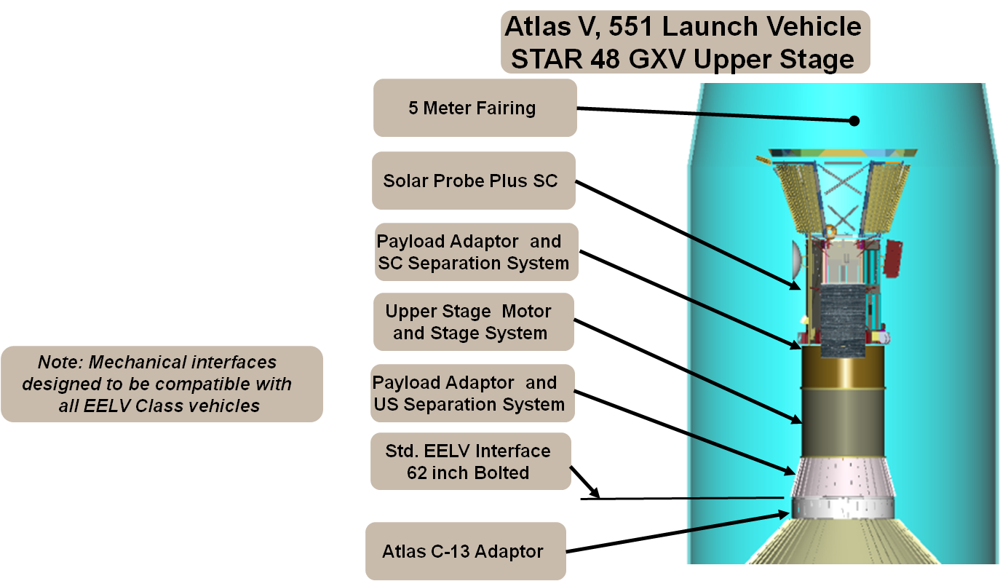
Launch System Overview
Launch System is the Launch Vehicle and Upper Stage
Mission performance is determined by combined LV and US performance
  SC separated mass: 665 kg
  C3 requirement: 154 km²/sec²
Significant Phase B effort to define launch vehicle performance

