Slide 1
SPP Spacecraft Emulator (SCE) Requirements Peer Review
Sam Sawada
samuel.sawada@jhuapl.edu
443-778-7020
June 27, 2013

Slide 2
Agenda
Staffing
Purpose/Goal of Review
Timeline (Emulator Development)
Results of SCE Tag Up MTG w/Instrument Teams on 6/21/13
Emulator Status Requirements Flow
Emulator Overview
Differences between Mini Emulator and Full Emulator
SPP Mini-Emulator Block Diagram
SPP Full-Emulator Block Diagram
SPP Emulator Updates
Requirement Document Review (Walk Thru Page by Page)
Conclusion
Back Up Slides

Slide 3
SCE Staffing
SPP SC Emulator Development Team
Sam Sawada, SPP Emulator Lead, Samuel.Sawada@jhuapl.edu
Mike Furrow, SPP Mission Systems Software Lead, Mike.Furrow@jhuapl.edu
Martha Kusterer, SPP SOC Lead, Martha.Kusterer@jhuapl.edu
Thomas Hauck, GSEOS, hauck@gseos.com
Harry Eaton, Embedded SW
Doug Wenstrand, FPGA Design
Geff Ottman, Engineering Support, Geffrey.Ottman@jhuapl.edu
Other Contributors
Additional Emulator Weekly Meeting Team Members
Joe Sheehi (RBSP Emulator Lead)
Alan Mick (Data Systems Engineering)
John Hayes (WISPR DPU/ISIS-EPI-Lo)

Slide 4
Purpose of Review
Primary Purpose:
Finalize requirements for FULL Emulator, specifically those related to physical interfaces to the instrument
Secondary Purpose:
Discuss GSEOS Requirements, Embedded Software Requirements
APL Independent Reviews
RBSP Emulator Lead
Joe Sheehi
SPP Instrument Emulators Leads for Avionics HW testing
Taylor Green
Dave Stott
Andrew Harris

Slide 5
Timeline (Emulator Development)
FEB 2013 SCE Emulator Intro Review w/Instrument Teams
APR 2013 Mini Emulator Schematic Review
MAY 2013 DRAFT Emulator Requirements Doc Completed
JUN 12, 2013 Mini Emulator PWAs Testing completed
JUN 20, 2013 Start Mini Emulator Deliveries
JUN 20, 2013 Start Support of Mini Emulator Deliveries
JUN 21, 2013 SCE Tag Up MTG w/Instrument Teams
JUN 27, 2013 Emulator Requirements Peer Review
DEC 2013 Start Full Emulator Design
FEB 2014 Emulator Design Peer Review
April 2014 Start Full Emulator Deliveries
April 2014 Start support of Full Emulator Deliveries

Slide 6
SCE Tag Up Meeting with Instrument Team - Results
Held a “Pre-Emulator Requirements Review” Meeting with the Instrument team on 6/21/13
Issues Discussed/Resolution
Item #1: Instrument Team requested to Baseline Linux, Emulator baseline is Windows-7
All instrument teams say they are okay with Windows, however, WISPR and EPI Hi says they prefer Linux (ie. Windows prone to reduced performance during Windows updates, & reboot issues). Also favor Linux for long term OS platform solution.
Action: Elena Adams to Work with Martha Kusterer, SPP SOC Lead and Mike Furrow, SPP Mission Systems Software Lead to update GSEOS SOW to exercise the Linux OS option. (Additional Cost). If accepted, Emulator would be compatible with both Windows and Linux OS platforms and Instrument team can choose desired OS to use. Instrument teams to justify need and document request in email.

Slide 7
SCE Tag Up Meeting with Instrument Team - Results
Issues Discussed/Resolution
Item #2: Seems none of the Instrument teams use the Full Emulator Internal 30V power supply used for Instrument power outputs and Aux power outputs (ie., Heater/Actuator outputs). They all use an external power supply. FIELDS in particular would like to have the power supply removed or turned off to reduce power supply switching noise coupling to data signals.
FIELDS would also use their own EGSE for Power switching circuits.
Other Instruments would still use the Emulator internal power switching circuits (FETS).
Options:
Remove Internal 30V Power Supply from the design.
Add a switch so that the 30V Power Supply can be turned off.
Action: Emulator Team’s choice to implement the easiest/design generic option.
Note: GSEOS SW supports GPIB device drivers using external USB/GPIB converter HW, allowing control of external power supply.

Slide 8
Emulator Status
Mini Emulator Hardware Status
16 boards are assembled/tested – 6/12/13
16 Emulator Front/Rear panels engraved – 6/19/13
1st Delivery to Instrument teams completed on 6/20/13
Purpose for Mini Emulators
Familiarize users with GSEOS and Emulator
Improve and fix issues with the Emulator and GSEOS early
Determine issues about customization early
SPP Embedded Software Status
UART Release 0 will be ready for delivery, ~ 6/25/13
SpaceWire Release 0 will be ready for delivery, ~ 7/31/13
SPP GSEOS Software Status
UART Release 0 will be ready for delivery, ~ 6/25/13
SpaceWire Release 0 will be ready for delivery, ~ 7/31/13

Slide 9
Emulator Requirements Flow
SPP General Instrument
ICD (GII) - DRAFT
(GIS_Electrical_Sections)
(SPP GIS Instru ICD CDH)
packet formats, data rates, timing
SPP GSEOS
ICD (Bios)
GSEOS Software Documents
SPP
GSEOS SOW
SPP OKBios User Manual
SPP GSEOS Users Manual
GSEOS Users Manual
SPP SpaceWire
ICD-DRAFT
7434-9075
Interface between
Emulator and Inst
SOC/ MOC Requirements
APL Documents
Interface between
Emulator and PC
SPP SC Emulator Requirements 7434-7001
SPP SC Emulator Software Development Plan 7434-9111
NOTES
Emulators are typically designed far in advance of S/C, Instruments and ground systems.
Requirements process needs to be ITERATIVE since relevant ICD’s are still changing
Mitigation
The SPP Emulator design provides maximum flexibility since most of its functionality is in the FPGA and Microblaze processor.
11 Mini-Emulators to be delivered early to better determine future requirements / issues.
APL’s experience with Emulator design: we are re-using best parts of prior emulators (RBSP, New Horizons, Messenger)
APL’s experience with GSEOS

Slide 10
Emulator Requirements Flow (Continued)
GSEOS
PC
Emulator
Instrument
SPP
GSEOS
USB
LVDS
OK XEM6010-LX45
FGPA
54K Flip Flops
FPGA provides
Flexibility to
Mitigate TBD
Requirements
OK FPGA
30V Inst power
MBLAZE
2
Aux power
8
RTD Temp Sense
8
Displays/ Switches
I/O Connectors
Grounding Scheme
Easier to change
(GSEOS SW, Embedded SW, FPGA code)
Hard to change (Hardware)

Slide 11
Differences: Full vs. Mini Emulators
Capability | Full Emulator |  | Mini-Emulator
Instrument CMD/TLM (UART/SpW) (A/B) Interface | YES |  | YES
1PPS/PPS_Gated Interface (Instr EGSE IF) | YES |  | YES
USB Interface to PC (Opal-Kelly) (Note: USB Power not used) | YES |  | YES
External 5V Input for Internal Emulator Logic | NO |  | YES
External AC Input for Internal Emulator Logic (AC/DC converters) | YES |  | NO
Optical Isolation | YES |  | NO
30V Power OUTPUTS (10) | YES |  | NO
Temperatures (8)/Voltage/Current Sensors | YES |  | NO
EXT 30V SC BUS Power Supply Input/ Internal 30V SC BUS Power Supply | YES |  | NO
Rack Mount | YES (5”H x 19”W x 14”D |  | NO (1”H x 5”W x 7”D)

Slide 12
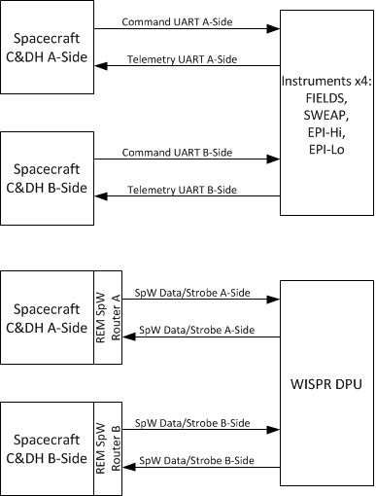
SPP Instrument Data Interfaces
Note:
FIELDS = FIELDS1 & FIELDS2

Slide 13
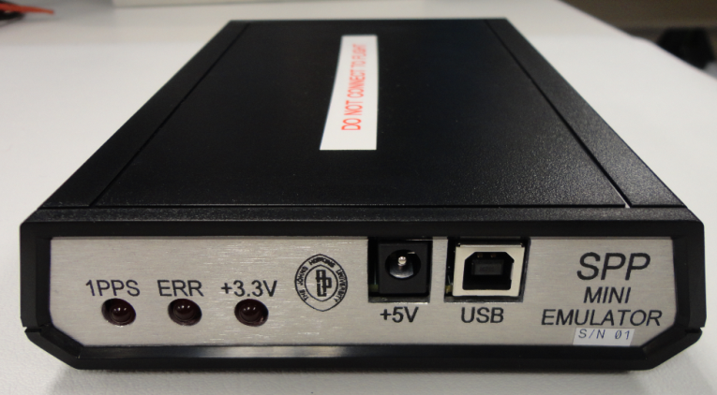
SCE Mini-Emulator
Provides Instrument Data Interfaces only, No Power Interfaces, No Temperature Interfaces
Also provides 1PPS and Gated_PPS Interfaces for Instrument EGSE
GSEOS Interface is fully compliant
Non-flight use only
SCE data connectors are female MDMs (9F)
SCE PPS test connector is male MDM (9F)

Slide 14
Mini-Emulator Block Diagram
SPP
SPACECRAFT
EMULATOR
INSTRUMENT
Interface
AC/5V
PWR
Adapter
5V Power
MINI-VERSION
TCP/IP
Side A
LVDS
convert
TLM/DAT
9
F
8
CMD/TLM UART/ SpW
(3.3V LVDS)
UART
CMD Baud rate = 115.2 Kbps
TLM Baud rate = 115.2kbps, 345.6 Kbps
Space Wire
CMD/TLM Signaling data rate = 30Mbps
+3.3V
Mini/Full EM Config
STROBE
CMD/DAT
STROBE
GSEOS
PC
Opal Kelly
Daughter
Card
(XEM6010)
HDR
TLM/DAT
Side B
STROBE
9
F
8
USB
CMD/DAT
INST CMD/TLM
EMU CMD/STAT
OPK CONFIG
STROBE
FPGA
INSTRUMENT
EGSE Interface
Microblaze Processor
Is part of FPGA
XC6S-LX45
12
LVAC244
Buffer
9
M
3
1PPS OUT TP
PPS_GATED1_TP
PPS_GATED2_TP
JTAG CONN
L
E
D
S
(3)
PPS
ERR
+3.3V
Test CONN
Note 1: USB Cable and 5V Adapter cable are provided with Emulator Delivery,
PC is not part of Delivery.
Note 2: CMD/TLM UART Signals are shared with SpW Data Signals. Strobe signal is not used for UART interfaces

Slide 15
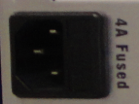
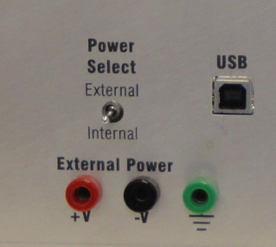
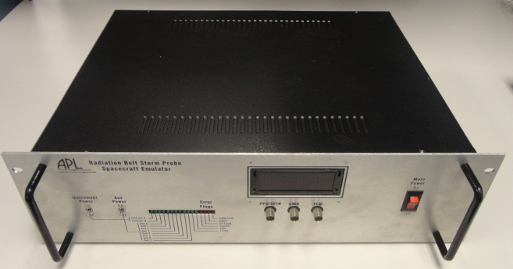
SCE Full-Emulator
Provides Instrument Data, Power and Temperature Interfaces
Also provides 1PPS and Gated_PPS Interfaces for Instrument EGSE
GSEOS Interface is fully compliant
Designed for use with Flight hardware
Data connectors are female MDMs (9F)
PPS test connector is male MDM (9M)
Instrument Power connector is female DSUB (9F)
Instrument RTD connector is male DSUB (9M)
External Power Supply IF: Banana Jacks
Front Panel D/S Test points: BNC

Slide 16
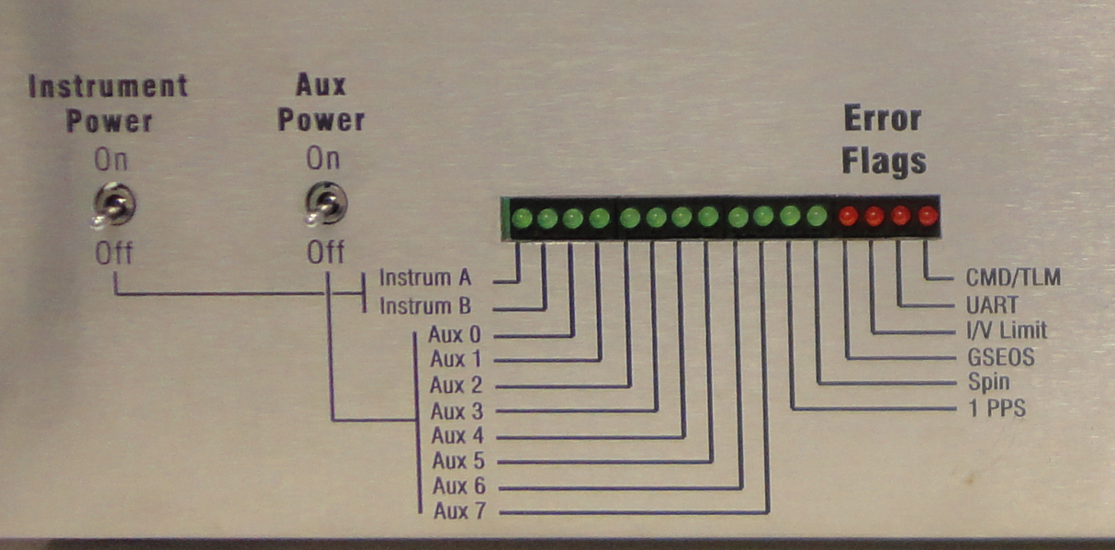
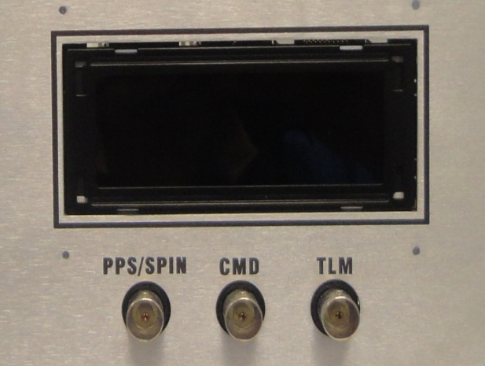
SCE Full-Emulator
Full Emulator Front Panel LED Interface/BNC TP Interface
Note: The 2 switches above drive Power FETs on/off; Internal P/S remains powered. Individual Instrument and Aux power outputs are Software controlled on/off. See next Slide.

Slide 17
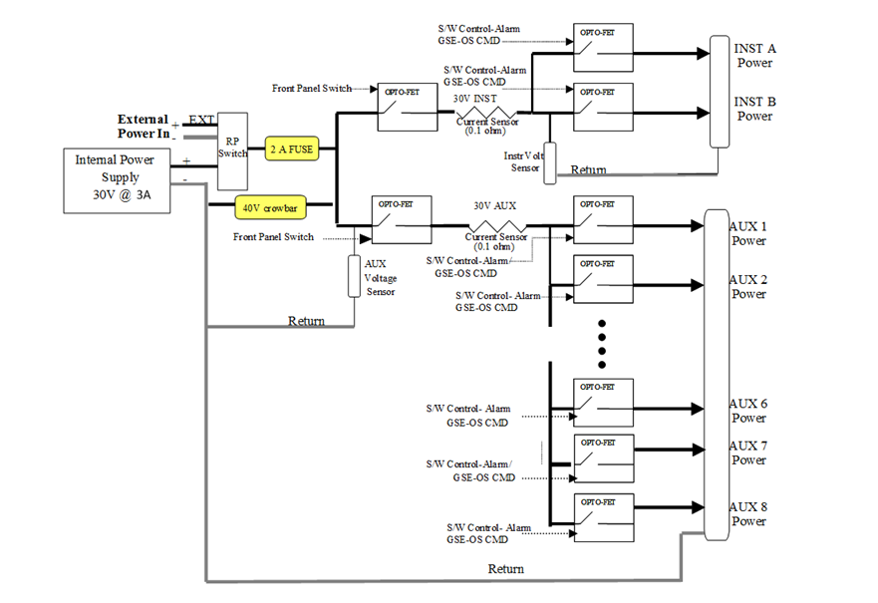
SCE Full-Emulator
Full Emulator Instrument Power Interfaces

Slide 18
Full-Emulator Block Diagram
LCD DISPLAY
SPP Emulator xx.xx
Volts Amps
INST xx.xx xx.xx
HTR xx.xx xx.xx
INSTRUMENT
Interface
TCP/IP
4
D/S OUT_TP
BNC
1PPS OUT TP
PPS_GATED1_TP
PPS_GATED2_TP
5V/3.3V
Power
3.3V
I/F
Power`
9
M
BUF
GSE-OS
PC
3
B
U
F
Side A
CMD/TLM UART/ SpW
(3.3V LVDS)
UART
CMD Baud rate = 115.2 Kbps
TLM Baud rate = 115.2kbps, 345.6 Kbps
Space Wire
CMD/TLM Signaling data rate = 30Mbps
Opal Kelly
Daughter
Card
FPGA
4
LVDS
convert
TLM/DAT
9
F
8
USB
STROBE
4
OPTO-ISO
CMD/DAT
INST CMD/TLM
EMU CMD/STAT
OPK CONFIG
STROBE
FPGA
TLM/DAT
Side B
STROBE
9
F
8
LED DISPLAY
Error Status,
Instr/Aux
PWR on/off Status
CMD/DAT
OPTO-ISO
STROBE
JTAG
SW On/Off Ctrl
EXT 30V POWER IN
Switch
EXT POWER RTN
I/V
Sensors
&
FET
Switches
CHASSIS GND
30V
25
F
INST Power A
30V@ 3A
Power
30V
INST Power B
16 CH
A/D
AC POWER
5V
I/F
Power
30V
8
Aux/Htr Power 1-8
8
25
M
8
8 RTD TEMP Sensors
RTD Temperature Sense

Slide 19
SPP SC Emulator Updates
Update Requirements to SPP Instrument ICDs and SpW ICD for WISPR DPU
Provide A/B UART interfaces
Provide A/B SpW link with configurable SpW bus schedule
Support Virtual PPS (no distinct 1PPS line)
Support 345.6 KBAUD (Was 400 KBAUD) Telemetry link from FIELDS and SWEAP
GSEOS version 7 will be used for SPP
Mini- and Full-Emulators will have 2 gated-PPS test outputs with GSEOS command for arm/disarm/one-shot with programmable pulse width and delay from PPS (Timing on Next Slide)-In addition to 1 PPS output
SCE data connectors will be female MDMs, PPS test connector will be male MDM

Slide 20
SPP SC Emulator Updates
5V Power no loner supplied thru USB interface, Separate External AC/5CV adapter plug used for Mini. Internal 5V supply used for Full
GSEOS SW verified compatibility with GPIB Drivers, but requires Ext HW supplied by Instrument Team (eg USB/GPIB converter)
Spacewire RMAP (Remote Memory Access Protocol) will be Implemented in Embedded SW

Slide 21
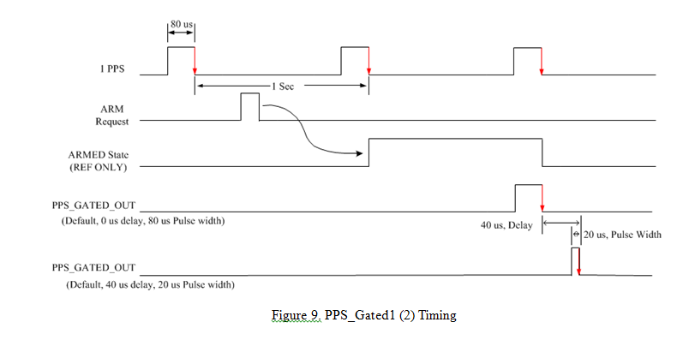
SPP SC Emulator Updates
1PPS & GATED PPS Timing (To Instrument EGSE)

Slide 22
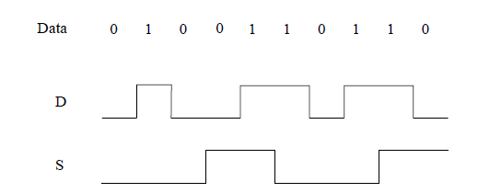
SPP SC Emulator Updates
UART Timing
SpaceWire Data/Strobe Timing

Slide 23
SPP SC Emulator Updates
Command/Telemetry Timing (UART)

Slide 24
SPP SC Emulator Updates
First Circuit Interface (UART/Spacewire)
FIN1031
SpW_Din_UART_CMD_P
9
From FPGA
SpW_Din_UART_CMD_P
3.3V LVDS
5
FIN1031
SpW_Sout_P
8
INSTRUMENT
INTERFACE
MDM9-FEMALE (J1, J2)
(Separate Connectors for Side A & Side B)
(mating connector is male)
Note: * = SpaceWire Strobe Signals
(Sin/Sout are not used for UART Interfaces)
Connector PN: M83513-13-A01CP (Right Angle)
(Glenair/Mouser)
From FPGA
SpW_Sout_N
4
3.3V LVDS
FIN1032
SpW_Din_UART_TLM_P
1
To FPGA
100
SpW_Din_UART_TLM_N
3.3V LVDS
6
FIN1032
SpW_Sin_P
2
To FPGA
100
SpW_Sin_N
7
3.3V LVDS
GND
3

Slide 25
SPP SC Emulator Updates
First Circuit Interface (1 PPS -EGSE I/F)
SN74LVC244ADBR
INSTRUMENT EGSE INTERFACE
MDM9-MALE (J3)
(mating connector is female)
Connector PN: M83513-10-A01CP (Right Angle)
(Glenair/Mouser)
Pins:2,3,7: Ground)
From FPGA
3.3V
LVCMOS
200 ohms
1PPS
1
GND
6
SN74LVC244ADBR
From FPGA
3.3V
LVCMOS
200 ohms
PPS_GATED1
4
GND
8
From FPGA
3.3V
LVCMOS
200 ohms
PPS_GATED2
5
GND
9

Slide 26
SPP SC Emulator Updates

Slide 27
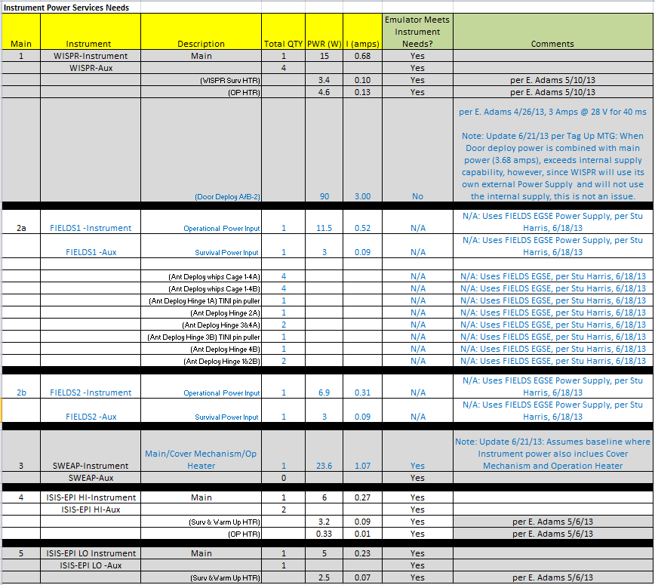
SPP SC Emulator Updates

Slide 28
Requirement Document Review
See SPP Emulator Requirements Document (7434-7001)
(Read Thru-page by page)

Slide 29
Conclusion
Instrument concerns
Questions?

Slide 30
Backup Slides
Backup slides

Slide 31
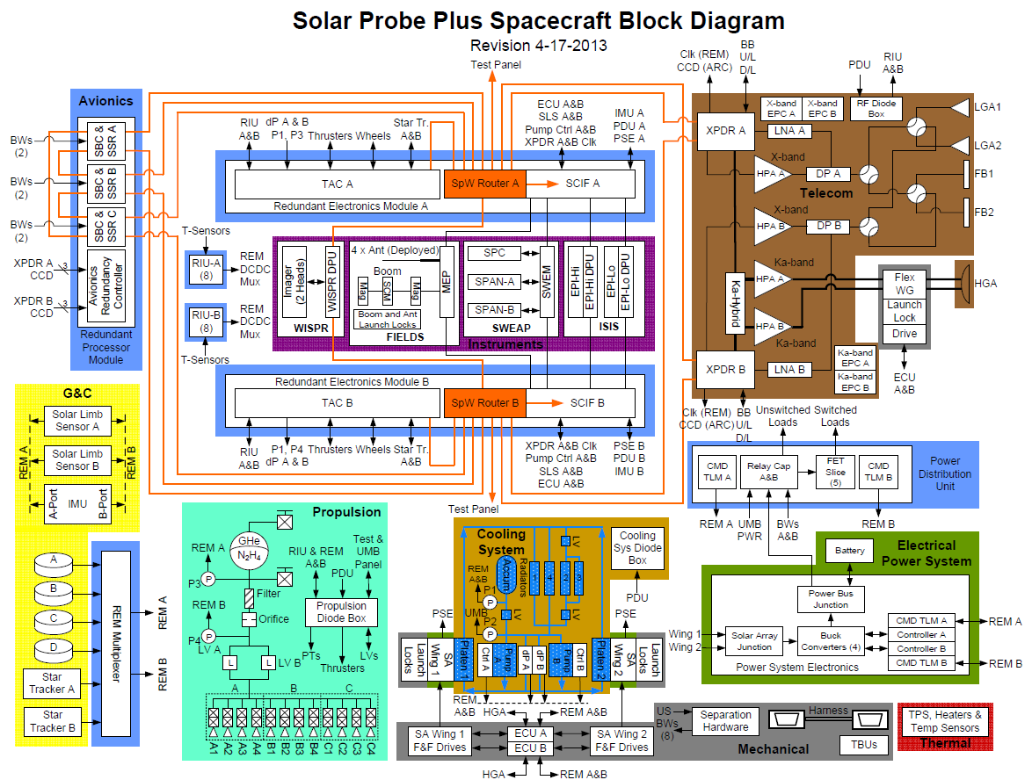
SPP Spacecraft Block Diagram

Slide 32
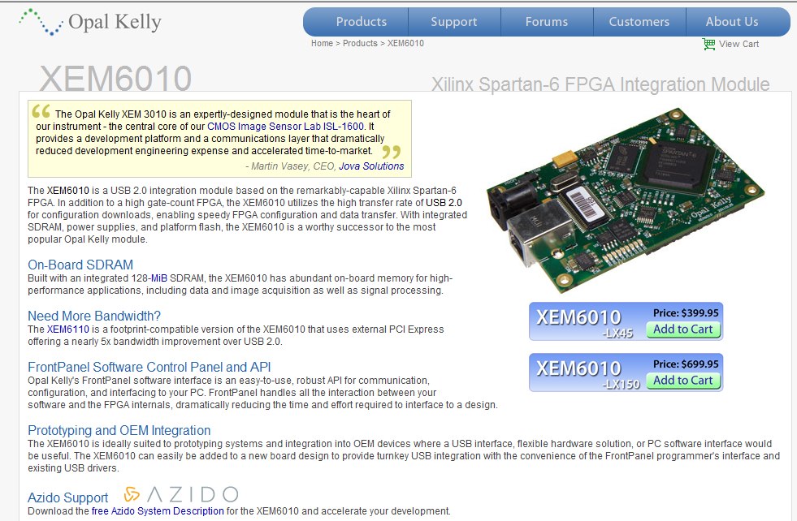
Opal Kelly Daughter Card

Slide 33
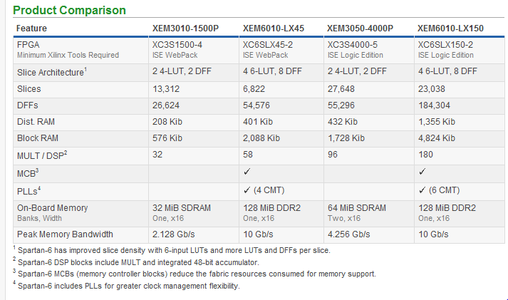
Opal Kelly Daughter Card
RBSP
SPP

Slide 34
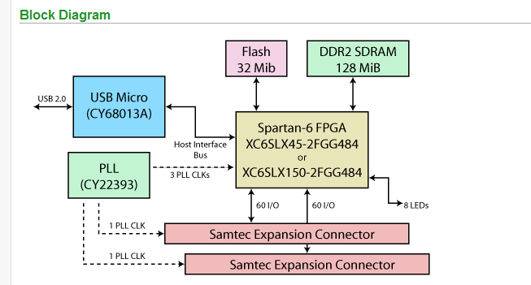
Opal Kelly Daughter Card

Slide 35
Mini Emulator HW Test Setup
AC/5V
PWR
Adapter
SPP SPACECRAFT
MINI EMULATOR
(UUT)
5V Power
+3.3V
Mini/Full EM Config
J3 PPS Test Conn
PC
Opal Kelly
Daughter
Card
(XEM6010)
HDR
SCOPE
1PPS OUT TP
PPS_GATED1_TP
PPS_GATED2_TP
9
M
3
BOB
USB
BOB
Cable
FPGA
J2 Instrument Side B
TLM/DAT
9
F
8
STROBE
CMD/DAT
(Move cable to J1/J2, as needed)
12
STROBE
JTAG CONN
TLM/DAT
J1 Instrument Side A
L
E
D
S
(3)
STROBE
9
F
8
PPS
ERR
+3.3V
Test CONN
CMD/DAT
STROBE
USB
SpaceWire
Brick
(2 port Router)
Link 1
3
1
2
Link 2 (NC)

Slide 36
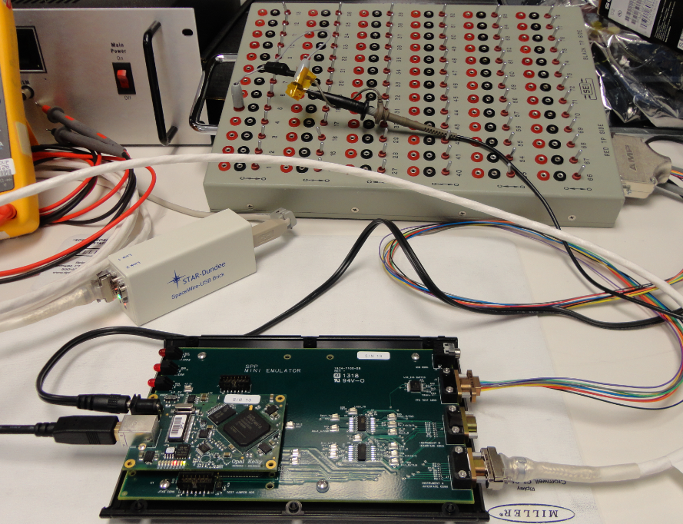
Mini Emulator HW Test Setup (Photo)

Slide 37
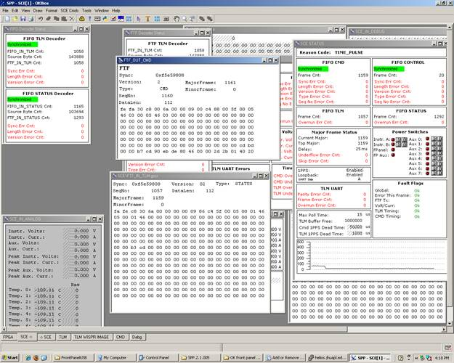
WISPR DPU Delivery DEMO GSEOS Screen Shot Results
Results from Mini Emulator SN1 Delivery to WISPR DPU Instrument Team running GSEOS Demo SW (Internal Loopback). Green indicates data is synchronized and running.

Slide 38
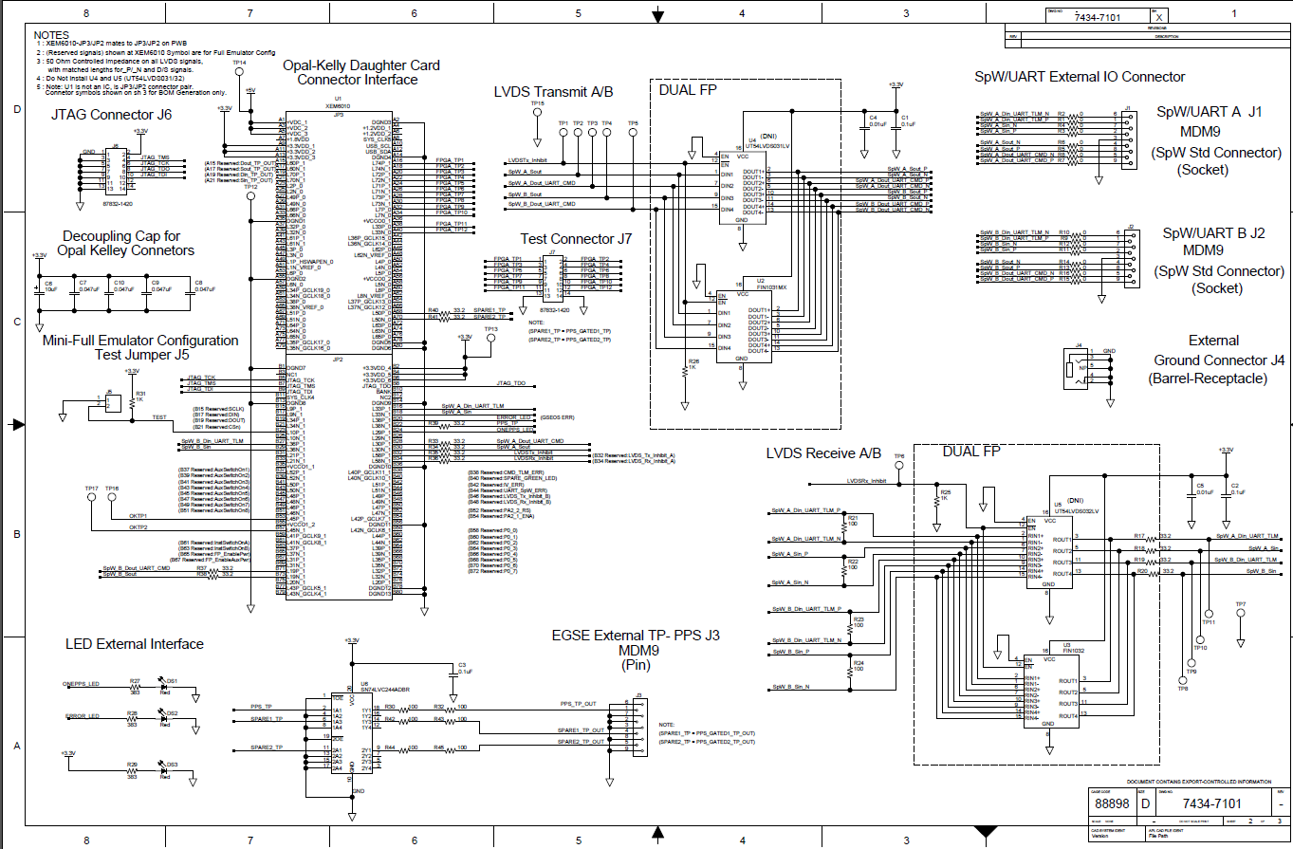
Mini Emulator Schematic

Slide 39
Emulator Documentation
APL Documents
SPP GSEOS Statement of Work
SPP GSEOS Proposal – response to SOW above
SPP SC Emulator Requirements (7434-7001)
SPP SC Emulator Software Development Plan (7434-9111)
SPP Emulator Software Design Document (7434-xxxx)
Design Files (PLM)
SPP Mini Emulator Top Assembly (7434-7110)
PWA (7434-7100)
Schematic (7434-7101)
Electrical Parts List (EPL) (7434-7102)
PWB (7434-7104)
SPP FPGA Design Files (GFORGE Repository)
SPP Emulator Embedded Software (GFORGE Repository)

Slide 40
Emulator Documentation (Continued)
GSE Software Documentation (www.gseos.com)
SPP Emulator ICD (Bios Manual) (Rev 11)
–describes packets between Emulator and GSEOS
SPP OK Bios Users Manual –describes Opal Kelly interface
SPP GSEOS User Manual (Rev xx) –How to use SPP GSEOS
GSEOS User Manual
APL Procedures
SPP Mini Emulator HW Test Procedure(7434-7021)
SPP Mini Emulator Startup Procedure (7434-7022)

Slide 41
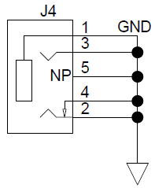
SPP SC Emulator Updates (Mini EM)
First Circuit Interface (GND-EGSE I/F)
GROUND
INTERFACE (Optional)
Barrel Receptacle
Connector PN: SJ1-3544N
(CUI Inc/Digikey)

Slide 42
Emulator Team Test Support
SCE deliverables will be the Mini- and Full-Emulators and GSEOS deployment via downloads.
SCE Team will develop Hardware and GSEOS Software User Manuals
User’s Manual will describe host PC configuration
User’s Manual will describe steps to complete a GSEOS, embedded firmware and embedded software upgrade
SCE Team will maintain a website forum for SCE Users

Slide 43
Instrument Team Test Support
Instrument Teams will provide:
Host PC to run GSEOS
The Mini-Emulator will be designed and tested for compatibility to 64-bit Windows 7 (32-bit Windows 7 would be OK with the proper Opal Kelly drivers and minor GSEOS configs)
The Full Emulator will offer additional flexibility as requested
GSEOS support of SOC operations will offer additional flexibility as requested
SCE will use an Opal Kelly XEM6010, the PC will need to have driver version 4.x installed (current designing to 4.2.5)
Harnessing
Flight-rated power supply for use with flight-unit testing using the Full-Emulator
As needed for HW development , test and debug: Detailed analysis and compliance GSE (O’scopes, logic analyzers, SpW/UART protocol analyzers, EMI/EMC and EDTRD-specific testing)

Slide 44
Emulator Deliverables
Mini-Emulator earliest delivery is in June 2013
Full-Emulator earliest delivery is in April 2014
Emulator Schedule updates will be via the Project IMS
FIELDS requested for 1 additional Full EM 5/28/13
(Total: 11 Full EMs)
 |  | FIELDS | WISPR | ISIS | SWEAP | Project Spares
Mini-Emulators | qty | 4 | 2 | 3 | 2 | 2
Full Emulators | qty | 1 | 2 | 3 | 2 | 2

Slide 45
Detail Mini-Emulator Deliverables
 | # | Delivery Date | Instrument User | Comment
Mini-Emulators | 1 | 6/20/13 | DPU #1
 | 2 | 6/21/13 | FIELDS #1
 | 3 | 6/26/13 | ISIS #1
 | 4 | 7/1/13 | SWEAP #1
 | 5 | 7/5/13 | FIELDS #2
 | 6 | 7/10/13 | DPU #2
 | 7 | 7/15/13 | ISIS #2
 | 8 | 7/18/13 | SWEAP #2
 | 9 | 7/23/13 | FIELDS #3
 | 10 | 7/26/13 | ISIS #3
 | 11 | 7/31/13 | FIELDS #4
 | 12 | 8/13/13 | SPARE #1
 | 13 | 8/21/13 | SPARE #2

