Slide 1
27 – ISIS Thermal
Gregory J Dirks
ISIS Thermal Lead (SwRI)
Notes:
introduction

Slide 2
Outline
Driving Instrument Thermal Requirements
Thermal Design and Implementation
Thermal Management
Heaters and Sensors
MLI Design
Materials and Finishes
System Thermal Analysis
Thermal Model Details
Design Cases
Optical Properties and Power Dissipation
Predictions and Margins
Resources and Requirements
EPI-Hi Circuit Board Analysis
Component Junction Temperature Calculations
Plans for Thermal Verification

Slide 3
Driving Requirements
Design Temperature Limits
Margin Guidelines – Includes Test and Model Uncertainty
Hot Limits 10 C and Cold Limits 5 C (Heater Controlled)
EPI-Hi
EPI-Lo
Component | Hot Op. (°C) | Cold Op. (°C) | Cold Surv. (°C)
EPI-HI HET | 40 | -25 | -40
EPI-Hi LET1 | 40 | -25 | -40
EPI-Hi LET2 | 40 | -25 | -40
EPI-Hi DPU | 40 | -25 | -40
EPI-Hi Bias | 40 | -25 | -40
EPI-Hi LVPS | 40 | -25 | -40
EPI-Hi HET Tel | 30 | -25 | -40
EPI-Hi LET 1 Tel | 30 | -25 | -40
EPI-Hi LET 2 Tel | 30 | -25 | -40
Component | Hot Op. (°C) | Cold Op. (°C) | Cold Surv. (°C)
Detector | 25 | -30 | -45
Anode Board | 55 | -30 | -45
Event Board | 55 | -30 | -45
Power Board | 55 | -30 | -45
Dome | 35 | -30 | -45

Slide 4
Driving Requirements
Interface Temperatures
Operational: 0 / +45 C
Non-Operational: 0 / +45 C
Heaters
75% Maximum Duty Cycle
Resistance Determined at 26 V
Environment
1.0 AU Sun at 110 Degrees from +Z Axis for 40 Minutes
Boundary Heat Flow
Flow from Spacecraft is No More Than 2.9 W in the Cold Case and No Less Than 0 W in the Hot Case

Slide 5
Thermal Design
EPI-Hi
E-box Radiator to Dissipate Internally Generated Heat
Telescopes Conductively Isolated from E-box
Operational Heaters on Telescopes
Survival Heaters on Telescopes and E-box
MLI on Surfaces Except Apertures, Radiator, and Bracket Interior Surfaces

Slide 6
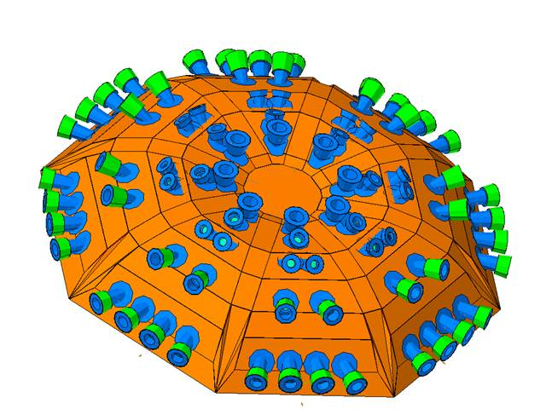
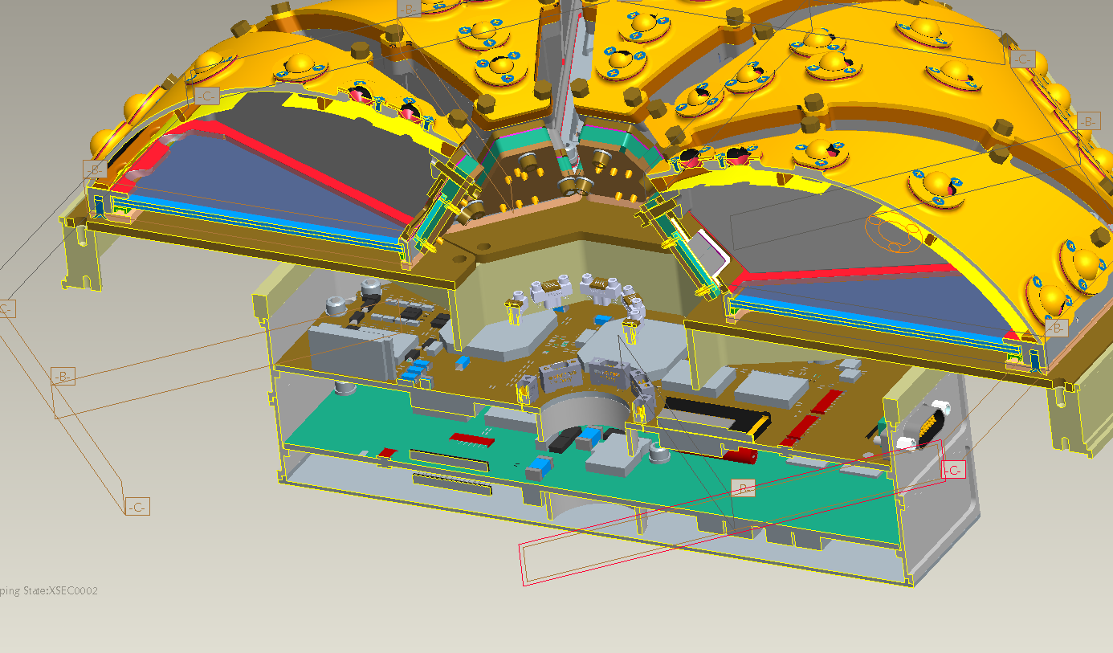
Thermal Design
EPI-Lo
Wedge Radiators (8) to Dissipate Internally Generated Heat
Eight Survival Heaters (One on Each Wedge)
MLI on Surfaces Except Apertures and Radiators

Slide 7
Thermal Design
ISIS
EPI-Hi and EPI-Lo are Thermally Isolated from the Bracket
Bracket is Thermally Isolated from the S/C

Slide 8
Heaters and Sensors
EPI-Hi Heater Operations
One S/C Thermistor on Each Telescope and Two S/C Thermistors on E-box (Primary and Redundant)
Operational Heaters on Telescopes are All on One S/C Service, but Controlled by E-box
Survival Heaters on Telescopes and the E-Box are All on One S/C Service and Controlled by S/C with Sense Location Currently Baselined as the E-box
Survival Heaters Also Used to Warm Instrument to Cold Operational Temperature for Cold Turn On by using Different Set Points

Slide 9
Heaters and Sensors
EPI-Lo Heater Operations
Two (Primary and Redundant) S/C Thermistors on Dome for Heater Control and One More (To Be Positioned)
All Survival Heaters are on One S/C Service (Separate from EPI-Hi) Controlled by S/C with Sense Location Currently Baselined as One of the Wedges
Survival Heaters are Used to Warm Instrument to Cold Operational Temperature for Cold Turn On by Using Different Set Points
Survival Heaters are Also Used to Maintain Minimum Cold Operating Temperature During Low Power Operating Conditions

Slide 10
MLI
Coverage
Entire Instrument Other than Apertures, Radiators
Specifications/Construction
Each Separate Blanket Grounded with Wire to S/C
Vented Using Edge Mesh Screens Directed away from Apertures
Edges and Seams Sealed using GBK Tape
Blankets Secured using G-10 Buttons and SS Snap Rings

Slide 11
Materials and Finishes
Radiators
Z-307 Conductive Black Paint
MLI
Outer Layer: StaMet
Thermal Isolators
G-10 Fiberglass
Bracket
All Surfaces are Alodine
EPI-Hi Ebox
All Surfaces are Alodine
EPI-Lo Electronics
All Surfaces are Alodine

Slide 12
Materials and Finishes
LET Apertures (3X):
Polyimide a=0.21, e=0.20
Aluminized a=.0.09, e=.0.02
Polyimide Side Facing Out
47 mm Diameter by 2 Microns Thick
Gold Ring a=0.23, e=0.03
HET Apertures (2X)
Black Kapton a=0.93, e=0.85
Aluminized a=0.09, e=0.02
Black Kapton Side Facing Out
30 mm Diameter by 5 mils (0.005 inches) Thick
Gold Ring a=0.23, e=0.03
EPI-Lo
Collimators are Z93C55 White Paint and Ag-MgF2

Slide 13
Thermal Model
EPI-Hi Modeled by Vertex Aerospace
Rommel Zara and Santino Rosanova
EPI-Lo Modeled by APL
Shawn Begley
Bracket Modeled by Vertex Aerospace
ISIS Model Integrated by Vertex Aerospace
All Models Created using Thermal Desktop Software
Updated Model Delivered to S/C TBD
Good Correlation between Instrument and S/C Results

Slide 14
Design Cases
Hot Operational
+45 C I/F Temperature
EOL Power and BOL Optical Properties
Low MLI e* = 0.03
Cold Operational
0 C I/F Temperature
BOL Power and BOL Optical Properties
High MLI e* = 0.05
Cold Non-Operational
0 C I/F Temperature
BOL Optical Properties and e* = 0.05
Hot Non-Operational
1.02 AU / 110 Degrees / 40 Minutes with +45 C I/F Temperature
BOL Optical Properties and e* = 0.03

Slide 15
Optical Properties
Radiator: Z-307 Black Paint
BOL: a = 0.95, e = 0.89
MLI Exterior: StaMet
BOL: a = 0.56, e = 0.83
EPI-Hi Apertures
HET BOL: a = 0.93, e = 0.85
LET BOL: a = 0.21, e = 0.20
EPI-Lo Collimators
Z93C55 BOL: a = 0.15, e = 0.91
Ag-MgF2 Range: a = 0.01/0.02, e = 0.07/0.09
Alodine Surfaces
BOL: a = 0.45, e = 0.12

Slide 16
Power Dissipation
ISIS Power Distribution
Cold Case uses CBE, Hot Case uses CBE+Cont.

Slide 17
Predictions
Hot Operational
Component | Hot Op Predict, °C | Hot Op Limit, °C | Margin, °C
IS_ISIS_EPI_LO_DETECTOR | 15.0 | 25.0 | 10.0
IS_ISIS_EPI_LO_EVENT | 21.3 | 55.0 | 33.7
IS_ISIS_EPI_LO_PWR_SUPPLY | 23.5 | 55.0 | 31.5
IS_ISIS_EPI_LO_MCP | 18.4 | 55.0 | 36.6
IS_ISIS_EPI_LO_ANODE | 17.3 | 55.0 | 37.7
IS_ISIS_EPI_LO_DOME | 13.1 | 55.0 | 41.9
IS_ISIS_BRACKET | 25.7 | NA | NA
Component | Hot Op Predict, °C | Hot Op Limit, °C | Margin, °C
IS_ISIS_TEL_HET | 1.8 | 30.0 | 28.2
IS_ISIS_TEL_LET1 | 7.7 | 30.0 | 22.3
IS_ISIS_TEL_LET2 | -0.8 | 30.0 | 30.8
IS_ISIS_EPI_HI_BIAS | 28.4 | 40.0 | 11.6
IS_ISIS_EPI_HI_DPU | 28.6 | 40.0 | 11.4
IS_ISIS_EPI_HI_HET | 28.4 | 40.0 | 11.6
IS_ISIS_EPI_HI_LET1 | 28.4 | 40.0 | 11.6
IS_ISIS_EPI_HI_LET2 | 27.2 | 40.0 | 12.8
IS_ISIS_EPI_HI_LVPS | 29.8 | 40.0 | 10.2
IS_ISIS_BRACKET | 25.7 | NA | NA

Slide 18
Predictions
Cold Operational
Component | Cold Op Predict, °C | Cold Op Limit, °C | Margin, °C
IS_ISIS_EPI_LO_DETECTOR | -14.6 | -30.0 | -15.4
IS_ISIS_EPI_LO_EVENT | -10.4 | -30.0 | -19.6
IS_ISIS_EPI_LO_PWR_SUPPLY | -9.5 | -30.0 | -20.5
IS_ISIS_EPI_LO_MCP | -10.4 | -30.0 | -19.6
IS_ISIS_EPI_LO_ANODE | -12.9 | -30.0 | -17.1
IS_ISIS_EPI_LO_DOME | -15.7 | -30.0 | -14.3
IS_ISIS_BRACKET | -9.8 | NA | NA
Component | Cold Op Predict, °C | Cold Op Limit, °C | Margin, °C
IS_ISIS_TEL_HET | -20.0 | -25.0 | -5.0
IS_ISIS_TEL_LET1 | -13.7 | -25.0 | -11.3
IS_ISIS_TEL_LET2 | -19.9 | -25.0 | -5.1
IS_ISIS_EPI_HI_BIAS | 3.4 | -25.0 | -28.4
IS_ISIS_EPI_HI_DPU | 3.7 | -25.0 | -28.7
IS_ISIS_EPI_HI_HET | 3.5 | -25.0 | -28.5
IS_ISIS_EPI_HI_LET1 | 3.5 | -25.0 | -28.5
IS_ISIS_EPI_HI_LET2 | 2.6 | -25.0 | -27.6
IS_ISIS_EPI_HI_LVPS | 4.6 | -25.0 | -29.6
IS_ISIS_BRACKET | -9.8 | NA | NA

Slide 19
Predictions
Hot Non-Operational
Component | Hot Surv Predict, °C | Hot Surv Limit, °C | Margin, °C
IS_ISIS_EPI_LO_DETECTOR | 34.7 | 55 | 20.3
IS_ISIS_EPI_LO_EVENT | 34.1 | 55 | 20.9
IS_ISIS_EPI_LO_PWR_SUPPLY | 34.1 | 55 | 20.9
IS_ISIS_EPI_LO_MCP | 34.4 | 55 | 20.6
IS_ISIS_EPI_LO_ANODE | 34.2 | 55 | 20.8
IS_ISIS_EPI_LO_DOME | 34.9 | 55 | 20.1
IS_ISIS_BRACKET | 37.4 | NA | NA
Component | Hot Surv Predict, °C | Hot Surv Limit, °C | Margin, °C
IS_ISIS_TEL_HET | 19.6 | 60 | 40.4
IS_ISIS_TEL_LET1 | 41.6 | 60 | 18.4
IS_ISIS_TEL_LET2 | 47.3 | 60 | 12.7
IS_ISIS_EPI_HI_BIAS | 36.4 | 55 | 18.6
IS_ISIS_EPI_HI_DPU | 36.4 | 55 | 18.6
IS_ISIS_EPI_HI_HET | 36.5 | 55 | 18.5
IS_ISIS_EPI_HI_LET1 | 36.5 | 55 | 18.5
IS_ISIS_EPI_HI_LET2 | 36.5 | 55 | 18.5
IS_ISIS_EPI_HI_LVPS | 36.4 | 55 | 18.6
IS_ISIS_BRACKET | 37.4 | NA | NA

Slide 20
Predictions
Cold Non-Operational

Slide 21
Resources
Survival Heater Power
Operational Heater Power
COLD SURVIVAL | EPI Lo | EBOX | HET | LET1 | LET2
On Time | 25034 | 23764 | 23764 | 23764 | 23764
Orbit Time | 57600 | 57600 | 57600 | 57600 | 57600
Total Energy | 125170 | 150901.4 | 16040.69 | 9980.88 | 17347.71
Duty Cycle | 43.46% | 41.26% | 41.26% | 41.26% | 41.26%
Power | 2.2 | 2.62 | 0.28 | 0.17 | 0.30
Total | 2.2 | 3.4
Component | Heater Power, W
EPI LO | 0
EPI HI Ebox | 0 | 0.07
EPI HI HET 1 | 0
EPI HI LET 1 | 0
EPI HI LET 2 | 0.07

Slide 22
Requirements
Heat Flow Across S/C to Bracket Interface
Hot Operational: 1.55 W
Cold Operational: 0.69 W
Hot Non-Op.: 0.61
In All Cases Heat Flow is From the S/C into the Bracket

Slide 23
Board Analysis
EPI-Hi Boards Analyzed
HET Shown is Representative of all Telescope Boards
Components and Power
All >50 mW were Explicitly Modeled
Remaining Power is Evenly Distributed on the Board
Boundary Condition
Test Limit of +50 C at Each Attachment Point
Junction Temperatures
Derating per EEE-INST-002
Complete Results are Shown in Thermal Analysis Document 16105-TA-01

Slide 24
Board Analysis
LVPS Board Temperature Contour Plot

Slide 25
Board Analysis
CDH Board Temperature Contour Plot

Slide 26
Board Analysis
Bias Board Temperature Contour Plot

Slide 27
Board Analysis
HET Board Temperature Contour Plot

Slide 28
Board Analysis
LVPS Component Junction Temperatures
DPU Component Junction Temperatures

Slide 29
Board Analysis
Bias Component Junction Temperatures
HET Component Junction Temperatures

Slide 30
Verification
ISIS Thermal Balance
Three Cases: Hot Operational, Cold Operational, and Cold Survival
Temperature Controlled Baseplate to S/C I/F Temperature Limits
Radiators with View to LN2 Cooled Chamber Shroud
Verify Heater Duty Cycle
Verify Interface Heat Flow
Correlate Thermal Model

