Slide 1
26 – ISIS Structural Analysis
Amanda Walther
ISIS Mechanical Engineering (SwRI)
Notes:
introduction

Slide 2
Suggested Outline
Introduction & overview illustrations
Driving requirements
Structural Analysis results for ISIS and its components
  FEM/Boundary Conditions
  Modal Results
  Stress Results
  Structural design margins and plans for strength verification
  Bolt analysis and torque margins
  Shock
  Circuit board analyses
Test results and model correlation
Peer review results
Remaining EM work
Major milestones
Verification plans
Summary

Slide 3
Mechanical Packaging & Structural
Design Description
Structural/Mechanical design description, including
Design description, with a complete and comprehensive definition of the entire design.
Requirements and design changes since PDR and rationale
Analyses are completed for mechanical/structural loads, stress, dynamics, fracture control, and torque margins & venting, thermal environment, including predicted performance and margins
  If applicable, finite element model demonstrating structural integrity of the housing under launch loads
  Analyses down to board level for electronics
Presentation on all analysis margins
Presentation of all required mechanical GSE design
Combined optical, thermal and mechanical budgets (specifically internal alignment plans)
Surface coating
Interface control documents (ICDs) formally released for subsystems
Final implementation plans, including engineering models, prototypes, flight units, and spares. Include any changes planned from EM to FM

Slide 4
Mechanical Packaging & Structural
Design Description (continued)
Engineering model/breadboard test results and design margins
Mechanisms qualification
Completed detailed design with bulk (~75%) of drawings signed off and ready for fabrication. (Drawings available.)
Completed (or near completion) Materials Identification List (MIL) including procured components
Brief report on fabrication plans and any items of concern for fabrication (possibly a report from an FFR, or a plan for one)
Fabrication, Assembly, Integration and Test plan/procedure at instrument level, including a detailed handling plan. Include purge requirements
Ground and in-flight calibration plans and their impact on mechanical alignments and I&T
Environmental test plans and test flow with test verification matrix
Integration and Environmental Test plans at observatory level
  Include LV operation requirements (pre fairing install, shipping, erection, and at pad)
  Purge requirements while on LV

Slide 5
Mechanical Packaging & Structural
Design Description (continued)
Mass report on margins, bottoms up mass stack-up reported
Presentation on mechanical risks (if any) to instrument delivery
Plans for shipping containers, environmental control, and transportation & logistics
Waivers sought against requirements

Slide 6
Outline
Requirements
Finite Element Model (FEM) Overview
Analysis Results
  Modal analysis – full electronics box
  Stress analysis – electronics box
  Individual board analysis
    Modal results
    Steinberg analysis for RVL response and component fatigue life
  Bolted joint analysis – EPI-Hi mounting fasteners

Slide 7
Requirements
Requirements taken from SPP EDTRD Rev B
Minimum first fundamental frequency: 80Hz
Random Vibration PSD Spectrum
  Applicable safety factors
    SF_{u} = 1.4 and SF_{y} = 1.25
    An additional factor of 1.28 is applied to account for increased Protoflight test levels
Frequency (Hz) | Qualification (G²/Hz) | Protoflight (G²/Hz) | Acceptance (G²/Hz)
20 | 0.016 | 0.016 | 0.008
50 | 0.1 | 0.1 | 0.05
600 | 0.1 | 0.1 | 0.05
2000 | 0.009 | 0.009 | 0.0045
Overall Grms | 9.93 | 9.93 | 7.0
Duration (mins) | 2 | 1 | 1
Frequency (Hz) | Qualification (G²/Hz) | Protoflight (G²/Hz) | Acceptance (G²/Hz)
20 | 0.008 | 0.008 | 0.0053
50 | 0.05 | 0.05 | 0.04
600 | 0.05 | 0.05 | 0.04
2000 | 0.0045 | 0.0045 | 0.0036
Overall Grms | 7.0 | 7.0 | 6.28
Duration (mins) | 2 | 1 | 1
Axis Normal to the Spacecraft Deck or Panel
(Y-Axis)
2 Orthogonal Axes, In-Plane of the Spacecraft Deck or Panel
(X- and Z-Axes)

Slide 8
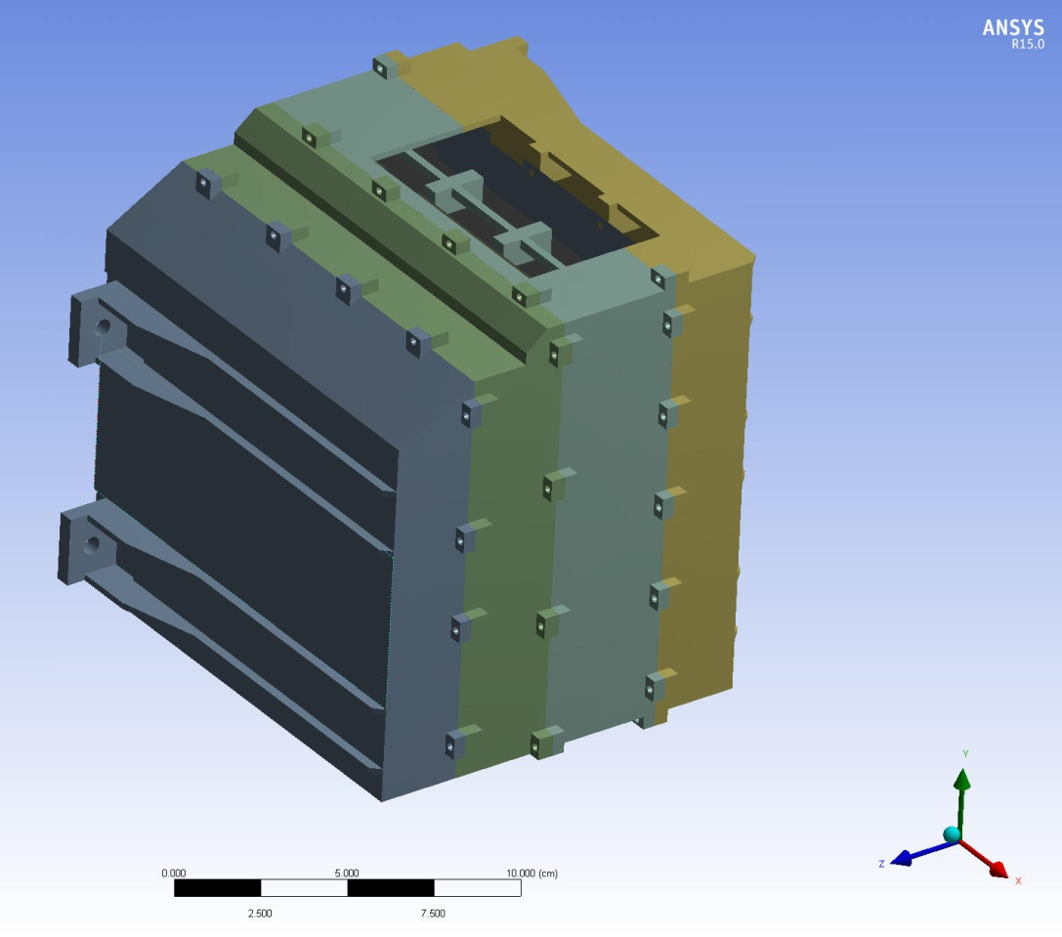
EPI-Hi Finite Element Model
Built in ANSYS Workbench 15.0
Used CBE (plus uncertainty mass of 4.205 kg
  Bracket geometry included
  EPI-Lo modeled as point mass
Elements:
Nodes:
Boundary conditions
  Bracket fixed at s/c mounting holes
FIGURE WILL BE UPDATED
AS ANALYSIS PROGRESSES

Slide 9
EPI-Hi Modal Analysis
EPI-Hi Modal results go here

Slide 10
EPI-Hi Random Vibration Analysis
PSD G acceleration applied uniaxially, all 3 major axes
  Load applied at bracket spacecraft mounting holes
Evaluated Acceptance levels, no notching applied
Constant damping ratio of 2%

Slide 11
EPI-Hi RVL Stress Results, X-Axis
3σ maximum stress
  Location
Margin of safety

Slide 12
EPI-Hi RVL Displacement Results, X-Axis
Maximum displacement
  location

Slide 13
EPI-Hi RVL Stress Results, Y-Axis
3σ maximum stress
  Location
Margin of safety

Slide 14
EPI-Hi RVL Displacement Results, Y-Axis
Maximum displacement
  Location

Slide 15
EPI-Hi RVL Stress Results, Z-Axis
3σ maximum stress
  Location
Margin of safety

Slide 16
EPI-Hi RVL Displacement Results, Z-Axis
Maximum displacement
  Location

Slide 17
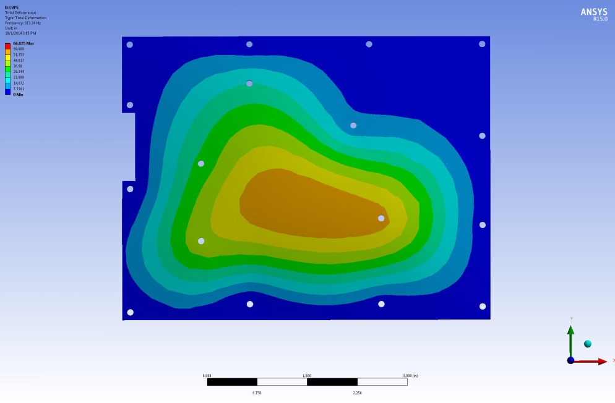
LVPS Modal Analysis
First mode: 373 Hz

Slide 18
LVPS Steinberg Analysis
In progress
LVPS
Reference | C162 | C163 | T3 | T5/T6 | U1 | C182 | U3 | U5 | U6
Part Number
PSD | 0.05 | 0.05 | 0.05 | 0.05 | 0.05 | 0.05 | 0.05 | 0.05 | 0.05
C | 1.26 | 1.26 |  |  | 1.26 | 2.25 | 1.26 | 1.26 | 1.26
h | 0.059 | 0.059 | 0.059 | 0.059 | 0.059 | 0.059 | 0.059 | 0.059 | 0.059
r | 0.707 | 0.707 |  |  | 0.707 | 0.707 | 0.5 | 0.5 | 0.707
L | 0.425 | 0.425 |  |  | 0.614 | 0.329 | 0.614 | 0.28 | 0.28
B (Effective) | 1.378 | 1.339 |  |  | 1.378 | 1.063 | 1.221 | 1.85 | 1.161
Freq (Desired) | 237 | 243 | #DIV/0! | #DIV/0! | 275 | 419 | 230 | 120 | 230
Freq (Ansys) | 373 | 373 | 373 | 373 | 373 | 373 | 373 | 373 | 373
Margin | 136 | 130 | #DIV/0! | #DIV/0! | 98 | -46 | 143 | 253 | 143
Z_{desired} |  |  | #DIV/0! | #DIV/0! |  | 0.0043
Zactual |  |  | 0.0050 | 0.0050 |  | 0.0050
Fatigue Life (min) |  |  | #DIV/0! | #DIV/0! |  | 351

Slide 19
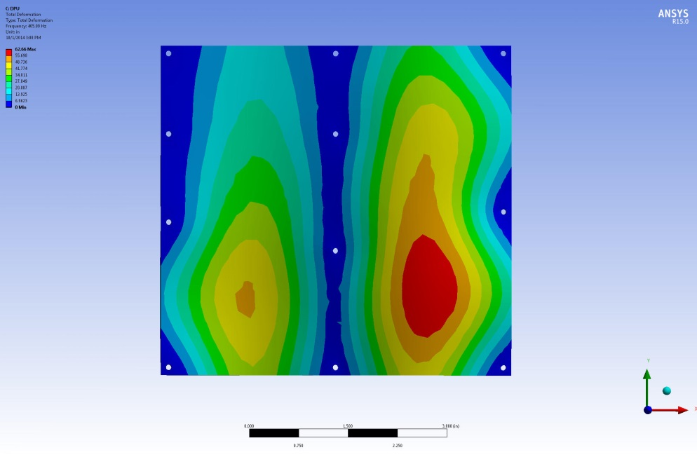
DPU Modal Analysis
First mode: 405 Hz

Slide 20
DPU Steinberg Analysis
In progress
DPU
Reference | 1 | 2 (U2?) | 3 | 4 | 5
Part Number |  | AX250-PQ208
PSD | 0.05 | 0.05 | 0.05 | 0.05 | 0.05
C | 1 | 1 | 1 | 1 | 1
h | 0.059 | 0.059 | 0.059 | 0.059 | 0.059
r | 1 | 1 | 1 | 1.26 | 1.26
L | 1.181 | 1.102 | 0.984 | 0.984 | 0.881
B (Effective) | 1.772 | 1.772 | 1.22 | 1.772 | 1.772
Freq (Desired) | 320 | 312 | 401 | 358 | 343
Freq (Ansys) | 405 | 405 | 405 | 405 | 405
Margin | 85 | 93 | 4 | 47 | 62
Z_{desired}
Zactual
Fatigue Life (min)

Slide 21
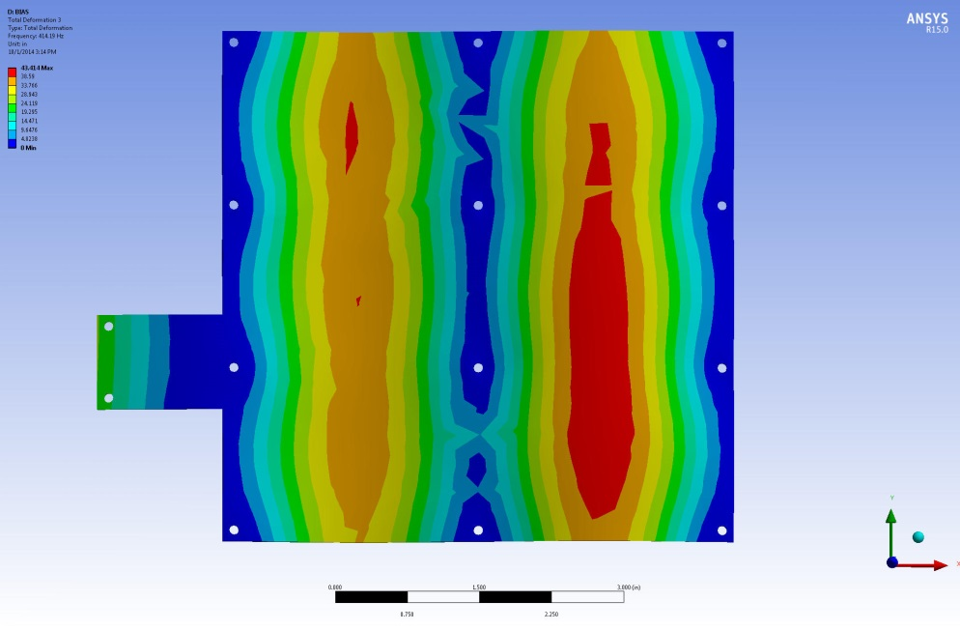
Bias Modal Analysis
First mode: 414 Hz

Slide 22
Bias Steinberg Analysis
In progress
BIAS
Reference | C90 | C3 | U10 | C108 | U12 | Q11 | Q2 | L8
Part Number | SRSI214X7R156M1J5 | SRSI214X7R156M1J5 | CD4069UBKMSR | SR1725X7R165K2NT95 | ISL70218 SRHMF | IRHNJ67234 | IRHNJ67234 | MIL4922-29L
PSD | 0.05 | 0.05 | 0.05 | 0.05 | 0.05 | 0.05 | 0.05 | 0.05
C |  |  | 1 |  | 1.26 | 2.25 | 2.25 | 2.25
h | 0.059 | 0.059 | 0.059 | 0.059 | 0.059 | 0.059 | 0.059 | 0.059
r | 1 | 1 | 1 | 1 | 1 | 0.707 | 0.707 | 1
L |  |  |  |  | 0.29 | 0.405 | 0.405 | 0.52
B (Effective) | 1.693 | 1.693 | 1.693 |  | 2.539 | 1.693 | 1.693 | 1.693
Freq (Desired) | 0 | 0 | 0 | #DIV/0! | 165 | 314 | 314 | 458
Freq (Ansys) | 414 | 414 | 414 | 414 | 414 | 414 | 414 | 414
Margin | 414 | 414 | 414 | #DIV/0! | 249 | 100 | 100 | -44
Z_{desired} |  |  |  |  |  |  |  | 0.0039
Zactual |  |  |  |  |  |  |  | 0.0044
Fatigue Life (min) |  |  |  |  |  |  |  | 360

Slide 23
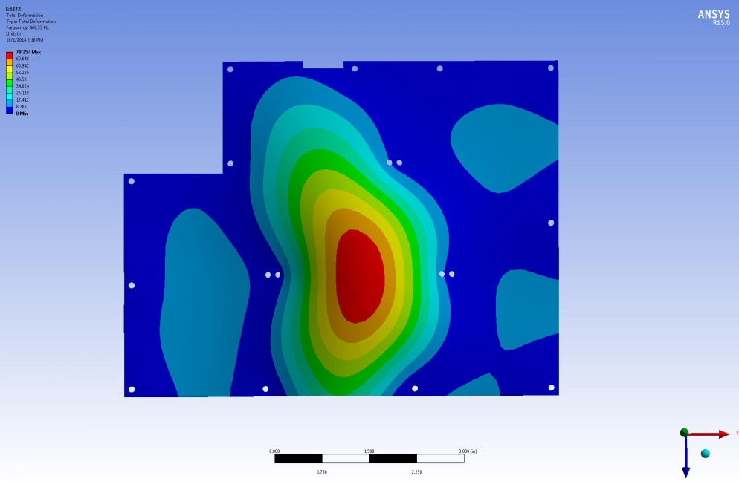
HET Modal Analysis
First mode: 468 Hz

Slide 24
HET Steinberg Analysis
In progress
HET
Reference | 1 | 2 | 3 | 4 | 5 | 6 | 7
Part Number
PSD | 0.05 | 0.05 | 0.05 | 0.05 | 0.05 | 0.05 | 0.05
C | 0.707 | 1 | 0.707 | 0.707 | 1 | 1 | 0.707
h | 0.059 | 0.059 | 0.059 | 0.059 | 0.059 | 0.059 | 0.059
r | 1 | 1.26 | 1 | 1.26 | 1.26 | 1.26 | 1.26
L | 0.906 | 0.945 | 1.378 | 1.063 | 1.417 | 1.26 | 1.26
B (Effective) | 1.653 | 1.811 | 1.693 | 1.693 | 1.811 | 1.772 | 1.76
Freq (Desired) | 231 | 346 | 268 | 290 | 407 | 395 | 301
Freq (Ansys) | 468 | 468 | 468 | 468 | 468 | 468 | 468
Margin | 237 | 122 | 200 | 178 | 61 | 73 | 167

Slide 25
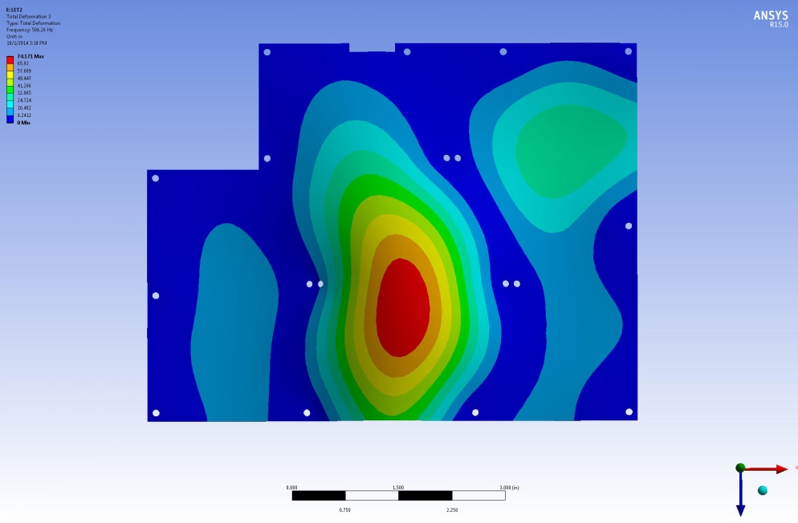
LET1 Modal Analysis
First mode: 506 Hz

Slide 26
LET1 Steinberg Analysis
In progress
LET1
Reference | 1 | 2 | 3 | 4 | 5 | 6 | 7
Part Number
PSD | 0.05 | 0.05 | 0.05 | 0.05 | 0.05 | 0.05 | 0.05
C | 0.707 | 1 | 0.707 | 0.707 | 1 | 1 | 0.707
h | 0.059 | 0.059 | 0.059 | 0.059 | 0.059 | 0.059 | 0.059
r | 1 | 1.26 | 1 | 1.26 | 1.26 | 1.26 | 1.26
L | 0.906 | 0.945 | 1.378 | 1.063 | 1.417 | 1.26 | 1.26
B (Effective) | 1.653 | 1.811 | 1.693 | 1.693 | 1.811 | 1.772 | 1.76
Freq (Desired) | 231 | 346 | 268 | 290 | 407 | 395 | 301
Freq (Ansys) | 506 | 506 | 506 | 506 | 506 | 506 | 506
Margin | 275 | 160 | 238 | 216 | 99 | 111 | 205

Slide 27
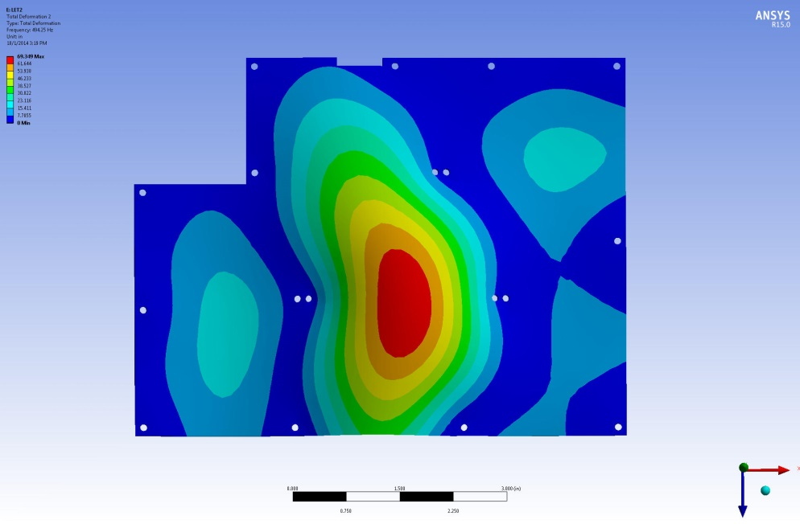
LET2 Modal Analysis
First mode: 494 Hz

Slide 28
LET2 Steinberg Analysis
In progress
LET2
Reference | 1 | 2 | 3 | 4 | 5 | 6 | 7
Part Number
PSD | 0.05 | 0.05 | 0.05 | 0.05 | 0.05 | 0.05 | 0.05
C | 0.707 | 1 | 0.707 | 0.707 | 1 | 1 | 0.707
h | 0.059 | 0.059 | 0.059 | 0.059 | 0.059 | 0.059 | 0.059
r | 1 | 1.26 | 1 | 1.26 | 1.26 | 1.26 | 1.26
L | 0.906 | 0.945 | 1.378 | 1.063 | 1.417 | 1.26 | 1.26
B (Effective) | 1.653 | 1.811 | 1.693 | 1.693 | 1.811 | 1.772 | 1.76
Freq (Desired) | 231 | 346 | 268 | 290 | 407 | 395 | 301
Freq (Ansys) | 494 | 494 | 494 | 494 | 494 | 494 | 494
Margin | 263 | 148 | 226 | 204 | 87 | 99 | 193

Slide 29
Bolted Joint Analysis
Results of bolted joint analysis of 5 EPI-Hi mounting fasteners goes here

Slide 30
Conclusion
Summary of analysis

Slide 31
Steinberg Solder Joint Fatigue Analysis
Calculated desired frequency to survive 20 million stress reversal cycles using the following equation
Compared desired frequency to modal results
Calculated fatigue life of components with a negative margin (desired frequency greater than calculated frequency) using the following equation
Cumulative random vibration exposure time is estimated to be less than 20 minutes

