Slide 1
25 – ISIS Bracket
Greg Dirks
ISIS Mechanical Engineering (SwRI)
Notes:
introduction

Slide 2
Outline
Introduction / Design Overview
Design Requirements
Design Changes Since PDR and Rationale
Structural Analysis Description and Results
Bracket Fabrication Overview
EM Bracket Test Description and Results
MICD and Drawing Status
Fabrication, Integration, and Test Plan
Summary

Slide 3
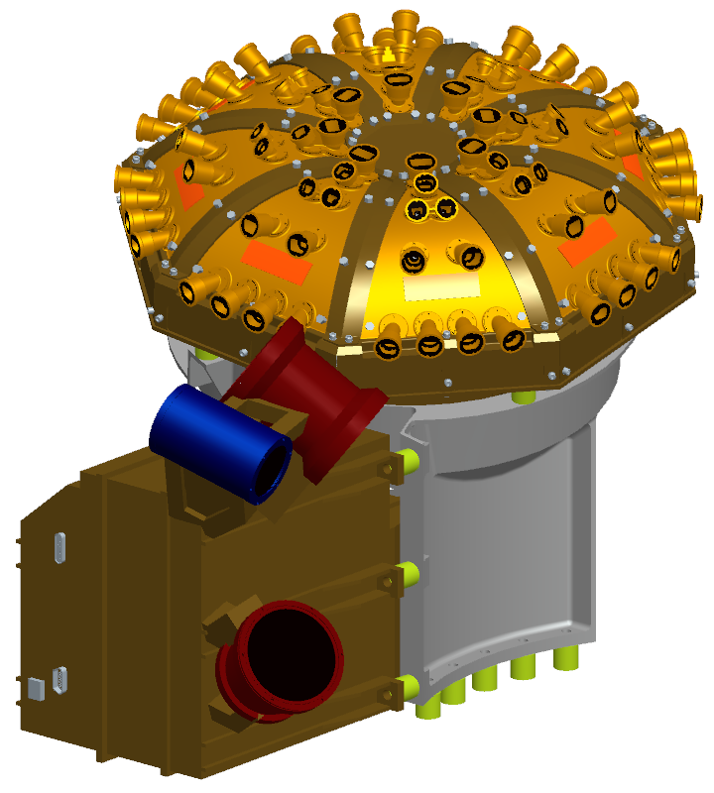
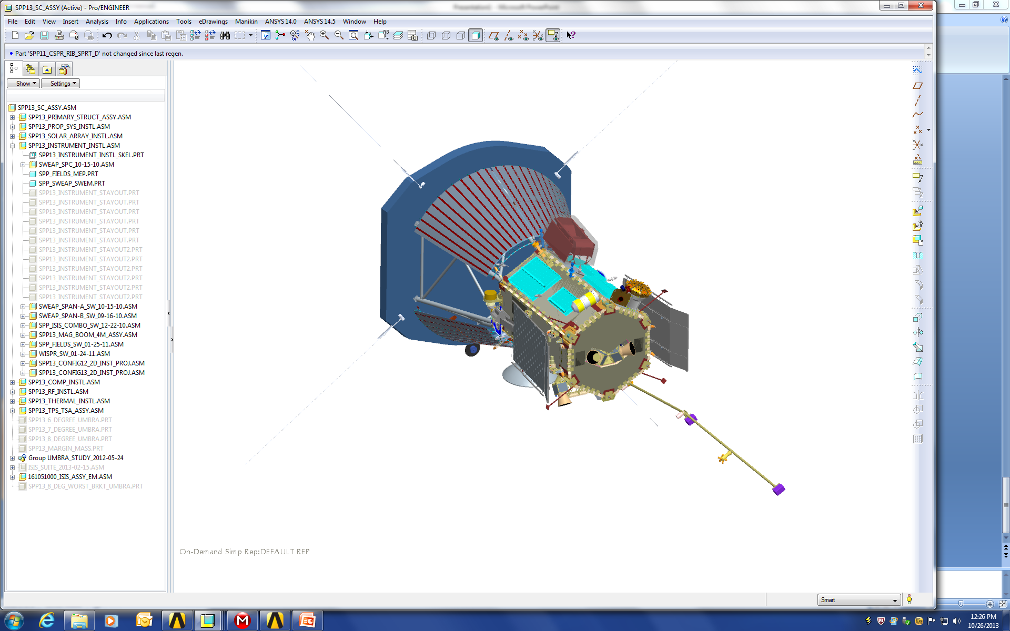
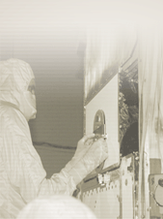
Introduction
The ISIS bracket is designed to support both the EPI-LO and EPI-HI instruments on the TBD spacecraft deck.
The ISIS bracket is machined from a monolithic extrusion of Aluminum 6061-T6511.
G10 glass epoxy composite thermal isolators are employed between the bracket and the mating surfaces (spacecraft deck, EPI-HI, and EPI-LO).
EPI-LO
ISIS Bracket
EPI-HI

Slide 4
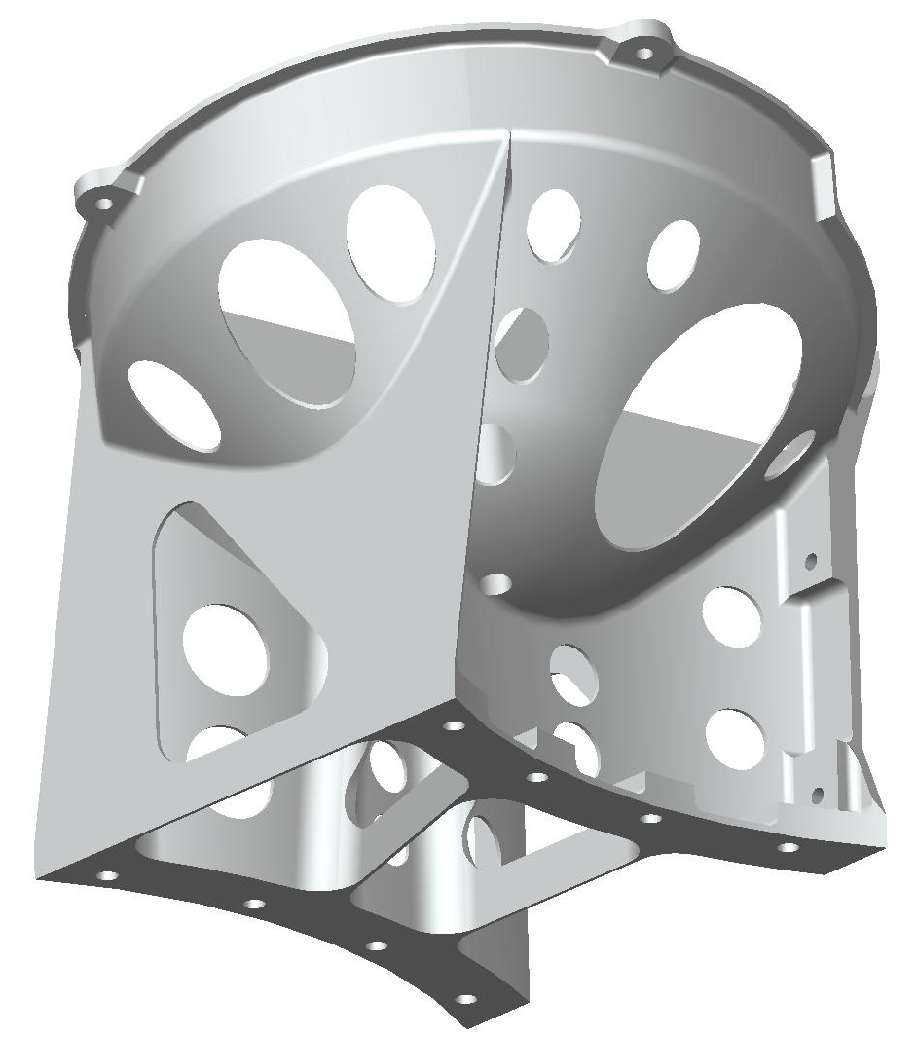
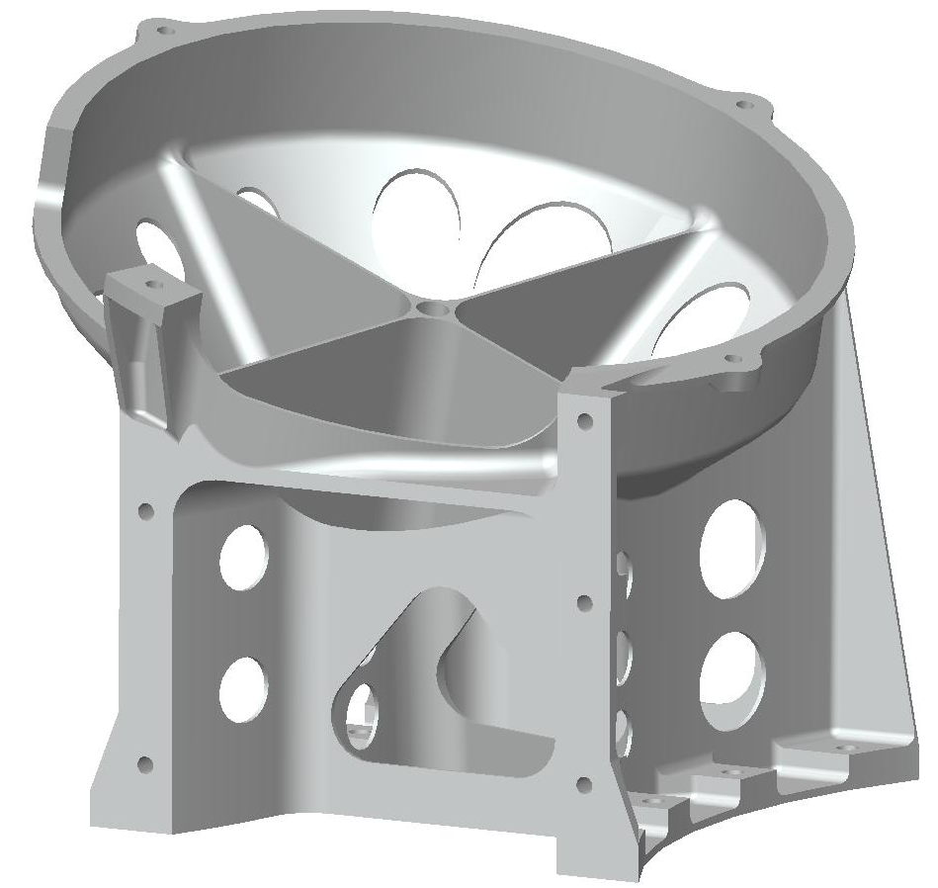
Design Overview

Slide 5
Structural Design Requirements
Design Requirements taken from SPP Environmental Design and Test Requirements Document (EDTRD), Document 7434-9039 Revision B
  A structural analysis shall be completed to verify the component structural integrity.
  All components shall have a minimum resonant frequency >80 Hz.
  All bus-mounted components and subsystems shall be designed to the quasi-static accelerations derived from the Mass Acceleration Curve.
  Stress analysis shall always show positive margins of safety.
  All components shall be designed to survive sine sweep and random vibration environments specified in EDTRD.
Modal and acoustic testing are not required for this subsystem. First mode >>50 Hz.

Slide 6
Additional Design Requirements
ISIS bracket must hold EPI-Hi and EPI-Lo in position on the SPP deck.
ISIS bracket must be capable of independently removing EPI-Hi and EPI-Lo, in either order.
All ISIS suite testing shall be performed on the bracket, with instruments or instrument analogs as appropriate.

Slide 7
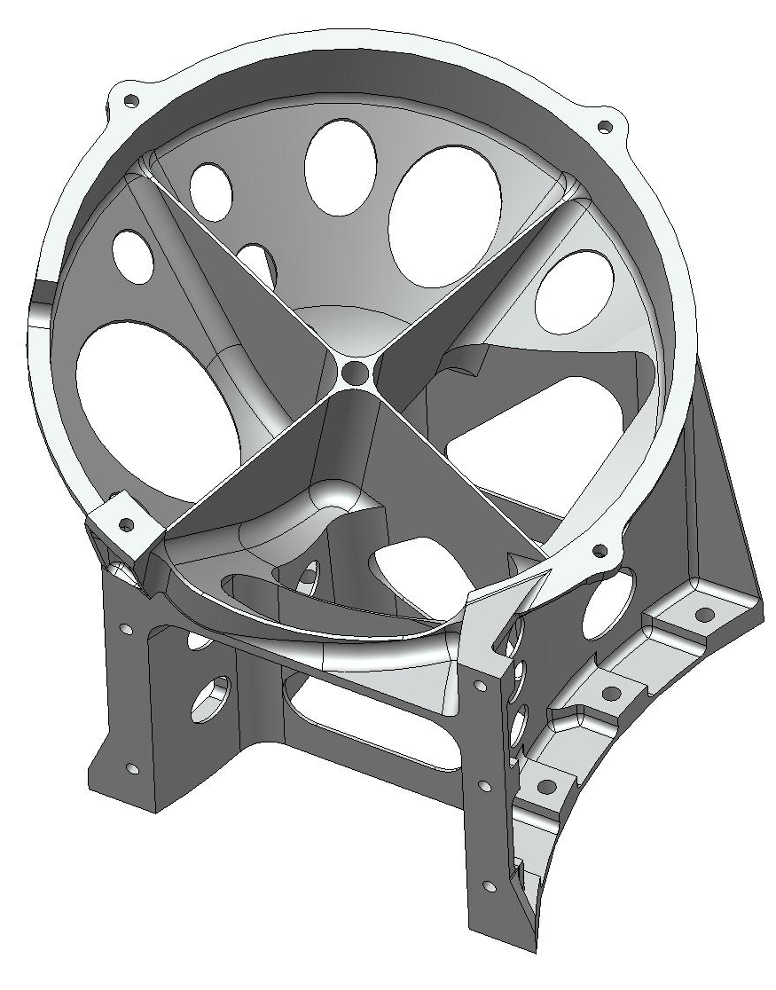
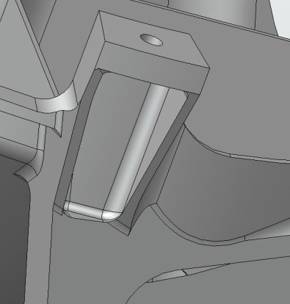
Design Changes Since PDR
Increased wall thickness of cylinder by .013 inches; Decreased thickness of cone by .005”
Added “crosshair” stiffening ribs inside bowl, extending one down to spacecraft mounting face
Strengthened EPI-Lo mounting foot:
Extended/added gussets
Merged intersection of cylinder and EPI-Hi mounting face
Increased machined radii
Added lightening holes and trimmed flanges to decrease mass
Mass: 898 grams (was 761 grams)

Slide 8
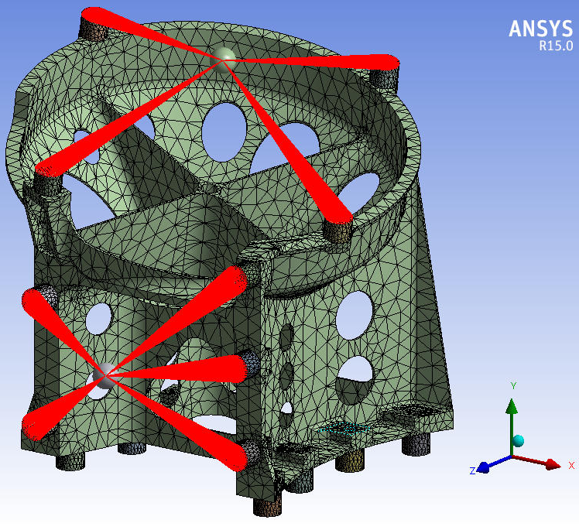
FEM/Boundary Conditions
FE Model Mass = 9.425 kg (CBE mass)
Fixed at isolator to spacecraft deck interface (8 places)
Point masses with rigid elements used to represent EPI-HI and EPI-LO instruments.
68k elements,126k nodes.

Slide 9
Material Properties
  Aluminum 6061-T611 (ASTM B221) Extruded Shape Properties
  Ultimate Tensile Strength: 38 ksi
  Yield Tensile Strength: 35 ksi
G10, glass/epoxy composite
  Compressive Strength: 65 ksi
Applicable Safety Factors
  SF_{u} = 1.4 and SF_{y} = 1.25
  An additional factor of 1.28 is applied to account for increased Protoflight test levels
Derated Allowable Stresses
  Aluminum: 21.2 ksi (minimum of 38/1.4/1.28 and 35/1.25/1.28)
  G-10: 36.3 ksi (65/1.4/1.28)

Slide 10
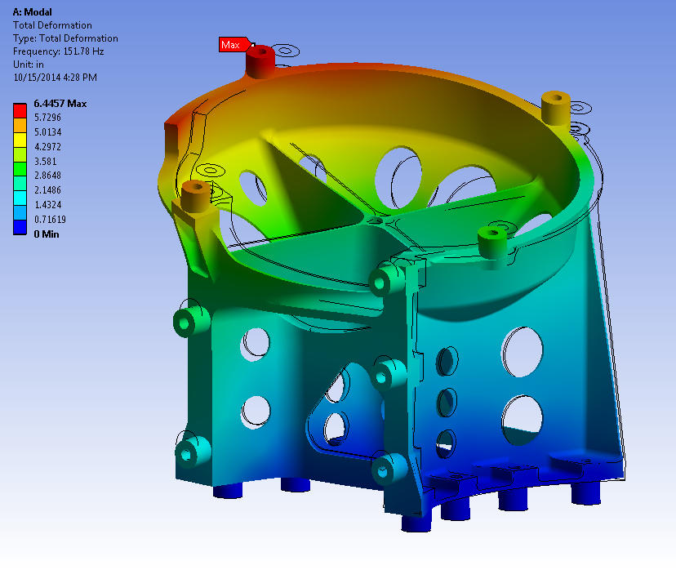
Modal Analysis
First mode: 151.8 Hz
Requirement: 80 Hz min.

Slide 11
Random Vibration Analysis
PSD G acceleration applied uni-axially, all 3 major axes
PSD input from EDTRD Rev B
  Evaluated Acceptance levels, with no notching applied
Frequency (Hz) | Qualification (G²/Hz) | Protoflight (G²/Hz) | Acceptance (G²/Hz)
20 | 0.016 | 0.016 | 0.008
50 | 0.1 | 0.1 | 0.05
600 | 0.1 | 0.1 | 0.05
2000 | 0.009 | 0.009 | 0.0045
Overall Grms | 9.93 | 9.93 | 7.0
Duration (mins) | 2 | 1 | 1
Frequency (Hz) | Qualification (G²/Hz) | Protoflight (G²/Hz) | Acceptance (G²/Hz)
20 | 0.008 | 0.008 | 0.0053
50 | 0.05 | 0.05 | 0.04
600 | 0.05 | 0.05 | 0.04
2000 | 0.0045 | 0.0045 | 0.0036
Overall Grms | 7.0 | 7.0 | 6.28
Duration (mins) | 2 | 1 | 1
Axis Normal to the Spacecraft Deck or Panel
(Y-Axis)
2 Orthogonal Axes, In-Plane of the Spacecraft Deck or Panel
(X- and Z-Axes)

Slide 12
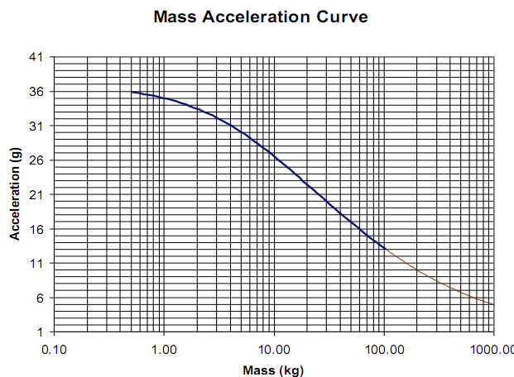
Mass Acceleration Curve (MAC)
<<<ADD TEXT EXPLANATION>>>
Bracket with Instruments:
Mass with uncertainty= TBD kg
MAC: for TBD kg, Acceleration=TBD g

Slide 13
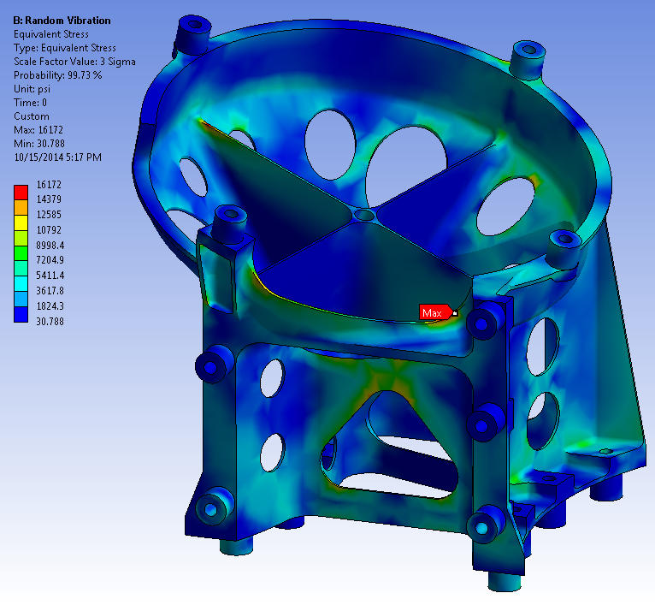
Stress Results
Worst Case Stress:
16.2 ksi; occurs at EPI-HI Clearance Notch in the X-axis load case.
Include table of all 3 load cases with max stresses, similar to the one below.
UPDATE

Slide 14
Spacecraft Mounting Fastener Loads
<<<Present mounting fastener loads>>>
<<<Present fastener strength analysis results?>>>

Slide 15
ISIS Bracket Fabrication
The ISIS bracket can be machined using conventional machining processes
  Monolithic design, will be machined from a single block
  All operations can be performed on a 4-axis mill
Thermal isolators and mass models will also be fabricated to be used during structural testing
  G10 isolators will be machined to flight-like quality
  Mass models to reflect instrument mass properties with flight-like mounting interfaces
Bracket height increase due to TPS shift can easily be accommodated as needed
  Working with S/C mechanical team; any shift in the TPS only requires translation normal to the deck to remain adjacent to the umbra

Slide 16
EM Bracket Testing Levels
Summary of Tests Levels Here

Slide 17
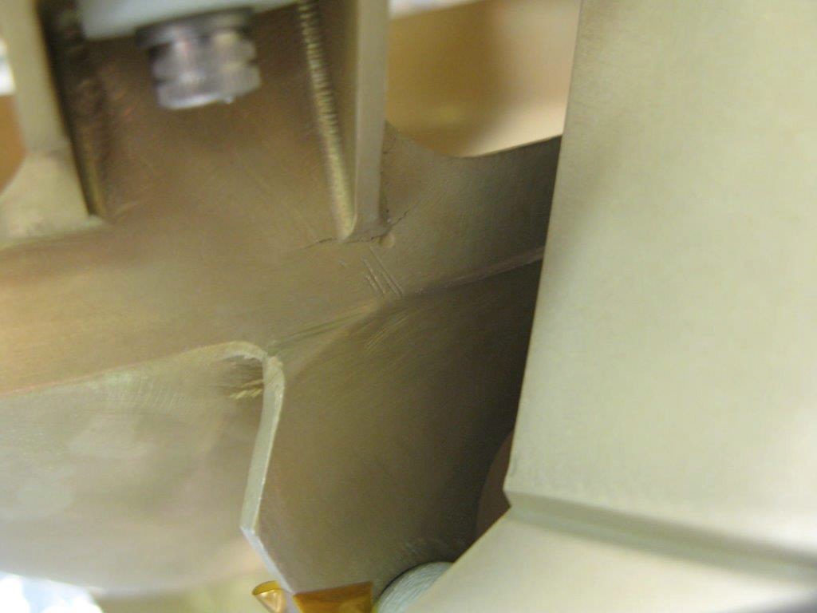
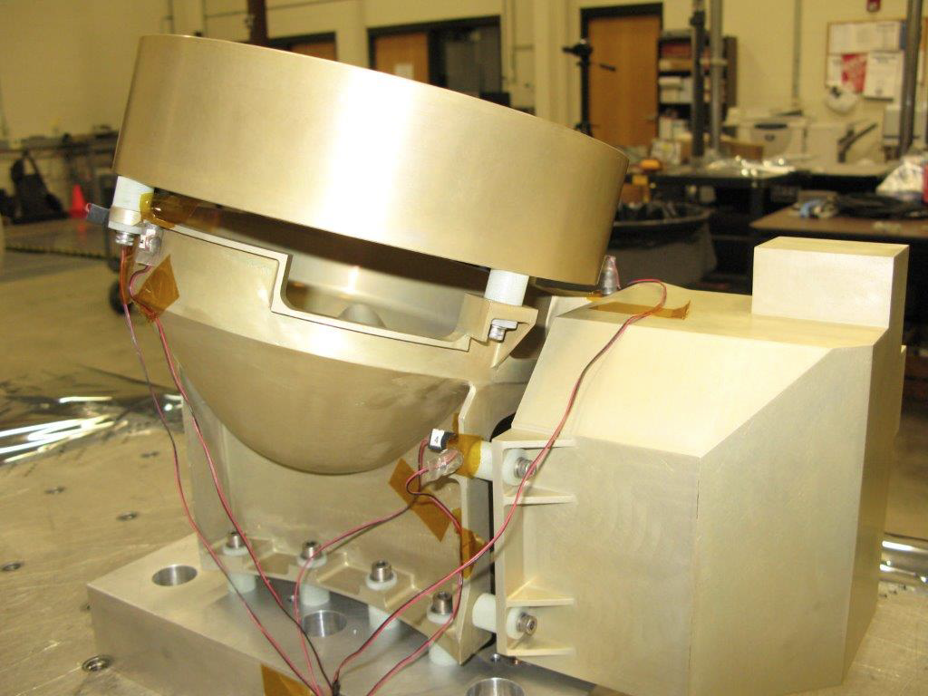
EM Bracket Testing
EM bracket (P/N 161054010-01 Revision -) was vibration tested at SwRI facilities in August 2014 (? verify).
  Instrument mass models and G10 thermal isolators employed.
  Mounted using flight quality mounting hardware
  Cracks developed at base of EPI-LO mounting foot

Slide 18
EM Bracket Testing
EM bracket redesigned to reduce stress.
Redesigned EM bracket (P/N 161054010-01 Revision TBD) was vibration tested at SwRI facilities in TBD 2014.
  Instrument mass models and G10 thermal isolators employed.
  Mounted using flight quality mounting hardware
  Pre & post test low-level sine sweeps used to identify any change in fundamental frequency.
Random vibration performed in each of three orthogonal directions per tables in EDTRD 4.4.3
Sine sweep performed in each of three orthogonal directions per sine environment (TBD) given in EDTRD 4.4.4
Results:
  Natural frequency: TBD
  No cracks or detrimental deformations observed.

Slide 19
EM Bracket Testing
Pictures of EM Bracket Testing (New Design) Here

Slide 20
MICD and Drawing Status
Table here of all related drawings with release status.

Slide 21
Fabrication, Integration, and Test Plan

Slide 22
Summary
ISIS Bracket Design and EM Bracket Testing have been completed
  Design satisfies EDTRD requirements
  Analysis exhibits positive margins of safety for all cases
  Testing of redesigned bracket validated new design
Ready to begin FM Bracket Fabrication.

