Slide 1
EPI-Lo Sensor Review – Part 2
Matt Hill (JHU/APL)
Deputy EPI-Lo Lead
Pre-CDR Peer Review
(not a CDR run-through)
6 NOV 2014
Matt Hill
EPI-Lo Deputy Lead Co-I (JHU/APL)
This document contains technical data that may be controlled by the International Traffic in Arms Regulations (22 CFR 120-130) and may not be provided, disclosed or transferred in any manner to any person, whether in the U.S. or abroad, who is not 1) a citizen of the United States, 2) a lawful permanent resident of the United States, or 3) a protected individual as defined by 8 USC 1324b(a)(3), without the written permission of the United States Department of State.
Notes:
introduction

Slide 2
Composition and Energy Coverage

Slide 3
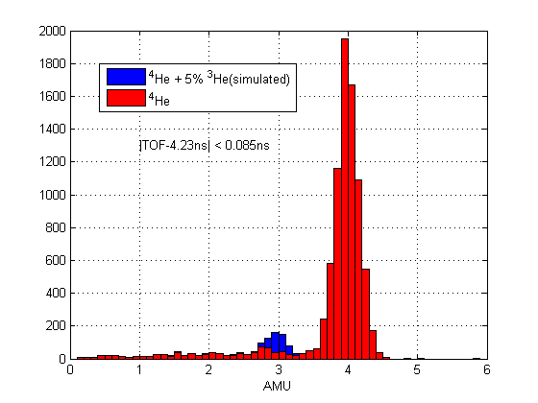
Composition and Energy Coverage
Don’s prescription: simulate 3He by scaling alpha E -> 0.75E and population to a fraction.
Aperture 4
S/B ~ 3

Slide 4

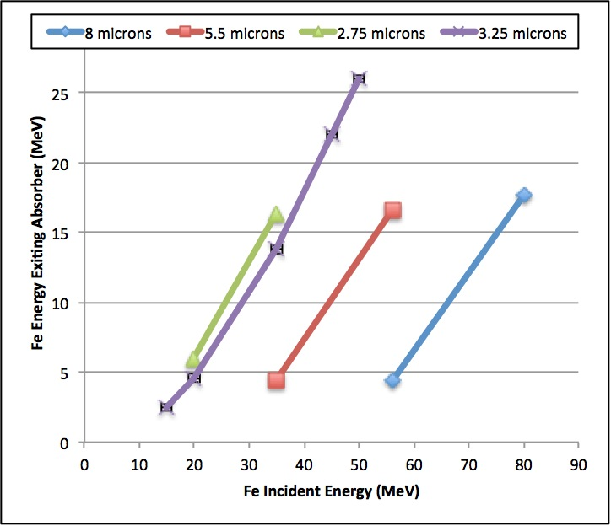
Energy Coverage: Fe absorber Method

Slide 5
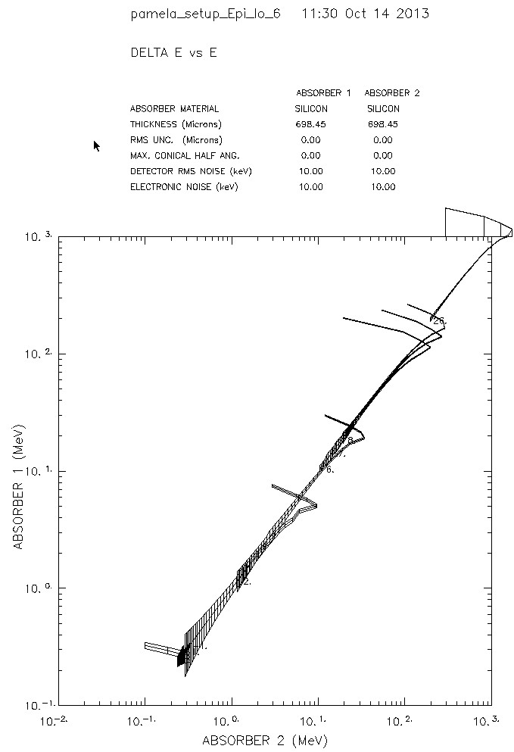
Energy Coverage: H, e- dE/dx vs E method

Slide 6
Calibration

Slide 7
EPI-Lo Calibration
EPI-Lo measurements are intended to generate the information needed to derive differential intensities (j[cm² -sr-s-keV]⁻¹)
The goal of EPI-Lo characterization and calibration efforts is to develop the quantitative procedures for converting the count rates (R [counts s⁻¹]) reported by EPI-Lo into estimates of j for the various defined ranges of energies, particle species, and arrival angles
“Calibration” for a particle instrument like EPI-Lo means determining the following:
  Transfer function from counts into flux (physical units)
  Characteristic of “Rate-in” versus “Rate-out”
  Response to visible and ultraviolet light
  Response to high energetic particle backgrounds

Slide 8
Calibration Types
Foreground
  Ions and electrons in the energy range of interest to the instrument
Background
  Electrons
  Characterize the rates from penetrating radiation
  Characterize response to Solar Wind and/or photoelectron impact
Light
  Characterize rejection of UV background, primarily H-alpha
  Characterize rejection of sunlight and glint

Slide 9
Tests at Instrument Level
30
*Science requires relative/absolute accuracy: 20%/50%. Ground calibration 20% precision, reduced to 10% in flight.

Slide 10
Foreground Calibration Requirements
Foreground Electrons
  40 keV to 1000 keV (Needed for understanding backgrounds)
    1 keV to 30 keV Electron Gun at APL
    30 keV to 100 keV Radioactive sources at APL
    125 keV to 1.6 MeV Accelerator at GSFC
Foreground Ions (H, He3, He4, O, Fe)
  40 keV to 15000 keV (Level 4 Requirements)
  (Goal: protons to 20 MeV)
    3 keV to 170 keV Accelerator at APL (November 2014)
    30 keV to 5 MeV Degraded alpha sources (already begun)
    125 keV to 1.6 MeV Accelerator at GSFC (16-27 Feb 2015)
    1 MeV to 20 MeV Accelerator at LBL (1 April 2015)
    ~40 MeV Fe Californium source 40 MeV 40-50 amu particles.

Slide 11
Background Calibration Requirement
Background Electrons
  2 eV to 10 MeV (from the expected environment)
    1 eV to 100 eV Hot filament at APL
    1 keV to 50 keV Electron Gun at APL
    125 keV to 1.6 MeV Accelerator at GSFC
    1 MeV to 10 MeV Accelerator at Idaho (uncertain)
Background Ions
  3 keV to 50 MeV (from the expected environment)
    3 keV to 170 keV Accelerator at APL
    30 keV to 5 MeV Degraded alpha sources
    125 keV to 1.6 MeV Accelerator at GSFC
    1 MeV to ~100 MeV Accelerator at LBL
Photons
  UV and visible lamps at APL (need to look into this)

Slide 12
Dust

Slide 13
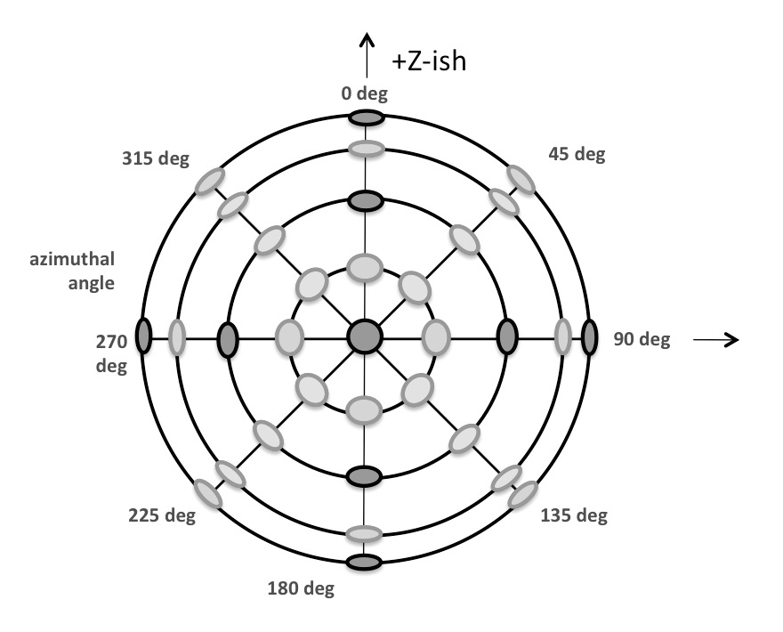
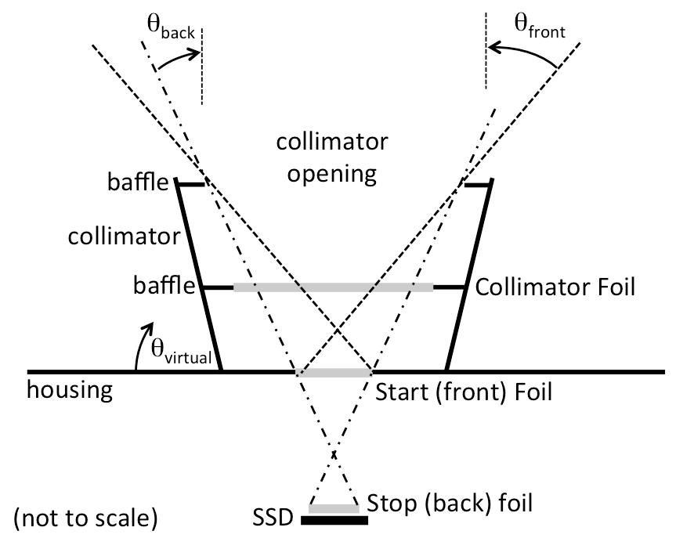
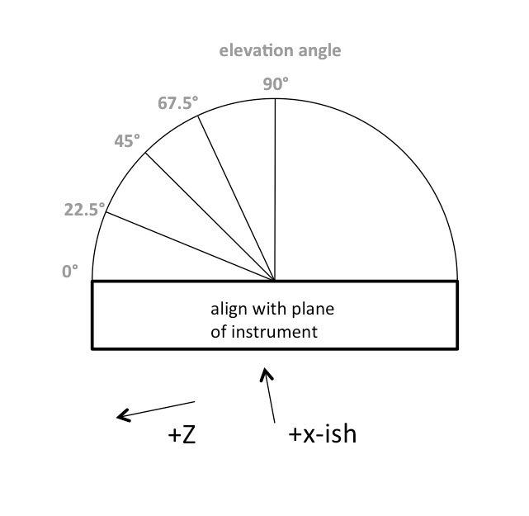
Background Measurement: Dust

Slide 14
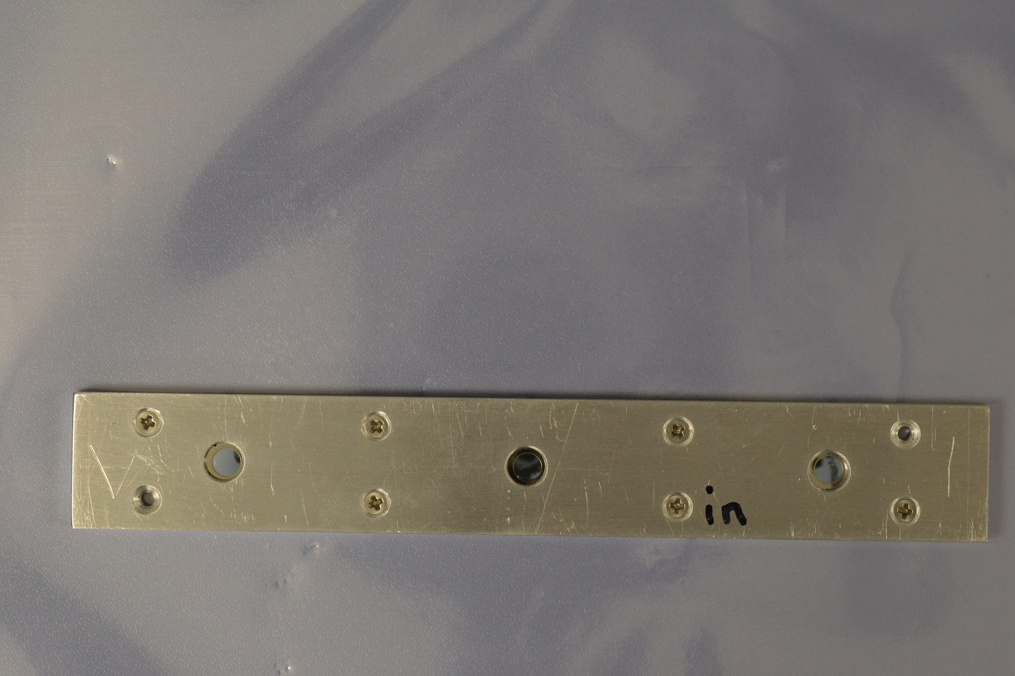
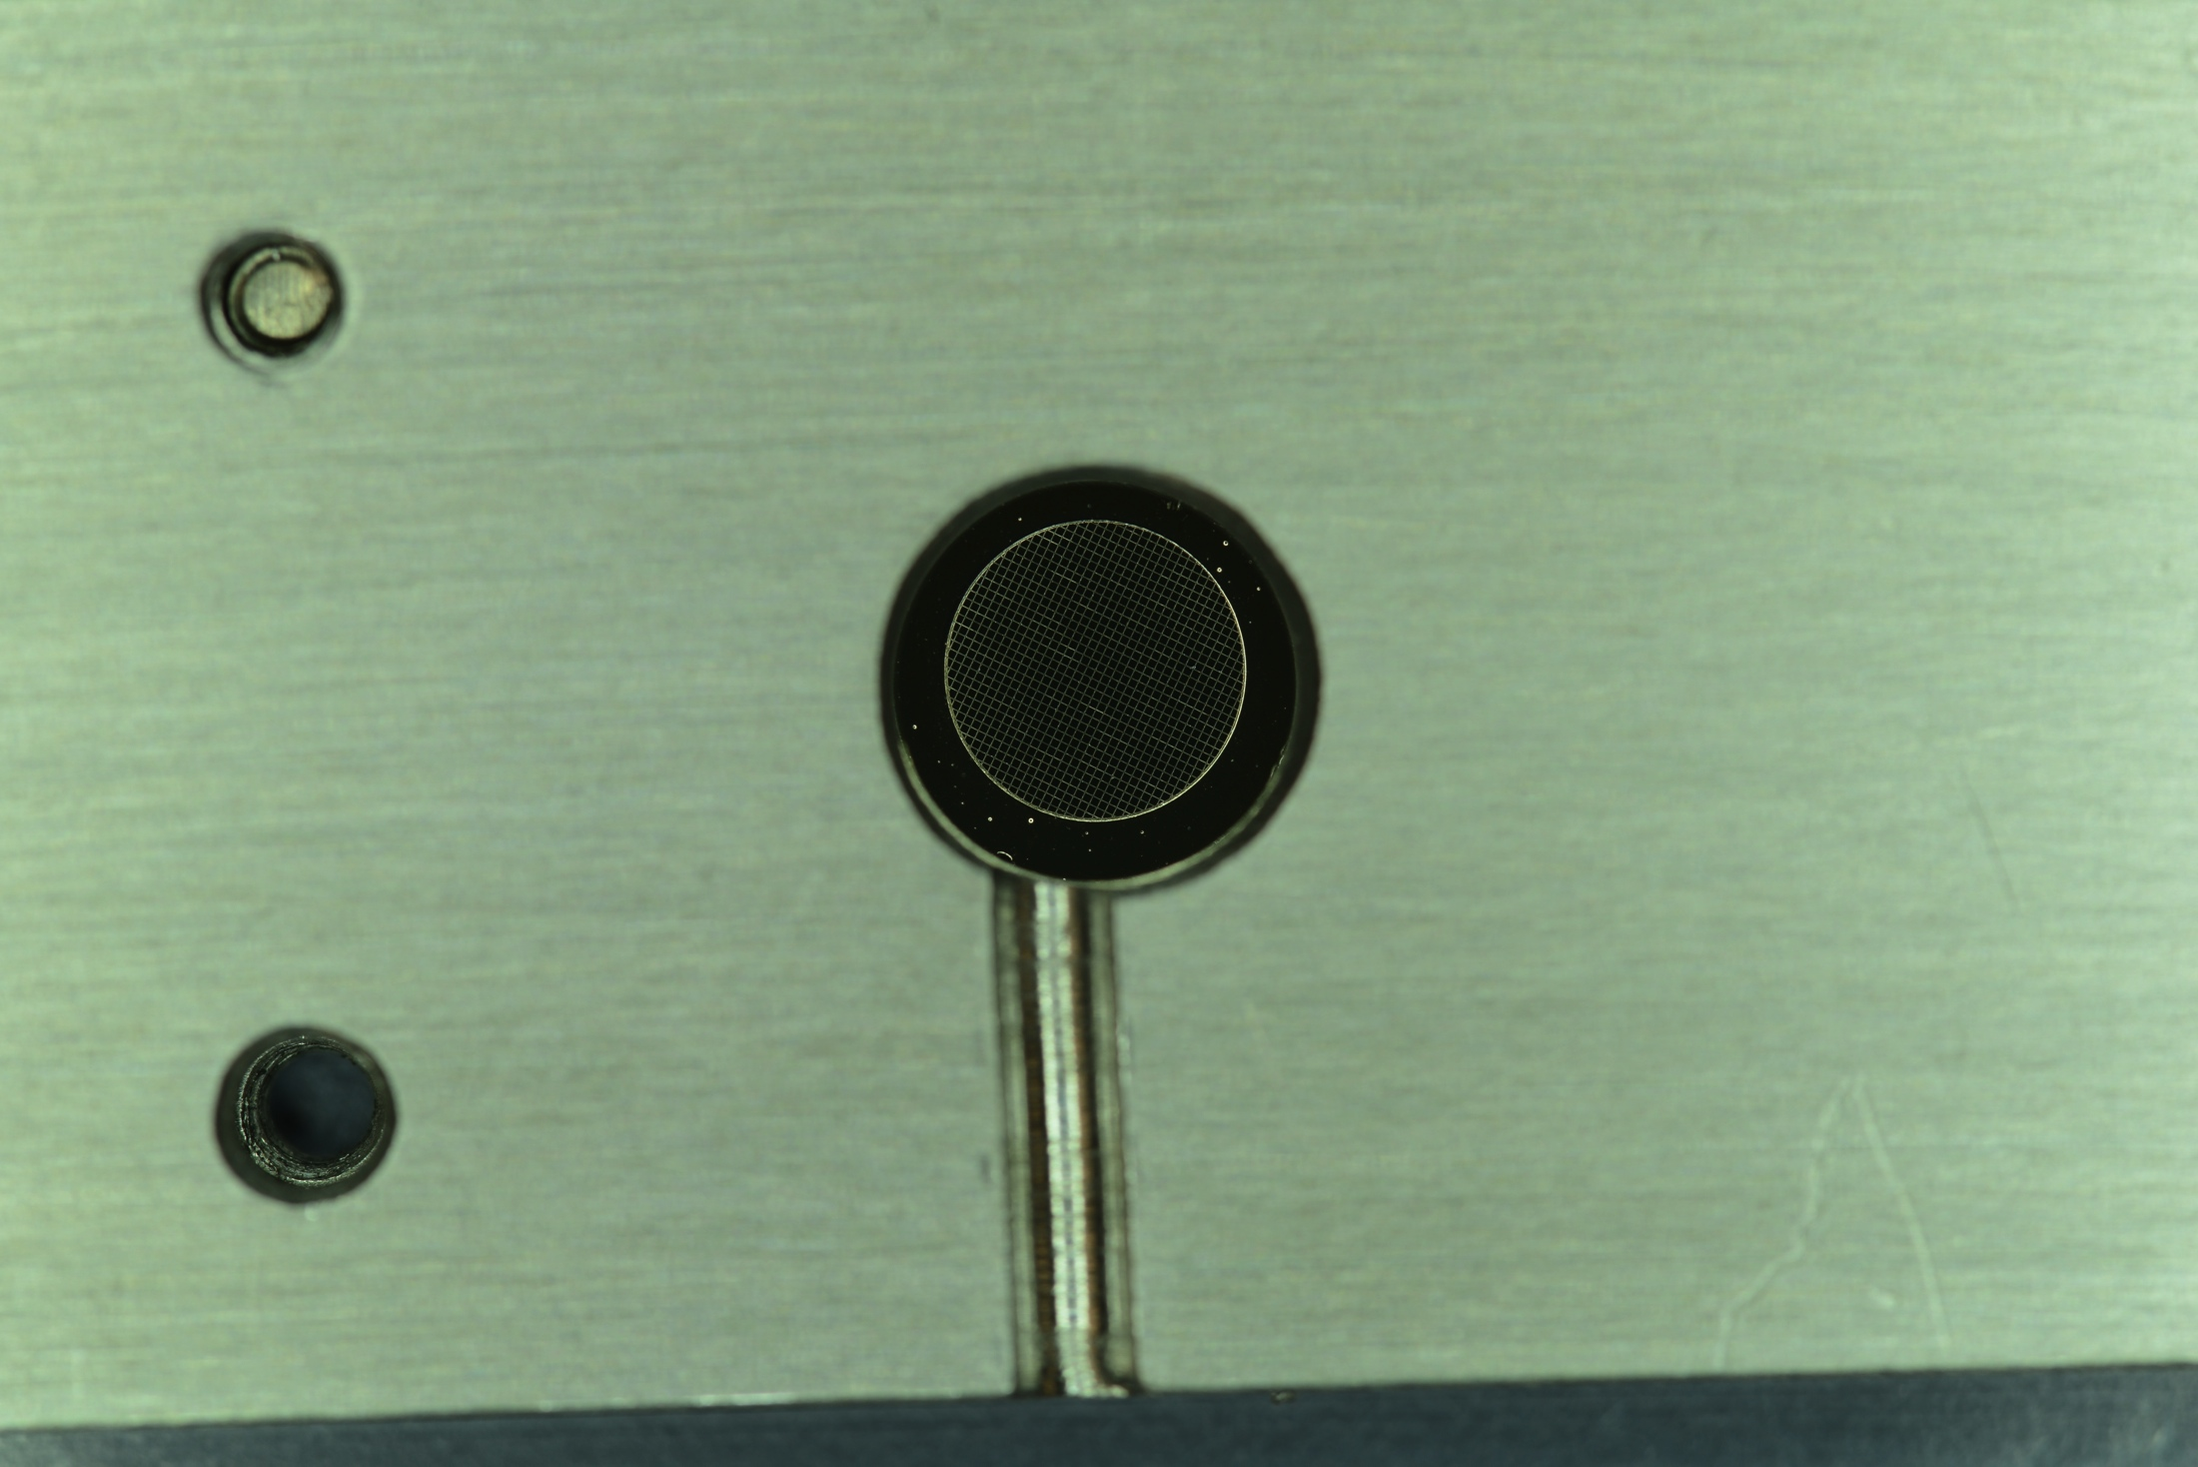
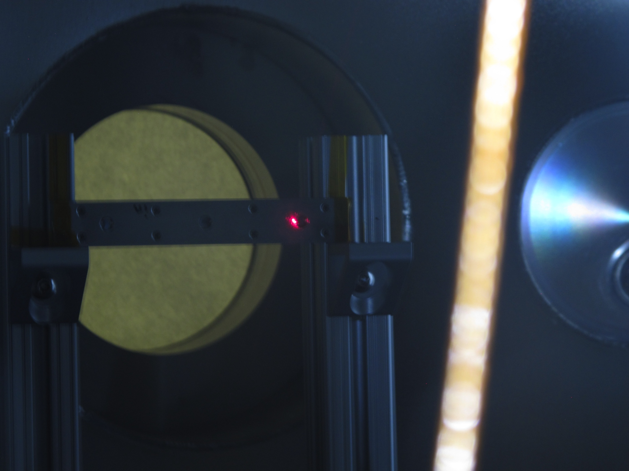
Background Measurement: Dust

Slide 15
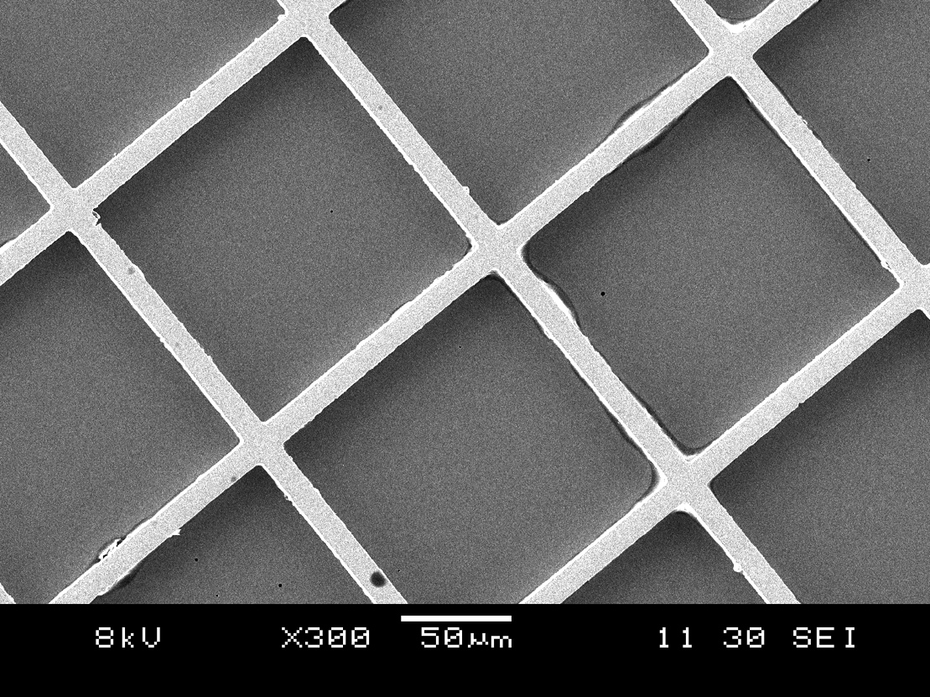
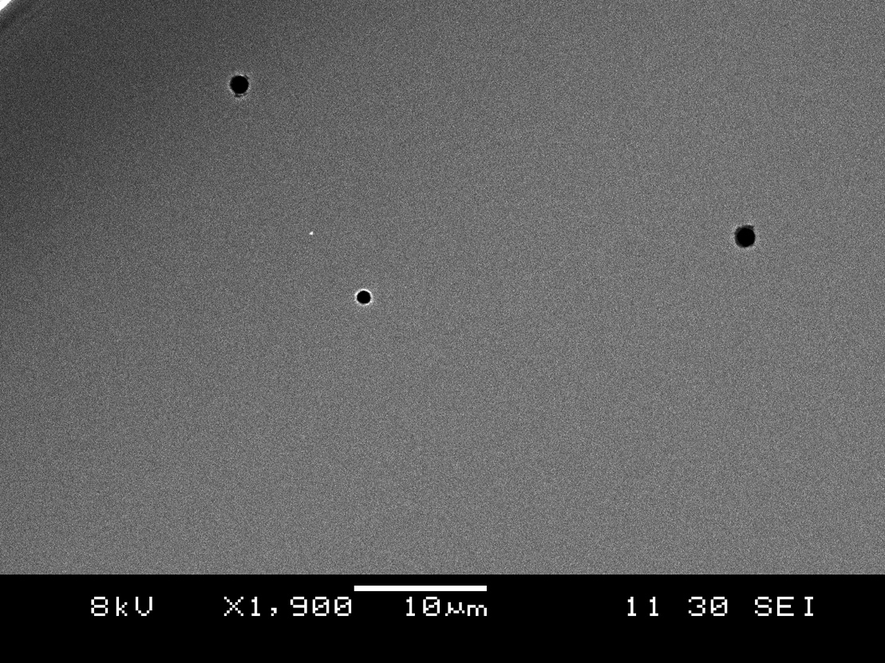
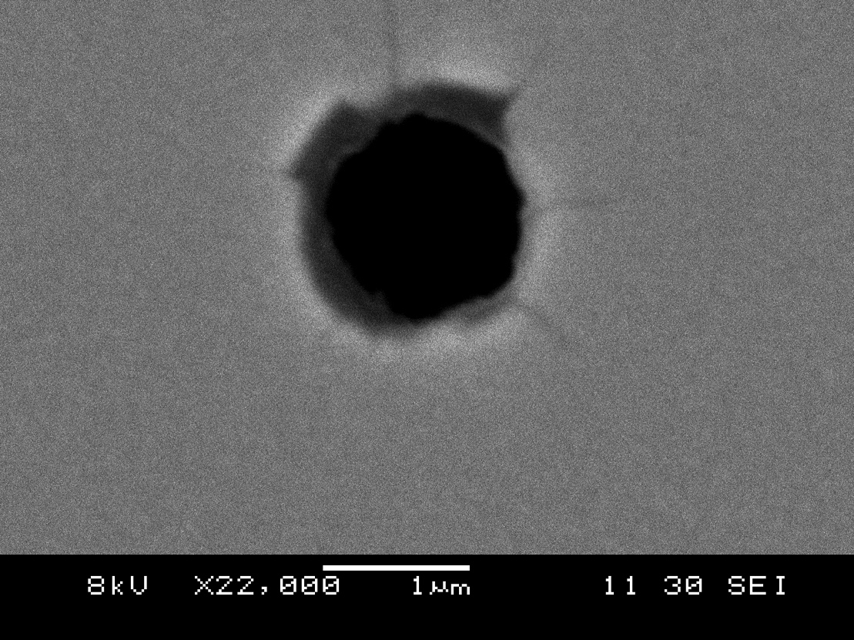
Dust: U of ColoradoTest

Slide 16
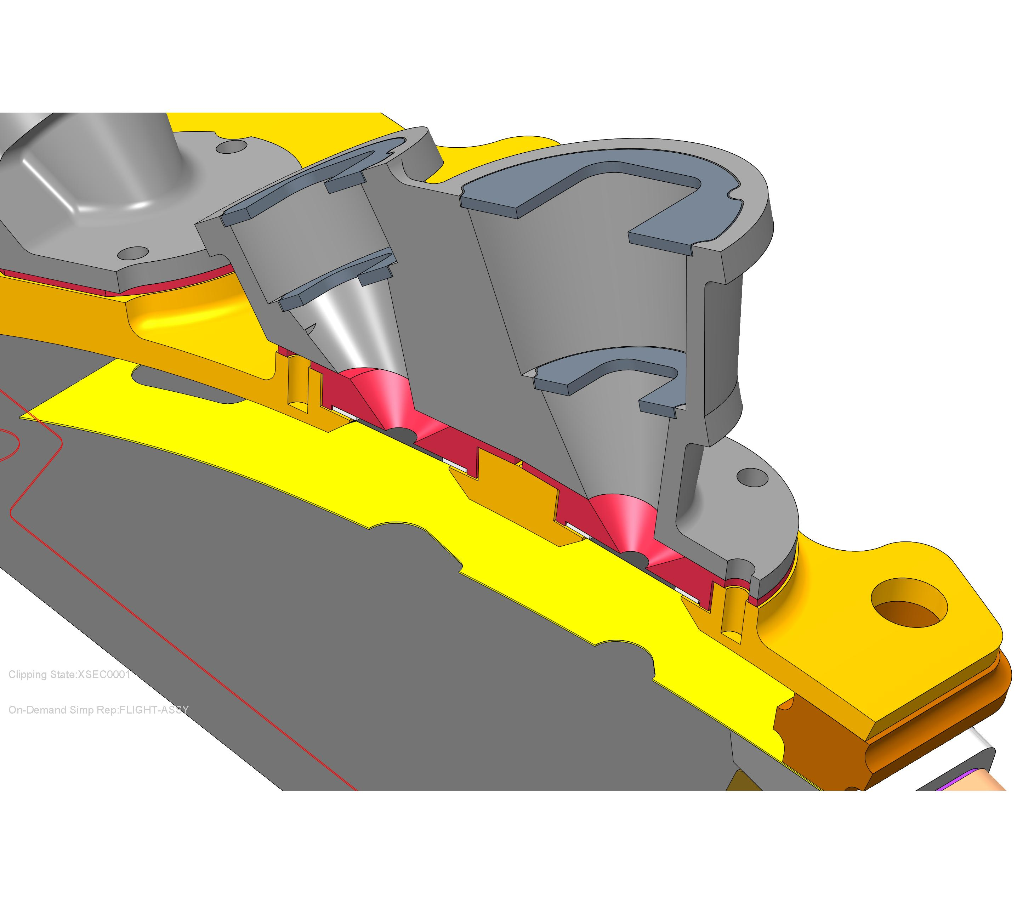
Collimators and Start Foils
Foils Mount on Apertures (red)
    Each elevation tailored for equal geometric factors
    Second foil at intermediate baffle (vented)
Collimators screw-mount to outer cover, capture foils
    Each elevation and azimuth is unique

Slide 17
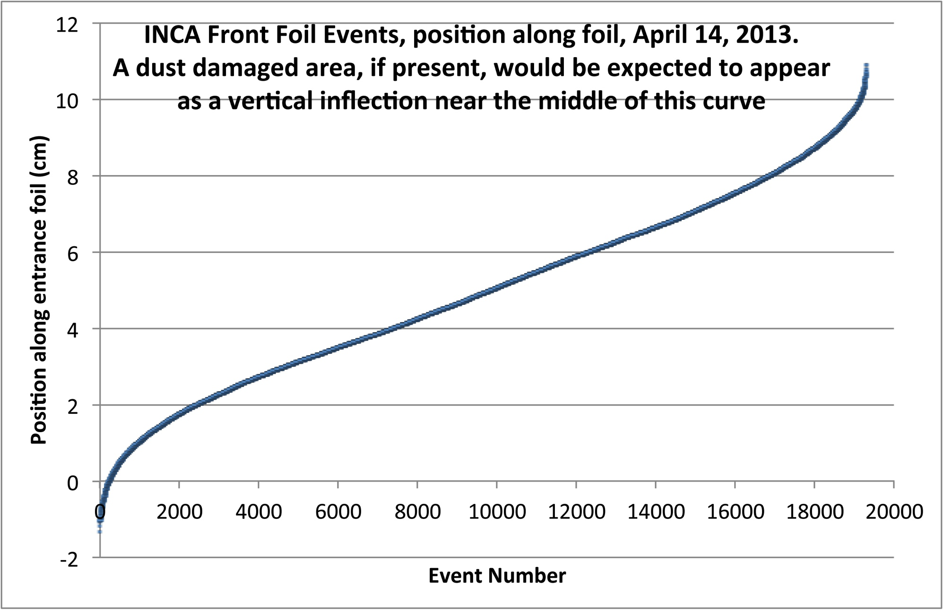
Flight Experience with Dust: Cassini

Slide 18
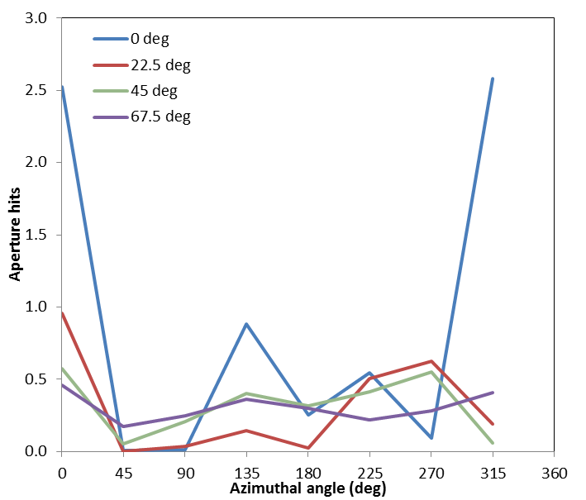
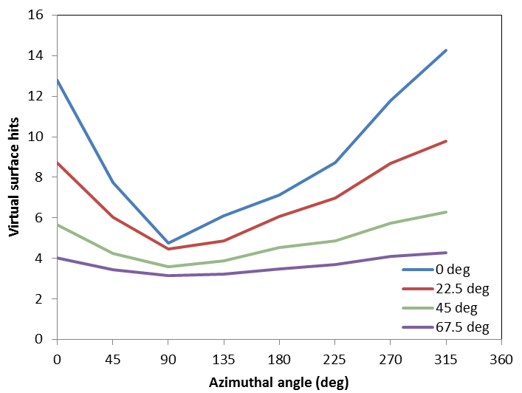
Dust: Simulating the Environment
Expect ~10 damage-inducing hits on each unprotected foil during entire mission
Reduced to ~1 hit per mission with collimator
Can lower further with pairs of pinholes
Start Foil Behind Collimator
Bare Start Foil

Slide 19
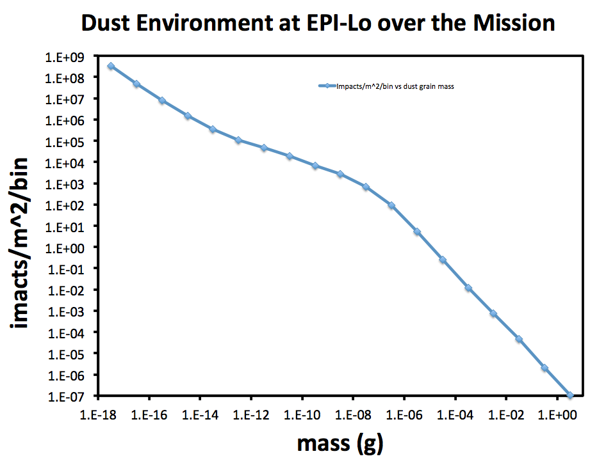
Environment: Dust

Slide 20
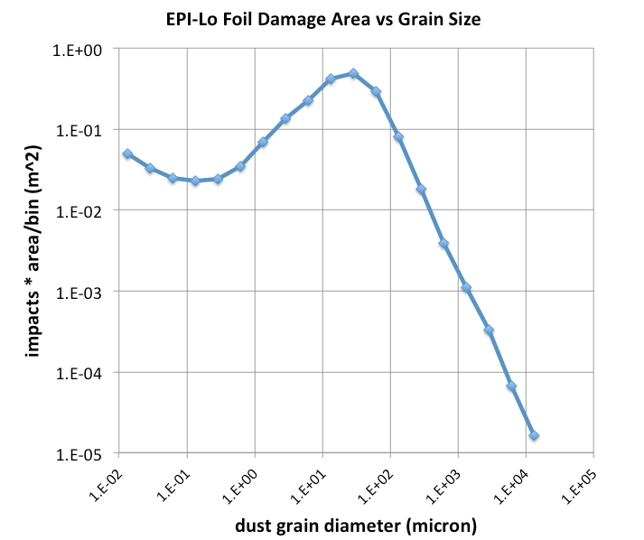
Environment: Dust
Smallest foil
10⁶ μm²

Slide 21
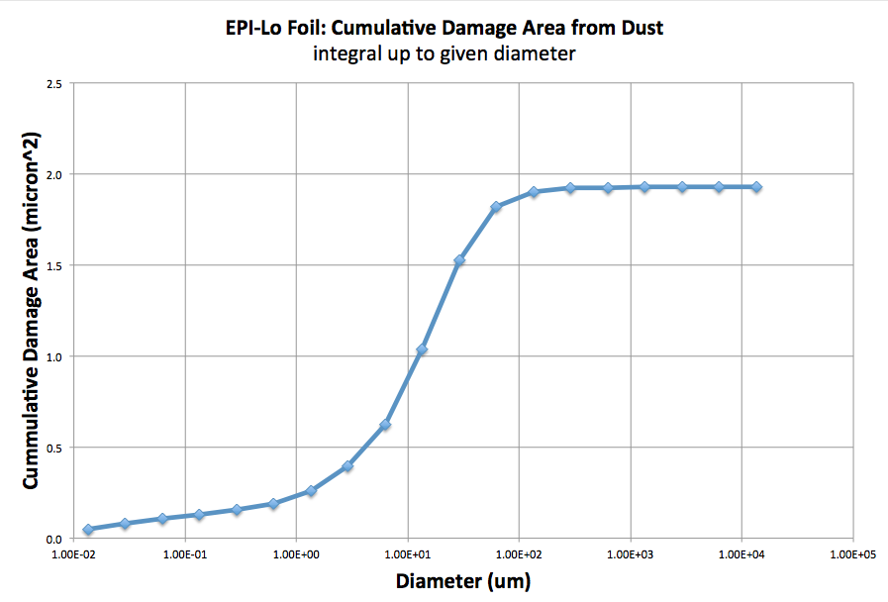
Environment: Dust
Smallest foil
10⁶ μm²

Slide 22
Light

Slide 23
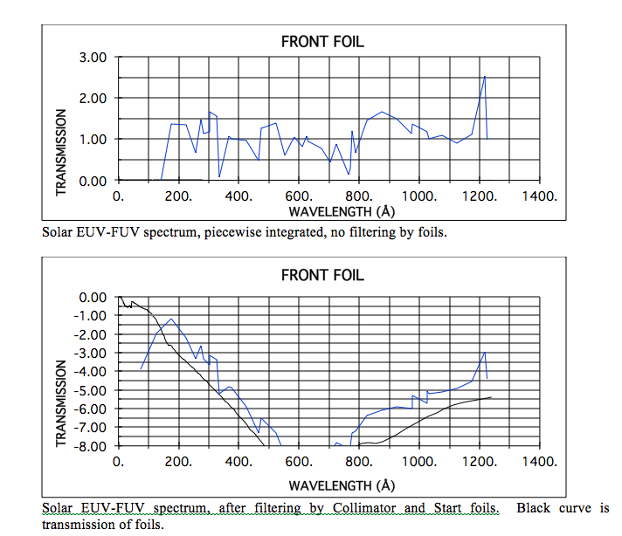
Light

Slide 24
Light and Dust Mitigation (2/2)
Dust may produce pairs of pinholes in the Start and collimator foils
  Foils are designed to stop solar-wind-energy electrons
  Pinhole pairs allow will still allow access to solar-wind electrons
Solar wind electrons have an energy of ~100 eV or less
Electrons that “leak in” through apertures are indistinguishable from Start secondary electrons
Solar wind electron flux ~2 x 10¹²/cm²-s-sr
Estimate foil pinhole as size of a support grid element is ~4.9 x 10⁻⁵ cm²
Geometric factor of a pair of pinholes separated by ~0.5cm is ~1.3 x 10⁻⁸
  The flux through a pinhole pair can be estimated as ~2.6 x 10⁴/s
  If every aperture had 1 grid-element pinhole, the total for a quadrant would be
  ~5.0 x 10⁵/s
  This rate would be well tolerated by the electronics processing
Such a pinhole pair would result in UV induced counting rates ~10/s

Slide 25
Status of EPI-Lo Scattered / Stray Light Analysis
Develop a stray light analysis of the EPI-Lo instrument that incorporates the reverse raytrace from the detector to object space
The reverse raytrace will result in three products:
  An antenna diagram of EPI-Lo projecting onto angular space of the sky (in progress)
  A reverse raytrace from the start foils to critical objects in the scattered FOV to model their reflectance and blackbody emission (in progress)
  A reverse raytrace from the start foils to critical objects, which scatter toward a disk representing the sun to model the scatter of the sun to the detector via s/c objects (TBD)
Assumptions:
The reverse raytrace is validated by the general radiance theorem
The reverse raytrace can yield the Geometrical Configuration Factor (GCF), which quantifies the mapping of projected area to projected solid angle
The GCF is scaled by the brightness of the source to determine the effective scatter/stray light power
The assigned scatter models, coating properties, and wavelength ranges supplied by the instrument designers represent the EPI-Lo/SPP

Slide 26
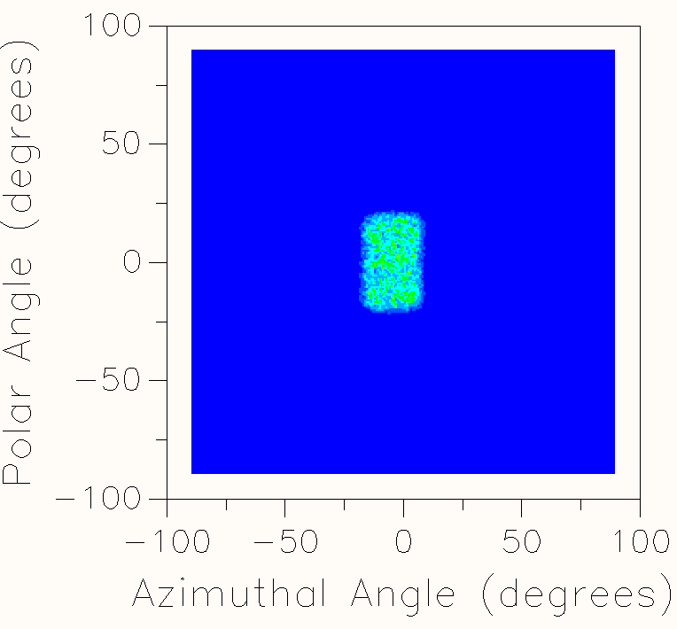
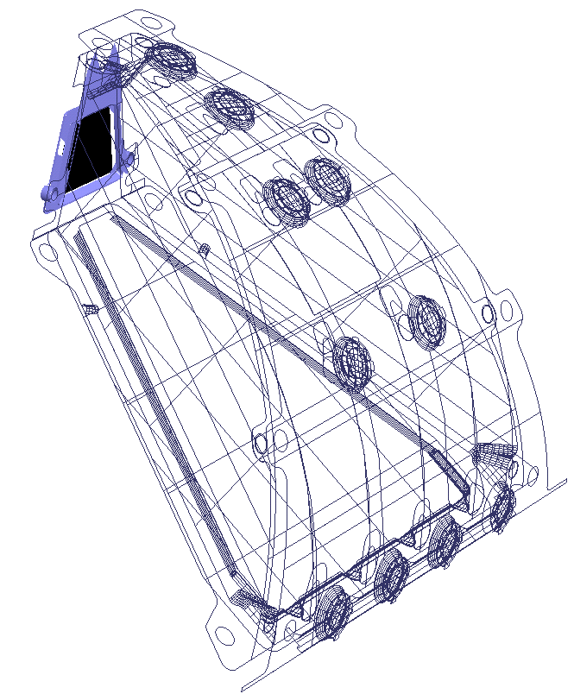
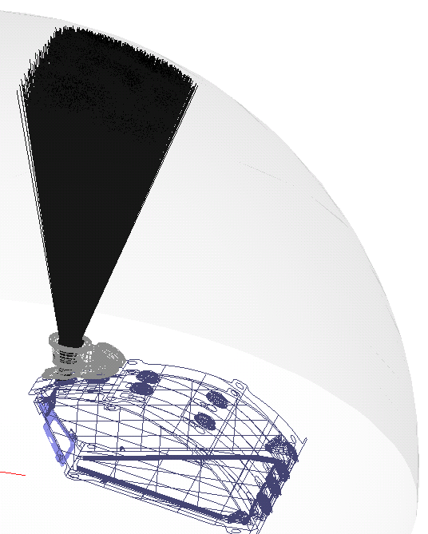
Status of EPI-Lo Ray Tracing Model
Start Foils (A-J) are set to be source for reversed ray tracing
A
B
D
C
F
E
J
I
H
G
Projection of start foil onto external hemisphere

Slide 27
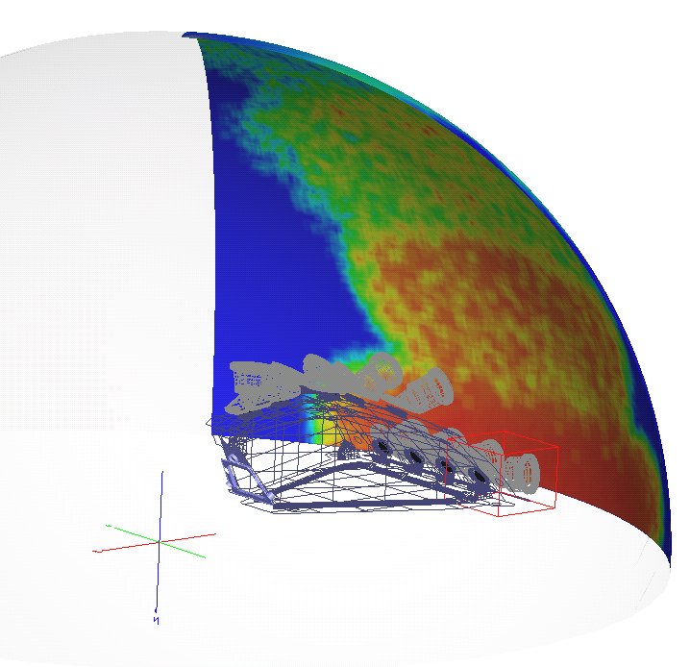
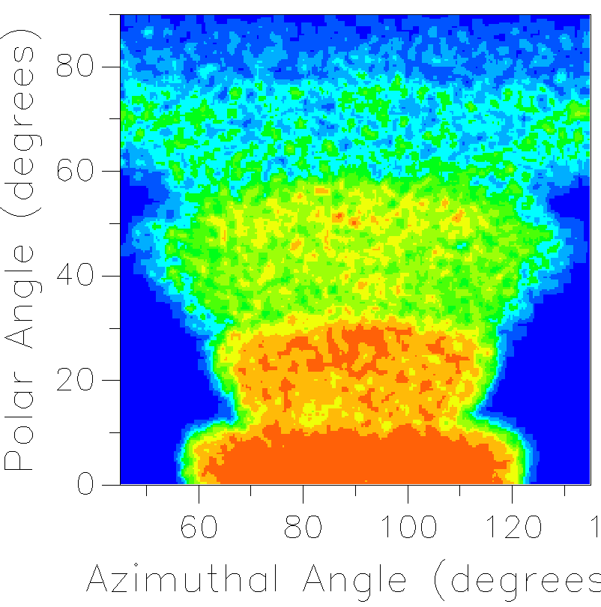
Status of EPI-Lo Ray Tracing Model
Start foil FOV projection for a single segment

Slide 28
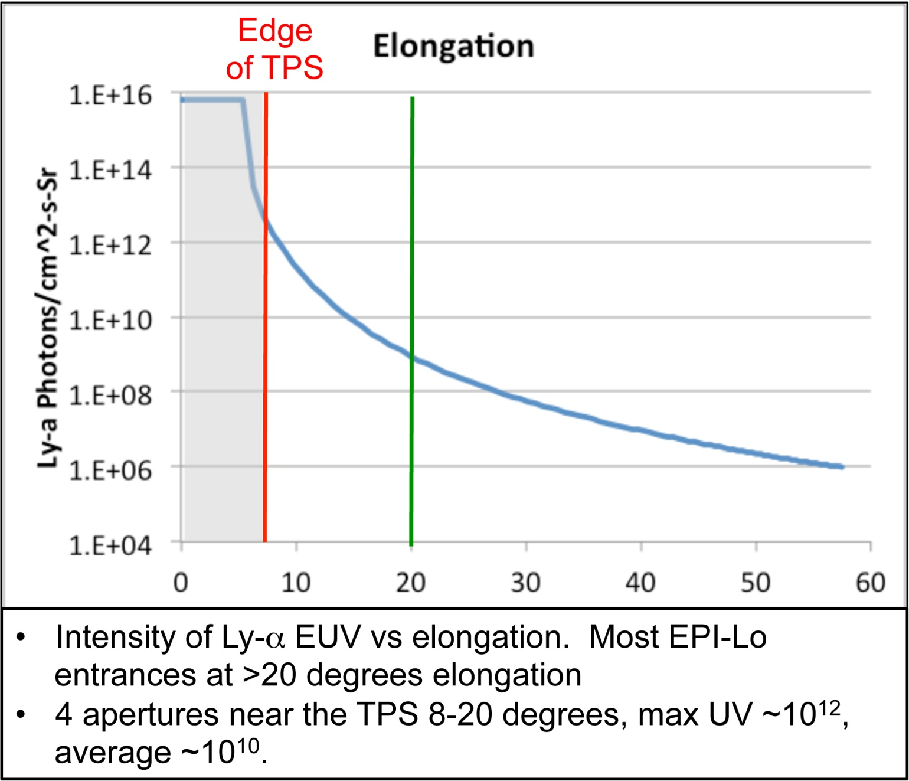
Light and Dust Mitigation (1/2)
Dust may produce pinholes in the Start and collimator foils.
Foils are designed to reduce UV by ~3 orders of magnitude.
A cell-sized pinhole may account for as much as ~0.4% of a foil area.
Dust-induced holes should be 10⁻⁴% of foil area
For the 4 foils closest to the TPS edge, the suppression factor must be ~4 orders of magnitude. For these, pinholes are important to UV suppression.

Slide 29
Event Logic and Data

Slide 30
EPI-Lo Block Diagram

Slide 31
Simplified Sensor & Event Board
sensor
event board
Quadrants A,B,C,D
Electronics for Quadrants A,B,C,D
particle
mode
anti-XEgy
m
u
x
Comparator
PW
anti-coinc. SSD
low
gain
ion
mode
ion-XEgy
FPGA
particle SSD
particle
mode
ADC
PH
m
u
x
Peak Detect
Ion SSD
high
gain
ion
mode
PW
energy measurement
A2
A2
A1
composite energy
A1
ea. quad has 2 wedges (octants)
event logic hard ware
&
flight soft-
ware
CFD
(start 1)
TDC 0
St1-Sp
A1
MCP
&
anode
board
CFD
(stop)
delay
TDC 1
St1-St2
delay
A2
TDC 2
St2-Stp
CFD
(start 2)
discriminators
Timing: TOF & position

Slide 32
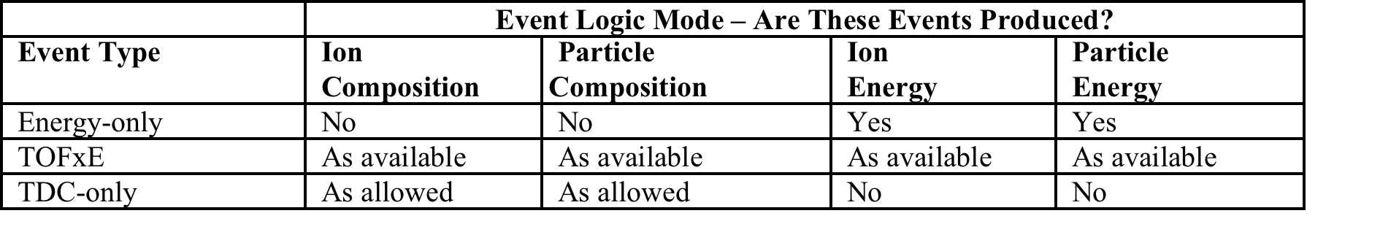
Event Logic: Event Modes
Event mode and event coincidence determine how TDC and Energy measurements are considered

Slide 33
Data Flow - Ion Composition, Part 1

Slide 34
Data Flow - Ion Composition, Part 2

Slide 35
Data Flow - Ion Energy, Part 1

Slide 36
Data Flow - Ion Energy, Part 2

Slide 37
Data Flow - Part. Composition, Part 1

Slide 38
Data Flow - Part. Composition, Part 2

Slide 39
Data Flow - Particle Energy, Part 1

Slide 40
Data Flow - Part Energy, Part 2

Slide 41
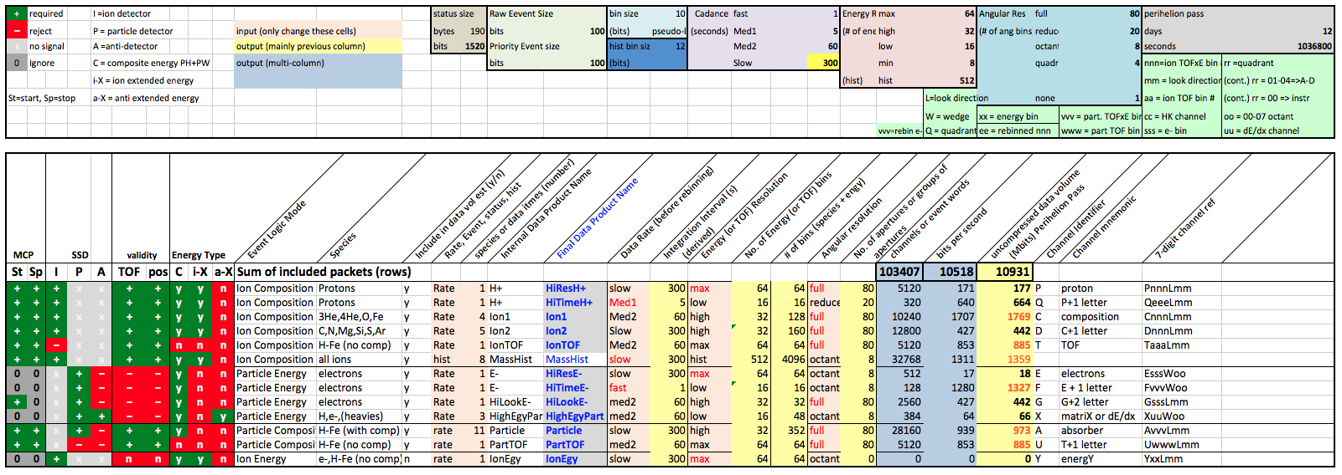
Data: Main Products

Slide 42
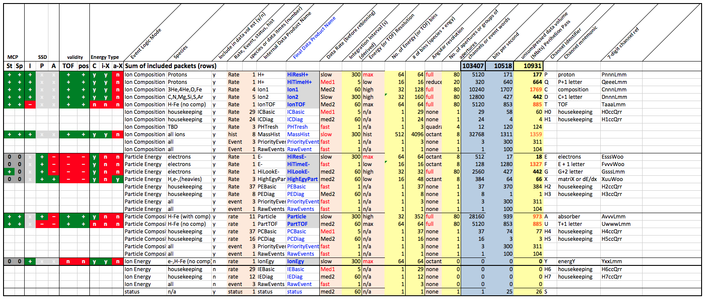
Data: Main Products

Slide 43
Burst: Motivation/Importance
Large SEP events seen at 1AU are associated with strong interplanetary shock waves. The energetic-particle characteristics (spectrum, intensity vs. time) are generally consistent with the predictions of diffusive shock acceleration (DSA) theory
DSA theory predicts that the rise of SEPs seen upstream of a shock is related to the diffusion coefficient, κ.
In general, κ is a function of position (most importantly distance from the Sun, r) and energy, E. That is κ = κ(r,E)
Measuring κ(r,E) near the Sun is extremely important for understanding how the Sun accelerates particles to high energies. The intensity of very dangerous SEPs with energies > 10MeV, for example, strongly depends κ(r,E). See the next slide.
Solar Probe Plus ISIS/Epi-Lo can be used to measure κ(r,E) close to the Sun for large SEP events. It will require sufficient time cadence and energy resolution to make a meaningful determination of κ(r,E). The purpose of this report is to estimate the requirements.

Slide 44
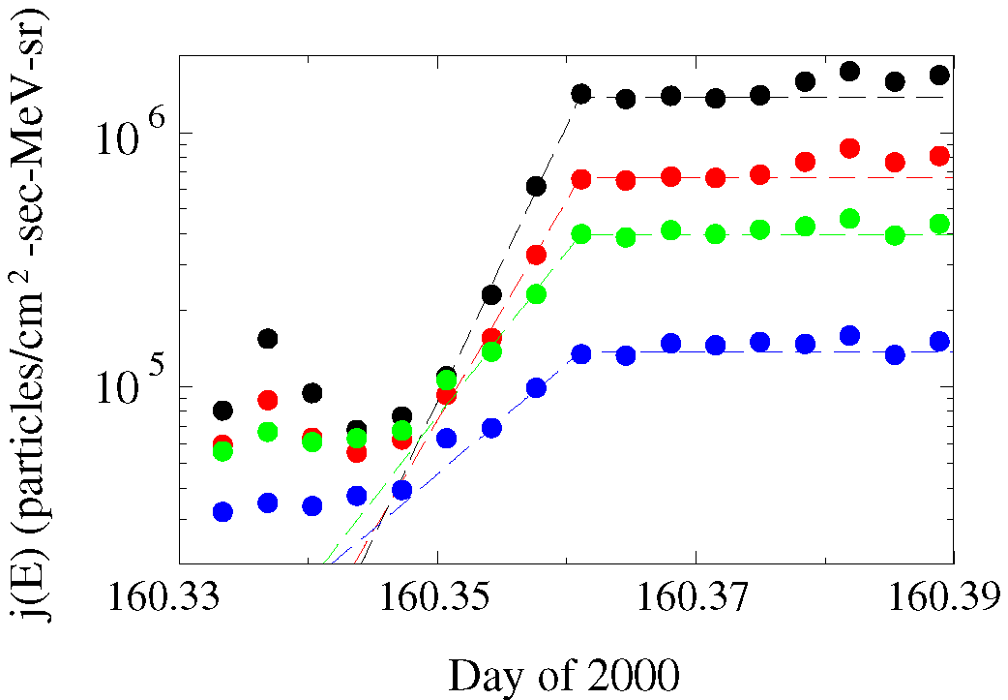
An even closer view. The total time period is about 1.5 hours. The rise time for the energies shown occurs over about 4 data points and each point is separated by 5 minutes.
55 keV
85 keV
145 keV
240 keV

Slide 45
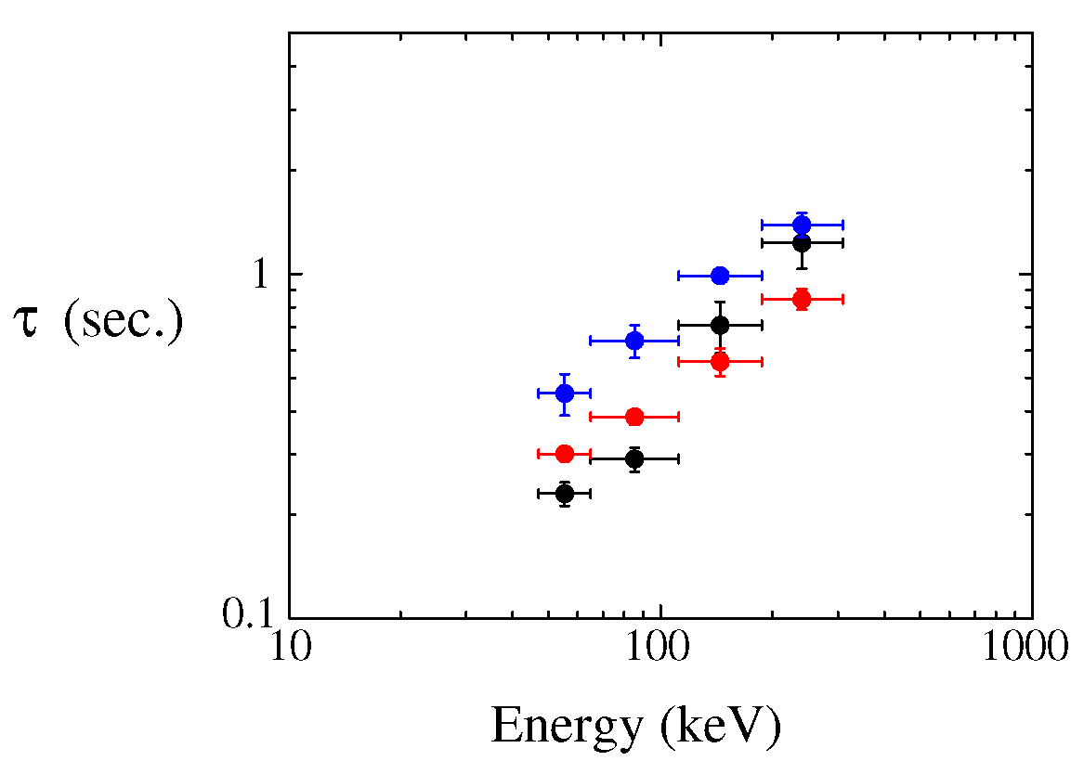
The exponential rise time expected for large SEP events observed at 10 solar radii as a function of energy. This is the same figure as that shown on slide 10, but with the rise time taken to be a factor of 1200 lower.

Slide 46
Energy coverage
It is important to resolve the exponential rise just prior to the passage of strong IP shocks for large SEP events over several energy bands. This will provide information on the energy dependence of the diffusion coefficient.
Because the diffusion coefficient is much smaller closer to the Sun, the rate at which particles are accelerated by the shock is much faster than it is at 1AU. The acceleration rate (according to DSA theory) is inversely dependent on the diffusion coefficient.
Thus, the energy at which the energy spectrum will roll over (sometimes called the spectral “break” energy) will be much higher closer to the Sun than it is at 1AU. For typical large SEP events at 1AU, the break energy is of the order of an MeV or so. It will likely be closer to a GeV near the Sun for large SEP events.
Thus, we need several energy bands that cover the entire range of Epi-lo to measure the exponential rise.
Note that the rise time is shortest at low energies. I would recommend that in burst mode there be 4 energy bands between 20keV and 200 keV, and 3 more above this.

Slide 47
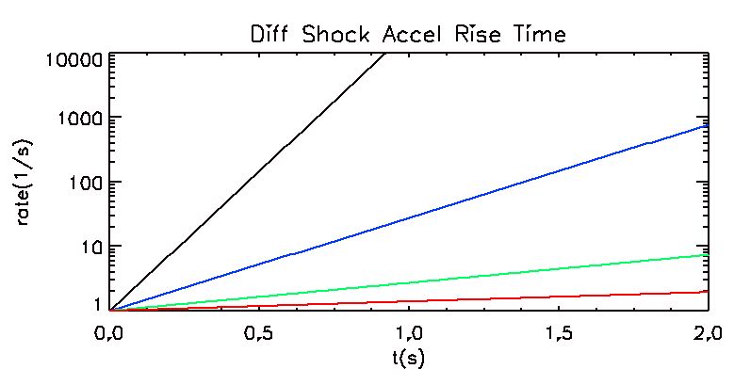
Assumption 1: At 1 AU the rise phase was complete w/in ~ 20 minutes. So at 10 R_{s} the rise phase will be completed in 1s (1200 times faster). 1 s is probably a safe minimum.
Assumption 2: The duration of the phase is (roughly) independent of energy over the 10’s keV to few MeV range
Comment: in the four examples below the different curves can be considered either different energies for the same event, or different events. They are just example profiles.
Particle Count
Rate
R(t) = e^{t/τ}
τ = 0.1 s
τ = 0.3 s
¼ second
τ = 1 s
τ = 3 s
Conclusion: If we have ion measurements every ¼ second (i.e., every other 1/8 second “slot” is in ion composition mode), then we should have enough temporal resolution to characterize the exponential rise times. This assumes we have sufficient statistics.
meh 2014-07-17

Slide 48
ISIS/EPI-Lo Burst Data Processing (concept)
The 1 kiB size of the Burst Items is notional.
Continually, once per second, a burst item is written to a circular buffer so that the oldest items are overwritten by the newest data. This allows a string of high-resolution burst-type data to be available at all times extending into the past a given amount.
When the burst trigger is activated an interval of post-trigger data is collected, then both pre and post trigger data are telemetered. The burst trigger can be internal or external to EPI-Lo.
The frequency of burst events will be limited to maintain the desired burst data volume allocation. This could be done, for example, by dividing the orbit into a number of segments each of which has one burst event (either the first triggered event, or the last buffer-full at the end of the segment).
Telemeter
Burst Buffer
oldest
newest
…
BURST BUFFER
The size of the burst buffer is estimated to be ~ 1 MiB, so can contain ~20 minutes (~1000 s) of data, assuming the 1 kiB Burst item.
time
time
…
burst data items
Pre-trigger data
Burst
Trigger
post-trigger data
meh 2014-07-01

Slide 49
ISIS/EPI-Lo Burst Data Item (concept) - 1 second - 1 kiB
There are 8 intervals (dubbed “slots”) per second. During each interval EPI-Lo is in a specified event logic mode.
We have four main modes:
Ion composition
Ion Energy
Particle composition
Particle Energy
Ion modes only measure ions, using the bottom, non Al flashed SSD, while the particle modes measure both ions and electrons using the top, Al flashed detector (formerly known as e- SSD).
The specific content of the 31 counters depends on the mode.
This provides down to 0.125 s resolution, depending on the selected mode pattern.
Burst Data item 1 kiB, 1s
Ancillary Data 32 bytes
(e.g., 8-slot pattern of modes)
…
Burst
Data item
1 kiB, 1s
31 four-byte
counters per slot
31 four-byte
counters per slot
31 four-byte
counters per slot
…
Slot 0
Slot 1
Slot 7
1/8 s
1/8 s
1/8 s
Time →

Slide 50
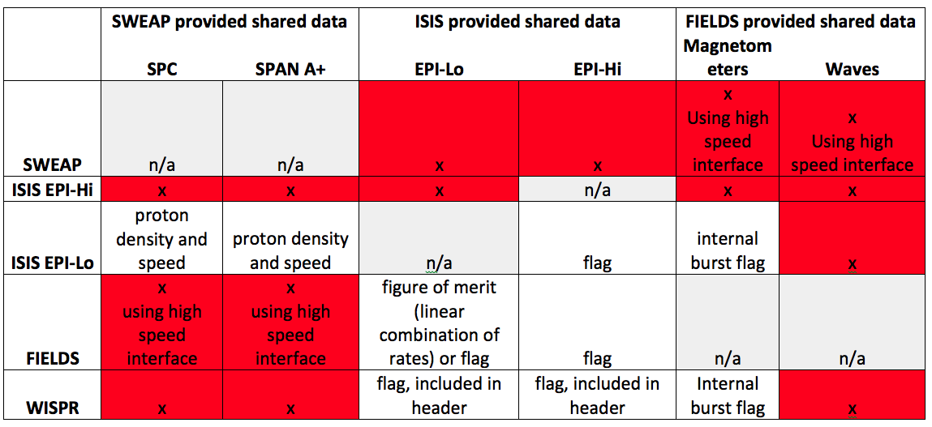
Data: Onboard Sharing

Slide 51
ISIS/EPI-Lo Potential Data Sharing Word
Eight Bit Word. Each bit is a flag, 0 = nominal, 1 = something exciting
0 - Hlo - low energy proton, rate flag 4 - He3 - He-3 (or other ion) rich event, composition flag
1 - Hhi - high energy proton, rate flag 5 - Hvy - heavy-ion rich event (e.g., Fe), composition flag
2 - elo - low energy electron, rate flag 6 - Han - proton anisotropy, beam flag
3 - ehi - high energy electron, rate flag 7 - ean - electron anisotropy, beam flag
[bits 0-3] Is the intensity high? Hlo, Hhi, elo, and ehi (protons and electrons, high and low energies) would all work the same way. We would specify the energy range (probably a table that specifies sets or ranges of our already defined channels: TOF vs E boxes for protons, and energy bins for e-) and specify a threshold rate value. When the total rate of all the included boxes exceeds the threshold we set the flag, otherwise we don't. It would be important to really look at the rate (or something that tracks with the rate), so we would have to account for the number of 1/8-second slots that go into the selected channels.
[bits 4-5] Is there an interesting ion composition? 3He and Hvy would work the same. We'd specify sets or ranges of channels in the numerator and denominator and a threshold ratio to define a helium or heavy (e.g., iron) -rich event.
[bits 0-5] In our parameter settings defining both types above we could have a parameter for determining directions (perhaps an eight-bit work with 1/0 = include/don't include for each octant).
[bits 6-7] Is there a particle beam? Han and ean are beam anisotropy flags. We either use the channels we've defined above for Hlo, Hhi, elo, and/or ehi or define am independent set or range or channels. Then we define numerator octants, denominator octants (8-bit set of flags), and a threshold ratio.
[bits 0-7] For any of these (particularly the last four flags) we might want to define a statistics threshold of some sort, requiring some minimum number of counts in the numerator and/or denominator.

Slide 52
Backup
Backup

Slide 53
Title

Slide 54
Title

Slide 55
Title

Slide 56
Title

Slide 57
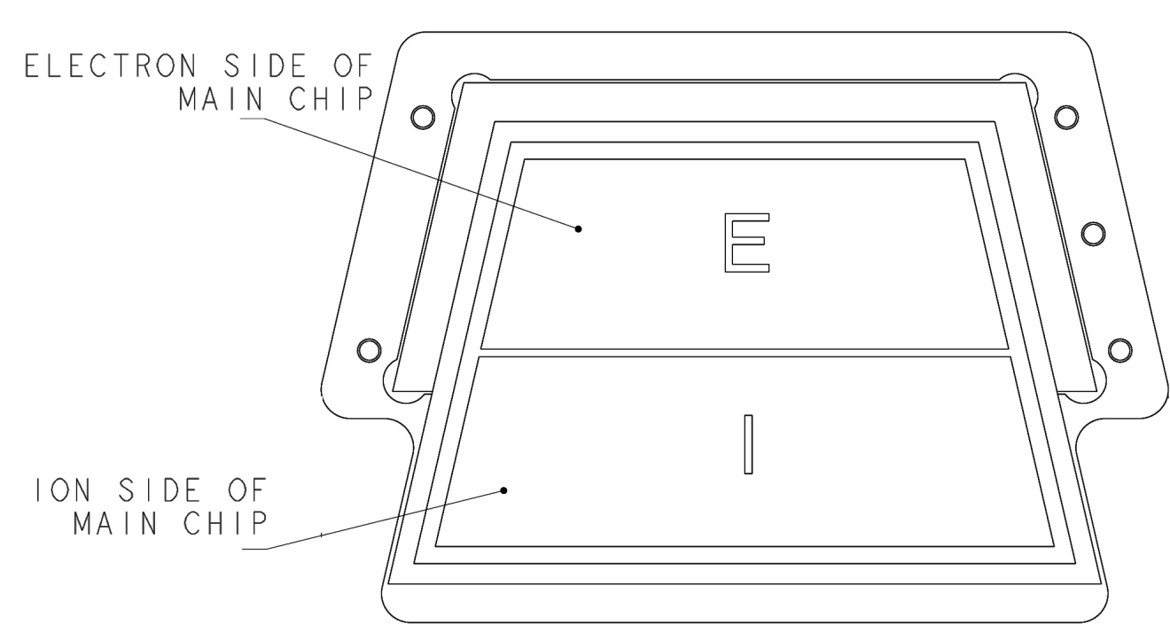
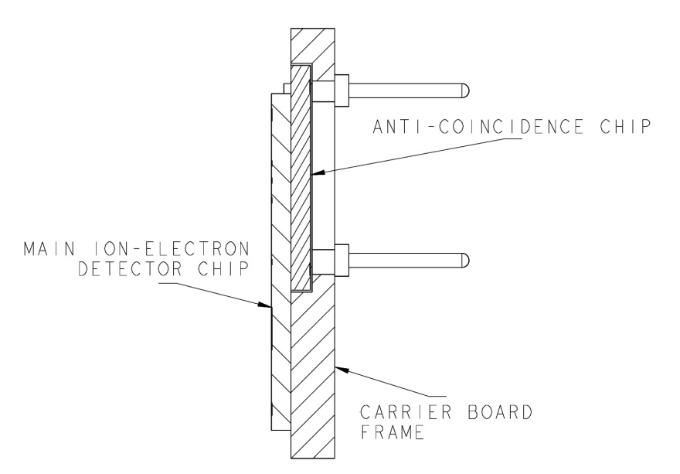
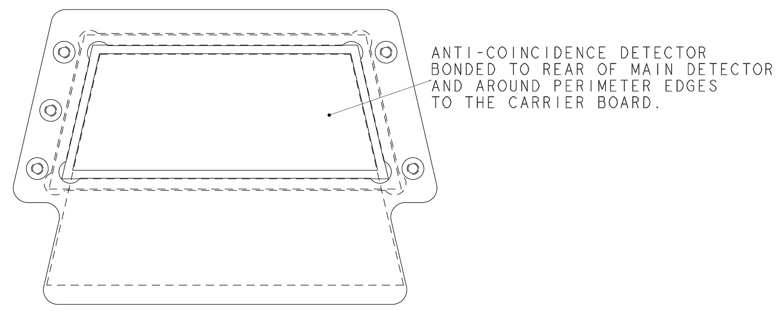
Anti-coincidence System
Electron SSD is backed by an anti-coincidence SSD
Improves S/N for electrons by a factor ~25 (from ~0.4 to ~10)

Slide 58
FPGA Block Diagram

Slide 59
End-to-End: Particles-to-Data Products
1. Science requirements
2. Environment: foreground and background
- protons and electron
- dust
- light
3. Foreground measurement: sensor head operation
- overview
- ions
- electrons
- calibration
4. Background response: effect and mitigation
- penetrating particles
- solar wind
- photons
- internally generated secondaries
- calibration
5. Event logic: processing the measurement
- block diagram
- event modes
- supporting measurements
6. Data: data products
- main data products
- subsidiary data products
7. Summary

Slide 60
End-to-End: Particles-to-Data Products
1. Science requirements
2. Environment: overview of foreground and background ions, electrons, photons, and dust.
- protons and electron spectra, worst case, expected variation over the mission (the stuff I’ve analyzed based mostly on Rob D’s work)
- expected dust impacts on the sensor (environment, and our Boulder test results)
- light (ticker foils towards the sun, light getting through dust holes, etc.)
3. Foreground measurement: how the instrument (sensor head) works to measure what we want to measure.
- how ions are measured (MCP/foils/2ndary e- for start/stop signal and position, SSD for energy in ion and particle detector
- how electrons are measured (primary, the SSD-only detection in the particle detector, and supplemental position sensing from starts)
- calibration to support these measurements
4. Background: how penetrators, solar wind electrons, light, and dust interferes with our measurements and what we’re doing about it.
- penetrating electrons and protons
- solar wind electrons (and protons)
- photon background rates
- internally generated secondaries
- electronics noise
- calibration/simulations to support these background estimates
5. Event Logic: how we take the measurements and break them down into specific measurements (ions vs electrons, energy ranges, composition, etc.)
- modes
- species measured during each mode
- supporting measurements: singles rates, etc.
6. Data: what products are we collecting and returning.
- main data products: species, energy, angular, temporal resolution
- subsidiary data products: event data, burst data, histogram data
7. Closure: how the data we’re getting responds to the requirements.

