Slide 1
Pre-CDR Peer Review
(not a CDR run-through)
6 NOV 2014
EPI-Lo Sensor Review – Part 1
Matt Hill (JHU/APL)
Deputy EPI-Lo Lead
Matt Hill
EPI-Lo Deputy Lead Co-I (JHU/APL)
This document contains technical data that may be controlled by the International Traffic in Arms Regulations (22 CFR 120-130) and may not be provided, disclosed or transferred in any manner to any person, whether in the U.S. or abroad, who is not 1) a citizen of the United States, 2) a lawful permanent resident of the United States, or 3) a protected individual as defined by 8 USC 1324b(a)(3), without the written permission of the United States Department of State.
Notes:
introduction

Slide 2
End-to-End: Particles-to-Data Products
1. Science requirements
2. Environment: overview of foreground and background ions, electrons, photons, and dust.
- protons and electron spectra, worst case, expected variation over the mission
- expected dust impacts on the sensor (environment, and our Boulder test results)
- light (ticker foils towards the sun, light getting through dust holes, etc.)
3. Foreground measurement: how the sensor head works to measure what we want to measure.
- how ions are measured (MCP/foils/2ndary e- for start/stop signal & pos., SSD for energy in ion & particle SSDs.
- how electrons are measured (the SSD-only detection in the particle detector & supplemental start pos. sensing)
- calibration to support these measurements
4. Background: how penetrators, solar wind e⁻, light, & dust interferes w/ our measurements and our mitigations.
- penetrating electrons and protons
- solar wind electrons (and protons)
- photon background rates
- internally generated secondaries
- electronics noise
- calibration/simulations to support these background estimates
5. Event Logic: Break the measurements into specific energy ranges, species, etc.
- block diagram
- event modes
- species measured during each mode
- supporting measurements: singles rates, etc.
6. Data: what products are we collecting and returning.
- main data products: species, energy, angular, temporal resolution
- subsidiary data products: event data, burst data, histogram data
7. Summary/Closure: Summary of presentation and how the data we’re getting responds to the requirements.

Slide 3
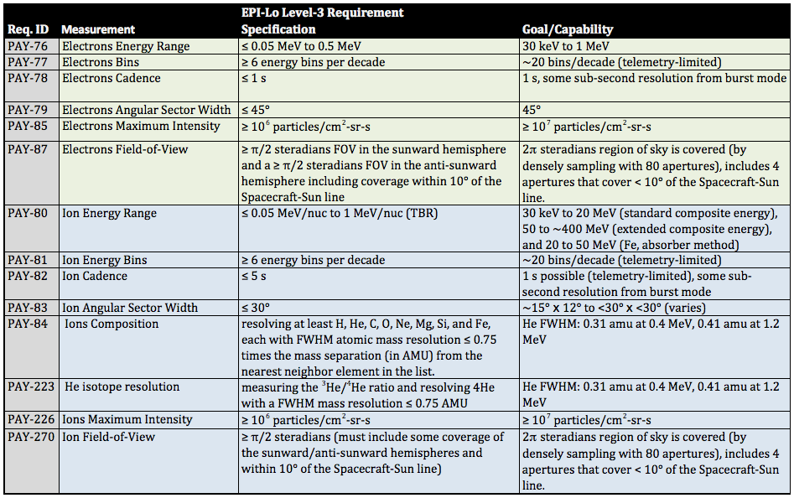
Measurement Requirements (L3s)

Slide 4
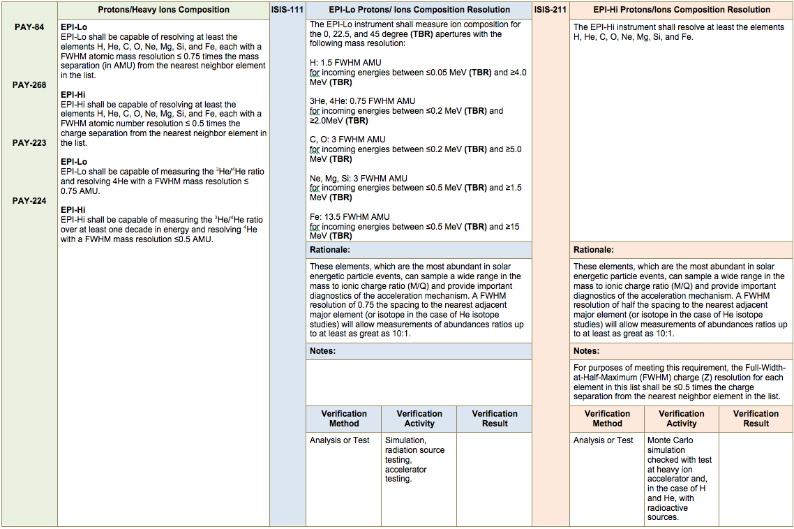
Key L4 Requirements: Composition

Slide 5
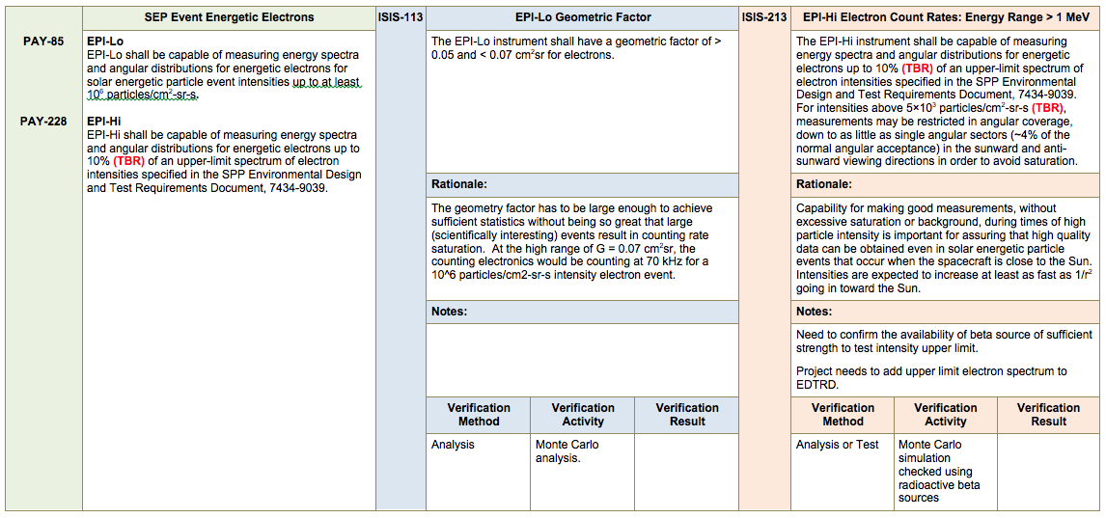
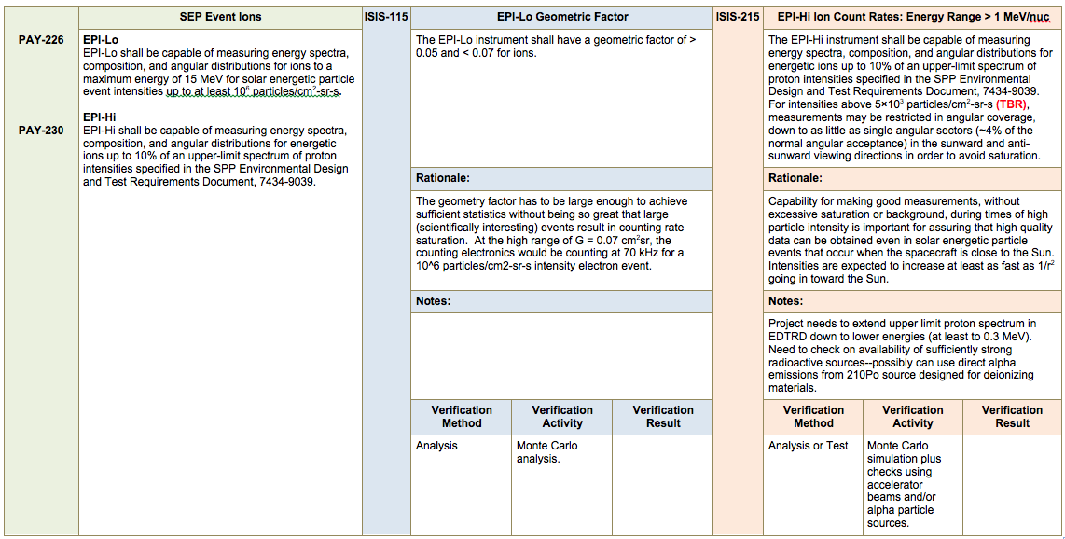
Key L4 Requirements: Geometry Factor

Slide 6
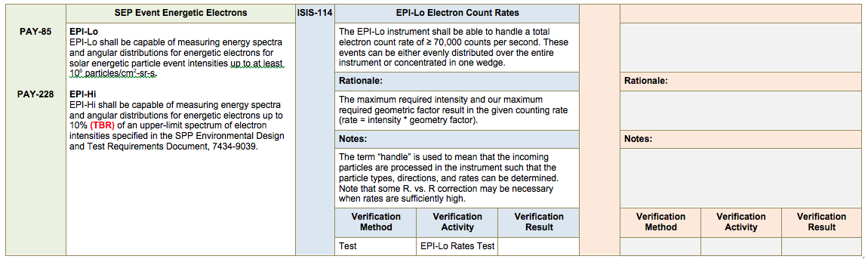
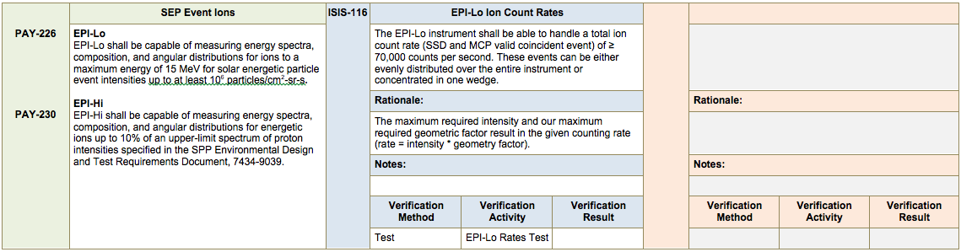
Key L4 Requirements: Count Rate

Slide 7
Instrument Overview

Slide 8
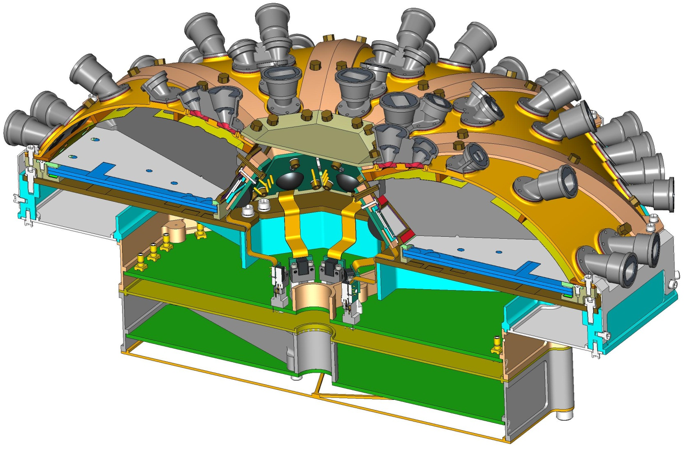
Instrument Overview
ANODE PWB ASSY
EVENT PWB ASSY
POWER SUPPLY ASSY
EPI-Lo Cross-Section View Isometric

Slide 9
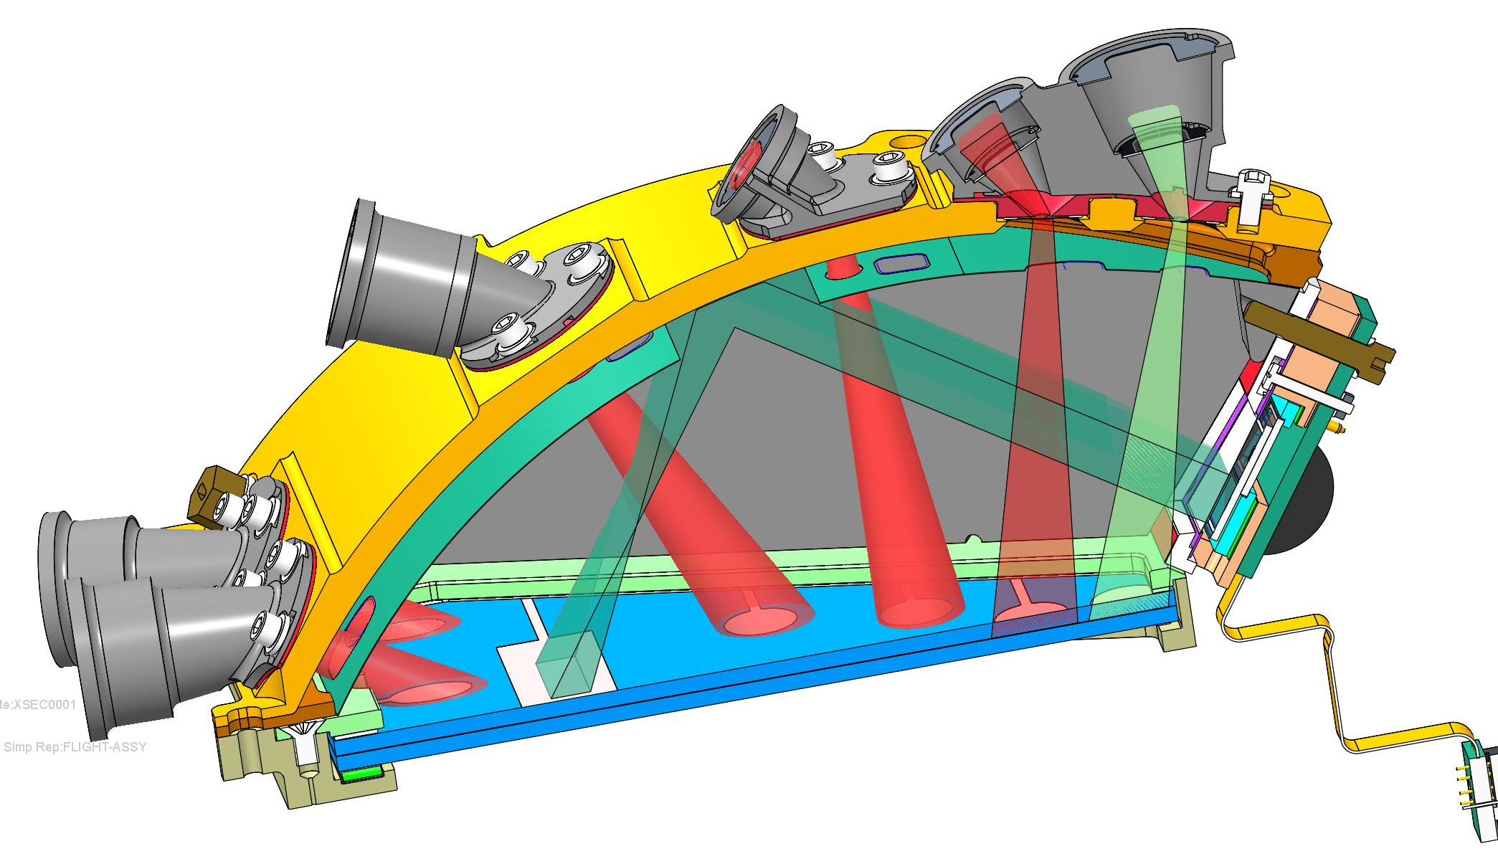
Instrument Overview

Slide 10
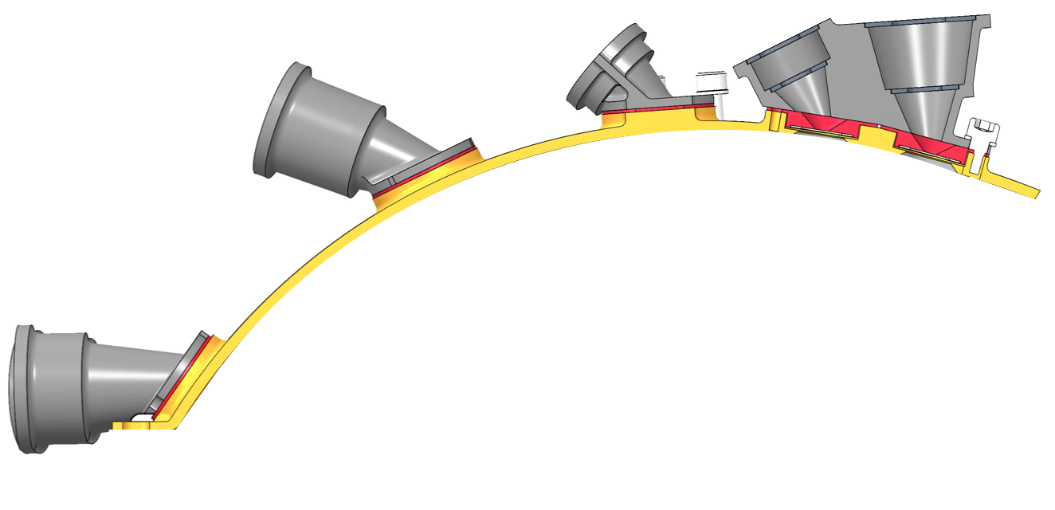
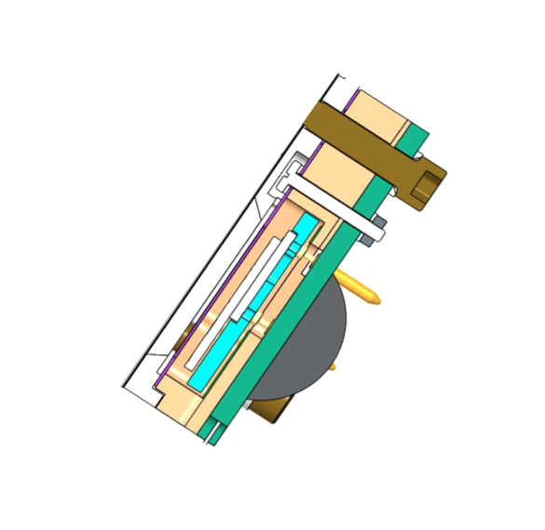
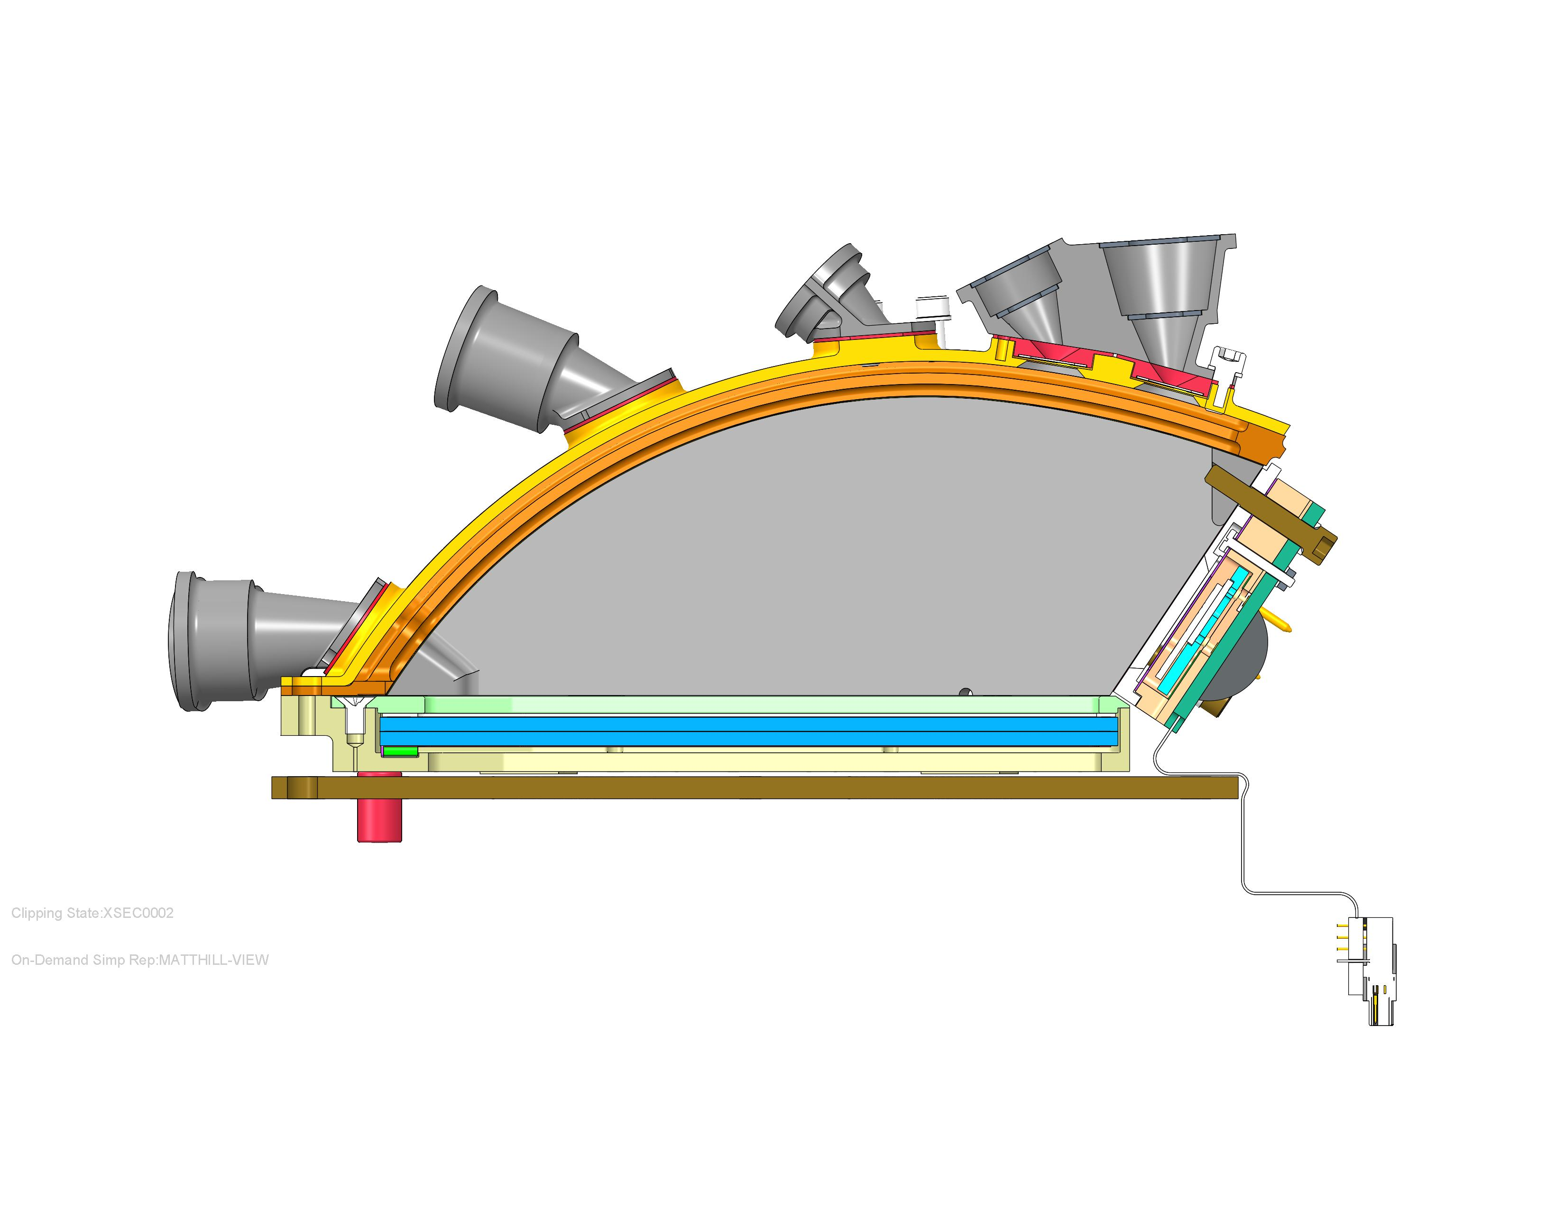
Sensor Overview:
start accel. grid holes need to be updated
Collimator Foil
Start Acceleration
Grid
Baffles
Collimators
First
  xxxxx
  xxxxxx
Second
Third
  xxxxxx
  xxxx
Forth
  xxxxxxx
  xxxxxx
Collimator
Foil
Start Foils
Stop Accel. Grid
Start Foils
MCP Grid
Stop Foil
Microchannel
Plate (MCP)
Solid State
Detectors (SSDs)
Anode
MCP Spacer

Slide 11
Sensor Voltages
start accel. grid holes need to be updated
start e⁻
acceleration
region
stop e⁻
accel.
region
Ground
All Foils
at Ground
100 V retarding
potential region
Equipotential
Volume
MCP
900 V
2900 V
Ground
SSDs
Anode
1000 V
3000 V

Slide 12
Foreground Measurement: Ions
Incident ion trajectory
start accel. grid holes need to be updated
Start electron trajectory
Stop electron trajectory
MCP
SSDs
Anode

Slide 13
Foreground Measurement: Ions
start accel. grid holes need to be updated
Ion Measurement Logic can toggle TOF, but no TOF ➔ no species identification

Slide 14
Foreground Measurement: Electrons
Incident Electron
start accel. grid holes need to be updated
Secondary
electrons
(infrequent)
MCP
Anode
SSDs

Slide 15
Foreground Measurement: Electrons
start accel. grid holes need to be updated
Stops from secondaries not indentifiable
Secondary Electrons from Start Foils possible, but Low Probability;
Start Electron only identifies entrance aperture

Slide 16
Secondary Electrons & Potentials
1000 V start e⁻
acceleration
region
1000V
stop e⁻
accel.
region
start accel. grid holes need to be updated
Grid
Equipotential
Volume
Grid
Grid
MCP
Anode
100 V retarding
potential region
2300 V
Across Plates
100 V
MCP-to-Anode
SSDs

Slide 17
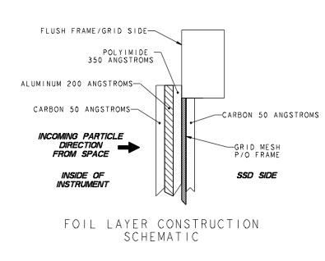
Foils
Nominal Start Foils
Mesh
50A Carbon
400A Polyimide
300A Aluminum
200A Palladium
50A Carbon
Thick Start Foils
Mesh
50A Carbon
500A Polyimide
1000A Aluminum
500A Palladium
50A Carbon
Collimator Foils
Mesh
1000Å of polyimide
50Å C flashing (inward-facing side)
Stop Foils
50A Carbon
200A Aluminum
350A Polyimide
Grid mesh
50A Carbon.

Slide 18
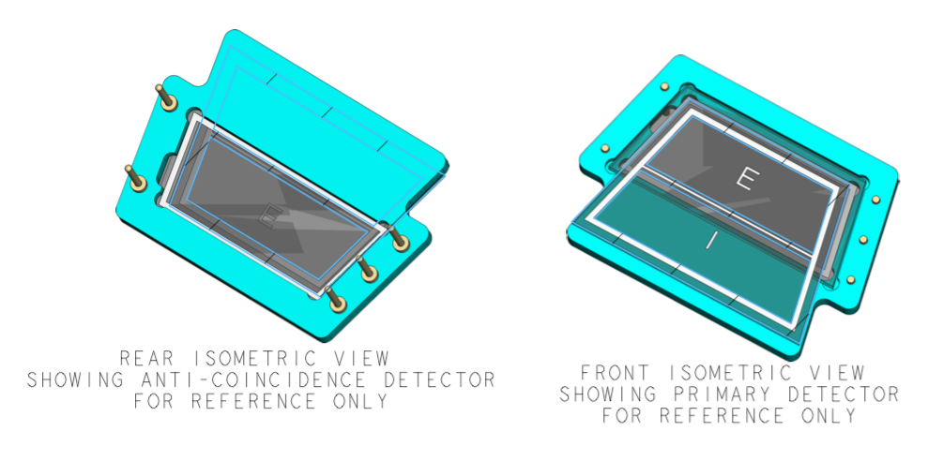
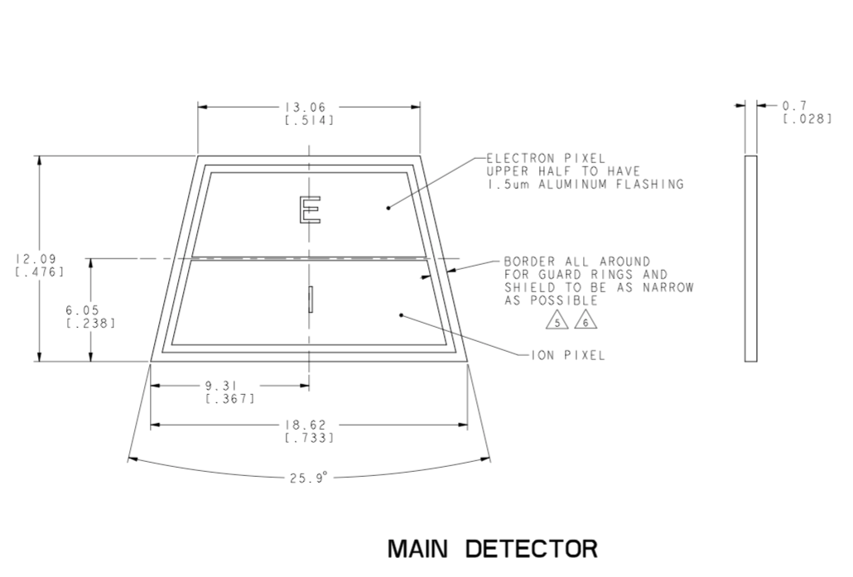
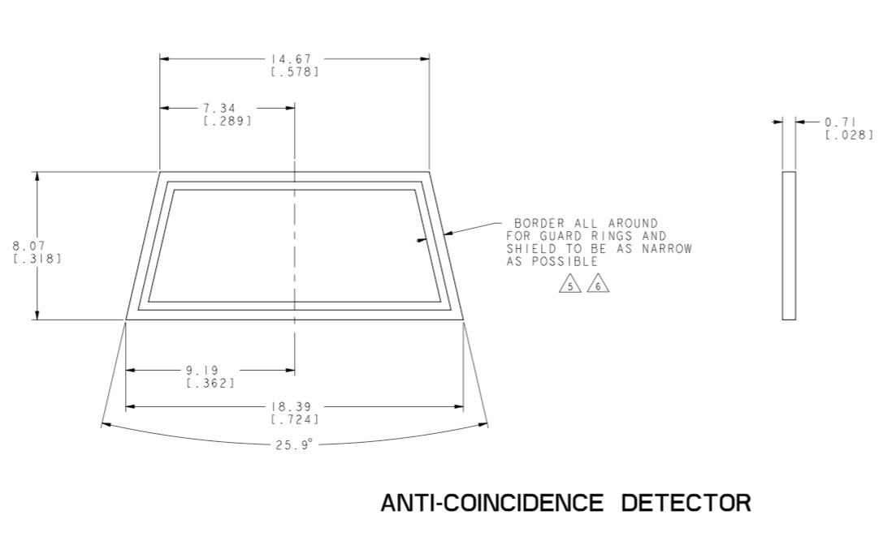
Solid State Detectors
Ion SSD
700 micron
0.91 cm² active area
50 nm dead-layer
Particle SSD
700 micron
3.2 micron Al flashing
0.81 cm² active area
50 nm dead-layer
Anti-Coincidence SSD
700 micron
0.86 cm² active area
50 nm dead-layer
Behind P-SSD (and part of I-SSD)

Slide 19
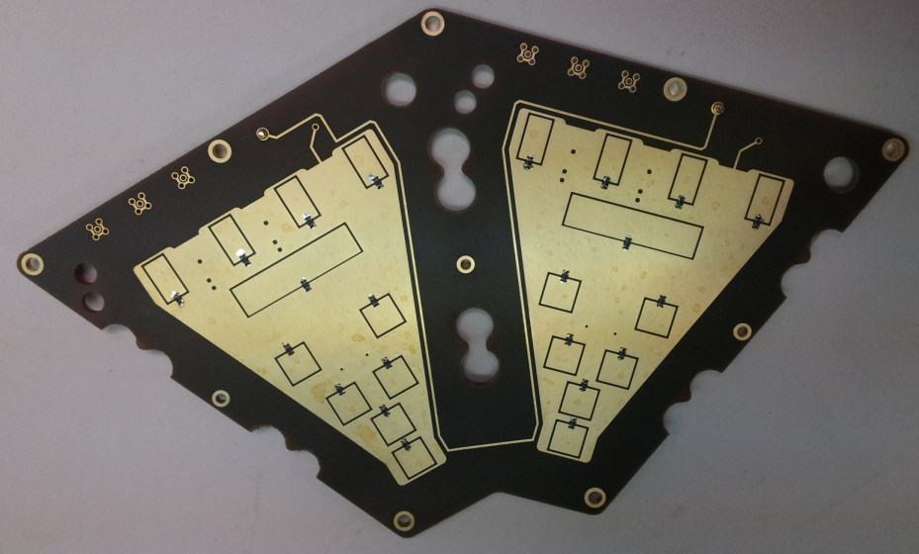
A: Looking down on the board
EPI-Lo Anode Board
Anode Board A
(example of boards A, B, C, and D)
Anode Pad Naming
A-19
A-9
pad connection
L19
L09
A-8
pad
L18
L08
A-6
A-17
A-18
image of bottom (component side) of board is flipped to align with front (pad side)
L17
L07
L06
L16
A-7
A-16
A-4
A-5
L04
A-15
L15
A-14
Begin
L14
L05
Side A1
Side A2
End
A-0
Wedge 1
Wedge 0
A-1
A-13
A-20
L00
L13
A-12
A-2
L01
L12
A-11
A-10
A-3
L02
L11
L03
L10
Electrical
Science
2014-04-07 meh

Slide 20
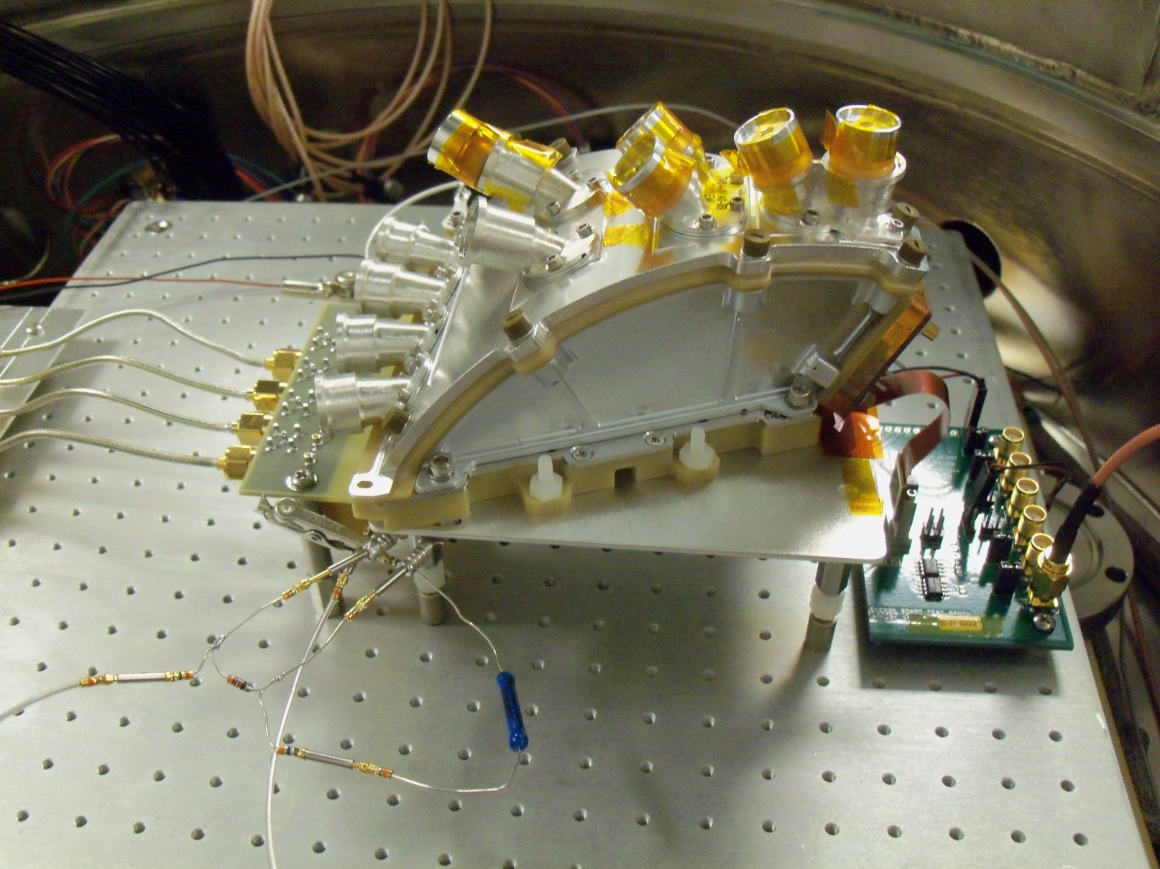
Start-Electron footprint mapping using a 2-D anode
Sources in
apertures 5-9
y
x
Prevent Stop-Electron interference by shifting all HVs down by 1kV.

Slide 21
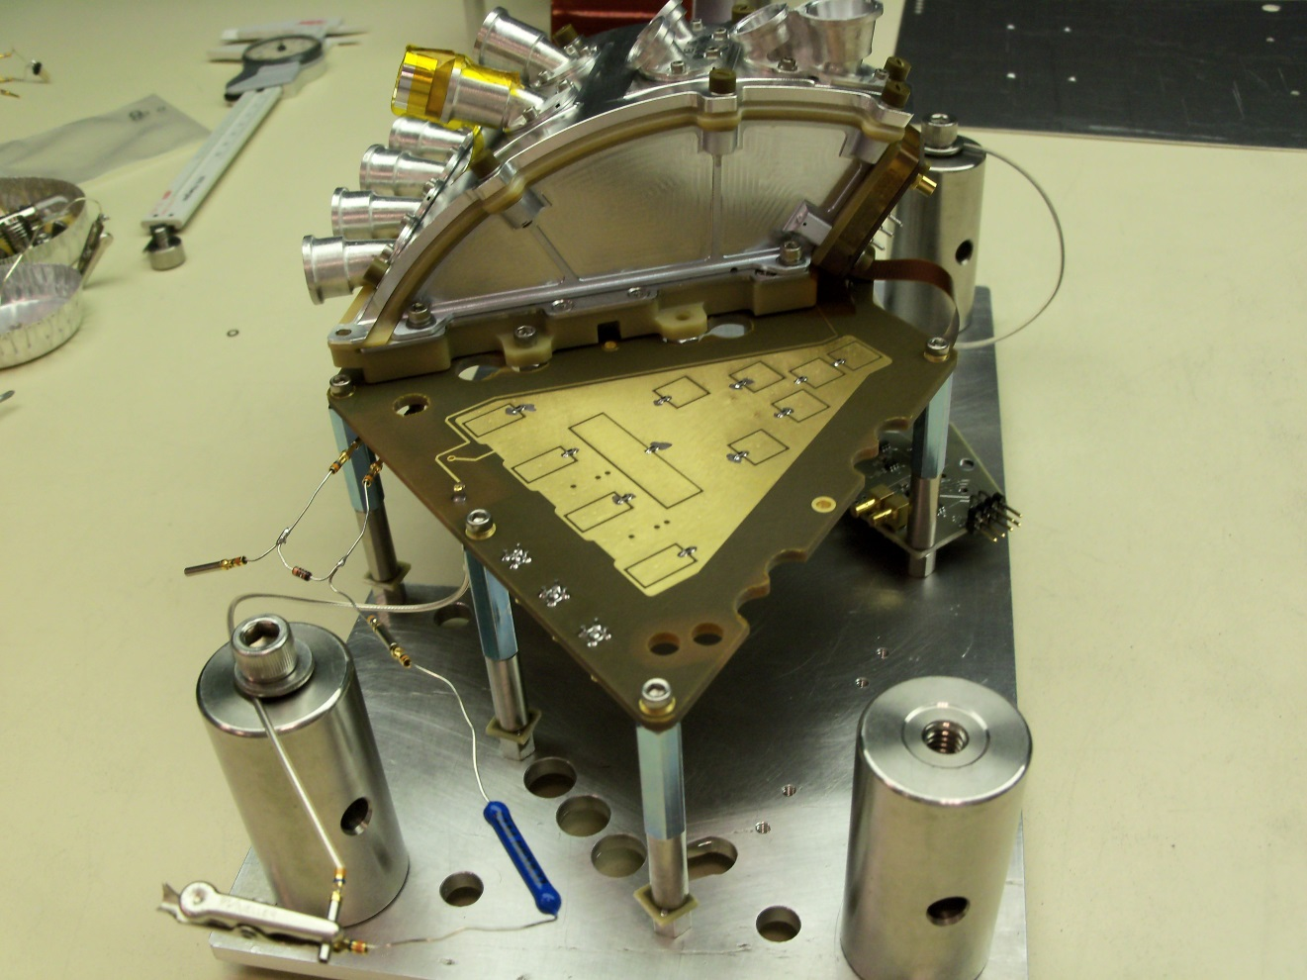
Sensor wedge mounted on EM Quadrant Anode Board
MCP Mask, Interplate spacer Mask
Readout still with lab electronics; NIM modules & LeCroy Scope.

Slide 22
Instrument Performance

Slide 23
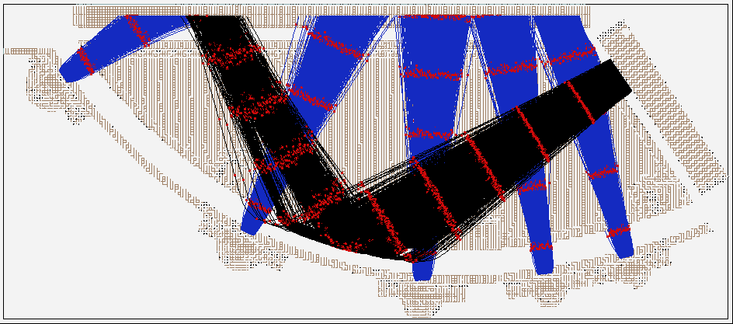
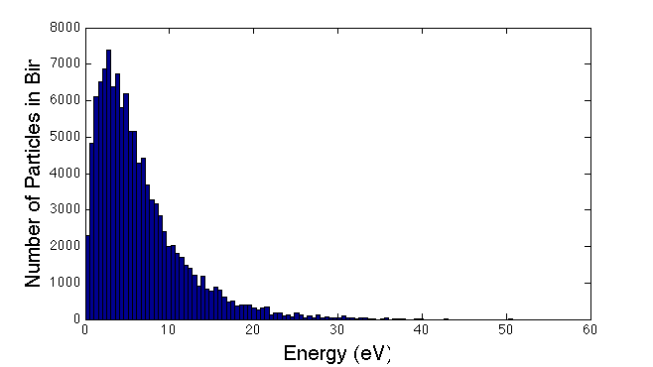
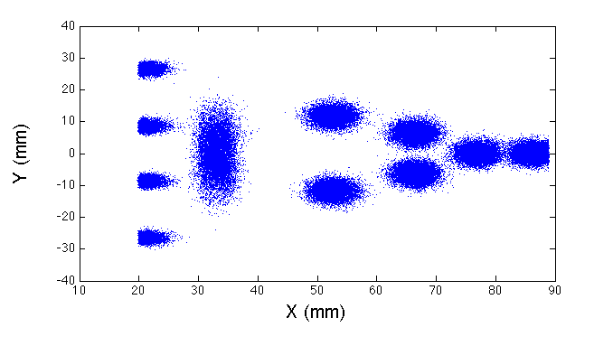
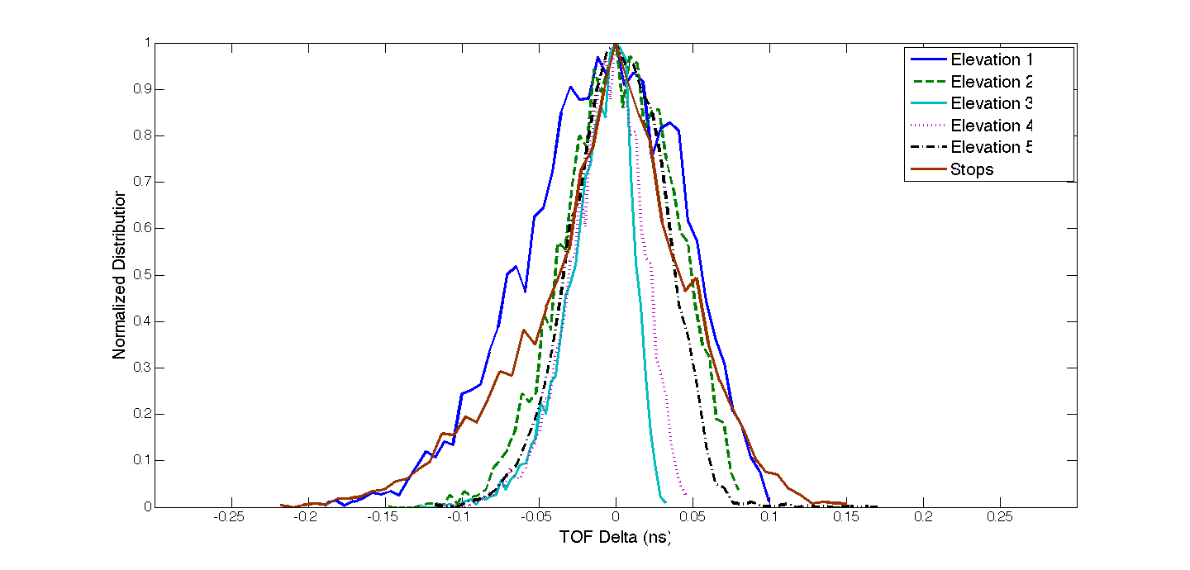
SIMION, Allegrini Energy Distribution
Sample Trajectories
Initial Energy Distribution
Hit Locations
Electron Dispersion
Elevation 3
Elevation 5
Name | Mean TOF (ns) | FWHM (ns)
Elevation 1 | 0.93 | 0.12
Elevation 2 | 2.12 | 0.08
Elevation 3 | 2.35 | 0.04
Elevation 4 | 2.32 | 0.05
Elevation 5 | 2.26 | 0.08
Stops | 5.23 | 0.09
Elevation 4
Elevation 2
Elevation 1
23

Slide 24
SIMION, Allegrini Energy Distribution
Sample Trajectories
Initial Energy Distribution
Electron Dispersion
Hit Locations
Electron Dispersion
Elevation 3
Elevation 5
Name | Mean TOF (ns) | FWHM (ns)
Elevation 1 | 0.93 | 0.12
Elevation 2 | 2.12 | 0.08
Elevation 3 | 2.35 | 0.04
Elevation 4 | 2.32 | 0.05
Elevation 5 | 2.26 | 0.08
Stops | 5.23 | 0.09
Elevation 4
Elevation 2
Elevation 1
24

Slide 25
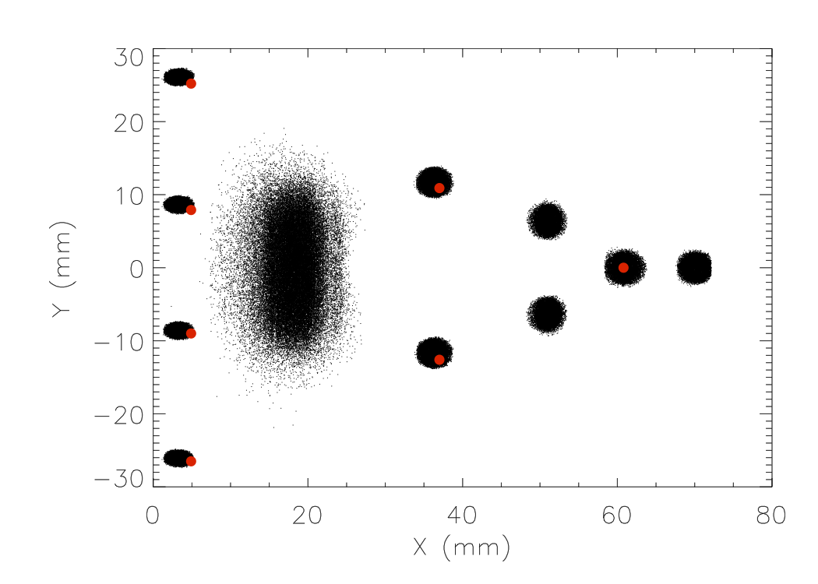
Microchannel Plate (MCP)
Simulation (black) versus measured centroids (red)
The misalignment in Y-direction was due to a registration offset in the setup
The offset in the X direction for the left-most data was caused by an obstruction at the edge of the MCP mount that has since been eliminated

Slide 26
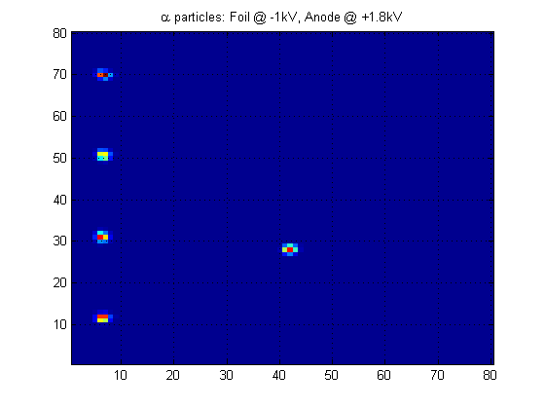
x – y positions, bin width=4ns (~0.8mm)
Y →
X →

Slide 27
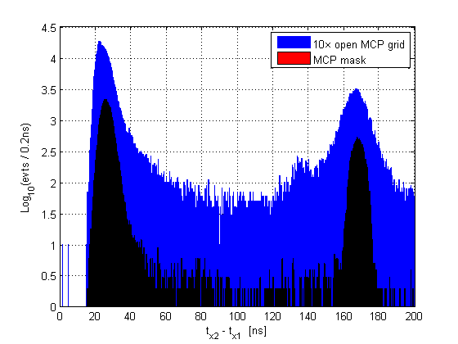
Comparison of mask and open MCP grid: X

Slide 28
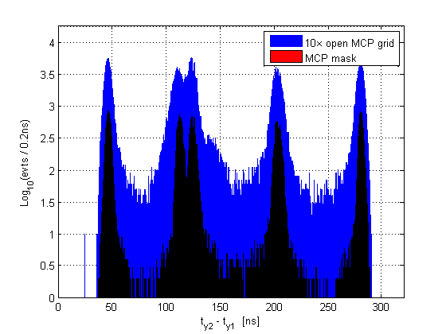
Comparison of mask and open MCP grid: Y

Slide 29
Particles and Counting Rates

Slide 30
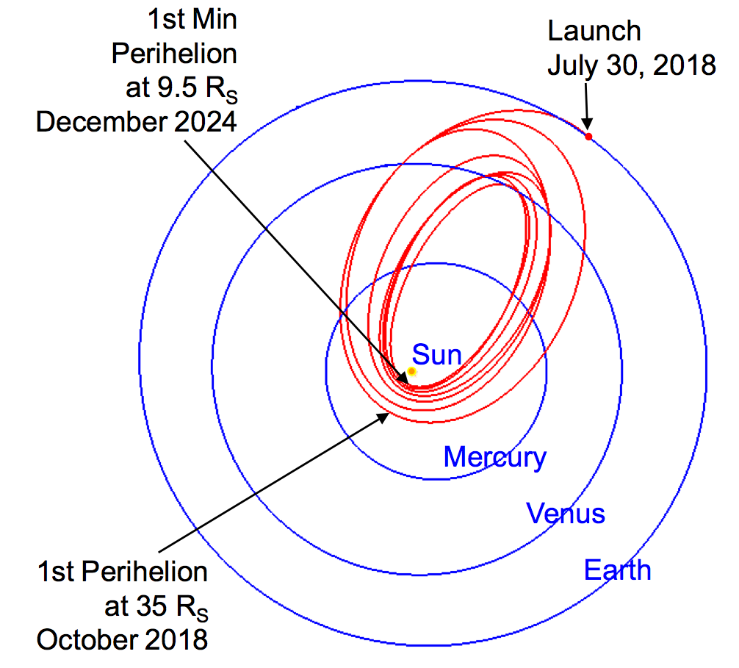
Orbits
Fluxes evaluated in the region from 9.5 – 30 Solar Radii (<0.14 AU)

Slide 31
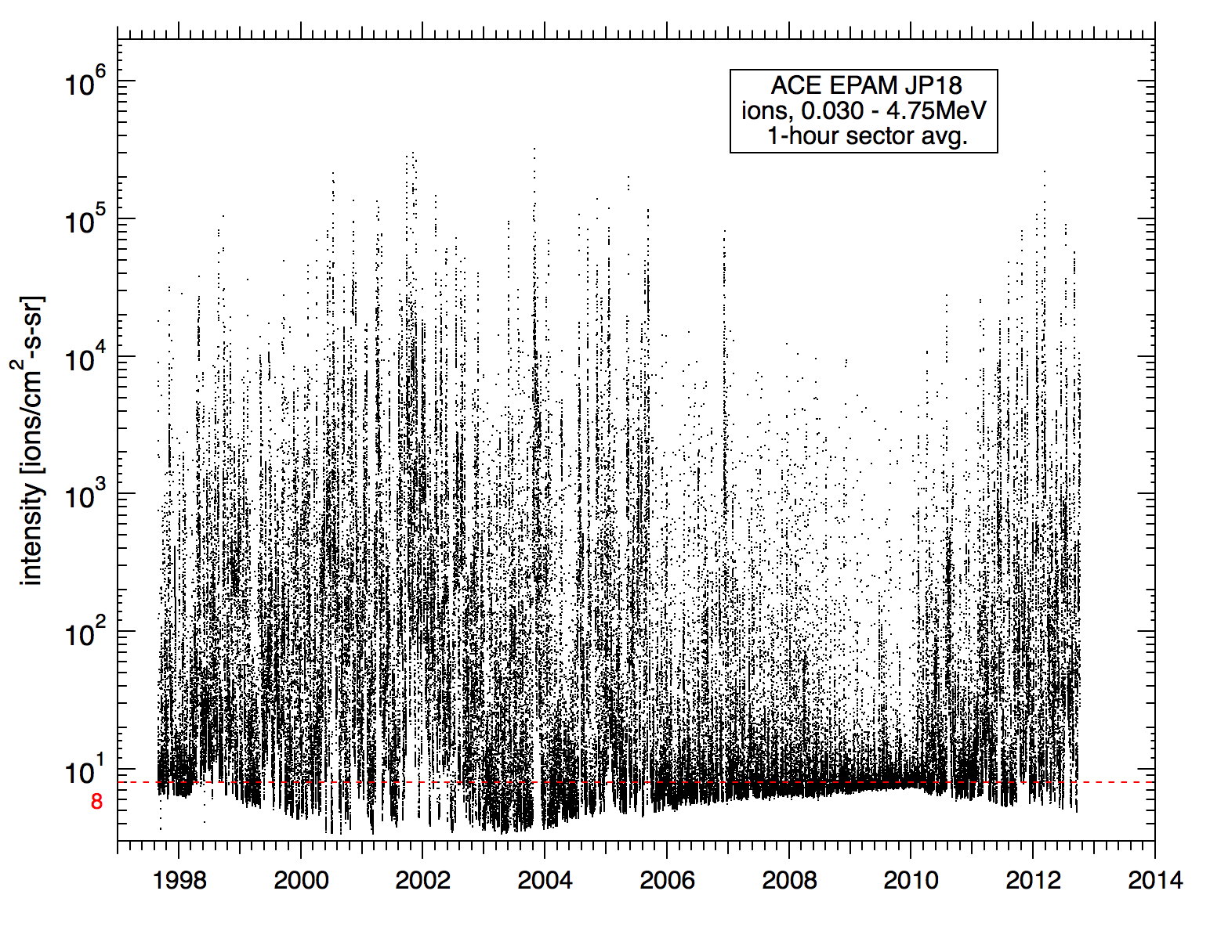
Initial data are integral intensities of ACE/EPAM protons over the 30 keV – 4.75 MeV range (1 hr avg)
The year 1998 is selected as representative of the time in the cycle analogous to the 2018 Launch date. This is an “active mission” condition because solar max conditions persist during the min perihelia.
Lowest EPAM energy is 66, so low-energy slope was used to extrapolate down to the 30 – 66 keV range

Slide 32
- Start at a given launch date, use the 1 AU flux and calculate the flux at the SPP position (using a power-law radial flux dependence) as it progresses in its orbits. Do this for each hour and histogram the number of occurrences (hours) in a given intensity bin.
- Do this for many launch times to account for the randomness of when particular events will occur (that is to account for the fact that a high-intensity event could take place when SPP is near the Sun or could happen when SPP is far from the Sun).

Slide 33
Proton Intensity

Slide 34
Proton Intensity
Protons

Slide 35
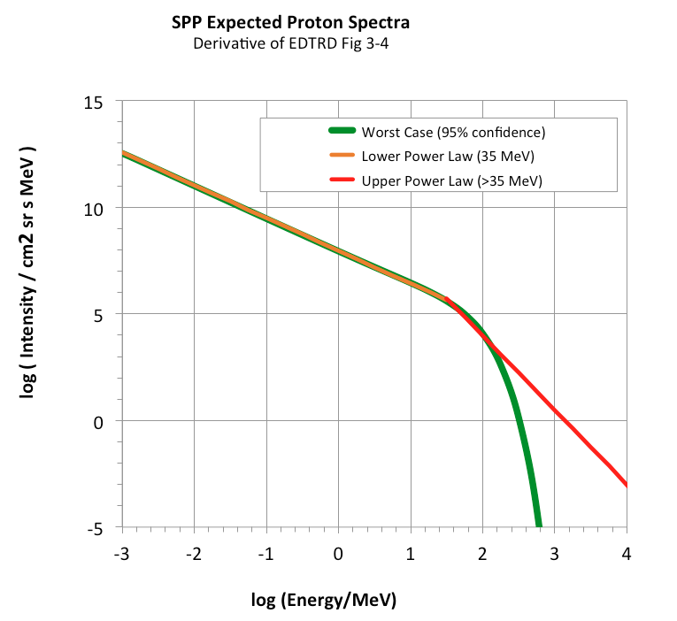
Worst Case Protons

Slide 36
Environment
Electron Spectra, expected, worst case, etc.

Slide 37
Electrons
10^{3.2} cm-2s-1sr-1MeV-1

Slide 38
Environment
Electron Spectra, expected, worst case, etc.

Slide 39
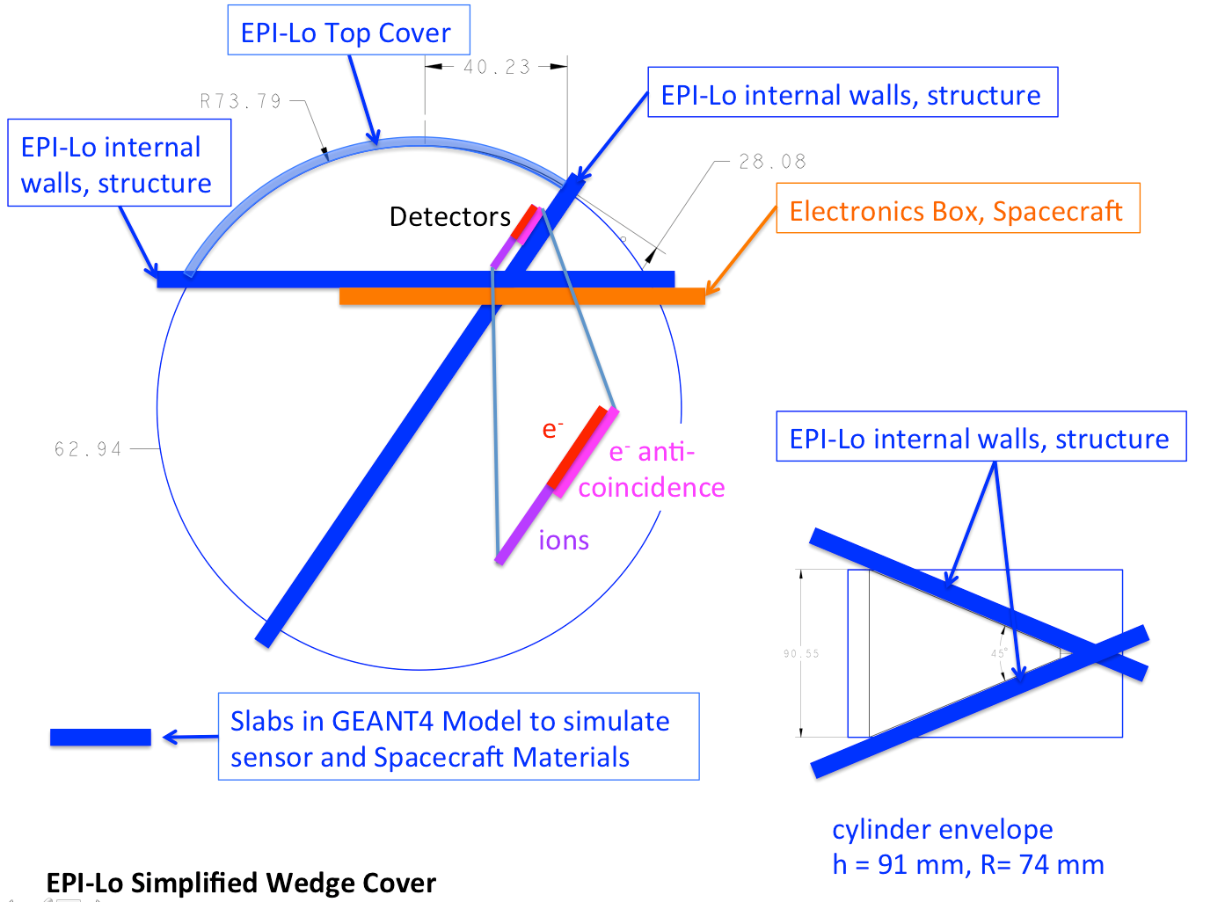
Anti-coincidence System: GEANT Setup
Improved setup for GEANT4 model of electron SSD anticoincidence

Slide 40
Anti-coincidence System: GEANT Results
Assumed electron flux of j(E) ~ E^{– 2.65} from ~10 keV to ~5 MeV
Penetrator rejection efficiency range from 83% to 95% from 1 MeV up to 10 MeV incident electron energy
Following peer review result of S/N of ~3 for foreground electrons with anti-coincidence, higher fidelity sensor model yields S/N ~10
New GEANT model accounts for more realistic geometry and extra shielding by structure
Only ~1% of electrons below 2 MeV penetrate to detectors in this model

Slide 41
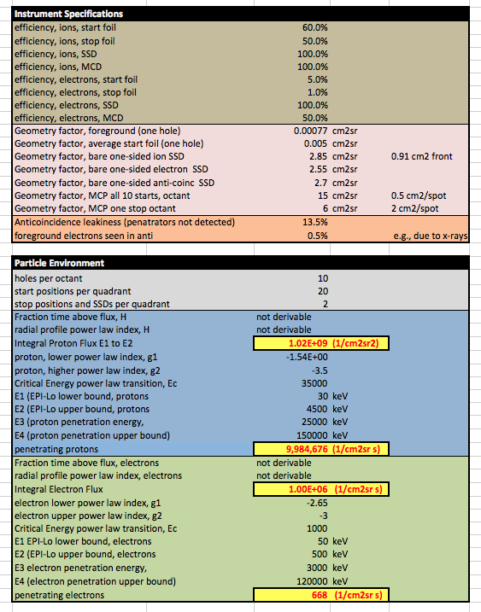
Particle Intensities and Rates

Slide 42
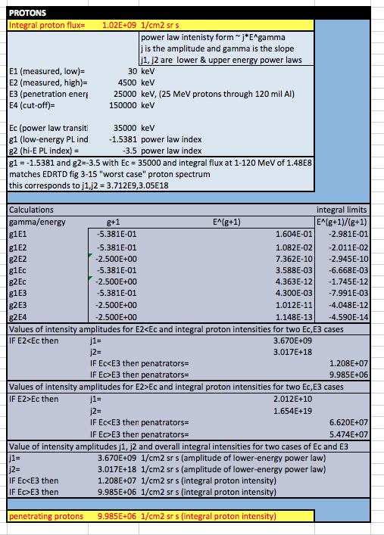
Particle Intensities and Rates

Slide 43
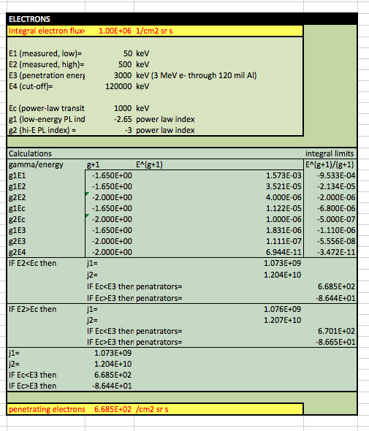
Particle Intensities and Rates

Slide 44
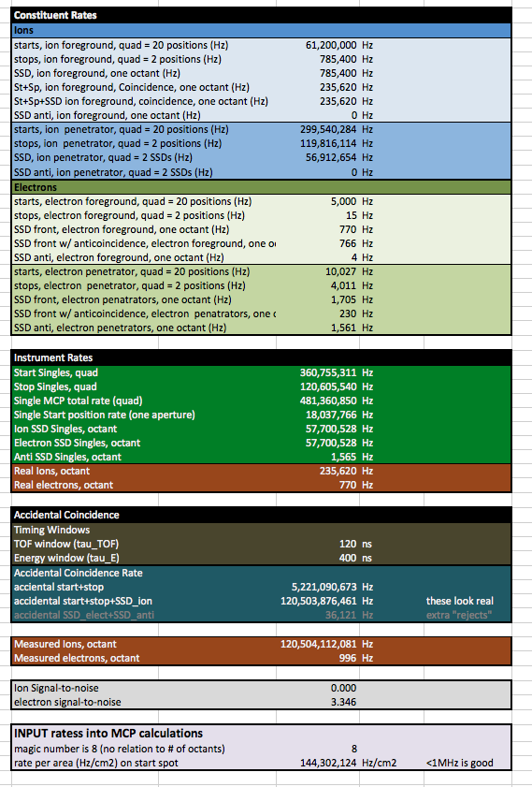
Particle Intensities and Rates

Slide 45
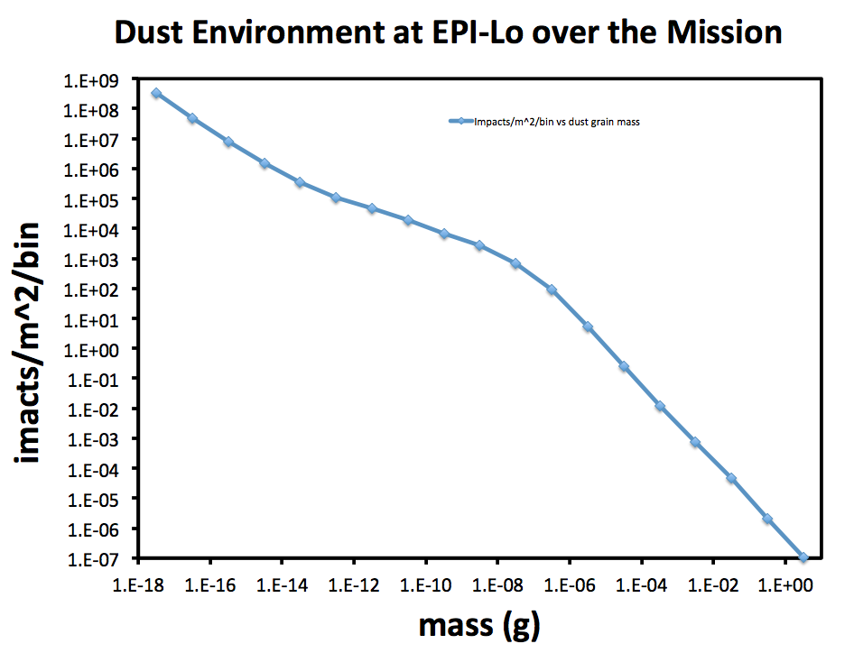
Environment: Dust

Slide 46
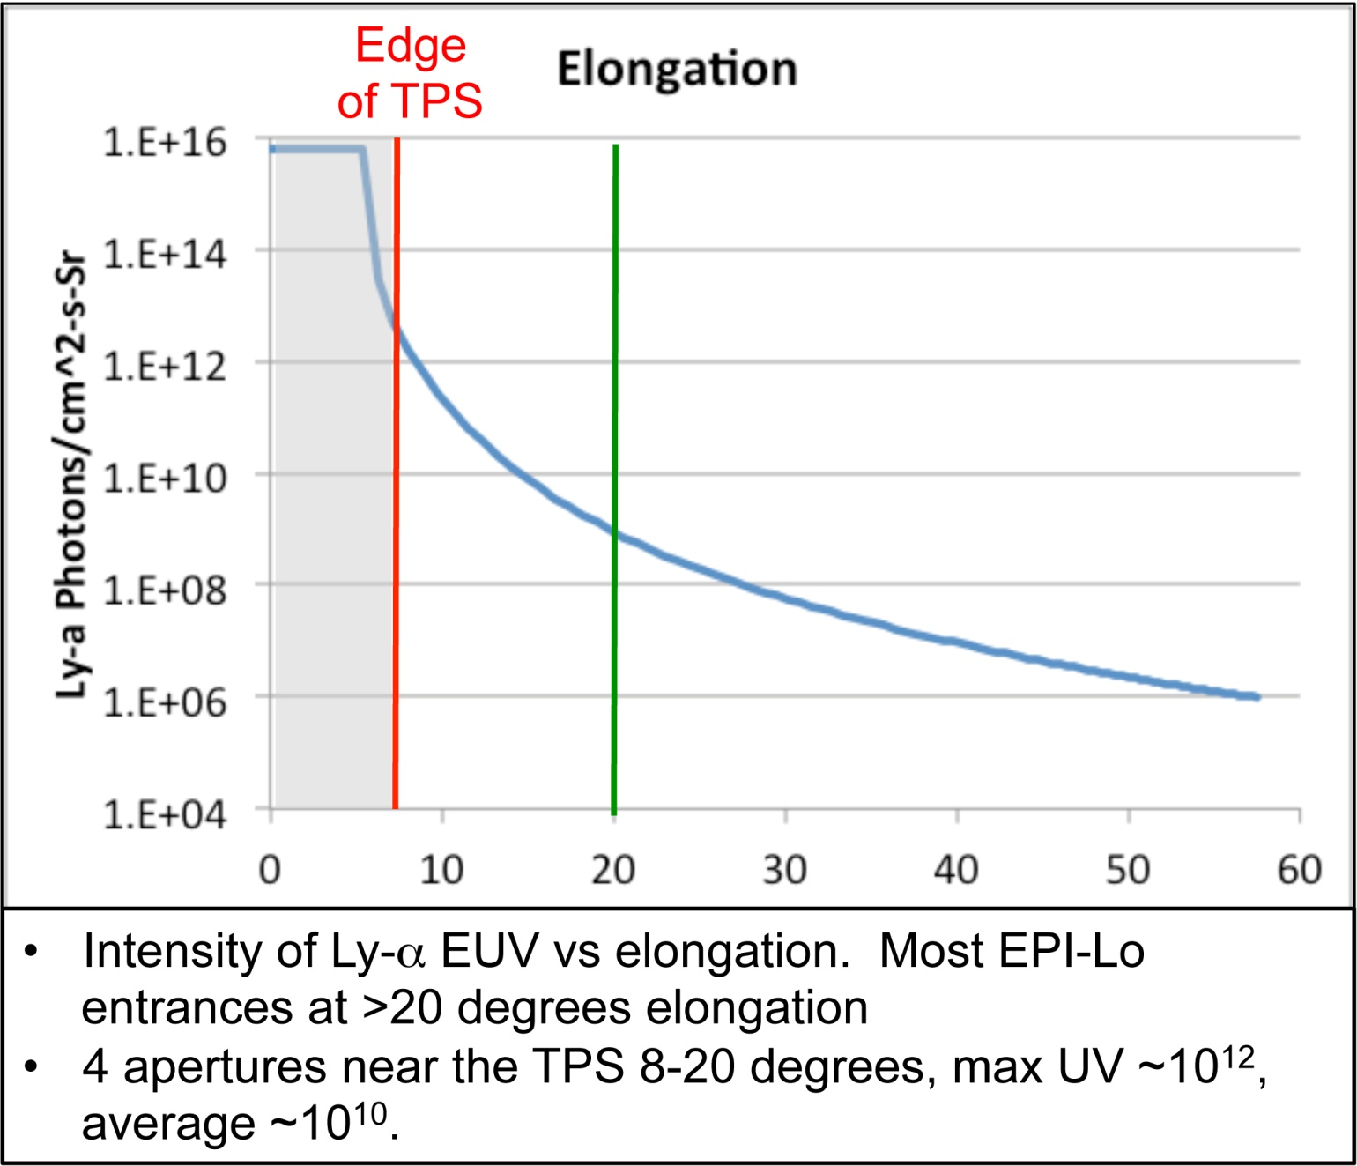
Light

Slide 47
Field of View

Slide 48
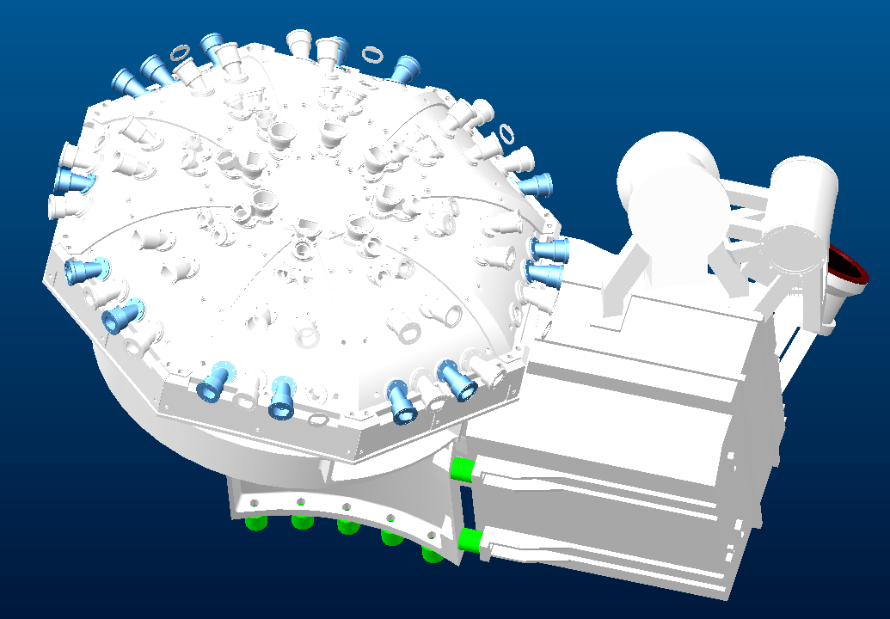
Mechanical/Electrical
D2
D1
C2
A1
A2
C1
B2
B1
Cutout for connectors

Slide 49
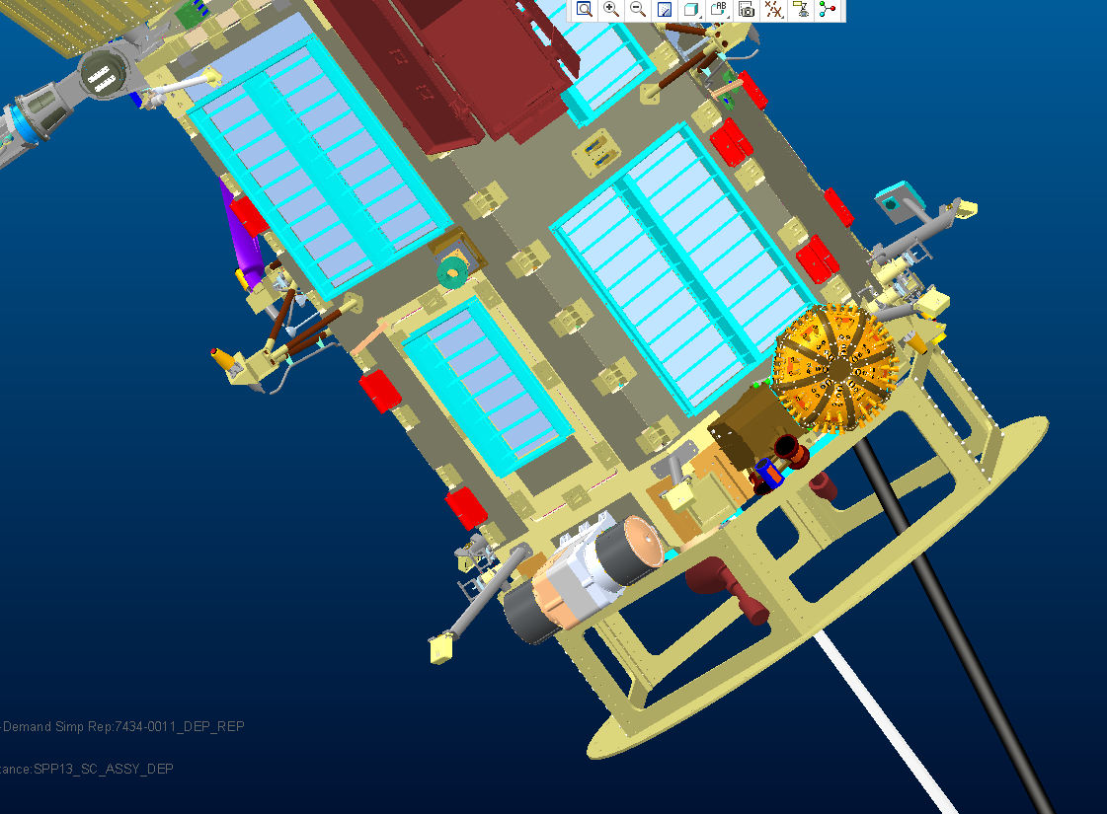
Mechanical/Electrical
Sun
B2
C1
C2
B1
D1
A2
D2
A1

Slide 50
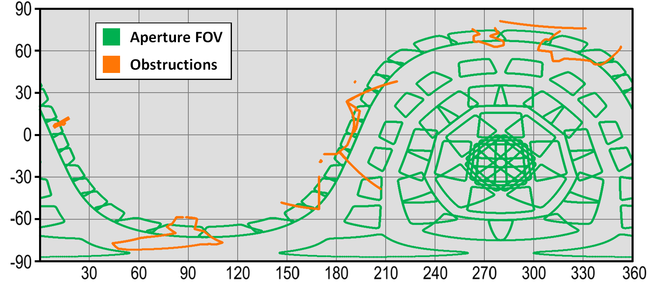
Looking at the Sky
Field of View
FIELDS
A2
Limb Sensor
B1
1
EPI-Hi
Engineering/Electrical
2
A1
Science
0
WISPR
Mag Boom
TPS
A2
A1
D2
B2
B1
1
7
FIELDS
3
2
0
B2
D2
C1
3
7
D1
Solar
Array
4
C1
D1
6
Limb
Sensor
6
C2
4
C2
5
5
Mechanical/Electrical – Quadrants are named A,B, C or D (corresponding to an anode board) with a 1 or a 2 designating which wedge/octant (which side of the board). Naming proceeds clockwise on instrument (viewed from above): A1, A2, B1, etc.
Science – Wedges/octants are named 0 to 7 counter-clockwise on sky, starting from EPI-Hi directed wedge (designed to match up with A1-D2 scheme.

Slide 51
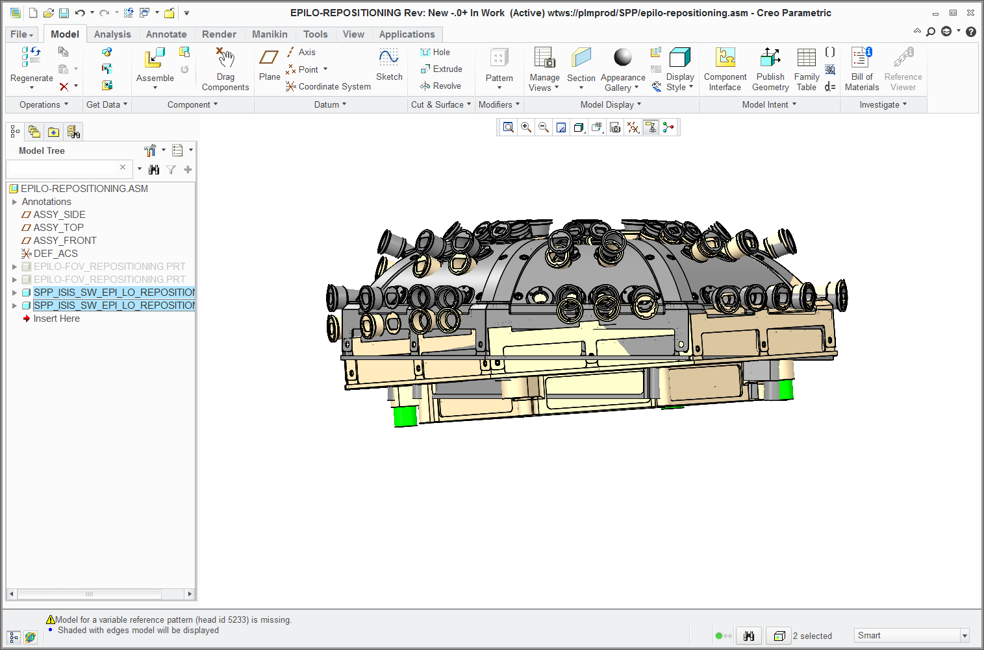
ISIS EPI-Lo Repositioning
ORIGINAL POSITION
REPOSITIONED
.060 inches below 8 degree umbra
Focal point .284 inches lower on instrument axis
Angled to minimize TPS obstruction

Slide 52
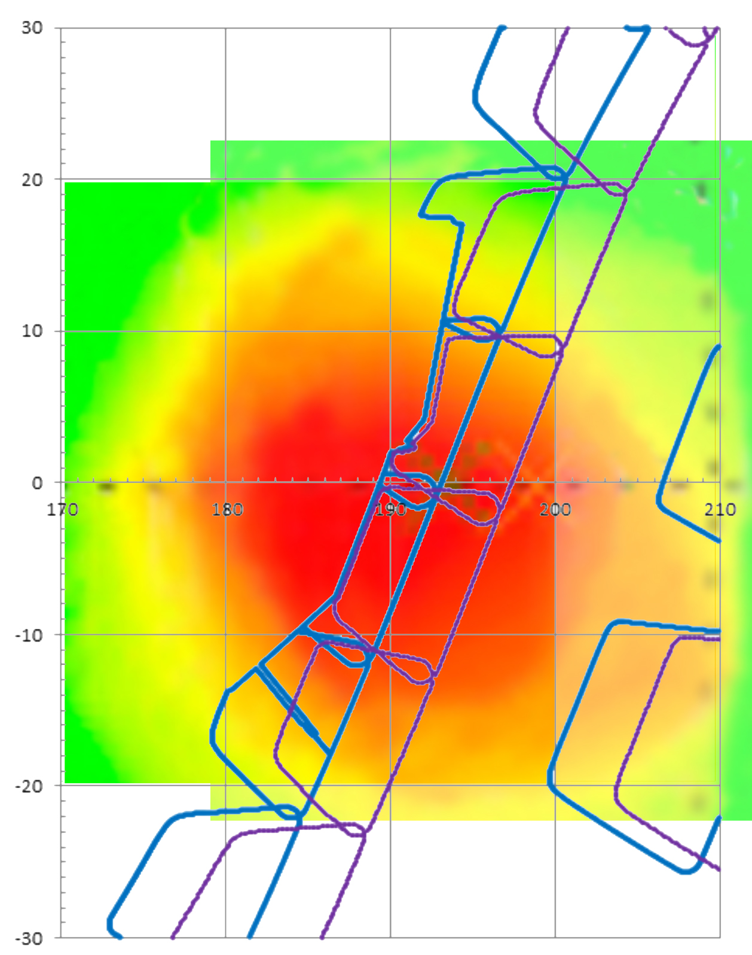
ISIS EPI-Lo FOV With Parker Probability
ORIGINAL FOV
REPOSITIONED FOV

Slide 53
ISIS EPI-Lo FOV With Parker Probability
ORIGINAL FOV
REPOSITIONED FOV

Slide 54
Electrical
A2
Looking at the Sky
Aperture naming
Look directions associated with Anode Board A
Mechanical / Science
L12
L11
A1
L13
W1
L10
L03
L15
L14
L02
L05
W0
L01
L17
L16
L00
L07
L04
L18
L06
L08
L19
L09
Mechanical / Science – Apertures are named from 0 to 9 for each wedge, counter-clockwise on sky starting on lowest elevation angle row.
For science only, all 80 holes are named from 00-79 by combining the wedge number and aperture number. Individual octants/wedges are named with a preceding W, thus there are eight octants named W0-W7. Individual holes are named with a preceding L (for look direction) so we have 80 apertures named L00-L79.

Slide 55
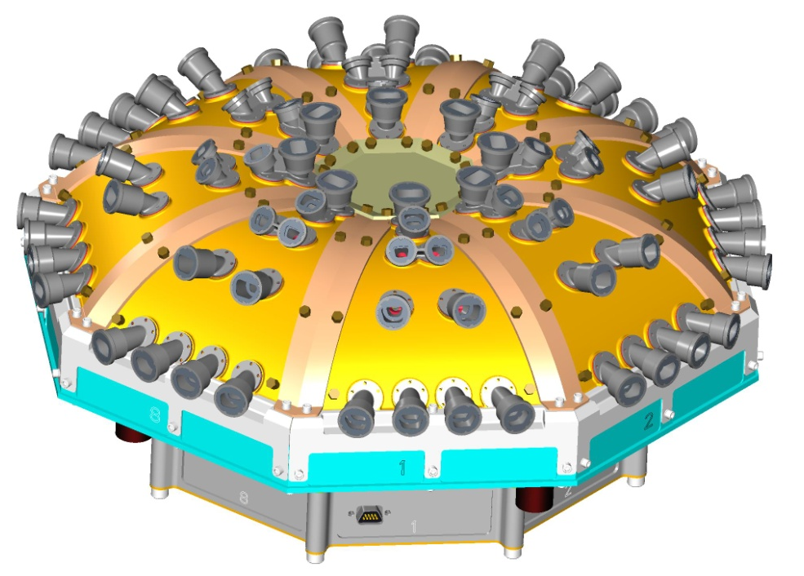
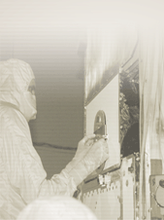
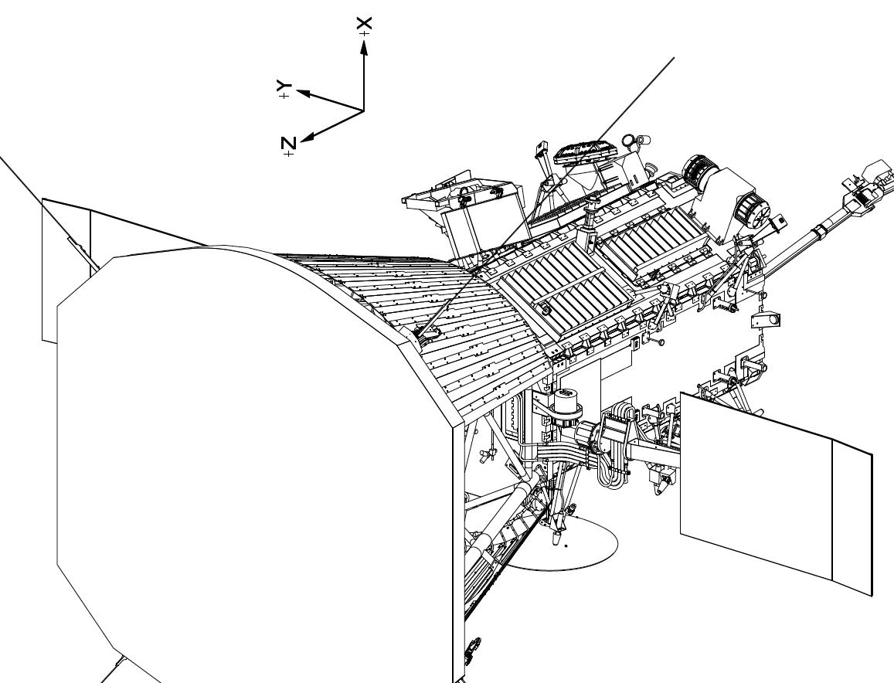
Instrument Overview

Slide 56
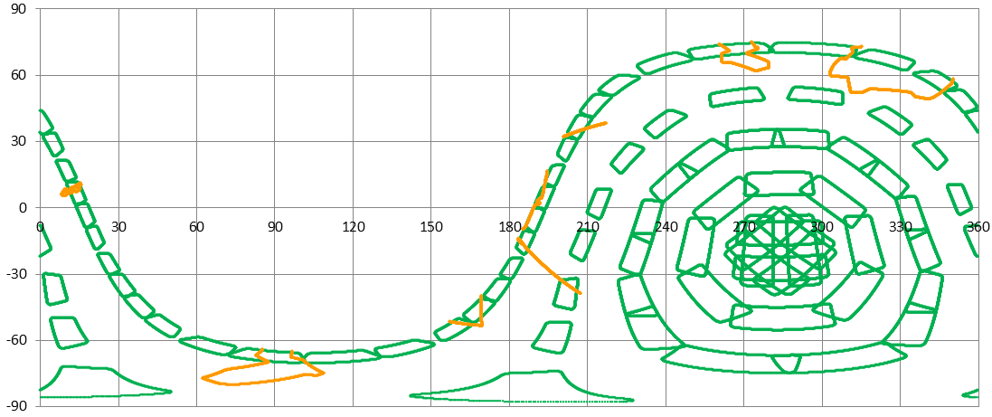
Particle FOV
UNOBSTRUCTED FOV
OBSTRUCTIONS TO FOV
ADCOLE Head
MAG Boom
WISPR
FIELDS
EPI-Hi
SUN
RAM
ADCOLE Head
TPS Leading Edge
Deployed Solar Array
56

Slide 57
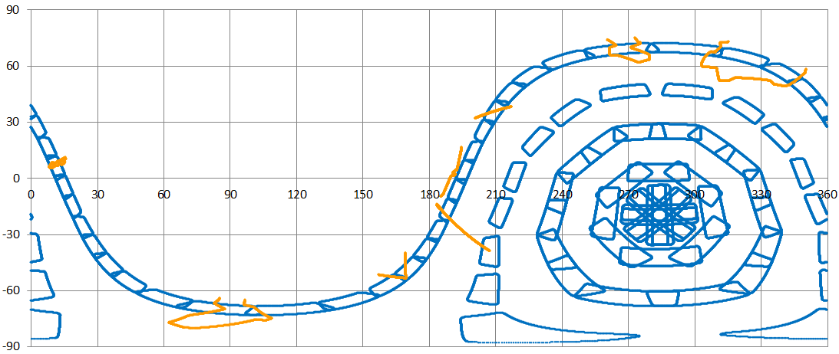
Ion FOV
UNOBSTRUCTED FOV
OBSTRUCTIONS TO FOV
ADCOLE Head
MAG Boom
WISPR
FIELDS
EPI-Hi
SUN
RAM
ADCOLE Head
TPS Leading Edge
Deployed Solar Array
57

Slide 58
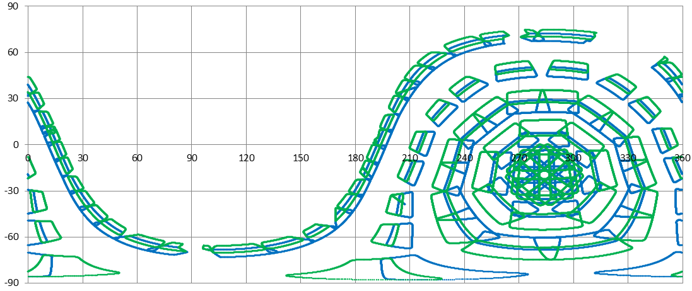
Particle and Ion FOV’s
PARTICLE FOV
ION FOV
SUN
RAM

Slide 59
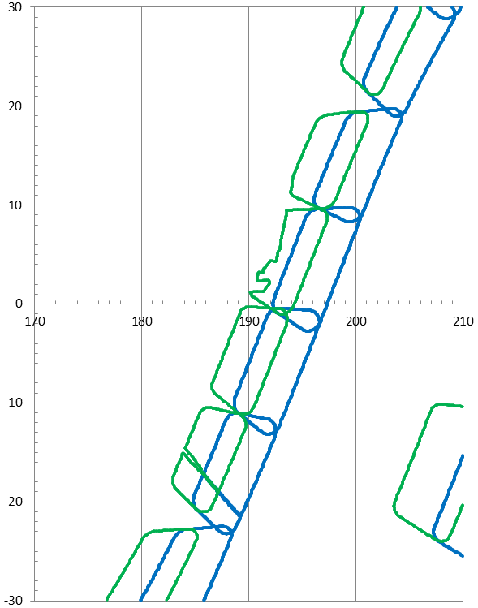
Particle and Ion FOV’s
PARTICLE FOV
ION FOV
SUN

Slide 60
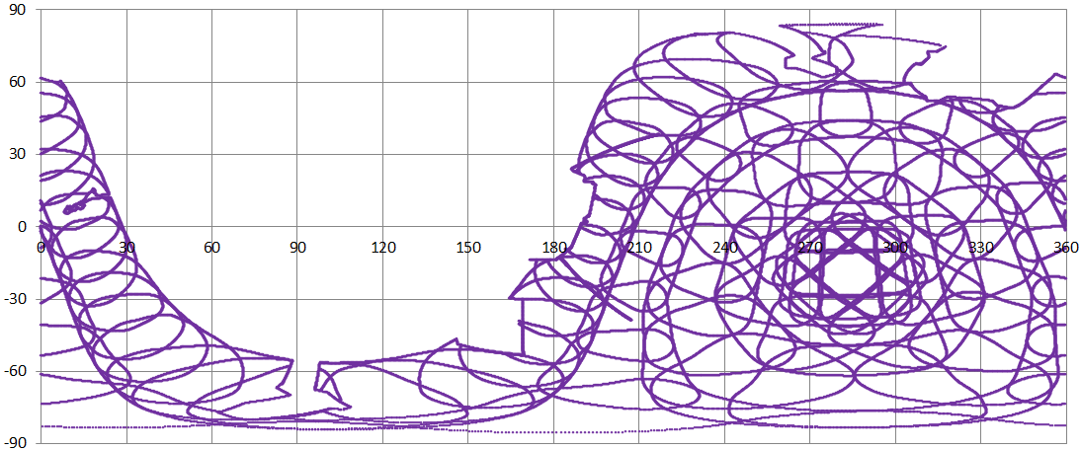
Start Foil FOV
SUN
RAM

