Slide 1
Energy Board

Slide 2
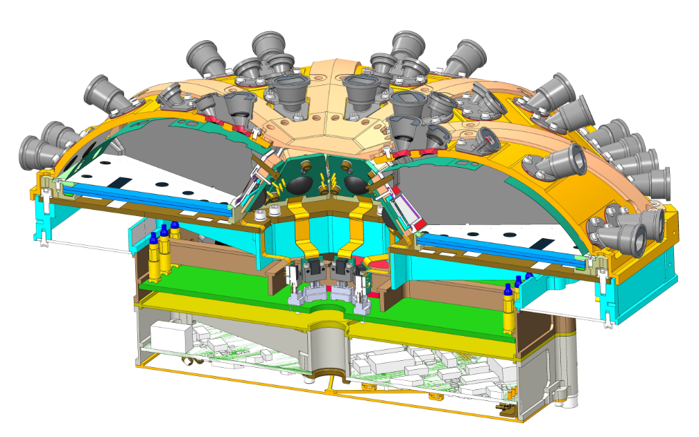
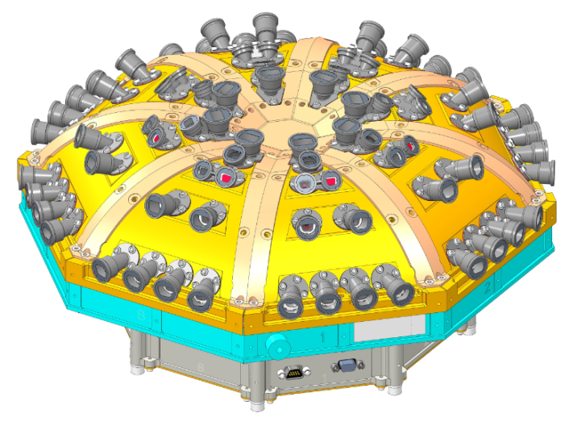
EPI-Lo Electronics Overview
Energy Boards (x8)
Anode Boards (x4)
Event Board
Power Board

Slide 3
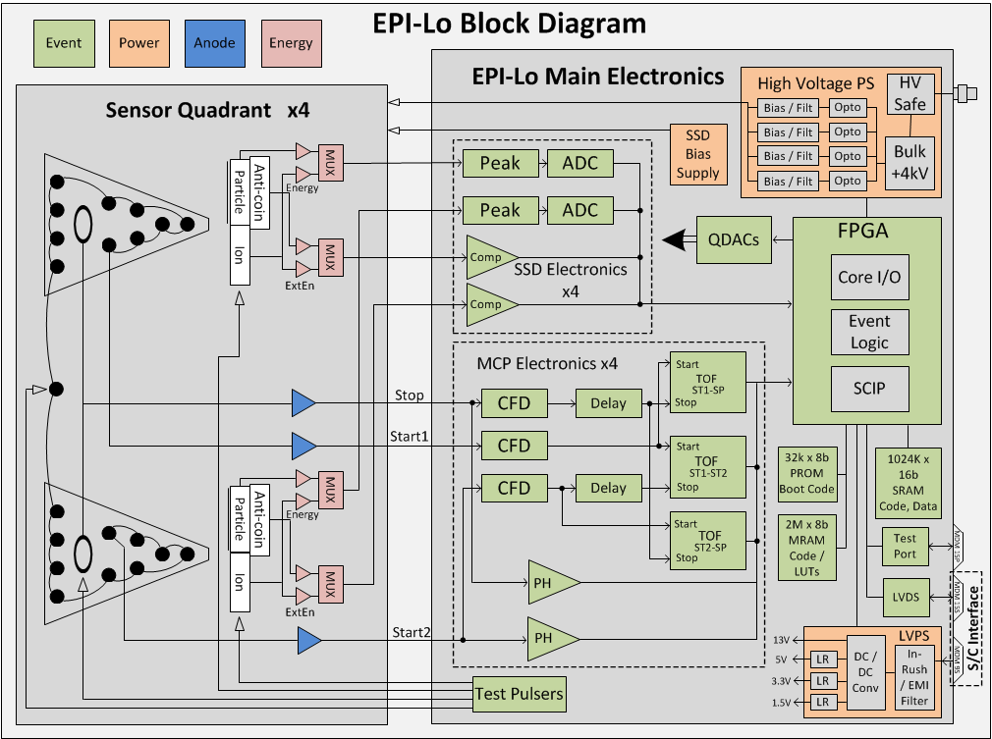
EPI-Lo Block Diagram

Slide 4
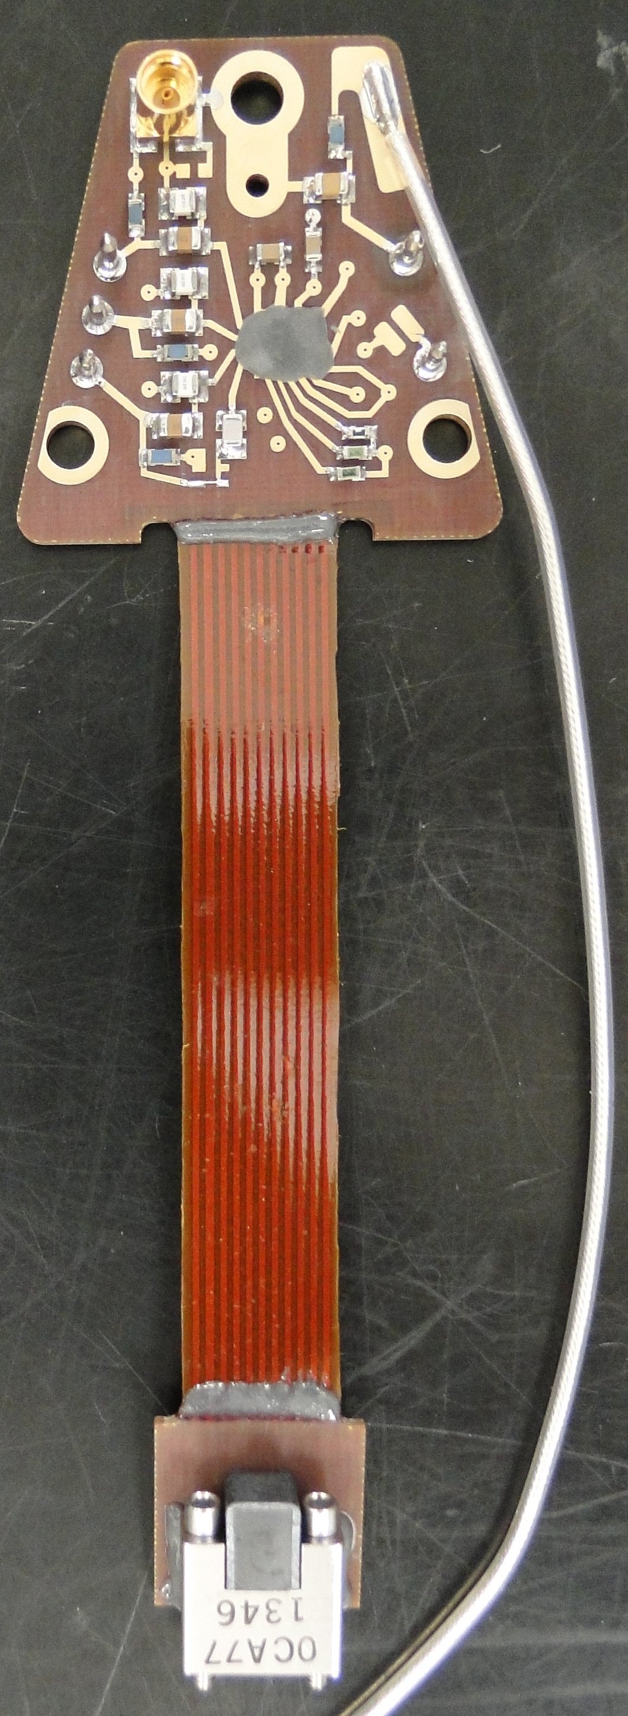
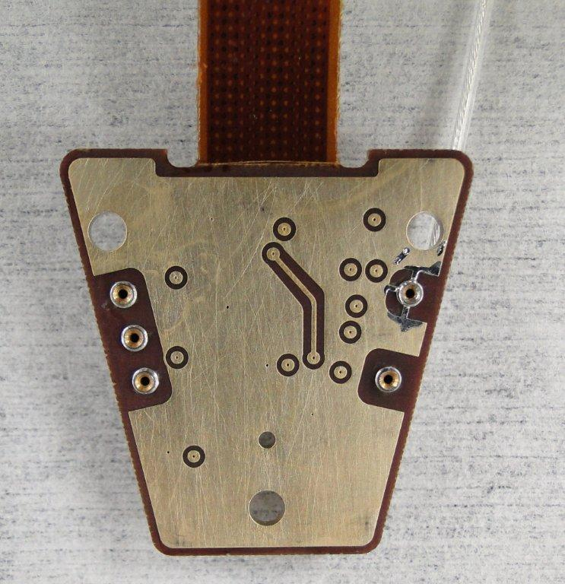
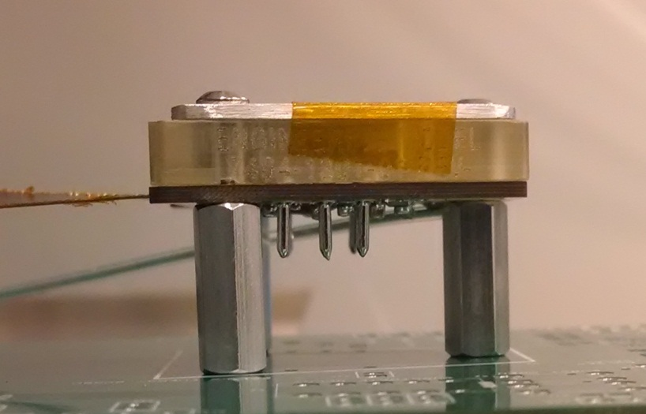
EPI-Lo – Energy Board
APL ASIC Energy Chip
Detector Pin Sockets
Integrated Flex Cable
SSD Bias Voltage Connection
Protective Cover
Solid State Detector
Ultem Detector Mount
Energy Board
Detector Pin Sockets
Test bench standoffs/PCB

Slide 5
APL Energy ASIC Heritage
APL Hockey Pucks
JUNO/JEDI
Van Allen Probes/RBSPICE
MMS/EIS
New Horizons/PEPPSI

Slide 6
Energy Board Requirements
Noise width: < 15 keV FWHM

Slide 7
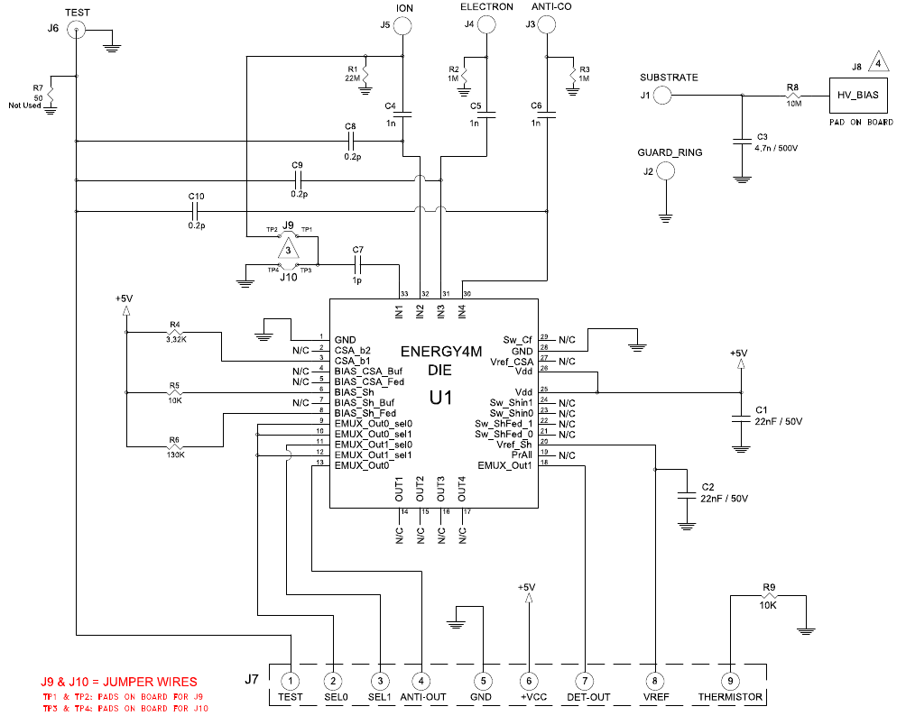
Energy Board Schematic

Slide 8
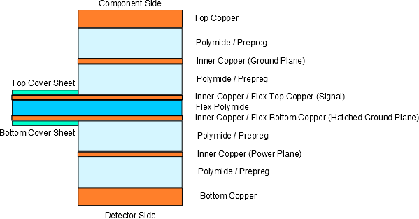
Energy Board PCB Layer Stackup
(not to scale)

Slide 9
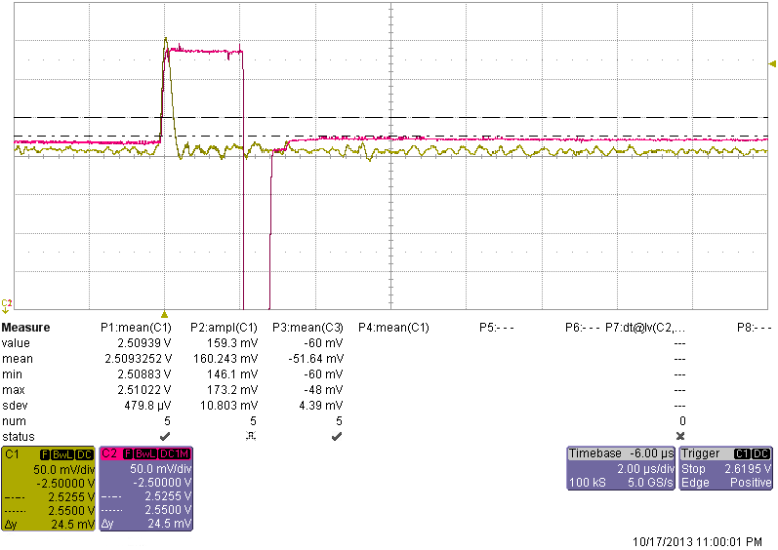
Energy Board Output Waveforms (1)
Peak Detect Reset
E ~ 238 keV
Yellow – Energy Board Output
Red – Peak Detect Output
50 mV/div
2 us/div

Slide 10
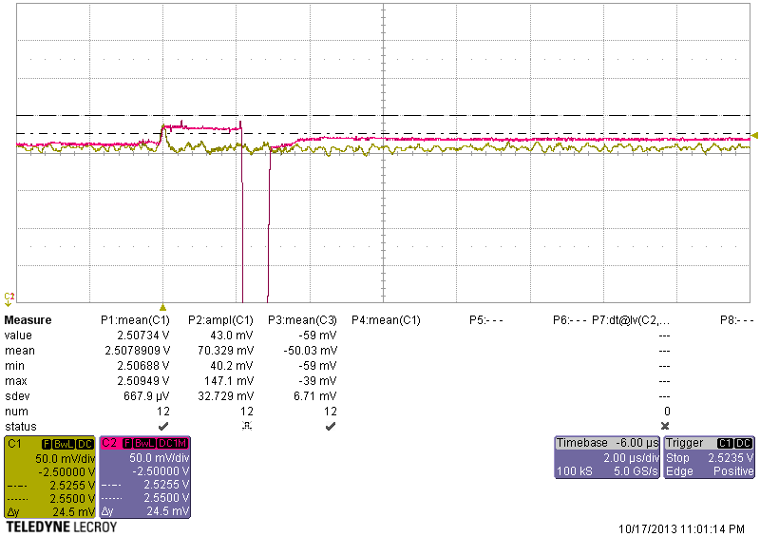
Energy Board Output Waveforms (2)
Peak Detect Reset
E ~ 60 keV
Yellow – Energy Board Output
Red – Peak Detect Output
50 mV/div
2 us/div

Slide 11
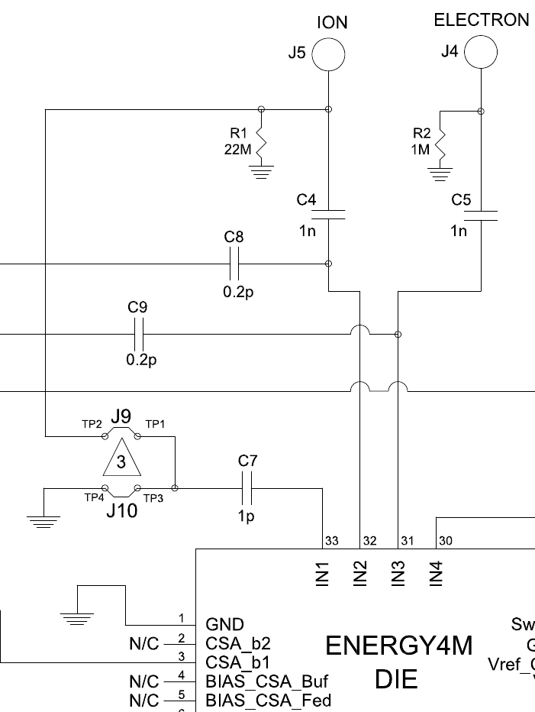
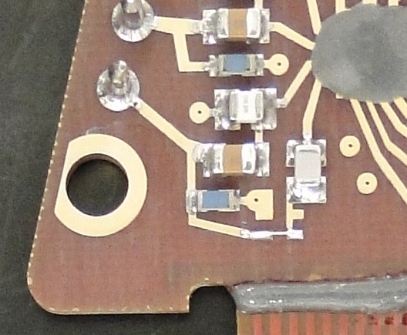
High Energy Ion Extension
Implementation
Small coupling capacitor siphons off a small amount of charge from the primary ion channel
J10 installed: Default configuration for unused channel
J9 installed: High energy channel configuration
J10
J9

Slide 12
High Energy Ion Extension
Test Circuit
Energy Board

Slide 13
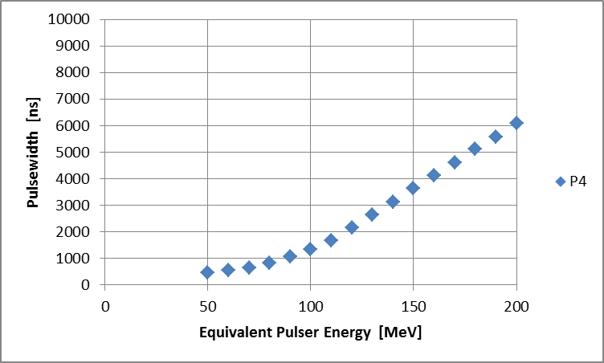
High Energy Ion Extension
Output (E > 50 MeV)
Pulsewidth (ignores glitch)
Yellow – Ion High Gain Channel Peak Detect Output (1 V/div)
Maroon – Ion Low Gain Channel Output (50 mV/div)
Blue – Ion Low Gain Channel Peak Detect Output (50 mV/div)
Green – Ion Low Gain Leading Edge Discriminator (5 V/div)
*Data courtesy of Ken Nelson

Slide 14
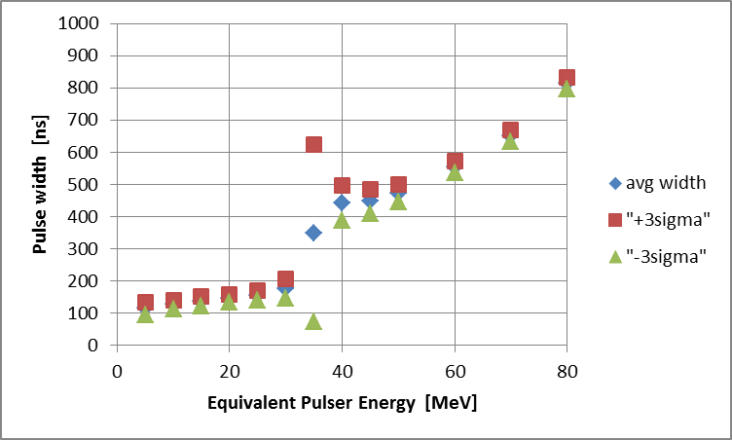
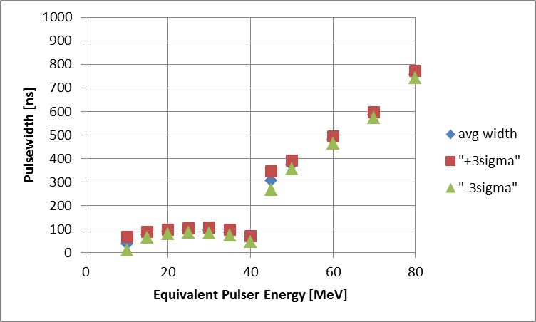
High Energy Ion Extension
Output (E < 50 MeV)
Nominal Threshold
Raised Threshold
Yellow – Ion High Gain Channel Peak Detect Output (1 V/div)
Maroon – Ion Low Gain Channel Output (50 mV/div)
Blue – Ion Low Gain Channel Peak Detect Output (50 mV/div)
Green – Ion Low Gain Leading Edge Discriminator (5 V/div)
*Data courtesy of Ken Nelson

Slide 15
High Energy Ion Extension
Current Methodology
Pulse height measurement used up to ~1.5 MeV
Pulse width measurement used in 1.5 MeV < E < 20 MeV
Low gain channel pulse width measurement used for E > 50 MeV (high gain preamp saturates)
For a continuous range of measurements other methods are required for ions with 20 MeV < E < 50 MeV
Use Electron pixel for 20 MeV < E < 50 MeV
Fabricate with thicker flashing to absorb ~17 – 26 MeV of ion energy
Resulting ions deposit ~3 – 24 MeV in detector
Electrons do not deposit this much energy in 700 um of Si
Require valid TOF

Slide 16
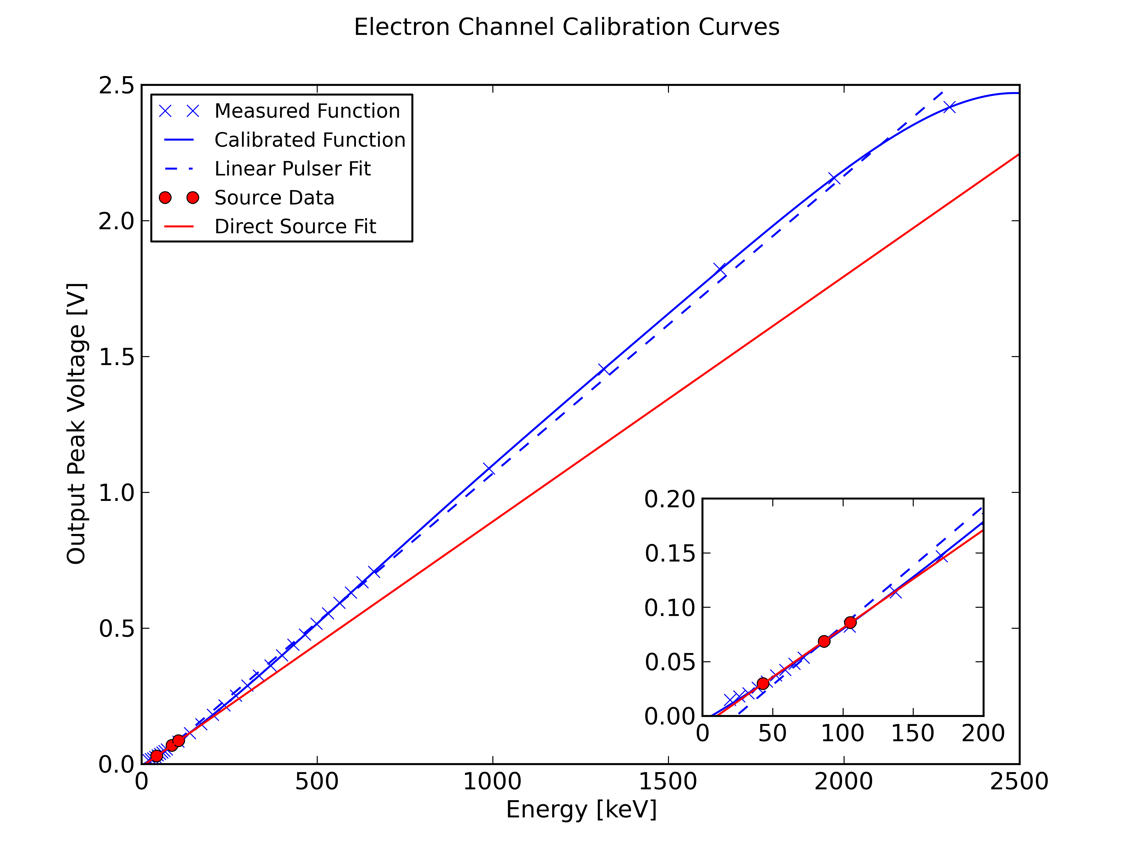
Energy Board Calibration
Sweep a pulser over energy range
Use source peaks to calibrate the pulser
Generate calibration table
For source points shown, error < 0.05 %
Other channels better than 0.5 %
Higher energy points needed
Plan to use Bi207 for ~1 MeV electrons

Slide 17
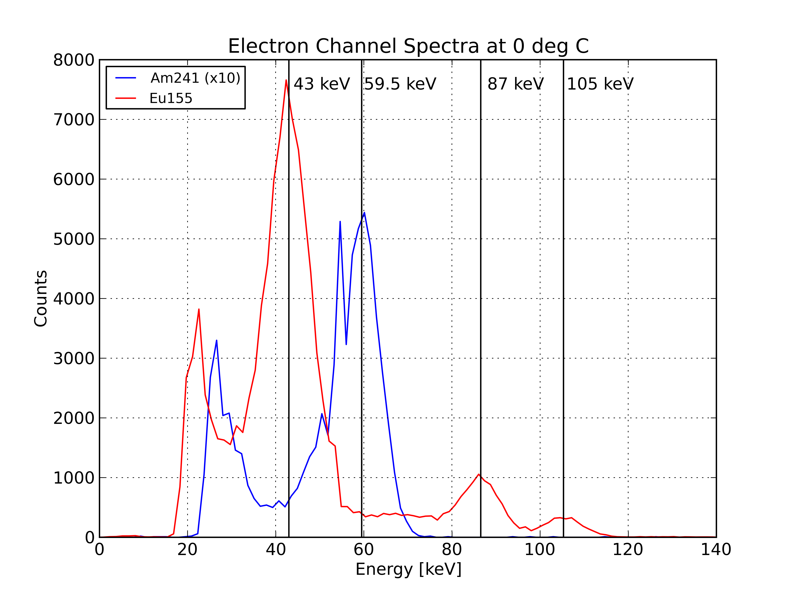
Energy Board X-ray Spectra
*
*Test bench ADC glitch

Slide 18
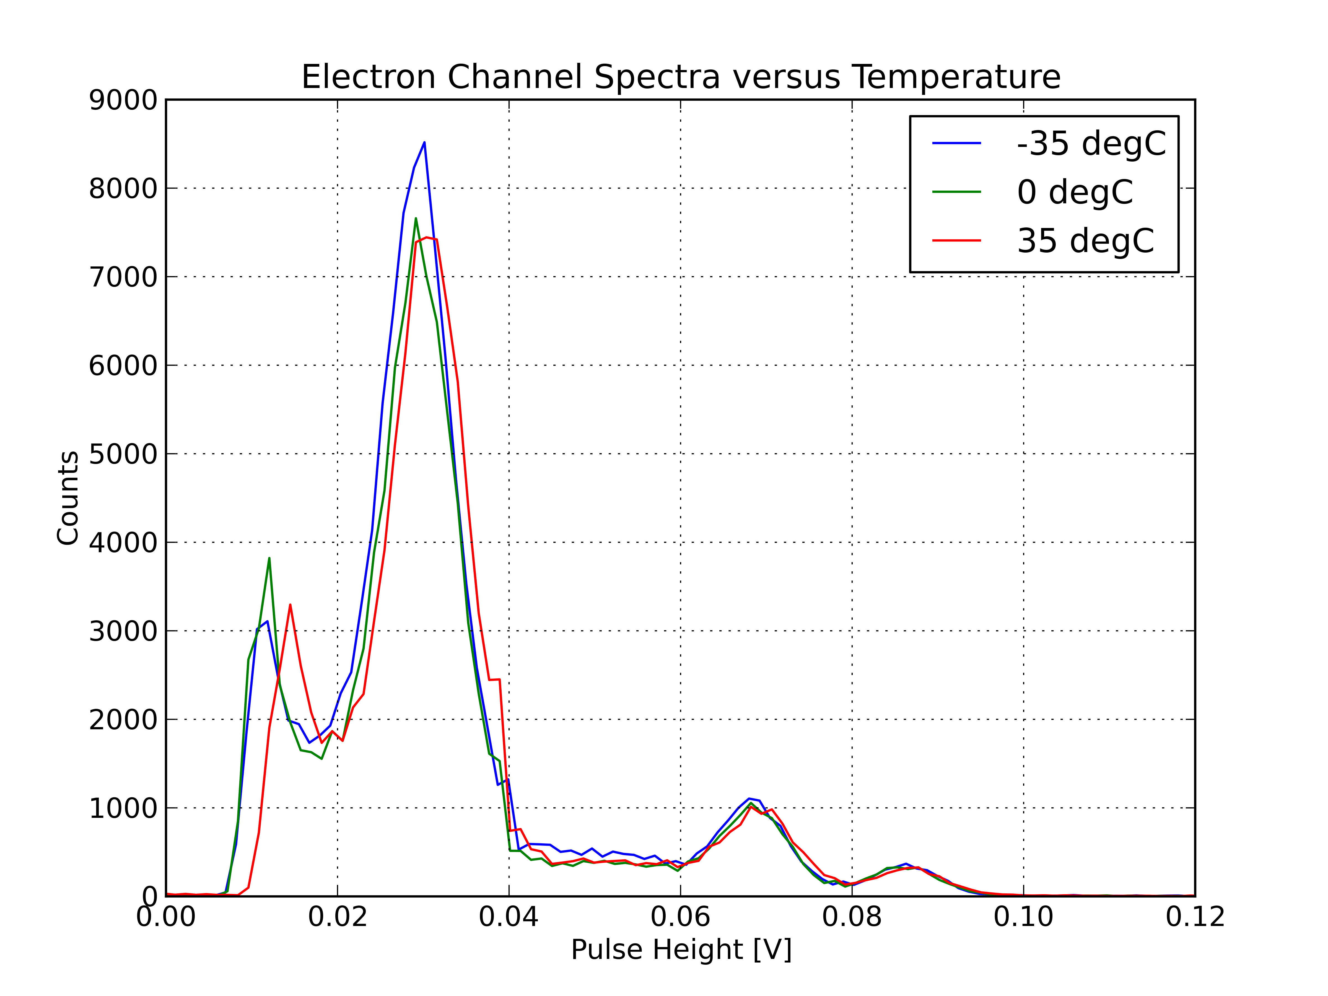
Energy Board Thermal Testing
Eu155 Spectra

Slide 19
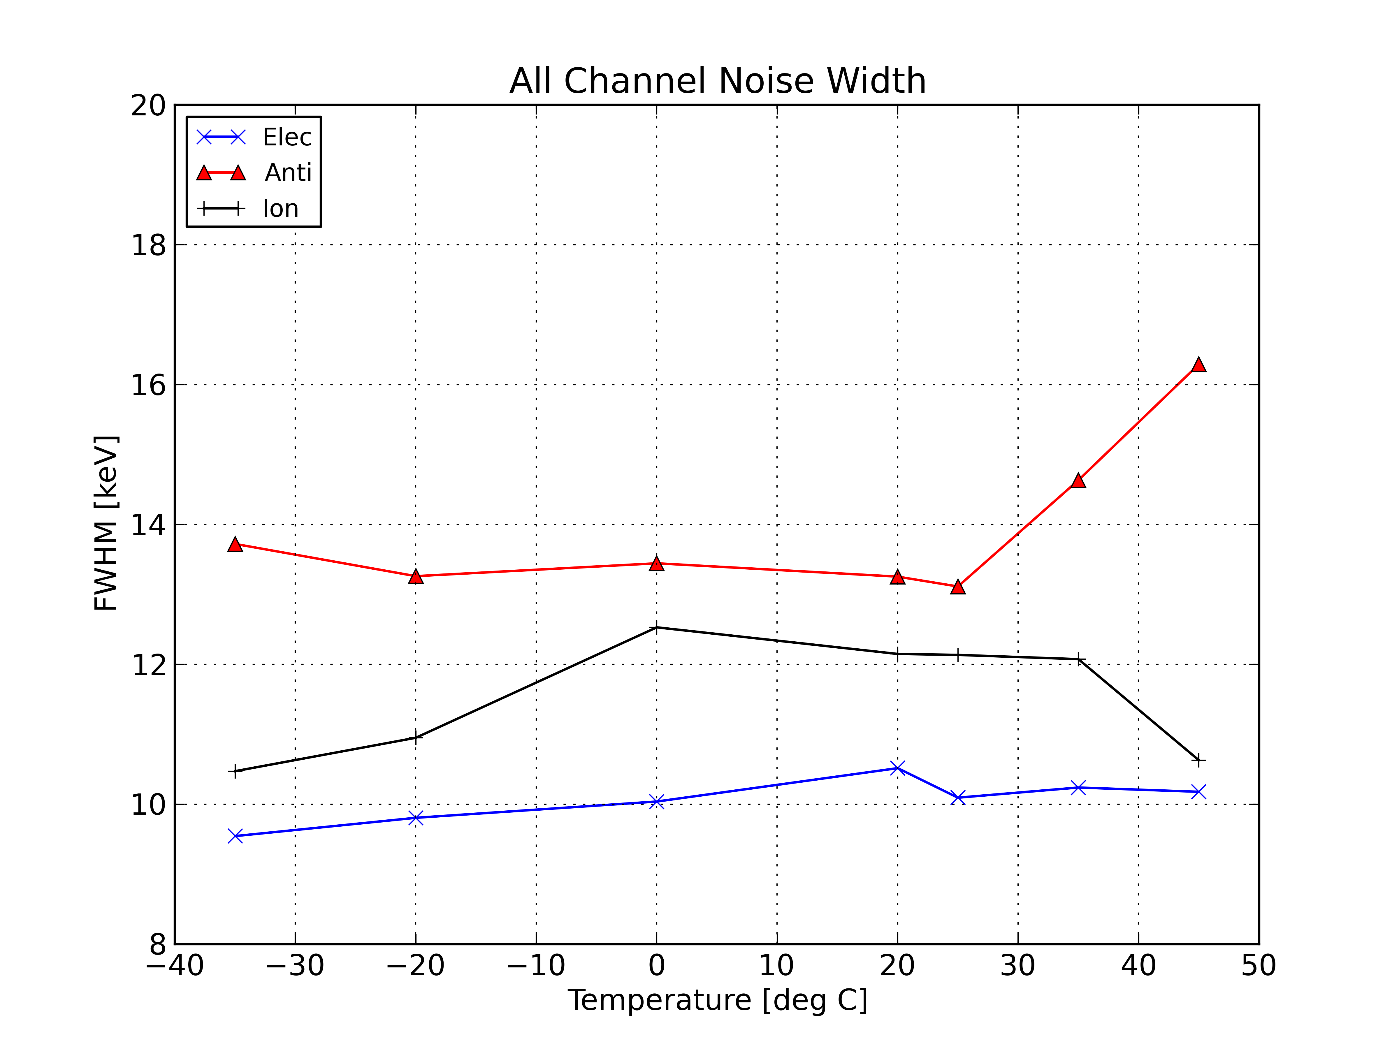
Energy Board Thermal Testing
Peak Width

Slide 20
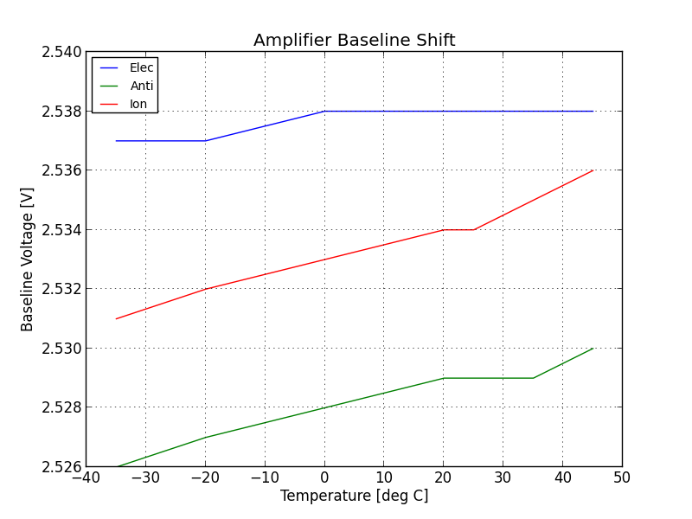
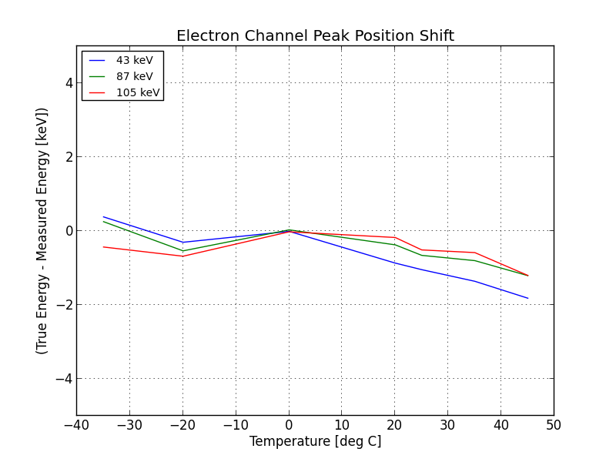
Energy Board Thermal Testing
Peak Location Stability

Slide 21
Energy Board Summary
Energy Board meets/exceeds all requirements
Extended ion energy range: 50 keV – 200 MeV
Normal ion channel E < 20 MeV
Elec channel with thicker flashing 20 MeV < E < 50 MeV
Ion extended energy channel E > 50 MeV
Not yet tested with high energy ions
Energy Board is on it’s way to being well calibrated
Calibration at low energies is very good
Higher energy points needed
Bi207 (~1 MeV electrons)
Energy Board thermal characteristics are acceptable
Noise width remains within spec beyond expected operating temperatures
Observed effects are small
Verify with higher energy point: Ba133 (356 keV x-ray)

