Slide 1
EPI-Hi LVPS Review D. Do

Slide 2
Input Requirements
Bus Voltage: 24-35Vdc
Inrush Current: <10A <10us, <4x or 2.5A <2ms
EMI

Slide 3
LVPS Output Requirements
 | Min Load (mA) | Max Load (mA)
+1.5V | 50 | 150
+1.8V | 20 | 60
+3.3V | 145 | 430
+6V | 79 | 500
+12V | 8 | 64
-6V | 6 | 19

Slide 4
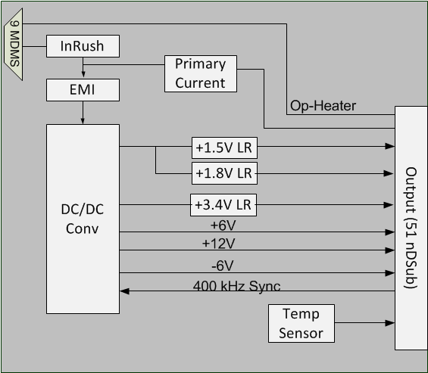
EPI-Hi Block Diagram

Slide 5
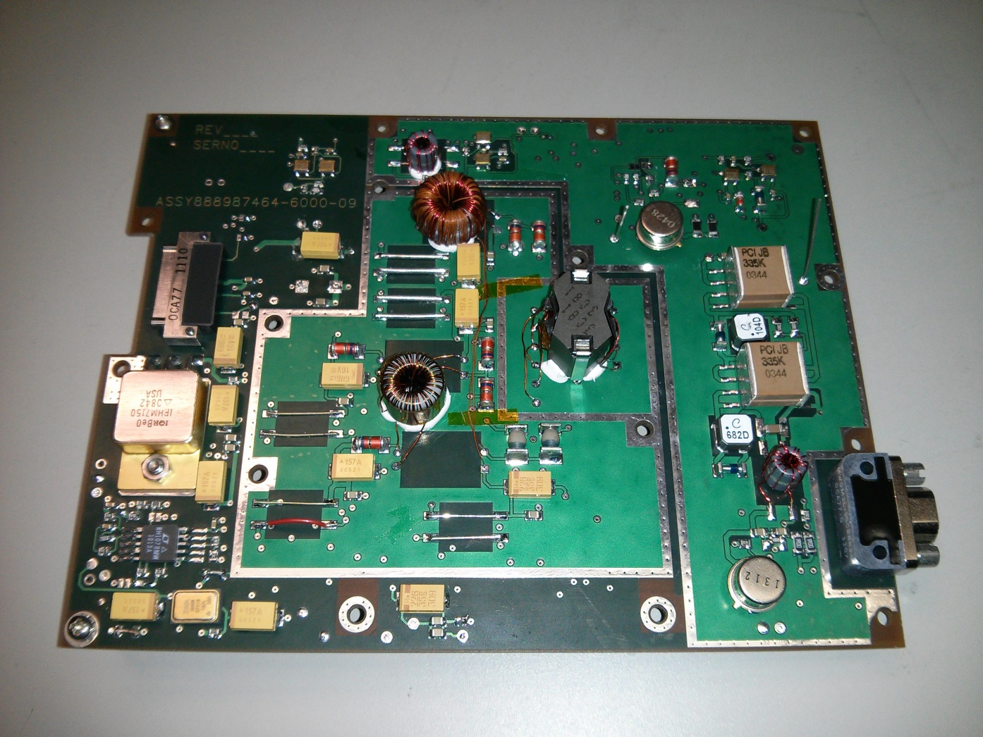
EM board
Secondary
Shield
Main Converter
Pri Shield
Sync clk
Output
Connector
Linear
Regulators
EMI
Input
Con.

Slide 6
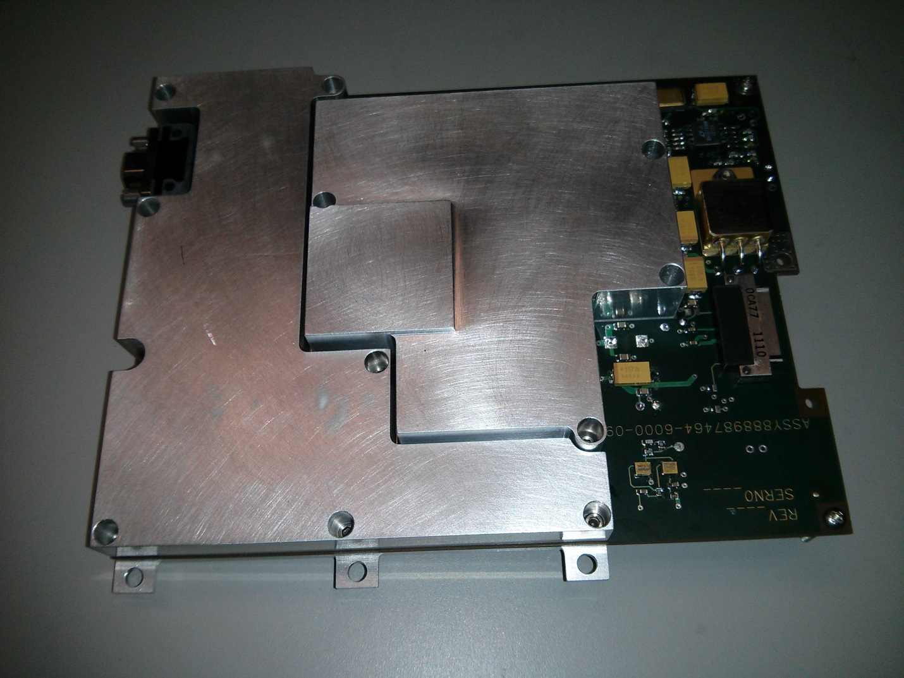
EM with shield

Slide 7
Regulation
31V Input
Voltage | Min | Max | Min Load | Nom Load | Max Load
+1.53 | +1.51 | +1.55 | 1.531 | 1.522 | 1.514
+1.82 | +1.8 | +1.84 | 1.815 | 1.81 | 1.81
+3.41 | +3.37 | +3.45 | 3.414 | 3.41 | 3.407
+6 | 5.8 | +6.2 | 6.2 | 5.98 | 5.97
+12 | +11.52 | +12.48 | 11.93 | 12.02 | 11.68
-6 | -6.2 | -5.8 | -5.98 | -6 | -6
Pri Current |  |  | 58mA/295mV | 144mA/728mV | 233mA/1.143V
Cross Regulation
Voltage | Min | Max | +1.53 Max | +1.82 Max | +3.41 max | +6 Max | +12 Max | -6 Max
+1.53 | +1.51 | +1.55 | 1.514 | 1.53 | 1.53 | 1.53 | 1.53 | 1.53
+1.82 | +1.8 | +1.84 | 1.815 | 1.81 | 1.81 | 1.815 | 1.815 | 1.815
+3.41 | +3.37 | +3.45 | 3.414 | 3.414 | 3.407 | 3.414 | 3.414 | 3.414
+6 | 5.8 | +6.2 | 6.19 | 6.18 | 6.19 | 5.85 | 6.2 | 6.19
+12 | +11.52 | +12.48 | 11.92 | 11.94 | 11.98 | 13.47 | 11.685 | 11.92
-6 | -6.2 | -5.8 | -5.91 | -5.93 | -5.84 | -6.07 | -6.11 | -5.9

Slide 8
Efficiency
Current efficiency at Nom load is > 75%.

Slide 9
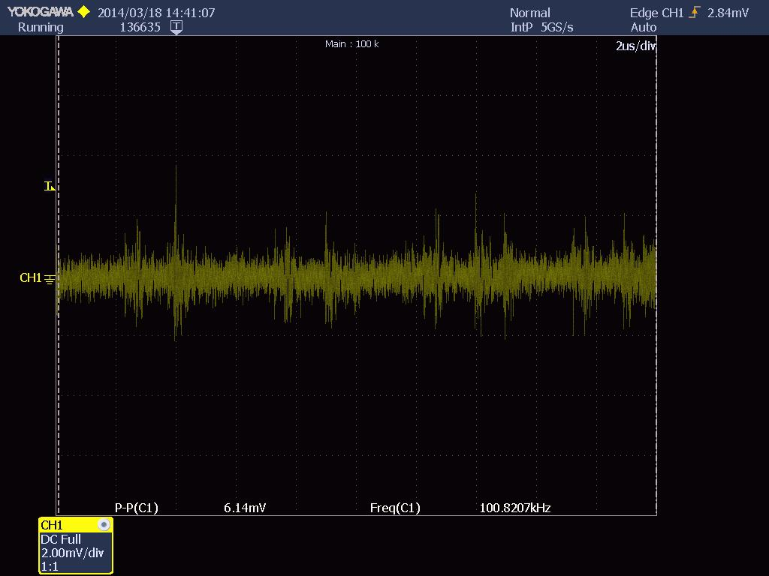
Output Ripple
Ripple is low but turn on spike is high.
Additional ceramic caps and common mode filter are placed on EM board.

Slide 10
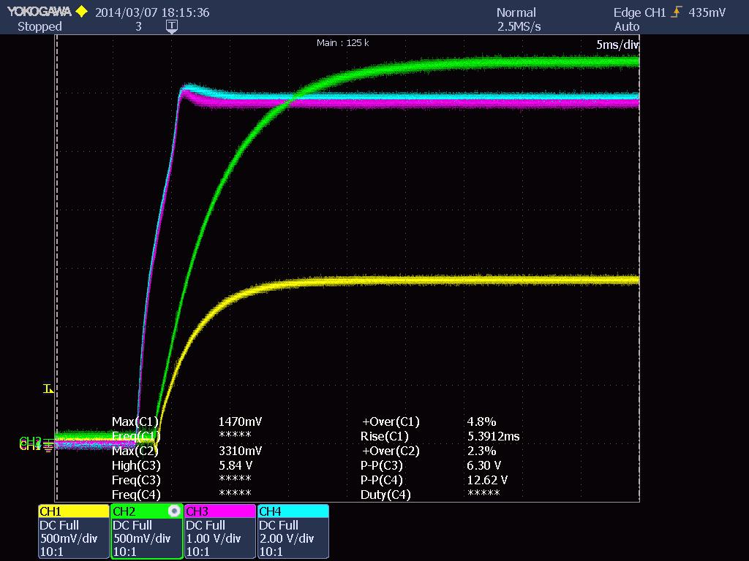
Turn on

Slide 11
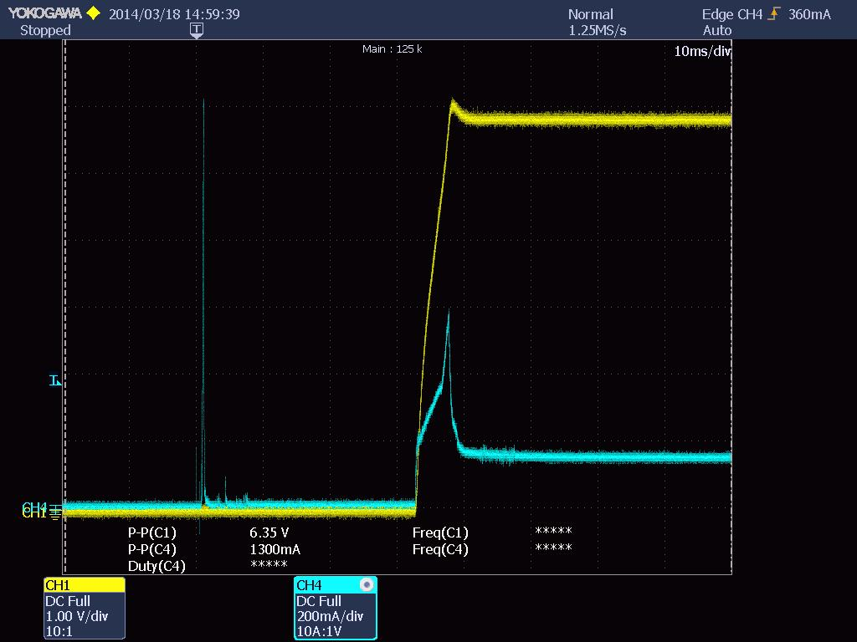
Inrush Current

Slide 12
Design Status
Final Part placement EPI LVPS is in progress.
Routing EPI-Hi LVPS starting next week
EM delivered and integrated with EPI-Hi instrument

