Slide 1
7464-0000 EPI-Lo EDR Structural Analysis
Shaughn London
Packaging Engineer
2014/10/31

Slide 2
Executive Summary
SPP EPI-Lo instrument analyzed
Created from EPI-Lo CAD model as of 8/14/2014
New wedge closeout cover design added to model (10/14/2014)
Instrument mass modeled as 3.26 kg (7.19 lbm)
Structural model analyzed based on 7434-9039 SPP EDTRD Rev B
Modal frequencies of assembly, Section 4.4.7.1
Quasi-static design limit load, Section 4.4.2.1
Random vibration analysis, Section 4.4.3, NOT done at this time, results dependent on SwRI bracket design
Structural analysis results summary
All metallic and composite subassemblies have positive margins of safety under Quasi-static loading
This presentation is a preliminary analysis of the baseline EPI-Lo instrument design, complete analysis will be performed pre-CDR

Slide 3
Background and Methodology
Instrument level structural model created using CAD Model from Designer
CAD model of instrument dated 8/14/2014
Wedge assembly updated to latest CAD design as of 10/14/2014
Environmental Structural Requirements (Section 4.4)
7434-9039 Rev B, SPP Environmental Design and Test Requirements Document
Subsystem to have min frequency > 80 Hz
Quasi-static load factor: 32g (Figure 4-11)
Factors of safety: Table 4-5. Unpressurized Factors of Safety
Random vibration: not done at this time frame due to dependence on SwRI bracket
Interested in assembly response
Fundamental frequencies and Interaction of board and chassis
Chassis response to MAC quasi-static load
Chassis & PWA dynamic response to random vibration input from 0-2,000 Hz, will be done fore CDR
FEA software
Pre/Post-processing: Femap V.11
Solver (static, modal, sine, random: ASD): MSC.Nastran V.2008
Solver (random: rms/peak): MAYA Structural Analysis Toolkit Pro V5.0.1

Slide 4
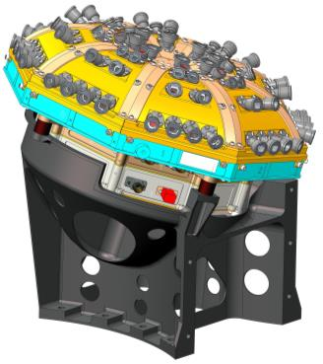
EPI-Lo Overview
EPI-Lo Instrument mounts to SwRI bracket at four mounting posts on Event PWA chassis, offset by four G-10 spacers (for thermal isolation)
EPI-Lo mounting interface NOT parallel to S/C deck, mounting face tilted and rotated about all three axes
SwRI bracket mounts to S/C deck, mounting interface parallel to S/C panel
SwRI Bracket
S/C Interface

Slide 5
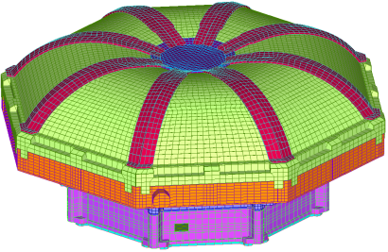
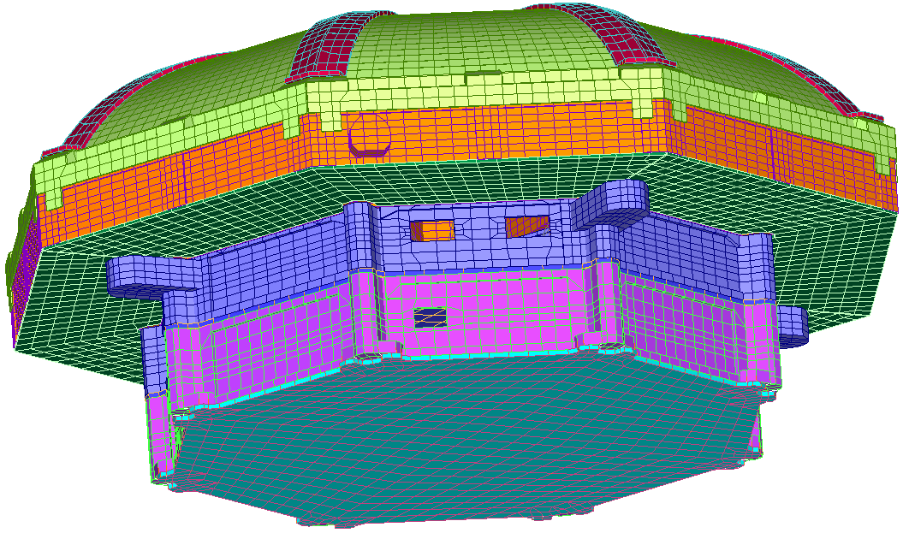
Finite Element Model Overview Instrument Level
Modeling Strategy
Plate elements where applicable: PWAs, frames, covers
Solid elements where necessary: frame bosses, bookbolt bosses, small aspect ratios
PWA: plate elements with EEE part mass smeared over total board area
Rigid elements (RBE2s): bookbolts, mounting hardware, Connectors
Model size: nodes = 88,811, elements = 70,269
Wedges (8x)
Closeout Covers (8x)
Anode Cover (4x)
Event ASSY
LVPS ASSY
Spider ASSY
LVPS Cover

Slide 6
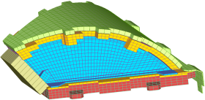
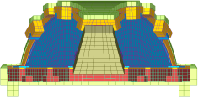
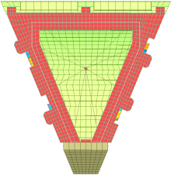
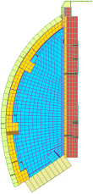
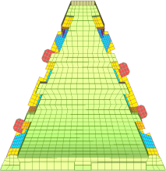
Finite Element Model Overview Wedge Assembly
EPI-Lo has 8 identical wedges
Top cover: plate elements, Al-6061 & collimator mass smear
Wedge Frame Insulator: plate and solid elements, Ultem1000
Side cover: beam and solid elements, Al-6061
MCP Cover: plate elements, SS 304
MCP: mass element & RBE3 to MCP cover and baseplate
MCP Baseplate: plate and solid elements, Ultem1000
SSD Assembly: plate elements, Ultem1000
Wedge assembly connected using RBE2s at all bolted interfaces
Wedge Frame Insulator
Top Cover
Anode ASSY
Side Cover
MCP Cover
MCP Baseplate
Front View
MCP
Bottom View
Side View
Top View

Slide 7
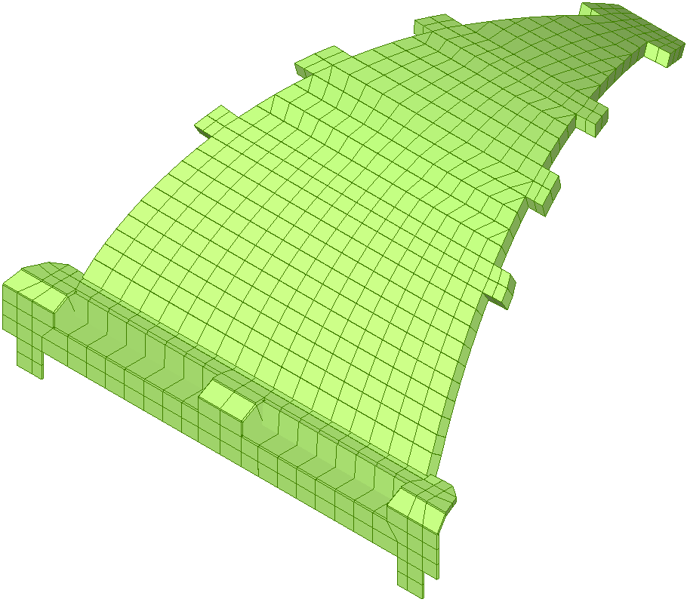
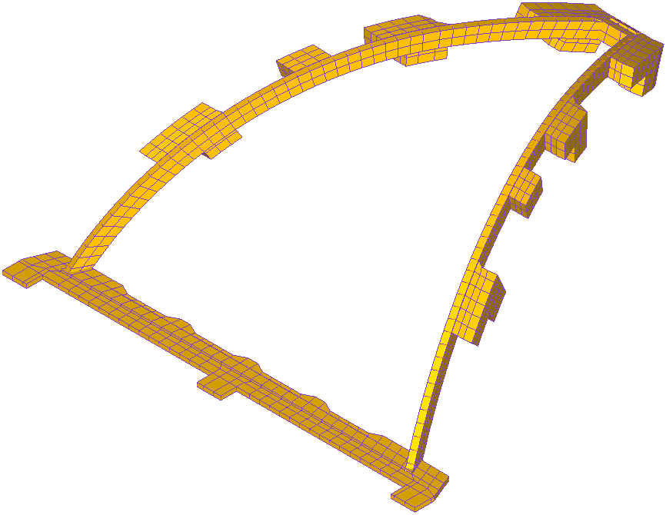
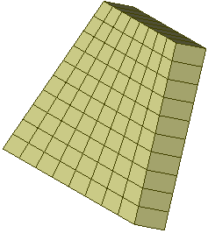
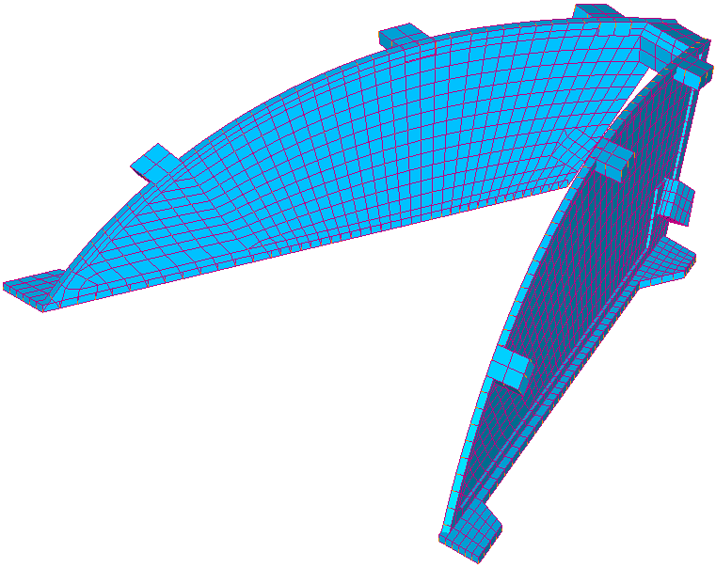
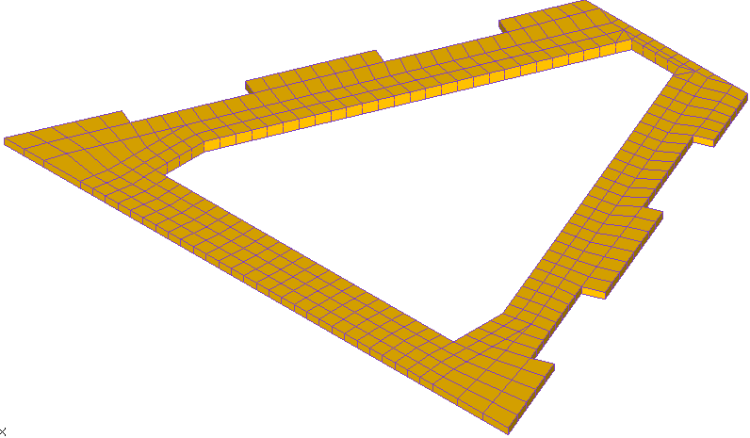
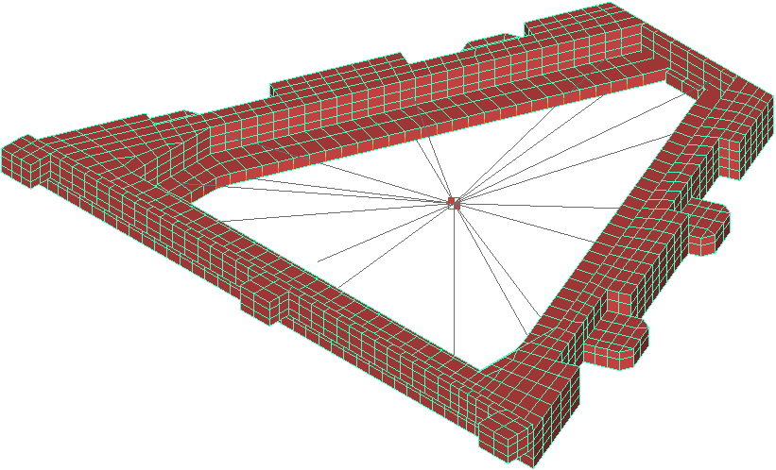
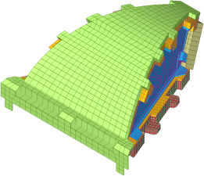
Finite Element Model Overview Wedge Assembly Exploded View

Slide 8
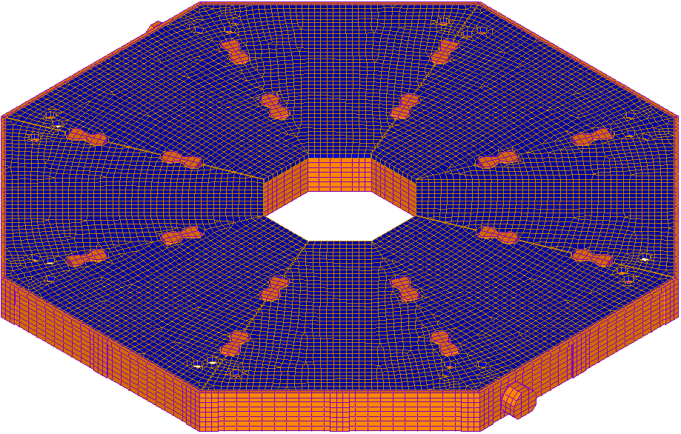
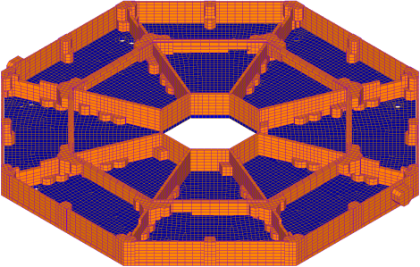
Finite Element Model Overview Spider & Anode PWAs
Spider frame modeled in detail using plate and solid elements with Al 6061 material properties
Anode PWAs (4x) modeled using plate elements and PWA material properties with estimated board mass smeared across PWA
PWAs connected to Spider frame at mounting hardware bosses using RBE2 elements
Top Side
Back Side
Anode PWA (4x)

Slide 9
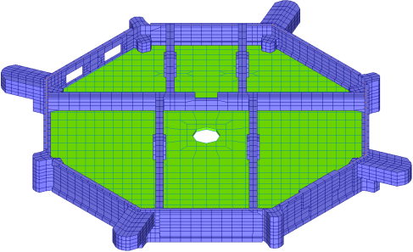
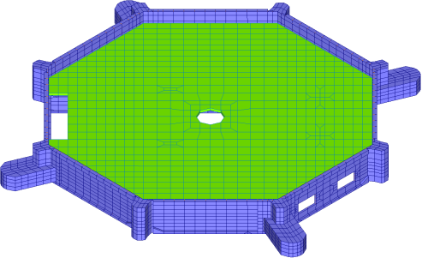
Finite Element Model Overview Event Slice Assembly
Event housing: plate and solid elements, Al 6061 material properties
Event housing thickness .040” at minimum, thicker at bosses
Event PWA: plate elements, PWA material properties and EEE part mass smeared across board
PWA: diameter = 7.5”, thickness = 0.093”
Right-angle MDM connectors modeled with RBE2s from frame to board
PWA connected to housing with RBE2s at mounting bosses
Back Side
Top Side
MDM Connectors

Slide 10
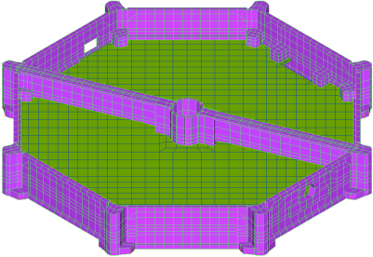
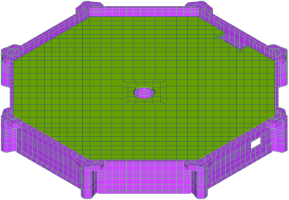
Finite Element Model Overview LVPS Slice Assembly
LVPS housing: plate and solid elements, Al 6061 material properties
LVPS housing thickness .040” at minimum, thicker at bosses
LVPS PWA: plate elements, PWA material properties and EEE part mass smeared across board
PWA: diameter = 7.5”, thickness = 0.093”
Right-angle MDM connector modeled with RBE2 from frame to board
PWA connected to housing with RBE2s at mounting bosses
Top Side
Back Side
MDM Connector

Slide 11
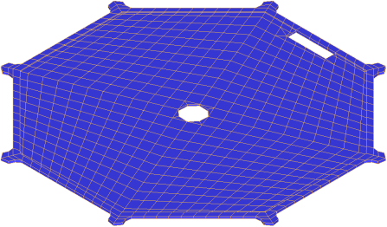
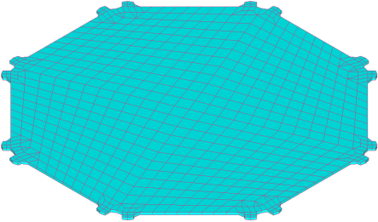
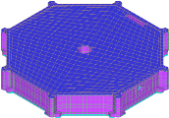
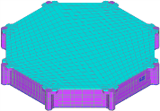
Finite Element Model Overview LVPS Covers
EMI & Bottom cover: plate elements, Al 6061 material properties
EMI cover design is 0.042” thick sheet with center attachment to LVPS frame
Bottom cover design is 0.062” thick sheet, rib stiffener pattern not included in this analysis iteration (will be for CDR)
EMI Cover
Bottom Cover
EMI Cover
Bottom Cover

Slide 12
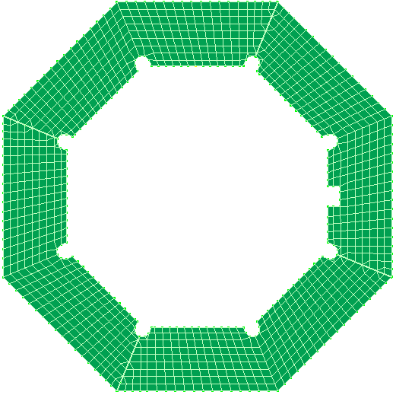
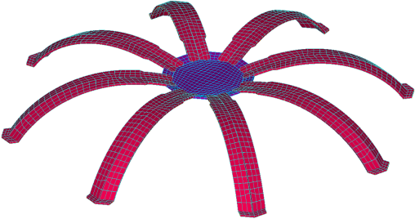
Finite Element Model Overview Wedge & Spider Closeout Covers
Wedge & Spider closeout covers: plate elements, Al 6061 material properties
Wedge closeout covers
Spoke covers (8x) modeled as .060” thick
Spoke center cover modeled as .055” thick
Connected to wedges and spider with RBE2 elements
Spider closeout covers
Modeled as 0.040” thick
Connected to spider with RBE2 elements
Spoke Center
Spider Cover (4x)
Spokes (8x)

Slide 13
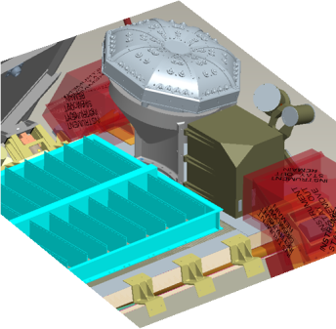
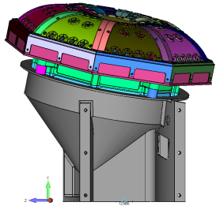
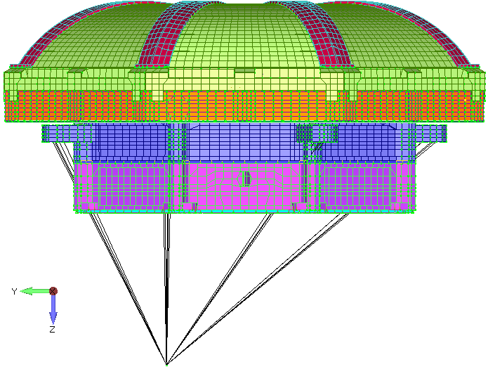
Finite Element Model Overview Boundary Conditions
Environmental loading conditions specified in EDTRD reference the S/C panels
Both in-plane (parallel) and out-of-plane (perpendicular) loading conditions
SwRI mounting bracket attached to S/C panel
EPI-Lo mounting interface on bracket not parallel to S/C panels
Bracket not modeled at this time, will be for CDR
For EDR, EPI-Lo FEM “spidered” (RBE2) to origin node, assume hard-mounted configuration with instrument parallel and perpendicular to S/C C.S.
Y
Z
X
B.C. Node

Slide 14
Mass and Material Properties
Mass breakdown table shown on next slide, reflects CBE (2014/10/07)
FEM mass tailored to match estimated EPI-Lo configuration plus approximately 3% margin for unaccounted for items
FEM board mass approximately 3% greater than CBE PWA mass
Unaccounted for mechanical, staking, conformal coat, etc.
More conservative approach, yields lower PWA frequency and larger displacement
EEE component mass smeared on PWAs, does not take into account local stiffening and mass of large EEE parts on PWA dynamic effects
Not modeled discretely: internal harnesses, bookbolt mass and connector mass
Model material property table shown below
Properties allocated as noted in previous slides
Material | E (Msi) | Yts (ksi) | Uts (ksi) | ρ (lbm/in³) | ν
PWA | 3.5 | N/A | 35 | N/A | 0.30
Al 6061 | 9.9 | 35 | 42 | 0.098 | 0.33
SS 304 | 30.0 | 45 | 80 | 0.289 | 0.29
Ultem 1000 | 0.4 | 16 | 16.5 | 0.046 | 0.30

Slide 15
Item Desc (Sub-ASSY) | Part # | Material | Est. Mass (Ea.) |  | FEM Mass (lb) | Qty (ea) | Est Mass (Total) |  | FEM Mass (total) |  | % Diff.
 |  |  | (lb) | (g) |  |  | (lb) | (g) | (lb) | (g)
Sensor Head ASSY | 7464-1000 |  | 0.377 | 184.7 | 0.390 | 8 | 3.018 | 1370.4 | 3.117 | 1415.0 | 3%
Wedge Top Cover | 7464-1206 | Al 6061 | 0.103 | 46.8 | 0.139 | 8 | 0.825 | 374.7 | 1.115 | 506.3 | 35%
Collimators (per wedge) |  | Al 6061 | 0.020 | 9.3 |  | 8 | 0.164 | 74.3
Wedge Frame Insulator | 7464-1202 | Ultem 1000 | 0.012 | 5.5 | 0.014 | 8 | 0.098 | 44.4 | 0.110 | 50.1 | 13%
Wedge Side Cover (L) | 7464-1201-09 | Al 6061 | 0.018 | 8.3 | 0.018 | 8 | 0.146 | 66.1 | 0.142 | 64.3 | -3%
Wedge Side Cover (R) | 7464-1201-10 | Al 6061 | 0.017 | 7.7 | 0.017 | 8 | 0.136 | 61.8 | 0.132 | 59.9 | -3%
MCP Housing | 7464-1101 | Ultem 1000 | 0.037 | 17.0 | 0.043 | 8 | 0.299 | 135.7 | 0.346 | 156.9 | 16%
MCP (2x) | 7464-1110 |  | 0.050 | 22.7 | 0.050 | 8 | 0.400 | 181.8 | 0.400 | 181.6 | 0%
MCP Cover | 7464-1105 | SS - 304 | 0.071 | 32.4 | 0.075 | 8 | 0.570 | 258.8 | 0.600 | 272.2 | 5%
SSD Assembly | 7464-1300 |  | 0.030 | 13.4 | 0.034 | 8 | 0.237 | 107.5 | 0.272 | 123.7 | 15%
SSD Housing | 7464-1303 | Ultem 1000 | 0.005 | 2.5 |  | 8 | N/A | N/A | N/A | N/A
SSD Cover | 7464-1203 | SS - 304 | 0.014 | 6.4 |  | 8 | N/A | N/A | N/A | N/A
SDD PWB | 7464-1354 | PWB | 0.003 | 1.4 |  | 8 | N/A | N/A | N/A | N/A
Connectors (SSD) | N/A |  | 0.007 | 3.2 |  | 8 | N/A | N/A | N/A | N/A
Wedge Hardware + Misc. | N/A |  | 0.018 | 8.2
Anode PWB | 7464-5302 | PWB | 0.176 | 79.8 | 0.182 | 4 | 0.703 | 319.2 | 0.726 | 329.8 | 3%
Spider Frame | 7464-0100 | Al 6061 | 0.704 | 319.5 | 0.724 | 1 | 0.704 | 319.5 | 0.724 | 328.7 | 3%
Spider Cover | 7464-0102-01 | Al 6061 | 0.049 | 22.4 | 0.050 | 3 | 0.148 | 67.3 | 0.149 | 67.6 | 0%
Spider Cover | 7464-0102-03 | Al 6061 | 0.050 | 22.8 | 0.050 | 1 | 0.050 | 22.8 | 0.050 | 22.9 | 0%
Event PWA Housing | 7464-4005 | Al 6061 | 0.346 | 156.9 | 0.370 | 1 | 0.346 | 156.9 | 0.370 | 168.1 | 7%
Event PWA | 7464-4004 | PWB | 0.540 | 245.2 | 0.555 | 1 | 0.540 | 245.2 | 0.555 | 251.7 | 3%
LVPS PWA Housing | 7464-3005 | Al 6061 | 0.291 | 132.1 | 0.334 | 1 | 0.291 | 132.1 | 0.334 | 151.5 | 15%
LVPS PWA | 7464-3004 | PWB | 0.496 | 225.2 | 0.513 | 1 | 0.496 | 225.2 | 0.513 | 232.8 | 3%
Bottom Closeout Cover | 7464-0101 | Al 6061 | 0.272 | 123.6 | 0.266 | 1 | 0.272 | 123.6 | 0.266 | 120.7 | -2%
EMI Cover | 7464-0104 | Al 6061 | 0.202 | 91.5 | 0.185 | 1 | 0.202 | 91.5 | 0.185 | 84.2 | -8%
Harness Cover | 7464-0108 | Al 6061 | 0.010 | 4.4 |  | 1 | 0.010 | 4.4
closeout Cover (Spoke) | 7464-0021 | Al 6061 | 0.022 | 10.1 | 0.022 | 8 | 0.178 | 80.8 | 0.174 | 78.8 | -2%
closeout Cover (Hub) | 7464-0022 | Al 6061 | 0.027 | 12.0 | 0.028 | 1 | 0.027 | 12.0 | 0.028 | 12.7 | 5%
Ti Bookbolts |  | Ti | 0.010 | 4.4 |  | 4 | 0.039 | 17.8
Misc Hardware |  |  | 0.001 | 0.4 |  | 32 | 0.025 | 11.5
 |  |  | Instrument Totals |  |  |  | 7.048 | 3,200 | 7.191 | 3,265 | 3%

Slide 16
Model Checkout and Modal Analysis
Model checkouts were performed
1g check, ensures model grounded and force sum matches model mass
Grid point singularity table check for proper autospc
Modal free check for rigid body motion, modes 1-6 & mass participation = 100%
Modal analysis of flight config. performed to find fundamental frequencies of system
Instrument oriented in hard-mounted configuration
EDTRD: instrument min freq must be greaten than 80 Hz
Desire min PWA freq > 150 Hz
Try to avoid modal coupling of subassemblies & chassis
Causes large displacements/stresses
Ideally design for octave rule (2x) separation of PWAs and chassis
Modal summary results on next slide
Event PWA mode #1 = 388 Hz (out-of-plane)
LVPS PWA mode #1= 406 Hz (out-of-plane)
First Instrument mode at 502 Hz (out-of-plane, and rotation about base)
PWA & instrument freqs. well separated in directional responses

Slide 17
Modal Analysis Results Summary Modal Effective Mass Fraction
Desc. | Mode# | Freq (Hz) | Tx | Ty | Tz | Rx | Ry | Rz
Bottom Cover, Mode #1 | 1 | 321.6 | 0.0% | 0.0% | 3.6% | 1.7% | 0.0% | 0.0%
Event PWA, Mode #1 | 2 | 388.5 | 0.0% | 0.1% | 12.4% | 4.3% | 0.1% | 0.0%
LVPS PWA, Mode #1 | 3 | 406.6 | 0.0% | 0.0% | 5.3% | 4.4% | 0.0% | 0.0%
LVPS PWA, Mode #2 | 4 | 441.3 | 0.0% | 0.3% | 2.3% | 0.1% | 0.2% | 0.0%
Event PWA, Mode #2 | 5 | 482.5 | 2.7% | 3.9% | 0.0% | 8.6% | 16.0% | 0.9%
LVPS PWA, Mode #3 | 6 | 491.6 | 4.0% | 1.3% | 0.1% | 3.3% | 15.3% | 2.3%
Instrument, Mode #1 | 7 | 502.1 | 6.9% | 15.5% | 0.5% | 18.1% | 18.9% | 4.4%
Instrument, Mode #2 | 8 | 507.8 | 11.6% | 7.5% | 3.5% | 1.5% | 26.0% | 5.0%
Event PWA, Mode #3 | 9 | 528.6 | 4.4% | 0.0% | 5.7% | 5.0% | 7.9% | 1.9%
Instrument, Mode #3 | 10 | 559.9 | 0.0% | 1.0% | 43.6% | 32.4% | 1.5% | 0.1%
EMI Cover, Mode #1 | 15 | 664.2 | 0.0% | 0.0% | 0.3% | 0.2% | 0.0% | 0.0%
Anode PWAs, Mode#1 | 70 | 1,147.0 | 0.0% | 0.0% | 4.9% | 2.7% | 0.1% | 0.0%
Anode Cover, Mode#1 | 98 | 1,402.2 | 0.1% | 0.6% | 0.0% | 0.0% | 0.0% | 0.2%
Sum Total | 244 | 2,000 | 86% | 90% | 87% | 89% | 86% | 89%
*Ti = translation in i-direction, Ri = rotation about i-axis

Slide 18
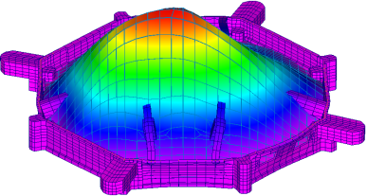
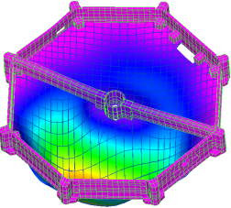
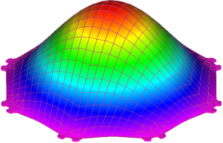
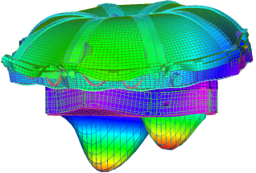
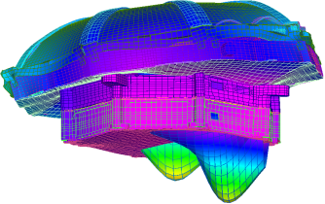
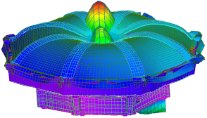
Mode Shapes for Various Components
Mode #1, 321 Hz, Bottom Cover
Mode #2, 389 Hz, Event PWA
Mode #3, 407 Hz, LVPS PWA
Mode #7, 502 Hz, Instrument
Mode #8, 508 Hz, Instrument
Mode #10, 560 Hz, Instrument

Slide 19
Quasi-Static Analysis von Mises Stress
Model analyzed for von Mises stress under quasi-static loading
Model simulated in hard-mounted condition, bracket not included
Interested mainly in chassis and PWA stress
Fastener analysis not done at this time
Factors of safety (FoS) taken from 7434-9039 SPP EDTRD rev B, table 4-5.
Metallic structures: FoSu = 1.4, FoSy = 1.25
Composite (PWA + Ultem1000): FoSu = 1.5, FoSy = N/A
Margins of safety (MoS) calculations performed,
MoS formula ->
MoS table on the following slide
All margin of safety results are positive under 32g quasi-static load in hard-mounted condition

Slide 20
Quasi-Static Analysis MoS Table
Description | Strength (ksi) |  | Factor of Safety |  | Margin of Safety (Yield) |  |  | Margin of Safety (Ult)
 | Yield | Ultimate | Yield | Ultimate | Z-Axis | X-Axis | Y-Axis | Z-Axis | X-Axis | Y-Axis
Wedge Top Cover | 35 | 42 | 1.25 | 1.4 | 15.08 | 12.34 | 12.54 | 16.65 | 13.63 | 13.85
Wedge Frame Insulator | N/A | 16.5 | N/A | 1.5 | N/A | N/A | N/A | 47.25 | 66.48 | 67.75
Wedge Side Cover | 35 | 42 | 1.25 | 1.4 | 12.27 | 10.94 | 11.10 | 13.56 | 12.10 | 12.28
MCP Housing | N/A | 16.5 | N/A | 1.5 | N/A | N/A | N/A | 3.45 | 8.17 | 4.26
MCP Cover | 31 | 71 | 1.25 | 1.4 | 10.46 | 15.74 | 15.86 | 17.63 | 26.21 | 26.41
SSD Assembly | N/A | 16.5 | N/A | 1.5 | N/A | N/A | N/A | 353.84 | 353.84 | 477.26
Anode PWB | N/A | 35 | N/A | 1.5 | N/A | N/A | N/A | 66.63 | 61.39 | 62.58
Spider Frame | 35 | 42 | 1.25 | 1.4 | 7.90 | 8.94 | 9.72 | 8.77 | 9.91 | 10.76
Spider Cover | N/A | 16.5 | N/A | 1.5 | 43.75 | 35.26 | 35.07 | 48.10 | 38.79 | 38.58
Event PWA Housing | 35 | 42 | 1.25 | 1.4 | 3.99 | 6.77 | 6.93 | 4.48 | 7.53 | 7.70
Event PWA | N/A | 35 | N/A | 1.5 | N/A | N/A | N/A | 27.08 | 51.79 | 55.22
LVPS PWA Housing | 35 | 42 | 1.25 | 1.4 | 17.56 | 45.58 | 32.80 | 19.37 | 50.11 | 36.08
LVPS PWA | N/A | 35 | N/A | 1.5 | N/A | N/A | N/A | 26.61 | 310.11 | 249.90
LVPS PWA Housing Cover | 35 | 42 | 1.25 | 1.4 | 16.63 | 104.17 | 92.64 | 18.34 | 114.38 | 101.74
EMI Cover | 35 | 42 | 2.53 | 2.68 | 20.79 | 46.89 | 41.79 | 22.90 | 51.54 | 45.95
closeout Cover (Spoke) | 35 | 42 | 1.25 | 1.4 | 44.05 | 63.64 | 65.69 | 48.42 | 69.92 | 72.17

Slide 21
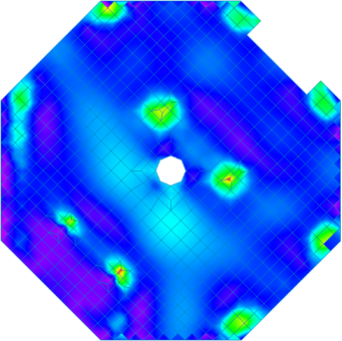
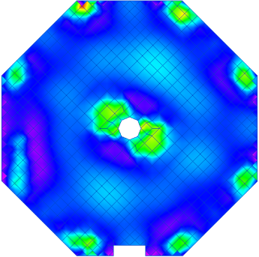
Quasi-Static Analysis PWA von Mises Stress
PWA von Mises results for the Event and LVPS assemblies: highest stress under out-of-plane loading (Z-axis)
Occur at PWA/housing mounting locations
Event PWA MoSu: 27 (Z-axis), 52 (X-axis), 55 (Y-axis)
LVPS PWA MoSu: 27 (Z-axis), 310 (X-axis), 250 (Y-axis)
psi
psi
Event PWA (Out-of-Plane Loading)
LVPS PWA (Out-of-Plane Loading)

Slide 22
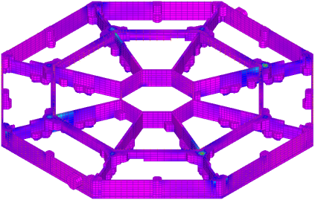
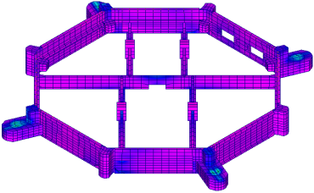
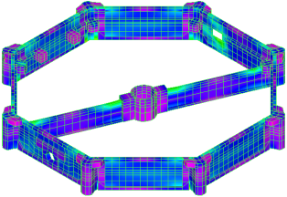
Quasi-Static Analysis Frame von Mises Stress
Spider Frame
psi
Event Frame
psi
Frame results for the Spider, Event and LVPS assemblies: highest stress under out-of-plane loading (Z-axis)
Spider Frame MoS (min): 7.9 (Z-axis), 8.9 (X-axis), 9.7 (Y-axis)
Event Frame MoS (min): 4.0 (Z-axis), 6.8 (X-axis), 6.9 (Y-axis)
LVPS Frame MoS (min): 17 (Z-axis), 45 (X-axis), 32 (Y-axis)
LVPS Frame
psi

Slide 23
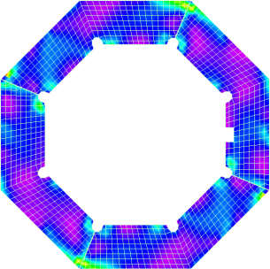
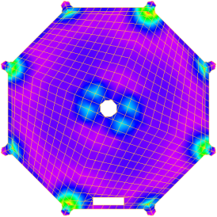
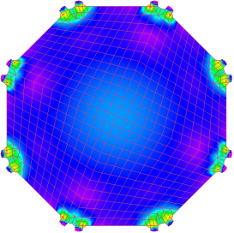
Quasi-Static Analysis Cover von Mises Stress
Spider Covers
psi
EMI Cover
psi
Highest stress results for the Spider cover (Y-axis), EMI cover and bottom cover (Z-axis)
Spider Cover MoS (min): 43 (Z-axis), 35 (X-axis), 35 (Y-axis)
EMI Cover MoS (min): 20 (Z-axis), 46 (X-axis), 41 (Y-axis)
Bottom Cover MoS (min): 16 (Z-axis), 104 (X-axis), 92 (Y-axis)
Bottom Cover
psi

Slide 24
Summary
Quasi-static and Modal analyses performed for the stand-alone EPI-Lo Instrument
MSC.Nastran and Femap used for analysis
Model simplified wherever possible to aid solution time
PWAs modeled as plate elements with uniform stiffness, thickness and density
Instrument analyzed as hard-mounted, SwRI bracket configuration not included
Passed all model checks; Modal free analysis and 1g static loads in all 3 directions
Modal analysis performed, 1st mode = 321 Hz (bottom cover), Instrument mode #1 = 502 Hz
Analysis environmental input levels per 7434-9039 SPP EDTRD Rev B
Analysis performed for all three orthogonal axes relative to instrument coordinate system
Quasi-static analysis per MAC
Random vibration analysis to be performed for CDR
All margin of safety positive for 32 g quasi-static loading

