Slide 1
EPI-Lo
Thermal
Shawn Begley
JHU APL

Slide 2
Overview
Instrument placement
Requirements
Instrument design (thermal perspective)
Analysis environments
Bounding cases
Instrument results
Important little details
Thermal testing

Slide 3
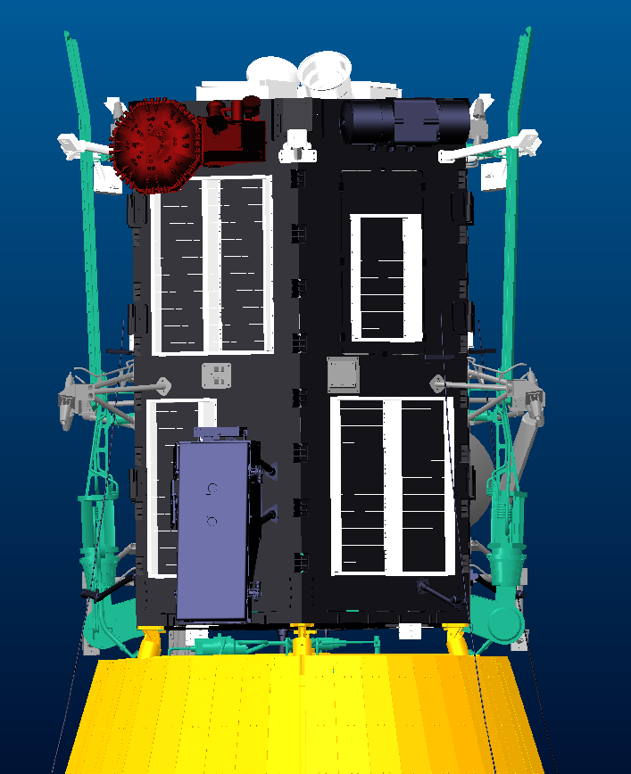
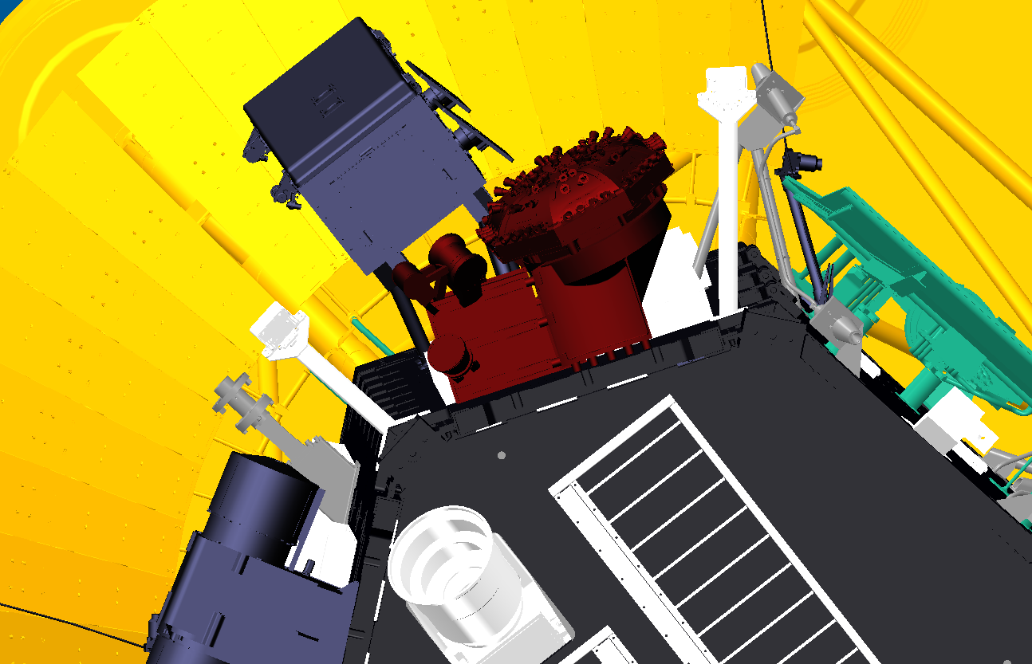

EPI-Lo Exposed to Space
EPI-Lo is part of the two instrument ISIS suite.
EPI-Lo and EPI-Hi reside on the same bracket.
Panel 2 on ram side of S/C.

Slide 4
Requirement
EDTRD 7434-9039 Rev B
SPP Contamination Control Plan 7434-9011
SPP Parts Control Plan 7434-9001
ISIS to Spacecraft ICD 7434-9058
M/T ICD 16105 1001
IRD 16105-ISIS-IRD-01

Slide 5
EDTRD
Boundary Temperatures
  S/C deck between 0 and 45° for all cases.
Limits on heat loads to the spacecraft
  ISIS must take less than 2.9W from the S/C in cold case (0°C Deck).
  ISIS must give less than 0.0W to the S/C in the hot case(45°C Deck).
Heaters
  75% duty cycle at 26V; 35V maximum.
Mission phases from launch to closest approach
  2 hours of sun at any angle possible at launch.
  Ram side will not see the sun after SWEAP transient slew in commissioning (>0.935 AU).

Slide 6
APL Testing Standard
Design and test temperature limits for S/C mounted components
Non-operational survival test limit
Operational Testing &
Flight allowable limit
Operational Testing &
Flight allowable limit
Non-operational survival test limit
Operational prediction
Operational prediction
5°C*
10°C
Analytical & design margin
10°C
Analytical & design margin
5°C*
*The 5°C limit is defined for the electronics boxes, for S/C mounted instruments, the value will be updated for each instrument; as the survival limit must be minimized to evaluate actual failure mechanisms.

Slide 7
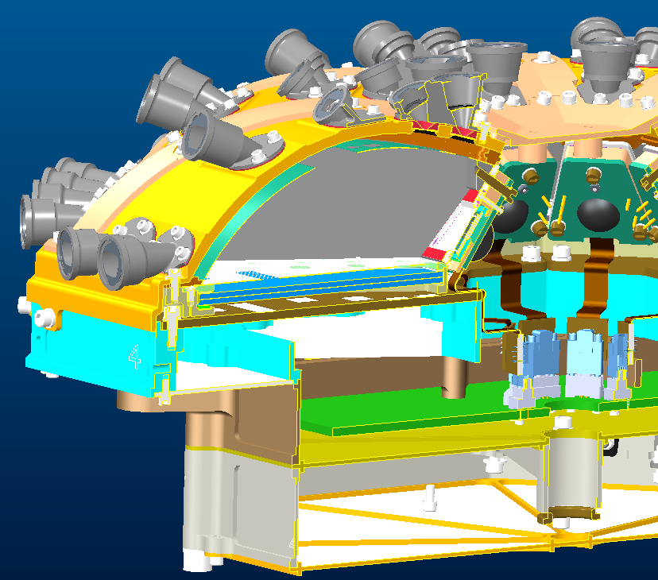
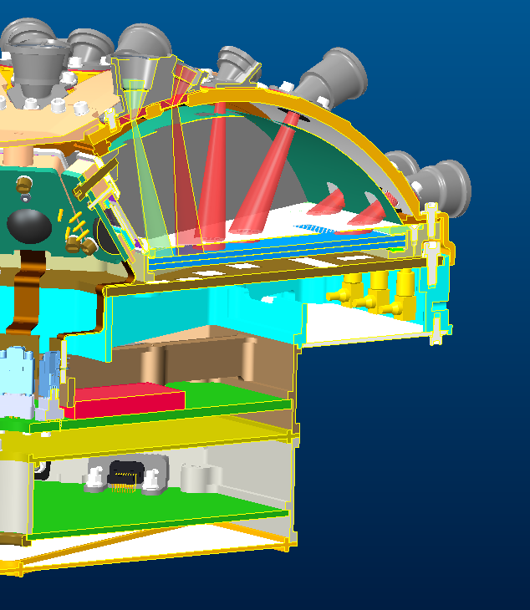
EPI-Lo has Single Thermal Zone
Aluminum exterior from middle to bottom cover
< 3.14 C/W thermal path from top to bottom
6°C exterior gradient shown in models
0.19W
0.85W
1.1W
1.8W

Slide 8
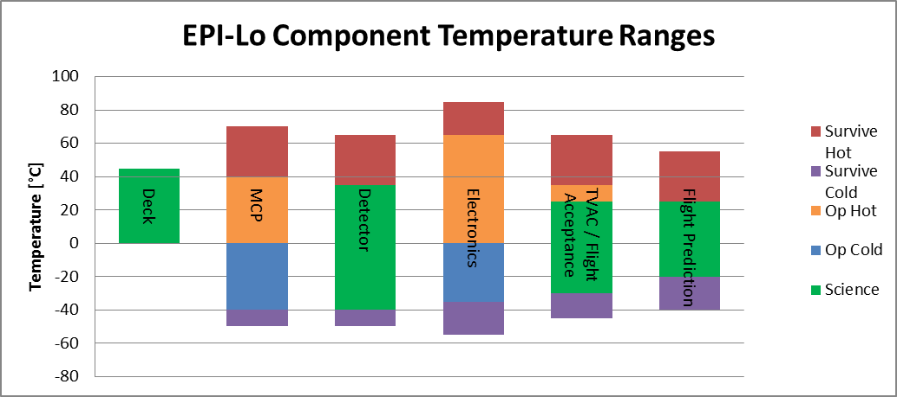
Detectors Drive Science Range
The SSD (solid state detector) system has lower noise at lower temperatures, resulting in reducing the energy at which the instrument can differentiate He3/He4
Standard low temperature limits on electronics sets minimum instrument temperature
Electronics warmed to -35C before turning on to
MCP considered thermally robust
  CTE mismatch and temperature swings are addressed in design
Component Limits Full Instrument

Slide 9
Analysis Environments Obtained from EDTRD
Extreme environments described in EDTRD
Embedded in simplified S/C thermal model
Little variation for EPI-Lo for most mission phases
  Survival
    Cold
    Sun at ~ 1AU in Mission Phases 1-2 ; < 2h
    SWEAP Transient Slew @ >.935 AU < 32 minutes and < 45 degrees from sun
  Operational
    Hot
    Cold
  S/C boundaries determined by bus operational state more than solar distance.

Slide 10
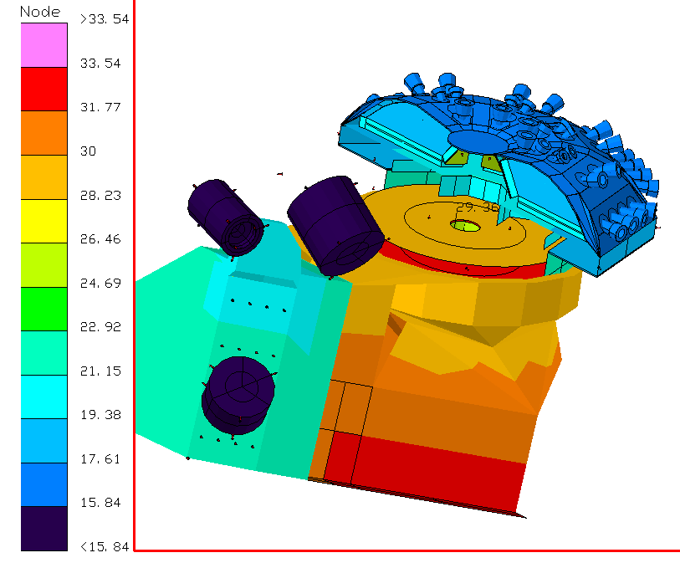
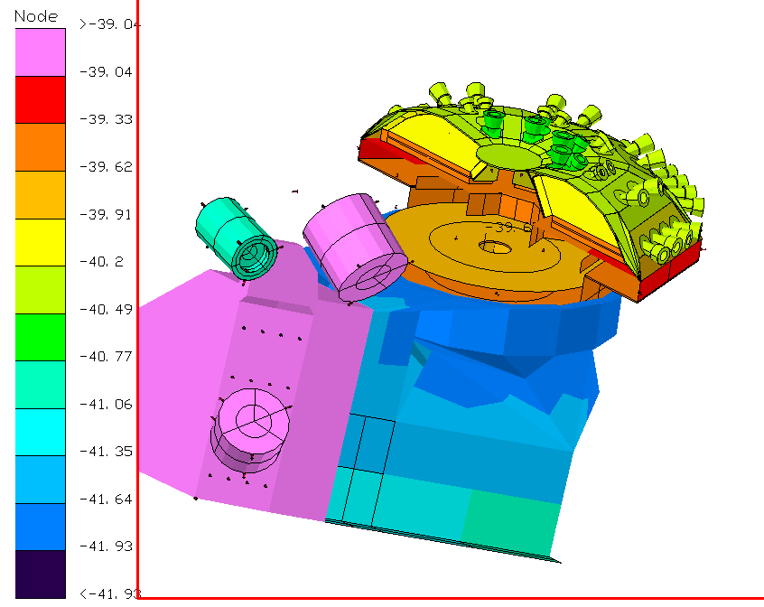
Results Driven by Noise and Available Power
Hot Op detector temperature prediction limited to 25°C prevent noise.
  Temperature set by adjusting radiative area of collimators.
Survival heater set point minimized to reduce power requirement.
  -40°C lower limit chosen as compromise between power reduction and temperature margin from manufacturers limits.
  S/C controlled survival heaters are located on wedge support structure.
Cold Op temperatures are -20 to -30°C
Hot Op
Survival Cold

Slide 11
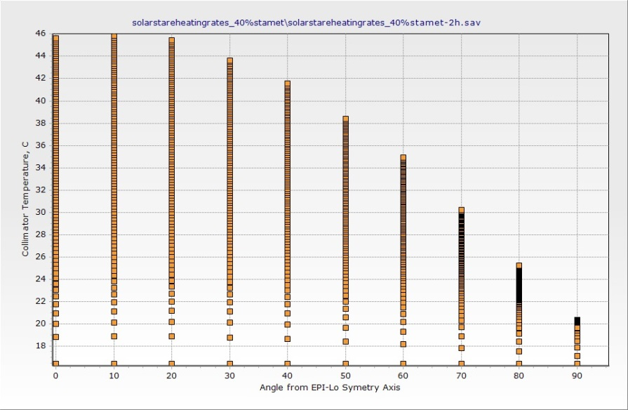
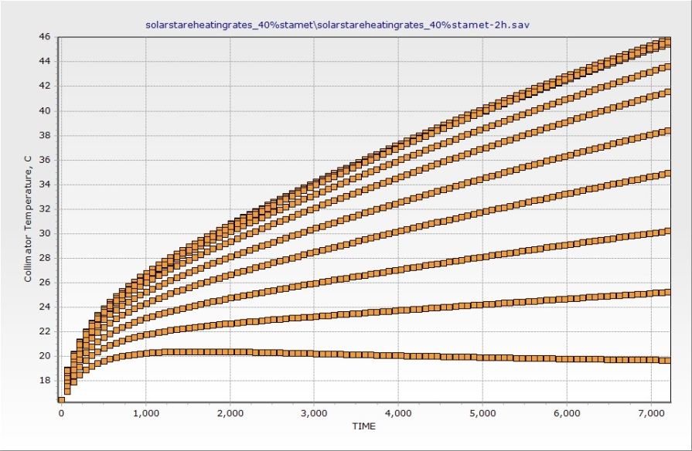
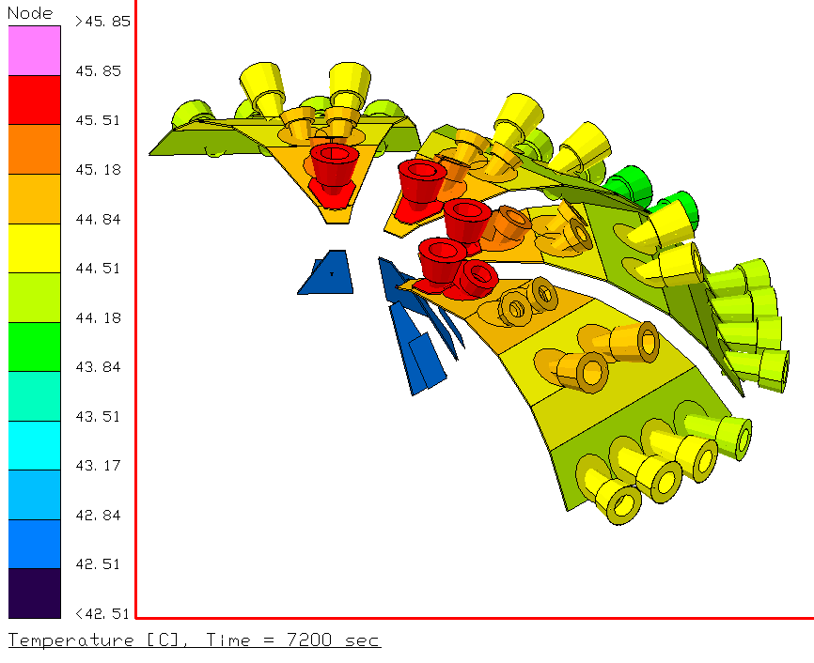
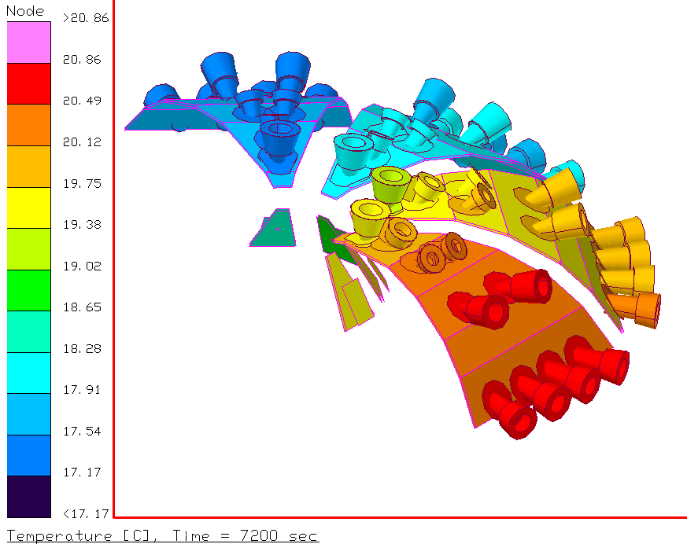
1AU, 2h Solar Stare is Tolerable
Worst case solar exposure occurs in first 2 hours of mission.
Symmetric instrument allows single variable scan for worst case orientation.
Conservative analysis assumes entire 2 hour period is spent with sun in one location
46°C Collimator temperature allows an absorptivity of 0.8 @ 1 AU
10° 90°

Slide 12
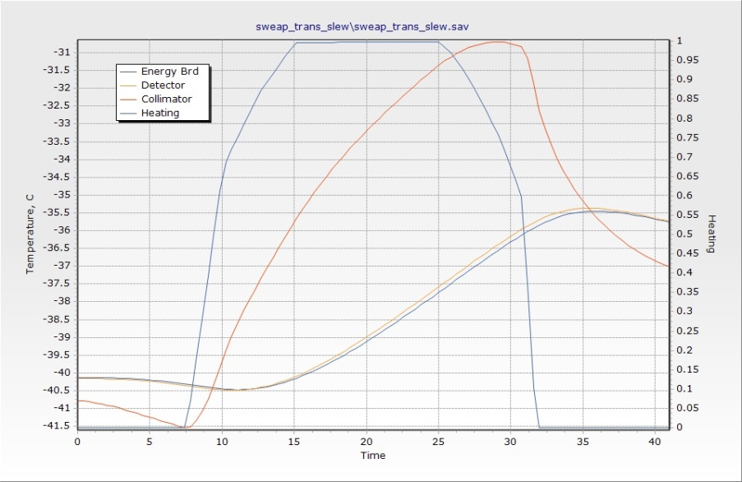
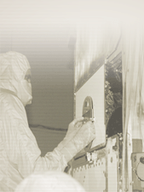
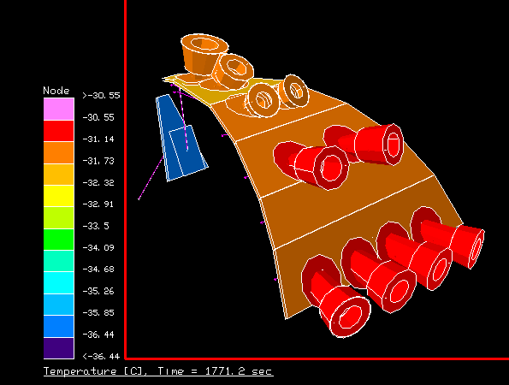
SWEAP Slew is Fast
SWEAP commissioning requires sun on ram instruments at 0.935 AU
Transient profile:
  rotates from +45° to -45° about S/C Y axis in <15 minutes
  Holds -45° for <10 minutes
  Rotates back to 0° in <7.5 minutes
<30 minutes in the sun has minimal affect on instrument
Foils could easily tolerate an absorptivity of 0.5
>0°
-45°
>0°

Slide 13
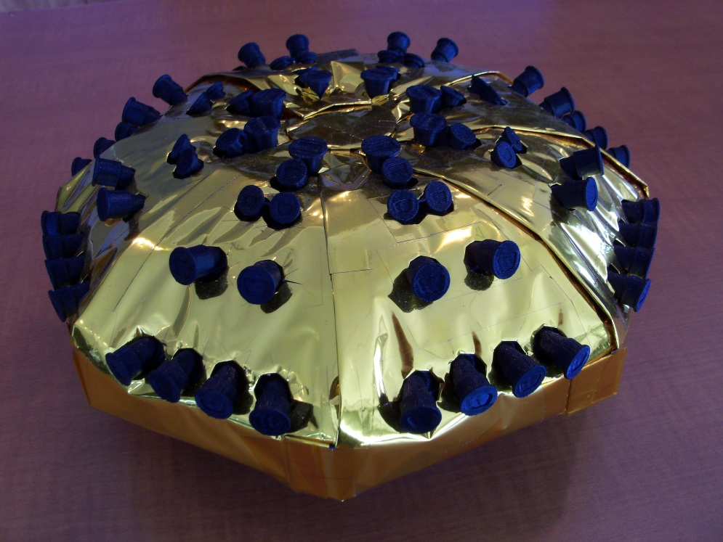
Blanketing concept shown feasible
Complex shape with high number of protrusions
Rapid prototype used for template creation
High temperature blankets without separators used to keep thickness down.
Concept will continue to develop in response to grounding, cover, and GSE needs

Slide 14
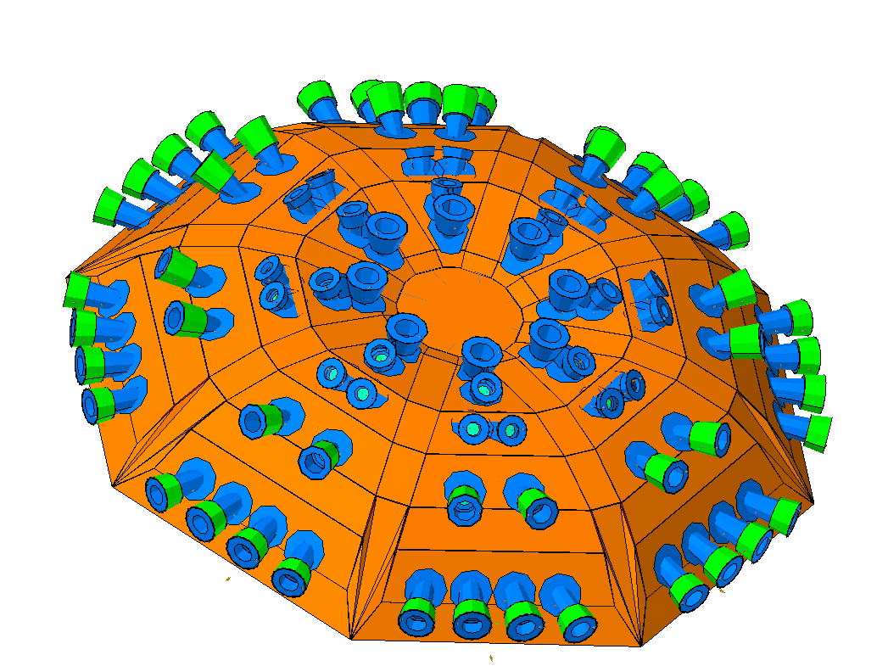
Variety of Surface Finishes Visible on Exterior
StaMet on black Kapton
  Same material as S/C
  Use for blankets and collimator radiators
Gold plated aluminum electronics
Nickel
Foil - carbon, polyimide, Nickel
Alodine aluminum – inside collimators
Ag with MgF₂ protective coating
  Low absorptivity / low emissivity protected silver finish
  ~100-550 nm MgF₂ over ~150 nm Ag

Slide 15
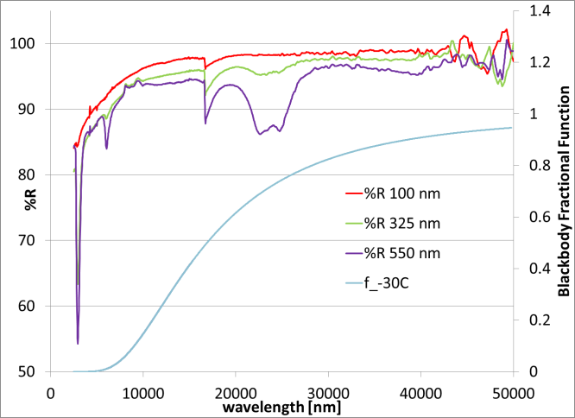
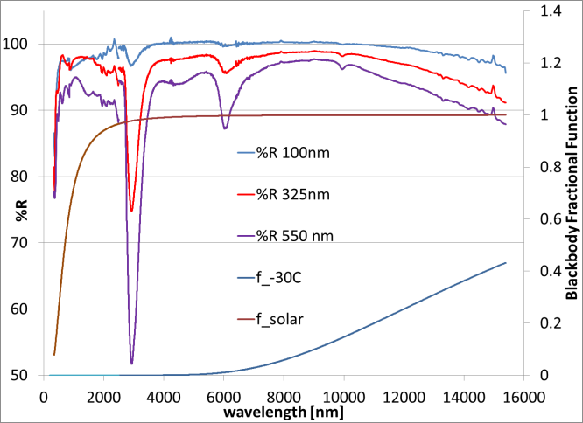
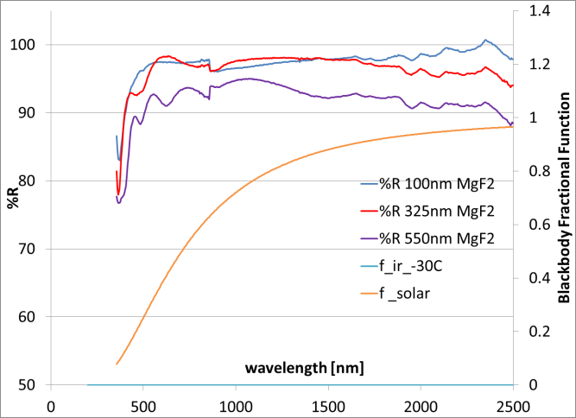
Protected Silver Coating has High Reflectivity
High reflectivity in the UV-Vis band reflects sunlight.
Thin film interference patters observable in the visible band
Measurements made on PerkinElmer Lambda 950 with integrating sphere
IR reflectivity show absorption bands that have little effect on thermal optical properties
Far IR measurements show reflectivity is maintained throughout all wavelengths of relevant thermal radiation
Specular samples required for Perkin Elmer 983 Spectrophotometer
Sample flatness issues reduced above 15 μm
Measurements made on PerkinElmer Spectrum 100 with integrating sphere

Slide 16
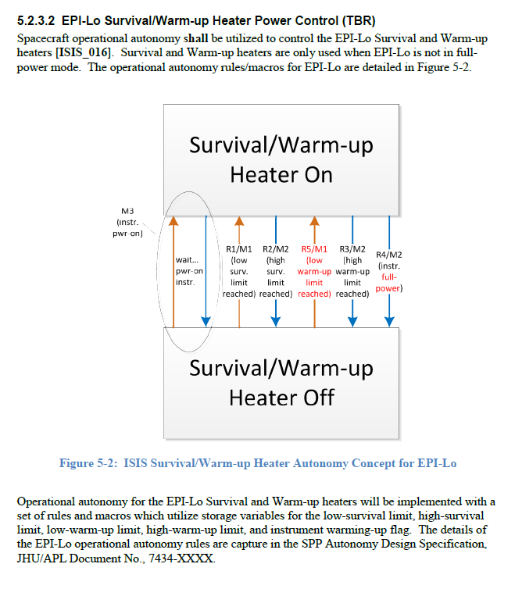
Heater Operation Concept Developed with S/C
RTDs read by S/C
PDU controls single heater service to EPI-Lo
  Survival
  Warm-up
~121.6 ohm resistance for heater network
  5.6W @26V
  10.0W @35V;
    ~5.0 in² required area
Safety thermostat with switch point at TBD°C to prevent overheating of instrument if PDU fails with energized circuit

Slide 17

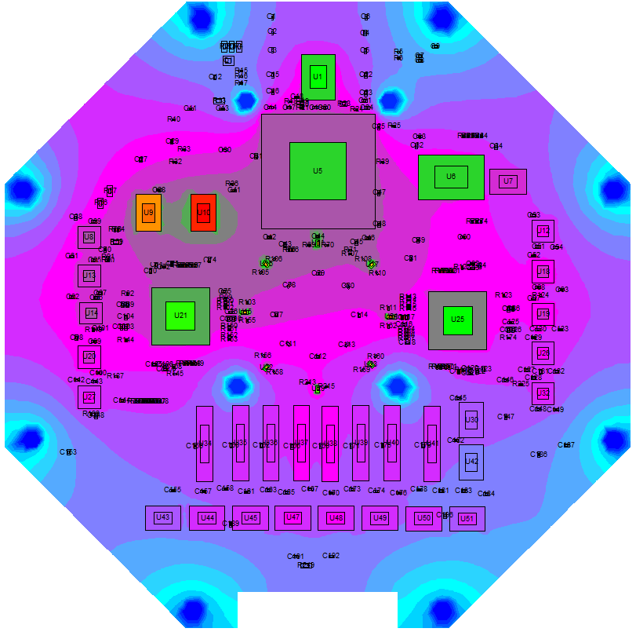
Board Analysis shows High Margins
Analysis completed by S. London 2014/10/27 on LVPS, Event and Anode boards.
Conservative 35C boundary temperature applied at all mounting locations
Detailed layouts included from electrical design files
Attachment method specified for all components requiring increased coupling to the board
All parts operate with margin

Slide 18
Various Heat Leak Paths to Deck Exist
Hot case deck temperature of 45°C and desire for cool detector temperatures
Radiation
  Blanketed or low emissivity surfaces
1’ Harness to deck
  0.007 W/C calculated; 0.01 W/C modeled
(4) 1/2” thick G-10 Isolators from EPI-Lo to bracket
  Ti Fastener; G-10 under head
  0.00481 W/C each
(10)Isolators from bracket to deck
  SS fasteners; no fastener insulator
  0.012296984 W/C each
(2)Ground straps
  0.00177 W/C each
Purge line

Slide 19
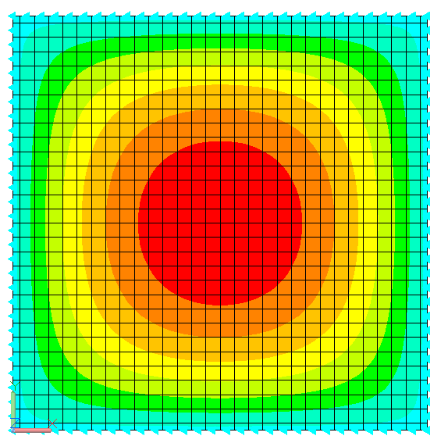
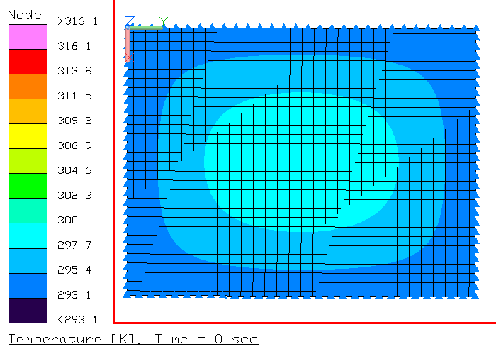
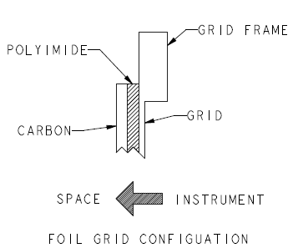
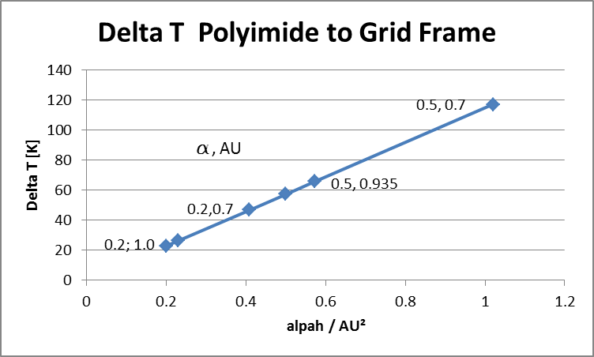
Outer Foils Must Survive Sun at 0.935 AU
Foils in collimator exposed to space and environmental heating
  12 μm nickel grid inner
    180 lines per inch.
  100 nm polyimide foil
  5nm amorphous carbon exterior
  Epoxy Bond
    EPON 828, VERSAMID 125
    Maximum temperature believed to be >150°C
    ~ 2% TGA weight Loss at 200°C
High solar transmission
  Only absorption affects foil temperatures
α,AU = 0.2,1.0
Grid wire boundaries
Conduction Only, No Radiative Cooling
7.1 mm
0.13 mm
Grid wire model
Polyimide model
5.4 mm
0.13 mm
Grid frame boundaries

Slide 20
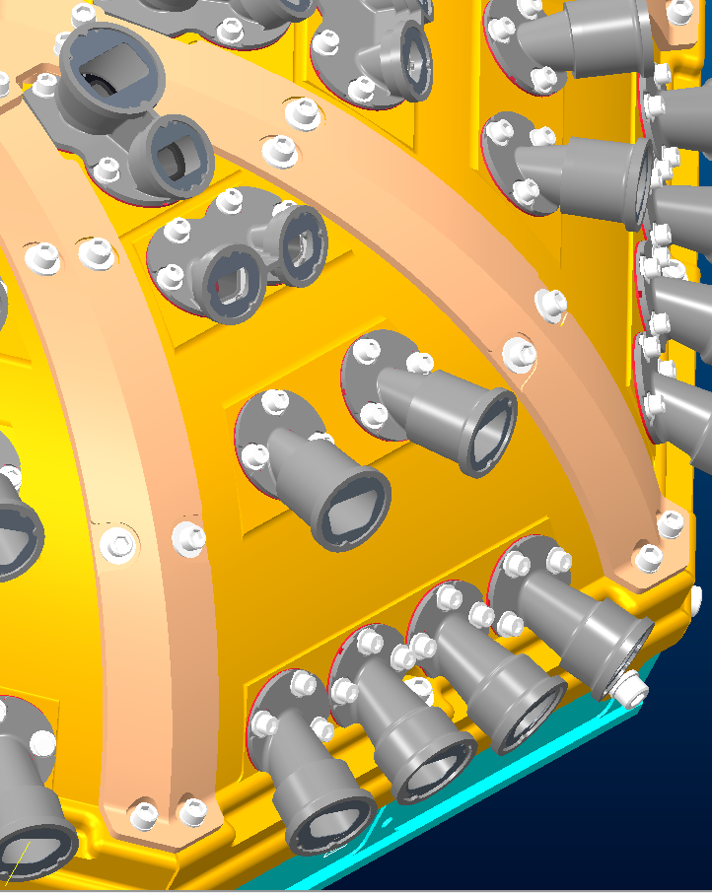
Collimators Protrude Through Blankets
Ag/MgF2 on all exterior collimator surfaces
64 openings in blanket allow instrument heat to radiate to space
Complex collimator geometry leads to difficulty controlling exact amount of collimator exposed.
Low emissivity finish reduces sensitivity to blanket fit.
Aluminum collimators coated with Ag and MgF₂.
  Multimeter shows acceptable electrical conductivity through coating
White paint or StaMet black Kapton provide high emissivity surface to reject heat.
Blankets cover fasteners and lower parts
Nickel baffle
Inside of collimator is Alodine
Outer 48 collimators may get high-e coating on large outer diameter

Slide 21
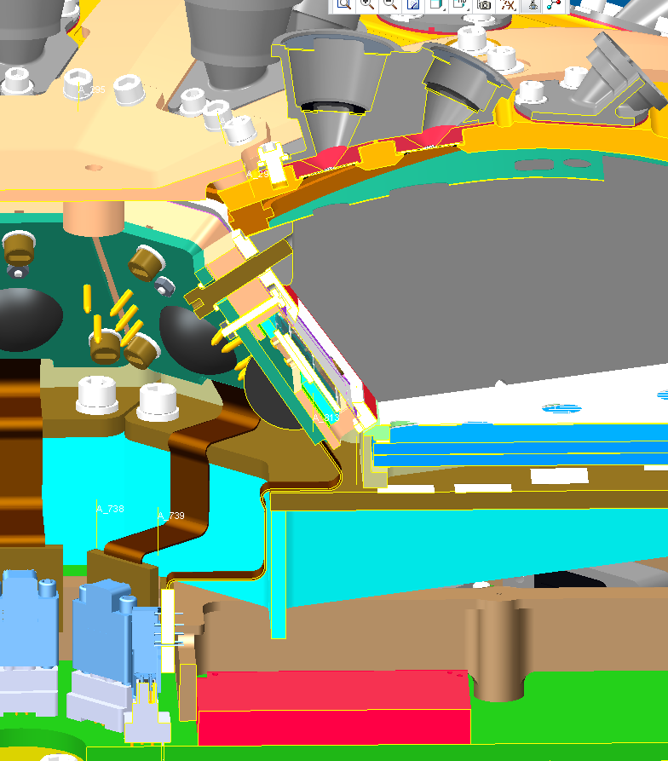
Minimal Detector Coupling
Detector is thermally isolated from wedge structure
Some coupling to thermally isolated and dissipating energy board
Best thermal path exists from energy board to event board through flex cable
  674 C/W thermal resistance to hot energy board.
Greater coupling from energy board to outer dome could buy a few °C.

Slide 22
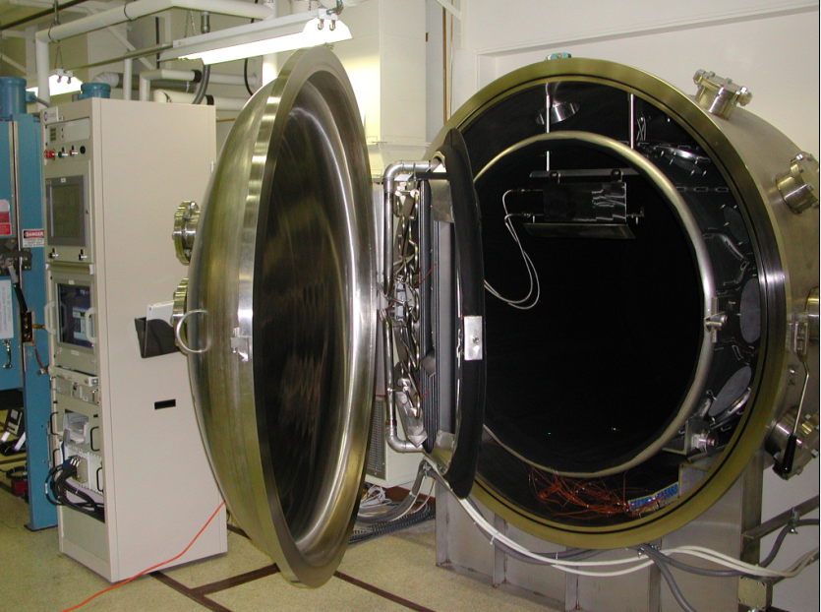
TVAC Testing Follows Example of Previous APL Particle Instruments
Thermal Balance
  Flight like blankets, bracket and EPI-Hi simulator
  LN₂ thermal shroud
  Survival heater test
  Test heaters adds additional environmental loads
Thermal Cycling
  Instrument cycled using flight acceptance limits
  Test blankets removed to aid transitions
  Alternative instrument mounting allowable
Bakeout
SSL facilities at APL are capable of all testing

