Slide 1
EPI-Lo Mechanical
Scott Cooper
Steve Layman
Shaughn London
Notes:
introduction

Slide 2
Outline
Development Status
Mechanical Design Requirements
Instrument Accommodation
Notable Design Changes Since PDR
Instrument Overview
Epi-Lo Drawing Tree
Sensor Design Details
Instrument Assembly Process
Prototype Hardware
Acoustic Test
Development Path Forward
Structural Analysis

Slide 3
Development Status
Assembled 2 EM MCPs
Performance test at HV
Assembled 1 EM wedge
Performance test at HV over op temp range
Assembled 2 prototype wedges
Acoustic test
Fabricated prototype spider frame
Integrated Event and Power PWAs with prototype board frames
Updated EM part fabrication in process
Awaiting mounting bracket to conduct vibe test
Structural analysis coupled with updated mounting bracket in work

Slide 4
Mechanical Design Requirements
7434-9039, SPP Environmental Design and Test Requirements Document
Subsystem to have min frequency > 80 Hz
PWAs to have min frequency > 150 Hz
Quasi-static load factor: 40g (Figure 4-11 & Table 4-19)
Factors of safety: Table 4-5, Unpressurized Factors of Safety
Random vibration levels: Table 4-8 and Table 4-9
Interface Documentation
7434-9058, ISIS to S/C ICD
7434-9066, SPP General Instrument to S/C ICD
7464-0008 EPI-Lo-S/C Mechanical ICD
161051001, ISIS Suite MICD
161051002, ISIS Bracket to Instrument MICD
7434-9040, ElectroMagnetic Environment Control Plan
7434-9553, SPP Purge Plan
7434-9555, SPP Alignment Plan
7464-9007, Epi-Lo Contamination Control Plan

Slide 5
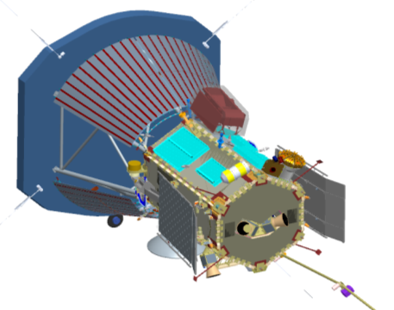
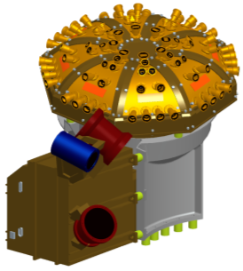
Instrument Accommodation
ISIS INSTRUMENT SUITE
SOLAR PROBE S/C
ISIS MOUNTING BRACKET
EPI-HI INSTRUMENT
MODELS SHOWN ARE NOTIONAL AND MAY BE OUTDATED
ISIS INSTRUMENT SUITE ON SPP

Slide 6
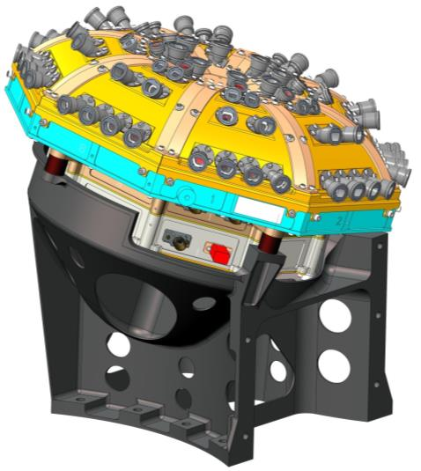
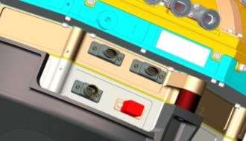
Epi-Lo on ISIS Mounting Bracket
SUFFICIENT CLEARANCE AT INSTRUMENT CONNECTOR PANEL
G-10 ISOLATORS,
4 PLCS
ISIS MOUNTING BRACKET, SWRI

Slide 7
Notable Design Changes Since PDR
Added vents to all blind holes in sensor assembly
Replaced individual collimator bosses on wedge cover with continuous surfaces
Added interlocking feature between SSD holder and SSD insulator to improve stop foil/MCP compression plate insulation
Added ground strap attach points to spider
Incorporated side closeout with wedge cover into single piece*
Added purge fitting boss to wedge side wall
Changed to heritage MDM safing connector*
Added HV wiring conduit outside of board frames
Modified openings in wedge acceleration grid, MCP grid, and MCP mask to improve sensor performance*
Added bolts to constrain center of electronics bulkhead to power board frame*
Added stiffening ribs to bottom cover*
Removed wedge torlon screws and made wedge insulator the common joining feature*
Added various internal restraining features for wiring*
* Fabrication of updated design in work
Note: Changes in black text are highlighted on subsequent charts

Slide 8
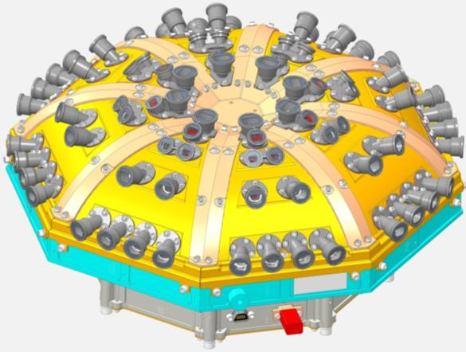
Instrument Overview
TOP CLOSEOUT
Replaced individual collimator bosses on wedge cover with continuous surfaces
WEDGE CLOSEOUT,
8 PLACES
SPIDER FRAME
WEDGE ASSEMBLY
8 places
Incorporated side closeout with wedge cover into single piece
Added ground strap attach points to spider
EPI-Lo Instrument Isometric View

Slide 9
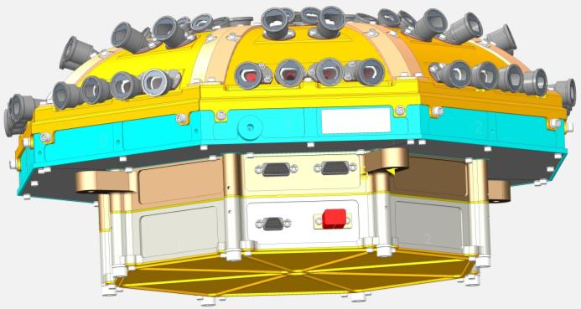
Instrument Overview
SPIDER
CLOSEOUTS,
8 PLACES
EVENT BOARD SLICE
MOUNTING INTERFACE, 4 PLACES
POWER BOARD SLICE
INSTRUMENT CONNECTOR PANEL
Changed to heritage MDM safing connector
EPI-Lo Instrument Side Isometric View

Slide 10
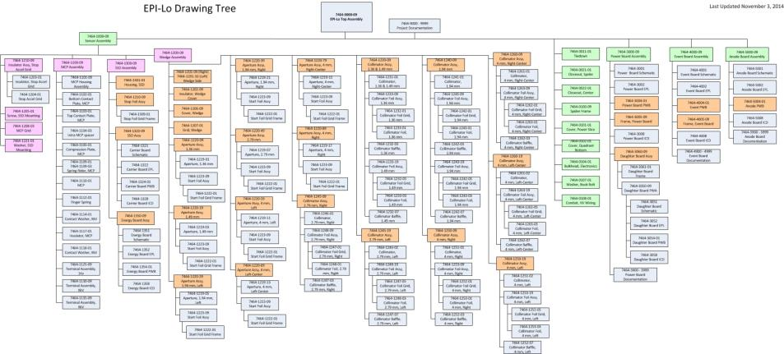
Epi-Lo Drawing Tree

Slide 11
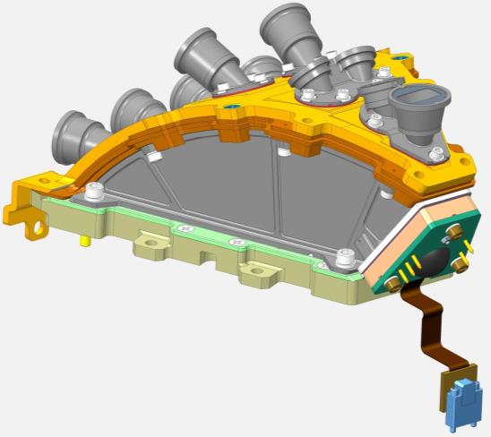
Wedge Design
WEDGE INSULATOR
ULTEM 2300
SENSOR COVER AT GROUND ALUMINUM 6061-T651
SSD INSULATOR
ULTEM 2300
MCP ASSEMBLY IN A ULTEM 2300 HOUSING
SIDE WALLS AT 1kV ALUMINUM 6061-T651
COMPRESSION PLATE AT 1kV
STAINLESS 303
Removed wedge torlon screws and made wedge insulator the common joining feature
EPI-Lo Sensor Wedge Assembly

Slide 12
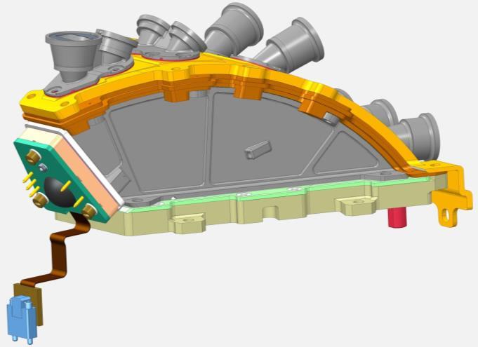
Wedge Design
Added purge fitting boss to wedge side wall

Slide 13
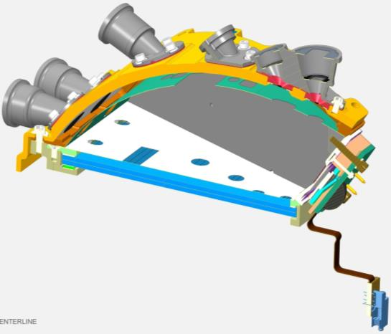
Wedge Design
COLLIMATORS, AT GROUND
8 PLCS
SENSOR WEDGE COVER, GROUND
APERTURE START FOIL GRID, GROUND
10 PLCS
WEDGE INSULATOR ULTEM 2300
WEDGE GRID, 1kV
SCREWS, TORLON
3 PLCS
MCP COMPRESSION PLATE, 1kV
MCP GRID, 1kV
BOTTOM MCP 2.9kV
TOP MCP, 900V
(TOP OF ANODE PWB NOT SHOWN, 3kV)
EPI-Lo Sensor Wedge Assembly Cross-Section View

Slide 14
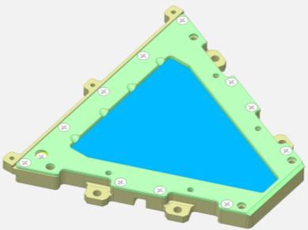
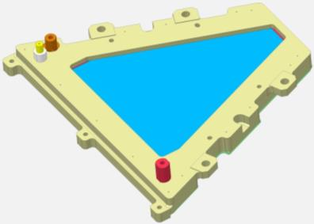
MCP Assembly Design
COMPRESSION PLATE
1KV LUG
BOTTOM VIEW
900V LUG
TOP VIEW
2.9KV LUG
MCP Assembly

Slide 15
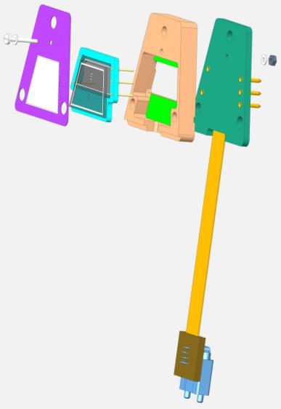
SSD Assembly Design
GROUNDING SCREW
SSD STOP GRID-FOIL, GROUND
ENERGY PWB ASSY
SSD ASSY
SSD ASSY HOUSING, ULTEM 1000
SSD Assembly Exploded View

Slide 16
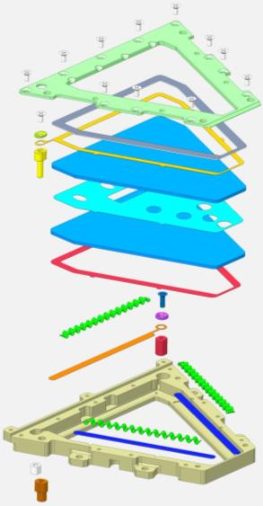
MCP Assembly Process
COMPRESSION PLATE
SCREW
INSULATED SHIM, ULTEM 1000
GUARD WASHER
900 V LUG ASSY
900V ELECTRODE
MCP
SLIDE-SPACER ELECTRODE
MASK, .002
MCP
LINEAR EXPANDERS, 3 PLACES
SCREW
WASHER
2.9 kV ELECTRODE
2.9kV LUG ASSY
NUT
SLIDES FOR EXPANDERS, 2 PLACES
1kV LUG ASSY
MCP HOUSING
MCP Assembly Exploded View

Slide 17
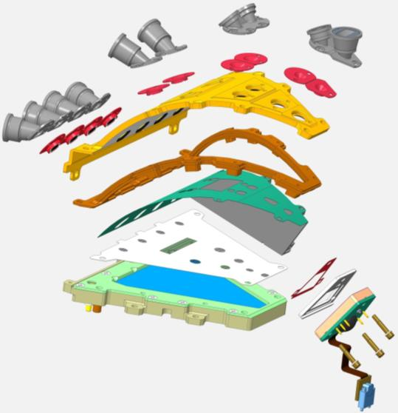
Wedge Assembly Process
COLLIMATORS
APERTURE START FOILS
WEDGE COVER
WEDGE INSULATOR,
ULTEM 2300
SIDE WALL, 1kV
WEDGE GRID
SSD WEDGE GRID, 1kV
SSD INSULATOR, ULTEM 2300
MCP GRID
(SIDE WALL REMOVED FOR CLARITY)
SCREWS, TORLON
3 PLCS
Added interlocking feature between SSD holder and SSD insulator to improve stop foil/MCP compression plate insulation
EPI-Lo Sensor Wedge Assembly Exploded View

Slide 18
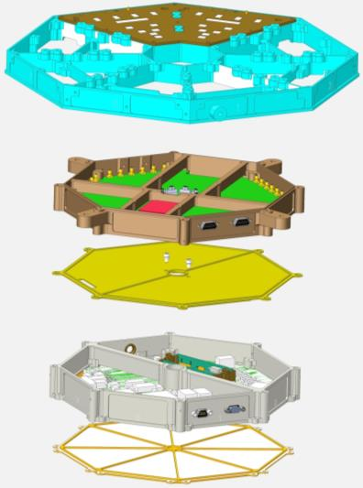
Spider and Electronics Integration
ANODE BOARD,
4 PLACES
SPIDER FRAME
EVENT BOARD PWA
ELECTRONICS BULKHEAD
Added bolts to constrain center of electronics bulkhead to power board frame
POWER BOARD PWA
Added stiffening ribs to bottom cover
BOTTOM COVER
EPI-Lo Electronics Frames Exploded View

Slide 19
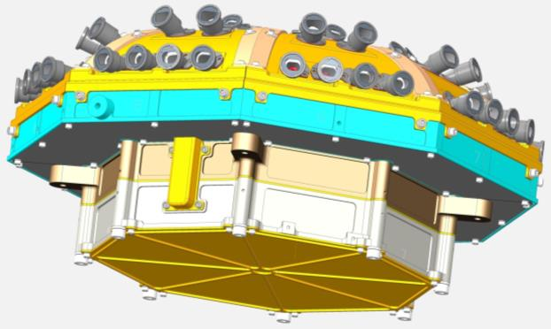
External High Voltage Wiring Conduit
Added HV wiring conduit outside of board frames
EPI-Lo Isometric View

Slide 20
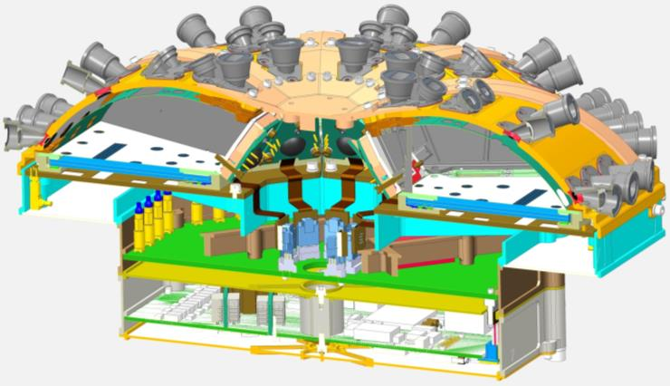
Wedge Integration and Cable Routing
ANODE BOARD CONNECTORS
(SEE NEXT SLIDE)
CABLE PASS THRU
EVENT BOARD CONNECTORS
CABLES TO ANODE BOARD
SSD ASSEMBLY
HARNESS CONNECTORS
INTER-BOARD HARNESS
WITH CLAMP
EPI-Lo Cross-Section Isometric View

Slide 21
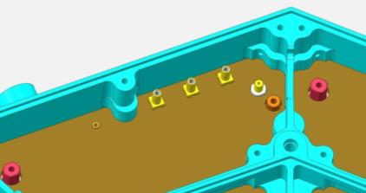
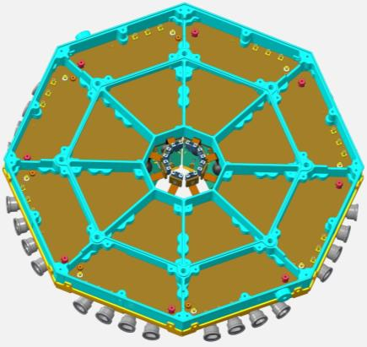
Anode Board Cable Connections
ANODE BOARD HV CONNECTORS
ANODE BOARD SIGNAL CONNECTORS
900V LUG
1KV LUG
2.9KV LUG
3.7 mm MIN SPACE BETWEEN LUG AND WALL
Anode PWB Assembly,
Bottom Side Shown
Mounted To Spider Frame

Slide 22
Instrument Closeout Installation
TOP CLOSEOUT
WEDGE CLOSEOUT
SPIDER CLOSEOUT
EPI-Lo Cross-Section Isometric View

Slide 23
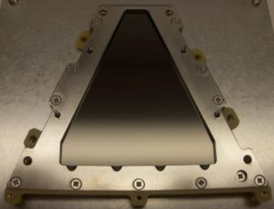
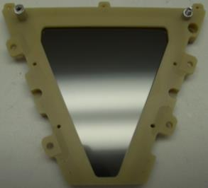
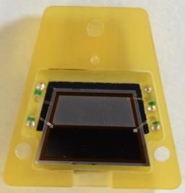
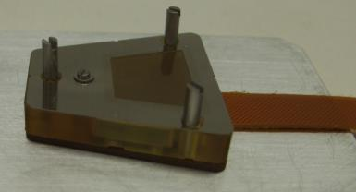
Prototype Subassemblies
EM MCP Assembly, Top
EM MCP Assembly, Bottom
EM SSD in Holder
EM SSD Assembly

Slide 24
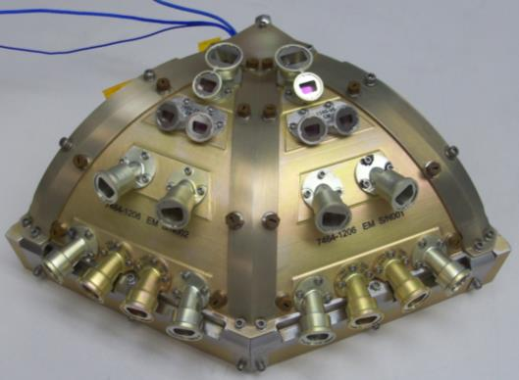
Acoustic Test
Conducted at NRL in reverberant chamber
October 1, 2014
Acceptance test at EDTRD’s MEFL
135.9 OASPL
1 minute duration
Protoflight test
MEFL +3dB
1 minute duration
Post-test inspection revealed no damage
HUNG FROM CHAMBER CRANE
EPI-Lo Prototype Acoustic Test Unit

Slide 25
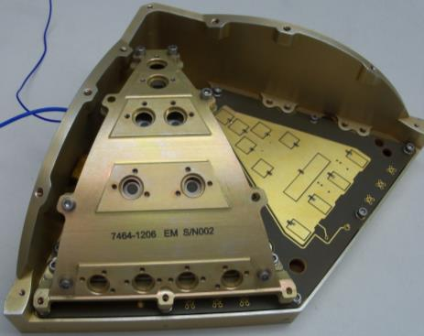
Acoustic Test Unit
Custom test fixture to mimic a single spider quadrant
Anode PWB
2 Prototype Sensor Wedge Assemblies
EM MCP Assemblies
Mechanical MCPs
EM SSD Assemblies
Energy PWB
EM Upper Wedge Assemblies
Included outdated Torlon screw design
Flight-like grids and foils in all locations
Most recent grid spacing not included
EPI-Lo Partial Acoustic Test Unit

Slide 26
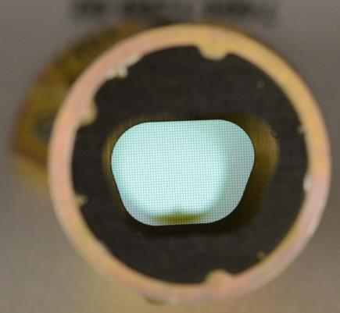
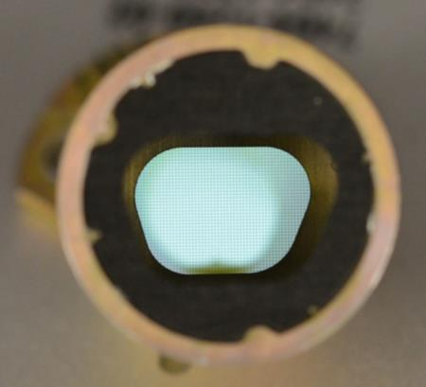
Collimator Foil Inspection
No collimator foil damage was noted after the acoustic test
PRIOR TO ACOUSTIC TEST
AFTER ACOUSTIC TEST
Collimator Foil Inspection (S/N 01, Look Direction #1 Shown)

Slide 27
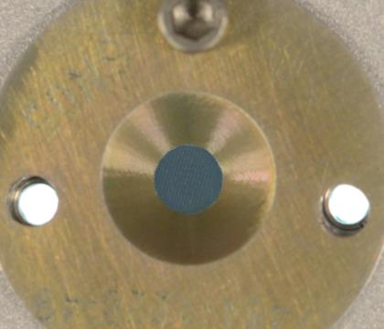
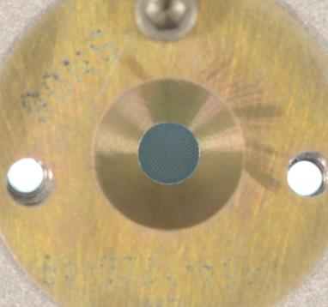
Start Foil Inspection
No start foil damage was noted after the acoustic test
PRIOR TO ACOUSTIC TEST
AFTER ACOUSTIC TEST
Start Foil Inspection (S/N 01, Look Direction #4 Shown)

Slide 28
Development Path Forward
Complete purge system design
Complete fabrication of updated designs
Update and complete GSE designs and fabrication
Assemble 2 EM wedges with updated parts
Conduct wedge thermal “stress” test
Conduct wedge blow-down test
Conduct force limited vibration test on ISIS bracket
Complete wire routing and tie down designs
Release EM drawings

Slide 29
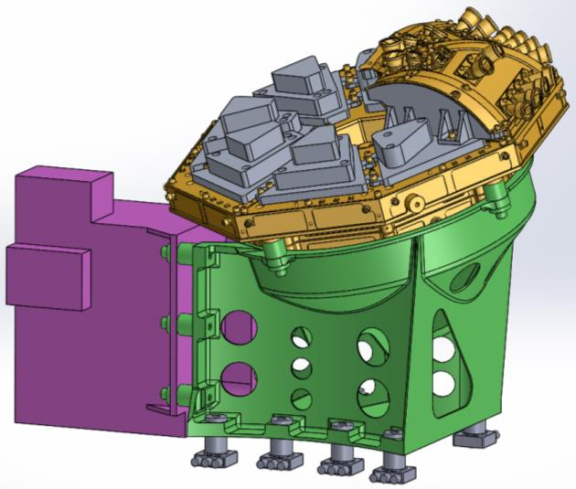
Vibration Test Set-Up
WEDGE MASS SIMULATORS, 6 PLCS
EM EPI-LO UNIT WITH 2 WEDGES
EPI-HI MASS SIMULATOR, SWRI
ISIS BRACKET
LOAD CELLS, 8 PLCS

