Slide 1
John Hayes
EPI-Lo Software Engineering (JHU/APL)
Notes:
introduction

Slide 2
Overview
Start-up: boot vs. application
Stored command sequence (macros)
Operations, per orbit
Instrument safety

Slide 3
Start-Up
Boot
  Time and status from spacecraft includes startup mode: selects manual vs. autonomous operation
  If autonomous operation is selected, EPI-Lo boot software will automatically try to boot a series of three programs from non-volatile memory (MRAM)
  If autonomous operation is not selected, EPI-Lo boot software will wait for commands
Application
  If autonomous operation is selected, EPI-Lo application software will automatically:
    Load macros from non-volatile memory
    Run the start-up macro
  If autonomous operation is not selected, EPI-Lo application software will wait for commands

Slide 4
Macros
Macros are stored sequences of commands
256 different macros can be defined
64 Kbyte of RAM is available for macro storage
Macros can nest 16 deep; up to 64 macros can execute concurrently
Real-time uplink commands take precedence over macro commands
Commands from a macro are echoed; the echo includes a flag indicating that the command is from a macro

Slide 5
Macros - Definition and Control Flow
Macros are “learned” by the instrument
  EPILO_MAC_DEF starts a macro definition; any command uplinked with its “macro” arg set will be appended to the macro
  EPILO_MAC_ENDDEF ends the definition
  While a macro is being compiled, any real-time command, i.e., one without a set “macro” arg will be executed.
  There is no need for macro compiler or macro memory management by ground software
Macro control flow commands:
  EPILO_MAC_DELAY and EPILO_MAC_PAUSE delay by a give number of seconds or until a given time, respectively
  EPILO_MAC_NEST and EPILO_MAC_RUN nest a macro and starts a concurrently executing macro, respectively
  EPILO_MAC_LOOP_BEGIN and EPILO_MAC_LOOP_END delimit a definite loop
  EPILO_MAC_HALT kills a running macro

Slide 6
Macros - Dataflow
Macros execute from RAM
Macros can be saved in non-volatile memory (MRAM)
  EPILO_MAC_SAVE saves and EPILO_MAC_RESTORE restores
  These are done en masse, i.e. all macros are saved/restored
Default macros can be pre-compiled in the flight software
  Usually provides default responses involving instrument safety
  Can be redefined or overridden by EPILO_MAC_RESTORE
EPILO_MAC_READ dumps macros and EPILO_MAC_CHECK checksums macros

Slide 7
Operations
Time and status from spacecraft includes
  Startup Mode: selects manual vs. autonomous operation
  Solar Distance:
    Current distance to the sun (km)
    Inbound vs. outbound flag
    Validity flag
  Power down warning flag
If autonomous operation is selected, EPI-Lo software will:
  Automatically load macros from MRAM
  Run startup macro; this ramps up HVs, etc.
  Monitor solar distance against a set of commandable thresholds
    Different threshold crossings trigger different macros to run
    Macros configure science collection, e.g. integration times, etc.

Slide 8
Operations - Regions Definition
EPILO_OP_REGION command defines a region within the orbit
  Arguments specify start of region; region extends to start of next region
  Argument also specifies macro to run when region is entered
  Up to 25 regions can be defined
EPILO_OP_READ command dumps the definition of all regions

Slide 9
Operations - Regions Initialization
EPILO_OP_INIT command initializations regions
  Deletes all region definitions
  Argument specifies macro to run
Region definitions can be saved in non-volatile memory (MRAM)
  Regions definition commands can be executed from macros, macros can be saved in MRAM, and therefore region definitions can be saved
  Region definitions for a “generic” orbit could be available in the default macros

Slide 10
Instrument Safety - Alarms and Monitors
Alarm packet is generated in response to a software problem or to a monitored value going out of limits
Monitors watch analog voltages, currents, and temperatures
  If a monitored value is out-of-limits just once, a transient alarm is reported
  If a monitored value is consecutively out-of-limits twice, a persistent alarm is reported and the software may take corrective action
  If a monitored value is consecutively out-of-limits more than twice, either corrective action is taken again, the shutdown macro is run, or nothing is done, depending on the thing being monitored
Commands:
  EPILO_MON_CNTRL enables or disables corrective action

Slide 11
Instrument Safety - Monitoring Algorithm
High response (low response is similar):
high once:
issue transient high alarm
high twice:
issue persistent high alarm
if enabled (via EPILO_MON_CNTRL command)
execute high response macro for this alarm
high more than twice:
case of monitor class
current/voltage:
if enabled (via EPILO_MON_CNTRL command)
run shutdown macro
temperature:
nop
count rate:
if enabled (via EPILO_MON_CNTRL command)
re-execute high response macro

Slide 12
Instrument Safety - HV Over-Current
Hardware monitors MCP HV current
  EPILO_MCP_CUR_LIMIT command sets current limit
  EPILO_MCP_CUR_ENB command enables/disables monitor
  Analog circuitry compares current against limit, generates “trip” on over-current
  FPGA monitors trip; if seen:
    Generates MCP HV shutdown
    Indicates “fault” to software
  HV cannot be turned back on until current is within limits and monitor is disabled
Software monitors fault indicator; if seen:
  Issue alarm packet
  Zeros control DAC
  Runs response macro
Independent current limits, monitors, and macros, per quadrant

Slide 13
Instrument Safety - Miscellany
Communications from spacecraft are monitored
  If no communications are received within a timeout, the safing macro (macro 2) is run
  EPILO_SAF_TIMEOUT command sets the timeout (s)
Watchdog timer monitors software health
  Timeout is ~4 seconds
  Managed by application software from lowest priority process
  Boot software starts on reset
    If watchdog reset, a memory dump is started
    If autonomous operation is selected, the dump is allowed to complete before restarting application software
Various “last-ditch” commands are available to macros
  EPILO_SAF_OFF requests power off
  EPILO_SAF_CYCLE requests power cycle
  EPILO_SAF_RESET forces a watchdog reset

Slide 14
Status
Software implemented and tested
Changes since peer review (Nov. 3, 2014)
  Added command and telemetry to support operation regions dump
  Added delay in boot software to allow watchdog reset memory dump to complete before autonomously re-booting

Slide 15
Appendix

Slide 16
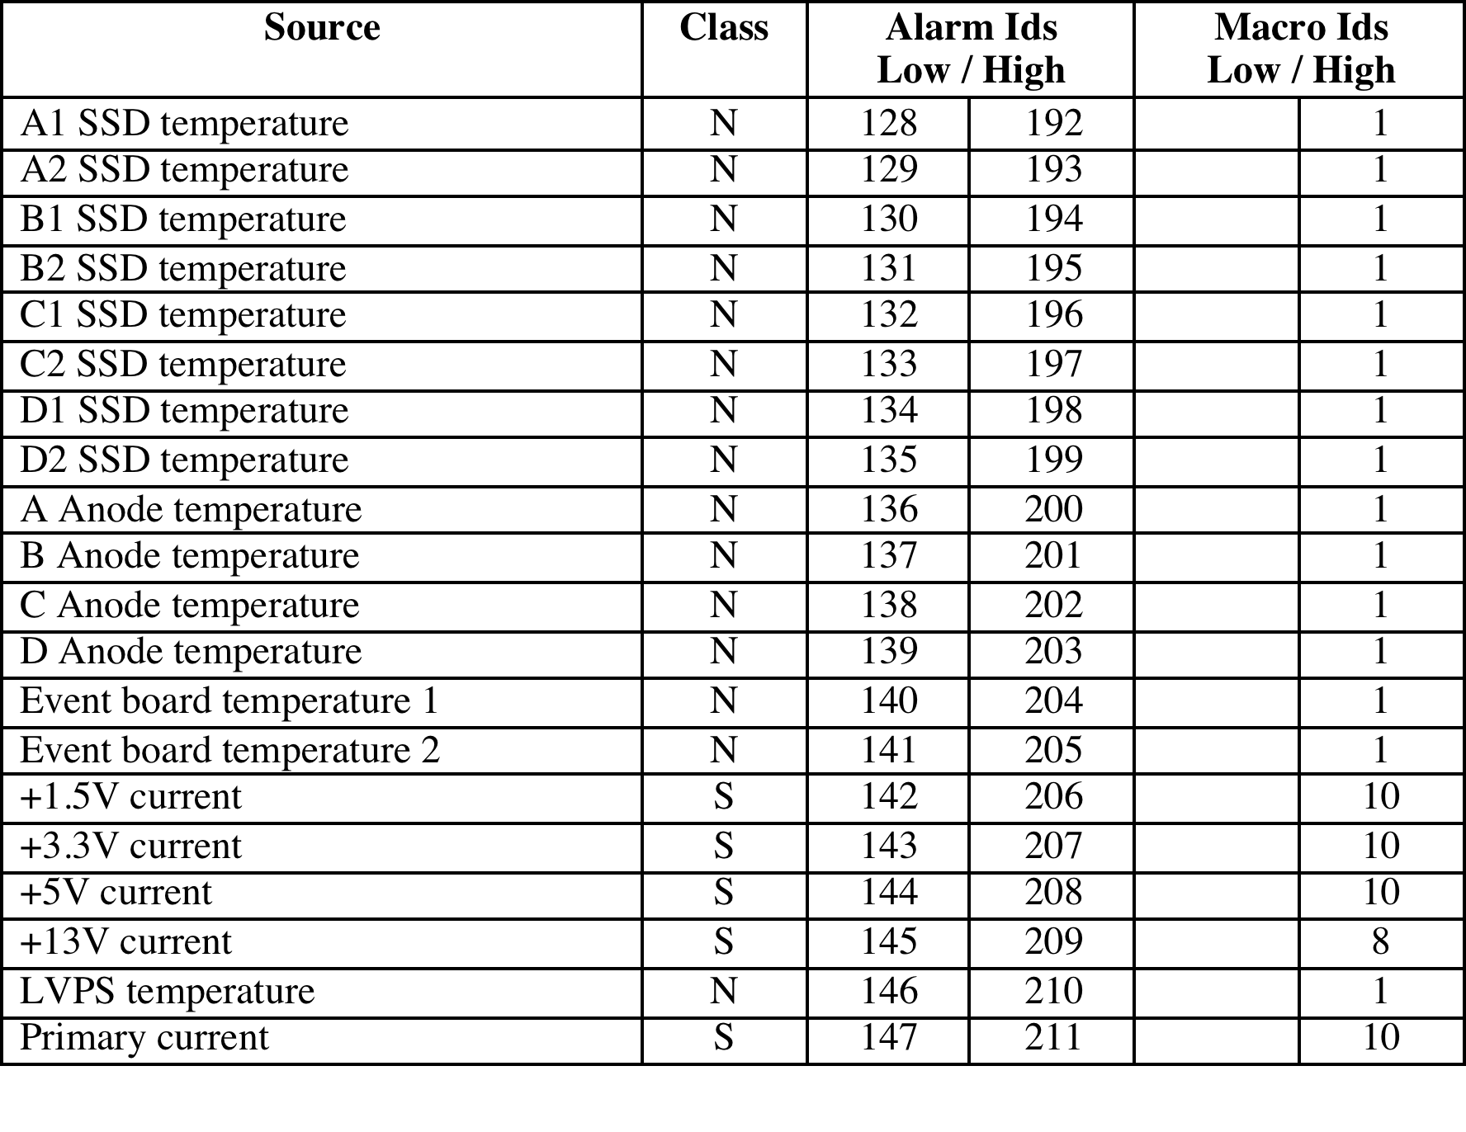
Monitored Data
High temperatures cause shutdown
Power supply problems cause emergency shutdown
+13V current too high triggers HV shutdown

Slide 17
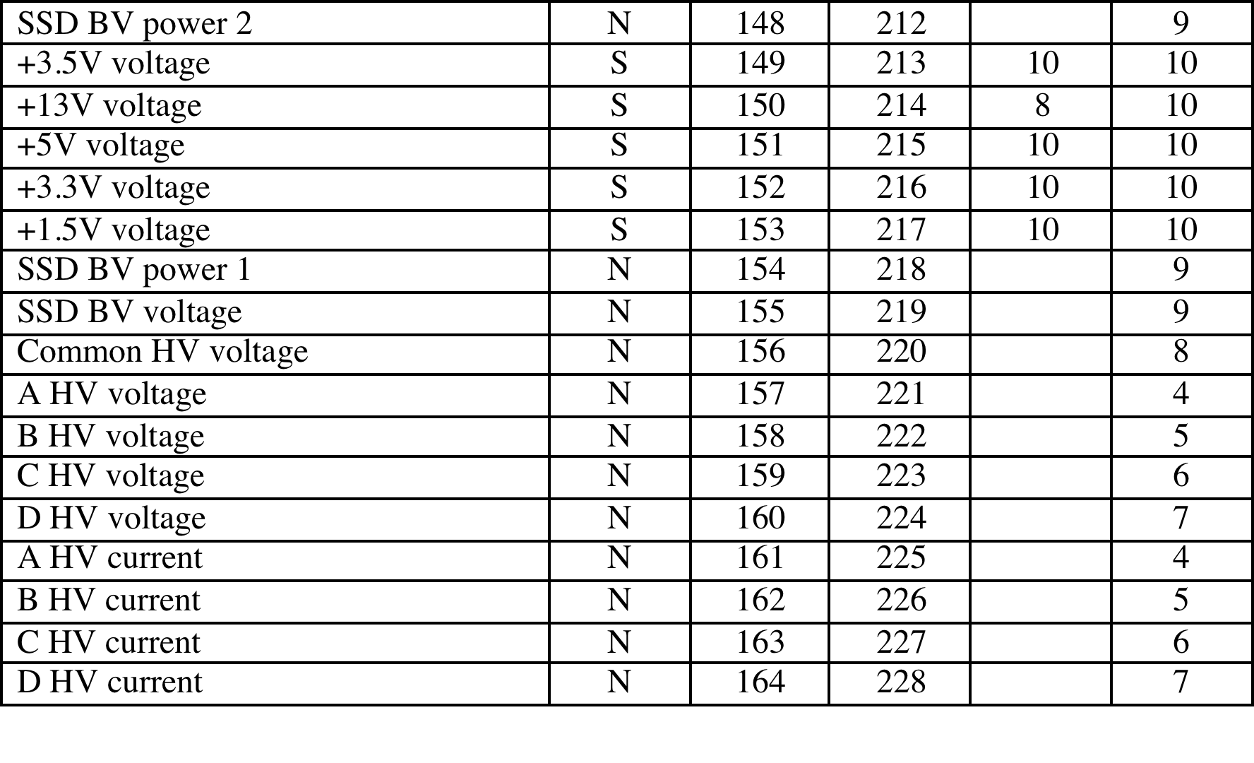
Monitored Data (Cont.)
+13V voltage too low, or common HV voltage too high triggers HV shutdown
SSD voltage or power too high triggers SSD shutdown
Current or voltage too high on individual HVs cause shutdown on just that HV

Slide 18
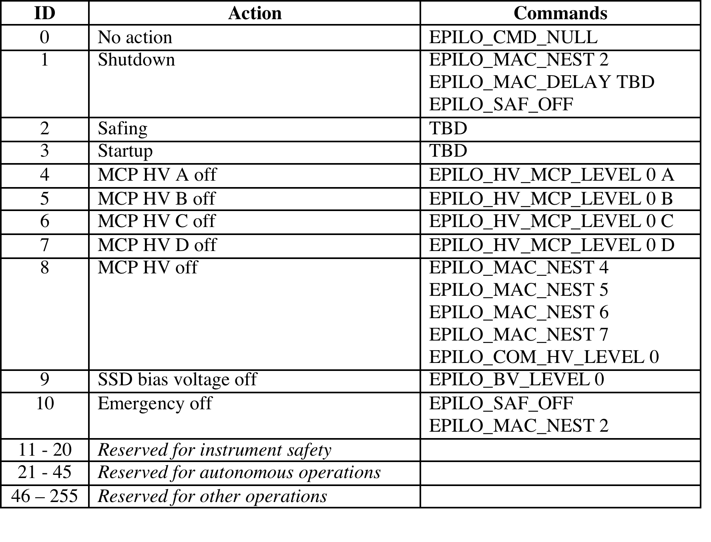
Default Macros
Only macros used by instrument safety autonomy have defaults
Safing stops science and ramps down HV and BV
Shutdown runs safing, waits, then requests power off
Emergency shutdown requests power off, then runs safing
Separate ramp down of each HV

