Slide 1
SPP Spacecraft Autonomy
6/24/2015

Slide 2
Spacecraft Autonomy Agenda
Spacecraft Autonomy Overview
Spacecraft Modes
Instrument Autonomy Overview
  EPI-Lo Instrument Autonomy
Payload Autonomy Overview
Instrument Heater Autonomy Overview
  EPI-Lo Heater Autonomy

Slide 3
Spacecraft Autonomy System Overview
The SPP Autonomy System is a Monitor→Response system where faults are detected and corrective actions are taken in response to the fault
  All Monitors are evaluated at a 1 Hz rate
The SPP C&DH Flight Software provides an on-board Autonomy Engine to facilitate the development of the Autonomy System. The Autonomy Engine supports four types of uploadable constructs that allow the Autonomy Engineer to independently develop the Autonomy System:
  Autonomy Rules
  Macros
  Storage Variables
  Computed Telemetry
The Autonomy Engine has over 15 years of heritage.
  Incremental enhancements have been made to the engine over the years

Slide 4
Spacecraft Autonomy System:
Attributes Overview
Autonomy Rules
  Autonomy rules specify the fault condition to be monitored. The fault condition (autonomy rule expression) may be a combination of any engineering telemetry and common arithmetic and logical operators
    Example expression: ( SC_MODE == OPERATIONAL ) && (BUS_VOLTAGE * BUS_CURRENT < 350.0)
  Rule Attributes
    Persistence: How long a fault must persist (M of N seconds)
    Maximum Fire Count: How many times an autonomy rule can fire
    Priority: Priority of the autonomy rule’s response macro when running concurrently with other macros
    Initial State: Whether the autonomy rule is enabled or disabled by default
Macros
  Macros specify a list of spacecraft commands designed to address a fault. They are invoked in response to the firing of an autonomy rule.
  Macros may call other macros (like invoking a subroutine). This allows a level of modularity to be applied to the macro design. Also, in the spirit of modularity, multiple autonomy rules may trigger the same macro

Slide 5
Spacecraft Autonomy System:
Attributes Overview
Computed Telemetry
  Computed Telemetry allow intermediate calculations to be defined from engineering telemetry (i.e., derived telemetry). The calculation results can then be used in autonomy rule expressions. Like autonomy rules, the expressions may be a combination of any on-board telemetry and common arithmetic and logical operators
    Example computed telemetry definition to calculate spacecraft power: BUS_VOLTAGE * BUS_CURRENT
    The resulting calculation can now be used in other autonomy rules
Storage Variables
  Storage Variables are global variables for the exclusive use of the Autonomy System. The values of the storage variables are typically used in the premise of autonomy rules.
  Commands are available to modify storage variables. Storage variables can be:
    Set to specific value (Ex: STOR_VAR_X = 13)
    Incremented and decremented (Ex: INCREMENT STOR_VAR_X)
    Assigned to existing value of telemetry point (Ex: STOR_VAR_X = BUS_CURRENT)
  Commands to modify storage variables are used in autonomy macros and by MOPS ground command

Slide 6
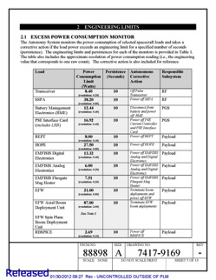
Instrument Autonomy Requirements & Documentation
Autonomy requirements applicable to all teams are captured in the General Instrument ICD, 7434-9066, rev B
Instrument specific requirements are captured in the ISIS to Spacecraft ICD, 7434-9058, rev B
All autonomy requirements are captured in the SPP Level 4 Autonomy Systems Requirements Document, 7434-9072, rev A
  Specific limits (current, temperature, power, etc.) are captured in a separate document known as the SPP Autonomy Engineering Limits Specification, 7434-9116
  All spacecraft and instrument subsystems that own any limits in the Autonomy System will be approvers on the document
Example from Van Allen Probes

Slide 7
Spacecraft Modes
There are six main spacecraft modes:
  Operational Mode – Level 3
  Operational Mode – Level 2
  Operational Mode – Level 1
  Safe Mode – Solar Array
  Safe Mode – Earth Acquisition
  Safe Mode - Standby
SPP allows both autonomous mode demotions and promotions
The intent of this overview is to provide simple definitions for the spacecraft modes since some autonomy rules are contingent upon mode

Slide 8
Operational Modes
There are three Spacecraft Operational Modes
  Operational Mode - Level 3: Highest mode of operation. All spacecraft operations allowed. Full science achievable.
  Operational Mode - Level 2: Demotion to this mode if G&C indicates less than full attitude and rate control, there is a command failure in a MOPS time-tagged sequence or there is a processor rotation. MOPS time-tagged sequences inhibited in this mode. Autonomy ensures full science still achievable (e.g., powering on instruments inside of 0.25 AU). TCMs, G&C Off Pointing and HGA downlink are not allowed.
  Operational Mode - Level 1: Demotion to this mode if there is a low battery state of charge. Instruments are powered off. Science not achievable.
    Autonomous promotion to Operational Mode - Level 2 once battery state of charge is nominal (science operations would then resume)

Slide 9
Safe Modes
There are three Spacecraft Safe Modes
  Safe Mode – Solar Array: Demotion to this mode for critical power/thermal fault. Instruments are powered off. Science not achievable in this mode.
    Autonomous promotion to Operational Mode - Level 1 when power/thermal fault has cleared (or 10 minutes have elapsed). If battery state of charge returns to nominal levels, promotion would continue to Operational Mode – Level 2 (science operations would then resume)
  Safe Mode – Earth Acquisition: Demotion to this mode if Command Loss Timer expires outside of 0.25 AU. Instruments are powered off. Science not achievable in this mode.
    Autonomous promotion to Operational Mode - Level 1 if spacecraft crosses 0.25 AU inbound while in this mode. If battery state of charge is nominal promotion would continue to Operational Mode – Level 2 (science operations would then initiate)
  Safe Mode – Standby: Demotion to this mode if there are excessive processor rotations. Instruments are powered off. Science is not achievable in this mode.
    No avenue to autonomously promote from this mode

Slide 10
Spacecraft Mode Capabilities

Slide 11
Instrument Autonomy Overview
The Spacecraft Autonomy System provides overarching protection which can either:
  Power On an instrument
  Power Off an instrument
  Power Cycle an instrument
    i.e., power instrument off for predefined number of seconds and then power it back on
Each instrument has its own internal safing
  Discussed in following presentations

Slide 12
Design Overview (1 of 3)
Each instrument sends Interface Transfer Frames (ITFs) to the Prime CDH at a 1 Hz (or higher) rate.
  Each ITF contains an 8-bit sequence counter that is incremented by the instrument. The Prime CDH Flight Software monitors the sequence counter and declares a failed aliveness if the sequence counter fails to increment or if the ITFs are not valid.
    This provides a mechanism for the Autonomy System to monitor instrument aliveness.
  Each ITF also contains a pair of bits so that each instrument can self-request a power off or power cycle of the instrument.
    A power off request trumps a power cycle request if both bits are asserted.
Autonomy can send an individual instrument a shutdown warning prior to removing power from the instrument
  In general, Autonomy will provide an instrument a 60-second shutdown warning if the power-down is not urgent

Slide 13
Design Overview (2 of 3)
For each instrument the Autonomy System provides the following protection:
  Self-Power Down Request: Power off an instrument that requests it
  Self-Power Cycle Request: Power cycle an instrument that requests it
  Instrument Stale Aliveness: Power off an instrument whose aliveness fails
  Instrument Excessive Power Consumption: Power off an instrument if its power consumption exceeds limits
  Instrument LVDS Over-Voltage: Power off an instrument if it applies LVDS over-voltage

Slide 14
Design Overview (3 of 3)
Because of the mission criticality of keeping the instruments operating, the Autonomy System includes provisions for powering on instruments in Operational Mode – Level 2 or 3.
  Instruments are powered on at 0.25 AU Inbound
  “Second-chance” power-on after specific power-downs
The Second-chance power-on in Operational Mode – Level 2 or 3 is selectively performed based on solar distance and based on the manner in which the instrument had been powered down.

Slide 15
ISIS EPI-Lo Requirements

Slide 16
EPI-Lo Power-On Sequence
Before powering on EPI-Lo, the instrument must be warmed up using its survival/warm-up heaters to a temperature suitable for power-on
The Autonomy System provides a macro that can be used by Mission Operations and Autonomy to perform the EPI-Lo power-on sequence
  Power on the EPI-Lo survival/warm-up heaters
  Wait until EPI-Lo’s temperature is suitable for power-on
  Power on EPI-Lo (into reduced-power mode)
  Wait for EPI-Lo to promote itself into full-power mode
  Power off the EPI-Lo survival/warm-up heaters

Slide 17
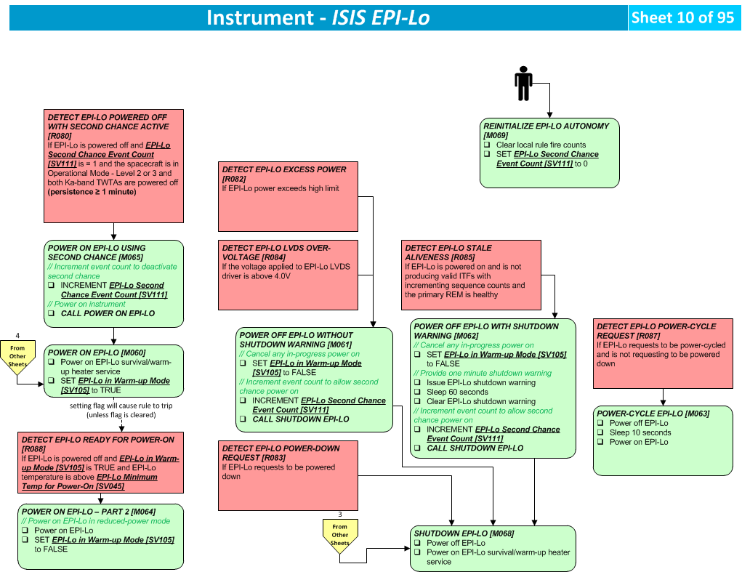
EPI-Lo Design

Slide 18
Payload Design Overview
Autonomy powers down the entire payload with shutdown warnings when configuring for the following spacecraft modes
  Operational Mode – Level 2 (outside 0.25 AU)
  Operational Mode – Level 1
  Safe Mode – Standby
  Safe Mode – Earth Acquisition
  Safe Mode – Standby + Earth Acquisition
Autonomy powers down the entire payload without shutdown warnings when
  an instrument is powered on outside 0.25 AU while Ka-band TWTA is on
Autonomy powers on the entire payload when configuring for the following spacecraft modes
  Operational Mode – Level 3 (inside 0.25 AU)
  Operational Mode – Level 2 (inside 0.25 AU)
Note: Flight Software will directly shutdown payload without warning on a demotion into Safe Mode – Solar Array

Slide 19
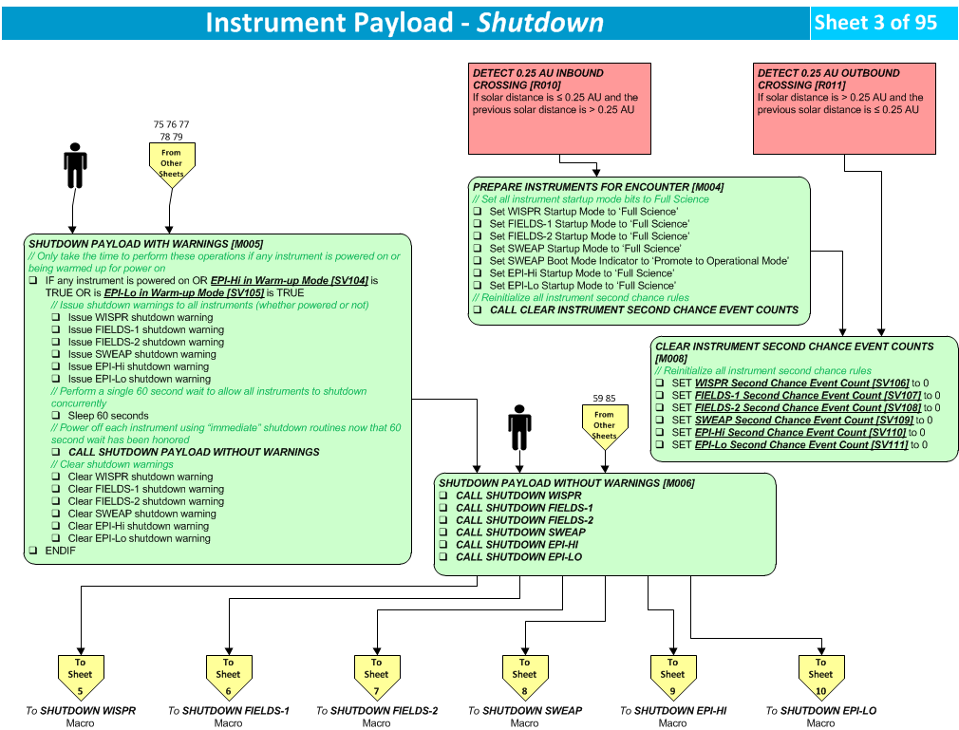
Payload Design (1 of 2)

Slide 20
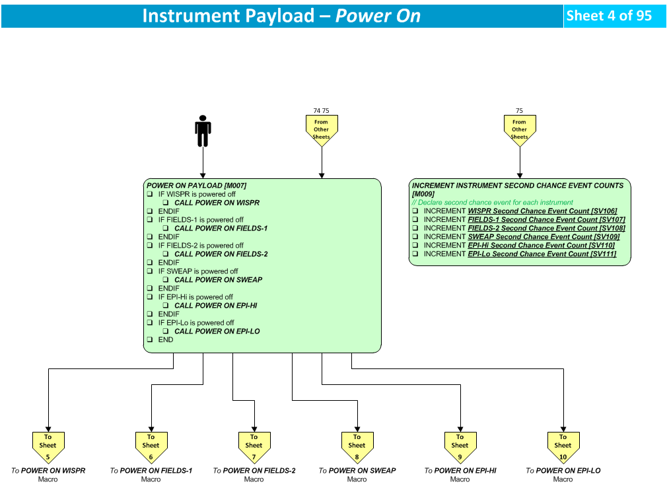
Payload Design (2 of 2)

Slide 21
Instrument Heaters Overview
Instrument heaters are single string
EPI-Lo survival and warm-up heaters are software controlled
  EPI-Lo does not have operational heaters
Autonomy also enforces instrument heater ground rules (individually negotiated with each instrument team)
  Instrument heater over-conductance rules eliminated post-Autonomy CDR with agreement from all instrument teams

Slide 22
Instrument Heater Requirements
AUT-169 | Autonomy shall power on the EPI-Lo survival/warm-up heaters if the heaters are powered off and any of the following conditions are true: 1. EPI-Lo is powered off and EPI-Lo's temperature is below a programmable powered-off low limit -OR- 2. EPI-Lo is powered on in reduced-power mode and its temperature is below a programmable reduced-power/warm-up low limit
AUT-170 | Autonomy shall power off the EPI-Lo survival/warm-up heaters if the heaters are powered on and any of the following conditions are true: 1. EPI-Lo is powered off and is not being warmed-up for power-on and its temperature is above a programmable powered-off high limit -OR- 2. EPI-Lo is powered on in reduced-power mode and its temperature is above a programmable reduced-power high limit -OR- 3. EPI-Lo is powered on in full-power mode

Slide 23
EPI-Lo Heater Power-On Sequence Details
EPI-Lo (differences from EPI-Hi shown in purple)
  When the instrument is off Autonomy operates the survival/warm-up heater service as a “software thermostat” between two programmable thresholds
  When the instrument is in Warm-up mode, Autonomy turns the heaters on and drives up the temperature
  Autonomy then waits until the instrument’s temperature is safe for power-on before applying power to the instrument
    When the instrument is powered it will start in Low Power mode
  Autonomy will continue to operate the survival/warm-up heater as a “software thermostat” between two different programmable thresholds while the instrument is in Low Power Mode
    The instrument will autonomously transition itself into Full Power Mode
  When the instrument is powered in Full Power Mode, Autonomy powers off the survival/warm-up heaters (instrument’s FSW will manage internal heaters)
  Note: Although the EPI-Lo survival/warm-up heater service includes a thermostat, it is only used only as a backup mechanism to mitigate a PDU failure. The primary temperature control is via Autonomy.

Slide 24
EPI-Lo Power-On Sequence Diagram

Slide 25
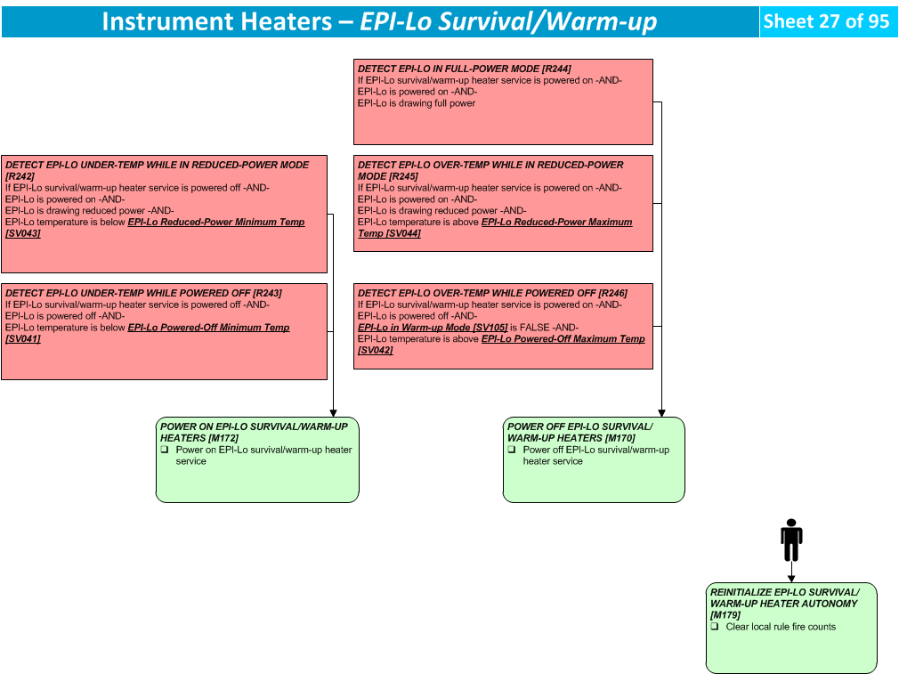
EPI-Lo Design

Slide 26
Summary
Instrument autonomy needs are well understood
Spacecraft autonomy team is staffed and ready to start rule development
Key Milestones:
  June 2015 FSW Build 1 Delivered and Available
    Includes Autonomy Engine and FSW interfaces to components
    Autonomy implementation and testing can proceed in earnest
  January 2016 FSW Build 2 Delivered and Available
    Includes most planned FSW functionality
    Autonomy implementation and testing continues
  July 2016 FSW Build 3 Delivered and Available
    Includes all planned FSW functionality
  August 2016 Delivery of Autonomy System to Spacecraft I&T
    Autonomy implementation and unit testing should be complete
    Start of autonomy testing on spacecraft and high fidelity simulators
    Fault Management testing begins on spacecraft and simulators

