Slide 1
24 – EPI-Hi Software
Andrew Davis & Rick Cook
EPI-Hi Software Engineering (Caltech)
Notes:
introduction

Slide 2
Outline
Flight Software Overview - Requirements
Flight Software Context – Architecture, main tasks
Changes Since Preliminary Design Review
Detailed Software Design
Functional description
Structural decomposition
Timing
Commands and Telemetry
Resource Margins
Software Verification and Testing
Development Environment
Status of Engineering Model Software
Development Environment and Support of Flight Operations
Backup Materials

Slide 3
Software Requirements
The EPI-Hi Flight Software Requirements Document details the flow-down from higher-level requirements, and from the GI and ISIS ICDs
These requirements are quite similar to those for our work on recent NuSTAR and STEREO missions
The same modular flight processor and software architecture that we used for NuSTAR and STEREO will meet the EPI-Hi requirements
The requirements are mapped into a set of modular software tasks, implemented on the EPI-Hi flight processors

Slide 4
Key/Driving Requirements
See the following slides in EPI-Hi Sensor Design Presentation:
Measurement Requirements
Species & Energy Coverage and Energy Binning
Helium Isotope Identification
Electron Identification
Measurement Cadences
Dynamic Range in Particle Intensities
Also see the FSW Reqs Doc, where, in addition to the above, we also have
Boot/initialization reqs
Time Synchronization reqs
Fault Protection & Autonomy
Command Processing
Event processing rate (events processed/second)
Thermal Control
Bias Supply, LVPS Control

Slide 5
Processor and Software Architecture
Software distributed across 4 Minimal Instruction Set Computers (MISCs)
1 MISC in DPU, 1 each in LET1, LET2, HET
Custom FPGA-embedded micro-controller
Design implemented in Actel RTAX250SL
Architecture used in STEREO and NuSTAR space missions
24-bit CPU, up to 512 Kwords SRAM, Forth operating system, can boot from MRAM or serial interface
MISC design and FORTH operating system stable since 2002
Only DPU MISC has MRAM (2M×8).
DPU can boot from MRAM, or via serial uplink from ground
The three “telescope” MISCs communicate with DPU MISC via RS-422 serial links, 460.8kbps
Telescope MISCs booted via serial link by DPU MISC
Telescope MISCs use boot images from DPU MRAM
Notes:
The P24 MISC has a 24-bit CPU core with dual stack architecture intended to efficiently execute Forth-like instructions. The processor design is simple to allow implementation within field programmable gate arrays. The basic MISC processor design is in the public domain. For the EPI-Hi application, the MISC design is implemented in the ACTEL RTAX250SL FPGA, with Caltech SRL customizations developed for the STEREO mission. The MISC can be clocked at speeds up to 25MHz; we will use [14.7] MHz (TBC) for the EPI-Hi application.
See the P24 MISC Processor Manual and Software Dev plan for more details.

Slide 6
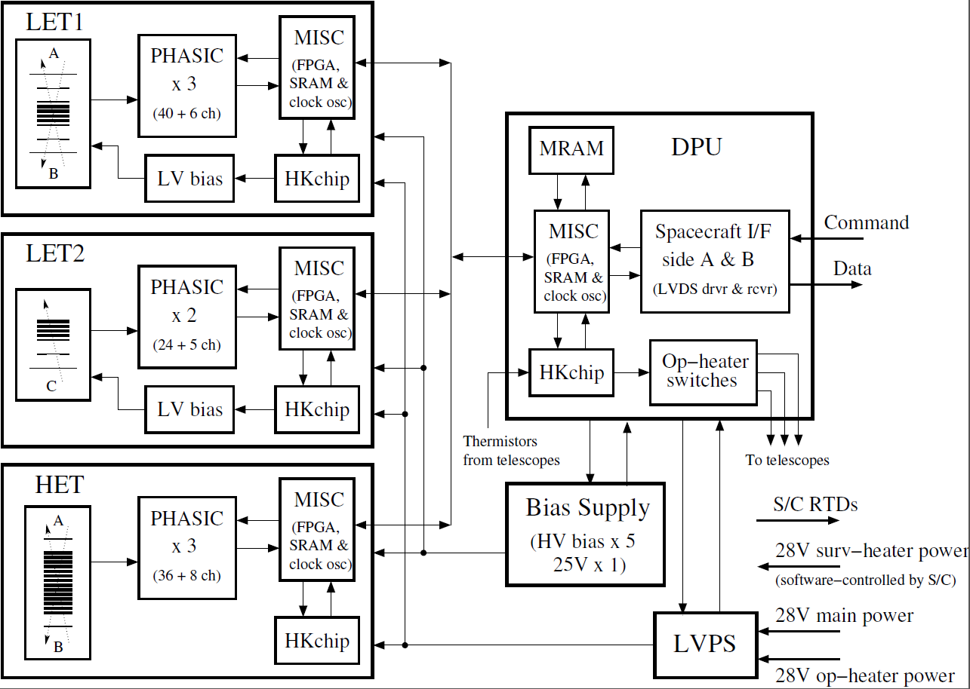
Processor and Software Architecture
Notes:
Data from the MISCs associated with the LET1, LET2 and HET telescopes (the peripheral MISCs) will be gathered by the DPU MISC and formatted for transmission to the spacecraft (per the SPP GIS
Interface between the EPI-Hi DPU and the spacecraft
The DPU MISC will interface with the spacecraft via two serial interfaces: command and telemetry (see Figure 2.1). These interfaces are defined in the SPP GIS. Commands, telemetry data and command responses from the DPU will be in the form of CCSDS packets enclosed within Instrument Transfer Frames (ITFs). The ITF protocols for transferring commands, command responses, and telemetry data over these interfaces are also defined in the EPI-Hi Instrument/Spacecraft ICD. Instrument telemetry data formats, and instrument CCSDS data packet definitions will be defined in the EPI-Hi Instrument Science Data Format document (Ref. 9).
Interface between the DPU MISC and the LET1, LET2, and HET MISCs
There will be two RS422 serial interfaces between the DPU MISC and each of the three peripheral MISCs (LET1, LET1, and HET MISCs). The first interface will be bi-directional, for transferring boot-code, commands, and command responses. The second interface will be uni-directional, for transferring data from the peripheral MISCs to the DPU. These interfaces will be defined in the EPI-Hi Inter-MISC command/data interface Document (Ref. 8).

Slide 7
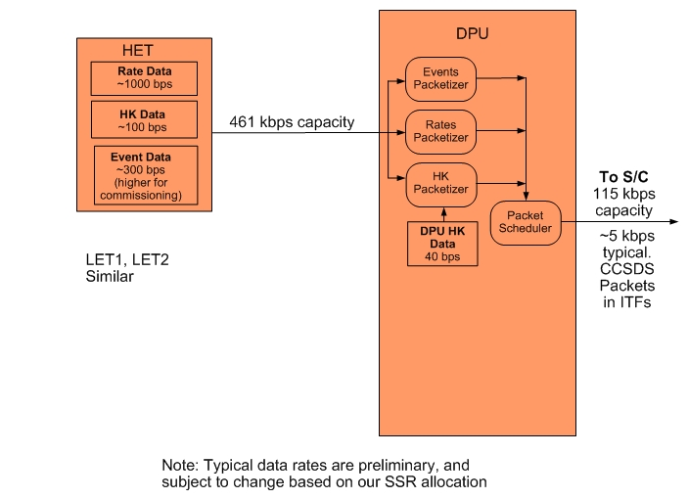
Instrument Data Flow

Slide 8
DPU Software Tasks
All DPU FSW Requirements are mapped into one or more of the following tasks:
Forth operating system and low-level I/O routines
Power-on and initialization sequence management
Telescope MISC serial boot sequence management
Command table maintenance
Housekeeping data collection
Inter-MISC communication management, and data acquisition/buffering from satellite MISCs
Support time-tagged command capability (macros), to support autonomous instrument operations during encounters
Setup and control of instrument LVPS, bias supply
Active control of operational heaters
Receive/Monitor status and time-synchronization data from the spacecraft, and perform autonomous mode adjustments as needed
Receive and process ground commands
Management of software uploads and MRAM “burns”
Time-averaging of science rates data
Formatting/compression/packetizing and transfer of science & housekeeping data and command responses to the Spacecraft
Monitor heartbeat from peripheral MISCs, and perform autonomous diagnostics/reboot as needed
Manage volume of instrument data transferred to SSRs on S/C as function of time

Slide 9
Telescope MISC Software Tasks
All DPU FSW Requirements are mapped into one or more of the following tasks:
Forth operating system and low-level I/O routines
Science data acquisition
Detection and handling of crosstalk signals from PHASICs
Science data processing and reduction (particle ID)
Science and diagnostic rates data accumulation
Command table maintenance
Housekeeping data acquisition
Processing of status, time-synchronization, and command data from the EPI-Hi DPU
Monitor key counting rates and adjust the telescope operating condition to optimize data quality (dynamic adj. of detector thresholds)
Monitor temperatures and adjust detector gain/offset settings to compensate for temperature variations
Formatting and transfer of science & housekeeping data and command responses to the EPI-Hi DPU
Setup and control of PHASICs and HK chips, and any instrument HV, bias supply, heaters, etc. not controlled by the EPI-Hi DPU.

Slide 10
Action Items from PDR
RFA #8: A 16-bit shift register to capture time history of discriminator output was added to the PHASICS to assist with identification of crosstalk in software. The corresponding software requirements need to be added to the specifications to support the required algorithms to detect crosstalk and to correct crosstalk.
Status: Added L5-INSTSW-74 FSW Requirements to support detection/correction of crosstalk in PHASIC signals
RFA #32: Since the SPP spacecraft flight software is not supporting time-tagged commands for instruments, if there is a need for this functionality, a requirement needs to be added to support time-tagged commands in instrument software.
Status: Modified L5-INSTSW-6 to make clear that time-tagged command sequences shall be supported in the FSW

Slide 11
FSW Peer Reviews Since PDR
Summarize results and action items from Nov 17 FSW Peer Review

Slide 12
Other Changes Since PDR
Results of trade studies (none)
Major changes in software requirements
Added rates compression task to DPU requirements
Major changes in ICDs (none)
Major changes in top-level design (none)
Major open technical issues, programmatic issues, or risks (crosstalk detection? …?)

Slide 13
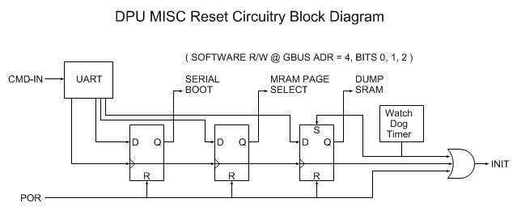
Boot Sequence and Initialization
Supports three ways to initiate boot: Power On Reset (POR), CMD-IN and Watch Dog Timer
“Reset Bit Field” is writable by CMD-IN and R/W by software
“Serial Boot” bit determines if boot is to be performed serially via CMD-IN or from MRAM
“MRAM Page Select” bit determined which page (0 or 1) of MRAM is source of boot images.
“Dump SRAM” bit determines if SRAM is dumped prior to boot. This bit is set by the watch dog timeout.
Details of resident boot program in backup slides

Slide 14
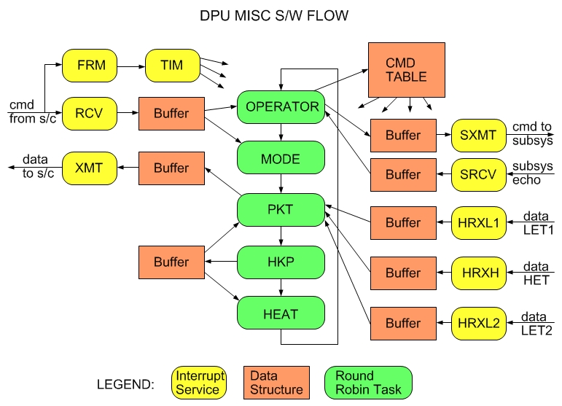
Software Flow – DPU MISC

Slide 15
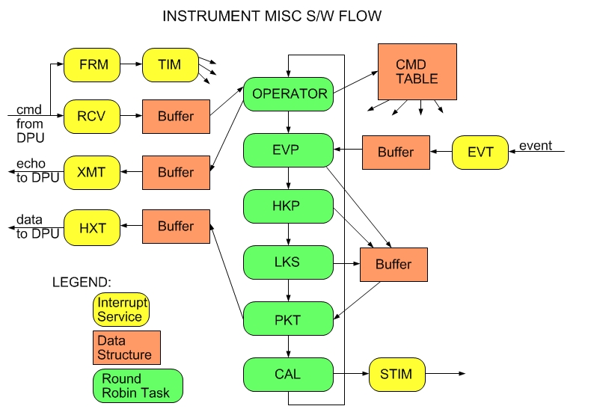
Software Flow – Telescope MISC

Slide 16
Critical Tasks: Metering of Telemetry to SSR
Available Inputs
From Spacecraft Time/Status Message, updated every second
Mission Elapsed Time (MET). Seconds since Jan 1 2010 (drifts).
Solar Distance (km).
Solar Distance Valid. 0=Not valid. 1=Valid.
Solar Distance Inflection. 0=Decreasing. 1=Increasing.
EPI-Hi SSR Allocation Status: SSR%FULL: 0-255. 255 = 100%
Note: S/C stops recording new EPI-Hi data to the SSR when this parameter reaches 255 (100% full)
Inputs set via ground command to DPU, prior to each Encounter
Total SSR Allocation (bytes): SSR_ALLOC. Equals number of bytes written to SSR when SSR allocation Status from spacecraft = 255 (100%).
This could be the same for every encounter, but may change…
Needed for DPU to meter the data flow to SSR.
Encounter Start time (MET seconds): ESTART (or Encounter Start Solar Distance?)
Predicted Encounter time length (seconds): ELENGTH
Needed for DPU to meter the data flow to SSR.
Amount of SSR allocation to reserve for use after end of encounter (bytes): SSR_RESERVE
EPI-Hi will (hopefully) be powered-up and delivering low-rate data to the SSR after the end of each encounter. The SSR allocation status from the spacecraft will be adjusted downwards (or reset to 0%) at some point after the end of the encounter, but the timing is TBD.

Slide 17
Critical Tasks: Metering of Telemetry to SSR
Proposed Data Metering Algorithm
WHILE (Encounter==TRUE)
Each Hour (or whatever time unit we agree upon)
#HOURS_LEFT = (ESTART + ELENGTH – MET)/3600
#BYTES_LEFT = (SSR_ALLOC * SSR%FULL) – SSR_RESERVE
IF (#BYTES_LEFT > 0)
#BYTESPERHOUR = #BYTES_LEFT/#HOURS_LEFT
ELSE
#BYTESPERHOUR = 0
ENDIF ENDWHILE
Nominally, the #BYTESPERHOUR value is enough to send 1 hour of “IN_ENCOUNTER” EPI-Hi rates and HK data, plus some events, to the SSR.
If solar activity is low early in an encounter, we won’t collect enough events in an hour to use up the full #BYTESPERHOUR. Thus, #BYTESPERHOUR may grow in size later in the encounter.
If we have a situation where we have to start an encounter and #BYTESPERHOUR < Rates+HK, then DPU will have a capability to decimate the Rates data

Slide 18
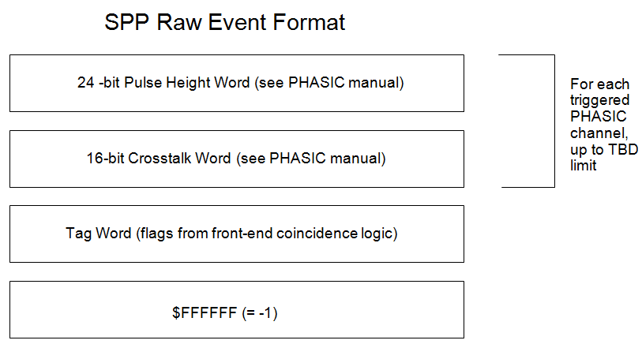
Critical Tasks: PHASIC Crosstalk Detection
To aid in identifying signals that have been contaminated by pileup or crosstalk, a 16 bit shift register in each PHASIC low and high gain signal chain is configured to sample the discriminator output.
During livetime and for about 0.5 usec after the system-wide closing of all linear gates via the clg signal (see PHASIC Manual, Ref. 11) the shift registers are clocked at 4 MHz.
When the clocking stops following clg, the shift registers are frozen until they are read out and contain information about the prior 4 usec of discriminator activity.
These shift registers for monitoring the discriminator activity were added for the Solar Probe PHASIC based on experience with the use of the STEREO PHASICs.
For each detector signal (pulse-height) read out from the PHASIC, 16 bits of discriminator output are also read out. The characteristics of these 16 bits are different for crosstalk signals versus real signals.

Slide 19
Critical Tasks: PHASIC Crosstalk Detection
CT_THRESH = Amplitude above which a valid pulse-height can generate crosstalk signals.
CT_MAX = Maximum amplitude of a crosstalk signal
FOR Each PHASIC
Find highest-amplitude signal = SIG_HI
IF (SIG_HI > CT_THRESH)
Scan through the PHASIC channels, and delete all channels from the list for which the 16 bits of discriminator output indicate the signal results from crosstalk.
Also delete from the list all channels from the list with pulse-height amplitude < CT_MAX, since they are likely to be crosstalk signals.
ENDIF
ENDFOR
The event is then processed, paying attention only to the channels left in the list, per the documented Onboard Event Processing scheme.

Slide 20
Critical Tasks: Thermal Control
Need description of op-heater thermal control algorithm from WRC

Slide 21
Critical Tasks: Inter-MISC communication
There are two standard RS-422 serial interfaces between the DPU and each of the telescope MISCs.
The first is a bi-directional interface for the transfer of commands and boot code from the DPU to the module, and the transfer of command responses from the module to the DPU. This interface is multiplexed between the modules.
The second serial interface is unidirectional, for the transfer of data from the subsystem to the DPU. The data interface is not multiplexed between the subsystems – each subsystem has its own data interface with the DPU.
Need description of CU “login” software used by DPU to communicate with telescope MISCs
Need description of block data and double-buffering system used to transfer data from telescope MISCs to DPU

Slide 22
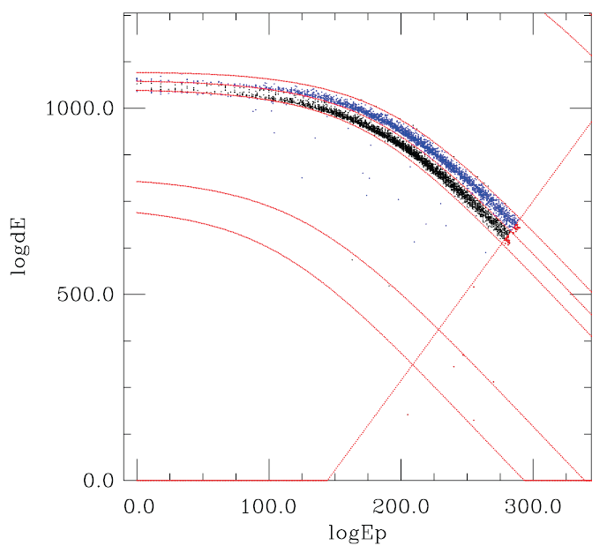
Critical Tasks: Onboard Particle ID
Output from a LET1 Monte Carlo simulation of 3He and 4He events was used as input to the latest version of our onboard particle ID algorithm, implemented on a MISC test board
Onboard algorithm maps events into a 2D dE-Eprime space, where boundary-curves define different regions for different species
Code currently processes events at ~ 9600 events/second, ~4x faster than max incoming rate
4He
3He
protons

Slide 23
Critical Tasks: Rates Averaging and Compression
Describe division of labor between telescope MISCs and DPU MISC for this task
Telescope MISCs perform all rate accumulations up to 1 minute cadence
DPU MISC performs all rate accumulations for cadences > 1 minute
Describe rate compression algorithm:
One simply takes a list of N fixed-length rates and just telemeters only those that are non-zero; a list of N tag bits is attached as a header to each block of N rates to indicate which rates made the cut.

Slide 24
Critical Tasks: Dynamic Adjustment of Detector Thresholds

Slide 25
Timing
Describe DPU and Telescope MISC timing cycle(s)

Slide 26
Commands
List commands implemented by the software
Group by functional area

Slide 27
Telemetry
List telemetry packets produced by the software
Please see the EPI-Hi Telemetry Data Format Doc, as this cannot be summarized in a single slide

Slide 28
Predicted memory, CPU Margins
LET1 MISC (LET2, HET similar)
SRAM 512kwords available (512k x 24 bits)
Basic OS, HK, I/O code + tables 20kwords
Event processing, particle ID 210kwords
Rates counters, double-buffered 10kwords
Event priority buffers 25kwords
SRAM usage ≈ 265/512 = 52%
MIPs 12 60% used (Maximum, dominated by event processing during intense SEP events)
DPU MISC:
SRAM 128kwords available (128k x 24 bits)
Basic OS, HK, I/O code + tables 20kwords
Detector module data buffers,
& rate accum, double-buffered 30kwords
CCSDS Packet buffers 20kwords
SRAM usage ≈ 70/128 = 54%
MRAM 2M x 8 bits ~70% used (2 sets of boot images)
MIPs 12 20% used
Needs Update

Slide 29
Integration, Testing and Verification
The EPI-Hi Flight Software Test Plan document defines this plan in detail. This plan will include a software requirements verification matrix.
Software tests will start at the module level. As the code builds up, system-level testing will start, and the majority of the test time will be targeted at the system level.
A Test Readiness Review will precede formal acceptance testing. SPP Project and ISIS personnel will oversee/participate in this review.
Formal acceptance tests will be performed on the EPI-Hi instrument, including the flight software, during the EPI-Hi integration and test phase.
During environmental tests and SPP I&T, more experience will be gained with the flight software, real sensor data, and with controlling the instrument via the SOC-MOC interfaces. Flight software changes may be expected as a result. Any changes in the flight software at this stage will result in CCB review, and a repeat of these acceptance tests.
The acceptance tests for the EPI-Hi flight software will be designed to verify each of the software functional requirements as called out in the requirements documents and also the functions provided by the Forth operating system, the I/O API, and the multitasking software running on the MISC processors.
A software requirements verification matrix will be created and maintained by the EPI-Hi team to aid in verifying that the software meets the requirements. The matrix will be available for review by the SPP Project. A preliminary software requirements verification matrix will be presented at CDR and a final version will be presented at the Software Acceptance Review, following successful completion of the acceptance tests.
A Software Acceptance Review will follow the successful completion of the acceptance tests, and the EPI-Hi team will present a test report. SPP Project will oversee/participate in this review.
Needs Update – describe WHAT tests will be conducted, test env, EGSE

Slide 30
Software Maintenance, Configuration Management
Configuration Management Plan is contained in Software Development Plan
Version control and software archiving: achieved via Subversion version control system (SVN) (http://subversion.apache.org/). The subversion server is hosted and maintained by Caltech Space Radiation Lab IT personnel. It is access-controlled for security, and is backed-up regularly.
The lead engineer will maintain the structure of the SVN repository, including separate directories for each of the MISC’s flight software, separate directories for different software builds, etc.
All problems and change requests will be documented/tracked in the Software Development Log by the lead engineer. Given such a small dev team, a change request tool such as JIRA is an unnecessary overhead.
After the beginning of I&T with flight hardware, all flight software changes will be approved by a CCB prior to being loaded into flight hardware. Also after this point, Version Description Documents (VDDs) will accompany all Software releases. The VDD will contain the functionality of the release, a list of closed software problem reports, a list of any liens/workarounds, installation instructions, and a list of deliverable source code files.
The CCB membership will consist of the EPI-Hi lead engineer and software developer, and the Epi-Hi Project Manager, plus any other ISIS or SPP Project engineers that the QA team at SWRI deems necessary.
Notes:
More details in Dev plan

Slide 31
Status of Engineering Model Software
Describe state of software currently in use on engineering model

Slide 32
Development Environment
Initial testing of new code takes place on MISC development boards
Forth system on development boards accessed via serial link to PC
New code is easily uploaded via the serial link
Testing of code that accesses hardware is done on EM units
Low-level MISC I/O routines are in everyday lab use, where MISCs are used to acquire test data and control test runs
The same central MISC / multiple satellite MISC architecture was used for NuSTAR and STEREO
EM units are preserved after launch, and used for testing/verification of software uploads and command sequences
NuSTAR MISC EM board
Needs Update – Flatsat EM unit picture
Notes:
Update with EPI-Hi EM board pic?

Slide 33
Flight Software Backup Materials
Candidate materials for
Instrument Critical Design Review

Slide 34
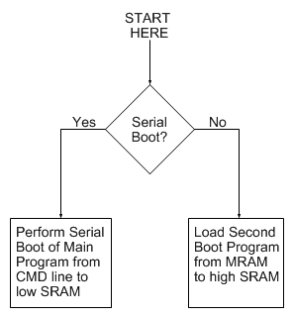
FPGA Resident Boot Program
Permanently coded as part of FPGA design.
Simple and small: <64 – 24 bit words
Either performs serial boot of Main Program into low SRAM via CMD-IN
Or loads second boot program from MRAM into high SRAM

Slide 35
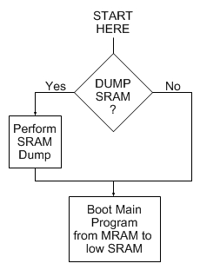
Second Boot Program
Optionally performs SRAM dump prior to booting Main Program from MRAM to low SRAM.
SRAM dump is somewhat complex, does not fit into FPGA resident boot program; hence need for second boot program.

Slide 36
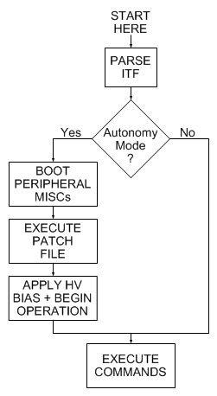
Main DPU Program
Reads and parses ITF from S/C.
Determines if in “autonomy mode”.
If so, boots peripheral MISCs, executes MRAM Patch File, applies HV bias, begins science operations in mode specified in S/C status message.
If not, just awaits further commands; i.e. during commissioning.

