Slide 1
Epi-Hi Flight Software
Detection and Handling
of Crosstalk signals from the PHASICs
for Epi-Hi
Andrew Davis
November 05, 2014

Slide 2
Description of Task
From Flight Software Requirements Doc:
Each Peripheral MISC FSW shall be capable of using the 16-bit shift register data provided by the PHASICs to detect and flag detector signals that result from crosstalk.
Context: To aid in identifying signals that have been contaminated by pileup or crosstalk, a 16 bit shift register in each PHASIC low and high gain signal chain is configured to sample the discriminator output. During livetime and for about 0.5 usec after the system-wide closing of all linear gates via the clg signal (see PHASIC Manual, Ref. 11) the shift registers are clocked at 4 MHz. When the clocking stops following clg, the shift registers are frozen until they are read out and contain information about the prior 4 usec of discriminator activity. These shift registers for monitoring the discriminator activity were added for the Solar Probe PHASIC based on experience with the use of the STEREO PHASICs.
Rationale/Flowdown: Self-imposed
ID: L5-INSTSW-75

Slide 3
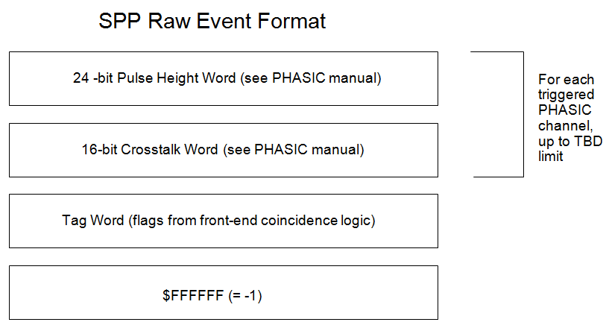
Available Inputs (1)
For each detector signal (pulse-height) read out from the PHASIC, 16 bits of discriminator output are also read out. The characteristics of these 16 bits are different for crosstalk signals versus real signals.

Slide 4
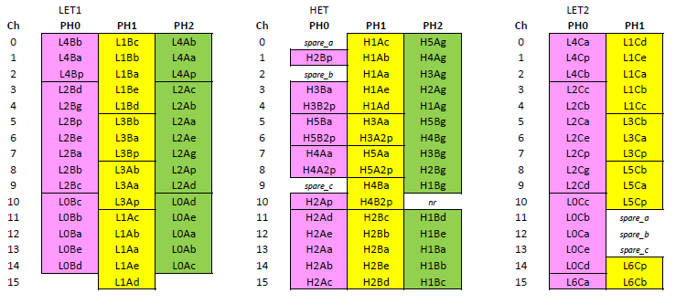
Available Inputs (2)
Within each telescope (LET1, LET2, HET), the detector signals are routed to the PHASIC inputs such that signals from adjacent detector layers are not on the same PHASIC.
This minimizes the chance that the coincidence-logic generates false triggers due to crosstalk signals.
Also, within each PHASIC, it is possible to identify crosstalk signals based on their amplitude, and the amplitude of the largest signal in the PHASIC – see later slides

Slide 5
Crosstalk Characteristics
What signal levels in one channel generate crosstalk signals on other channels in a PHASIC?
What is the distribution of amplitudes of crosstalk signals? Maximum amplitude?
If a channel on a PHASIC has a signal large enough to generate crosstalk, are all other channels on that PHASIC affected the same?
What about 2 large valid signals on a PHASIC? Do the crosstalk signals on other channels add?
This is TBD – Can Rick Cook provide input? Is this all the same as in STEREO PHASICs?

Slide 6
Examples of Valid and Crosstalk patterns in 16-bit Discriminator Shift Registers
This is TBD – Can Rick Cook provide input?

Slide 7
Proposed Crosstalk Detection Algorithm (1)
CT_THRESH = Amplitude above which a valid pulse-height can generate crosstalk signals.
CT_MAX = Maximum amplitude of a crosstalk signal
FOR Each PHASIC
Find highest-amplitude signal = SIG_HI
IF (SIG_HI > CT_THRESH)
Scan through the PHASIC channels, and delete all channels from the list for which the 16 bits of discriminator output indicate the signal results from crosstalk.
Also delete from the list all channels from the list with pulse-height amplitude < CT_MAX, since they are likely to be crosstalk signals.
ENDIF
ENDFOR
The event is then processed, paying attention only to the channels left in the list, per the documented Onboard Event Processing scheme.

