Slide 1
Review of Suitability of PHASIC Design Parameters for the Meeting Science Requirements of the ISIS/EPI-Hi Instrument for Solar Probe Plus

Slide 2
Introduction: Sensor System
EPI-Hi is designed to measure energetic nuclei from ~1 to ~100 MeV/nuc and electrons from ~0.5 to ~5 MeV including:
identification of major elements
identification of ³He
energy spectra
angular distributions
timing
the sensor system consists of three solid-state detector telescopes including:
one double-ended Low Energy Telescope designated LET1
one single-ended Low Energy Telescope designated LET2 largely identical to LET1 but omitting the end that is blocked by the SPP spacecraft
one double-ended High Energy Telescope (HET)

Slide 3
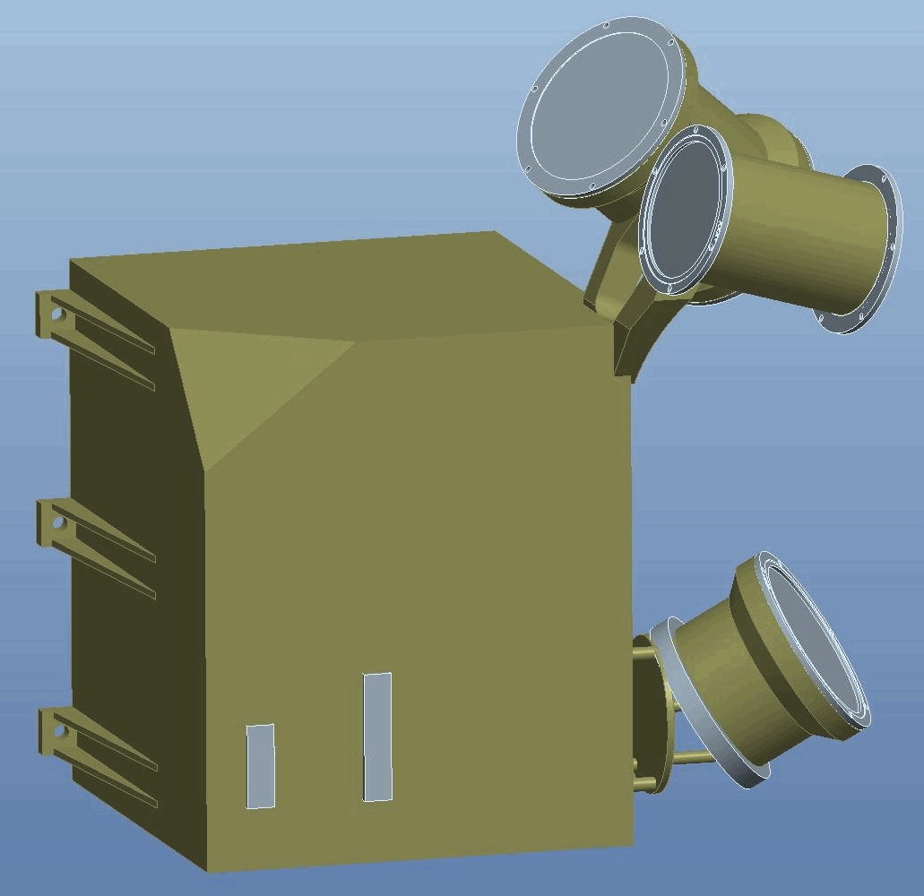
EPI-Hi Configuration
LET1 (double ended)
HET (double ended)
Electronics Box
LET2 (single ended)

Slide 4
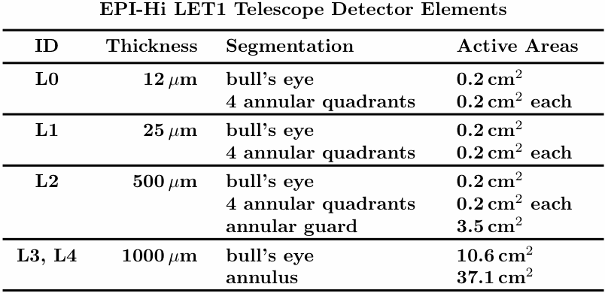
Note: active Si is shown in color, inactive materials in black or grey.

Slide 5
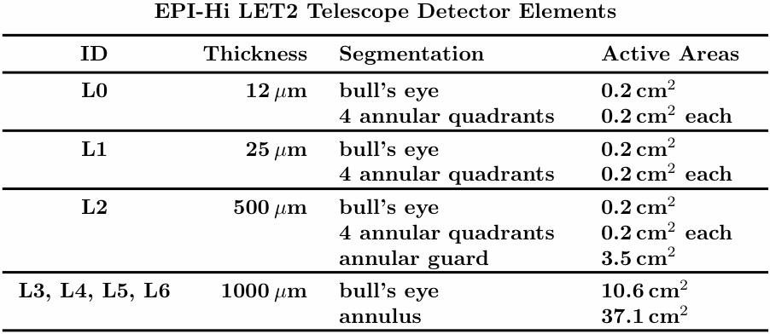
Note: active Si is shown in color, inactive materials in black or grey.

Slide 6
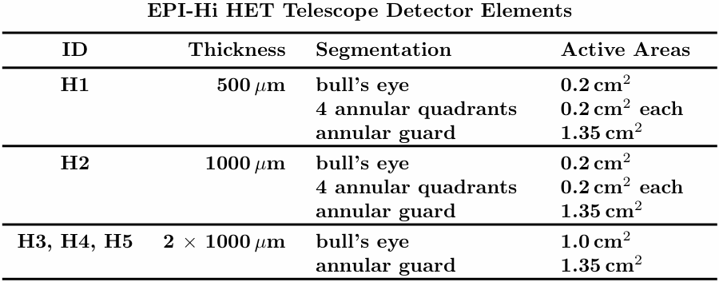
Note: active Si is shown in color, inactive materials in black or grey.

Slide 7
Introduction: Front End Electronics
Measurements of particle energy losses in the solid state detectors are made using a Caltech-designed ASIC that is packaged with associated passive components in a hybrid circuit. The ASIC and the hybrid in which it is incorporated are called the ``PHASIC’’
The PHASIC was originally developed for the LET and HET instruments on the STEREO mission. They have continued to perform well in these applications from launch in 2006 through the present.
EPI-Hi requires an new version of the PHASIC in order to meet the harsher radiation requirements of the SPP mission. The goal is to achieve total dose tolerance >100 krad versus the ~12-20 krad of the STEREO PHASIC.
Although most of the SPP PHASIC design has been directly adapted from the STEREO version, several performance enhancements have been incorporated. The most significant of these is an increase of the dynamic range from ~10000 (full scale/threshold) to at least 23000 to allow measurements from electrons through Z=30 nuclei.

Slide 8
Present Status and Near-Term Plans
Design of the SPP PHASIC has been completed and the layout is approaching completion. Details of the ASIC design and validation were successfully reviewed (6 Dec 2012).
The SPP PHASIC design is about to be submitted for fabrication of a prototype ASIC using a non-rad-hard process equivalent to that used to make the STEREO ASIC. This ASIC will be installed in refurbished hybrids left over from STEREO in order to:
obtain ASICs for testing on a significantly shorter time scale and at significantly lower cost than is possible for the final rad-hard parts.
test the performance in comparison to expectations based on Spice simulations
provide PHASICs that can be used in developing pulse height analysis boards for the EPI-Hi engineering model (EM)

Slide 9
Objective and Scope of this Review
Parameters for use in the PHASIC design were selected to optimize the ASIC for use with the EPI-Hi detector telescopes to meet the measurement objectives of EPI-Hi.
This review is intended to confirm the adequacy of the ASIC that has been designed for meeting these objectives.
Parameters that should be considered include:
full scale energy
threshold energy
channel resolution
noise performance
capabilities for measurements at high count rates
Some parameters are programmable so that the PHASIC will be suitable for use with a variety of different detector designs. For programmable parameters the suitability of the range of programmability should be considered.

Slide 10
PHASIC Functional Description
The SPP PHASIC includes 16 identical dual-gain pulse height analysis circuits, each of which processes signals from a different detector element.
Each pulse height analysis circuit consists of a single charge sensitive amplifier and two parallel gain and shaping chains each of which is followed by a discriminator, peak detector, and Wilkinson rundown ADC.
The preamplifier sensitivity is programmable using a 4-bit binary value designated N_{f} that determines the feedback capacitance according to
C_{f} = N_{f} x 5 pF (N_{f} = 1, 2, ..., 15)
Additional 1-bit programmability is included in one of the shaping amplifiers such that the ratio between the gains of the two chains can be selected to be either 40:1 or 68:1.
The Wilkinson ADC for each chain provides 11-bit digitization (2048 channels). In addition, the peak detector circuit is configured such that an input of 0 MeV results in an offset channel value ~48.

Slide 11
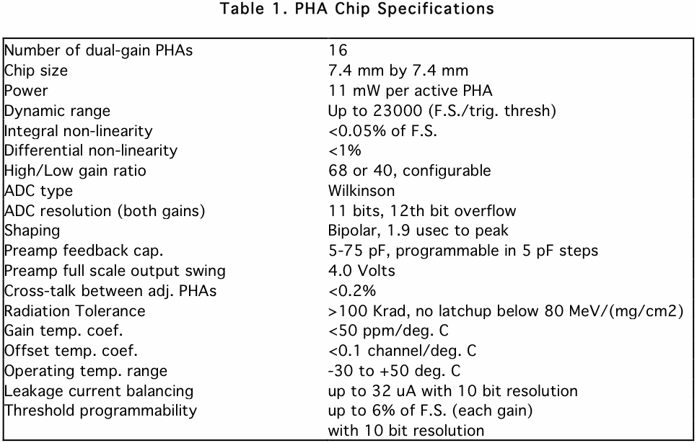

Slide 12
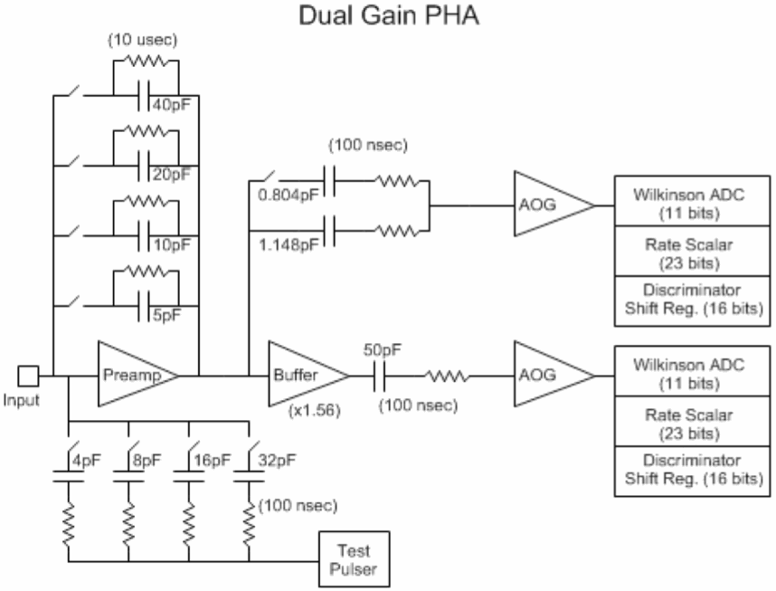
(1 of 16 PHASIC channels)
low gain (LG) chain
high gain (HG) chain
AOG: Amplifier/Offset/Gate circuit

Slide 13
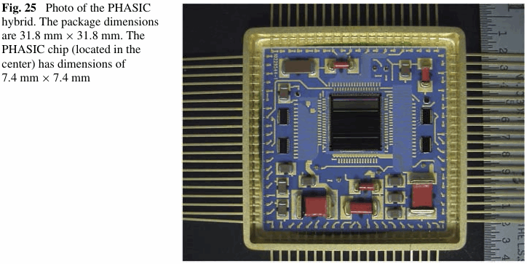
STEREO PHASIC
Mewaldt et al., Space Sci. Rev. 136, 285, 2008
SPP PHASIC is being designed with the constraint that it be compatible with the hybrid packaging used for the STEREO PHASIC:
results in a significant cost reduction compared with developing a new hybrid
allows use of leftover STEREO hybrids (with chip removed) for packaging early engineering units of SPP PHASIC

Slide 14
PHASIC Threshold Requirements
The required detection threshold is driven by the need to measure Z=1 particles (protons and electrons) at moderate-to-high velocities.
In the LET telescopes the threshold determines the highest energy to which protons can be detected since their energy loss in the thin front detectors falls below threshold before they penetrate the entire LET stack. The energy at which this occurs should be high enough to provide some overlap with the lower-end of the HET energy response.
The threshold also determines the efficiency for detecting electrons.
In LET, the thin detectors (L0, 12 μm and L1, 25 μm) are not required for electron measurements. No directional information (other than front-back) is obtained.
In HET, the H1 and H2 detectors (500 μm and 1000 μm, respectively) do provide some directional information, but broadened by electron scattering.
Memo by Dick Mewaldt (which includes the figures shown on the next two slides) explains the threshold requirements in more detail.

Slide 17
Parameters Used in Monte Carlo Simulations
yellow: PHASIC parameters
green: detector parameters
clear: derived quantities

Slide 18
Performance Checks
Monte Carlo simulations were performed to check the ion response of the EPI-Hi telescopes using the SPP PHASIC for processing the signals.
The Monte Carlo included:
requirement that pulses exceed a threshold of PHASIC assumed to be set at 6x the rms noise in the high gain analysis chain
rms noise derived using Spice model of PHASIC and taking into account detector capacitance, feedback and FET gate capacitances, wiring capacitances, and in some cases additional capacitances used for stabilizing the charge amplifier
digitization using high- or low-gain ADC depending on whether pulse height exceeds the full scale of the high-gain ADC
isotropic distribution of incident particles with an assumed E⁻² intensity spectrum
Bohr/Landau fluctuations in particle energy losses
detector dead layers
estimated detector thickness non-uniformity

Slide 19
Performance Checks (cont.)
The ion Monte Carlo did not include:
ion multiple scattering
ion channeling in the Si crystals
dead-layer non-uniformity
Landau/Vavilov energy loss fluctuations beyond those covered by Bohr’s formula (Gaussian approximation)
pulse pileup effects (relevant under high-rate conditions)
cross talk among electronic channels (on-board correction planned, as done for STEREO/LET)

Slide 20
Element Response
For each range (i.e., detector in which particles can stop) plot the energy loss in the last detector penetrated versus the energy in the stop detector
Assumed composition is that typical of large SEP events, but with only the most-common isotope included for each element.
Need to check that the major elements can be identified in each range: H, He, C, O, Ne, Mg, Si, Fe. Other elements will also be included in the on-board analysis, but are not required.
Dashed lines indicate LG full scale, HG full scale, and required trigger threshold. In some cases a second, lower threshold value is also indicated as a goal.
An additional goal is to place the HG full scale between the He and C tracks (to the extent that that is possible) to simplify analysis of data during high rate periods when processing of HG signals may be omitted for some detector elements in order to limit geometrical factor for H and He and thereby reduce dead time.

Slide 21
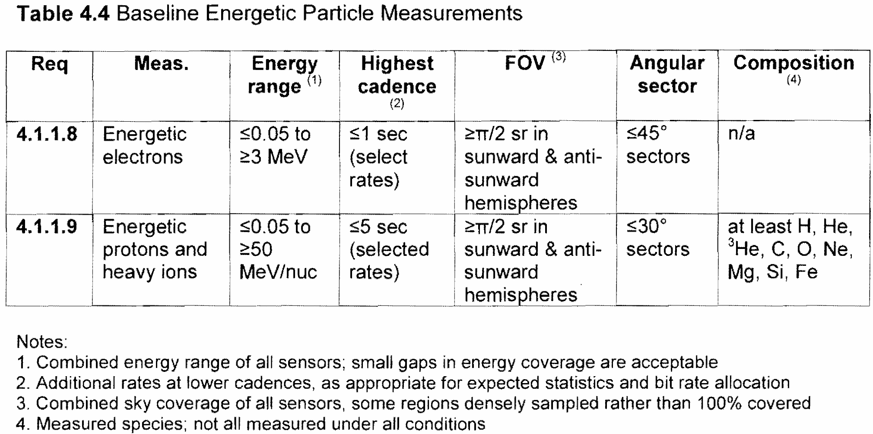
Level 1 Measurement Requirements for Energetic Particles
EPI-Hi covers the energy range above ~1 MeV/nuc for ions and above ~0.5 MeV for electrons
EPI-Lo covers lower energies

Slide 22
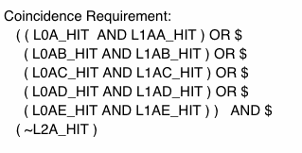
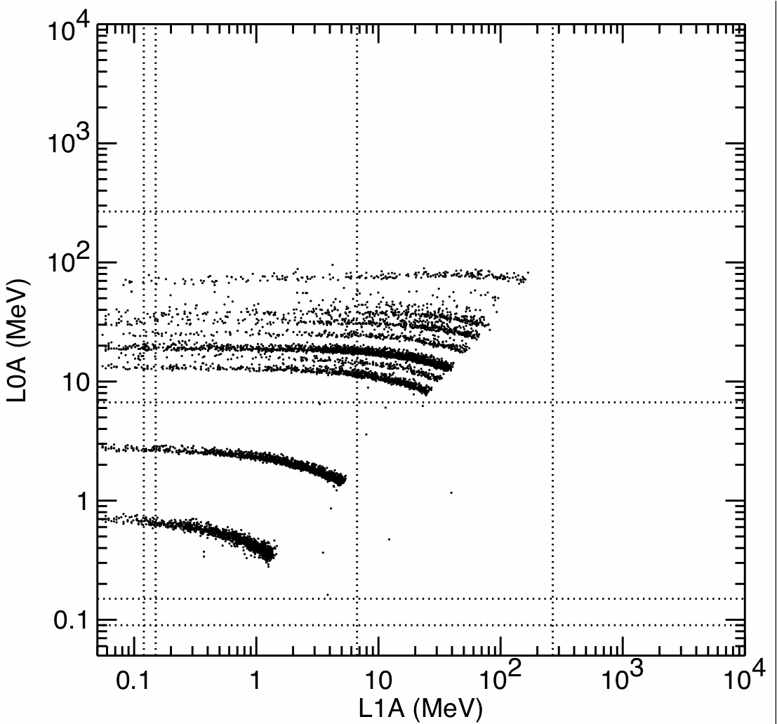
only active Si is shown
Notes:
sim001_let027_cropped.gif

Slide 23
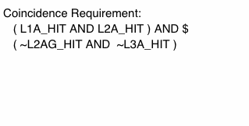
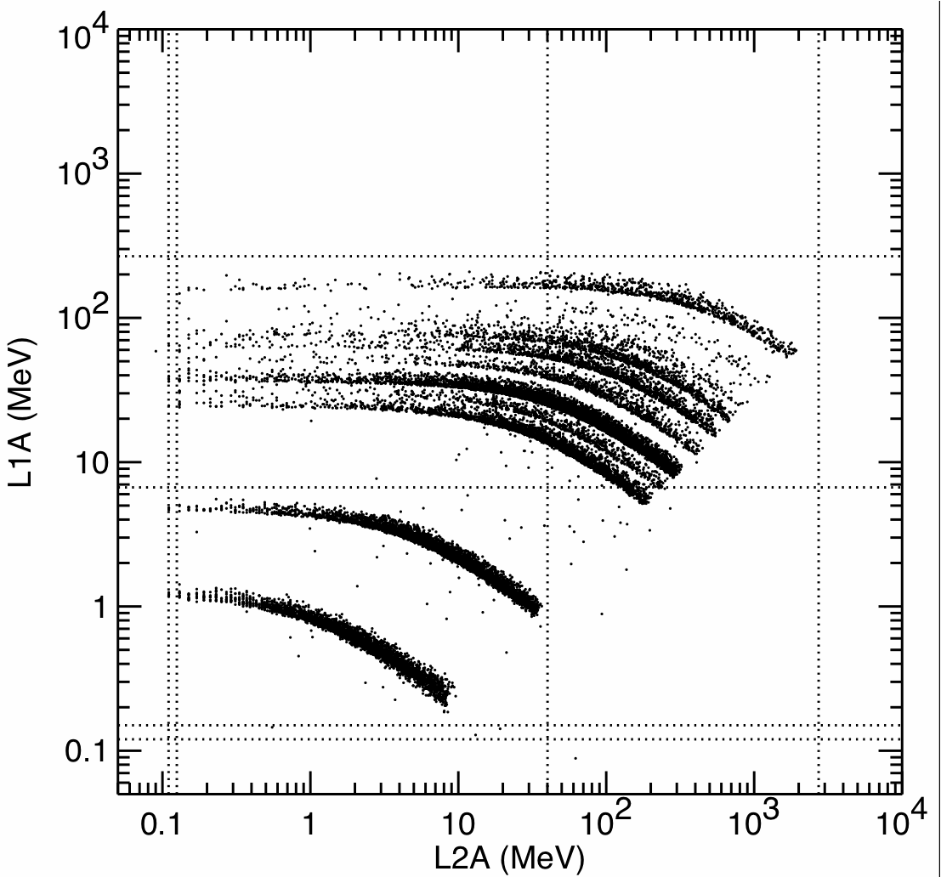
only active Si is shown
Notes:
sim001_let028_cropped.gif

Slide 24
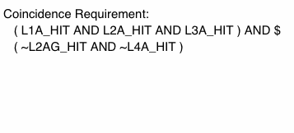
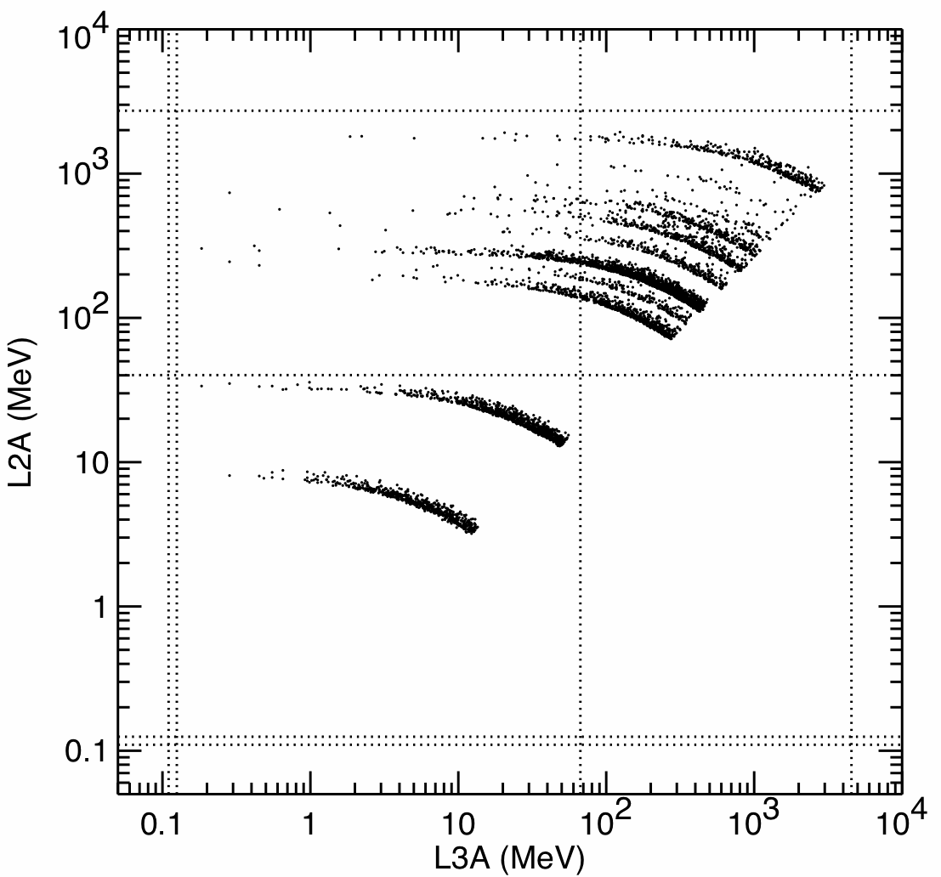
only active Si is shown
Notes:
sim001_let029_cropped.gif

Slide 25
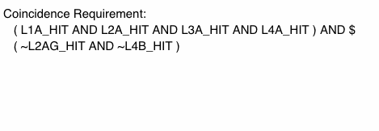
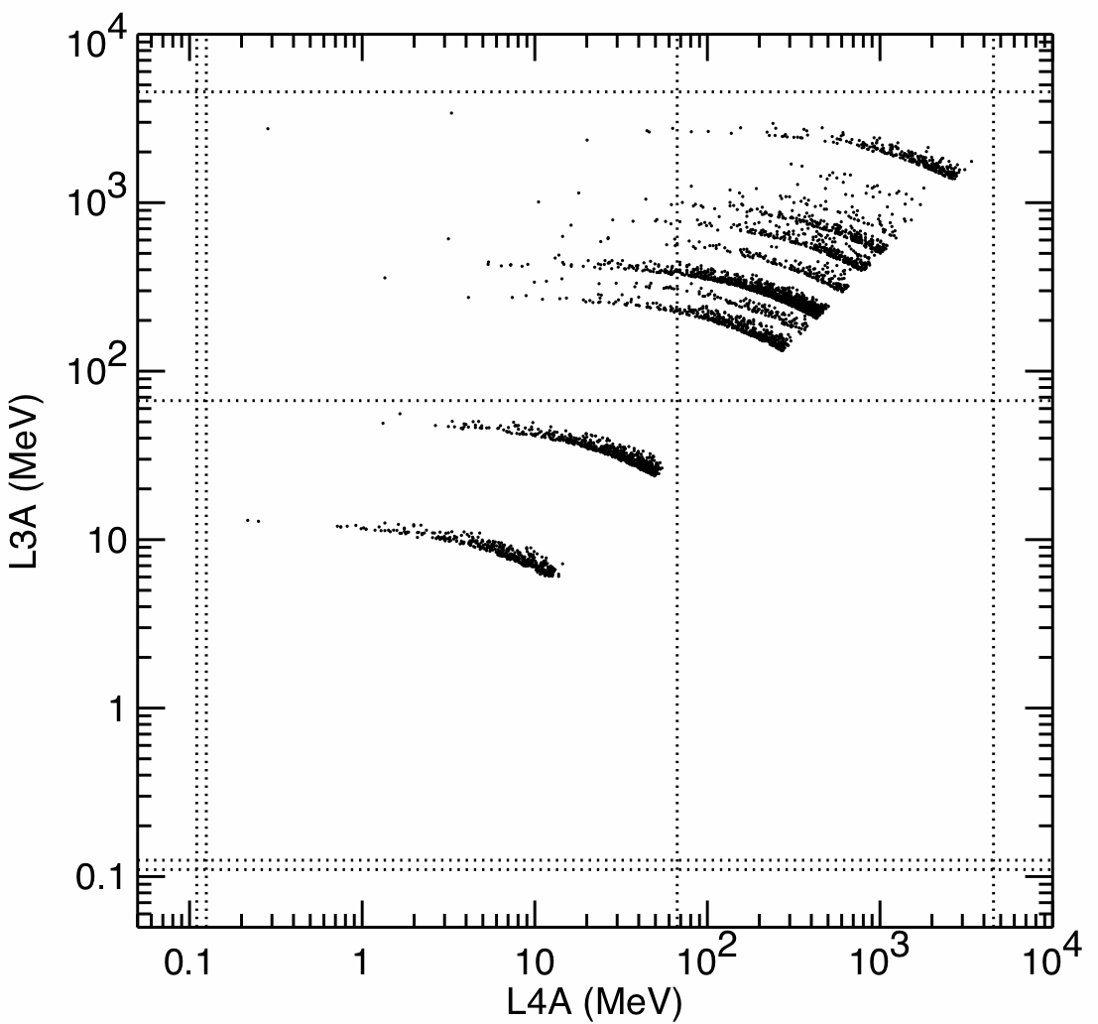
only active Si is shown
Notes:
sim001_let030_cropped.gif

Slide 26
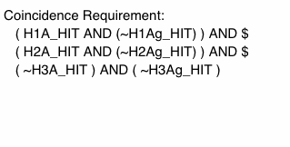
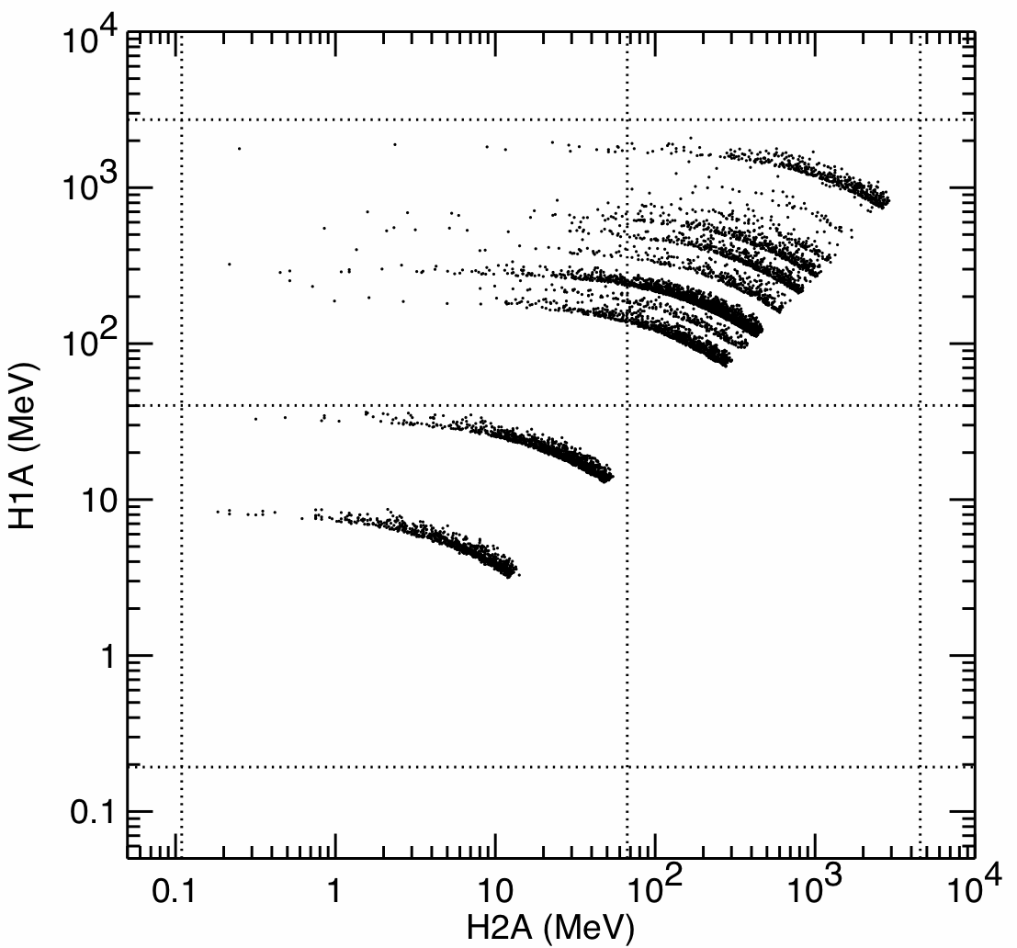
only active Si is shown
Notes:
sim001_het010_cropped.gif

Slide 27
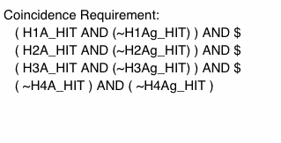
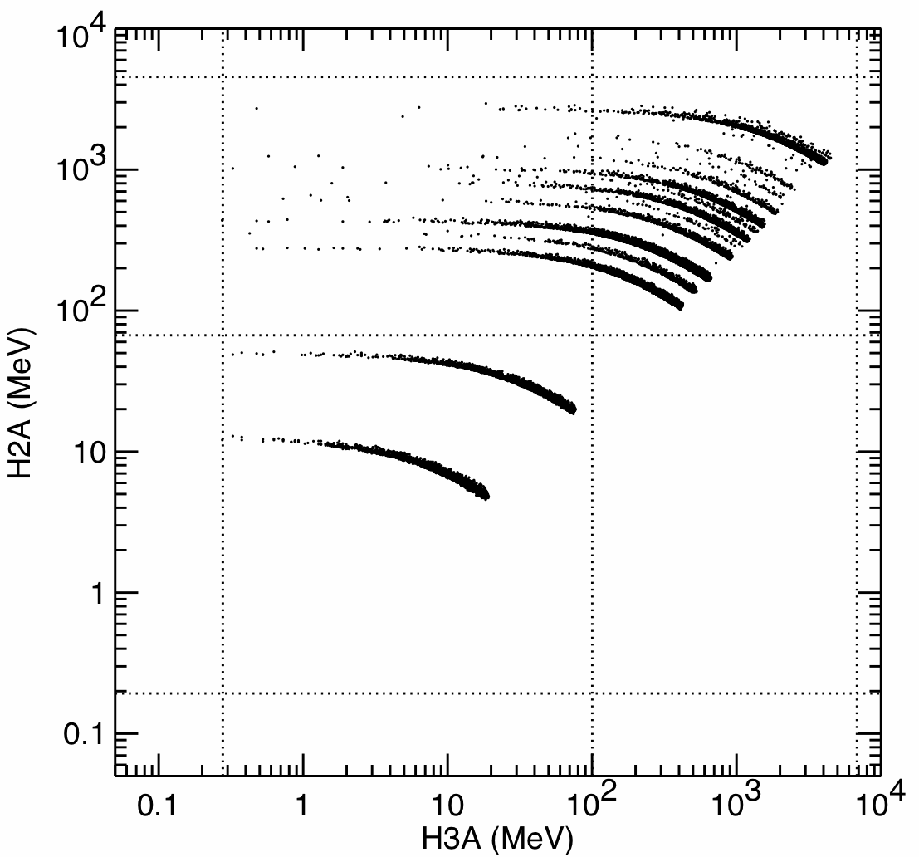
only active Si is shown
Notes:
sim001_het011_cropped.gif

Slide 28
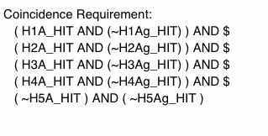
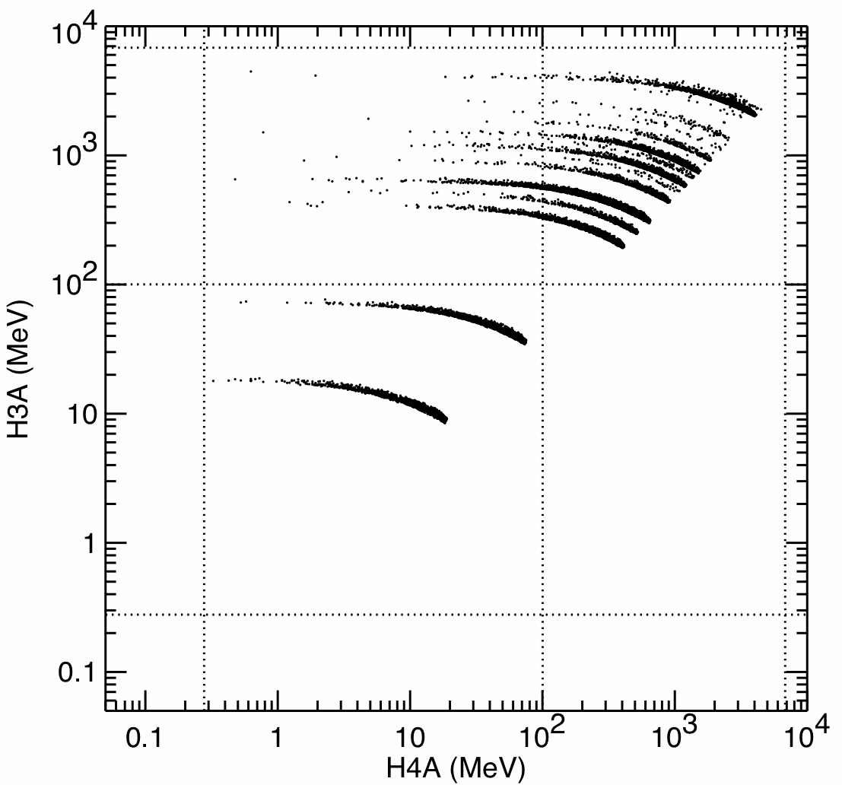
only active Si is shown
Notes:
sim001_het012_cropped.gif

Slide 29
Channel Width Effects on Element Identification
On-board element identification is done by applying an angle correction to the measured pulse heights to map measured ΔE-E’ point onto the nominal response track for particles incident at 0° to the detector normal.
A region (“species box”) in this angle-corrected channel number space is defined for each element of interest and the on-board software determines the atomic number for each event by determining which region it fall into.
The width of the ADC channels needs to be small enough compared to the track spacing so that edges of the species boxes can be used to separate tracks with sufficient accuracy.
Channel width effects are of greatest concern near the lower edge of the low gain analysis chain where the elements C, N, and O tend to fall.
The following plots show these regions for L1A vs L2A and L2A vs L3A before applying the angle corrections. The points on the plots correspond to discrete LG ADC channels.
After angle corrections, the tracks will be concentrated along the lower edge of the non-angle-corrected tracks shown on the plots.

Slide 30
spacing between C and N tracks: ~21 L1 channels

Slide 31
spacing between C and N tracks: ~21 L2 channels

Slide 32
Isotope Response
The only isotopic composition measurement requirement is ³He/⁴He, which is a key indicator of an impulsive SEP event origin.
Measurement of ³He/⁴He is only required over a portion of the energy range and a portion of the geometrical acceptance.
A reasonable goal is to measure ³He/⁴He down to values of ~10%.
Mass resolution is dominated by the range of angles in an angular acceptance bin (selected by pixels hit in the front two or three detectors), next most important contribution is expected to be due to Bohr/Landau fluctuations, assuming the thickness uniformity goals for thin LET detectors are met.
The ³He measurement is typically most useful at the lowest energies since impulsive event energy spectra tend to be soft; higher energy ³He can be encountered in large, gradual events due to acceleration of ³He from a suprathermal seed population.
An additional isotopic composition measurement goal is ²²Ne/²⁰Ne (the ²¹Ne abundance is typically negligible), which can be enhanced by factors up to ~6 in impulsive events.

Slide 33
Isotope Response Plots
Equal abundances of ³He and ⁴He (or ²²Ne and ²⁰Ne) at equal E/M are assumed in order to illustrate track separations and widths.
The contribution of the PHASIC to the mass resolution depends on noise level and channel width.
The best isotope resolution is obtained for particles having incidence directions close to the normal to the detectors because secθ is flat near 0°.
For purposes of determining whether the PHASIC performance will be suitable for He isotope measurements it is sufficient to look at simulations for incidence directions least affected the spread in incidence angles.
Cases for LET are shown. HET cases are shown only where there is no LET case with the same ΔE and E’ detector thicknesses. When the detector thicknesses are the same the PHA gains and channel widths are the same and the HET noise may be slightly better than that for LET (due to smaller detector capacitance).

Slide 34
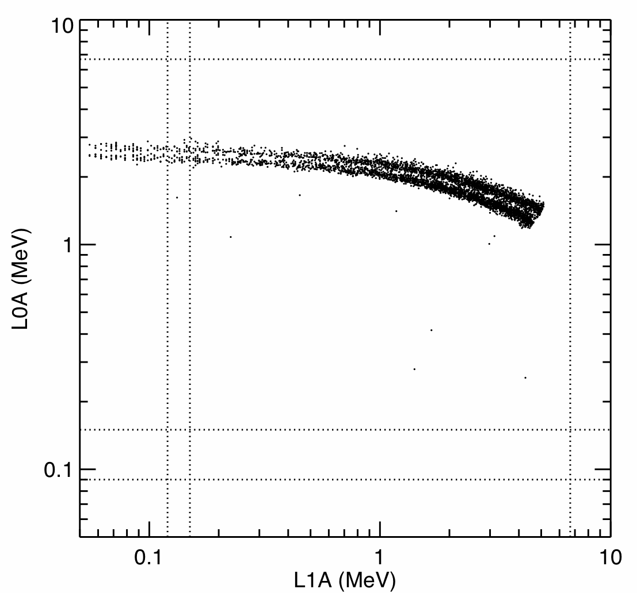
He isotopes stopping in L1A
only aligned pixels in L0A and L1A used for trajectory
~20% of the L0A vs L1A geometrical acceptance
only active Si is shown
Notes:
sim001_let043

Slide 35
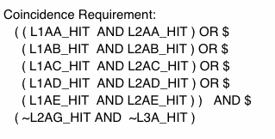
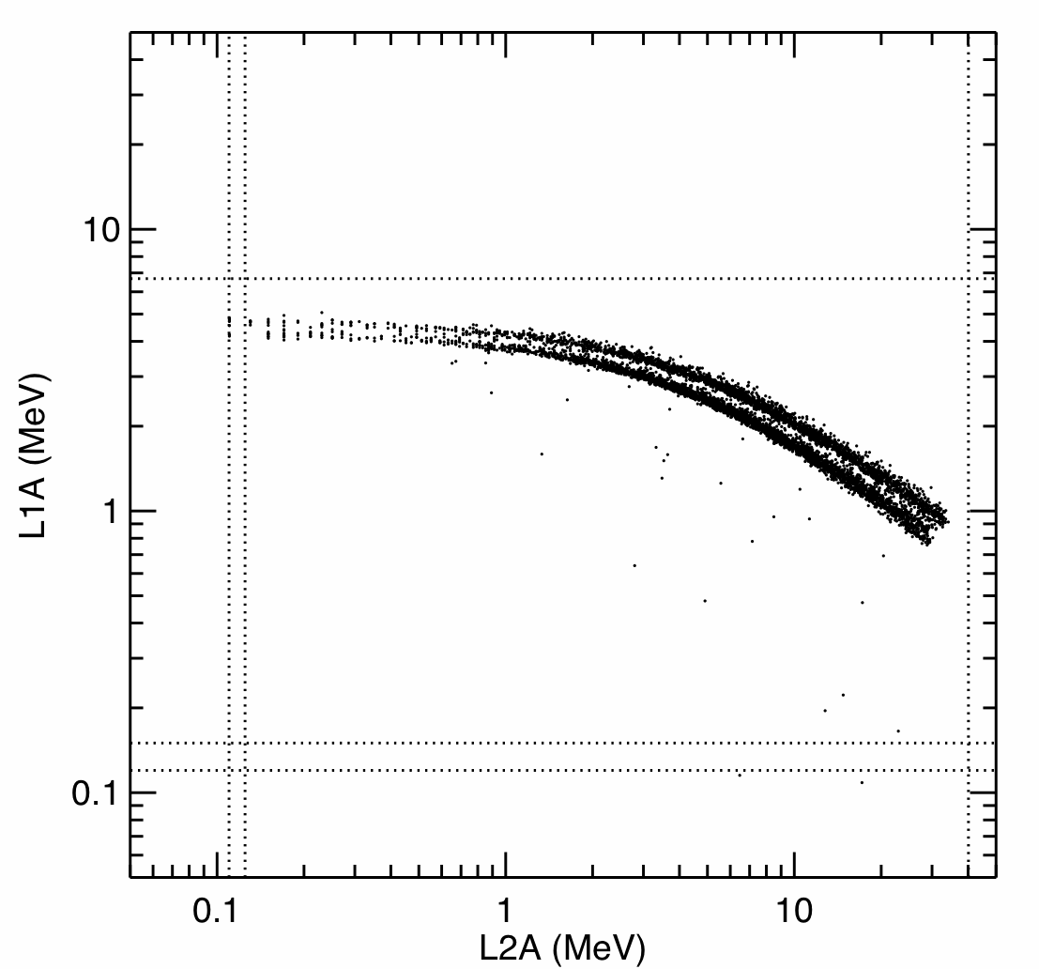
He isotopes stopping in L2A
only aligned pixels in L1A and L2A used for trajectory
~20% of the L1A vs L2A geometrical acceptance
only active Si is shown
Notes:
sim001_let036

Slide 36
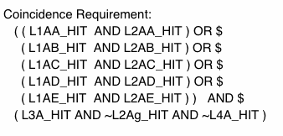
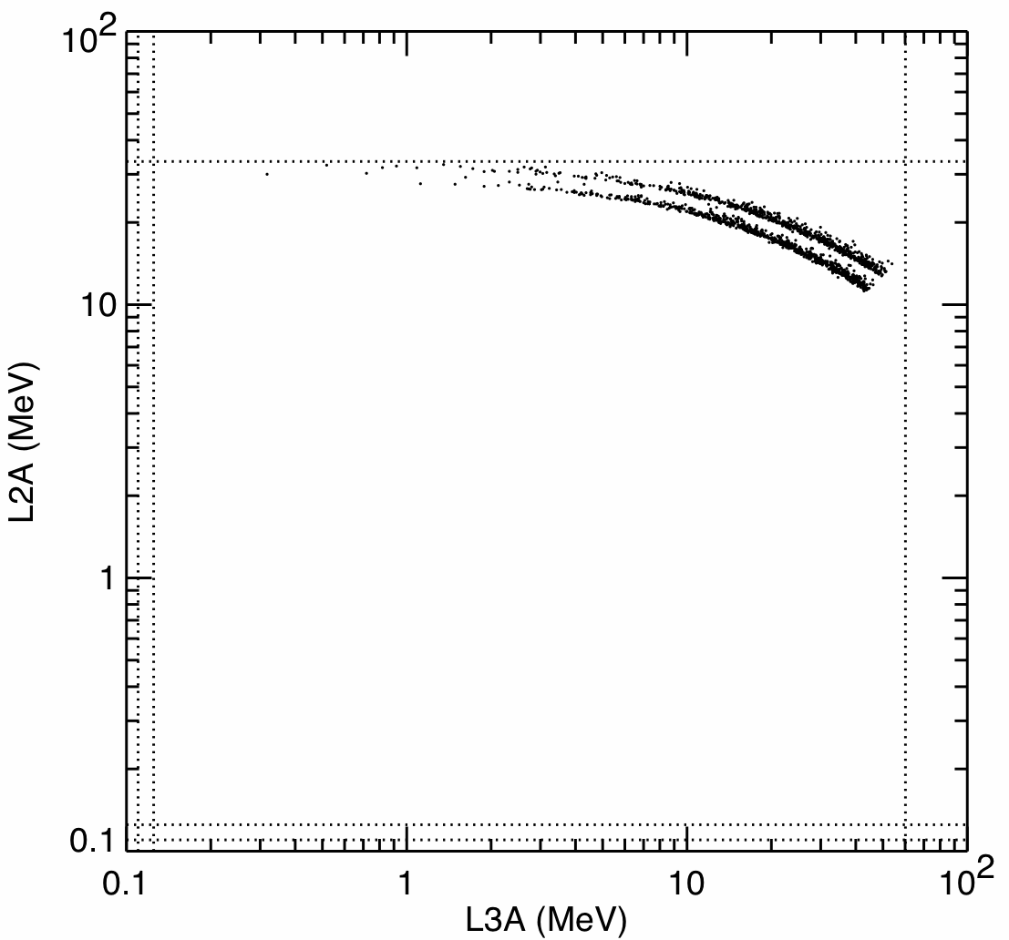
He isotopes stopping in L3A
only aligned pixels in L1A and L2A used for trajectory
~20% of the L2A vs L3A geometrical acceptance
only active Si is shown
Notes:
sim001_let044

Slide 37
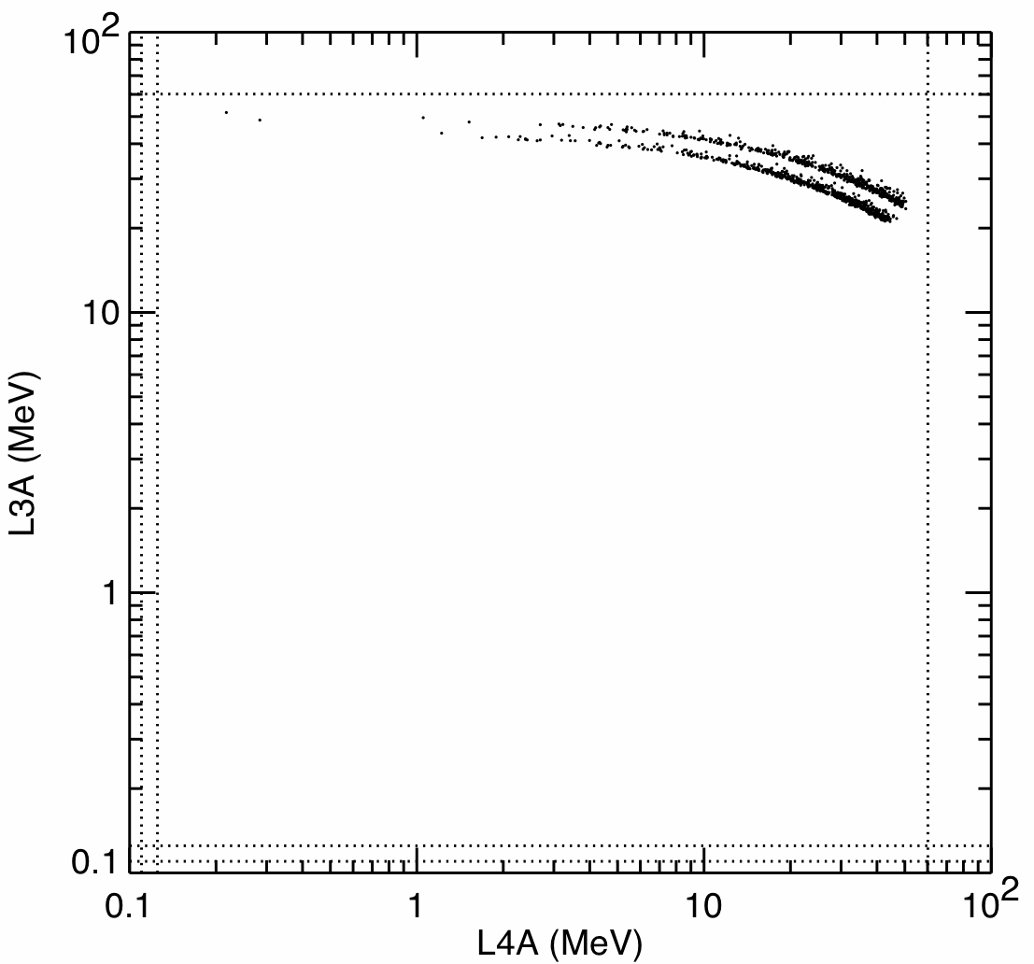
He isotopes stopping in L4A
only aligned pixels in L1A and L2A used for trajectory
~20% of the L3A vs L4A geometrical acceptance
only active Si is shown
Notes:
sim001_let045

Slide 38
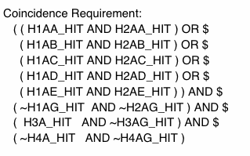
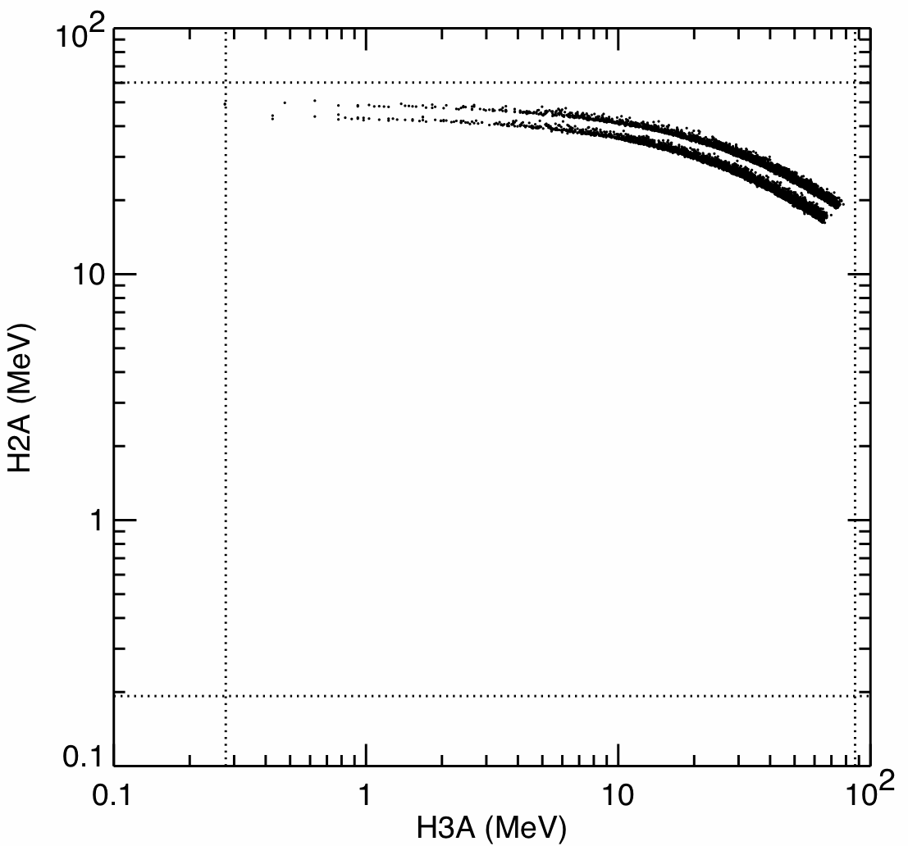
He isotopes stopping in H3A
only aligned pixels in H1A and H2A used for trajectory
>~20% of the H2A vs H3A geometrical acceptance
only active Si is shown
Notes:
sim001_het013

Slide 39
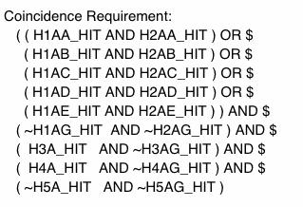
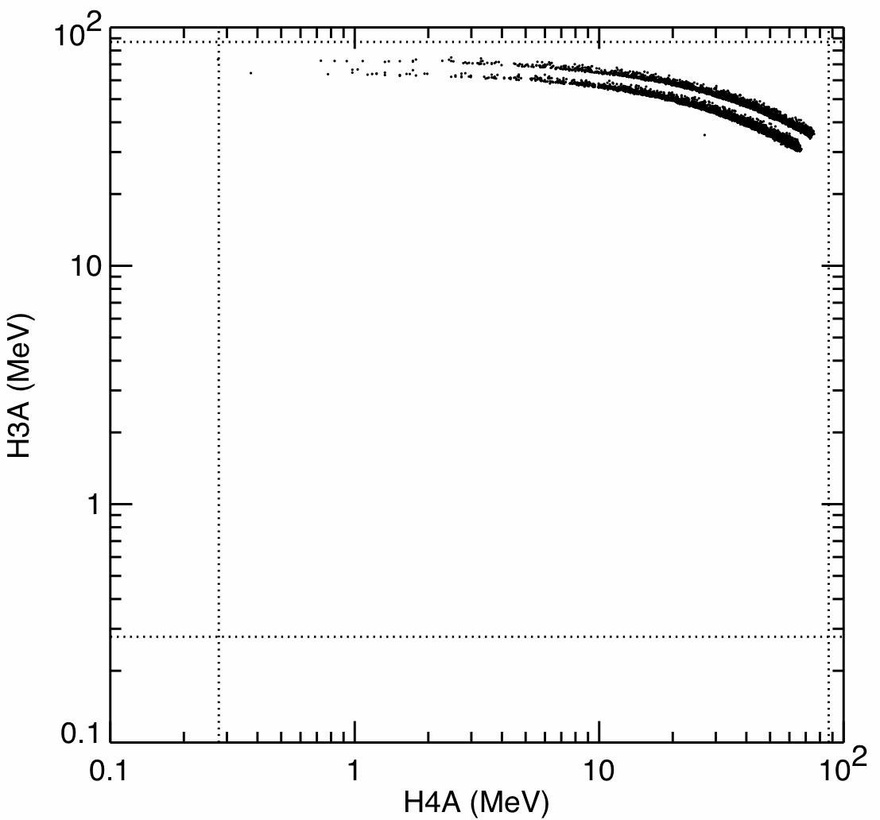
He isotopes stopping in H4A
only aligned pixels in H1A and H2A used for trajectory
>~20% of the H3A vs H4A geometrical acceptance
only active Si is shown
Notes:
sim001_het014

Slide 40
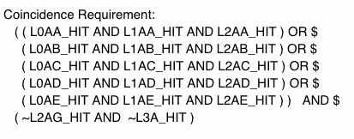
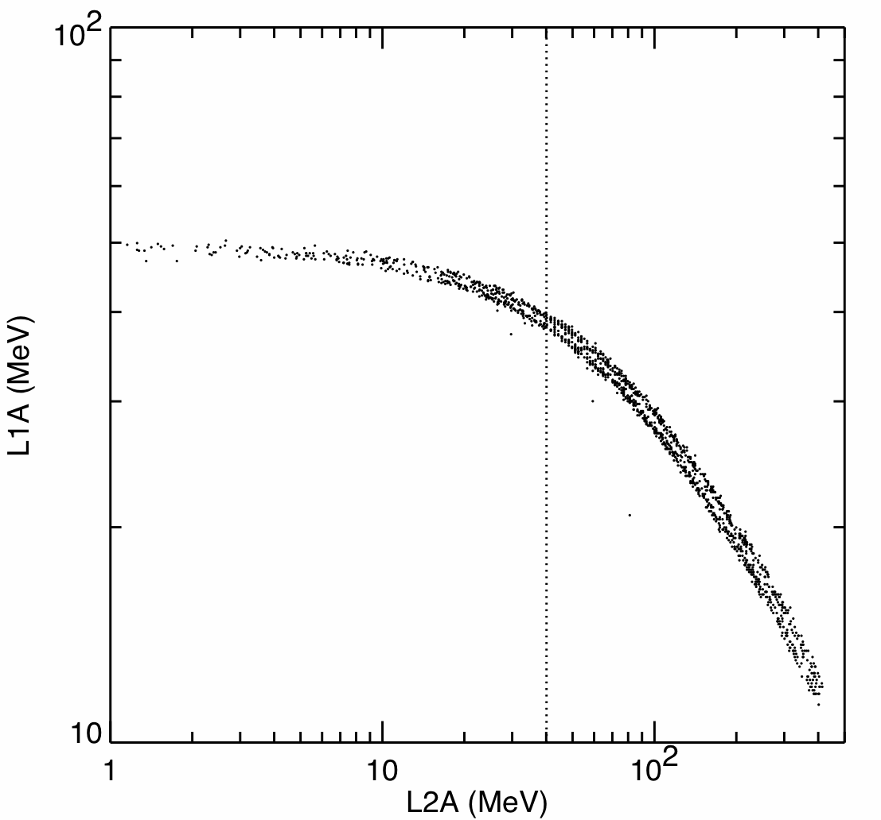
One example of ²⁰Ne—²²Ne isotope separation
aligned pixels in L0A, L1A and L2A used for trajectory
small portion of geometrical acceptance
only active Si is shown
Notes:
sim001_let036

Slide 41
Count Rate Effects
The SPP PHASIC has the same pulse shaping as the STEREO PHASIC (bipolar with 1.9 μs time to peak) and similar run-down rate for the Wilkinson ADC. Thus pulse pile-up effects and dead time per event should be similar.
As with STEREO/LET and HET, EPI-Hi will use a “dynamic threshold” scheme in which the high gain analysis channel will be turned off for selected detector segments when count rates get too high. This reduces the geometrical factor for measuring H and He while preserving the full geometrical factor for heavier nuclei. STEREO measurements have shown that this approach is effective in extending measurement capabilities to high count rates.
EPI-Hi is intended to measure energetic particle intensities significantly higher than those commonly encountered near 1 AU. To deal with these higher intensities the EPI-Hi telescopes have been made significantly smaller and more compact and have additional passive shielding surrounding the detector stacks. Thus the instrument modifications to handle the high intensities are in the telescope designs, not by means of PHASIC design changes.
A quantitative study of the intensities that can be measured by EPI-Hi is going to be undertaken in the near future.

Slide 42
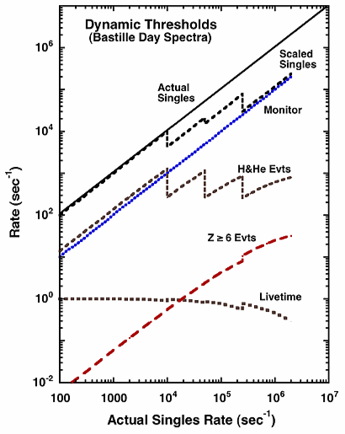
Dynamic Threshold System on STEREO/LET

