Slide 1
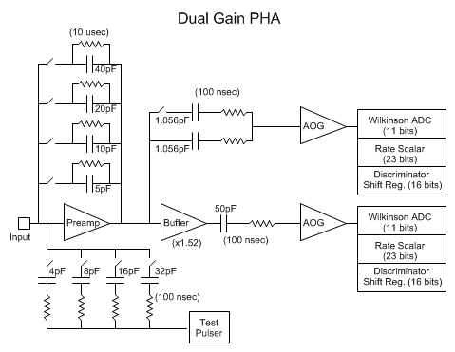
PHASIC Overview
PHASIC stands for “Pulse Height Analysis System Integrated Circuit”.
Originally developed and used in NASA’s STEREO mission.
Each PHASIC contains 16 complete dual-gain pulse height analysis (PHA) chains.
STEREO PHASICs still operational in space.
Mods for SPP include widening dynamic range, and improving total dose tolerance to >100 krad.

Slide 2
PHASIC Packaging
PHASIC die is installed in an 80-pin hermetic Kovar package along with a few passive components to form a “hybrid” circuit.
Hybrid substrate design and passives same as for STEREO.
PHASIC hybrid to be qualified and screened to class H (as on STEREO).
Passive components include a precision resistor for each PHA chain that sets the rundown current. Allows PHA channel gain to have low <50 ppm/degC temperature coefficient.

Slide 3
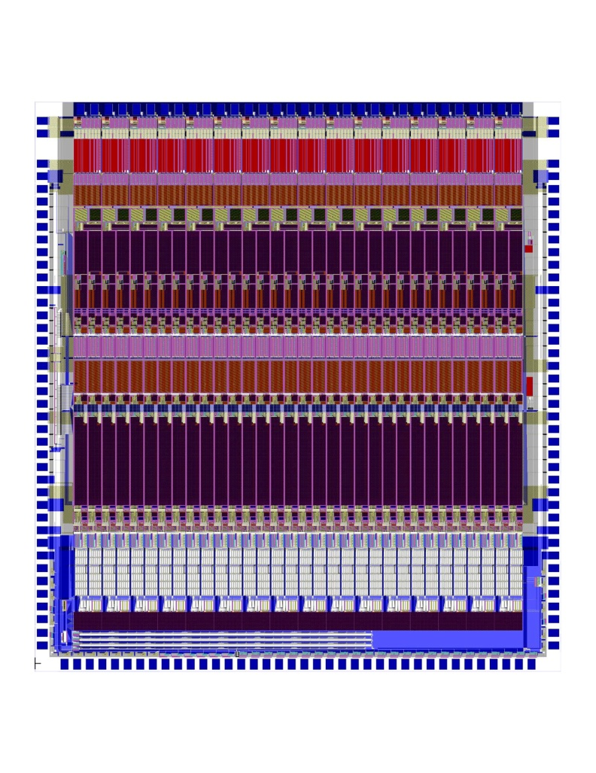
PHASIC Radiation Tolerance
Total dose tolerance improved by adding proven Aeroflex processing steps to commercial ON-Semi C5N CMOS process.
Layout modified to comply with slight Aeroflex design rule differences.
12 krad improves to >100 krad.
Latch-up threshold should still be >80 MeV/(mg-cm²) due to use of “rad-hard-by-design” guard rings.

Slide 4
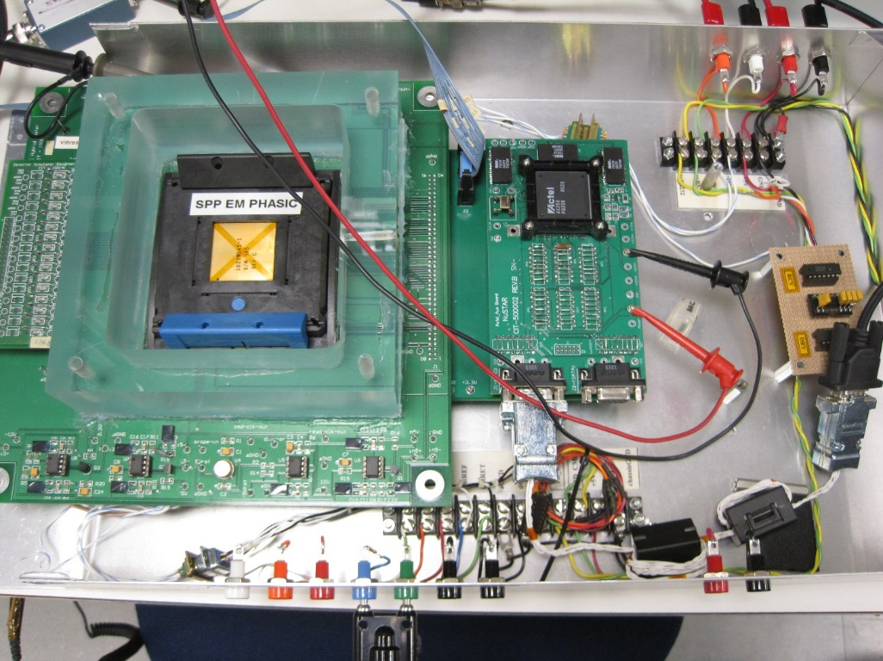
PHASIC test fixture
Dedicated test fixture supports automated DC and AC testing over temperature using forced air thermal control
Automated test procedure about 80% complete. See “PHASIC Testing for Stereo.docx” and “sample-test-report.pdf”.

Slide 5
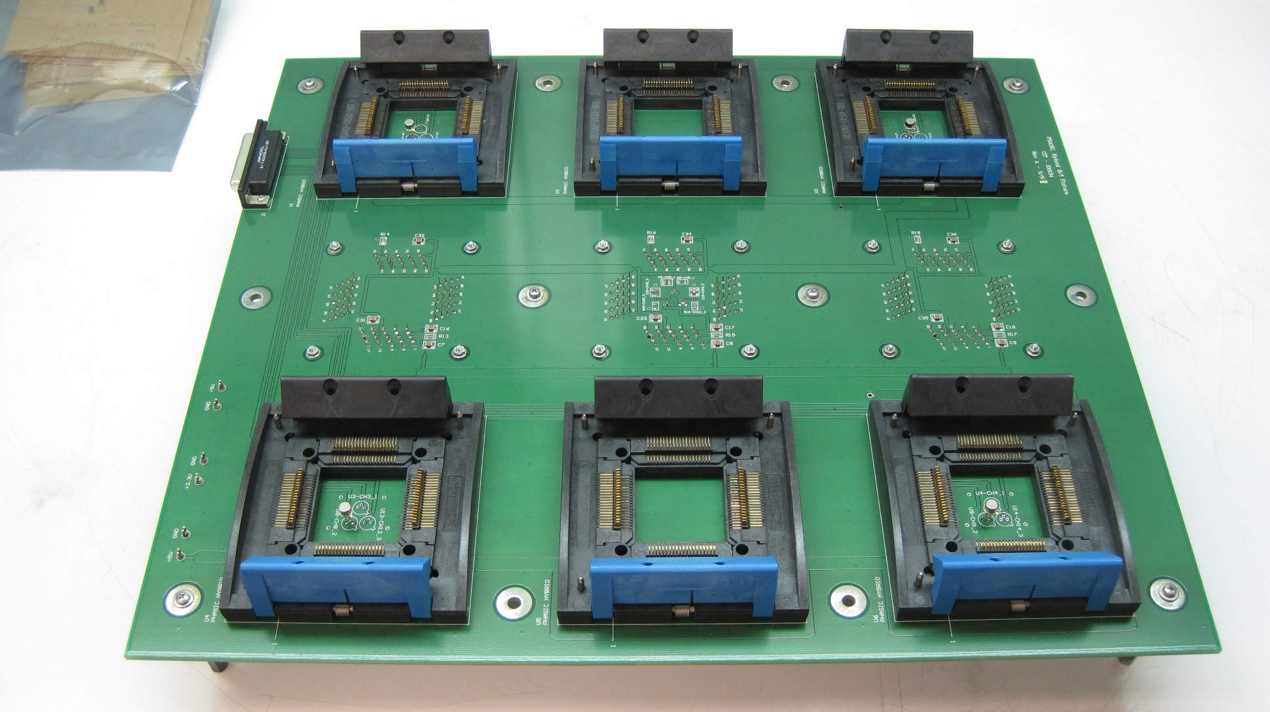
PHASIC burn in fixture
From STEREO program

Slide 6
PHASIC Status
Engineering run though ON-Semi C5N commercial process was completed, yielding EM wafers and dice.
EM dice installed in STEREO hybrids and tested.
Test results indicate noise and dynamic range goals achieved and minor digital mods successful. (see “pre-flight-fab.doxc” for details)
PHASIC Manual was updated to account for SPP mods.
EM dice installed in STEREO hybrids used in EM telescope boards: LET1, HET, LET2.
Earlier peer reviews successfully completed.
Flight wafers received on 10/15/14.
Wafers being diced and JPL is ready to package them into STEREO hybrids.
Hopefully early test results will be available for peer review.

Slide 7
HK Chip
Housekeeping Chip is a new ASIC design for use in EPI-Hi.
Includes most auxiliary functions needed for a small instrument in a 68-pin hermetic ceramic package.
Delta sigma modulator, for making DC voltage (0-5V) measurements to monitor power supply voltages, currents, and instrument temperatures.
35-input analog multiplexor.
12 10-bit DACs with option of rail to rail buffered output.
12 digital outputs designed to drive opto-isolated power switches for heater control.
DACs may be ganged for greater voltage setting resolution.
DAC outputs may be internally routed to modulator for precision measurement => low precision DACs can be used to generate high precision voltages and improved in-flight PHASIC calibration.

Slide 8
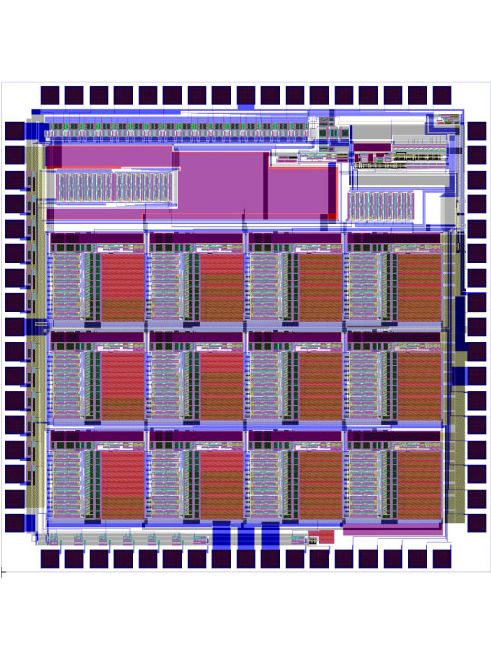
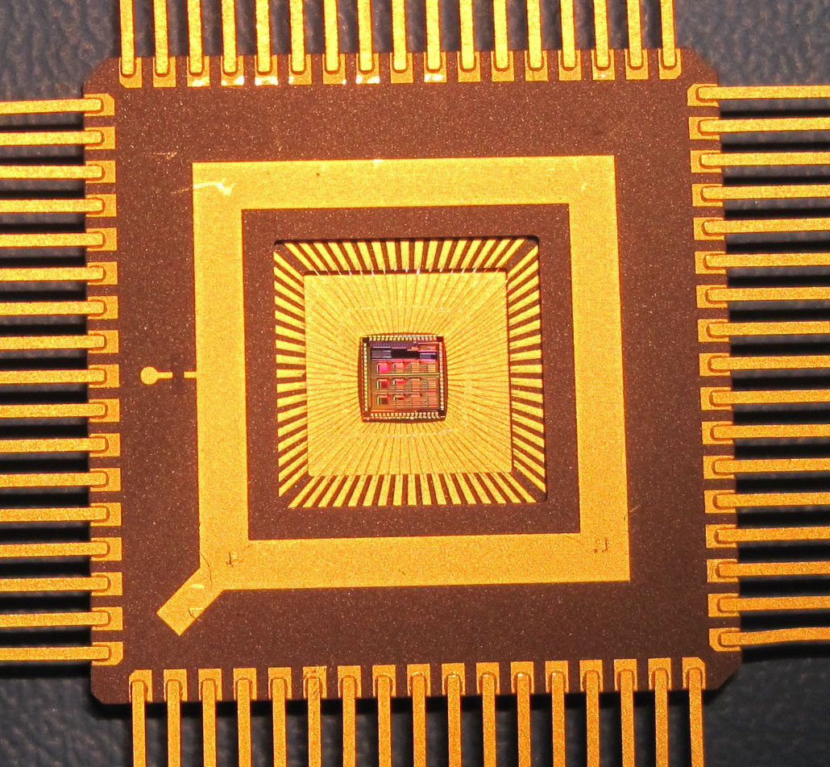
HK Chip Packaging
HK Chip packaged in hermetic 68-pin ceramic package.
HK Chip to be qualified and screened to level Q, with PIND test included.

Slide 9
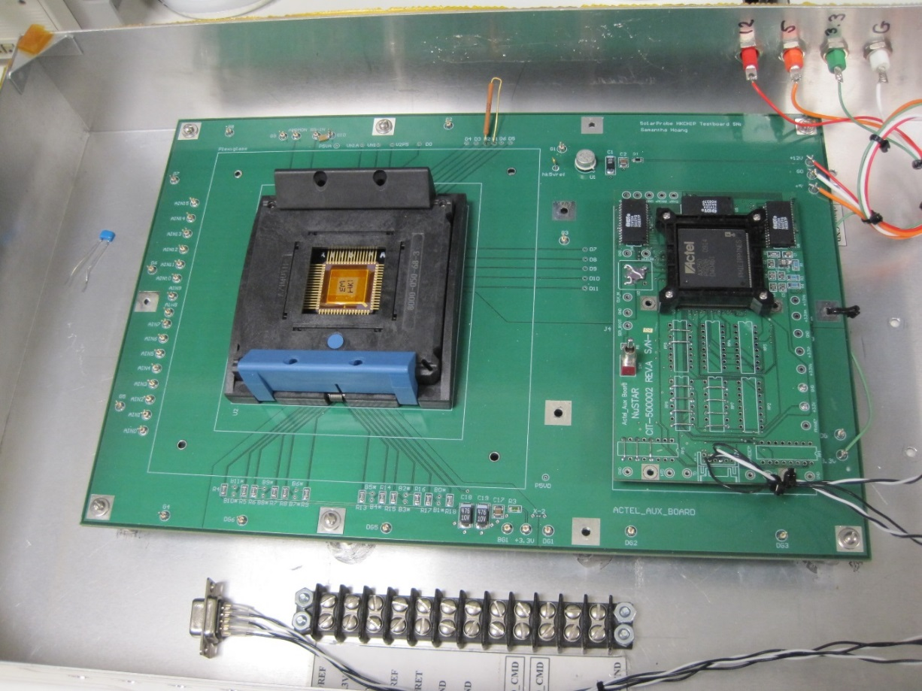
HKchip test fixture
Dedicated test fixture allows DC and AC test over temperature using forced air thermal control.
Automated test procedure about 60% complete.

Slide 10
HK Chip Status
Fabrication of EM parts was done simultaneous with EM PHASIC fab through ON-Semi.
Test results: DAC linearity good to 10 bits; Delta sigma modulator can provide up to 18-bit performance. Buffer amps, digital outputs and power on reset circuit all perform properly (see “pre-flight-fab.docx” for minor caveats)
EM dice in flight-like packages used in EPI-HI telescope EM boards: several months of bench testing to date.
HKchip flight fab simultaneous with PHASIC, with Aeroflex radiation hardening steps.
Earlier peer reviews successfully completed.
Flight wafers arrived 10/15/14 (passed 100 krad). Dicing in progress.
Hopefully early test results will be available for peer review.
HKchip manual early draft is available.

Slide 11
ASIC Radiation Test Plan
Very recent wafer level total dose testing done by Aeroflex shows “passed” at 100 kRad. (see “Aeroflex_FM_wafers.pdf”)
Additional die level total dose testing is planned for both PHASIC and HKchip, with full pre and post device characterization. Co60 at Aerospace and protons at Berkeley with Aerospace help. (For NuSTAR ASIC we did both gammas and protons. For STEREO PHASIC we did just gammas.)
Latch-up testing to be done at Berkeley with Aerospace help. Results for similar STEREO PHASIC showed no latch-up below 80 MeV/(mg/cm2). (“rad-hard by design” layout rules for guard rings => high latch-up threshold)

