Slide 1
19 – EPI-Hi Mechanical Peer Review 11/07/2014
P
Sandy Shuman
EPI-Hi Mechanical Lead (GSFC)
Notes:
introduction

Slide 2
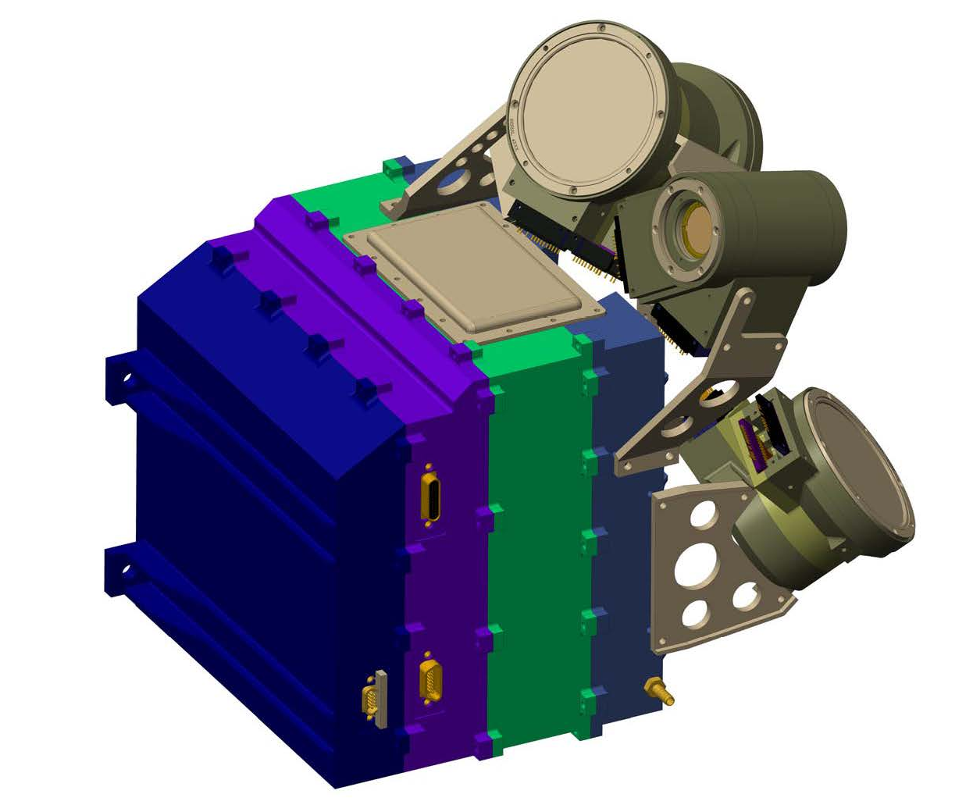
EPI-HI Component Configuration
LET 1 Telescope
HET Telescope
LET2 Telescope
LVPS
LET2 Electronics
DPU/Bias
LET & HET Electronics

Slide 3
Driving Requirements
Telescope locations and fields of view must conform to those negotiated with the Project prior to PDR
Detectors must be 0.5 mm apart in telescope stacks
Front foils and detectors must survive acoustics, venting, and interplanetary dust
Meet weight limit
Meet environmental requirements (acoustic, vibration, thermal, EMI/RFI)

Slide 4
Design Changes Since PDR
Added R’s and C’s to detector mounts
- This made the flex circuits longer
Rotated some detectors by 45 degrees wrt stack detectors
These both complicated the mounting of the telescopes from the electronics enclosure
Have any telescope

Slide 5
EPI-HI Enclosure Requirements
Work within mass constraints.
Package boards maintaining adequate parts clearance board to board.
Provide needed interconnect means between boards and each other and boards to telescopes.
Provide adequate RF and/or ground shielding board to board and through the enclosure.
Provide thermal isolation from spacecraft bracket.

Slide 6
EPI-HI Electronics Enclosure
Electronics box is made up of 4 major components, the LVPS Assembly, the DPU/HV Bias Assembly, the HET1/LET1 Electronics Assembly and the LET2 Electronics Assembly
Each Electronics Assembly is mounted in a perimeter style frame.
All “frames” when assembled together will provide a continuous RF shield for internal electronics.
Internal shielding between critical components will create separate shielded areas as necessary for proper electronics function.
Board interconnect is achieved using rigid/flex boards w/ built in cables terminating to individual nanonics/microstrip connectors on mating boards.
Connections to the S/C will be via standard D Subminiature connectors

Slide 7
EPI-HI Electronics Enclosure
DPU Board (mounted in one side of frame)
Flex connection to Telescope Boards
Flex connection to LVPS
S/C connectors (PCB mount)
PCB’s mounted to machined in posts in chassis
Bias Supply Board (mounted in one side of frame)
Flex connection to 3 Detector Boards
Flex connection to DPU Board
R/F shielding
PCB’s mounted to machined in posts in chassis

Slide 8
EPI-HI Electronics Enclosure
LET2 Telescope Electronics Assembly
Receives flex connection from Bias Board
Receives flex connection from DPU Board
Receives 2 flex connections from Telescope
Housing provides feet for Instrument to bracket mounting.
HET1 & LET1 Electronics Assembly
(each board)
Flex connection from Bias Board
Flex connection from DPU Board
2 Flex connections from Telescope
PCB’s mounted to machined in posts in chassis

Slide 9
EPI-HI Electronics Enclosure
Low Voltage Power Supply
Receives flex connection from DPU Board
S/C connectors (PCB mount)
Individually shielded primary/secondary circuits top and bottom.
Housing is tapered to avoid HET Telescope FOV
Housing provides feet for Instrument to bracket mounting.
PCB’s mounted to machined in posts in chassis
*LVPS Board provided by APL *Chassis and shields designed/provided by GSFC/SWRi

Slide 10
EPI-HI Interconnect
ELECTRONICS BOARDS (REAR VIEW)
ELECTRONICS BOARDS (FRONT VIEW)

Slide 11
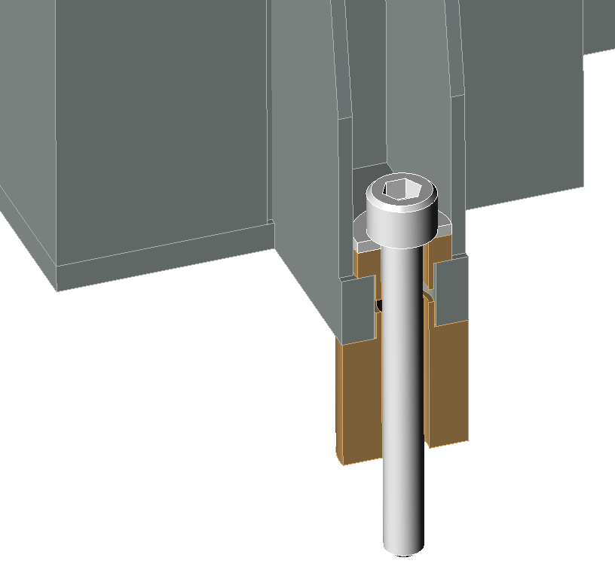
EPI-HI Thermal Isolation
Typical Mounting Foot Showing Thermal Isolation
Mounting Bolt
Washer
Ultem Isolation Bushings

Slide 12
Mount Design Requirements
Detector Mounts
Able to transmit signals from silicon detectors, via wirebond connections to output connector
Allows the stacking of detectors maintaining 0,5mm spacing surface to surface between thickest detectors (1,0mm)
Allows any detector to be stacked face up or face down with any other detector
Allows for the protection of wire bonds from being crushed on either side when placed on flat surface during storage and/or test
Provides electrical breakdown protection to next detector, when stacked, of up to 200V differential between crown of HV wirebonds to conductive surface of opposing detector

Slide 13
EPI-HI Detector Mount
Recessed detector shelf for silicon detector installation.
Micro-strip connector output
Flex stiffener to rigidize the area where connector is mounted.
Alignment achieved with alignment pins and concentric stacking shelves on mount and connector.
Tolerancing for mounts will be tightly constrained, but within current CNC machining capabilities.
Detector alignment will be verified through measurement and testing on assembled flight detectors.

Slide 14
EPI-HI Detector Mount
Mount design allows stacking of detectors face to face, face to back and back to back while maintaining same spacing.
Mounts are spaced 1,5mm apart when stacked allowing for 0,5mm separation between thickest detectors.
Detector Voltage ranges from ~2V up to ~200V
Mounts provide adequate spacing/protection for wirebond clearance.

Slide 15
EPI-HI Telescope Design
3 Telescope comprised of silicon wafer detectors.
Telescope body provides ~6,0mm of aluminum shielding to block unwanted particles from entering through the housing body.
Foils will have carbon coating facing outwards to achieve proper thermal characteristics.
Telescopes are mounted directly to the top of the enclosure allowing the flex interconnect cable to be routed internally to provide proper RF shielding.
Telescopes will all have red-tag covers over aperture openings.

Slide 16
EPI-HI HET Telescope
2- ~130um (5 mil) Foils for micro-meteorite /light protection on each end.
Comprised of 16 silicon wafer detectors mounted in flex-rigid mounts.
The front two detectors at each end are spaced apart in order to set a 90 degree FOV angle.

Slide 17
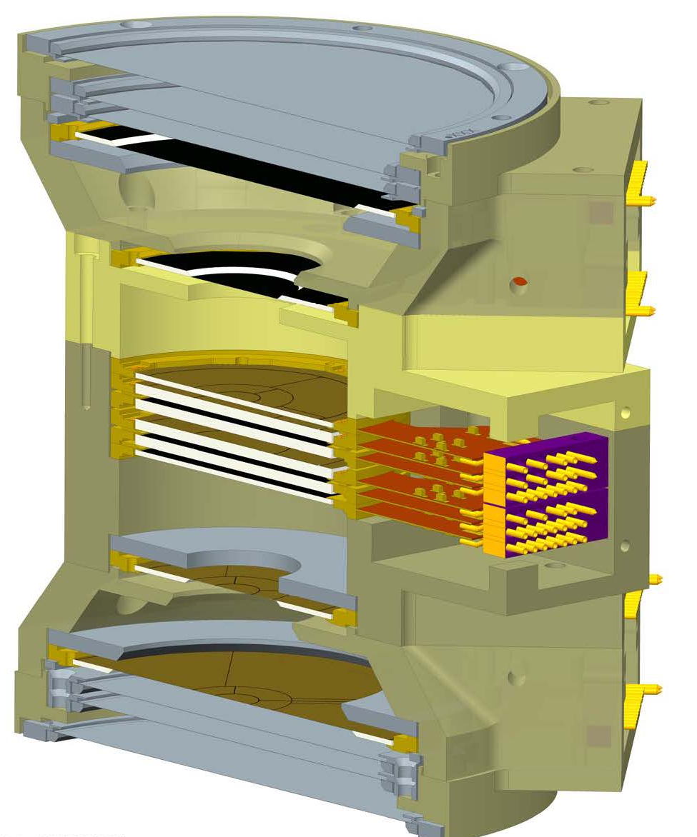
EPI-HI LET Telescopes
LET1 Telescope
3 Foils for micro-meteorite/light protection on each end.
Outer foil to be 2um polyimide.
Inner 2 foils to be 1um polyimide.
Comprised of 10 silicon wafer detectors mounted in flex-rigid mounts.
The front 3 detectors at each end are spaced apart in order to set a 90 degree FOV angle.
LET2 Telescope
Comprised of one half of a LET1 Telescope.
3 Foils for micro-meteorite/light protection
Outer foil to be 4um polyimide.
Inner 2 foils to be 2um polyimide.
LET1 Telescope shown

Slide 18
EPI-HI Telescope Purge
Purge will be established to the individual telescopes with a single purge fitting on the outside of the instrument.
Purge will be distributed internally through a manifold that will send the purge gas into the center volume of each telescope.

Slide 19
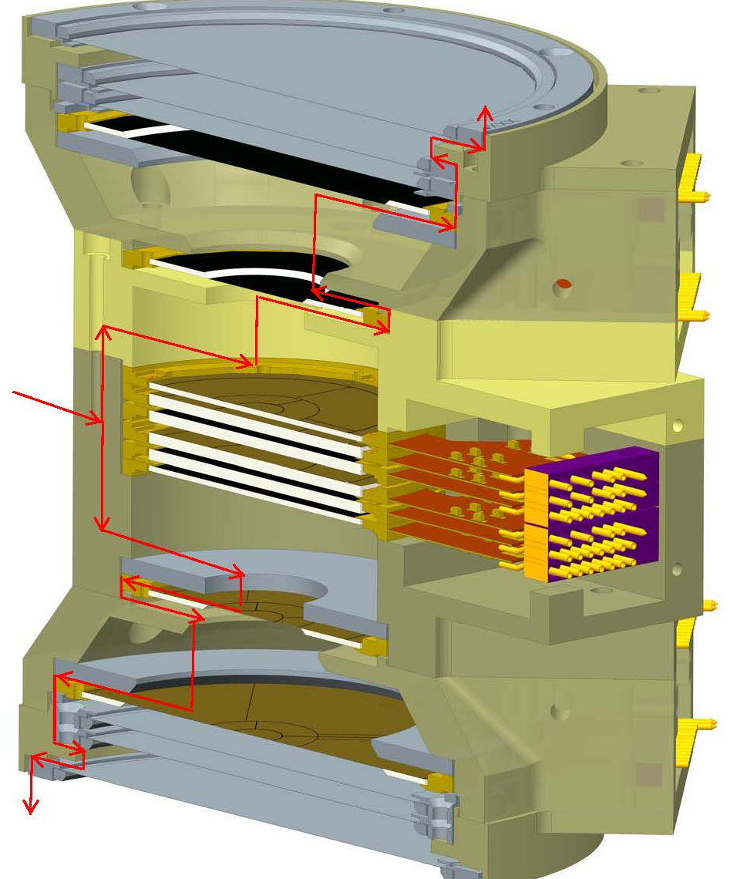
EPI-HI Telescope Venting
Heritage venting strategy that was used on several prior missions
Purge gas enters thru housing into open center volumes
Gas then flows outwards thru vent slots in housing shelves, detector mounts and foil rings
Gas exits each end of the telescope thru vent slots below outer foil
PURGE GAS

Slide 20
EPI-HI Interface Control Dwg

Slide 21
EPI-HI Interface Control Dwg

Slide 22
EPI-HI Interface Control Dwg

Slide 23
Drawing List
DPU Electronics
2190786
2190787
2190788 Outline drawing
2190789 PWB
2190790 PWA
HV Bias Electronics
2190791 Bias Shield Top
2190792 Bracket, LET2/HET Bias Connector
2190793 Outline drawing
2190794 Bracket, LET1 Bias Connector
2190795 ASSY, Bias Board
2190796 Outline Drawing LET1 Interconnect Cable
2190797
2190798
2190799
LET1 Telescope
2190800 LET1 Telescope Assembly
2190801 LET1 Housing Center
2190802 LET1 Housing L1 Spacer
2190803 LET1 Housing L0 Spacer
2190804 LET1 Connector Cover
2190805 Assembly, Red-Tag Covers
2190806
2190807
2190808
2190809 Red-Tag Covers
LET2 Telescope
2190810 LET2 Telescope Assembly
2190811 LET2 Housing
2190812 LET2 Connector Cover
LVPS Electronics
2190765 LVPS Assembly Drawing
2190766 PWB Outline Drawing
2190767 Shield
2190768
2190769
2190770 Interface Control Drawing
LET1 Electronics
2190771
2190772
2190773 Outline drawing Electronics Board
2190774 PWB
2190775 PWA
LET2 Electronics
2190776
2190777
2190778
2190779
2190780 PWA
HET Electronics
2190781
2190782
2190783
2190784
2190785 PWA

Slide 24
Drawing List (cont)
2190813
2190814 LET Collimator
2190815 Assembly, LET Telescope Aperture Foils
2190816 Foil Mounting Ring, LET Aperture
2190817 Telescope Mounting Ring, LET Aperture
2190818
2190819
HET Telescope
2190820 HET Telescope Assembly
2190821 HET Housing
2190822 HET Collimator
2190823 HET Bottom Cover
2190824 HET Connector Cover
2190825
2190826
2190827
2190828
2190829
Detector Mounts
2190830 L0 Detector Assembly
2190831 L0 Detector Mount
2190832 L1 Detector Assembly
2190833 L1 Detector Mount
2190834 LET Stack Detector Assembly
2190835 LET Stack Detector Mount
2190836
2190837
2190838
2190839
2190840 HET Stack Detector Assembly
2190841 HET Stack Detector Mount 2190842
2190843
2190844 H1 Detector Mount
2190845 H1 Detector Assembly
2190846
2190847
2190848
2190849
EPI-HI Instrument Box
2190850 EPI-HI Top Assembly
2190851 MICD EPI-HI Instrument
2190852
2190853
2190854
2190855
2190856 LET2 Frame
2190857 HET / LET1 Frame
2190858 LVPS Frame
2190859 DPU/Bias Frame
2190860
2190861
2190862 LET1 to HET Telescope bracket
2190863 HET Telescope Bracket
2190864 LET Telescope Bracket

Slide 25
Resources – Mass Comparison w/ PDR
@PDR
Current
Subsystem | Mass [ g ]
LET1 telescope LET1 board | 225 258
LET2 telescope LET2 board | 145 233
HET telescope HET board | 120 250
DPU board Bias Supply & RF shields LVPS & RF shields | 197 225 + 130 160 + 100
Elec. box, hardware & shielding Telescope brackets Thermal hardware MLI blankets | 925 + 250 +100 160 50 100
Total | 3,628
Mass [ g ]
265 258
159 233
120 250
197 225 + 51 160 + 100
995+ 307 +100 63 50 100
3,628

