Slide 1
EPI-Hi Electronics
MISC Booting for SPP
Rick Cook
Electrical Systems Engineer

Slide 2
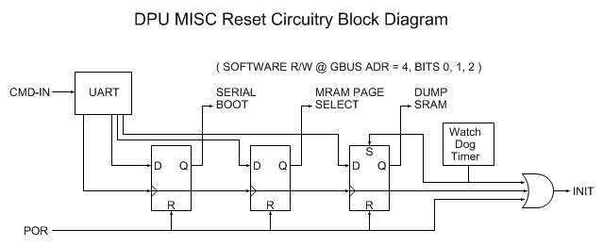
Boot Logic
Supports three ways to initiate boot: Power On Reset (POR), CMD-IN and Watch Dog Timer
“Reset Bit Field” is writable by CMD-IN and R/W by software
“Serial Boot” bit determines if boot is to be performed serially via CMD-IN or from MRAM
“MRAM Page Select” bit determined which page (0 or 1) of MRAM is source of boot images.
“Dump SRAM” bit determines if SRAM is dumped prior to boot. This bit is set by the watch dog timeout.

Slide 3
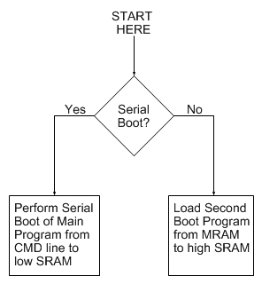
FPGA Resident Boot Program
Permanently coded as part of FPGA design.
Simple and small: <64 – 24 bit words
Either performs serial boot of Main Program into low SRAM via CMD-IN
Or loads second boot program from MRAM into high SRAM

Slide 4
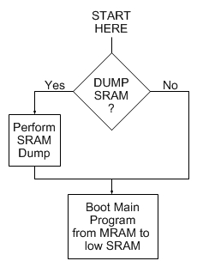
Second Boot Program
Optionally performs SRAM dump prior to booting Main Program from MRAM to low SRAM.
SRAM dump is somewhat complex, does not fit into FPGA resident boot program; hence need for second boot program.

Slide 5
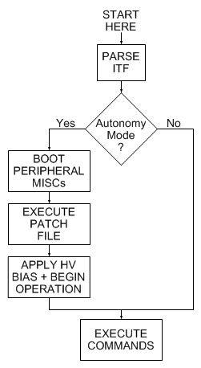
Main Program
Reads and parses ITF from S/C.
Determines if in “autonomy mode”.
If so, boots peripheral MISCs, executes MRAM Patch File, applies HV bias, begins science operations in mode specified in S/C status message.
If not, just awaits further commands; i.e. during commissioning.

