Slide 1
EPI-Hi Flight Software Overview
Andrew Davis & Rick Cook
EPI-Hi Software Engineering (Caltech)
Notes:
introduction

Slide 2
Outline
Personnel
Flight Software Overview – Requirements
Operations Concept
Flight Software Context – Architecture, main tasks
Detailed Software Design
Functional description
Structural decomposition
Timing
Commands and Telemetry
Resource Margins
Software Verification and Testing
Configuration Management
Status of Engineering Model Software

Slide 3
Personnel
High-level science requirements and algorithms
Mark Wiedenbeck
Dick Mewaldt
Tycho von Rosenvinge
Electrical engineer, low-level and hardware-oriented flight software
Rick Cook (Backup: Jill Burnham)
Science flight software
Andrew Davis (Backup: Hiromasa Miyasaka)
Engineering and flight software personnel have all worked together in same roles for STEREO and NuSTAR missions

Slide 4
Applicable Documents
7434-9066 SPP_GI_ICD
7434-9058 ISIS_ICD
SPP-CIT-010 EPI-Hi Flight Software Development Plan
SPP-CIT-011 EPI-Hi Flight Software Requirements Doc
SPP-CIT-012 EPI-Hi Instrument Flight Software Design Doc
SPP-CIT-013 EPI-Hi Instrument Flight Software Test Plan
SPP-CIT-014 EPI-Hi Instrument Flight Software Verification/Test Matrix
SPP-CIT-015 EPI-Hi Telemetry Data Format & Command Dictionary
Caltech Internal Docs/Memos:
PHASIC User Manual
HKchip User Manual
P24 MISC Processor Manual
EPI-Hi Event Processing and Particle Identification Scheme
LET & HET Dynamic Threshold Recommendations
LET & HET Rate Data Definitions

Slide 5
Software Requirements
The EPI-Hi Flight Software Requirements Document details the flow-down from higher-level requirements, and from the GI and ISIS ICDs
These requirements are quite similar to the requirements on our recent NuSTAR and STEREO missions
The same modular flight processor and software architecture that we used for NuSTAR and STEREO will meet the EPI-Hi requirements
The requirements are mapped into a set of modular software tasks, implemented on the EPI-Hi flight processors

Slide 6
Key/Driving Requirements
See the FSW Reqs Doc, where we find requirements related to
Boot/initialization
Time synchronization
Housekeeping telemetry
Fault protection and autonomy
Command processing and S/C Interface Management
Processing rate (events processed/second)
Thermal control
Bias supply, LVPS control
Inter-MISC Communications
Science Measurement Requirements
Instrument Livetime
Species and Energy Coverage
Energy Binning
Look-direction binning
Helium Isotope Identification
Electron Identification
Measurement Cadences
Dynamic Range in Particle Intensities

Slide 7
FSW Action Items from CDR (1)
RFA06: Should the time-tagged commanding capability be resident in the EPI-Hi DPU only, or in the DPU and each of the three telescopes? RATIONALE: This should be resolved quickly and documented. FWIW, it seems to me that the DPU capability is probably sufficient, and, being simpler, is the preferred solution.
Response: The EPI-Hi time-tagged commanding capability will be resident in the EPI-Hi DPU only. This is currently documented in the EPI-Hi FSW Requirements (L5-INSTSW-162), and the EPI-Hi FSW Design Document (section 3.4.3.7).
Status: Complete, Concurred by Requestor

Slide 8
FSW Action Items from CDR (2)
RFA07: Identify specific requirements for macros that must be provided as tested functional elements of the EPI-Hi deliverable. Identify responsible developer, schedule, and verification processes. RATIONALE: The EPI-Hi software includes significant capability to perform time-tagged macro execution. These macro sequences are software, but they do not appear to be covered by the EPI-Hi s/w development plan.
Response: EPI-Hi is intended to operate as a fully-autonomous instrument under normal circumstances. All of the FSW capabilities and tasks required to fulfill this requirement are described in the EPI-Hi FSW Design Document. The time-tagged command capability for EPI-Hi is intended to fulfill a *possible* need to set a parameter or change a mode at some specific time in the future. We have not as yet identified any situation where we will need this capability, but we are implementing the capability in the EPI-Hi FSW because the SPP S/C FSW is not providing this capability. Thus there are at this point no macros defined that will be "provided as tested functional elements of the EPI-Hi deliverable". The algorithm for implementing the time-tagged command capability is simple, and is described in the EPI-HI FSW Design Document in Section 3.4.3.7. It uses existing capabilities of the resident Forth operating system. The capability will be tested during instrument comprehensive performance tests, as specified in the EPI-Hi FSW Verification & Test Matrix. Within the Comprehensive Performance Test Script, a few simple macros will be defined that will set a few selected instrument FSW parameters to a new value at a specific time in the future. Should we decide that a time-tagged command is required at some stage during the mission (or during I&T), the macro that implements the command will be thoroughly tested on our EPI-Hi EM-unit prior to uploading it to the flight unit.
Status: Complete, Concurred by Requestor

Slide 9
FSW Action Items from CDR (3)
RFA08: EPI-Hi Provide a SW Verification matrix that maps SW requirements to a verification test. RATIONALE: The EPI-Hi FSW Test Plan describes the testing phases and process, but not the content of the tests.
Response: EPI-Hi did in fact deliver a FSW Verification matrix at CDR, but perhaps it was not provided to the reviewers. The matrix maps each FSW Requirement to a FSW task described in the FSW Design Document, and to a verification test. Current version of FSW Verification matrix forwarded to Project.
Status: Complete, Concurred by Requestor

Slide 10
Processor and Software Architecture (1/2)
Software distributed across 4 Minimal Instruction Set Computers (MISCs)
1 MISC in DPU, 1 each in LET1, LET2, HET
Custom FPGA-embedded micro-controller
Design implemented in Actel RTAX250SL
Architecture used in STEREO and NuSTAR space missions
24-bit CPU, up to 512 kwords SRAM, Forth operating system, can boot from MRAM or serial interface
MISC design and Forth operating system stable since 2002
Only DPU MISC has MRAM (2M×8).
DPU can boot from MRAM, or via serial uplink from ground
The three “telescope” MISCs communicate with DPU MISC via RS-422 serial links, 460.8kbps
Telescope MISCs booted via serial link by DPU MISC
Telescope MISCs use boot images from DPU MRAM
Notes:
The P24 MISC has a 24-bit CPU core with dual stack architecture intended to efficiently execute Forth-like instructions. The processor design is simple to allow implementation within field programmable gate arrays. The basic MISC processor design is in the public domain. For the EPI-Hi application, the MISC design is implemented in the ACTEL RTAX250SL FPGA, with Caltech SRL customizations developed for the STEREO mission. The MISC can be clocked at speeds up to 25MHz; we will use [14.7] MHz (TBC) for the EPI-Hi application.
See the P24 MISC Processor Manual and Software Dev plan for more details.

Slide 11
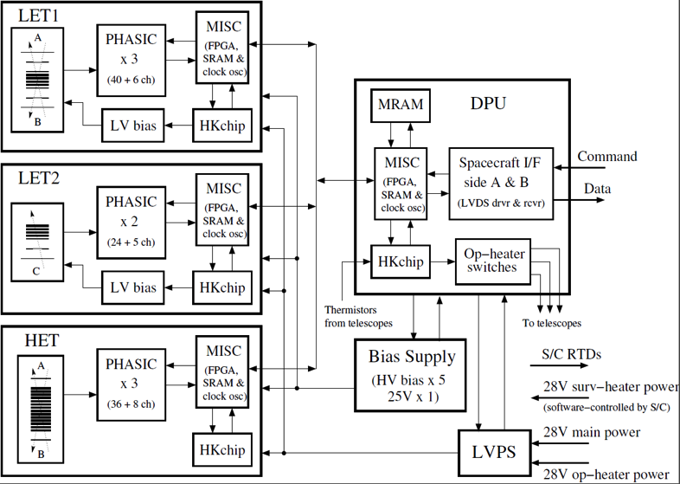
Processor and Software Architecture (2/2)
Notes:
Data from the MISCs associated with the LET1, LET2 and HET telescopes (the peripheral MISCs) will be gathered by the DPU MISC and formatted for transmission to the spacecraft (per the SPP GIS
Interface between the EPI-Hi DPU and the spacecraft
The DPU MISC will interface with the spacecraft via two serial interfaces: command and telemetry (see Figure 2.1). These interfaces are defined in the SPP GIS. Commands, telemetry data and command responses from the DPU will be in the form of CCSDS packets enclosed within Instrument Transfer Frames (ITFs). The ITF protocols for transferring commands, command responses, and telemetry data over these interfaces are also defined in the EPI-Hi Instrument/Spacecraft ICD. Instrument telemetry data formats, and instrument CCSDS data packet definitions will be defined in the EPI-Hi Instrument Science Data Format document (Ref. 9).
Interface between the DPU MISC and the LET1, LET2, and HET MISCs
There will be two RS422 serial interfaces between the DPU MISC and each of the three peripheral MISCs (LET1, LET1, and HET MISCs). The first interface will be bi-directional, for transferring boot-code, commands, and command responses. The second interface will be uni-directional, for transferring data from the peripheral MISCs to the DPU. These interfaces will be defined in the EPI-Hi Inter-MISC command/data interface Document (Ref. 8).

Slide 12
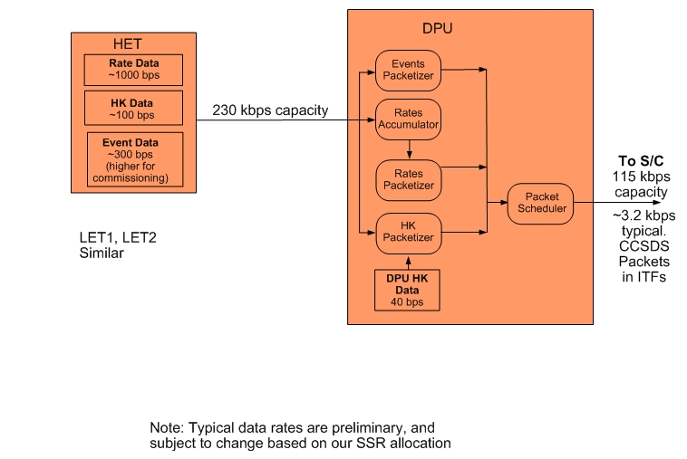
Instrument Data Flow

Slide 13
Operations Concept (1)
The DPU FSW orchestrates the operation of the instrument and controls the command/data interfaces with the spacecraft.
The detector module FSW controls detector operation, data acquisition, data processing, and manages the command/data interfaces with the DPU.
The instrument has only two normal operating modes:
Spacecraft-Sun Distance R<=0.25 AU (Encounter Science Mode)
Spacecraft-Sun Distance R > 0.25 AU (Low-rate Science Mode)
These two modes differ only in the data transmission rate from the DPU to the spacecraft, and in how the DPU responds to fault conditions.
The data collection rate and the operating mode of the three detector modules remains the same in these two modes.
In both modes, the detector modules transmit the same data products at the same rate to the DPU. The DPU decides, based on the mode, what data are to be transmitted to the spacecraft to be stored on the SSR.
Essentially, each of the detector modules has only one operating mode.

Slide 14
Operations Concept (2)
Four special operational modes are currently defined. These modes are:
Commissioning mode: Very similar to Low-rate Science Mode. In Commissioning mode, the data transmission rate from the DPU to the spacecraft is tailored to match the real-time downlink baud-rate available during commissioning, thus optimizing the capability of the instrument team to monitor the instrument during commissioning.
Software upload mode: Data acquisition and some non-essential functions will be halted.
Calibration Science mode: Statistically significant samples of Pulse Height Analysis (PHA) event data will be accumulated and returned to validate onboard assignments of species, energy, and incidence angle, and for assessing instrument backgrounds. This mode will be activated outside 0.25 AU by command one or more times early in the mission when sufficiently high intensities of solar energetic particles are present for calibration purposes. This mode, which will be used for a few days after activation of the mode, will require the return of a data volume significantly greater than that provided by the Low-rate Science Mode.
Safe mode is a mode where the instrument sits in a “quiet” state, awaiting commands from the ground, performing no data acquisition functions. This mode is reserved for instrument I&T, commissioning, and instances where the flight software encounters some irrecoverable fault.
As in the two normal operating modes, the mode change occurs in the DPU, not in the detector modules.

Slide 15
DPU Software Tasks
All DPU FSW requirements are mapped into one or more of the following tasks:
Forth operating system and low-level I/O routines
Power-on and initialization sequence management
Telescope MISC serial boot sequence management
Command table maintenance
Housekeeping data collection
Inter-MISC communication management, and data acquisition/buffering from satellite MISCs
Support time-tagged command capability (macros), to support autonomous instrument operations during encounters
Setup and control of instrument LVPS, bias supply
Active control of operational heaters
Receive/Monitor status and time-synchronization data from the spacecraft, and perform autonomous mode adjustments as needed
Receive and process ground commands
Management of software uploads and MRAM “burns”
Accumulation of science rates data
Compression of science rates data
Formatting/packetizing and transfer of science and housekeeping data and command responses to the spacecraft
Monitor heartbeat from peripheral MISCs, and perform autonomous diagnostics/reboot as needed
Manage volume of instrument data transferred to SSRs on S/C as function of time

Slide 16
Telescope MISC Software Tasks
All telescope MISC FSW requirements are mapped into one or more of the following tasks:
Forth operating system and low-level I/O routines
Science data acquisition
Detection and handling of crosstalk signals from PHASICs
Science data processing and reduction (particle ID)
Science and diagnostic rates data accumulation
Command table maintenance
Housekeeping data acquisition
Processing of status, time-synchronization, and command data from the EPI-Hi DPU
Send heartbeat message to DPU once per second
Monitor key counting rates and adjust the telescope operating condition to optimize data quality (dynamic adj. of detector thresholds)
Monitor temperatures of PHASICS and detector electronics
Formatting and transfer of science & housekeeping data and command responses to the EPI-Hi DPU
Setup and control of PHASICs and HKchips

Slide 17
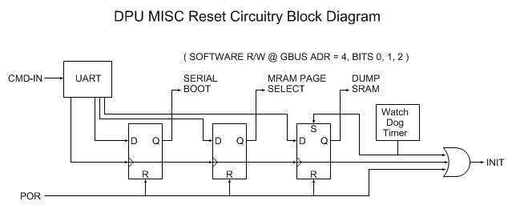
Boot Sequence and Initialization
Supports three ways to initiate boot: Power On Reset (POR), CMD-IN and Watch Dog Timer.
“Reset Bit Field” is writable by CMD-IN and R/W by software.
“Serial Boot” bit determines if boot is to be performed serially via CMD-IN or from MRAM.
“MRAM Page Select” bit determined which page (0 or 1) of MRAM is source of boot images.
“Dump SRAM” bit determines if SRAM is dumped prior to boot. This bit is set by the watch dog timeout.
Details of instrument boot process described in Autonomy Presentation

Slide 18
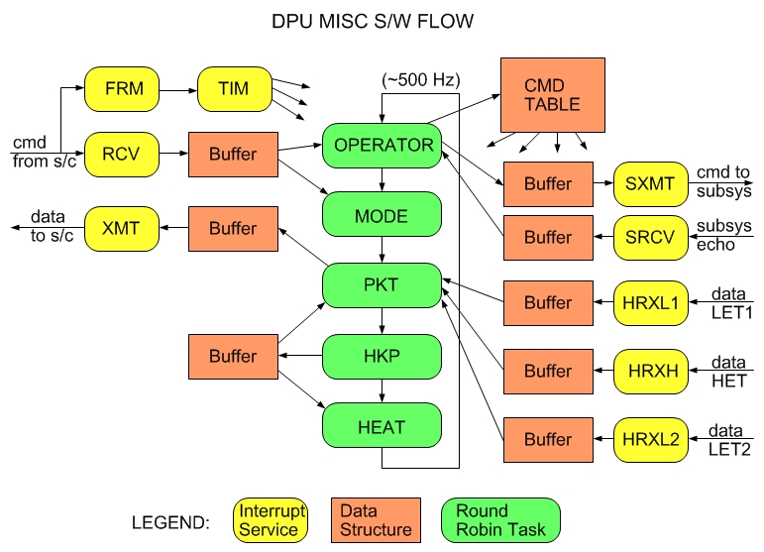
Software Flow – DPU MISC

Slide 19
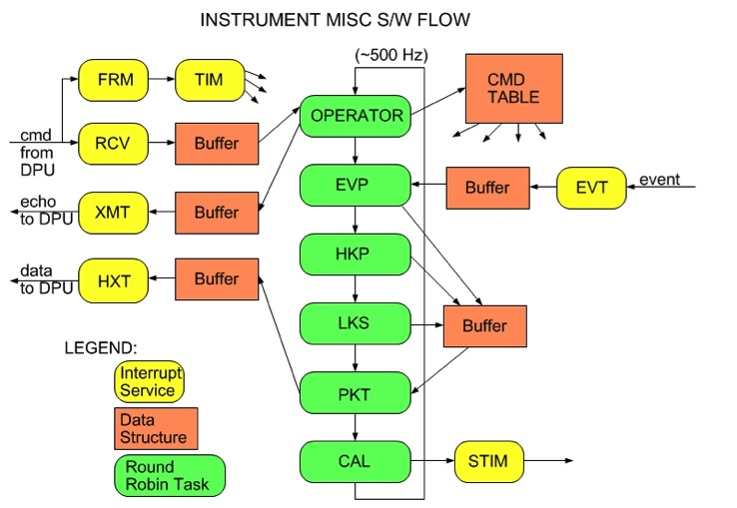
Software Flow – Telescope MISC

Slide 20
Inter-MISC Communication
There are two standard RS-422 serial interfaces between the DPU and each of the telescope MISCs.
The first is a bi-directional interface for the transfer of commands and boot code from the DPU to the module, and the transfer of command responses from the module to the DPU. This interface is multiplexed between the modules.
If a command message is destined for HET, LET1, or LET2, then the DPU initializes the multiplexed serial command link to the appropriate sensor based on a routing command contained in the command message, and forwards the command to the appropriate sensor.
This command routing software is the same as used on NuSTAR, and the SEP instrument suite on STEREO.
The second serial interface is unidirectional, for the transfer of data from the subsystem to the DPU. The data interface is not multiplexed between the subsystems – each subsystem has its own data interface with the DPU.
Double-buffering is implemented in each telescope MISC: data accumulated during period N is transferred to the DPU during period N+1.
Double-buffering is implemented in the DPU: data received during period N is packetized and transferred to the S/C during period N+1.

Slide 21
Electron and Ion Event Processing
The EVP task in the main round-robin multitasking loop in each telescope MISC polls the incoming event FIFO. If an event is available in the FIFO, the EPROC task is called to process the event. EPROC consists of a set of subtasks:
XTALK: check cross-talk flags generated by the PHASICs for each pulse-height reported for an event. Check for other known signal cross-talk features
SORT: assign a category for each event, e.g. RANGE 2A, RANGE 3B, etc.
MULTI: resolve any cases of multiple hits in a detector layer for an event
EUNPACK: Select dE, Ep, and L values, for use by SCALC task
CRIT: apply any trajectory or other consistency criteria (these will be range-dependent)
SCALC: for each (dE, Ep, L), identify the species (electron, proton, 3He, 4He, C, …)
ECALC: for electrons and protons, calculate energy (ETOT). For Z>=2, calculate ETOT/M
CTR_INC: increment appropriate rate counters based on results of SCALC and ECALC

Slide 22
Electron and Ion Event Processing Performance
Max execution times for each EPROC subtask (usecs):
XTALK 220
SORT 35
MULTI 96
EUNPACK 50
CRIT 25
SCALC 107
ECALC 130
CTR_INC 20
Max execution time for EPROC is 683 usecs
1464 events processed/second.
Execution times are for an event with a large number of pulse-heights. Most events will be short-range, with only a few pulse-heights. Short-range events can be processed at a rate of ~2500/second.
The requirement is to process proton and electron events at a rate of at least 1000 events/second.

Slide 23
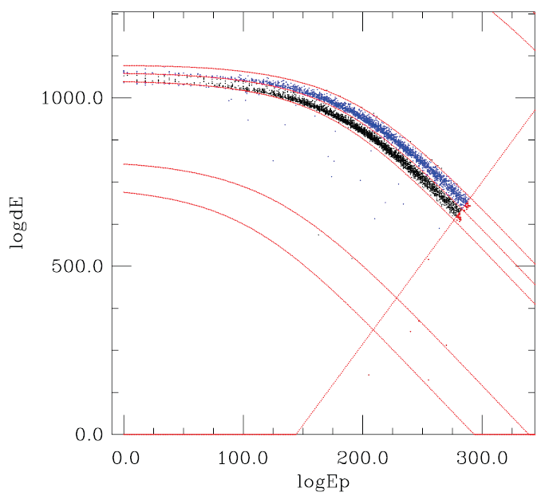
Onboard Particle Identification (SCALC)
Output from a LET1 Monte Carlo simulation of 3He and 4He events was used as input to the latest version of our onboard particle ID algorithm, implemented on a MISC test board
Onboard algorithm maps events into a 2D dE-Eprime space, where boundary-curves define different regions for different species
SCALC processes events at ~ 9400 events/second
4He
3He
protons

Slide 24
Science Rates Accumulation and Compression
We have specified the division of labor between the telescope MISCs and the DPU MISC for these tasks as follows:
Telescope MISCs perform all rate accumulations up to 1 minute cadence
1 minute ion rates
1 minute sectored rates
1 minute ENA rates
1 minute Neutral rates
1 minute Pixel rates
10 second electron, proton, He, Z>=6 rates
10 second Neutral rates
1 second electron and proton rates
DPU MISC performs all rate accumulations for cadences > 1 minute
1 hour science rates
5 minute sectored rates
DPU MISC implements compression of all rates prior to packetization
Take a list of N fixed-length rates and telemeter only those that are non-zero; a list of N tag bits is attached as a header to each block of N rates to indicate which rates made the cut.
Tested on STEREO rates data, this simple scheme results in compression factors of ~1.4 during large SEP events, to ~5 during solar quiet times.

Slide 25
DPU Timing Cycles
Asynchronous
Receive command echoes from telescope MISCs
Every 1 second
Read Time/Status from S/C Command ITF
Check for/interpret commands in S/C Command ITF
Send SYNC to telescope MISCs
Read rates/events/HK data blocks from telescope MISCs
Packetize/transfer command echoes to S/C (as needed)
Packetize/transfer event data to S/C
Update heartbeat status for each telescope MISC
Every 4 seconds
Acquire DPU HK data
Update op. heater control parameters
Every minute
Packetize/transfer 1sec, 10sec, and 1min rates to S/C
Packetize/transfer selected HK data to S/C
Accumulate 5min and 1hr rates (from 1min rates)
Do command table checksum check
Every 5 minutes
Packetize/transfer 5min rates to S/C
Every 10 minutes
Packetize/transfer 10min rates to S/C
Every hour
Update data->SSR metering parameters
Packetize/transfer 1hr rates to S/C

Slide 26
Telescope MISC Timing Cycles
Asynchronous
Process events in the event FIFO from the front-end electronics
Check for/interpret commands from DPU
Xfer Command responses to DPU, if needed
Every 1 second
Receive/decode SYNC from DPU
Xfer 1s rates for previous second to DPU
Xfer prioritized event data to DPU
Update CAL/STIM pulser settings
Every 4 seconds
Acquire HK data, transfer to DPU
Every 10 seconds
Xfer 10s rates for previous 10 seconds to DPU
Every minute
Xfer 1minute rates for previous minute to DPU
Update dynamic threshold state parameters
Do command table checksum check

Slide 27
Telemetry and Commands
The EPI-Hi Telemetry Format Document contains the following:
Packet ApID assignments for instrument CCSDS packets. EPI-HI is assigned 96 ApIDs.
Telemetry data formats and instrument CCSDS packet definitions
Event data format
Cadences for Rates data telemetry for each operating mode
The routine command dictionary

Slide 28
Predicted Memory, CPU Margins
LET1 MISC (LET2, HET similar)
SRAM 512kwords available (512k x 24 bits)
Basic OS, HK, I/O code + tables 20kwords
Event processing, particle ID 230kwords
Rates counters, double-buffered 10kwords
Event priority buffers 25kwords
Total SRAM usage ≈ 285/512 = 56%
MIPs 12 60% used (Maximum, dominated by event processing during intense SEP events)
DPU MISC:
SRAM 128kwords available (128k x 24 bits)
Basic OS, HK, I/O code + tables 20kwords
Detector module data buffers,
& rate accum, double-buffered 30kwords
CCSDS Packet buffers 30kwords
Total SRAM usage ≈ 80/128 = 63%
MRAM 2M x 8 bits ~70% used (2 sets of boot images)
MIPs 12 30% used
Inline with APL Space Exploration Sector guidelines for processor and memory margins

Slide 29
Integration, Testing and Verification
The EPI-Hi Flight Software Test Plan document defines this plan in detail. The plan includes a software requirements verification matrix.
Software tests will start at the module level. As the code builds up, system-level testing will start, and the majority of the test time will be targeted at the system level.
A Test Readiness Review will precede formal acceptance testing. SPP Project and ISIS personnel will oversee/participate in this review.
Formal acceptance tests will be performed on the EPI-Hi instrument, including the flight software, during the EPI-Hi integration and test phase.
During environmental tests and SPP I&T, more experience will be gained with the flight software, real sensor data, and with controlling the instrument via the SOC-MOC interfaces. Flight software changes may be expected as a result. Any changes in the flight software at this stage will result in CCB review, and a repeat of these acceptance tests.
The acceptance tests for the EPI-Hi flight software will be designed to verify each of the software functional requirements as called out in the requirements documents and also the functions provided by the Forth operating system, the I/O API, and the multitasking software running on the MISC processors.
Most of the acceptance tests are enshrined in a scripted Comprehensive Performance Test that is run at regular intervals during environmental tests and I&T by the EPI-Hi team.
A software requirements verification matrix is maintained by the EPI-Hi team to aid in verifying that the software meets the requirements. The matrix is available for review by the SPP Project. A preliminary software requirements verification matrix will be presented at CDR and a final version will be presented at the Software Acceptance Review, following successful completion of the acceptance tests.
A Software Acceptance Review will follow the successful completion of the acceptance tests, and the EPI-Hi team will present a test report. SPP Project will oversee/participate in this review.

Slide 30
Software Maintenance, Configuration Management
A Configuration Management Plan is contained in Software Development Plan
Version control and software archiving: achieved via subversion version control system (SVN) (http://subversion.apache.org/). The subversion server is hosted and maintained by Caltech Space Radiation Lab IT personnel. It is access-controlled for security, and is backed-up regularly.
The lead engineer will maintain the structure of the SVN repository, including separate source trees for each of the MISC’s flight software, separate directories for different software builds, etc.
All problems and change requests will be documented/tracked in the Software Development Log by the lead engineer.
After the beginning of I&T with flight hardware, all flight software changes will be approved by a CCB prior to being loaded into flight hardware. Also after this point, Version Description Documents (VDDs) will accompany all software releases. The VDD will contain the functionality of the release, a list of closed software problem reports, a list of any liens/workarounds, installation instructions, and a list of deliverable source code files.
The CCB membership will consist of the EPI-Hi lead engineer and software developer, and the EPI-Hi Project Manager, plus any other ISIS or SPP Project engineers that the QA team at SwRI deems necessary.
Notes:
More details in Dev plan

Slide 31
Status of Engineering Model Software
FSW running on EPI-Hi EM-unit in “Flatsat” configuration
GSEOS EGSE communicating with EM-Unit via either mini or “full” spacecraft emulators
HK, event, rates, and command-response data flowing from Detector modules to DPU
Data in CCSDS packets, encapsulated in ITFs, flowing from DPU to GSEOS
DPU interpreting virtual 1 PPS time/status ITF from S/C emulator
Commands and command responses flowing

Slide 32
DPU FSW Status
DPU MISC Flight Software Task | Heritage | % Done | Assignee | Notes
Forth operating system and low-level I/O routines | 95% | 100% | WRC
Power-on and initialization sequence management | 60% | 80% | WRC
Detector module MISC serial boot sequence management | 80% | 100% | WRC
Command Table Maintenance | 100% | 100% | WRC
Housekeeping data acquisition | 50%* | 100% | WRC
Inter-MISC communication management, data acquisition and buffering from Peripheral MISCs | 90% | 100% | WRC
Support time-tagged command capability (macros) | 0% | 40% | WRC | Algorithm drafted, under review by science team
Setup and control of instrument LVPS and bias supply | 50%* | 100% | WRC
Active control of operational heaters | 80%* | 100% | WRC
Receive/Monitor status, and time-synchronization data from the spacecraft, and perform autonomous mode adjustments as needed | 10% | 40% | WRC | Rec/monitor status and time-synch data part of task is 100% done. Perform autonomous mode adjustments part is 0% done.
Receive and process ground commands | 100% | 100% | WRC
Management of software uploads and MRAM burns | 75% | 50% | WRC
Accumulation of science rates data | 75%* | 60% | AJD | Acquisition of rates data from telescope modules is done. Accumulation of rates into longer-cadences is not done.
Compression of science rates data | 0% | 50% | AJD
Formatting/packetizing and transfer of science & housekeeping data and command responses to the Spacecraft | 50% * | 80% | WRC and AJD | General data packetization scheme done. HK, events, Cmd-response and preliminary rates data packetization done. Final rates packets awaiting full definition of science rates
Monitor heartbeat from peripheral MISCs, and perform autonomous diagnostics/reboot as needed | 60% | 60% | WRC
Manage volume of instrument data transferred to SSRs on S/C as function of time | 0% | 40% | AJD | Algorithm drafted, under review by science team
* general scheme is inherited, specifics are unique

Slide 33
Detector Module FSW Status
LET1, LET2, and HET MISC Flight Software Tasks – each MISC performs a similar set of functions: | Heritage | % Done | Assignee | Notes
Forth operating system and low-level I/O routines | 95% | 100% | WRC
Power on and initialization sequence management | 60% | 100% | WRC
Science data acquisition | 50% * | 100% | WRC
Detection and handling of crosstalk signals from PHASICs | 50%* | 60% | WRC/AJD | Algorithm for implementing this task is done. Awaiting specifics of characteristics of 16-bit crosstalk register from PHASIC
Science data processing and reduction (particle ID) | 20% | 70% | AJD | Software for analysis of ions/electrons is written and partially tested. Needs further testing and refinement with real particle event data. Algorithms for ENA, Neutrals, and penetrating particles handling needs input from science team.
Science and diagnostic rates data accumulation | 50%* | 80% | AJD | Need to implement particle species/energy bins
Command Table Maintenance | 100% | 100% | WRC
Housekeeping data acquisition | 50% * | 100% | WRC
Processing of status, time-synchronization, and command data from the EPI-Hi DPU | 50% * | 100% | WRC
Send heartbeat message to DPU once per second | 50% | 100% | WRC
Monitor key counting rates and adjust the telescope operating condition to optimize data quality | 80% | 70% | WRC | Refinement of STEREO dynamic-threshold software for EPI-Hi
Monitor temperatures of detector electronics and PHASICs | 100% | 100% | WRC
Formatting and transfer of science & housekeeping data and command responses to the EPI-Hi DPU | 50% * | 80% | WRC and AJD | Need final definition of rates data blocks to complete this task
Setup and control of PHASICs and HK chips | 50% * | 100% | WRC
Detector Leakage Current Monitoring and Balancing | 100% | 100% | WRC
Control of Electronics Test Pulser Cycling | 92.8% | 71.3% | WRC
* general scheme is inherited, specifics are unique

Slide 34
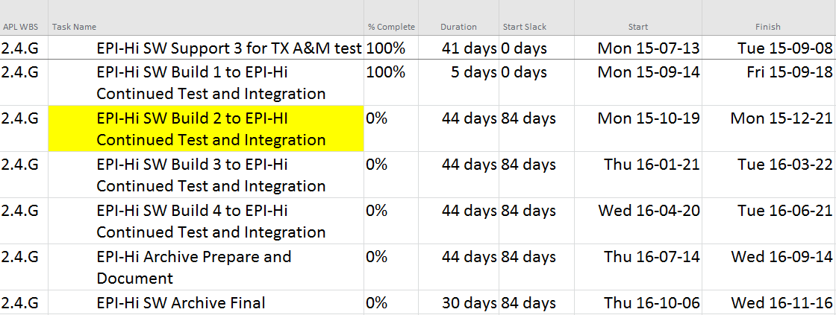
FSW Schedule

Slide 35
Backup Slides

Slide 36
DPU Interrupt Analysis
DPU Interrupt Analysis
description | priority | maximum | maximum | min interrupt | max allowed | maximum | average | average (*)
 |  | execution | execution | period (usec) | servicing delay | cpu load (%) | rate (/sec) | cpu load (%)
 |  | time (clocks) | time (usec) |  | (usec)
timer | 10 | 475 | 32.1 | 2000 | 1965 | 1.6 | 500 | 1.6
gse tx uart | 9 | 105 | 7.1 | 95.5 |  | 7.4 | 0 | 0.0
gse rcv uart | 8 | 90 | 6.1 | 95.5 | 763.9 | 6.4 | 0 | 0.0
sc tx uart | 7 | 130 | 8.8 | 95.5 |  | 9.2 | 500 | 0.4
sc rcv uart | 6 | 179 | 12.1 | 95.5 | 763.9 | 12.7 | 500 | 0.6
tele tx uart | 5 | 60 | 4.1 | 47.7 |  | 8.5 | 0 | 0.0
tele rcv uart | 4 | 70 | 4.7 | 47.7 | 381.9 | 9.9 | 0 | 0.0
het rcv uart | 3 | 51 | 3.4 | 47.7 | 381.9 | 7.2 | 200 | 0.1
let2 rcv uart | 2 | 51 | 3.4 | 47.7 | 381.9 | 7.2 | 200 | 0.1
let1 rcv uart | 1 | 51 | 3.4 | 47.7 | 381.9 | 7.2 | 200 | 0.1
frame | 0 | 212 | 14.3 | 1000000 |  | 0.0 |  | 0.0
 |  |  |  |  |  | ---------------- |  | ---------------
 |  |  |  |  |  | 77.4 |  | 2.9
 |  |  |  |  |  |  |  | (*) overestimated due to
 |  |  |  |  |  |  |  | use of MAX execution times

Slide 37
Telescope Board Interrupt Analysis
Telescope Board Interrupt Analysis
desciption | priority | maximum | maximum | min interrupt | max allowed | maximum | average | average (*)
 |  | execution | execution | period (usec) | servicing delay | cpu load (%) | rate (/sec) | cpu load (%)
 |  | time (clocks) | time (usec) |  | (usec)
timer | 10 | 475 | 32.1 | 2000 | 1965 | 1.6 | 500 | 1.6
cmd tx uart | 9 | 105 | 7.1 | 47.7 |  | 14.9 | 0 | 0.0
cmd rcv uart | 8 | 90 | 6.1 | 47.7 | 381.9 | 12.7 | 0 | 0.0
data tx uart | 7 | 63 | 4.3 | 47.7 |  | 8.9 | 200 | 0.1
event | 6 | 300 | 20.3 | 500 |  | 4.1 | 2000 | 4.1 | (**)
frame | 5 | 212 | 14.3 | 1000000 |  | 0.0 | 1 | 0.0
 |  |  |  |  |  | ---------------- |  | ---------------
 |  |  |  |  |  | 42.2 |  | 5.7
 |  |  |  |  |  |  |  | (**) this interrupt rate is throttled
 |  |  |  |  |  |  |  | the max execution time is actually more
 |  |  |  |  |  |  |  | like 700 cycles, but 300 is a practical limit
 |  |  |  |  |  |  |  | for realistic event lengths

Slide 38
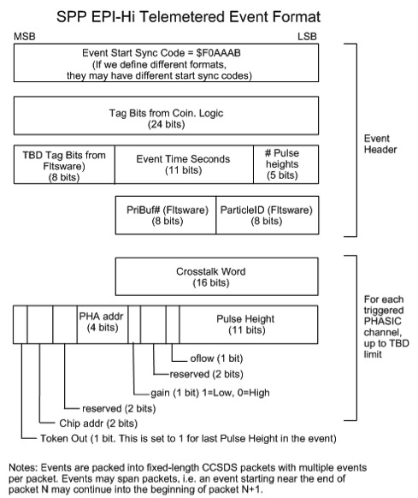
Telemetered Event Data Format

