Slide 1
Sensor Overview
Rick Cook & Andrew Davis
EPI-Hi Software Engineering (Caltech)
Eric Christian (GSFC)
Notes:
introduction

Slide 2
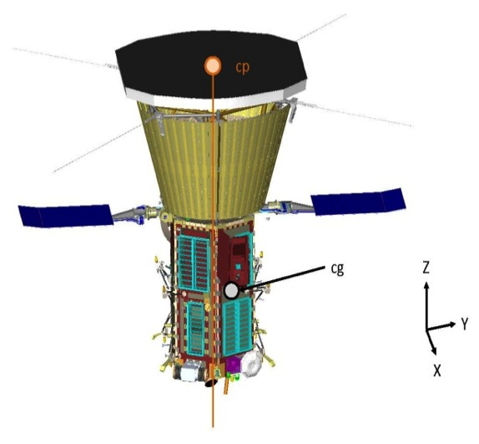
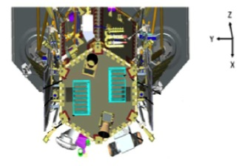
EPI-Hi Instrument
Location of instrument on spacecraft
ISIS-EPI-HI
ISIS-EPI-HI

Slide 3
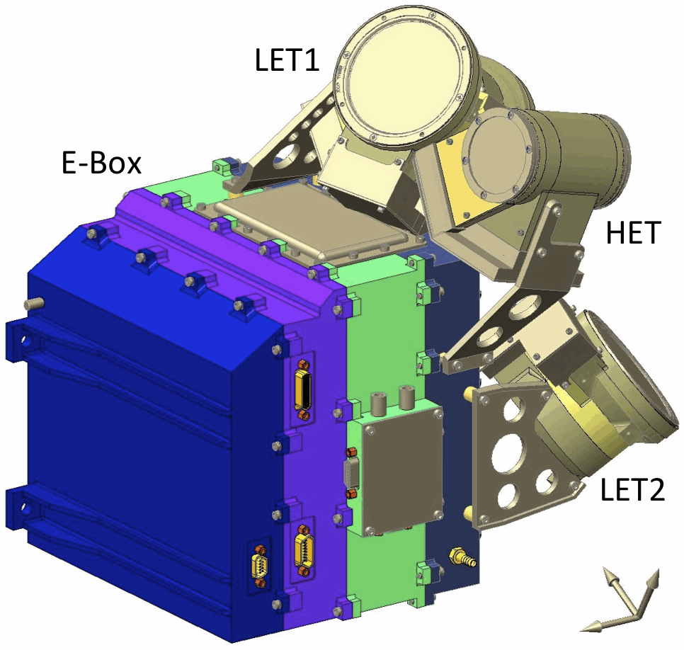
Design Overview
Sensor Approach
All sensor elements are ion-implanted silicon solid-state detectors
Multiple detector telescopes to provide large energy range and sky coverage
Some telescopes double-ended to increase sky coverage
Detector segmentation to provide
angular sectoring and adjustable
geometrical factor
Heritage
Numerous energetic particle
instruments over the past 40 years
Direct predecessor: STEREO/LET & HET

Slide 4
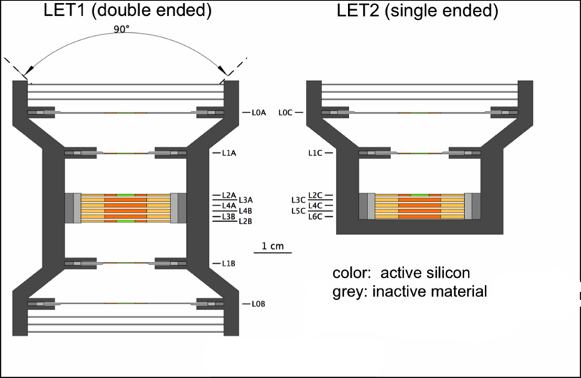
Sensor Design (1/2)
Low-Energy Telescopes: Conceptual Cross Sections

Slide 5
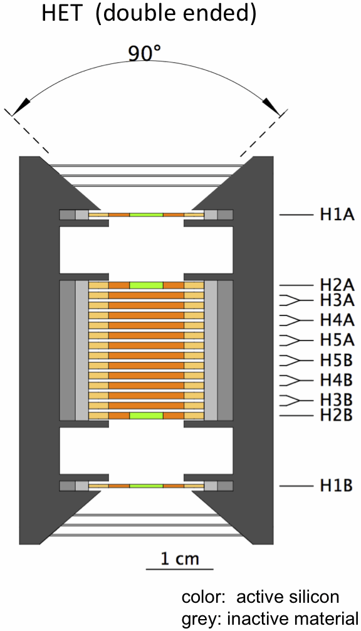
Sensor Design (2/2)
High-Energy Telescope: Conceptual Cross Section

Slide 6
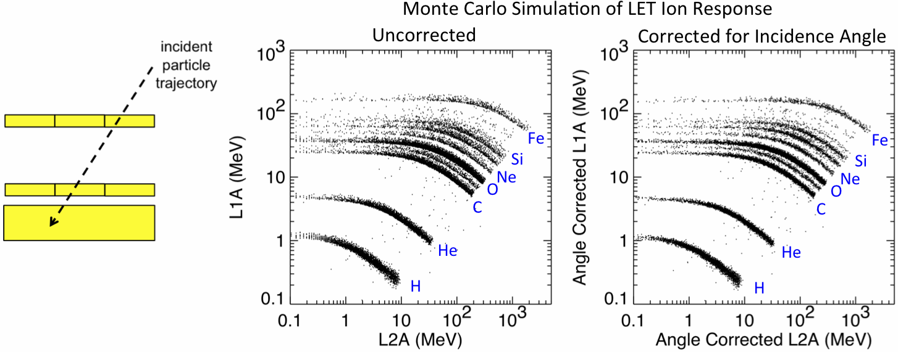
Principle of Operation
Energy loss measurements from the detector in which a particle stops (E’) and the preceding detector (ΔE) organize the data into distinct tracks for the various elements.
Segmentation of front two detectors provides information about particle direction of incidence that is used to obtain mean thickness penetrated in the ΔE detector and make an on-board correction to the measured energies to optimize species resolution.
Energy assigned on-board includes energies measured in overlying detectors and calculated energy loss in windows.

Slide 7
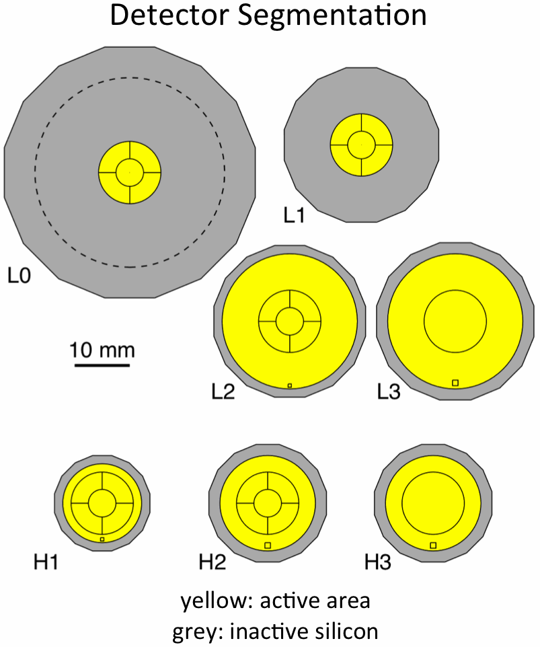
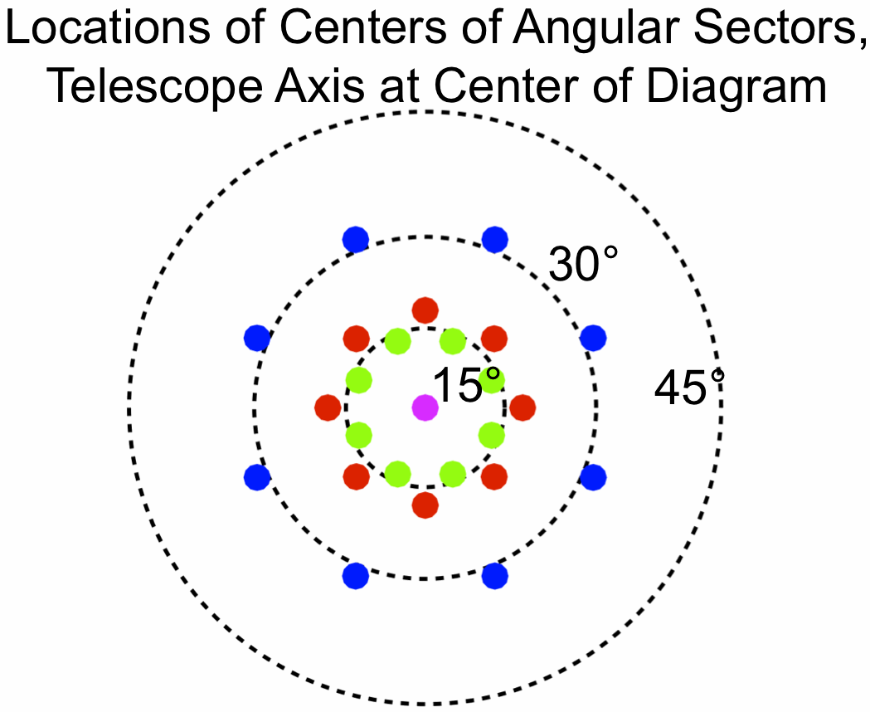
Angular Sectoring
Particle directions of incidence are determined based on active elements hit in two position-sensitive Si detectors (L0 and L1, L1 and L2, or H1 and H2)
Each of these detectors has central bull’s eye surrounded by 4 quadrants
Quadrants in L2 (H2) rotated 45° about the telescope axis relative to those in L1 (H1)
25 combinations of hit elements in the two detectors are used to assign event to a viewing sector
L0 and L1 have quadrants aligned to optimize mass resolution; at low energies 3 sectors rather than 25
HET provides sectored electron data, LET1 provides only front-back direction information for electrons

Slide 8
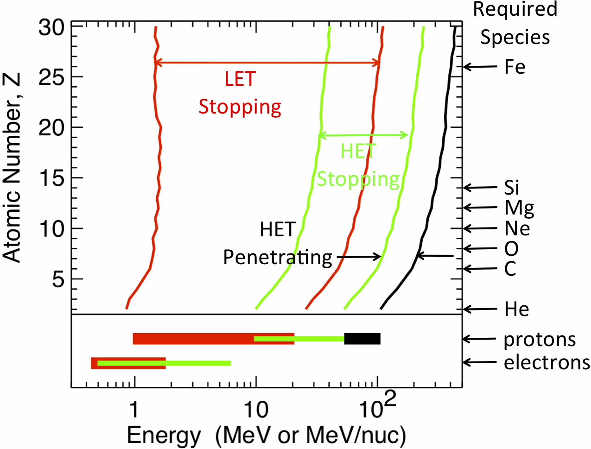
Species and Energy Coverage
Rates are accumulated on-board in logarithmically spaced energy bins (> 6 bins/decade)
Larger energy bins are used for some rates accumulated at the highest cadence (1 second) in order to increase statistical accuracy

Slide 9
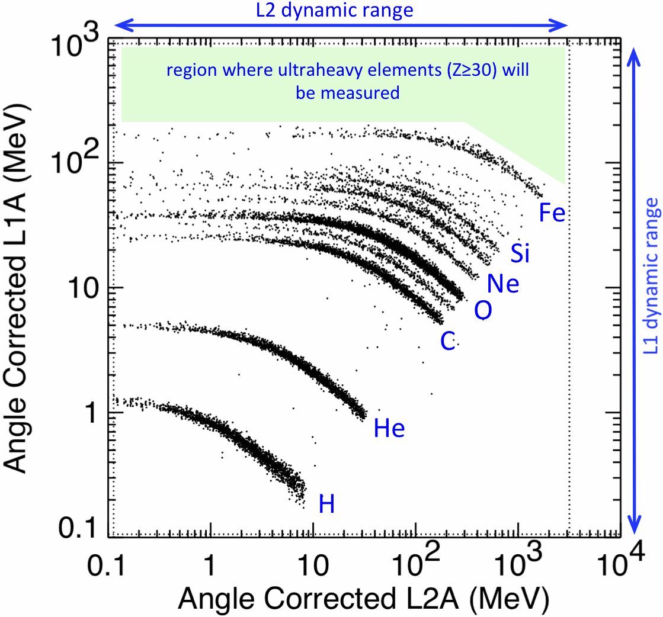
Element and Isotope Resolution
Monte Carlo simulations shows that all required species are identified
³He/⁴He is a key measurement that needs isotopic resolution
Simulations show that there is clear separation between ³He and ⁴He in a high-resolution subset of the events (particles with near vertical trajectories)

Slide 10
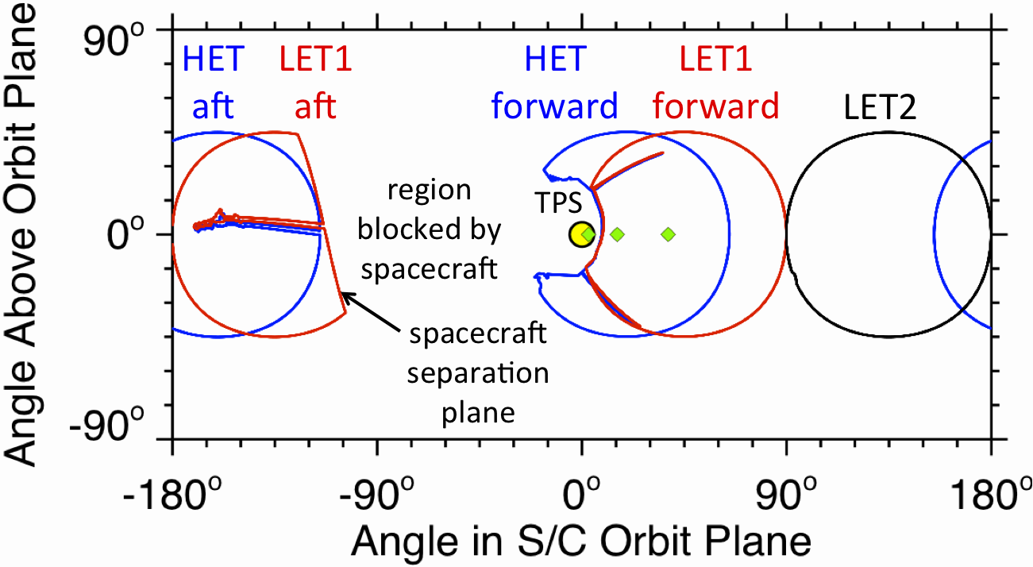
Fields of View (FOV)
Sun (yellow circle) shown with angular size seen from 10 R_{S}
Mean Parker spiral field angles (green diamonds) shown for 400 km/s at heliocentric distances (left to right) of 10 R_{S}, 0.25 AU, and 0.70 AU
Full energy coverage in forward and aft regions of overlap between LET1 and HET

Slide 11
Measurement Cadences
Highest cadence: 1 second
Used for one electron bin below and one above 1 MeV
Used for 4 proton bins above 1 MeV
Intermediate cadence: 10 sec
Used for narrow energy bins for e, H, He, ³He
Used for intermediate-width energy bins for element groups CNO, NeMgSi, Fe
Normal cadence: 60 sec
Used for narrow energy bins for ³He, and major elements from C through Ni
Used for wide energy bins for groups of ultra-heavy elements
Used for angular distributions in one broad-energy-range proton bin and one broad-energy-range electron bin
Low cadence: 300 sec
Used for angular distribution of e, p, He, ³He, CNO, NeMgSi, and Fe in intermediate energy bins
Very low cadence: 1 hr
All rates accumulated at cadences of 60 sec and 300 sec are also accumulated over 1 hr

Slide 12
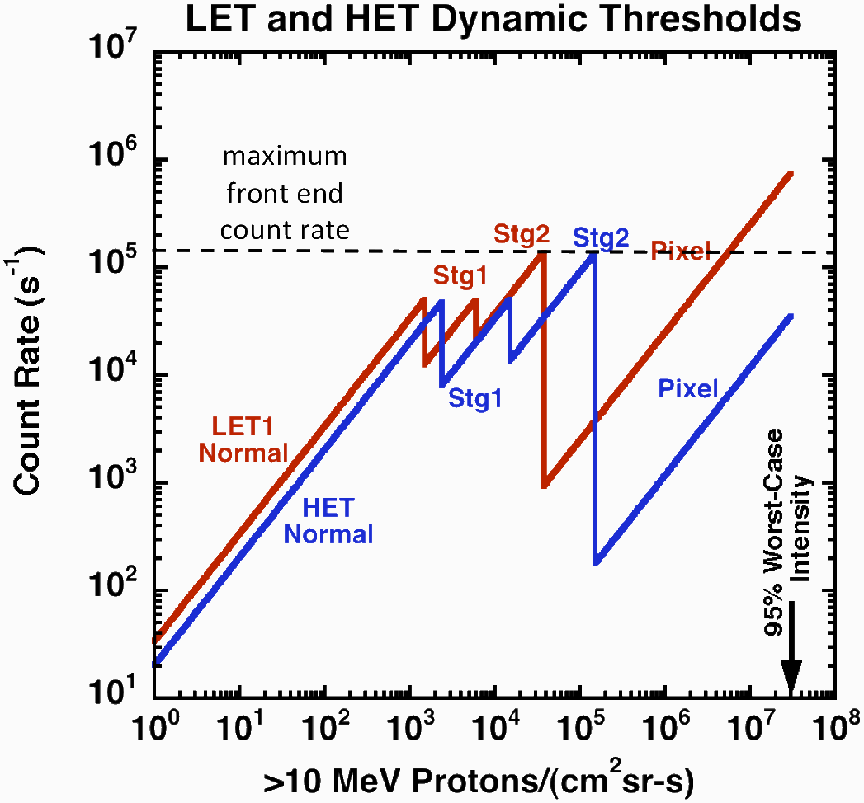
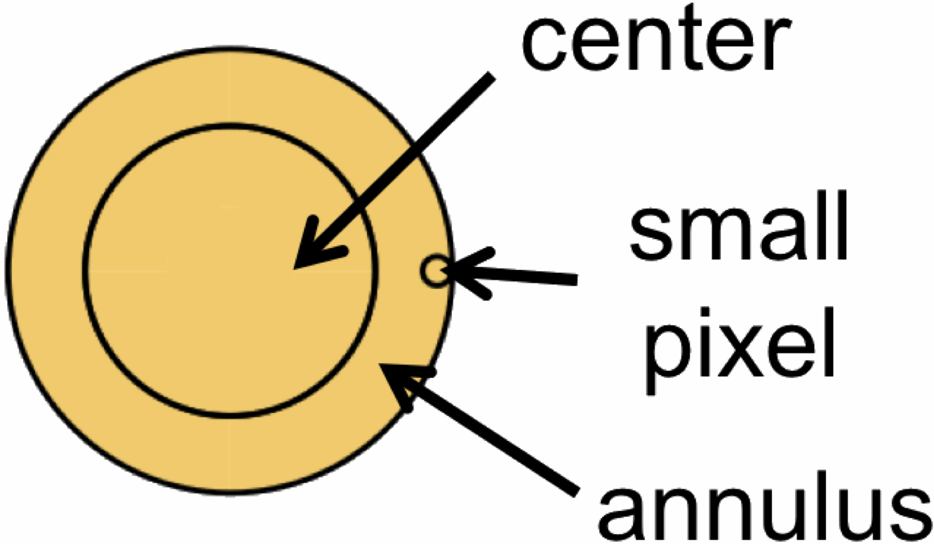
Dynamic Range in Particle Intensities
Effective collecting area for protons decreased during period of high particle intensities
There is significant uncertainty in the radial dependence of SEP intensities close to the Sun
The EDTRD includes a worst-case spectrum having a >10 MeV intensity of 3×10⁷/cm²sr-s (95% confidence)
Both HET and LET use dynamic thresholds when intensities exceed ~2000 /cm²sr-s
In order to measure proton intensities in extreme events, singles count rates from several small (1 mm²) pixels are used with thresholds raised on all other detector elements

Slide 13
Summary
Operation of EPI-Hi is relatively simple because there is essentially only one science mode, although at times not all cadences for the particle rates are sent to the spacecraft SSR.
For example, during cruise phase (r > 0.25 AU) only the longest cadences are transmitted to greatly reduce data rate.
Sensor has graceful degradation. Failed segments/detectors/telescopes reduce but do not completely disable science return.
Enhanced with flexible trigger equations
It is very important that EPI-Hi collect data as much of the time as possible. SEP events can have durations of a week or more and gaps in the data can complicate the interpretation.

