Slide 1
EPI-Hi Technology Development

Slide 2
Outline
objective
approach
development strategy and status
fidelity of test article
test performed
transition to flight

Slide 3
Objective
Develop new approach to fabricating multi-element ion-implanted silicon solid-state detectors thinner than ~30μm with the following features:
thicknesses in the range ~10 to 30 μm
good control of absolute thickness and detector-to-detector variation (±1 μm)
good thickness uniformity (~0.2% or better rms variation) to allow good species resolution (e.g., He isotope separation)
mechanical robustness to provide good manufacturing yield and to survive launch environment without breaking

Slide 4
Approach
fabrication based on commercial silicon-on-insulator wafers (SOI)
detector pn junctions produced on device layer of SOI using conventional ion-implantation technology
supporting handle layer etched away under portion of the wafer containing detector active area
thin SiO₂ interface between the two wafers acts as etch stop that makes thickness control and uniformity independent of etch rate variations
remaining thick “picture frame” immediately outside the thinned region provides robust mechanical support and avoids the need to wirebond to the fragile thin membrane
production of ohmic contact and dicing into individual detectors done after thinning

Slide 5
Thin Silicon Detector Fabrication Process Summary
thin device wafer
buried oxide
thick handle wafer
silicon-on-insulator (SOI) wafer, commercial product
photoresist mask
ion implant to produce diode pn junctions on device layer
wet etch to remove handle layer under active area—oxide acts as etch stop
nitride mask
etch away oxide from underneath active area
ion implant from back to produce detector’s ohmic contact
dice wafer into individual thin detectors with thick supporting frames

Slide 6
PLACE-HOLDER SLIDE
SOI THICKNESS CHARACTERISTICS:
THICKNESS COMPARISON BETWEEN THINNED TEST SAMPLES OF SOI AND CONVENTIONAL (STEREO/LET) DETECTORS
MANUFACTURER DATA ON THICKNESS UNIFORMITY OF SOI PURCHASED FOR EPI-Hi THIN DETECTOR DEVELOPMENT

Slide 7
Development Strategy and Status
Background
prototyping studies carried out by a collaboration between LBNL (diode fabrication) and Caltech/JPL since 2003
prior Caltech/JPL collaboration with Micron Semiconductor (Lancing, Sussex, England) allowed them to develop the capability for making thin, supported detectors from conventional silicon wafers; thickness control and uniformity were did not meet specifications
Phase B Activity
efforts to prototype EPI-Hi thin detectors from SOI wafers has been funded during phase B both at Micron and LBNL
testing and evaluation being carried out by the manufacturers and by Caltech/JPL and GSFC
Flight Detectors
plan to down-select to a single source for flight detectors based on test results

Slide 8
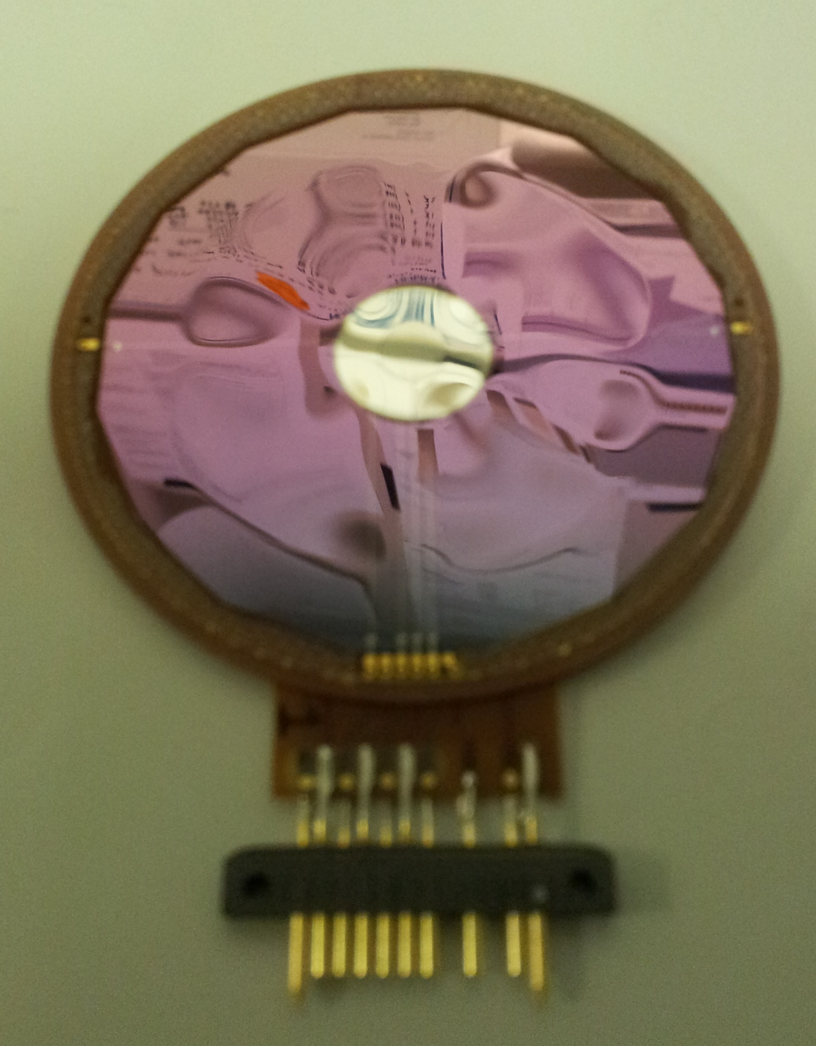
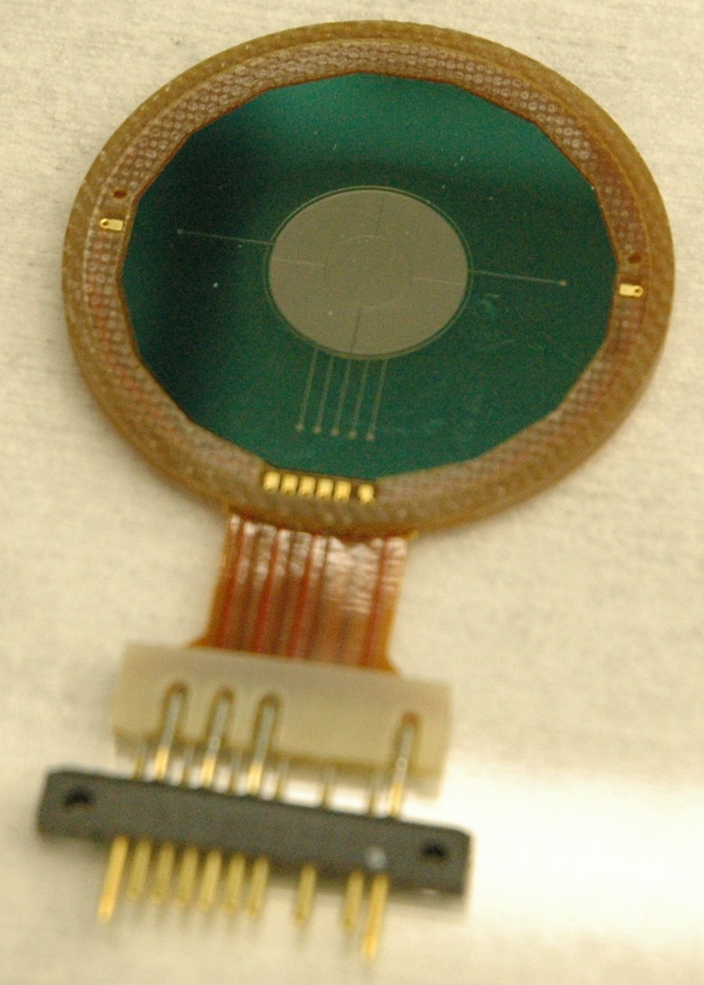
PLACE-HOLDER SLIDE
Photograph of Thin Detectors
L0 Detector from
MIcron Semiconductor
L1 Detector from LBNL
Labeling needed:
dimension
location of active area
comment about waviness

Slide 9
PLACE-HOLDER SLIDE
Photograph of SOI wafer after thinning

Slide 10
Fidelity of the Test Article
flight detectors are expected to be identical to the prototypes
the same photolithography masks will be used
no changes are anticipated in process parameters (ion implantation energy, annealing temperature and time, etc.)
it presently appears that a sufficient supply of SOI wafers may be left over from the phase B work to allow fabrication of all of the flight detectors and spares
no changes are anticipated in the detector mounts (provided by GSFC to both LBNL and Micron)
possible exceptions
if expected risk from dust impacts is judged to be excessive, a modest increase in detector thickness (e.g., 12μm —> 15μm) could be considered
if LBNL is selected to make flight detectors, adhesive used for gluing detectors into mounts may be changed to that conventionally used by Micron

Slide 11
Tests Performed
electrical characteristics
leakage current versus bias (IV) —> maximum operating voltage
capacitance versus bias (CV) —> bias required for full depletion
particle response
alpha particles from ²⁴⁴Cm source (5.8 MeV —> 1.45 MeV/nuc)
accelerator beams of heavy ions
thickness characteristics
thickness and thickness uniformity inferred from particle response tests checked against expectations from SOI characteristics
stability in expected environment
thermal-vacuum life test at GSFC—our standard test for flight qualification of all silicon detectors
total dose testing using ⁶⁰Co gamma-ray source at JPL
mechanical robustness
acoustic test of mechanical model made from thinned SOI

Slide 12
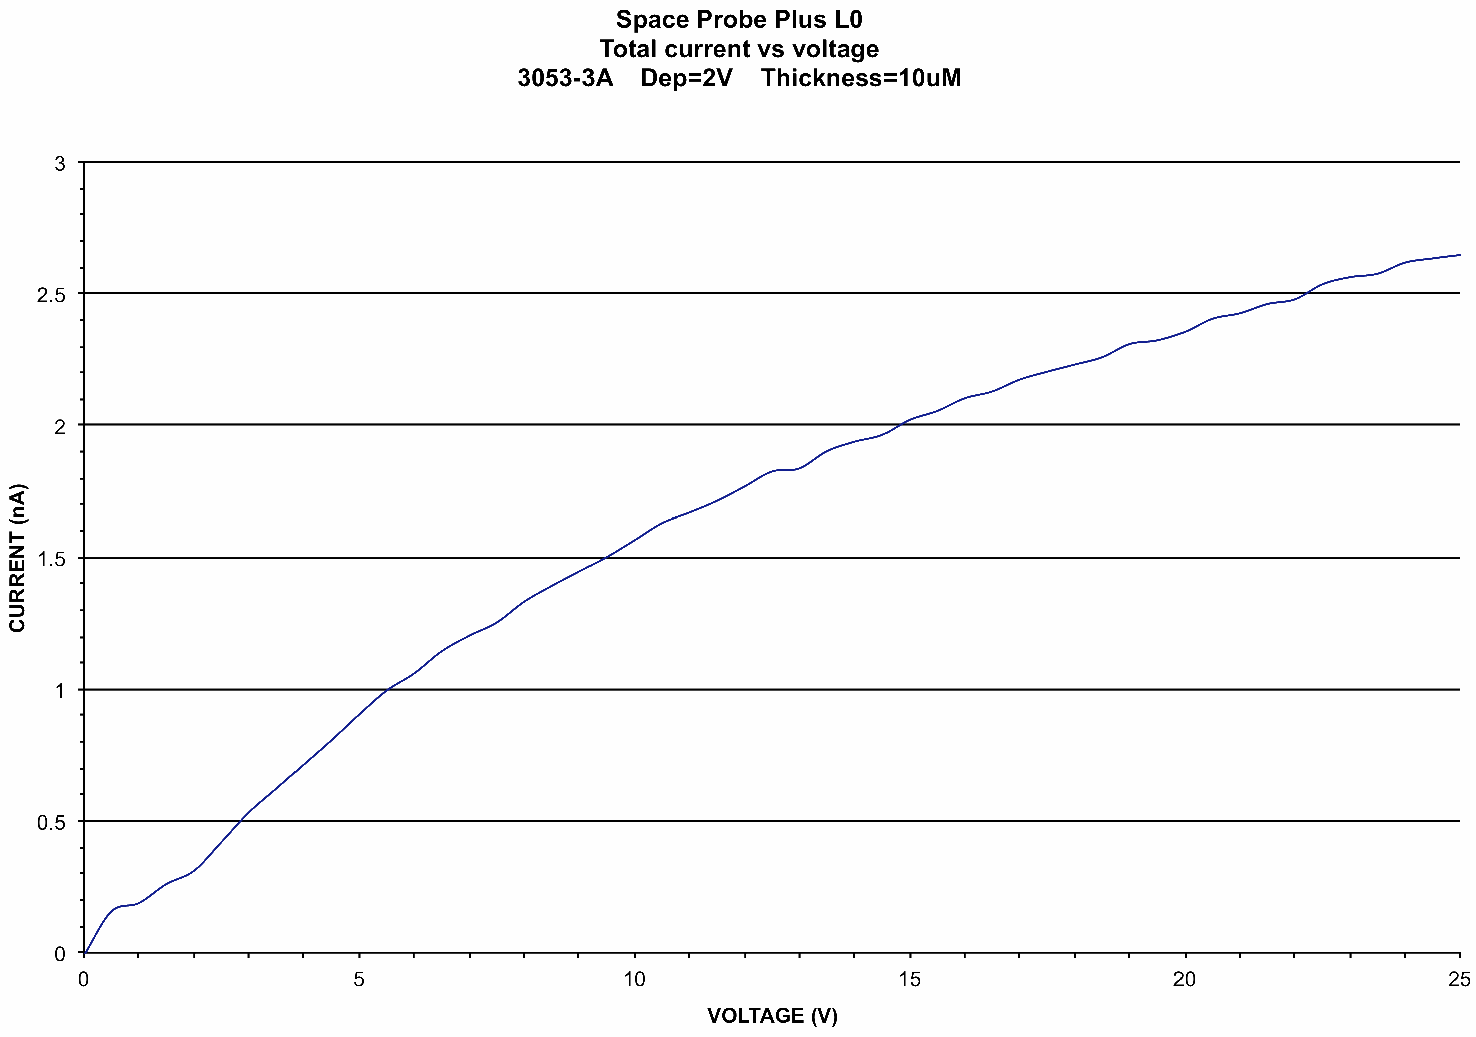
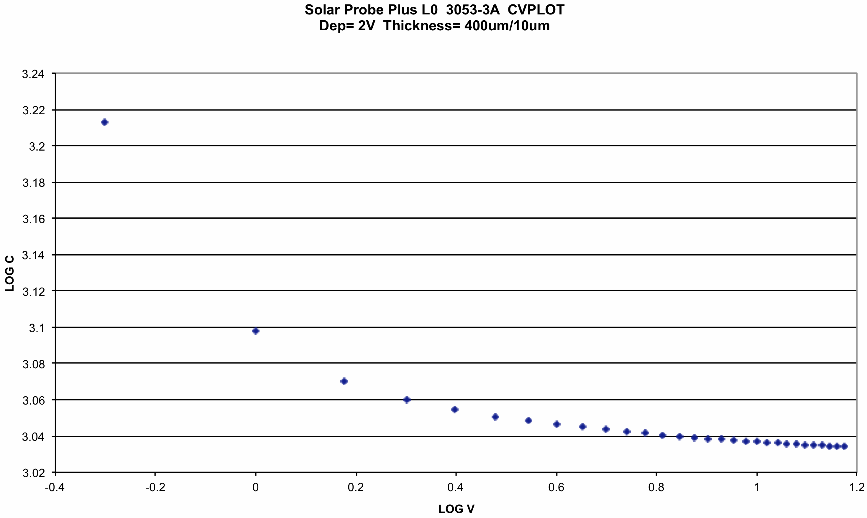
PLACE-HOLDER SLIDE
Plots of electrical characteristics
IV curve(s)
CV curve(s)
breakdown voltage > 25V
full-depletion voltage ~2V

Slide 13
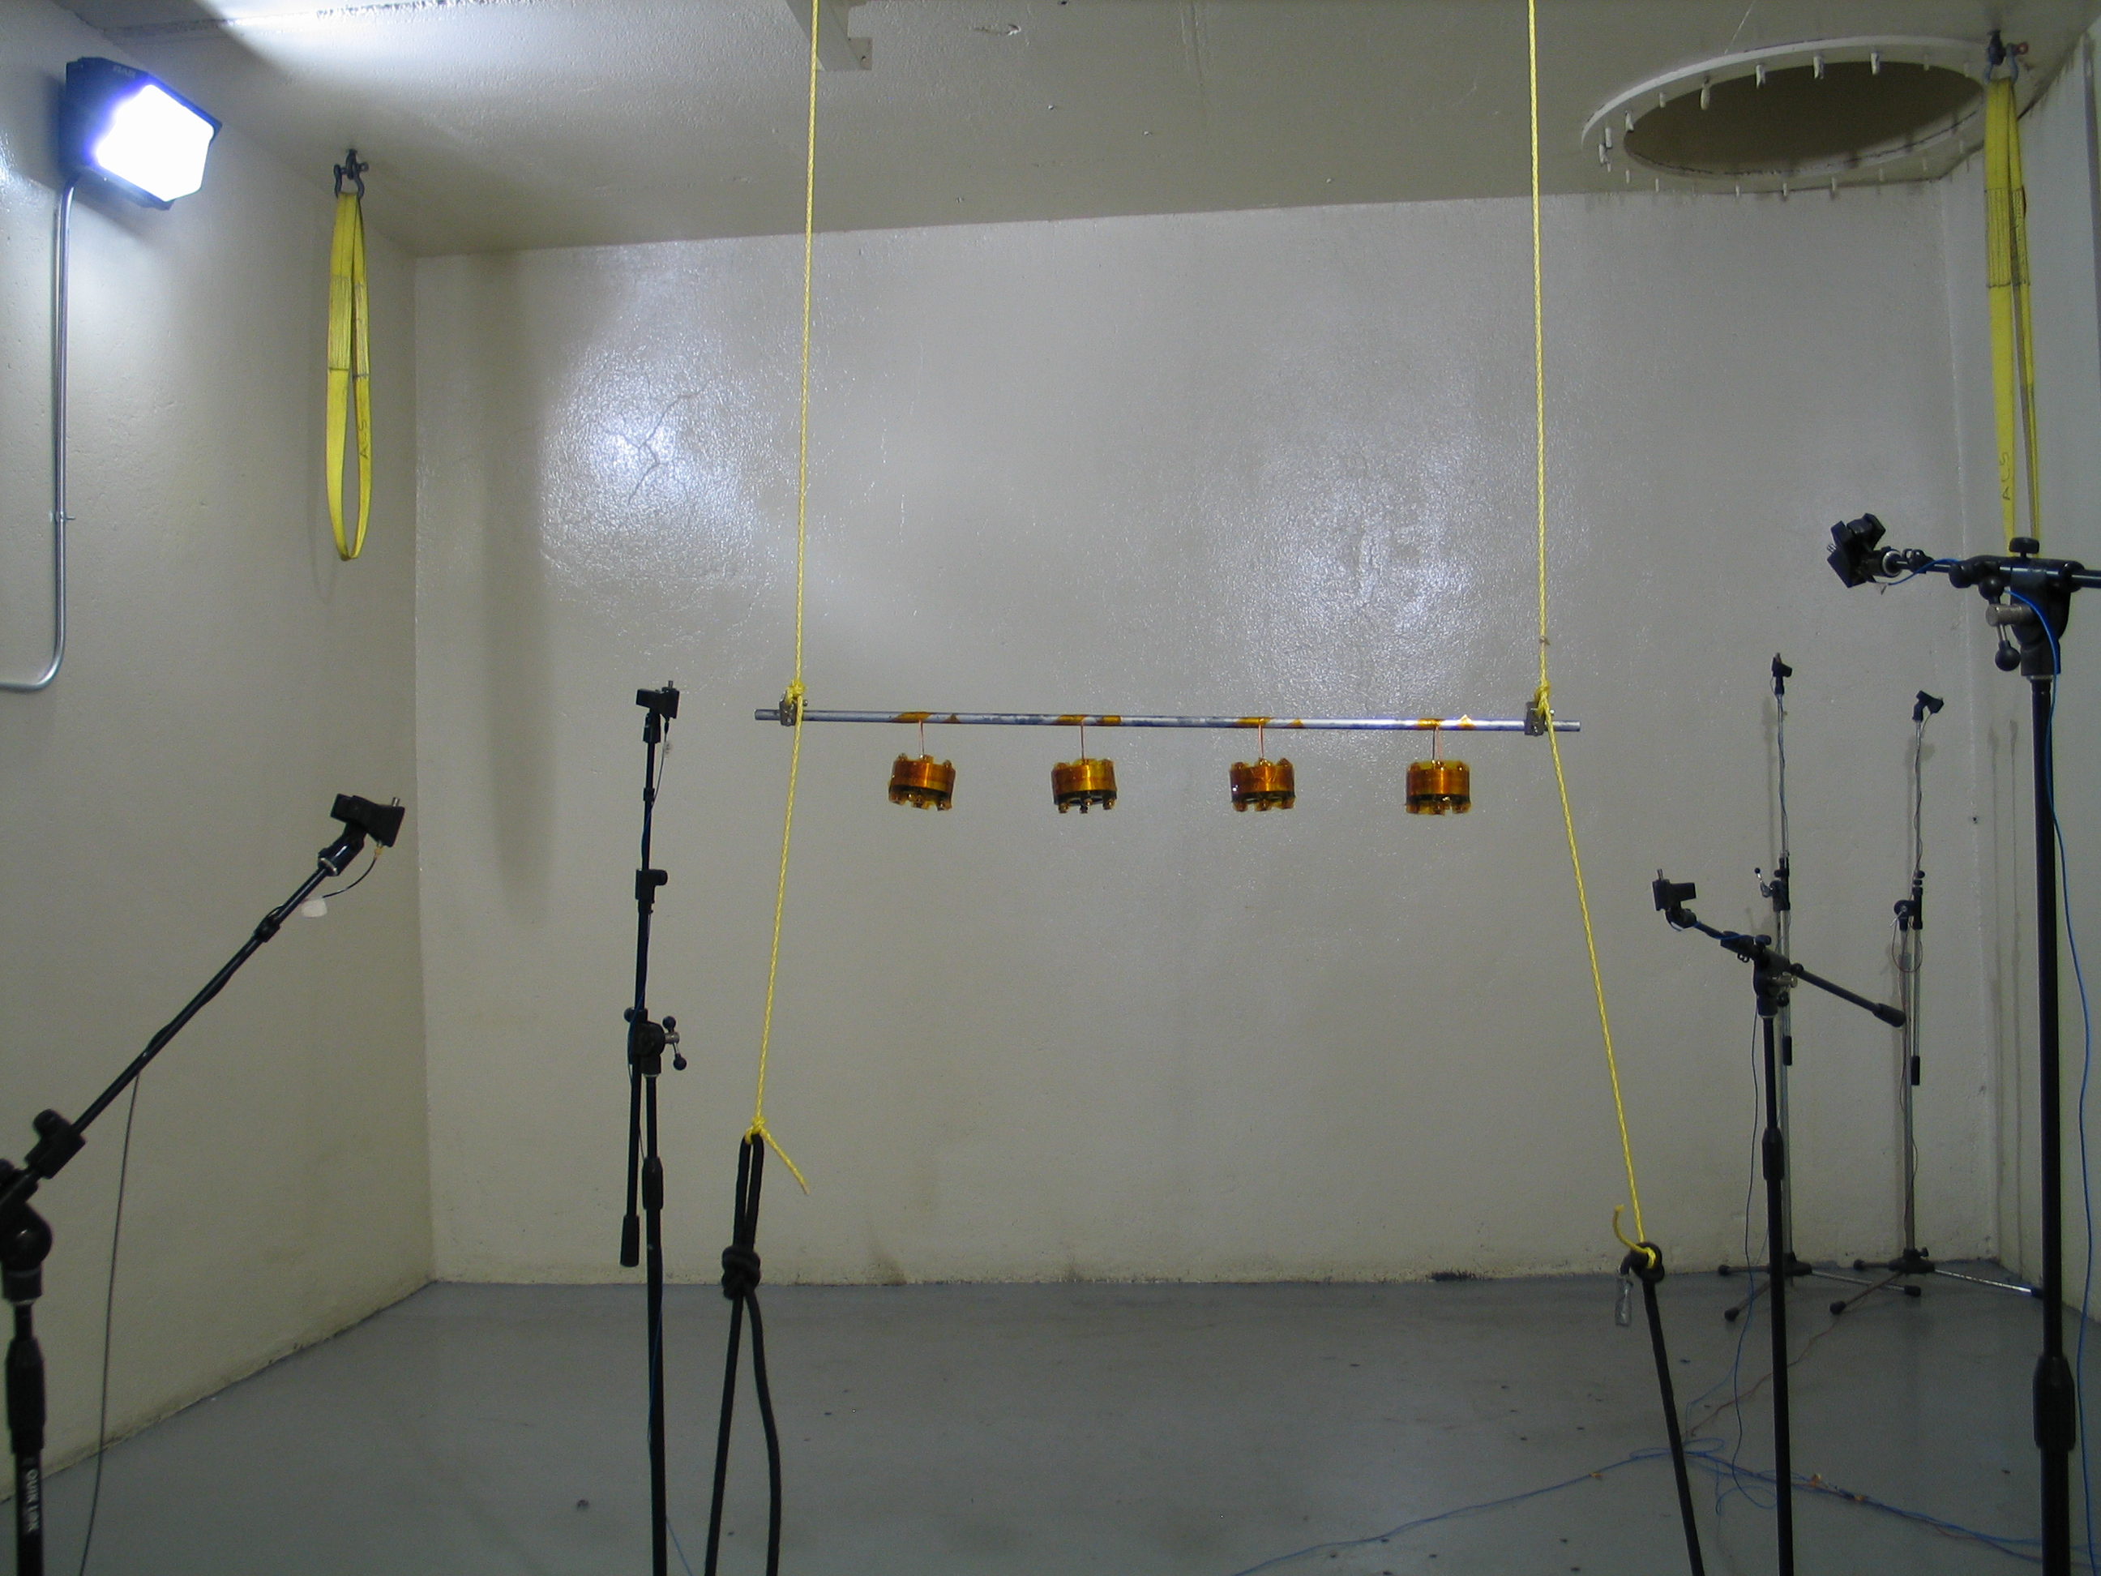
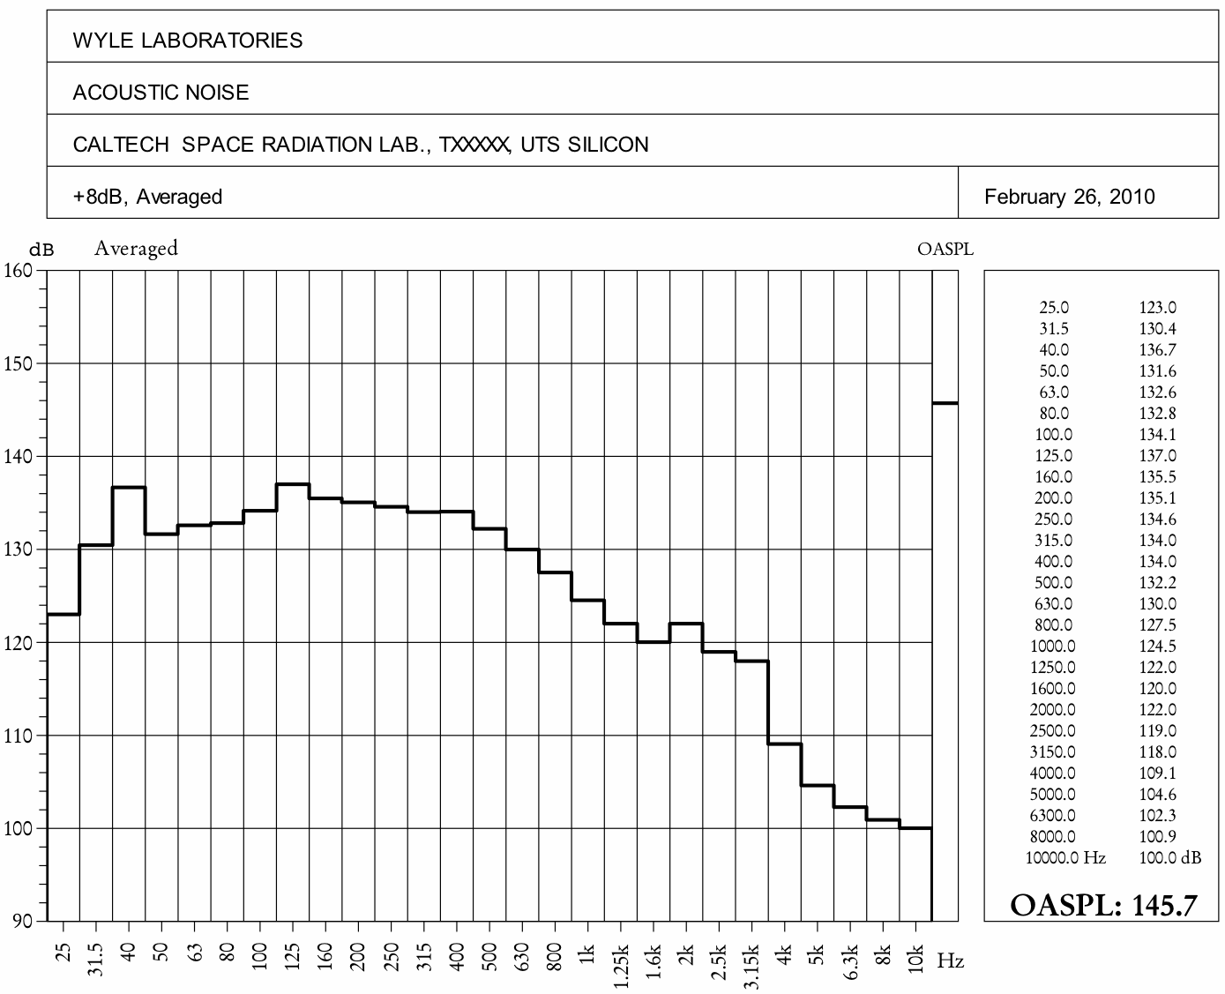
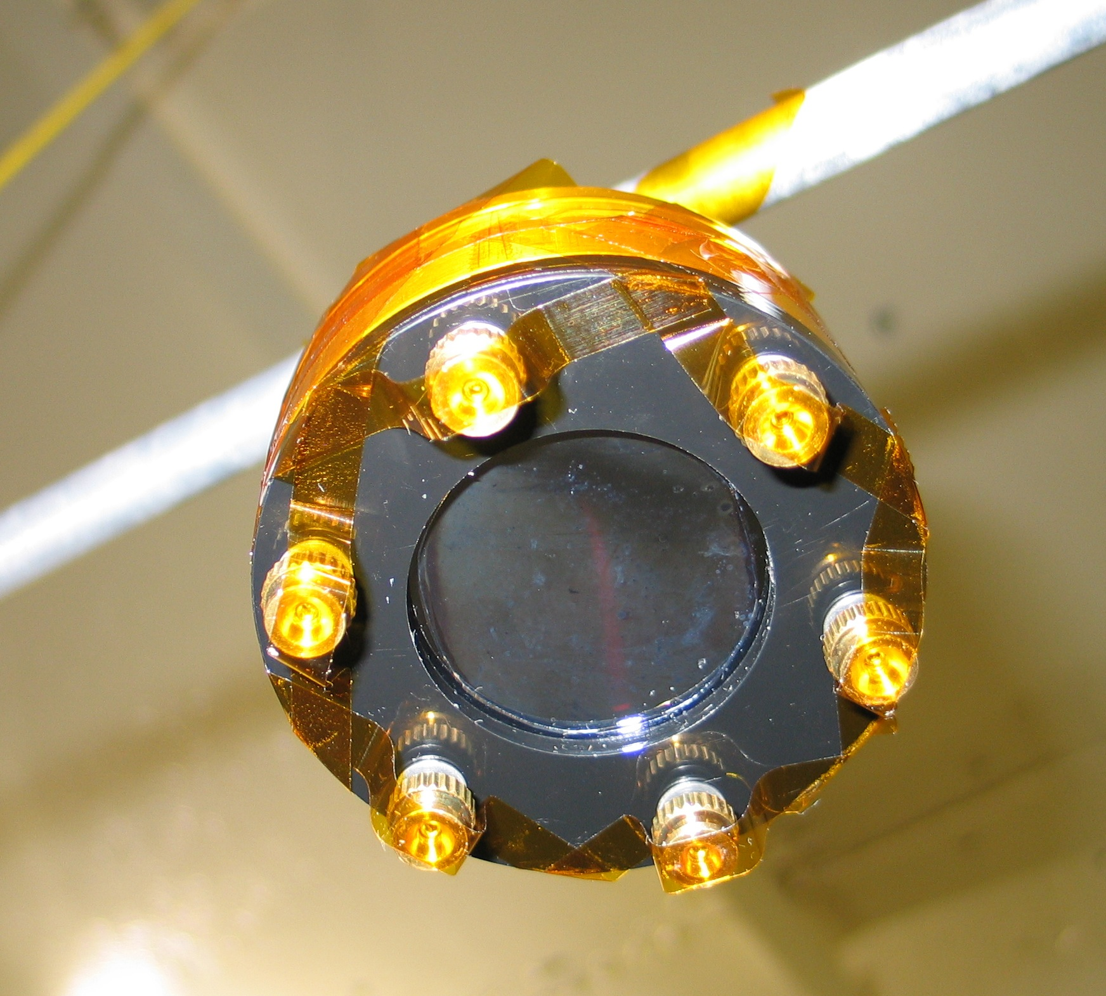
PLACE-HOLDER SLIDE
Acoustic Test of Mechanical Sample L0
silicon membrane
10 μm thick
~3.4 cm diameter
highest test level: 145 dB = SPP spec + 8 dB

Slide 14
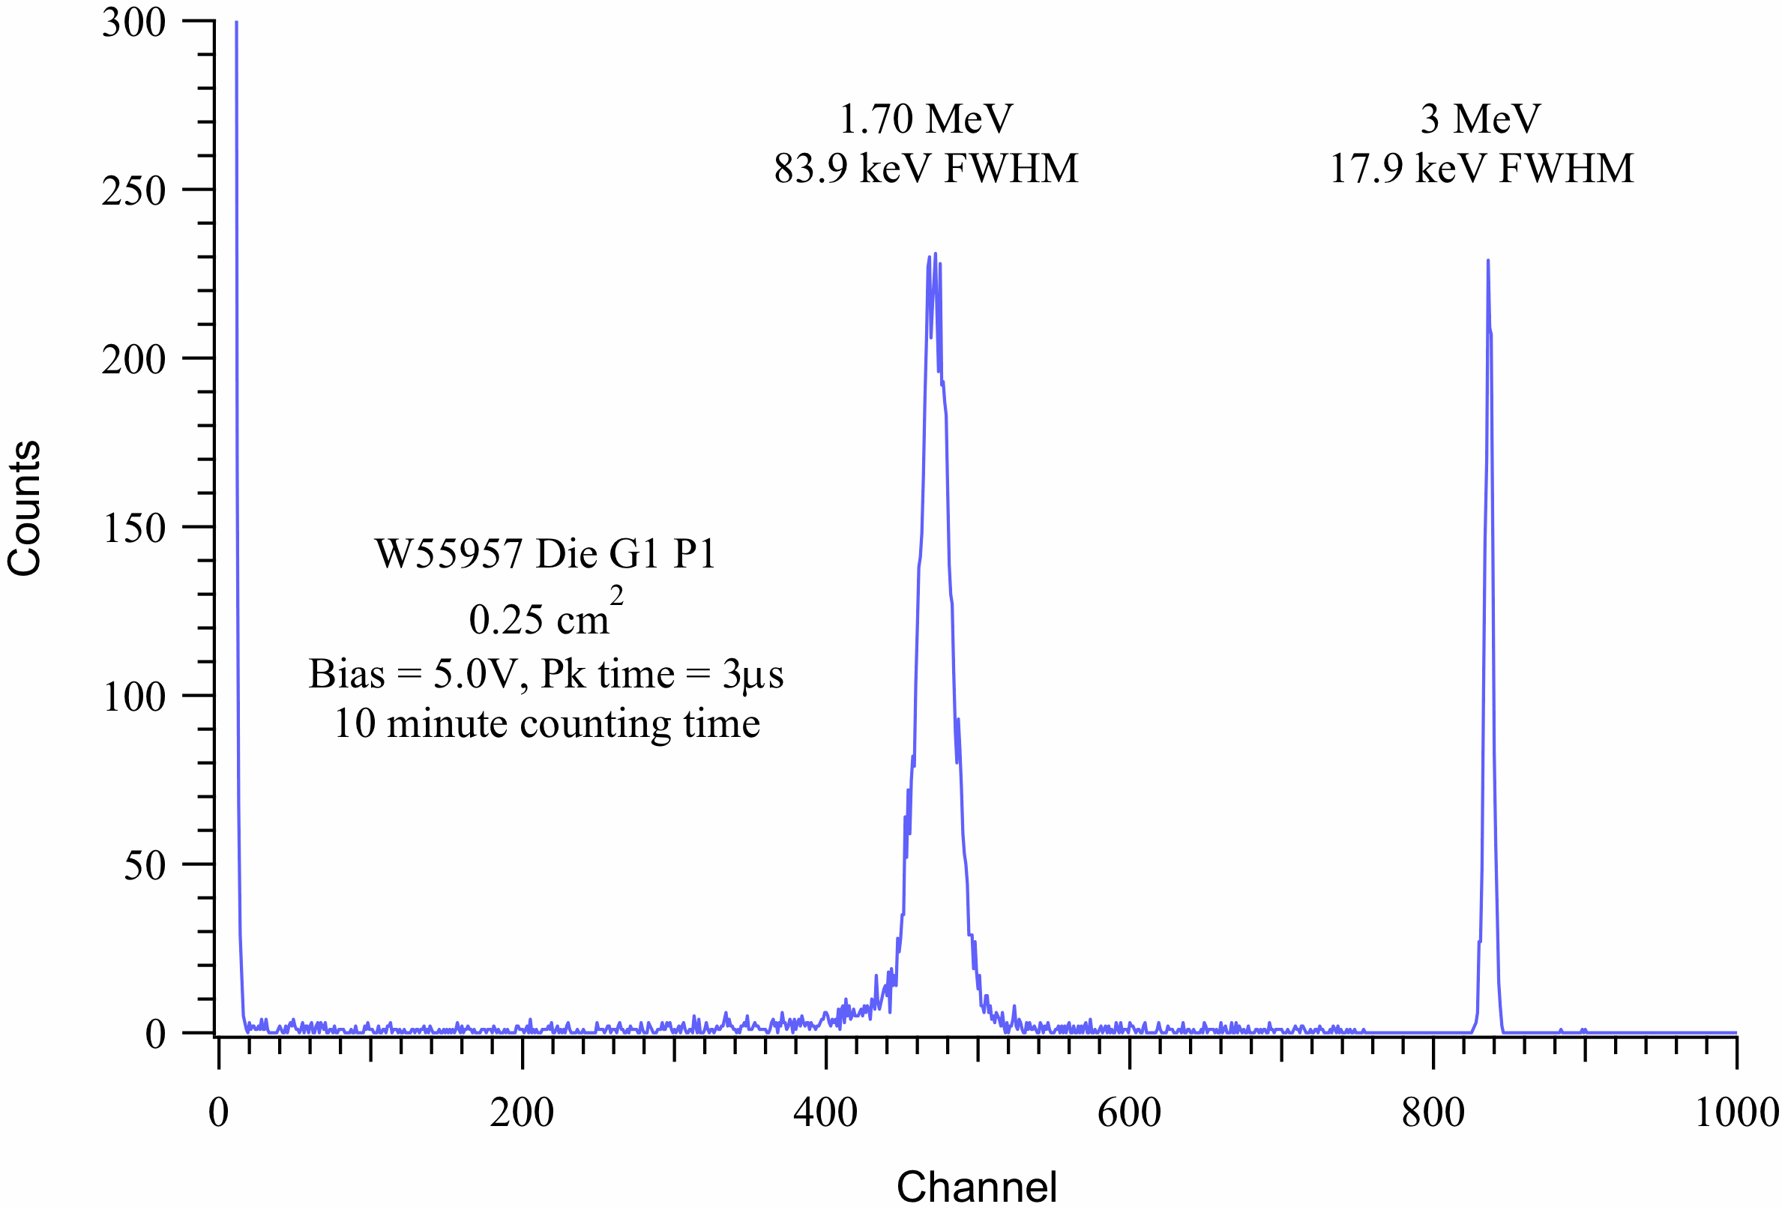
POSSIBLE PLACE-HOLDER SLIDE
PLOTS OF PARTICLE TEST RESULTS—ALPHAS
He mass histogram made using alpha particles—comparison with expected resolution
Possibly easier alternative to consider:
mono-energetic alpha particle ΔE and E’ distributions compared with expectations
NOTE: these data are not from EPI-Hi detectors; they are from a LBNL pre-prototype detector (15μm thick, 1cm² active area, 4 pixels)
²⁴¹Am alpha ΔE
calibration pulser

Slide 15
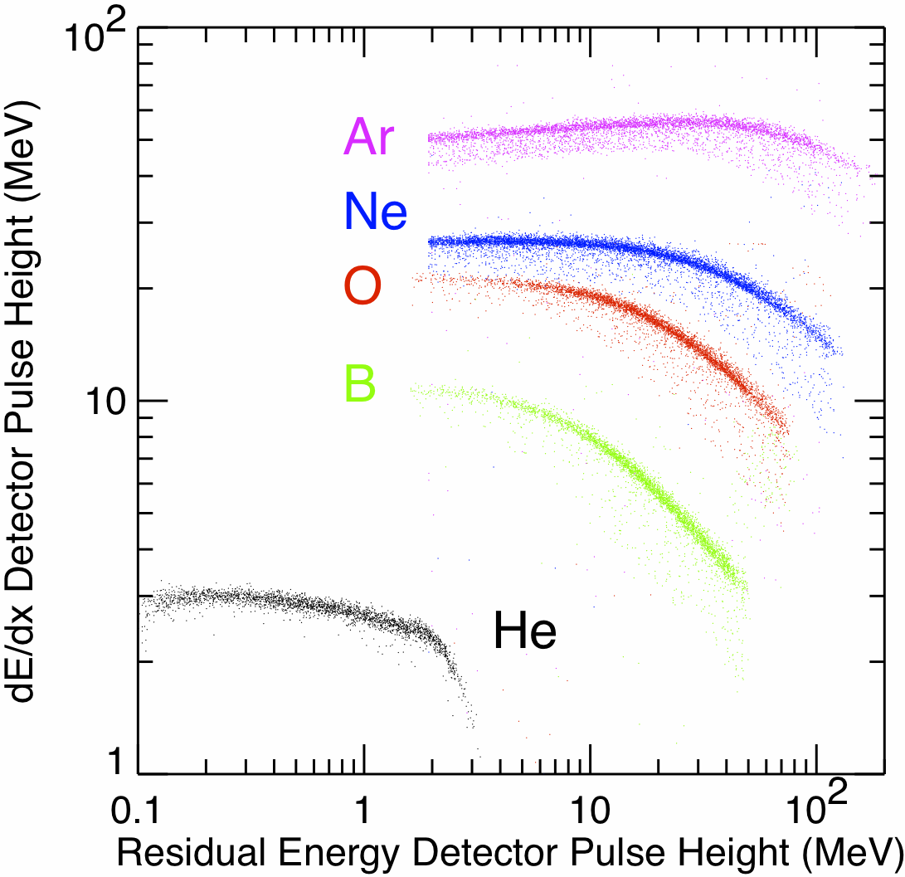
PLACE-HOLDER SLIDE
PLOTS OF PARTICLE TEST RESULTS—HEAVY IONS
ΔE vs. E’ cross plot showing element tracks
NOTE: these data are not from EPI-Hi detectors; they are from 2007 test of Ortec thin surface barrier detectors at the LBNL 88-inch cyclotron

Slide 16
Transition to Flight
extend selected prototype tests to cover additional detectors that have been fabricated in phase B—determine whether there are any detector-to-detector differences that might affect
yield
selection of manufacturer for flight detectors
test program needed for flight devices
select manufacturer for flight detectors

