Slide 1
EPI-Hi Sensor System

Slide 2
Outline
requirements
system overview (?)
detector telescopes
measurement capabilities
energy range and resolution
fields of view and angular sectoring
species coverage / composition
cadences
dynamic range in particle intensities
expected performance compared with requirements
maturity of design
system testing approach
summary
need to update outline to reflect slides that follow

Slide 3
EPI-Hi Measurement Requirements
Protons and Heavy Ions
energy range: 1 MeV/nuc (TBR) to ≥50 MeV/nuc
energy binning: ≥6 bins per decade
cadence: at least energy bin with time resolution of 5 s or better
FoV: ≥π/2 sr in sunward and anti-sunward hemipsheres (incl. 10° from S/C-Sun line)
angular sectoring: ≤30° sector width
composition: at least H, He, C, O, Ne, Mg, Si, Fe, ³He
species resolution: FWHM ≤ 0.5 (TBR) × separation from nearest abundant neighbor
max intensity: up to 10% (TBR) of upper limit proton spectrum from EDTRD
Electrons
energy range: 0.5 MeV (TBR) to ≥3 MeV
energy binning: ≥6 bins per decade
cadence: at least energy bin with time resolution of 1 s or better
FoV: ≥π/2 sr in sunward and anti-sunward hemipsheres (incl. 10° from S/C-Sun line)
angular sectoring: ≤45° sector width
max intensity: up to 10% (TBR) of upper limit electron spectrum from EDTRD*
*Note: upper limit electron spectrum not yet specified in EDTRD

Slide 4
EPI-Hi Sensor System Overview
Sensor Approach:
all sensor elements are silicon solid state detectors
multiple detector telescopes to provide large energy range and sky coverage
some telescopes double ended to increase sky coverage
detector segmentation to provide angular sectoring and adjustable geometrical factor
Heritage:
numerous energetic particle instruments over the past 40 years
direct predecessor: STEREO/LET & HET
Key Differences:
thinner detectors and windows to reduce energy threshold
compact telescope designs to reduce saturation at high particle intensities and backgrounds at low intensities

Slide 5
EPI-Hi Block Diagram
3 detector telescopes:
one double-ended low-energy telescope (LET1)
one single-ended low-energy telescope (LET2)
one double-ended high-energy telescope (HET)
all sensor elements are ion-implanted silicon solid-state detectors
signals from each telescope processed by an individual electronics board

Slide 6
Low-Energy Telescopes: LET1 and LET2
Energy Range
Stack Thickness through L4B: 3.5 mm of Si
highest stopping energies:
H & He: ~25 MeV/nuc
C: ~45 MeV/nuc
Fe: ~100 MeV/nuc
e: ~1.3 MeV
Front Detector Thickness: 12 μm Si
Combined window thicknesses: 3 μm Si equiv.
energies to penetrate windows + first detector:
H: ~1.0 MeV
He: ~0.9 MeV/nuc
C: ~1.3 MeV/nuc
Fe: ~1.5 MeV/nuc
e: ~0.4 MeV (penetration to L3)
HET2 is single ended and identical to HET1 down through L3B
Need to replace figure with version that includes inactive elements (windows, housing, etc.)

Slide 7
High-Energy Telescope: HET
Energy Range
Stack Thickness: 15 mm of Si
highest stopping energies:
H & He: ~55 MeV/nuc
C: ~100 MeV/nuc
Fe: ~230 MeV/nuc
e: ~6 MeV
Front Detector Thickness: 0.5 mm Si
energies to penetrate windows + first detector:
H & He: ~10 MeV/nuc
C: ~18 MeV/nuc
Fe: ~36 MeV/nuc
e: ~0.4 MeV
colored regions: active Si
grey colored: inactive material

Slide 8
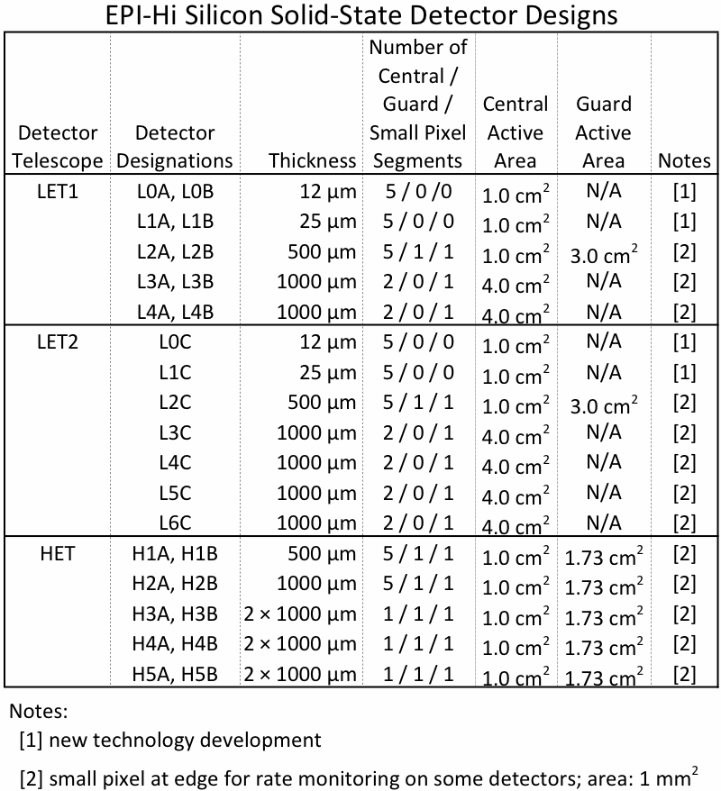
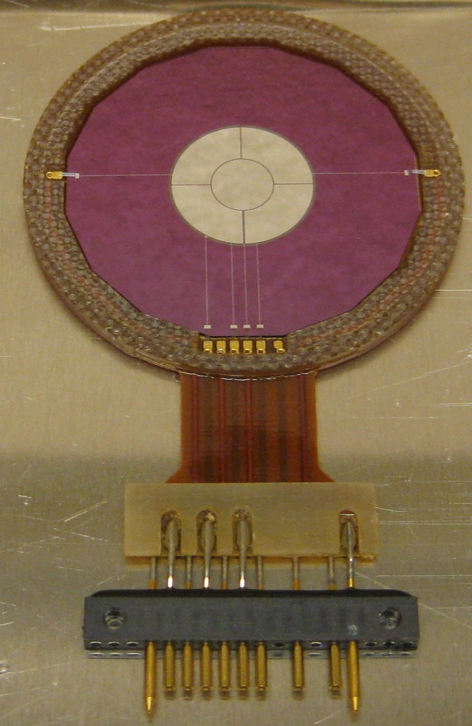
Solid State Detectors
Segmentation of Active Areas:
center
small pixel
guard
prototype L1 detector

Slide 9
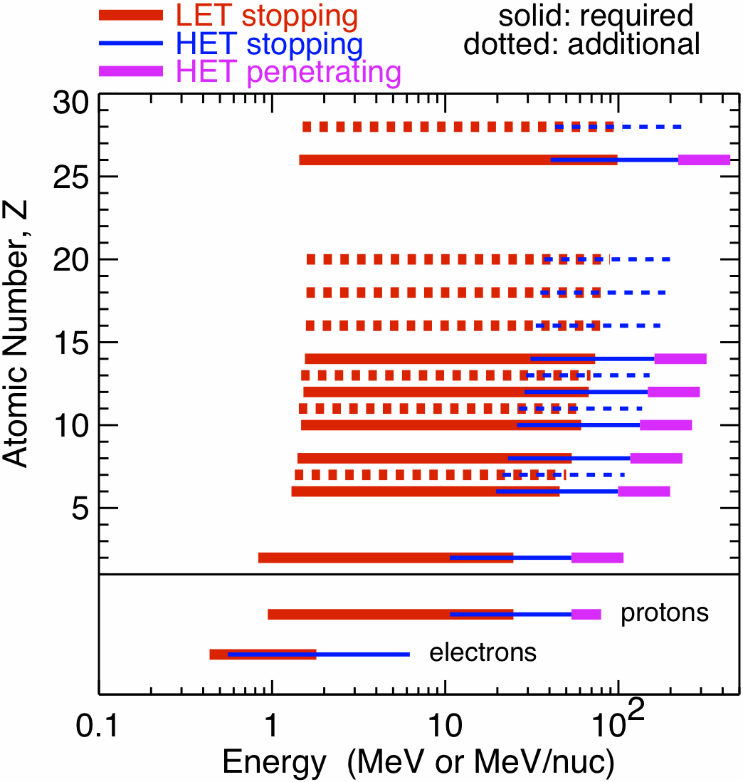
Measurement Capabilities:
Species and Energy Coverage and Energy Binning
Rates are accumulated on board in logarithmically spaced energy bins of width of a factor of 2^½ or 2^¼
Bin width of 2^½ corresponds to ~6.6 bins per decade
Larger bins are used for some rates accumulated at the highest cadence (1 second) in order to increase statistically accuracy.

Slide 10
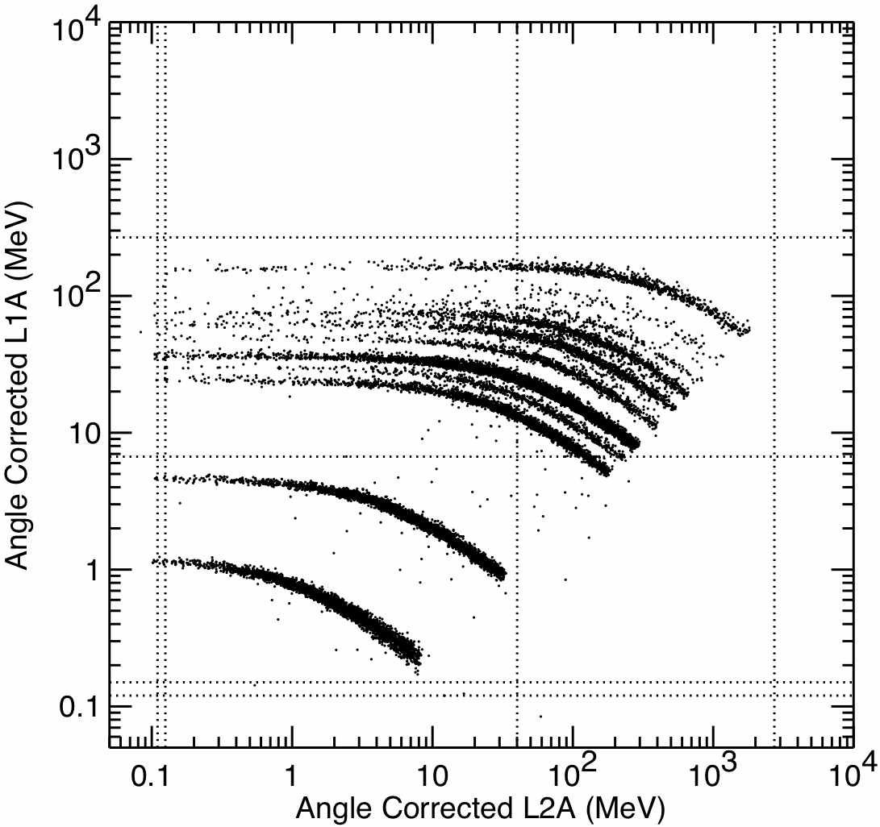
Measurement Capabilities:
Species Coverage / Elemental Composition
Energy loss measurements from the detector in which a particle stops (E’) and the preceding detector (ΔE) organize the data into distinct tracks for the various elements.
Sector information is used to obtain mean thickness penetrated in the ΔE detector and make an on-board correction to the measured energies to optimize species resolution.
Energy assigned on board includes energies measured in overlying detectors and calculated energy loss in windows.
Monte Carlo simulation of ion response.
Example:
ΔE measured in L1A (25 μm)
E’ measured in L2A (500 μm)
all incidence directions included
Fe
Si
O
Ne
C
He
H

Slide 11
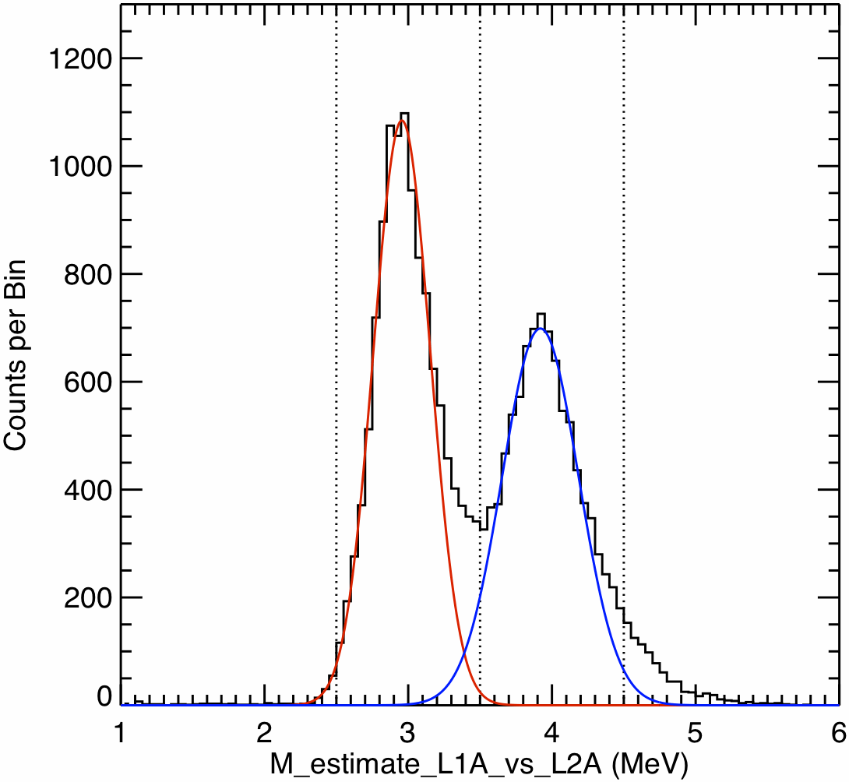
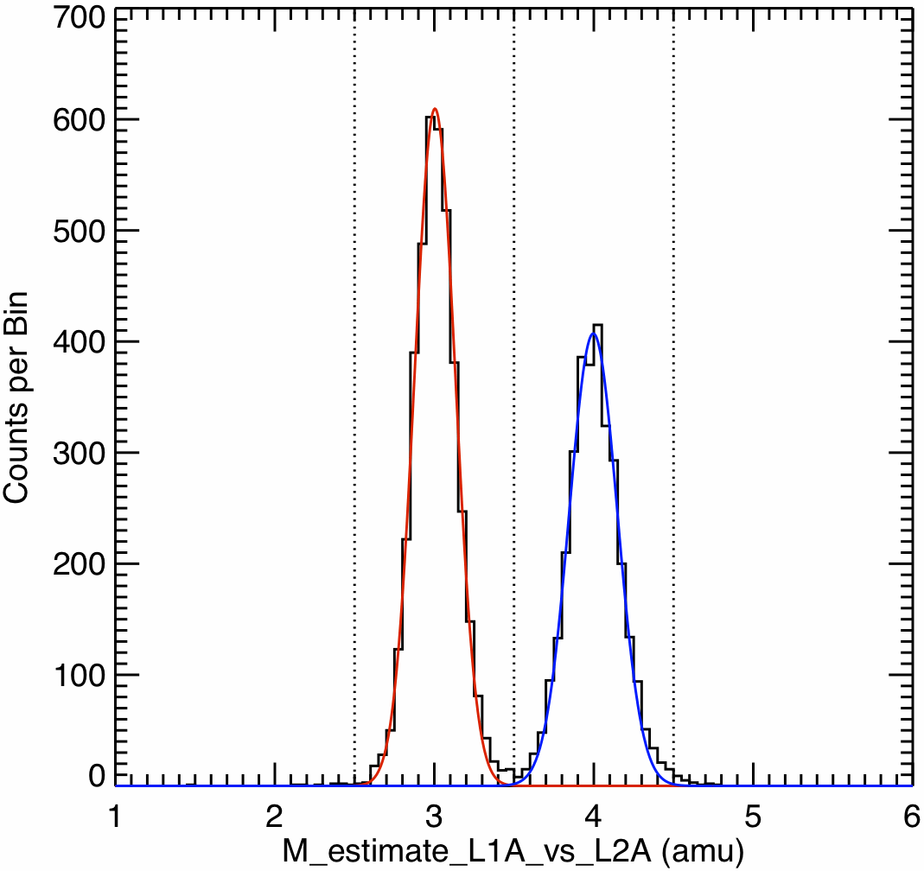
Measurement Capabilities:
Helium Isotope Identification
geometry defined by L0•L1•L2 coincidence (~1/4 of L1•L2 geometry)
full geometry defined by L1•L2 coincidence
FWHM:
³He 0.47 amu
⁴He 0.64 amu
FWHM:
³He 0.30 amu
⁴He 0.35 amu
Monte Carlo simulation of He isotope resolution: example based on L1A vs L2A
resolution dominated by effect of incidence angle uncertainty on ΔE thickness penetrated
restricting analysis to narrow-angle sectors gives higher resolution dataset
other effects (e.g., channeling) limit measurable ³He/⁴He ratio at energies of a few MeV/nuc to >~5%

Slide 12
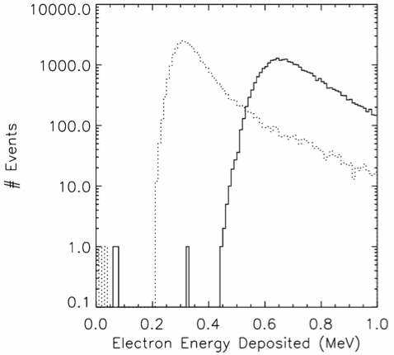
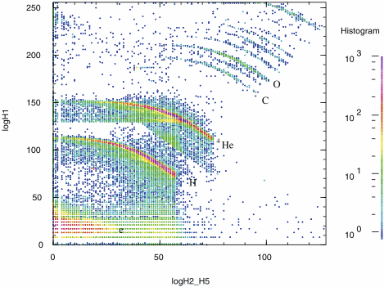
Measurement Capabilities:
Electron Identification
Example: measurements from the STEREO/HET telescope in the 13 Dec 2013 SEP event
STEREO/HET Electron Threshold: GEANT4 simulation
1000 μm detector
2000 μm detector
von Rosenvinge et al., Space Sci. Rev., 136, 391, 2008
EPI-Hi HET uses a 500μm front, detector vs 1000μm in STEREO/HET
high-energy electrons should deposit ~0.17 MeV in H1 and be detectable using the modeled 0.11 MeV threshold
once electronic noise level has been measured in a realistic setup, we will assess whether a modest increase in the H1 thickness is desirable
electrons

Slide 13
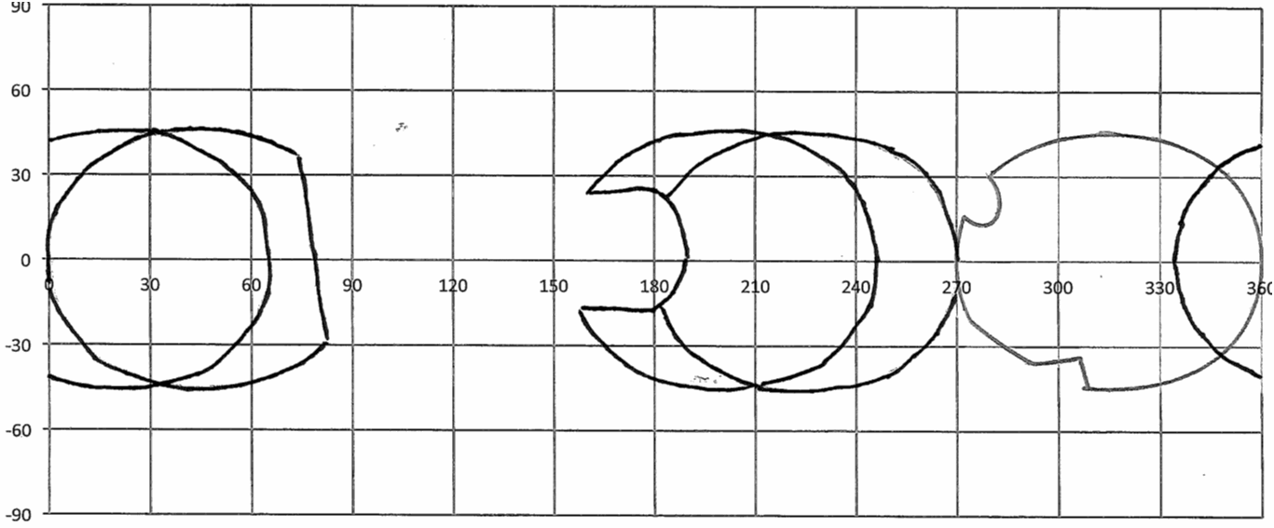
Measurement Capabilities:
Fields of View
five 45°-degree half-angle view cones
HET
aft
LET1
aft
HET
forward
LET1
forward
HET
aft
LET2
region blocked by spacecraft
TPS
replace with better version of this figure after confirming determining whether the FoVs shown here (from January 2011) are still correct
regions with full energy coverage

Slide 14
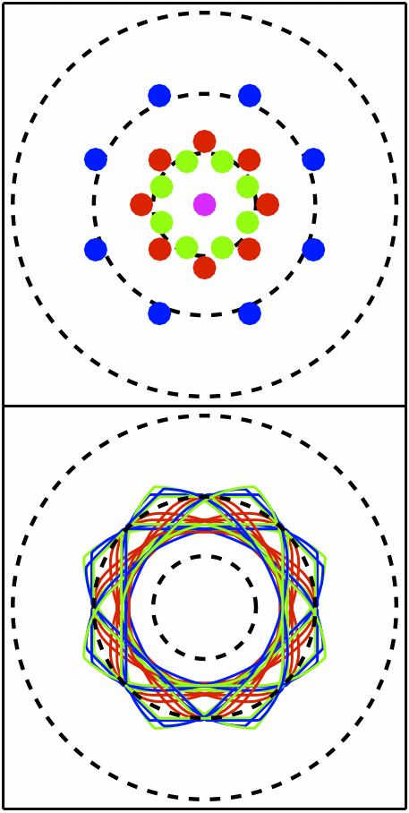
Measurement Capabilities:
Angular Sectoring
quote value(s) for rms spreads of angles encompassed by individual sectors
Locations of Centers of Angular Sectors
15°
Particle direction of incidence determined based on active element hit in two position-sensitive Si detectors (L0 and L1, L1 and L2, or H1 and H2)
each of these detectors has central bull’s eye surrounded by 4 quadrants
area of each active element is 0.2 cm²
quadrants in the second detector rotated 45° relative to those in the first first
25 combinations of hit elements in the two detectors used to assign event to a viewing sector
significant overlaps among sectors allows measurements of particle distribution with angular resolution smaller than the size of a sector
HET provides sectored electron data, LET1 provides only front-back direction information for electrons
30°
45°
Shapes and Orientations of Angular Sectors (plotted relative to sector center location)
15°
30°
45°

Slide 15
Measurement Capabilities: Cadences
highest cadence: 1 second
used for one electron bin below and one above 1 MeV
used for 4 proton bins above 1 MeV
intermediate cadence: 10 sec
used for narrow energy bins for e, H, He, ³He
used for intermediate energy resolution bins for element groups CNO, NeMgSi, Fe
normal cadence: 60 sec
used for narrow energy bins for ³He, and major elements from C through Ni
used for wide energy bins for groups of ultraheavy elements
low cadence: 300 sec
used for angular distribution of e, p, He, ³He, CNO, NeMgSi, and Fe in intermediate energy bins
ultra-low cadence: 1 hr
all rates accumulated at cadences of 60 sec and 300 sec are also accumulated over 1 hr

Slide 16
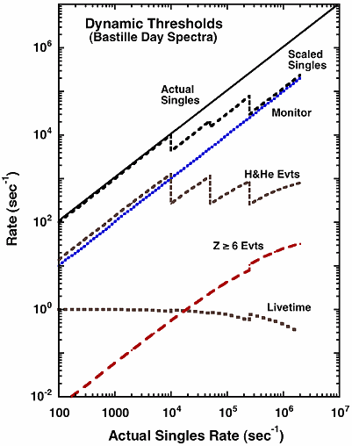
Measurement Capabilities:
Dynamic Range in Particle Intensities (1/3)
Example from STEREO/LET
protons and He dominate the EPI-Hi count rates and the associated deadtime
a “dynamic threshold” system, successfully used in the LET and HET instruments on STEREO, allows the adjustment of the geometrical factor for protons and He while maintaining the full geometrical factor for Z≥6 elements
in several stages, thresholds are raised on all but one active element in detectors progressively deeper in the stack to suppress protons and He over a portion of the instrument geometrical factor
a detector element that remains sensitive to protons and He is used to monitor the actual rate and so that thresholds can be returned to the lower values (with some hysteresis) when particle intensities have decreased
count rates at which thresholds are dynamically raised and lowered are controlled by entries in the command table
Mewaldt et al., Space Sci. Rev.,
136, 285, 2008

Slide 17
Measurement Capabilities:
Dynamic Range in Particle Intensities (2/3)
the EPI-Hi front-end electronics can process slightly more than 10⁵ events/s from all detector elements combined
dynamic threshold approach:
stage 1: raise the threshold on 4 of the 5 segments of the L1 detectors to exclude protons and He decreases the count LET count rate by a factor ~5
stage 2: raise the threshold on 4 of the 5 segments of the L2 detectors for an overall count rate reduction by a factor ~25
stage 3: raise the threshold on the outer segments of the L3 and L4 detectors for a modest additional reduction of the count rates for high-energy particles entering through the telescope apertures and to reduce count rate from out-of-geometry particles entering through the sides of the telescope
stage 4: raise the thresholds on all detector elements to eliminate protons and He from the normal analysis and obtain some information about the proton and He spectra from singles rates measured in “small pixels” that are instrumented on several of the detectors
based on the STEREO example, when stage 4 is reached the actual singles rate (without raised thresholds) would be ~2×10⁶/s and the livetime fraction would be ~30%

Slide 18
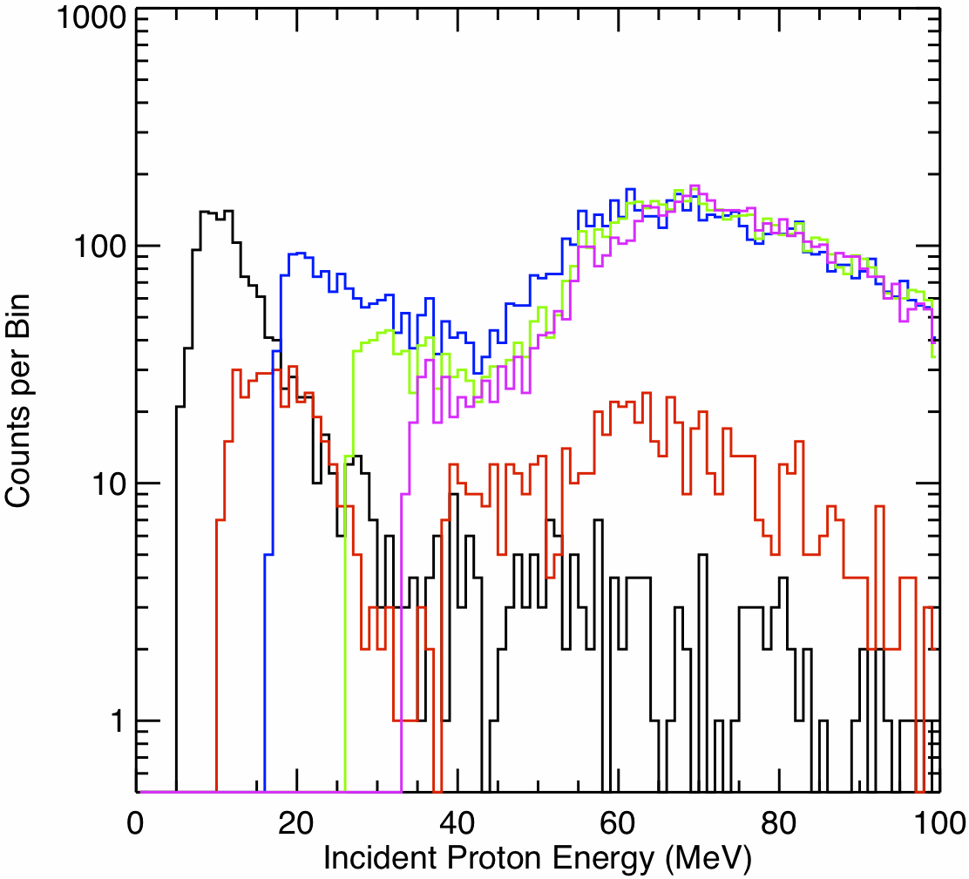
Measurement Capabilities:
Dynamic Range in Particle Intensities (3/3)
in large SEP events the intensity ratio (protons+He)/(Z≥6)≈300 so when count rate due to protons plus He would be 2×10⁶/s without dynamic thresholds raised, the count rate of Z≥6 still be below 10⁴/s, about an order of magnitude below the maximum rate capability of the front end electronics, so useful measurements of heavy nuclei are still possible
in order to provide some information about protons and He at the highest intensities, singles rates in small (1 mm²) instrumented on selected detectors will be used
small pixel rates can be calibrated against rates in other detector segments until dynamic threshold level 4 is enabled
by setting the thresholds on the small pixels set slightly below value expected from stopping protons, some information about the incident energy spectrum is obtained from the dependence of pixel count rate on depth in the telescope
H3-H5 detectors
central area: 1 cm²
1 mm² pixel
omit histogram—too complicated to explain in a short amount of time?
pixel count triggers above 5 MeV threshold: H1 through H5

Slide 19
Bonus Science
The design of EPI-Hi lends itself to several measurements without requiring modifications of the hardware design:
ultraheavy elements
22Ne/20Ne isotope ratio measurements
neutral particles including gamma-rays, neutrons, and energetic neutral atoms

Slide 20
Summary

