Slide 1
EPI-Hi Calibration
Richard Mewaldt
Notes:
introduction

Slide 2
Outline
  Introduction
  Species and Energy Ranges
  Calibration Plan
  Facilities
  Test Flow
  In-Flight Calibration

Slide 3
Introduction
  EPI-HI Measurement Requirements:
  – Composition, energy spectra, and angular distributions of ions and xxxxxelectrons in flare and CME-related SEP events, and at shocks
  – Required Species for EPI-Hi
  • H, ³He, ⁴He, C, O, Ne, Mg, Si, Fe ≤ 1 MeV/nuc (TBR) to ≥ 50 MeV/nuc
  – Required Species for Mission
  • Electrons with ≤ 0.5 MeV to ≥ 3 MeV
  – SEP Directional Distributions
  • The combined LET and HET fields of view are required to measure S SEP angular distributions over ≥ π/2 sr in both the sunward and anti- S sunward directions
  EPI-Hi Measurement Goals:
  – SEP Ions: Composition and energy spectra of ~16 species with
  1 ≤ Z ≤ 28 and trans-Fe element groups
  – SEP Electrons with ≤ 0.05 to 6 MeV

Slide 4
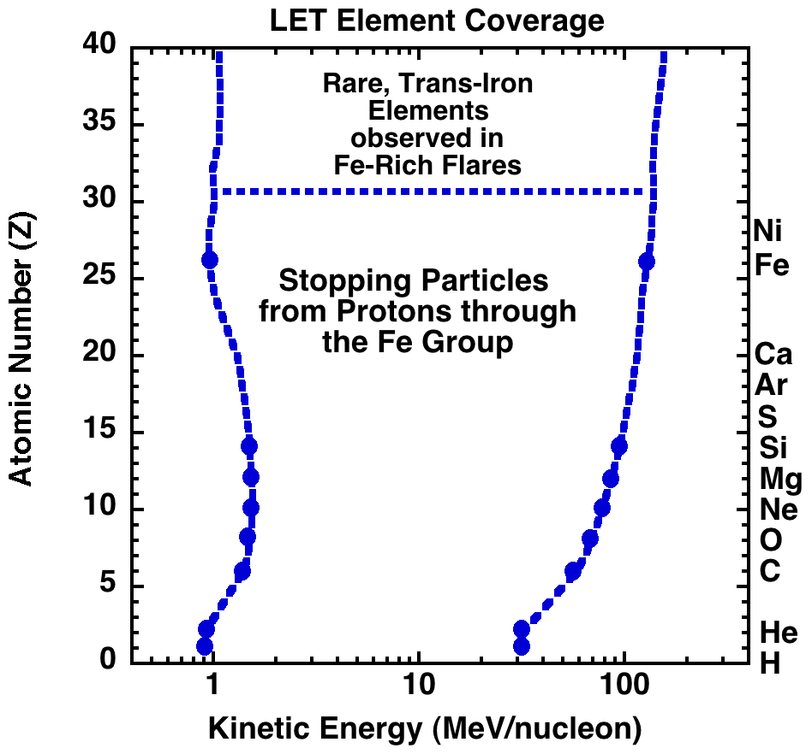
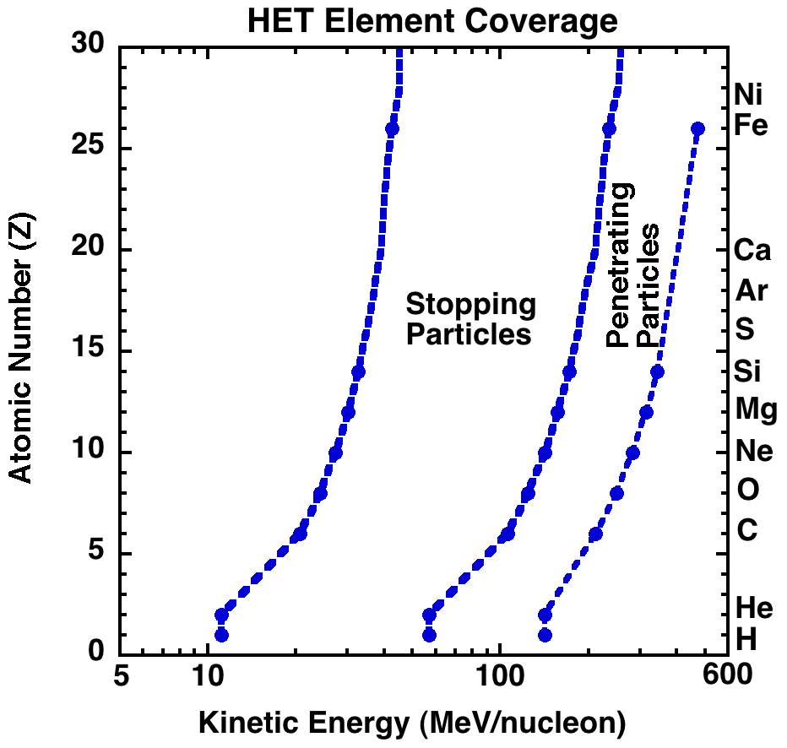
Species and Energy Ranges
LET and HET energy coverage for stopping elements is shown below. Note that LET and HET have considerable energy overlap. Also shown is the energy range over which HET can identify penetrating ions. Required species are indicated by blue dots. LET will also measure rare trans-Fe species often overabundant in ³He-rich flares.

Slide 5
Calibration Plan
  Calibration Plan:
  • Lab measurements of electronic gains, offsets, linearity, thresholds, noise, and temperature variations
  • Alpha-particle and heavy-ion mapping of detector uniformity
  • Accelerator measurements of heavy-ion dE/dX-E-Range parameters, combined with modeling
  • Monte-Carlo simulations of expected detector performance
  • Monte-Carlo determinations of LET and HET geometry factors for directional sectors versus “range” in the telescope
  • Accelerator measurements of heavy-ion dE/dX–E’ “tracks” for new flight detectors and end-to-end testing/tuning of on-board particle identification algorithms
  • In-flight measurements that optimize/validate on-board particle identification processes

Slide 6
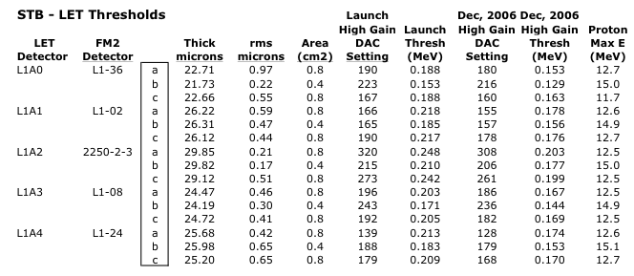
Calibrating Detector Energy Thresholds
Each dual-gain PHA chain contains a precision test pulser that will be used to measure the preflight and in-flight trigger thresholds of the 88 separate detector segments in EPI-HI. The Table below shows a sample of such data for the STEREO LET-B sensor. Typically, in-flight thresholds can be set lower than pre-flight thresholds.

Slide 7
Measuring Gains/Offsets of PHASICS
Onboard particle identification requires accurate calibrations of the
flight electronics and their dependence on temperature
Onboard measurements of the nuclear charge (Z) and kinetic energy (E) of energetic particles requires accurate pre-launch and in-flight measurements of the gain and offset of individual PHASIC circuits.
Since the SPP orbit may lead to significant temperature variations, these parameters must be measured, and available for implementation
Although the PHASICs are relatively stable with temperature, it is prudent to be prepared for unexpected temperature excursions.
The LET and HET designs also allow for periodic on-board calibration of the transfer function of each ADC on a grid of logarithmically-spaced points.
A Figure with new PHASIC Data would be welcome

Slide 8
Monte Carlo Simulations
Monte Carlo simulations were used throughout the LET & HET design process to identify and optimize parameters controlling charge and energy resolution.
Such simulations continue to be important in evaluating accelerator and laboratory measurements of detector and electronic performance.
For example, the simulation shown here illustrates the expected resolution of ³He and ⁴He in the LET telescope
(insert simulation of ³He/⁴He mass distribution [or heavy-ion ΔE vs E’ tracks, or charge histogram, from Mark)

Slide 9
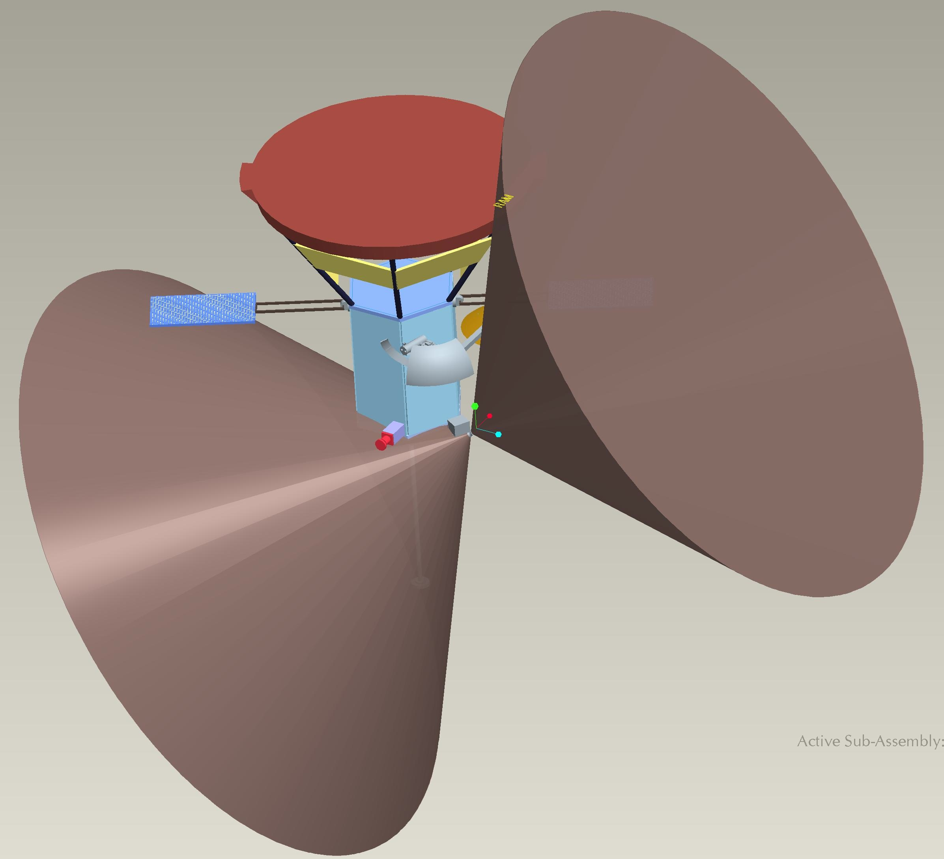
Calibrating LET/HET Fields of View
The combined LET and HET fields of view are to cover ≥ π/2 sr in both the sunward and anti-sunward directions (see LET-1 example below)
• The geometry factor and directional coverage of each of the 25 sectors within each cone will be determined with a Monte Carlo calculation taking into account the pointing directions of the three telescopes relative to the spacecraft and Sun and any obstructions.
• The relative geometry factors of each
sector can be validated in-flight
during the decay phase of SEP events
when energetic particles become nearly
isotropic in the rest frame of the solar wind
LET-1 Field of View

Slide 10
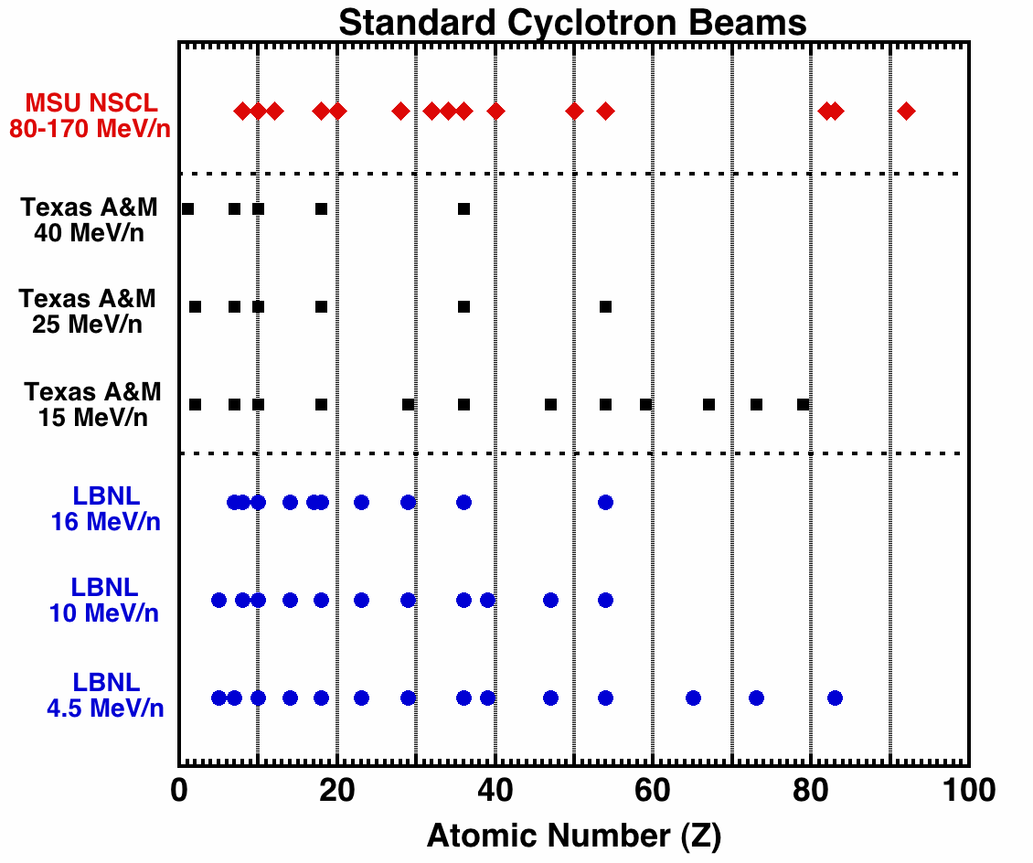
Facilities – Accelerator Calibrations
There are three appropriate heavy-ion accelerators in the U.S.
• All 3 cover the key heavy-ion xcharge range (6≤Z≤28) and also
provide for trans-iron (Z>30) xcalibrations
• However, only MSU covers the xfull energy range of EPI-Hi.
• The MSU accelerator also xreachesrhigh enough energy to xproduce a much greater yield of xlower-Z fragments
• In the past we have also used xthe heavy-ion accelerator in xDarmstadt, Germany
Propose an accelerator calibration of EPI-Hi (or the engineering unit) for 2016

Slide 11
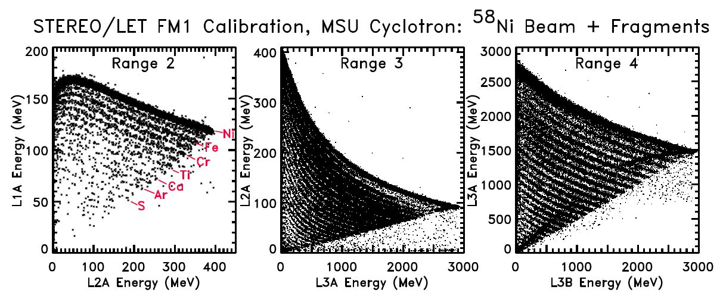
Facilities – Accelerator Calibration Data
LET & HET use ΔE vs. Residual Energy (E’) to measure SEP composition
The ΔE vs. E’ tracks for lighter species are obtained by fragmenting a
heavy-ion beam on a polyethylene target
The example below from STEREO/LET uses a ⁵⁸Ni beam at the MSU NSCL
This also provides an end-to-end test of the onboard identification system

Slide 12
Electron Calibrations
  HET will measure energetic electrons with 0.5 – 6 MeV
  • The electron response will be simulated using GEANT-4, which was used to calibrate the REPT sensors on the Van Allen Probes (Baker et al. 2012)
  • HET is 13.5 mm of Si deep with a (2-ended) geometry factor of G ≈ 0.5 cm²sr compared to 23 mm deep and 0.2 cm²sr for REPT. The HET threshold is 0.5 MeV because of a thinner front end
  • Based on the calibrations of REPT
  and SAMPEX/PET, the HET energy
  range of 0.5 – 6 MeV is achievable
  • Routine testing of the HET electron
  response will use β−decay sources
  like¹⁰⁶Ru and ⁹⁰Sr.
  xx
  • LET will also provide electron
  measurements over a more limited
  energy range REPT electron calibration using GEANT-4

Slide 13
Calibration Test Flow
Overview of Key Steps
Determine how the Science Requirements drive detector, electronics, and software requirements (noise, resolution, dynamic range, near-Sun environment)
(requirements on detector thickness, uniformity, noise)
(requirements on PHASIC noise, dynamic range, radiation hardness)
Evaluate expected instrument performance with calculations and simulations
Develop new detector/electronic hardware; new flight software
Test new detectors, hardware, software with real/simulated particles to determine if they meet requirements? (Accelerator and lab tests; simulations)
Perform an end-to-end test of all systems at a heavy ion accelerator
In-flight tuning and validation of onboard analysis routines

Slide 14
Calibration Test Flow
Calibrate New Detectors, PHASICS, and Software
Task | Complete | In Progress | Scheduled For
New, thin SSDs meet uniformity and response requirements |  | √
New PHASIC meets dynamic range, noise, requirements | √
Test linearity, temperature-stability performance of new PHASIC |  | √
Calibrate transfer function of flight PHASICS vs. temperature |  |  | ?
Propose for beam time at MSU Superconducting Cyclotron Lab |  |  | 2014
Improved on-board He-mass algorithms meet requirements |  |  | ?
Simulate HET and LET SEP electron response using GEANT-4 |  |  | 2014-2015
Test SEP electron detection and γ-ray background with lab sources |  |  | 2014-2015
Validate on-board analysis routines at accelerator |  |  | 2016
Determine location of element tracks at MSU accelerator |  |  | >2018
Inflight tuning/validation of on-board analysis routines |  |  | ≥2018
I invite suggestions/corrections

Slide 15
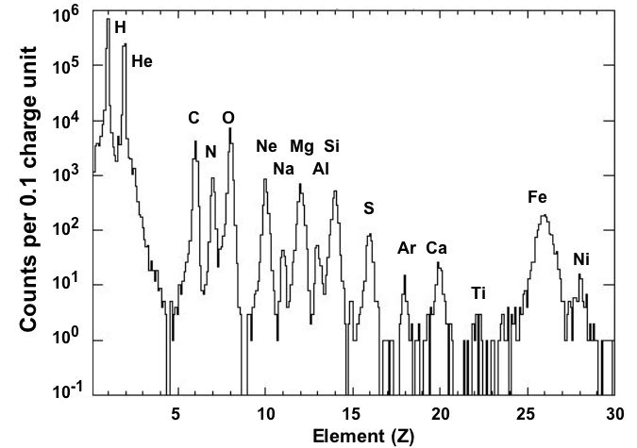
In-Flight Calibration
Pulse-height data from the EPI-Hi LET and HET sensors will provide the final calibration of the on-board particle identification system. Shown are STEREO LET data from the Dec. 2006 SEP events. Sixteen elements are resolved.
EPI-Hi should provide similar resolution extending to ~100 MeV/nuc.
STEREO/LET Data
~ 6–30 MeV/nuc
December, 2006

Slide 16
In-Flight Electronics Calibration
The gain, offset, and threshold of each PHASIC channel will be periodically calibrated onboard using built-in DACs that stimulate multiple detectors. The Figure shows an example of in-flight calibration data from STEREO/LET. Such calibrations are especially important if the temperatures of the LET and HET electronics vary significantly over the course of the SPP orbit.

Slide 17
In-Flight Calibration
STEREO/LET event data from the Dec. 2006 SEP events are plotted on the L1vsL2 and L2vsL3 matrices after correction for incidence angle and individual L1 and L2 segment thicknesses (~25 and ~50 µm thick). Colored bands show regions used for on-board particle identification. EPI-Hi detectors range from 10 µm to 2000 µm thick.

Slide 18
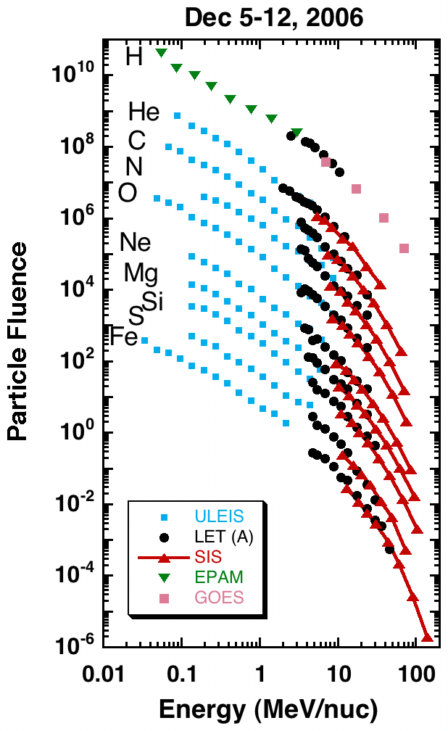
In-flight Energy Spectra
To achieve EPI-Hi science requirements the nuclear charge (Z) and kinetic energy of SEP ions must be measured to construct energy spectra.
Shown at right are energy spectra that combine ACE, GOES & STEREO data measured while the STEREOs were still near Earth. They cover the same energy range as EPI-Lo & Hi (~0.05 to >100 MeV/nuc). Measured intensities are plotted with no correction factors.
The approaches outlined here will enable EPI-Lo and EPI-Hi to produce similar energy spectra.

