Slide 1
EPI-Hi Flight Software
Andrew Davis, Rick Cook
Notes:
introduction

Slide 2
Outline
Software requirements, software design and functionality, software documentation and unit testing as well as plans for software integration, testing and verification at the instrument level
Plans for software maintenance for the duration of the mission
Description of the software development environment and plans for preserving the development environment
Maturity of the design, heritage, what’s new/different from previous missions
Projected CPU, SRAM, MRAM margins
Backup slides on Boot sequence
Notes:
NOTE: this is the outline provided by Scott

Slide 3
Software Requirements
The Flight Software Requirements Document details the flow-down from higher-level requirements, and from GIS and SIS ICDs
These requirements are quite similar to those for our work on recent NuSTAR and STEREO missions
The same modular flight processor and software architecture that we used for NuSTAR and STEREO will meet the EPI-Hi requirements
The requirements are mapped into a set of modular software tasks, implemented on the EPI-Hi flight processors

Slide 4
Documentation Status
Document | Status/due date
Flight Software Requirements | Baseline draft Delivered
Flight Software Development Plan | Baseline draft Delivered
Flight Software Design Document | Prelim draft delivered at PDR
Flight Software Test Plan | Due by CDR
Test verification matrix | Due by CDR
Instrument Telemetry Data Format Document | Due by CDR
P24 MISC Processor Manual | Delivered
PHASIC User Manual | Delivered
These docs are responsive to the GI ICD, the SI ICD, and the PAIP

Slide 5
Processor and Software Architecture
Software distributed across 4 Minimal Instruction Set Computers (MISCs)
1 MISC in DPU, 1 each in LET1, LET2, HET
Custom FPGA-embedded micro-controller
Design implemented in Actel RTAX250SL
Architecture used in STEREO and NuSTAR space missions
24-bit CPU, up to 512 Kwords SRAM, Forth operating system, can boot from MRAM or serial interface
Only DPU MISC has MRAM (2M×8).
DPU can boot from MRAM, or via serial uplink from ground
The three “satellite” MISCs communicate with DPU MISC via RS-422 serial links, 460.8kbps
Satellite MISCs booted via serial link by DPU MISC
Satellite MISCs use boot images from DPU MRAM
Notes:
The P24 MISC has a 24-bit CPU core with dual stack architecture intended to efficiently execute Forth-like instructions. The processor design is simple to allow implementation within field programmable gate arrays. The basic MISC processor design is in the public domain. For the EPI-Hi application, the MISC design is implemented in the ACTEL RTAX250SL FPGA, with Caltech SRL customizations developed for the STEREO mission. The MISC can be clocked at speeds up to 25MHz; we will use [14.7] MHz (TBC) for the EPI-Hi application.
See the P24 MISC Processor Manual and Software Dev plan for more details.

Slide 6
Processor and Software Architecture
Notes:
Data from the MISCs associated with the LET1, LET2 and HET telescopes (the peripheral MISCs) will be gathered by the DPU MISC and formatted for transmission to the spacecraft (per the SPP GIS
Interface between the EPI-Hi DPU and the spacecraft
The DPU MISC will interface with the spacecraft via two serial interfaces: command and telemetry (see Figure 2.1). These interfaces are defined in the SPP GIS. Commands, telemetry data and command responses from the DPU will be in the form of CCSDS packets enclosed within Instrument Transfer Frames (ITFs). The ITF protocols for transferring commands, command responses, and telemetry data over these interfaces are also defined in the EPI-Hi Instrument/Spacecraft ICD. Instrument telemetry data formats, and instrument CCSDS data packet definitions will be defined in the EPI-Hi Instrument Science Data Format document (Ref. 9).
Interface between the DPU MISC and the LET1, LET2, and HET MISCs
There will be two RS422 serial interfaces between the DPU MISC and each of the three peripheral MISCs (LET1, LET1, and HET MISCs). The first interface will be bi-directional, for transferring boot-code, commands, and command responses. The second interface will be uni-directional, for transferring data from the peripheral MISCs to the DPU. These interfaces will be defined in the EPI-Hi Inter-MISC command/data interface Document (Ref. 8).

Slide 7
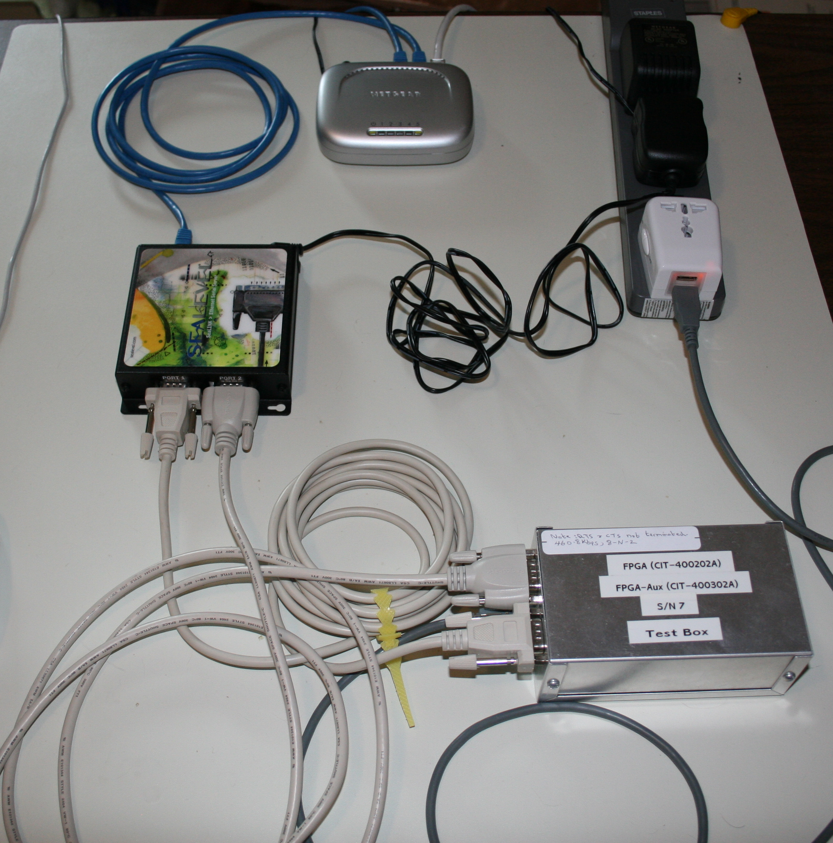
Development Environment
Initial testing of new code takes place on MISC development boards
Forth system on development boards accessed via serial link to PC
New code is easily uploaded via the serial link
Testing of code that accesses hardware is done on EM units
Low-level MISC I/O routines are in everyday lab use, where MISCs are used to acquire test data and control test runs
The same central MISC / multiple satellite MISC architecture was used for NuSTAR and STEREO
EM units are preserved after launch, and used for testing/verification of software uploads and command sequences
Ethernet microhub
RS422 to
ethernet
MISC Dev Bd
Command and data interfaces
Interface to MISC
Development Board
Notes:
Update with EPI-Hi EM board pic?

Slide 8
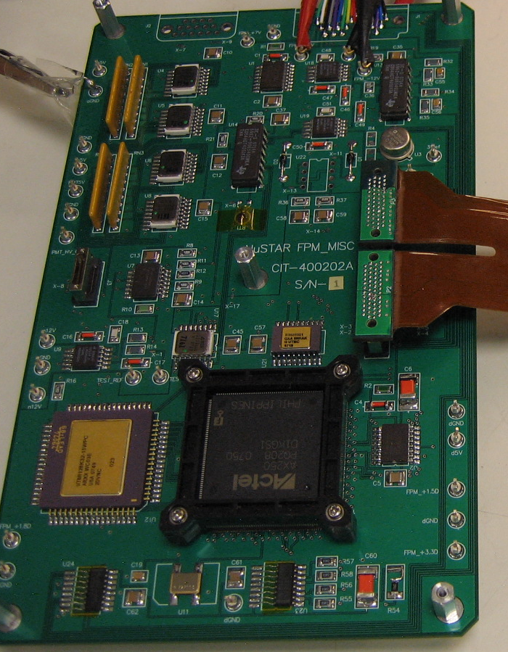
Development Environment
Initial testing of new code takes place on MISC development boards
Forth system on development boards accessed via serial link to PC
New code is easily uploaded via the serial link
Testing of code that accesses hardware is done on EM units
Low-level MISC I/O routines are in everyday lab use, where MISCs are used to acquire test data and control test runs
The same central MISC / multiple satellite MISC architecture was used for NuSTAR and STEREO
EM units are preserved after launch, and used for testing/verification of software uploads and command sequences
NuSTAR MISC EM board
Notes:
Update with EPI-Hi EM board pic?

Slide 9
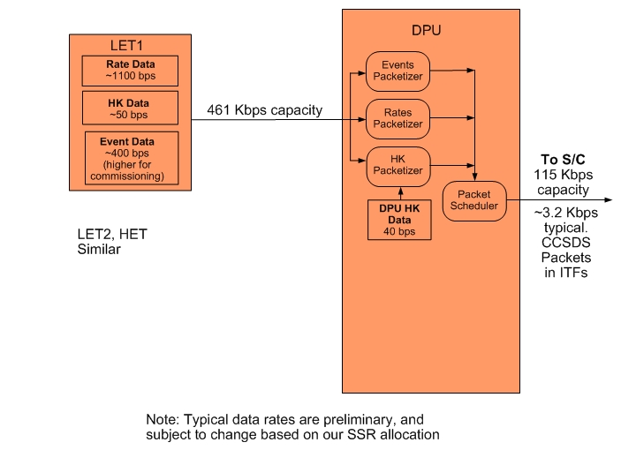
Instrument Data Flow

Slide 10
DPU Software Tasks
Forth operating system and low-level I/O routines
Power-on and initialization sequence management
Satellite MISC serial boot sequence management
Housekeeping data collection
Inter-MISC communication management, and data acquisition/buffering from satellite MISCs
Setup and control of instrument LVPS, bias supply, heaters, and other electronics systems
Receive/Monitor status and time-synchronization data from the spacecraft, and perform autonomous mode adjustments as needed
Management of software uploads and MRAM “burns”
Formatting and transfer of science & housekeeping data and command responses to the Spacecraft
Monitor heartbeat from peripheral MISCs, and perform autonomous diagnostics/reboot as needed

Slide 11
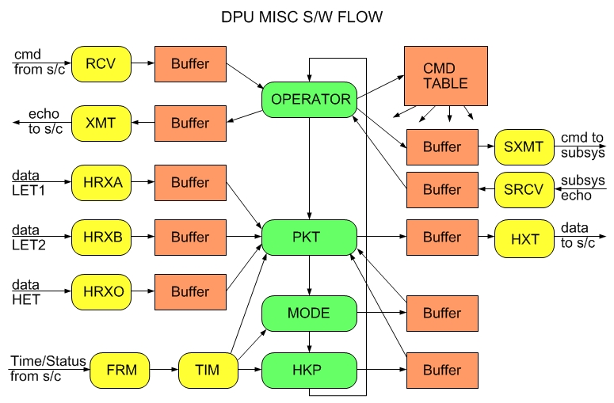
Software Flow – DPU MISC

Slide 12
Satellite MISC Software Tasks
Forth operating system and low-level I/O routines
Science data acquisition
Science data processing and reduction (particle ID)
Housekeeping data acquisition
Processing of status, time-synchronization, and command data from the EPI-Hi DPU
Monitor key counting rates and adjust the telescope operating condition to optimize data quality
Monitor temperatures and adjust detector gain/offset settings to compensate for temperature variations
Formatting and transfer of science & housekeeping data and command responses to the EPI-Hi DPU
Setup and control of any instrument HV, bias supply, heaters, etc. not controlled by the EPI-Hi DPU.

Slide 13
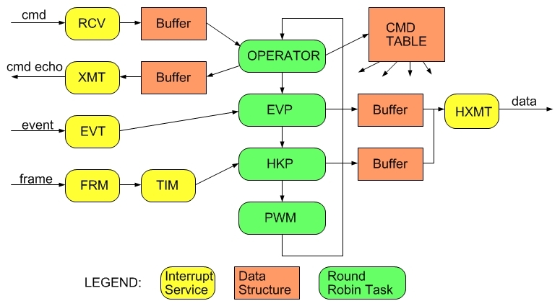
Software Flow – Detector Module MISC

Slide 14
Integration, Testing and Verification
The EPI-Hi Flight Software Test Plan document will define this plan in detail. This plan will include a software requirements verification matrix.
Software tests will start at the module level. As the code builds up, system-level testing will start, and the majority of the test time will be targeted at the system level.
A Test Readiness Review will precede formal acceptance testing. SPP Project and ISIS personnel will oversee/participate in this review.
Formal acceptance tests will be performed on the EPI-Hi instrument, including the flight software, during the EPI-Hi integration and test phase.
During environmental tests and SPP I&T, more experience will be gained with the flight software, real sensor data, and with controlling the instrument via the SOC-MOC interfaces. Flight software changes may be expected as a result. Any changes in the flight software at this stage will result in CCB review, and a repeat of these acceptance tests.
The acceptance tests for the EPI-Hi flight software will be designed to verify each of the software functional requirements as called out in the requirements documents and also the functions provided by the Forth operating system, the I/O API, and the multitasking software running on the MISC processors.
A software requirements verification matrix will be created and maintained by the EPI-Hi team to aid in verifying that the software meets the requirements. The matrix will be available for review by the SPP Project. A preliminary software requirements verification matrix will be presented at CDR and a final version will be presented at the Software Acceptance Review, following successful completion of the acceptance tests.
A Software Acceptance Review will follow the successful completion of the acceptance tests, and the EPI-Hi team will present a test report. SPP Project will oversee/participate in this review.

Slide 15
Software Maintenance, Configuration Management
Configuration Management Plan is contained in Software Development Plan
Version control and software archiving: achieved via Subversion version control system (SVN) (http://subversion.apache.org/). The subversion server is hosted and maintained by Caltech Space Radiation Lab IT personnel. It is access-controlled for security, and is backed-up regularly.
The lead engineer will maintain the structure of the SVN repository, including separate directories for each of the MISC’s flight software, separate directories for different software builds, etc.
All problems and change requests will be documented/tracked in the Software Development Log by the lead engineer. Given such a small dev team, a change request tool such as JIRA is an unnecessary overhead.
After the beginning of I&T with flight hardware, all flight software changes will be approved by a CCB prior to being loaded into flight hardware. Also after this point, Version Description Documents (VDDs) will accompany all Software releases. The VDD will contain the functionality of the release, a list of closed software problem reports, a list of any liens/workarounds, installation instructions, and a list of deliverable source code files.
The CCB membership will consist of the EPI-Hi lead engineer and software developer, and the Epi-Hi Project Manager, plus any other ISIS or SPP Project engineers that the QA team at SWRI deems necessary.
Notes:
More details in Dev plan

Slide 16
Software Heritage
The flight software inherits some major components from previous projects:
The Forth kernel and real-time multi-tasking S/W are the same as for the SEP instrument suite on STEREO, the NuSTAR mission, and the many MISC processors used ubiquitously in ground test equipment at Caltech
The inter-MISC communication S/W is the same as for STEREO & NuSTAR
The software for packetizing instrument data into CCSDS packets and scheduling the transfer of data packets to the spacecraft is the same as for STEREO & NuSTAR
The software for processing instrument commands, routing commands to detector module MISCs, and packetizing command responses is the same as for STEREO & NuSTAR, except for the unpacking of the commands from the telecommand ITF.
The onboard analysis and binning of particle event data by the detector module MISCs has significant heritage from STEREO
Notes:
More details in Dev plan

Slide 17
Software Heritage – What’s Different?
The instrument boot sequence is quite different, given the lack of hardware reset line and the increased autonomy requirements – see separate boot sequence presentation.
Each MISC FSW shall provide a capability to execute command sequences, i.e. macros. This is actually inherent in the Forth OS, but we need to write some utility code to make the implementations of timed command sequences simple/friendly
The DPU MISC FSW needs to manage a section of MRAM as a “patch file” archive. Need subroutines to transfer between SRAM cmd buffer and the MRAM patch file, and routines to read and execute the patch file. This capability needed to support autonomous reconfiguration to known op state after power-on/reset.
The DPU shall monitor the telemetry of the detector module MISCs, and perform an SRAM dump and reboot upon detection of a fault.
Need to understand interaction between EPI-Hi autonomy rules and S/C autonomy rules for all possible fault scenarios

Slide 18
Software Heritage – What’s Different? (2)
Management of the volume of EPI-Hi instrument data telemetered to the Spacecraft as a function of time, based on the Solid-State-Recorder "fill-level" information in the Spacecraft status message, and other commandable parameters
Extraction of Forth instrument commands from the telecommand ITFs. In previous missions, the S/C unpacked our commands from ITFs/packets for us.
  Although the onboard analysis and binning of particle event data by the detector module MISCs has significant heritage from STEREO, there are new challenges – we want to do a better job on 3He/4He than on STEREO, and the design of the detector stacks is more complex.

Slide 19
Predicted memory, CPU Margins
LET1 MISC (LET2, HET similar)
  SRAM 512kwords available (512k x 24 bits)
    Basic OS, HK, I/O code + tables 20kwords
    Event processing, particle ID 210kwords
    Rates counters, double-buffered 10kwords
    Event priority buffers 25kwords
    SRAM usage ≈ 265/512 = 52%
  MIPs 12 60% used (Maximum, dominated by event processing during intense SEP events)
DPU MISC:
  SRAM 128kwords available (128k x 24 bits)
    Basic OS, HK, I/O code + tables 20kwords
    Detector module data buffers,
    & rate accum, double-buffered 30kwords
    CCSDS Packet buffers 20kwords
  SRAM usage ≈ 70/128 = 54%
  MRAM 2M x 8 bits ~70% used (2 sets of boot images)
  MIPs 12 20% used

Slide 20
Pre-PDR Peer Review Summary
Need to review NASA software standards docs listed in PAIP, ensure we are in compliance
Other reviewer comments are TBD

Slide 21
Backup Slides
Backup Slides

Slide 22
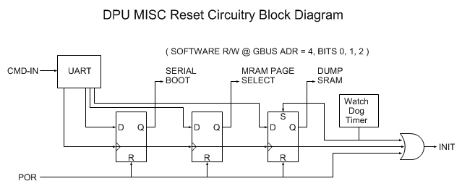
Boot Logic
Supports three ways to initiate boot: Power On Reset (POR), CMD-IN and Watch Dog Timer
“Reset Bit Field” is writable by CMD-IN and R/W by software
“Serial Boot” bit determines if boot is to be performed serially via CMD-IN or from MRAM
“MRAM Page Select” bit determined which page (0 or 1) of MRAM is source of boot images.
“Dump SRAM” bit determines if SRAM is dumped prior to boot. This bit is set by the watch dog timeout.

Slide 23
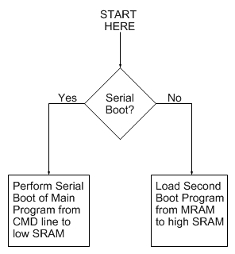
FPGA Resident Boot Program
Permanently coded as part of FPGA design.
Simple and small: <64 – 24 bit words
Either performs serial boot of Main Program into low SRAM via CMD-IN
Or loads second boot program from MRAM into high SRAM

Slide 24
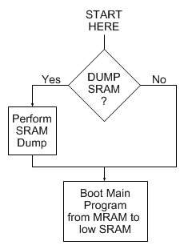
Second Boot Program
Optionally performs SRAM dump prior to booting Main Program from MRAM to low SRAM.
SRAM dump is somewhat complex, does not fit into FPGA resident boot program; hence need for second boot program.

Slide 25
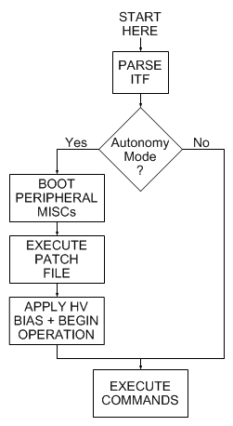
Main Program
Reads and parses ITF from S/C.
Determines if in “autonomy mode”.
If so, boots peripheral MISCs, executes MRAM Patch File, applies HV bias, begins science operations in mode specified in S/C status message.
If not, just awaits further commands; i.e. during commissioning.

