Slide 1
Performance Assurance
Joerg Gerhardus
Notes:
introduction

Slide 2
Outline
Safety, quality and reliability program being used in the development of the instrument
Description of software quality system, and software IV&V plans
EEE parts selection and screening plans as well as materials selection and screening plans
Any special processes required to build the instrument
Contamination control and ESD
Plans for selection and qualification of special items such as detectors and mechanisms
Any exceptions being taken to the SPP PAIP
Preliminary FMEA, or plans for FMEA, Fault Tree Analysis
Describe the manner in which the reliability engineer works with the design team to ensure that reliability is maximized

Slide 3
Outline
Requirements
SMA Oversight & PAIPs
Organization
Design Assurance
Hardware Quality
Software Quality
Safety
Path Forward

Slide 4
SPP PA Requirements and PAIPs
APL Requirements:
Solar Probe Plus (SPP) Instrument Mission Assurance Requirements Compliance Matrix
APL document # 7434-9096 Rev. -
ISIS Implementation through plans (PAIP) and operating procedures:
SwRI: 16105-PAIP-01 Rev. 0, released TBD
APL: Solar Probe Plus (SPP) Performance Assurance Implementation Plan; APL document # 7434-9003 Rev. -, released TBD
Caltech: CIT-SPP-004 Rev. A, released 10/07/2013

Slide 5
Performance Assurance Implementation Plan
Deliverables
General Quality Requirements
Procurement
QA Surveillance
Training and Certification
Design and Development Review Process
Configuration Management
Non Conformance Process and Reporting
Hardware Quality Requirements
Manufacturing, Inspection, Assembly, Test, and Inspection Planning
Controlled Stores
Fabrication processes
Inspection
Acceptance Test Verification
Handling Packaging, Shipping
Software Quality Requirements
Requirements Analysis
Reviews
Verification and Validation
Safety
Reliability Assurance
EEE Parts Program

Slide 6
PA Organization Chart
APL
SPP
Luke Becker
SwRI
(SPP ISIS)
Eric Edlund
Joerg Gerhardus
APL
(EPI Lo)
Jim Burgum
Caltech
(EPI Hi)
Branislav Kecman
SwRI
(Bracket)
Eric Edlund

Slide 7
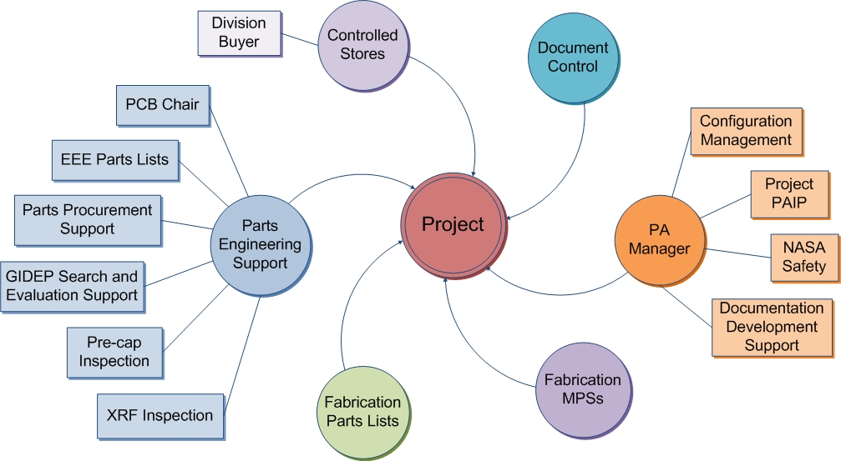
Project Quality Assurance
Project Team PA
Reliability engineering
Parts acquisition oversight
Division 15 PA Manager and Staff
Coordinate Div 15 Resources
Independent Project Quality Engineer
Oversight & Coordination
QA Engineering
QA Inspections
Partner QA
Implement local PAIP and support SwRI’s SPP ISIS PA Lead

Slide 8
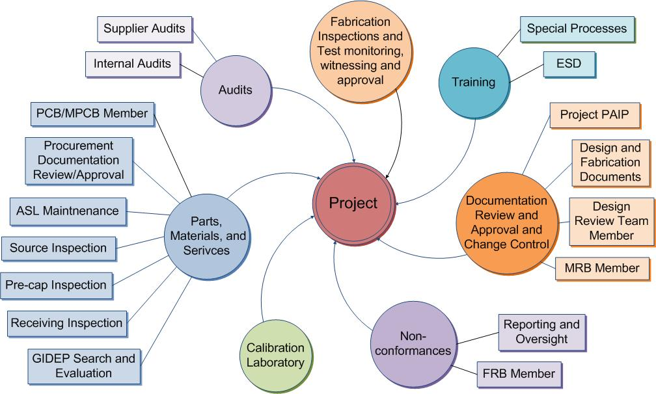
Quality Tasks

Slide 9
Design Assurance
Hardware designs governed by
Design process and controls
Requirements Definition
System Engineering Process
Design Planning
Peer Reviews and checklist
Verification and Validation
Control of Design Changes
Software designs governed by
Structured software development process
Contract Reviews, Software Development Folder, Planning
Review of Requirements, and checklist
Software Design Specification, Design Peer Reviews, and checklist
Coding Standards, Configuration Control, and Code Walkthroughs
Test Plans, Test Preparations, Formal Testing, and Reporting
Independent QA surveillance and reporting

Slide 10
Quality Assurance
Procurements per released drawing and indentured parts list
Periodic GIDEP alert verification performed on EEE parts list
QA Receiving Inspection of EEE parts for flight hardware
Flight PWB procurement and coupon testing at GSFC
SwRI coordinates PCB effort for SPP ISIS with mission-level PCB

Slide 11
Quality Assurance (cont’d.)
Non-conformance control:
Per organization’s established procedures
MRB and FRB established
All non-conformances will be processed as Anomalies or Problem/Failure reports and reported through SwRI to APL as required
Workmanship
Technicians and inspectors are certified to NASA 8739 standards. Vince Ganley & Connie Ovalles are the in-house Level B certified instructors and are available to support other organizations as needed.
ESD
Engineers, operators, and technicians are certified to NASA-STD-8739.7 / ANSI ESD S20.20.

Slide 12
Safety
SPP ISIS will provide Safety inputs
The NPR-8715.3A process circle summarizes the overall safety program risk management approach:
Safety Hazards Analysis
Implementation of hazard controls
Verification

Slide 13
EPI Hi/Lo Hazards and Mitigations
TBD
Need input from Scott

Slide 14
Summary
SPP ISIS Performance Assurance plans and requirements are in place
PAIPs written in response to the APL MAR Matrix requirements
SwRI QA independently verifies that we follow plans

