Slide 1
ISIS Power
David Do
Notes:
introduction

Slide 2
Outline
EPI-Lo and EPI-Hi LVPS
  Power requirements
  Block diagrams
  Circuit topologies and descriptions
  Circuit margins
  Packaging
  Thermal management
Plans for testing including bench checkout equipment
Maturity of the design (BB testing, design, analysis completed)
Preliminary parts lists and any special testing required
Summary and follow-up from peer review held prior to the instrument PDR

Slide 3
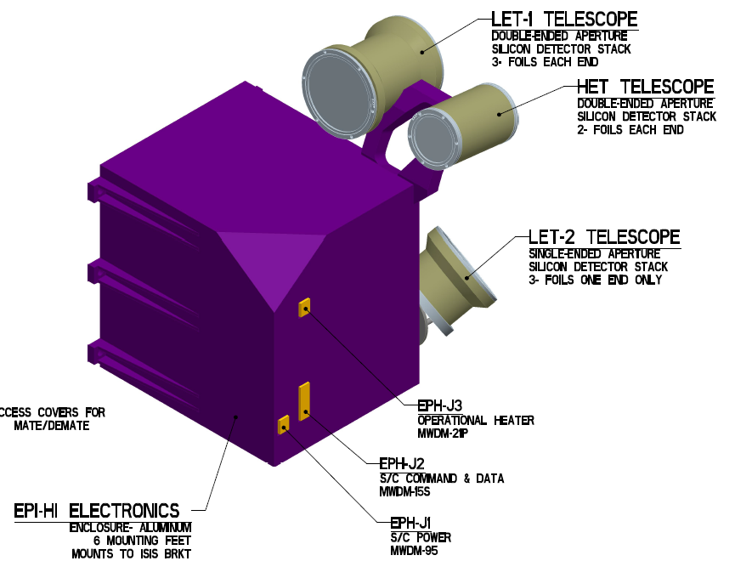
EPI-Hi Electronics Overview

Slide 4
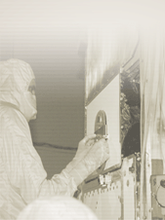
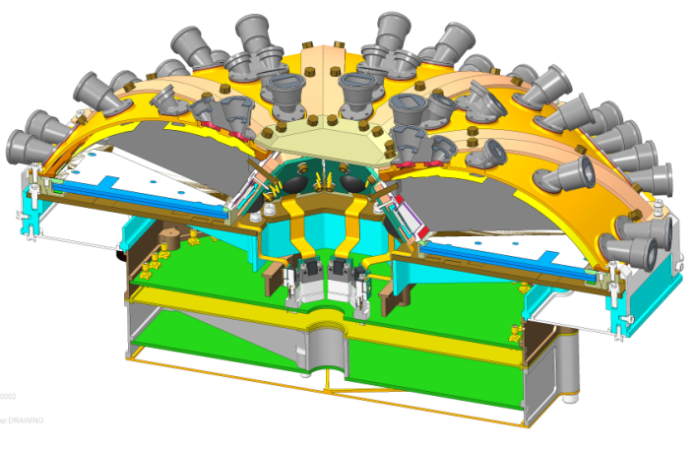
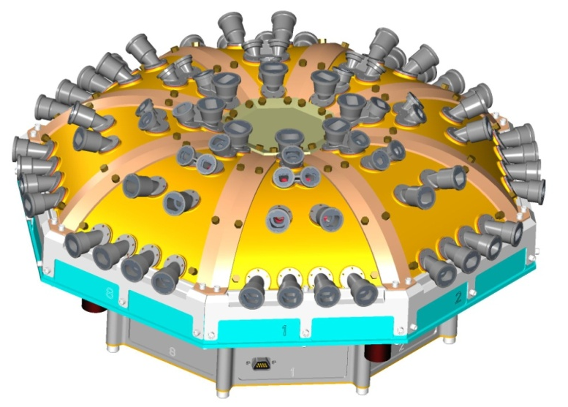
EPI-Lo – Electronics Overview
Energy Boards (x8)
Anode Boards (x4)
Event Board
Power Board

Slide 5
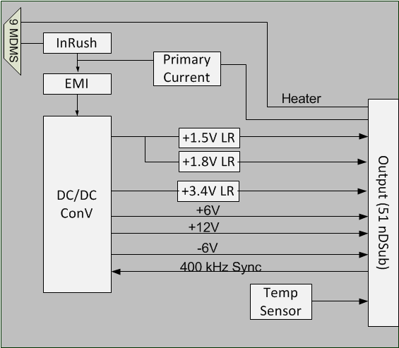
EPI-Hi Block Diagram

Slide 6
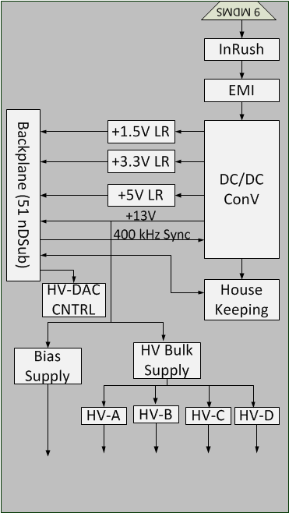
EPI-Lo Block Diagram

Slide 7
Environment Requirements
Thermal
  Survival is -55C to +75C
  Operational is -20C to +55C
  Turn-on at -30C
  Qualification Test -30C to +65C
Radiation
  75 kRad (includes RDM=2)
  LET > 70 MeV*cm2/ mg
    For LET < 70 MeV*cm2/ mg appropriate SEE mitigation shall be applied
update

Slide 8
LVPS Major Input Requirements
Requirements from Solar Probe Bus
Input Specification
  Operate over bus voltage of 24 to 35V
  Survive any standing or fluctuating voltage from 0 to 40V
  Meet EMI/EMC
  Inrush current limit
  Primary Secondary isolation >1MOhm
  Overall efficiency > 70%

Slide 9
Input Power Requirement
  EMI/EMC
  Inrush Current
CE01& CE03 Limit
In-Rush Current Limit

Slide 10
Output Requirements:
EPI-Hi:
  Generate low voltages: +12V, +6V, +3.3V, +1.8V, +1.5V & -6V
  Primary input current telemetry
  Temp sensor
  Provide path for heater voltage
EPI-Lo:
  Generate low voltages: +13V, +5V, +3.3V and +1.5V
  House keeping through ADC for primary input current, temperature, output currents and output voltages
  Generate high voltages and bias voltages to sensors

Slide 11
Interface
EPI-Hi
  Input connector: MWDM2L-9SCBRR2-0.110-429
  Output connector: 891-008-51PSBRT1T-429TH
EPI-Lo
  Input connector: MWDM_L-9SSMR
  Inter board connector: 891-008-51PSBRT1T-429
  Safing connector: 803-005-07M5-3EN
  Bias voltage connector: 09-9001-1
  High voltage: Pig tails

Slide 12
Power Topology
Common for EPI-Hi and EPI-Lo:
  Main converter is forward with resonant reset operating at 200kHz. Efficiency is >80%.
  Digital voltages are linear regulated
EPI-Lo HVPS:
  Bulk high voltage is set at 3.5kV
  High voltages of up to 3.4kV are controlled through Optocouplers
  Bias voltage is up to 200V

Slide 13
EPI-Hi Output Requirements
 | Output Regulation | Min Load (mA) | Nom Load (mA) | Max Load (mA)
+1.53V | ±2.5% | 50 | 100 | 150
+1.82V | ±2.5% | 20 | 40 | 60
+3.41V | ±2.5% | 145 | 287 | 430
+6V | ±5% | 79 | 338 | 500
+12V | ±7% | 8 | 16 | 64
-6V | ±7% | 6 | 12.6 | 19

Slide 14
EPI-Lo Output Requirement
 | Outputs Regulation | Min Load (mA) | Nom Load (mA) | Max Load (mA)
+1.5V | ±3% | 45 | 80 | 200
+3.3V | ±3% | 150 | 200 | 460
+5V | ±5% | 115 | 135 | 160
+13V | ±5% | 10 | 63 | 90

Slide 15
Sensor Voltages
Collimators
Grounded Foils
Tecan Grid
SSD
1000V
100V
+ 900V
MCP
MCP
+2900V
+3000V
100V
Anode/Preamp
900V (total diode drop)
MCP Return is a ground reference at HVPS (allows MCP current measurement across resistor)
MCP return
HVPS Out +3300V Max

Slide 16
EPI-Lo HVPS Requirements
 | Max Output Voltage (V) | Min Load (uA) | Max Load (uA)
Bias | 200 | 0 | 20
Bulk | 3400 | 0 | 250
HVPS | 3300 | 0 | 40
Grid | 1000 | 0 | 1
MCP | 900 | 0 | 40

Slide 17
HVPS Current Limit
Control range: 0uA to 125uA
Control granularity: <1uA
Response time: <1ms

Slide 18
LVDS Fault Mitigation
Transformer: primary and 3.3V winding is well isolated
+3.3V is linear regulated from +3.6V
Linear pass transistor is rated for 100V
Preliminary thermal analysis shows 33°C rise

Slide 19


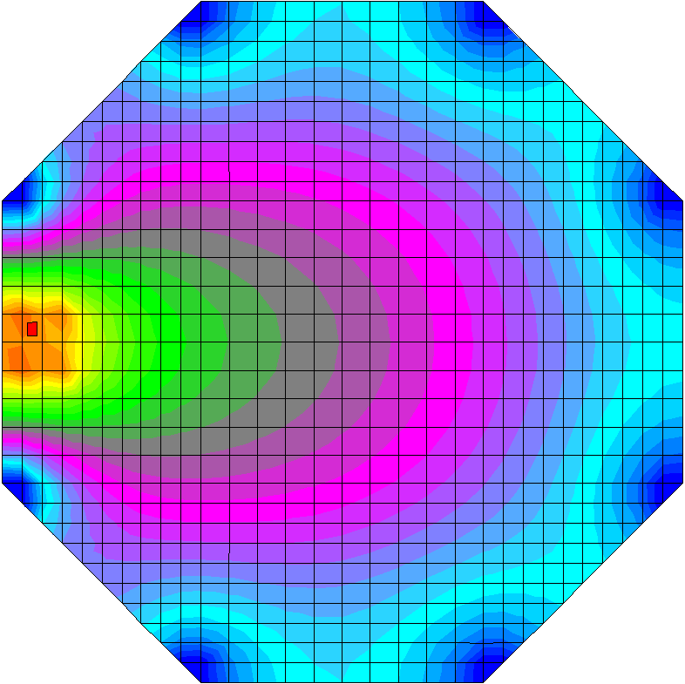
Thermal Analysis
Ran two cases: 4 oz and 6 oz Cu in PWB
Thermal contours similar, one plot shown with two contour levels for ea PWB case
TO-254 temps for 4oz
  Junction = 46.6°C
  Case = 27.0°C
TO-254 temps for 6oz
  Junction = 32.8°C
  Case = 13.2°C
4oz Cu
6oz Cu

Slide 20
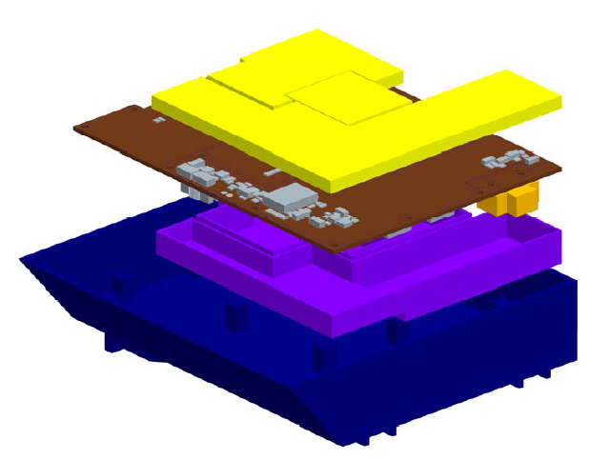
EPI-Hi Package
Top Shields
LVPS Board
Bottom Shields
Chassis

Slide 21
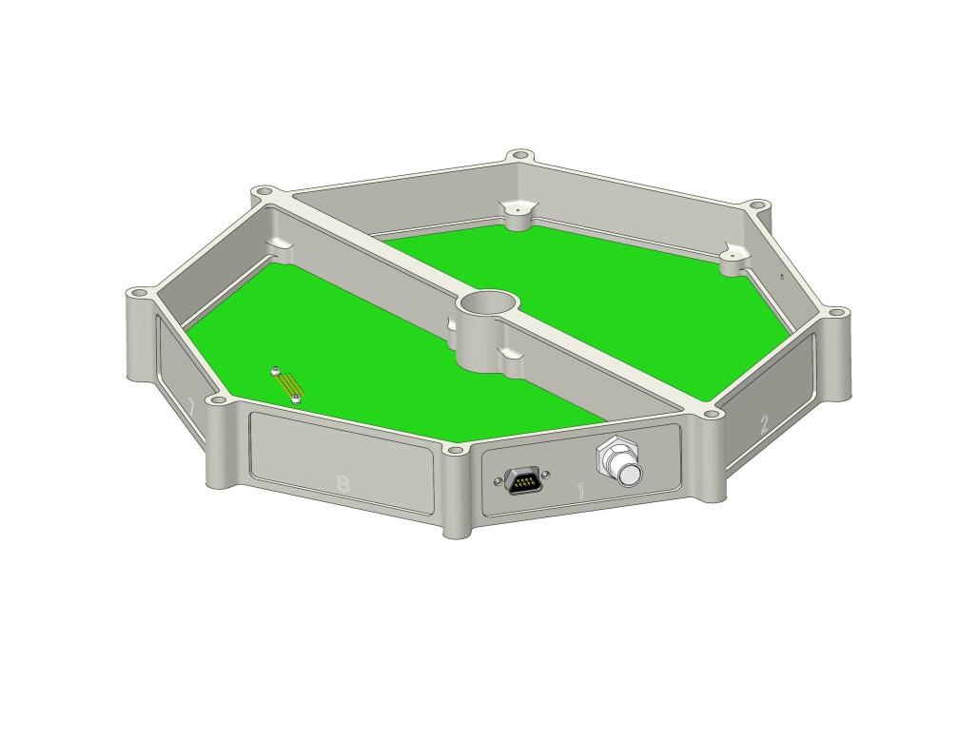
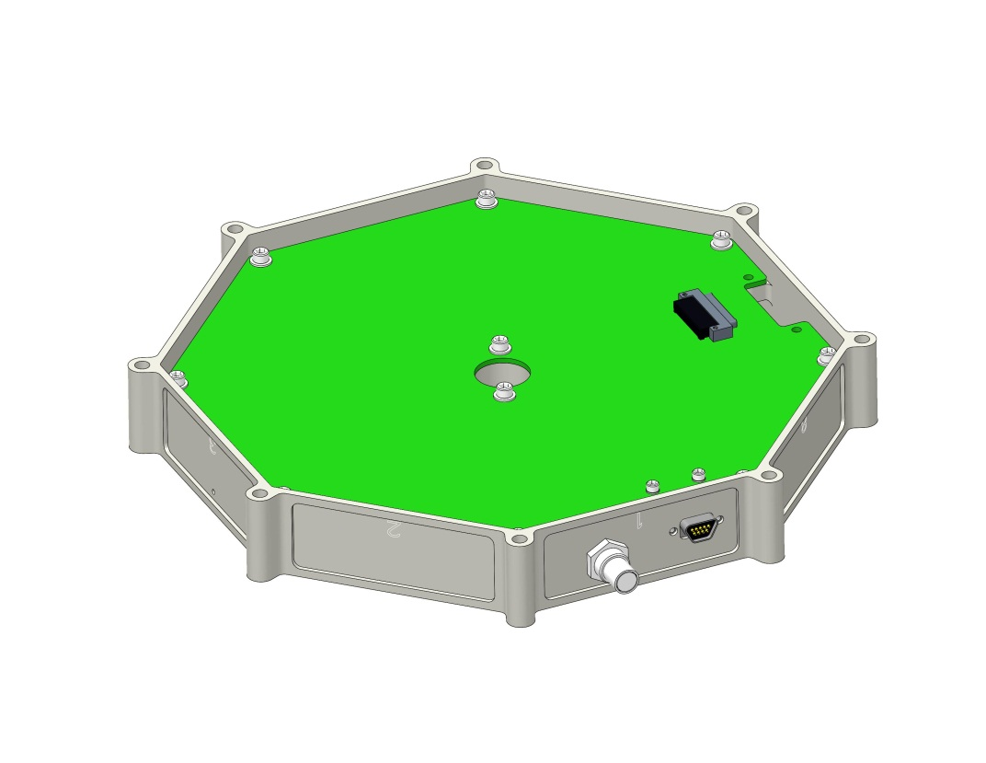
EPI-Lo Packaging
Interconnect
Packaged in octagon frame
Stiffener goes across the board
Power dissipation is estimated <1.5W
Input
Safing

Slide 22
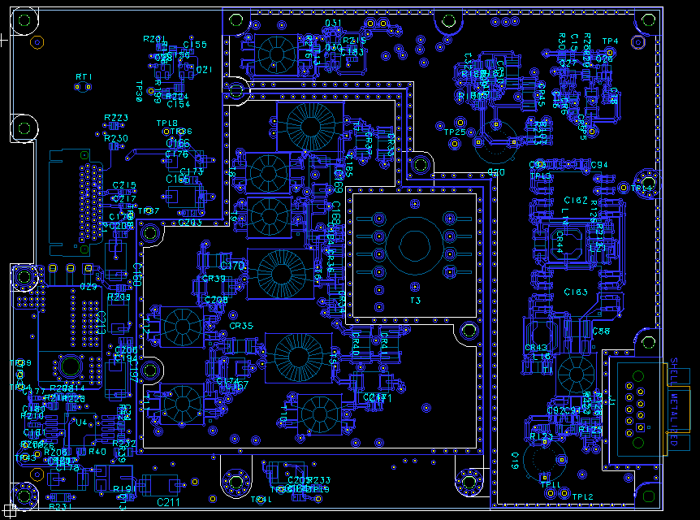
EPI-Hi Board Layout
Secondary Shield
Primary
Shield
Output
Input

Slide 23
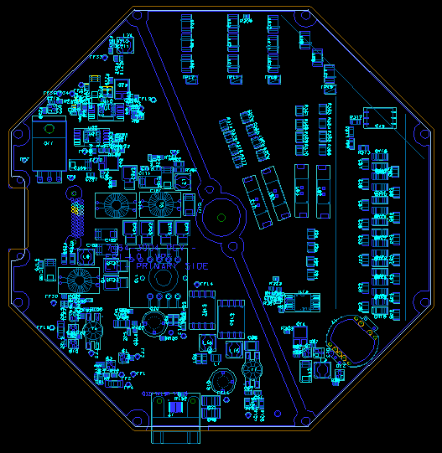
EPI-Lo Board Placement
HVPS
LVPS

Slide 24
Plans for testing
Follows APL Manufacturing Flow, these are significant highlights
  Populate Passive Components with Automatic Measurement.
  Populate Actives and Install Known Tailors or Tailor Flags
  Install into Flight Frame
  Execute Test Procedure to Test and Tailor Entire Board
  ESS Testing
  Execute Functional Test Procedure
  Photograph and Conformal Coat
  Execute Test Procedure to Calibrate and Characterize Board (over temperature)
  Release to Next Assembly

Slide 25
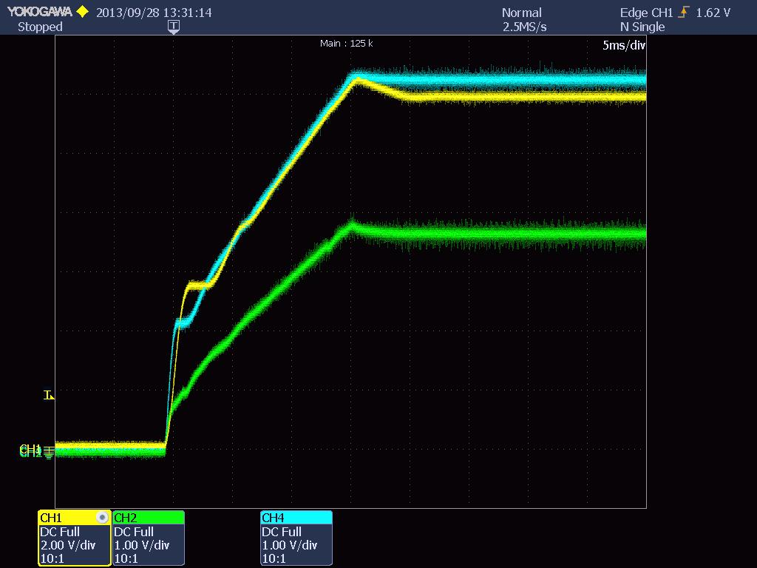
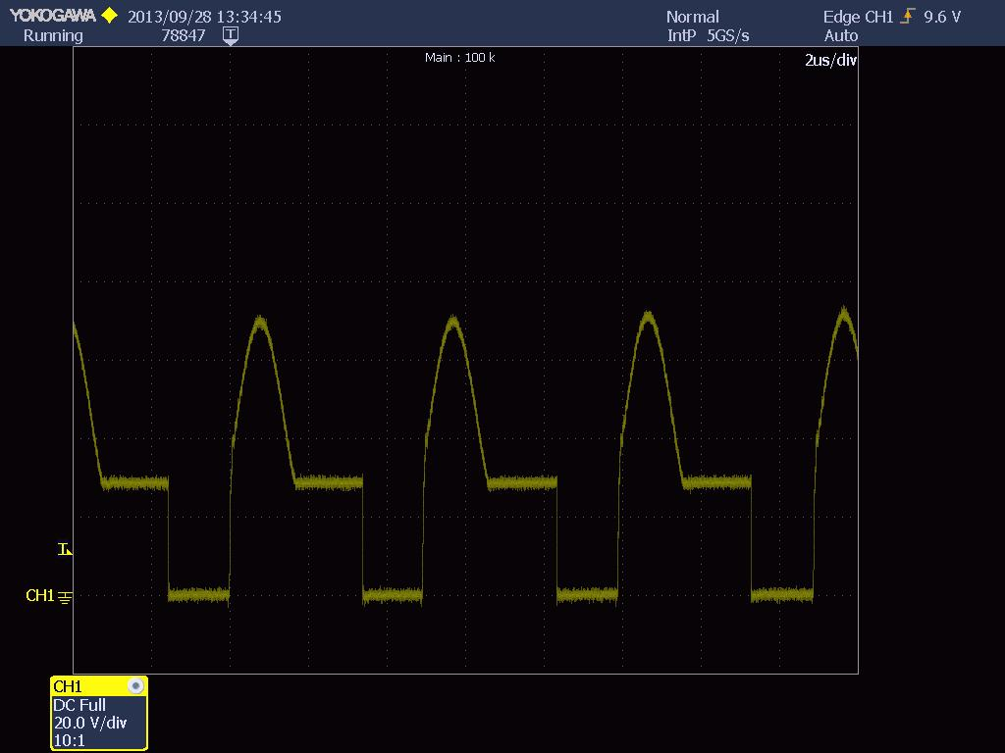
Breadboard Testings
Start Up
Transformer Reset

Slide 26
Output Regulation and Efficiency
 | Load(A) | Regulation(V) | Power(W)
+1.53V | 0.14 | 1.505 | 0.2107
+3.41V | 0.287 | 3.69* | 0.9758
+6V | 0.338 | 5.97 | 2.01786
+12V | 0.016 | 11.98 | 0.19168
-6V | 0.012 | 5.95 | 0.0714
input | 0.159 | 28 | 4.452
 |  |  | 78%
*+3.41V shown preregulated. Efficiency is calculated using +3.4V.
+3.41V and +1.82V linear regulator have same design as +1.53V.

Slide 27
Analysis
Preliminary EMI completed
Worst Case analysis for digital voltages completed: ±2.3%

Slide 28
Voltage Regulation WCA Method and Assumptions
WCA Method
  Extreme Value Analysis in Mathcad
Temperature Range
  -20C to +65C operational
Resistors Variation
  K resistors are 100 ppm (0.8%) + 1% initial tolerance + 2% Aging ≈ 4%
  E resistors are 25 ppm (0.2%) + 0.1% initial tolerance + 1% Aging ≈ 1.3%
  Z resistor are 5ppm(0.04%)+ 0.01% initial tolerance 0.16% Aging ≈ 0.2%
RH1078
  100Krad data from datasheet
PWM5302S
  100Krad data from datasheet

Slide 29
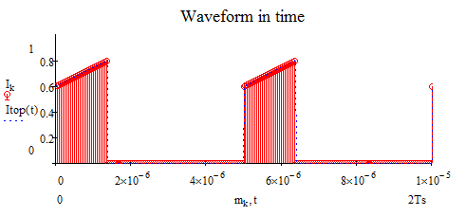
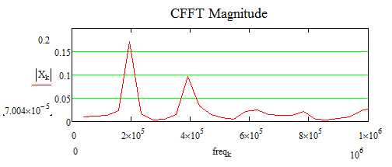
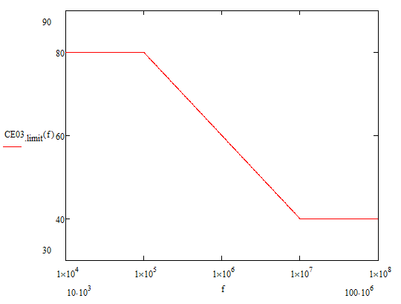
EPI-Lo EMI Analysis
Primary Current in Discrete Time
Primary Current in CFFT
CE03 Limit
EMI Filter Attenuation

Slide 30
Parts
All parts are rad-hard to 100krad
No parts concerns
Add table of parts

Slide 31
Status Summary
EPI-Hi
  EM PCB Fabricated
EPI-Lo
  EM Placement completed
  EM Board is in layout phase

Slide 32
Plan Forward
EPI-Hi
  Complete testing EM
  Fabricate flight
EPI-Lo
  Fabricate and completing testing EM
  Fabricate flight
Finalize all documentation and procedures for flight build
Build, tailor, calibrate, and qualify flight units

Slide 33
Peer Reviews
EPI-Hi LVPS: May 2013
EPI-Lo Power: Aug 2013
Major Action Items:
  EPI-Hi:
    Shielding over switching circuits
    Output loads
    Output regulations
  EPI-Lo:
    MCP voltage accuracy
    LVDS fault mitigation
    Bias Voltage Zener diode protection

