Slide 1
EPI-Hi Electronics
Branislav Kecman / Rick Cook
Notes:
introduction

Slide 2
EPI-Hi Electronics
Electronics System Overview
Rick Cook
Electrical Systems Engineer

Slide 3
Key Driving Requirements
Support three independent charged particle telescopes: LET1, LET2 and HET.
For each telescope provide for detection of coincident signals from various Si detector elements to define “events” caused by the incidence of individual nuclei, electrons and neutral particles/photons.
For each event, provide pulse height analysis of the signal amplitudes in the various stimulated detector elements. Large dynamic range is needed for measurement of electrons through Zn nuclei.
Sort and count the events according to particle type and energy.
Integrate the counts for the various particle/energy categories over time periods ranging from seconds to hours.
Format the count rate data into packets and transmit them to the s/c.
Include in data packets the raw pulse height data for a sample of events to aid in-flight calibration.
Monitor instrument health by measurement of detector leakage currents, instrument temperatures, power supply voltages and total instrument current draw, and include this “housekeeping” data in telemetry packets.
Respond to commands for altering threshold voltages, bias voltages, etc. and performing instrument self-tests and auxilliary functions.
Control instrument operational heaters.

Slide 4
Constraints and their Implications
Constraints
  Both power and mass are very tightly constrained
  Design should be single string, yet reliable
  Primary data collection occurs when s/c cannot communicate with Earth
  Radiation environment is more severe than in typical mission
Implications
  Reliability through minimization of parts count and use of “natural” redundancy
  Use of custom radhard VLSI: PHASIC and HKCHIP
  Design should be “bullet proof” with regard to radiation affects: no latch-up, no processor crash due to SEU, total dose tolerant > 100 kRad
  Design should be capable of autonomous operation during primary data collection period (<0.25 AU from sun)

Slide 5
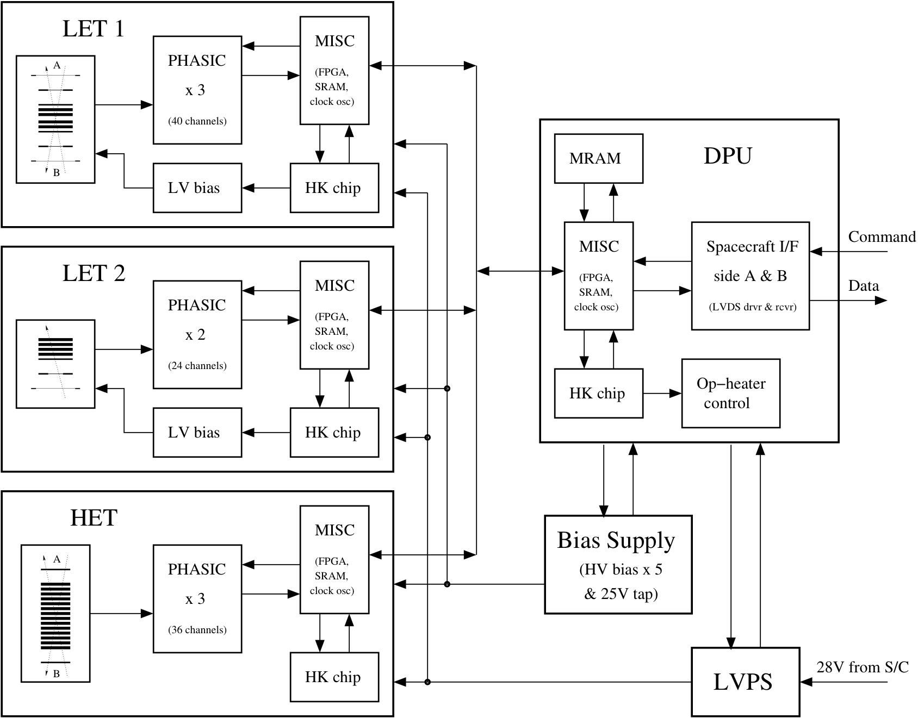
EPI-Hi Block Diagram

Slide 6
Key Features
Each telescope supported by independent electronics board including PHASICs, processor (MISC) and HKCHIP.
A separate DPU board provides a processor dedicated to formatting data and providing a single point interface with s/c.
Low Voltage Power Supply (LVPS) and Bias Supply board are shared.
Bias Supply board contains separate supplies for separate telescope “ends”. (limited redundancy)
Logic and processors are implemented within RTAX 250 FPGAs. A single FPGA is used on each telescope board and on the DPU board.
Large system heritage from earlier projects: STEREO and NuSTAR.

Slide 7
Instrument to S/C Electrical Interfaces
Interfaces with S/C specified by ICD under APL control
Command and data interfaces with S/C go through DPU board, have redundant A and B sides
Both command and data interfaces are 115.2 kbaud LVDS using radhard drivers/receivers specified by APL.
Reset and Timing signals removed from interface by APL for simplicity. Functions included in command signal protocol.
MISC boot method has been modified to accommodate lack of Reset signal.
S/C supplies separate 30V power services for survival and operational heaters.
S/C monitors instrument temp via S/C supplied thermistors.

Slide 8
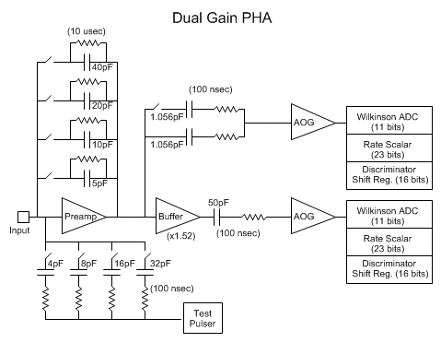
PHASIC Overview
PHASIC stand for “pulse height analysis system integrated circuit”
Originally developed and used in NASA’s STEREO mission.
Each PHASIC contains 16 complete dual gain pulse height analysis (PHA) chains.
STEREO PHASICs still operational in space.
Mods for SPP include widening dynamic range, and improving total dose tolerance to >100 krad

Slide 9
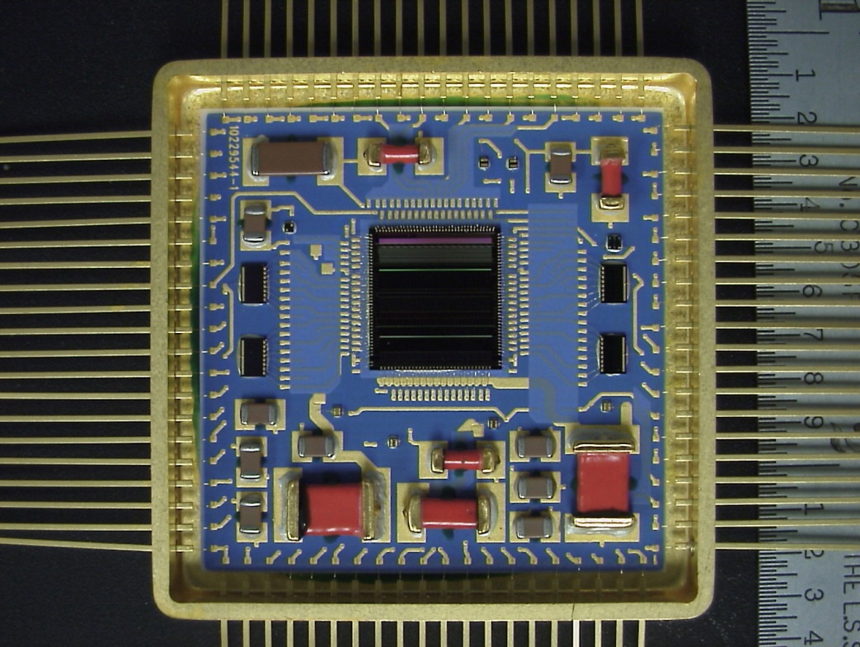
PHASIC packaging
PHASIC die is installed in an 80-pin hermetic Covar package along with a few passive components to form a “hybrid” circuit.
Hybrid substrate design and passives same as for STEREO.
PHASIC hybrid to be qualified and screened to class H (as on STEREO).
Passive components include a precision resistor for each PHA chain that sets the rundown current . Allows PHA channel gain to have low <50 ppm/degC temperature coeficient.

Slide 10

PHASIC Mods near Preamp
Preamp output stage changed from “follower” to “open drain” to increase output swing.
Preamp compensation method changed for lower noise.
Buffer added in high gain signal chain
High/Low gain ratio increased from 20 to 68, with programmable option of 40
High/low gain boundary falls between alphas and carbon for most detectors

Slide 11
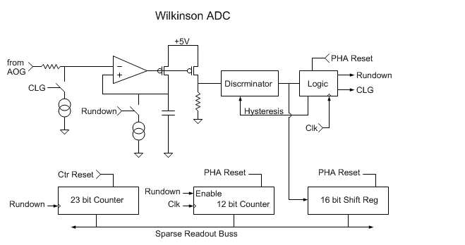
PHASIC Mods near Peak Detector
Peak Detector
Current Mirror
STEREO Peak detector contained two differential amplifier stages at input. For Solar Probe reduced to one stage but with higher current resulting in lower noise.
Size of FETs in current mirror at output increased to improve matching and threshold uniformity.

Slide 12
PHASIC Mods near Peak Detector cont.
16 bit shift register added to capture time history of discriminator output to aid in cross-talk identification.

Slide 13
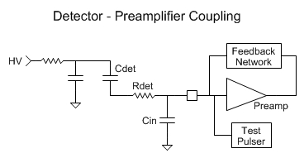
Predicted PHASIC noise/threshold
Cf = Nf * 5pF
Det | Cdet (pF) | Rdet (ohm) | Cin (pF) | Nf | Threshold (MeV) | Full Scale (MeV) | Zn @ 45 (deg) | Freq(G.C.) (MHz) | Phase Margin (deg)
L0 | 208 | 0 | 30 | 1 | 0.09 | 268 | 83 | 12.3 | 98
L1 | 93 | 30 | 40 | 1 | 0.05 | 268 | 251 | 13.3 | 65
L2(H1) | 20 | 10000 | 60 | 6 | 0.12 | 2802 | 2660 | 13.4 | 60
L3(H2) | 40 | 7500 | 80 | 9 | 0.19 | 4337 | 4092 | 10.8 | 61
H3 | 30 | 15000 | 80 | 13 | 0.28 | 6155 | 6203 | 10.5 | 56

Slide 14
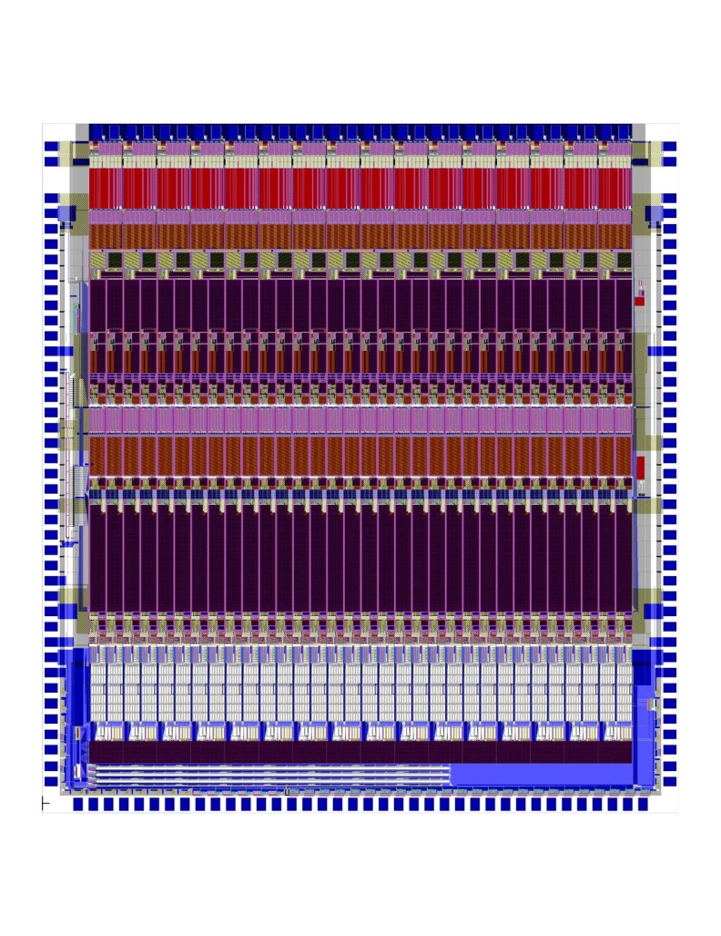
PHASIC Radiation Tolerance
Total dose tolerance improved by adding proven Aeroflex processing steps to commercial ON Semi C5N CMOS process.
Layout modified to comply with slight Aeroflex design rule differences.
12 krad improves to >100 krad
Latchup threshold should still be >80 MeV/(mg-cm2) due to use of guard rings

Slide 15
PHASIC Status
Engineering run though C5N commercial process was completed, yielding “EM” wafers and dice.
EM dice installed in STEREO hybrids and tested.
Due to need to operate some SPP channels at higher gain, systematic noise was issue; due to PHASIC in socket on test fixture.
Completed new test fixture without socket. Residual noise was eliminated, allowing full performance testing to proceed.
Initial test results indicate noise and dynamic range goals achieved and new 16 bit SR’s are functional.
Linearity and threshold testing in progress (should be done by PDR).
PHASIC Manual has been updated to account for SPP mods.

Slide 16
What is a MISC?
MISC stands for “Minimal Instruction Set Processor”
Public domain design concept by Charles Moore, inventor of FORTH
Our implementation defined in 2002 for STEREO, with Dr. C.H. Ting
24 bit word width; Four 6-bit instructions per word
All instructions execute in single clock cycle
Dedicated I/O bus and instructions
11 prioritized interrupts
Both MISC design and FORTH operating system stable since 2002.
Compact design fits nicely in RTAX250.
Data and Return stacks implemented using “block ram” in RTAX250, with EDAC becomes SEU tolerant.
RTAX250 implementation (flown on NuSTAR) runs @ 15 MHz
MISC uses 36% of RTAX250 “R cells” (flip-flops) and 63% of “C cells” (logic gates), leaving 1050 R cells and 900 C cells for application specific logic.
Estimated app specific logic for telescope board: 500 Rcell, 300 Ccell based on similar STEREO design, i.e. < 50% of available resources

Slide 17
HK Chip
Housekeeping Chip is a new ASIC design for use in EPI-HI.
Includes most auxiliary functions needed for a small instrument in a 68 pin hermetic ceramic package:
Delta sigma modulator, for making DC voltage (0-5V) measurements to monitor power supply voltages, currents, and instrument temperatures.
35 input analog multiplexor
12 10-bit DACs with option of rail to rail buffered output
12 digital outputs designed to drive opto-isolated power switches for heater control
DACs may be ganged for greater voltage setting resolution
DAC outputs may be internally routed to modulator for precision measurement => low precision DACs can be used to generate high precision voltages and improved in-flight PHASIC calibration.

Slide 18
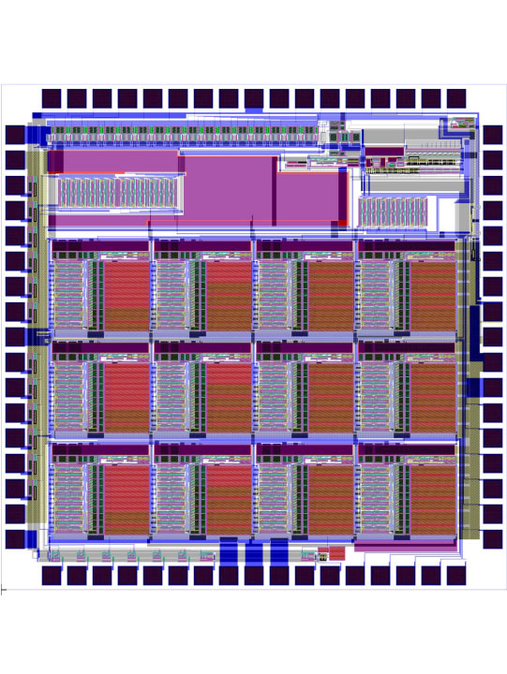
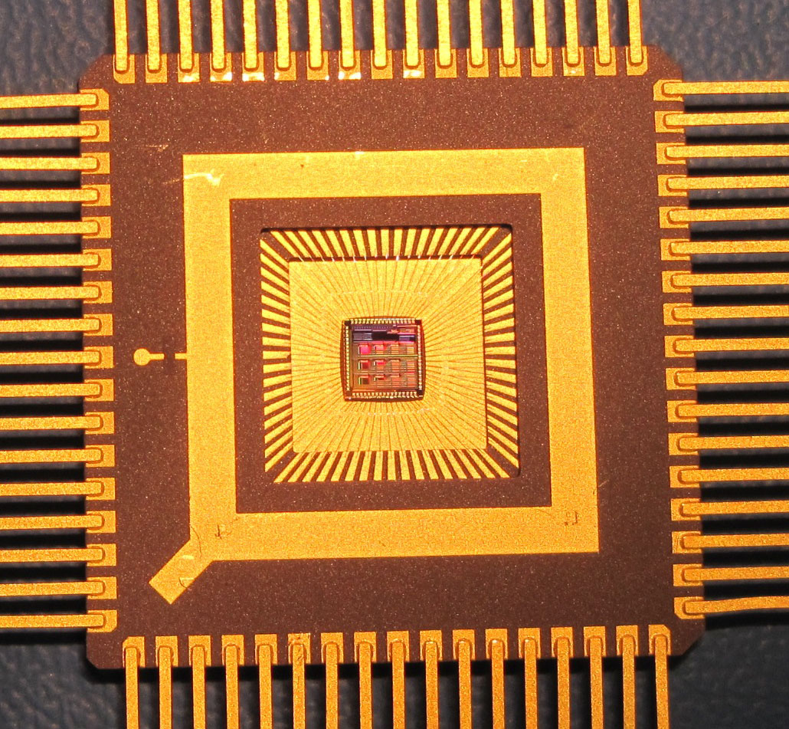
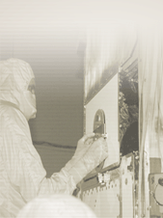
HK Chip Packaging
HK Chip packaged in hermetic 68 pin ceramic package
HK Chip to be qualified and screened to level Q, with PIND test included.

Slide 19
HK Chip Status
HK Chip was laid out using Aeroflex design rules.
Fabrication of EM parts was done with ON Semi C5N process through MOSIS.
Test results: DAC linearity limited to 8 bits; Delta sigma modulator can provide up to 18 bit performance. Buffer amps, digital outputs and power on reset circuit all perform properly.
Design judged adequate for flight re-spin with Aeroflex radiation hardening.
Flight re-spin will occur simultaneously with PHASIC flight fab on same wafers.

