Slide 1
EPI-Hi Mechanical
Sandy Shuman

Slide 2
EPI-HI Instrument
Location of instrument on spacecraft

Slide 3
Picture of FOV’s on spacecraft x3

Slide 4
EPI-HI Component Configuration
LET 1 Telescope
HET Telescope
LET2 Telescope
LVPS
LET2 Electronics
DPU/Bias
LET & HET Electronics

Slide 5
EPI-HI Enclosure Requirements
Work within mass constraints.
Package boards maintaining adequate parts clearance board to board.
Provide needed interconnect means between boards and each other and boards to telescopes.
Provide adequate RF and/or ground shielding board to board and through the enclosure.
Provide thermal isolation from spacecraft bracket.

Slide 6
EPI-HI Electronics Enclosure
Electronics box is made up of 4 major components, the LVPS Assembly, the DPU/HV Bias Assembly, the HET1/LET1 Electronics Assembly and the LET2 Electronics Assembly
Each Electronics Assembly is mounted in a perimeter style frame.
All “frames” when assembled together will provide a continuous RF shield for internal electronics.
Internal shielding between critical components will create separate shielded areas as necessary for proper electronics function.
Board interconnect is achieved using rigid/flex boards w/ built in cables terminating to individual nanonics/microstrip connectors on mating boards.
Connections to the S/C will be via standard D Subminiature connectors

Slide 7
EPI-HI Electronics Enclosure
DPU Board (mounted in one side of frame)
Flex connection to Telescope Boards
Flex connection to LVPS
S/C connectors (PCB mount)
PCB’s mounted to machined in posts in chassis
Bias Supply Board (mounted in one side of frame)
Flex connection to 3 Detector Boards
Flex connection to DPU Board
R/F shielding
PCB’s mounted to machined in posts in chassis

Slide 8
EPI-HI Electronics Enclosure
LET2 Telescope Electronics Assembly
Receives flex connection from Bias Board
Receives flex connection from DPU Board
Receives 2 flex connections from Telescope
Housing provides feet for Instrument to bracket mounting.
HET1 & LET1 Electronics Assembly
(each board)
Flex connection from Bias Board
Flex connection from DPU Board
2 Flex connections fromTelescope
PCB’s mounted to machined in posts in chassis

Slide 9
EPI-HI Electronics Enclosure
Low Voltage Power Supply
Receives flex connection from DPU Board
S/C connectors (PCB mount)
Individually shielded primary/secondary circuits top and bottom.
Housing is tapered to avoid HET Telescope FOV
Housing provides feet for Instrument to bracket mounting.
PCB’s mounted to machined in posts in chassis
*LVPS Board provided by APL *Chassis and shields designed/provided by GSFC

Slide 10
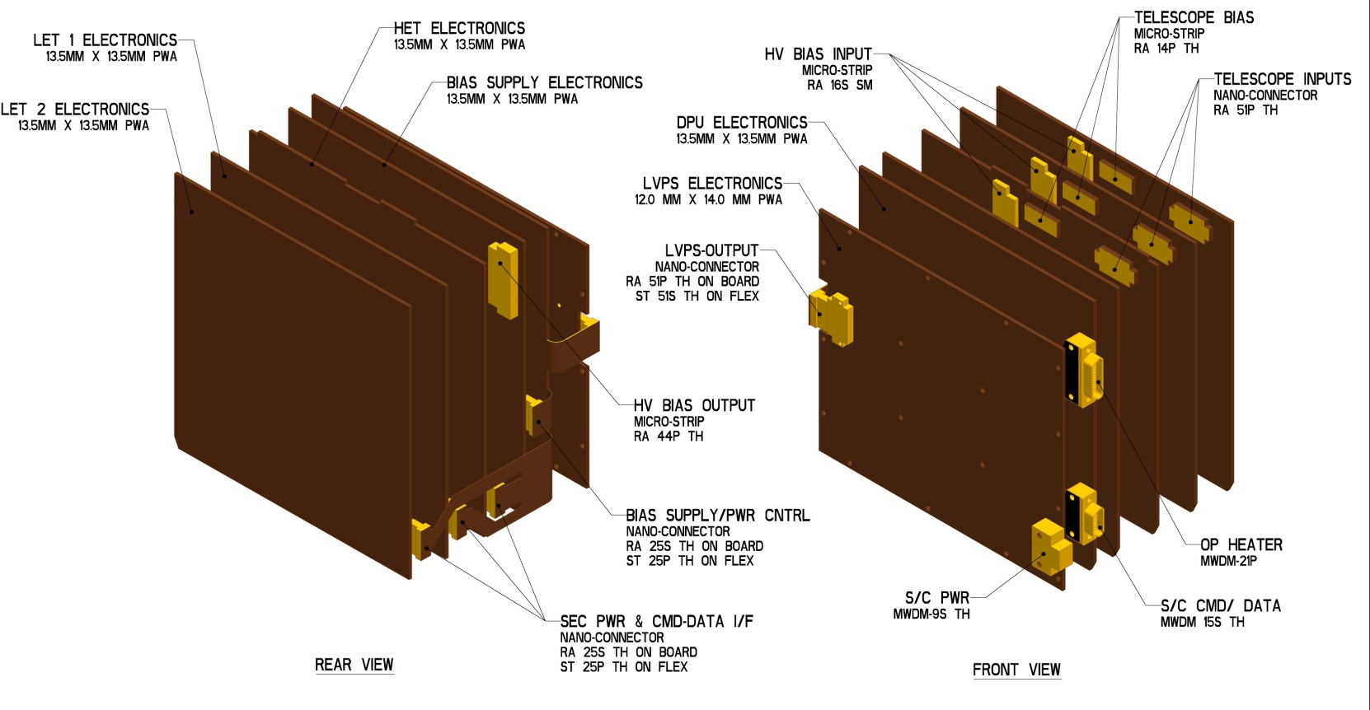
EPI-HI Interconnect

Slide 11
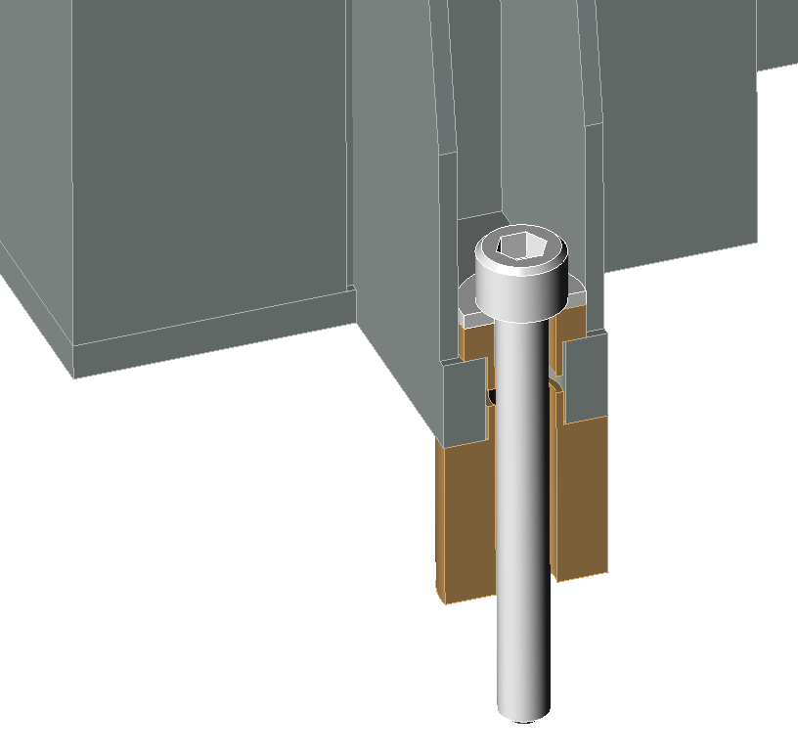
EPI-HI Thermal Isolation
Typical Mounting Foot Showing Thermal Isolation
Mounting Bolt
Washer
Ultem Isolation Bushings

Slide 12
Mount Design Requirements
Detector Mounts
Able to transmit signals from silicon detectors, via wirebond connections to output connector
Allows the stacking of detectors maintaining 0,5mm spacing surface to surface between thickest detectors (1,0mm)
Allows any detector to be stacked face up or face down with any other detector
Allows for the protection of wire bonds from being crushed on either side when placed on flat surface during storage and/or test
Provides electrical breakdown protection to next detector, when stacked, of up to 200V differential between crown of HV wirebonds to conductive surface of opposing detector

Slide 13
EPI-HI Detector Mount
Recessed detector shelf for silicon detector installation.
Micro-strip connector output
Flex stiffener to rigidize the area where connector is mounted.
Alignment achieved with alignment pins and concentric stacking shelves on mount and connector.
Tolerancing for mounts will be tightly constrained, but within current CNC machining capabilities.
Detector alignment will be verified through measurement and testing on assembled flight detectors.

Slide 14
EPI-HI Detector Mount
Mount design allows stacking of detectors face to face, face to back and back to back while maintaining same spacing.
Mounts are spaced 1,5mm apart when stacked allowing for 0,5mm separation between thickest detectors.
Detector Voltage ranges from ~2V up to ~200V
Mounts provide adequate spacing/protection for wirebond clearance.

Slide 15
EPI-HI Telescope Design
3 Telescope comprised of silicon wafer detectors.
Telescope body provides ~6,0mm of aluminum shielding to block unwanted particles from entering through the housing body.
Foils will have TBD coating to achieve proper thermal characteristics.
Telescopes are mounted directly to the top of the enclosure allowing the flex interconnect cable to be routed internally to provide proper RF shielding.
Telescopes will all have red-tag covers over aperture openings.

Slide 16
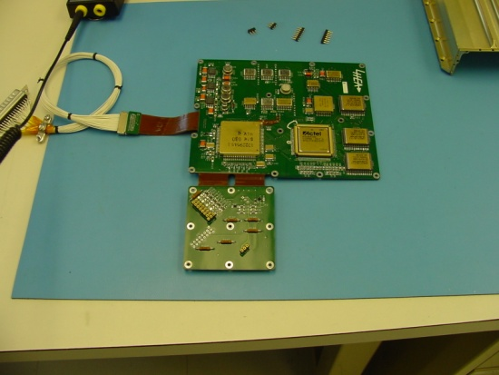
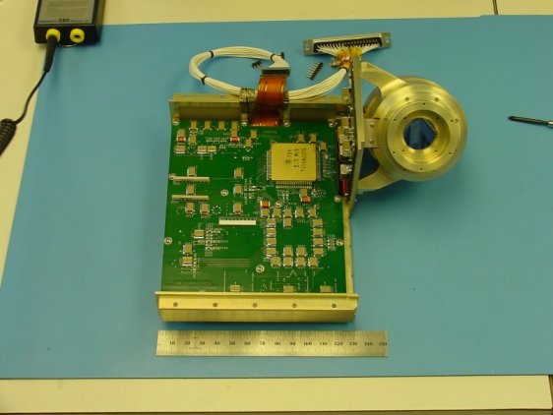
EPI-HI Telescope Design
Heritage design
Uses alignment pins to stack detectors in telescope body.
Mounting bracket designed into telescope body.
Output signal cable will be completely enclosed in assembly providing proper shielding.
Pictures shown are of STEREO\HET Telescope

Slide 17
EPI-HI HET Telescope
2- ~130um (5 mil) Foils for micro-meteorite /light protection on each end.
Comprised of 16 silicon wafer detectors mounted in flex-rigid mounts.
The front two detectors at each end are spaced apart in order to set a 90 degree FOV angle.

Slide 18
EPI-HI LET Telescopes
LET1 Telescope
3 Foils for micro-meteorite/light protection on each end.
Outer foil to be 2um polyimide.
Inner 2 foils to be 1um polyimide.
Comprised of 10 silicon wafer detectors mounted in flex-rigid mounts.
The front 3 detectors at each end are spaced apart in order to set a 90 degree FOV angle.
LET2 Telescope
Comprised of one half of a LET1 Telescope.
3 Foils for micro-meteorite/light protection
Outer foil to be 4um polyimide.
Inner 2 foils to be 2um polyimide.
LET1 Telescope shown

Slide 19
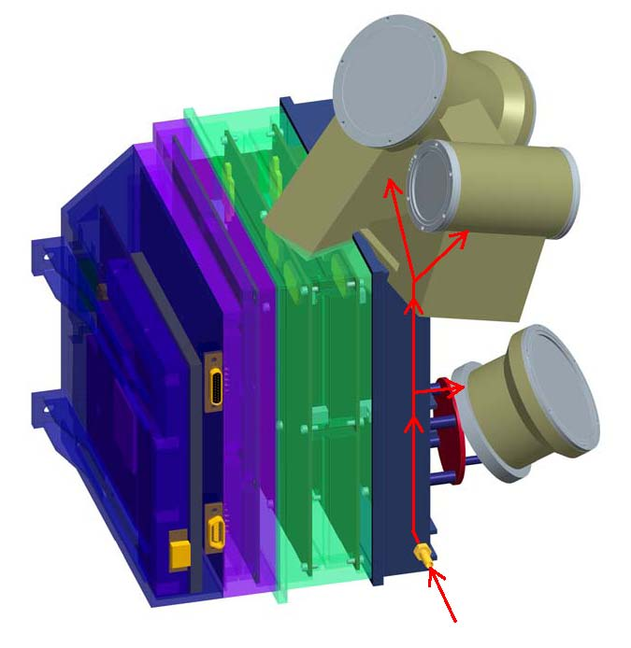
EPI-HI Telescope Purge
Purge will be established to the individual telescopes with a single purge fitting on the outside of the instrument.
Purge will be distributed internally through a manifold that will send the purge gas into the center volume of each telescope.

Slide 20
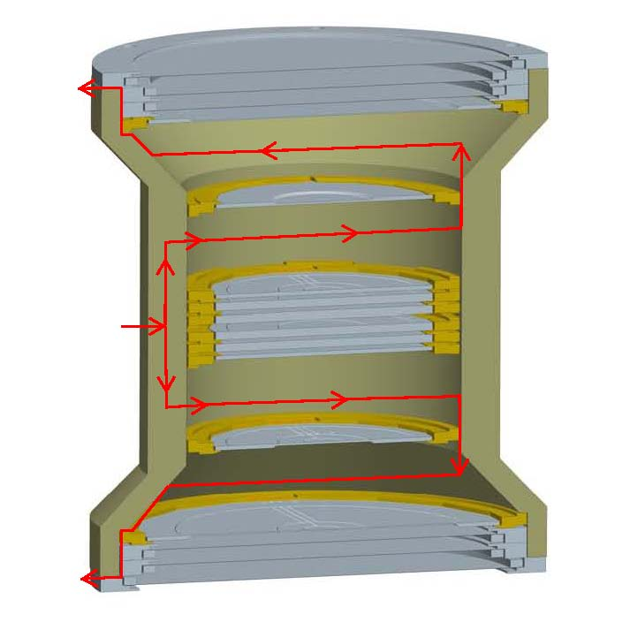
EPI-HI Telescope Venting
Heritage venting strategy that was used on several prior missions
Purge gas enters thru housing into open center volumes
Gas then flows outwards thru vent slots in housing shelves, detector mounts and foil rings
Gas exits each end of the telescope thru vent slots below outer foil
PURGE GAS

