Slide 1
EPI-Lo Sensor
Don Mitchell, Matt Hill, Ralph McNutt
DRAFT 2013-10-14 5:53 PM
Notes:
introduction

Slide 2
Outline EPI-Lo Sensor Design
ISIS Science Requirements Relevant for EPI-Lo
EPI-Lo Instrument
Block Diagram(s)
Principles of Operation Overview
Sensor Voltages
Electrostatic Optics
Collimators and Start Foils
Solid State Detectors & Stop Foils
  Anti-coincidence System
  GEANT
Microchannel Plate (MCP)
Mass Resolution
Light & Dust Mitigation
Follow-up from peer reviews
Summary
THIS IS NOT UP TO DATE...IGNORE THIS PAGE.

Slide 3
The EPI-Lo Instrument Requirements
Parameter | Required | Goal (Capability) | Comment/Heritage
Electron Energies | 50 - 500keV | 25 - 1000 keV | Electron capability from JEDI, RBSPICE
Ion Energies | 50 keV/nucleon – 15000 keV Total E | 50 keV/nucleon – 15000 keV Total E | Capability partially based on RBSPICE capabilities. Top energy ~250keV/nuc for Fe
Energy Resolution | 45% for required energy range | 40% for required energy range | Telemetry limited
Time sampling | 5 sec | 1 sec | Telemetry and/or statistics limited
Angle resolution | <30° x <30° | Ions, ~15 x 12 to <30° x <30° e-, 45° | Varies with elevation
Pitch Angle (PA) Coverage | 0°-90° or 90°-180°, some samples in both hemispheres | 0°-90° or 90°-180°, some samples in both hemispheres
Time for Full PA | 1 – 5 sec | 1 – 5 sec | Telemetry limited
Ion Composition | H, He3, He4, C, O, Ne, Mg, Si, Fe | H, He3, He4, C, O, Ne, Mg, Si, Fe | He3/He4 ~50 to 1000 keV/nuc
Electron Sensitivity: j=Intensity | j = 1E1-1E6/cm²-s-sr | Sensor-G:0.144 (cm².sr) Pixel-G: ~0.02 (cm².sr) Up to 6E6 1/s counting | j=Intensity (1/cm²-s-sr) G=Geom. Factor (cm²-sr) 8 pixels/sensor
Ion Sensitivity | j = 1E1-1E6/cm²-s-sr | Sensor-G:0.16 (cm².sr) Pixel-G: ~0.002 (cm².sr) Up to 3.5E6/s rate (TOFxE) | 80 pixels/sensor

Slide 4
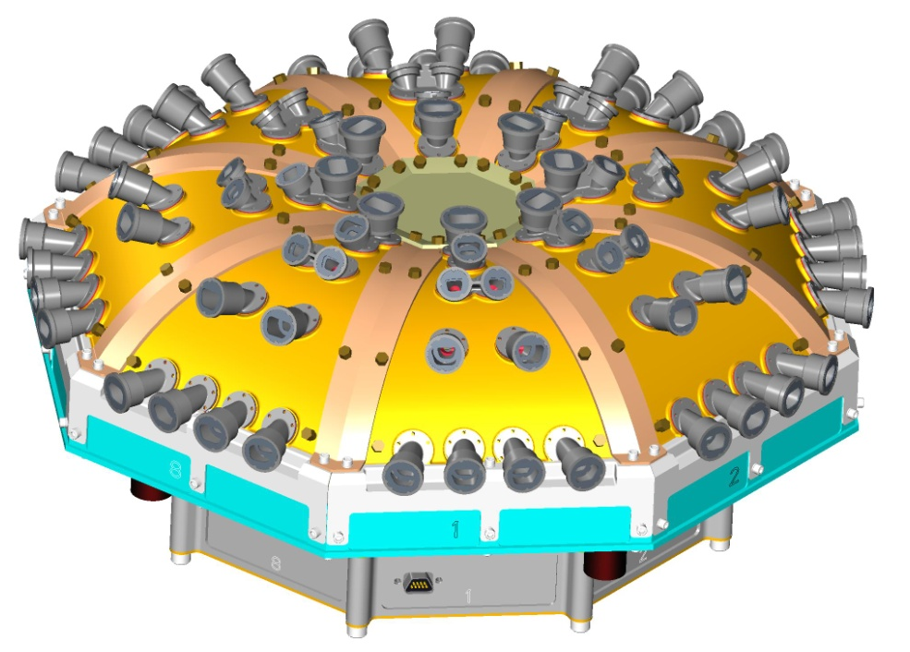
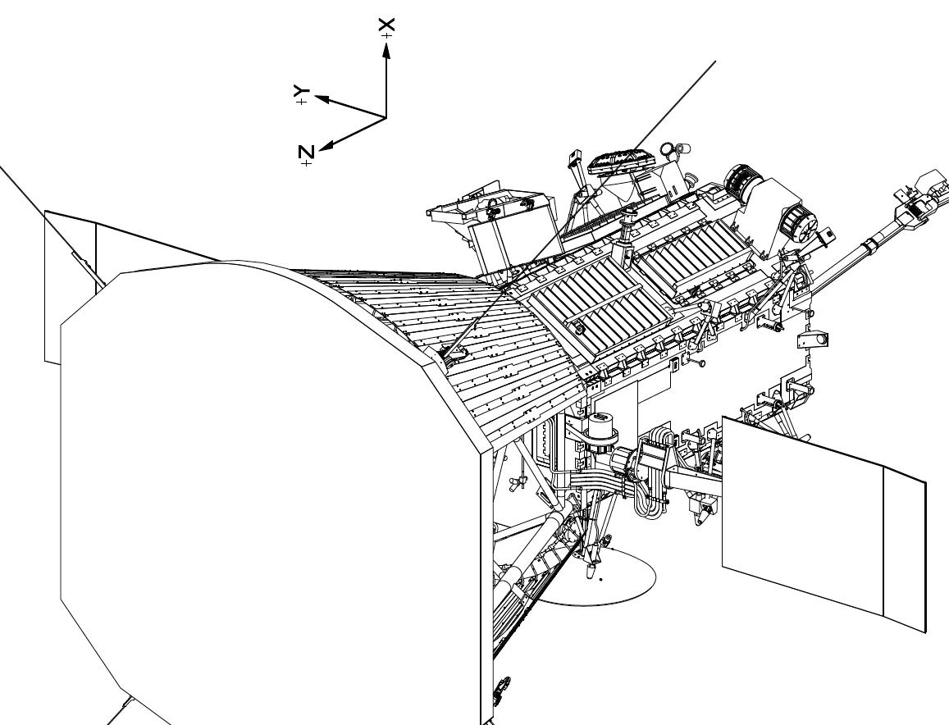
The EPI-Lo Instrument

Slide 5
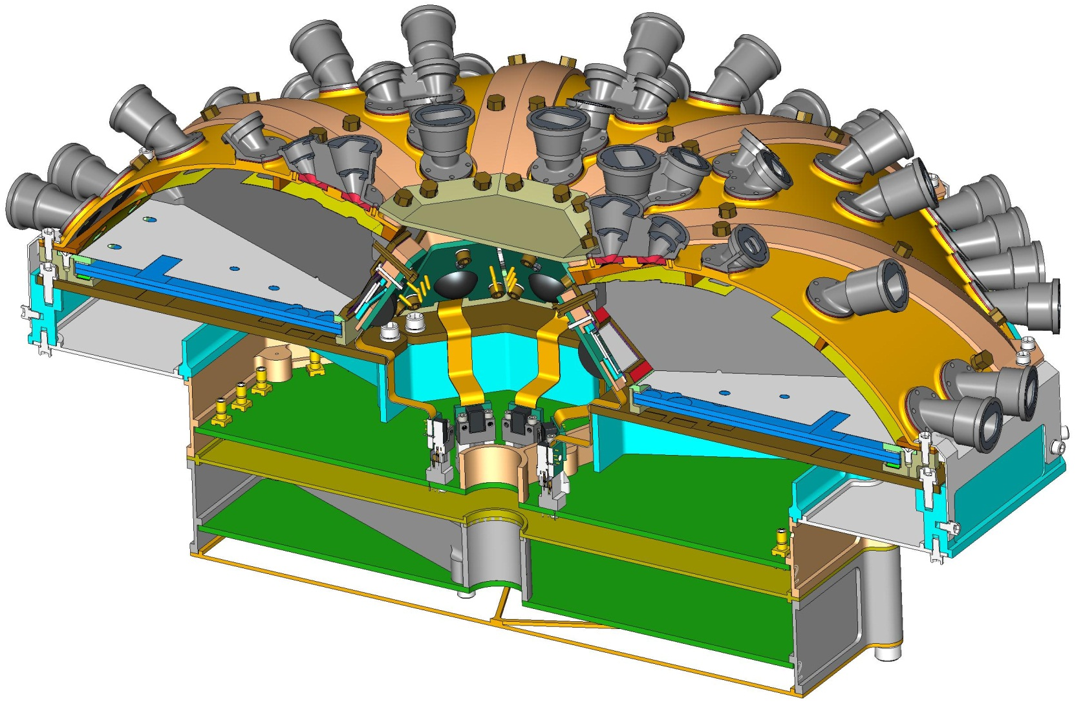
EPI-Lo Instrument, cut-away
ANODE PWB ASSY
EVENT PWB ASSY
POWER SUPPLY ASSY
EPI-LO CROSS-SECTION VIEW ISOMETRIC

Slide 6
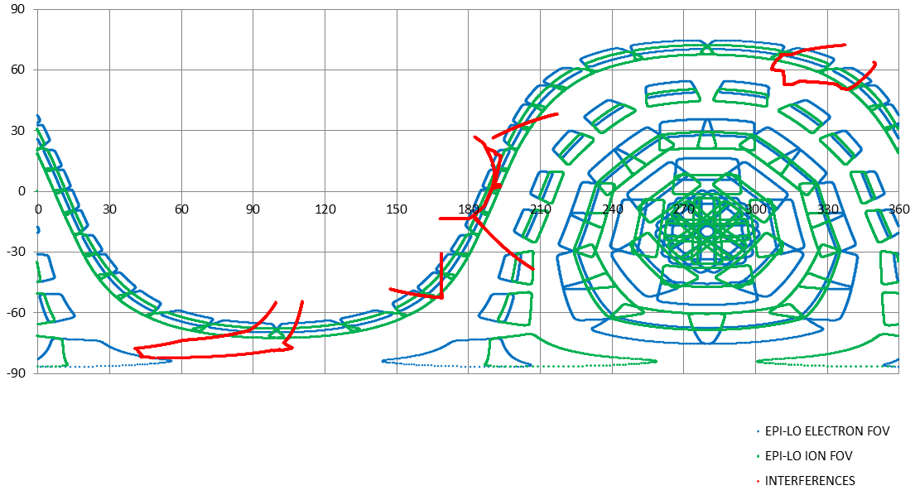
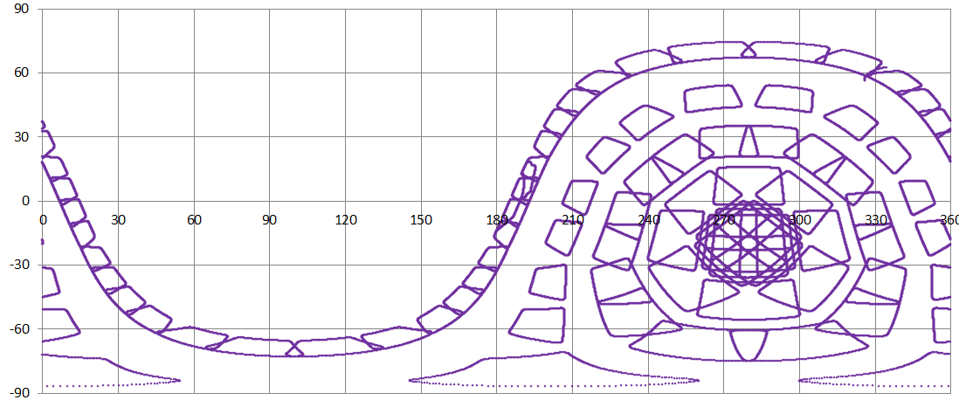
The EPI-Lo Field of View
SUN
RAM

Slide 7
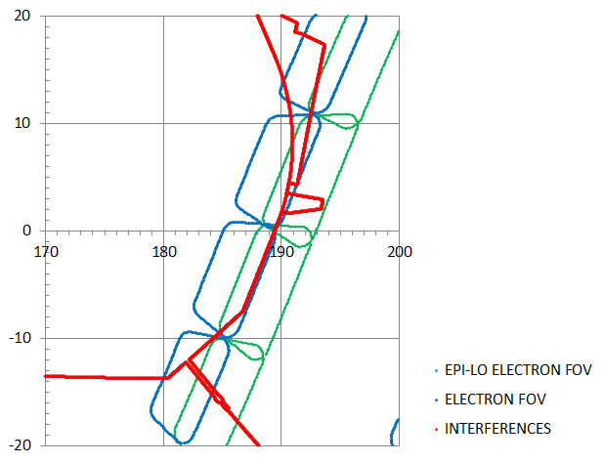
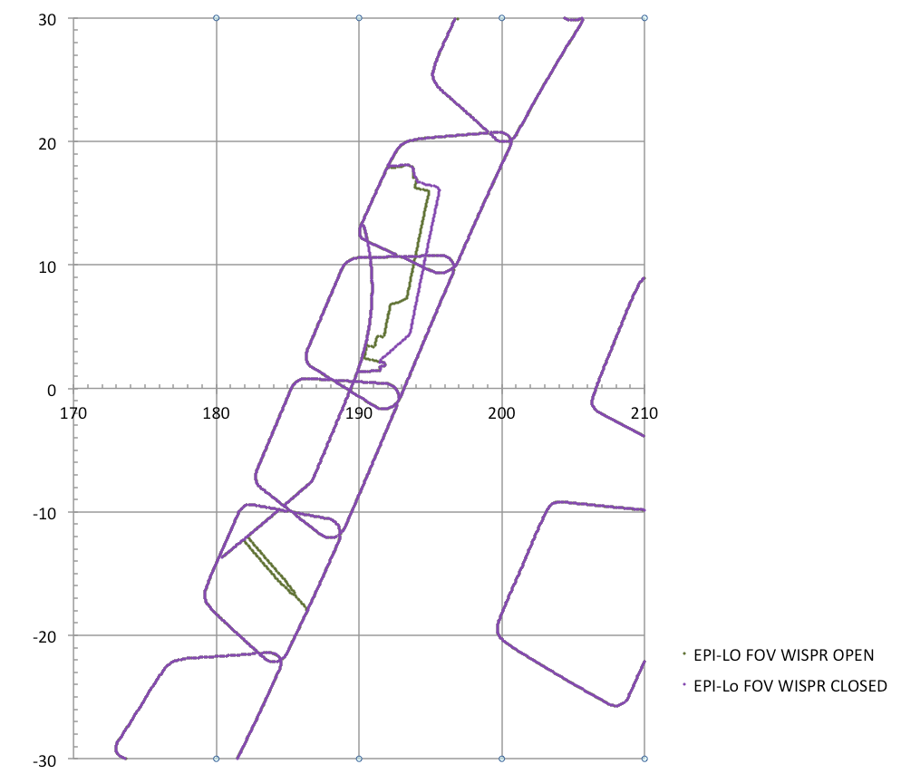
The EPI-Lo Field of View
These trapezoids, with the rounded corners, represent EPI-Lo unobstructed FOV’s
This line(s) represent the obstruction caused by WISPR: Red was March 2013 and 2011-ish envelope and yellow is the Sept 2013 one. Outer purple is the closed door (Sept 2013).
This line(s) represents the obstruction caused by the TPS
Don’t think this red obstruction was in 2011 model. Part of WISPR?
SUN
At 0 degrees elevation, the viewing angle is 9.4 degrees off from looking straight at the sun
ion
electron

Slide 8
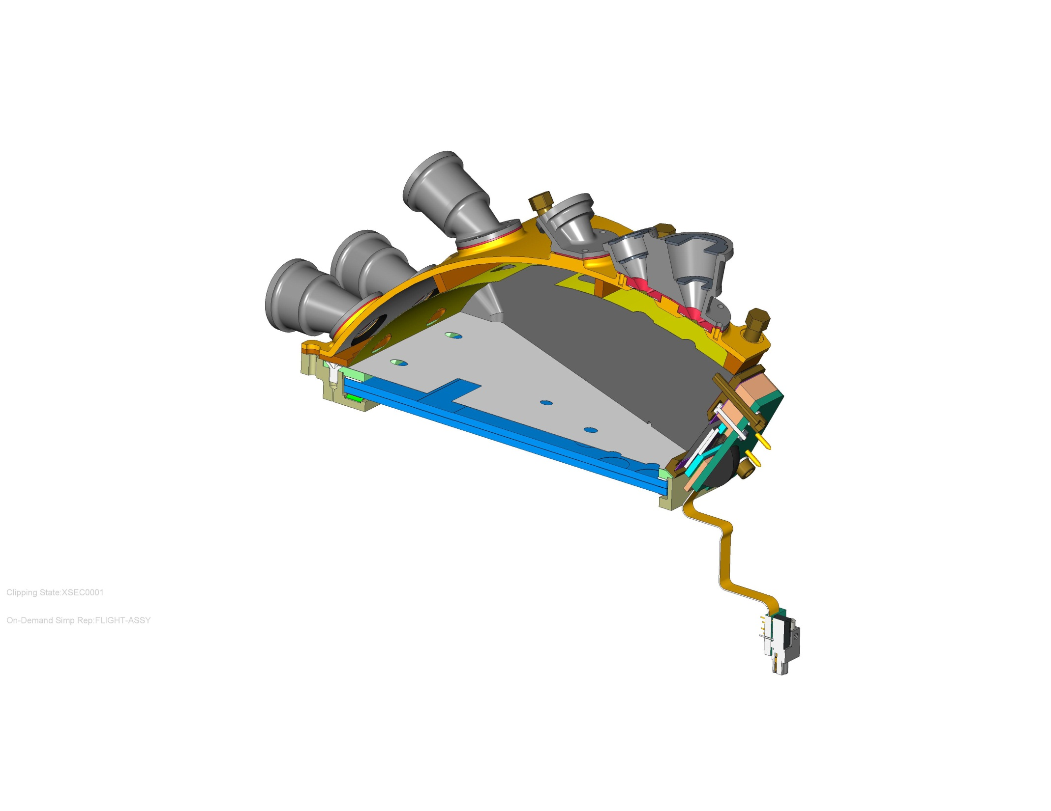
EPI-Lo Wedge Components
SENSOR WEDGE COVER, GROUND
APERTURE START FOIL GRID, GROUND
COLLIMATORS, AT GROUND
ACCELERATION SURFACE, +1kV
INSULATOR, SENSOR WEDGE COVER
ULTEM 1000
MCP COMPRESSION PLATE, 1kV
SCREWS, TORLON
MCP GRID, 1kV
BOTTOM MCP 2.9kV
TOP MCP, 900V
(TOP OF ANODE PWB NOT SHOWN, 3KV)
EPI-LO INDIVIDUAL SENSOR WEDGE ASSY CROSS SECTION

Slide 9
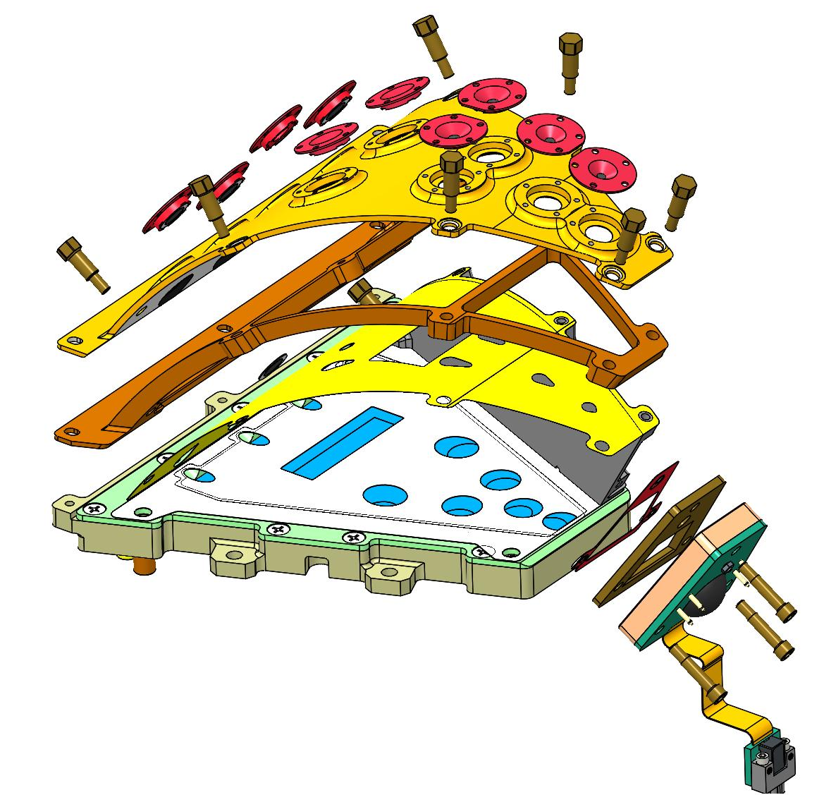
EPI-Lo Wedge, Exploded View
APERTURE START FOILS, GROUND
WEDGE COVER, GROUND
WEDGE COVER INSULATOR, ULTEM 2300
WEDGE GRID, 1KV
SIDE WALL REMOVED FOR CLARITY
EPI-LO INDIVIDUAL SENSOR WEDGE ASSY CROSS SECTION

Slide 10
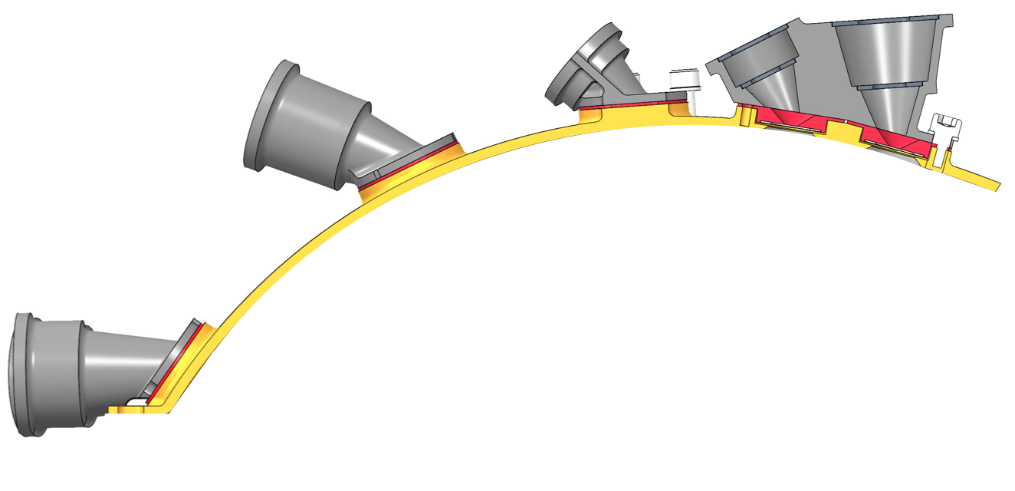
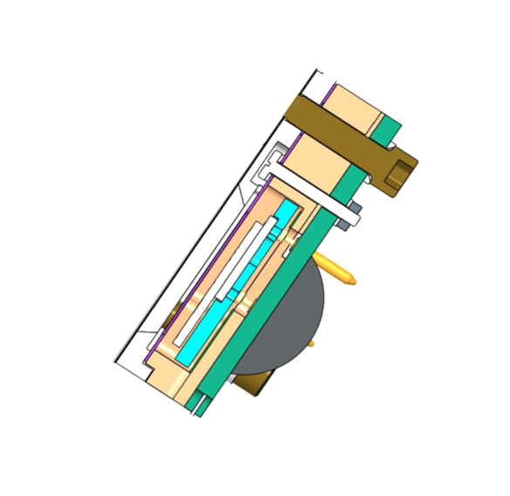
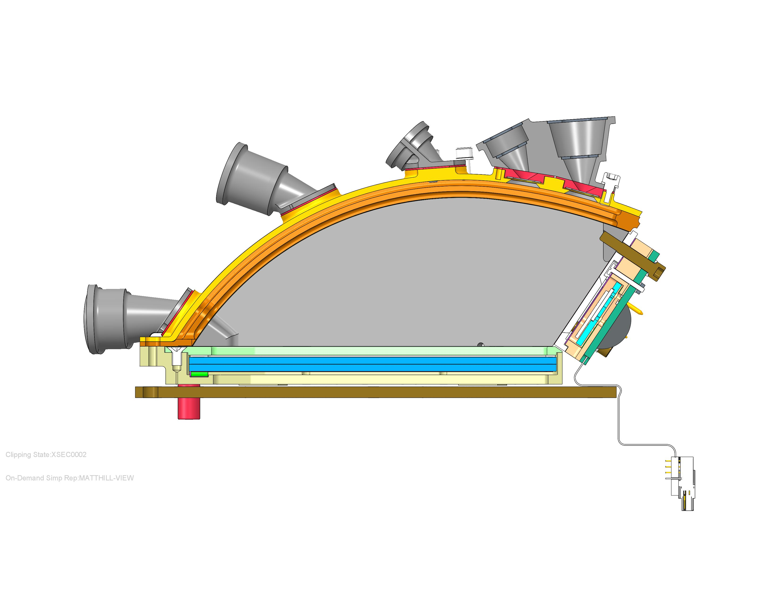
Sensor Functional Schematic
Start Acceleration
Grid
Baffles
Collimators
First
  xxxxx
  xxxxxx
Second
Third
  xxxxxx
  xxxx
Forth
  xxxxxxx
  xxxxxx
Start Foils
Stop Accel. Grid
MCP Grid
Stop Foil
Start Foils
Microchannel
Plate (MCP)
Solid State
Detectors (SSDs)
Anode
MCP Spacer

Slide 11
Sensor Voltages
start e⁻
acceleration
region
stop e⁻
accel.
region
Ground
All Foils
at Ground
100 V retarding
potential region
Equipotential
Volume
MCP
900 V
2900 V
Ground
SSDs
Anode
1000 V
3000 V

Slide 12
Secondary Electrons & Potentials
start e⁻
acceleration
region
stop e⁻
accel.
region
Grid
Equipotential
Volume
Grid
Grid
MCP
100 V retarding
potential region
2000 V
Across Plates
100 V
MCP-to-Anode
SSDs
Anode

Slide 13
Ions (Energy, TOF, and Position)
Incident Ion
Start
Secondary
Electrons
Stop
MCP
SSDs
Anode

Slide 14
Electrons: Energy (& Position)
Incident Electron
Secondary
Electrons
(infrequent)
MCP
Anode
SSDs

Slide 15
Energetic Electron Measurement
?
?
?
?
?
Secondary Electrons from Start Foils possible, but Low Probability;
Start Electron present identifies entrance aperture

Slide 16
Energetic Ion Measurement
Ion Measurement Logic can require TOF or not, but with not TOF, no species

Slide 17
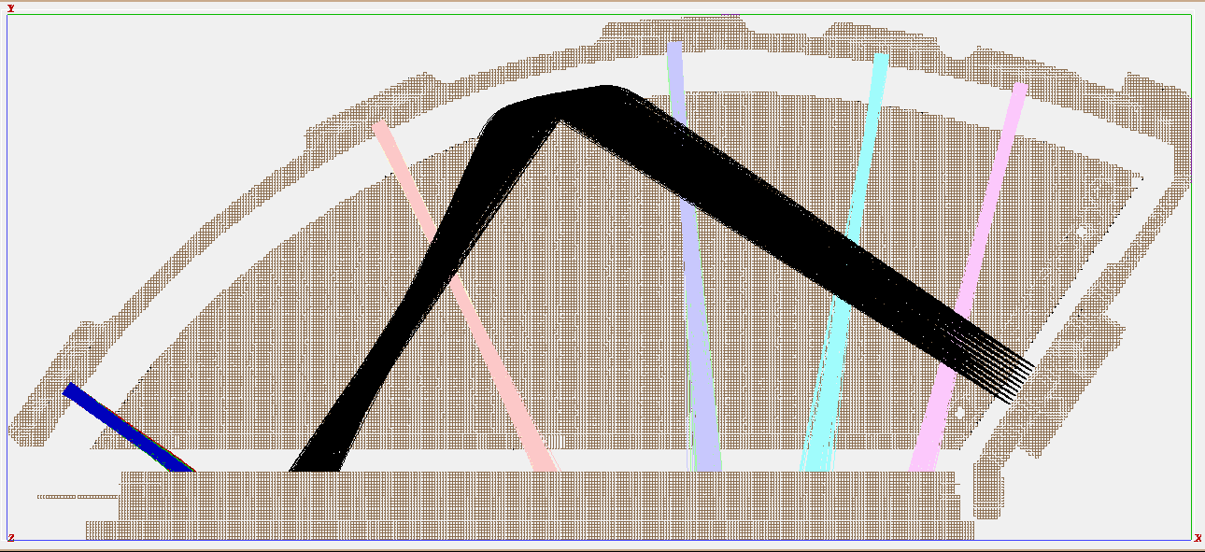
Electrostatic Optics
SIMION simulation of electron optics using ~3eV random initial electron velocities.

Slide 18
Sensor Voltages
start e⁻
acceleration
region
stop e⁻
accel.
region
Ground
All Foils
at Ground
100 V retarding
potential region
Equipotential
Volume
MCP
900 V
2900 V
Ground
SSDs
Anode
1000 V
3000 V

Slide 19
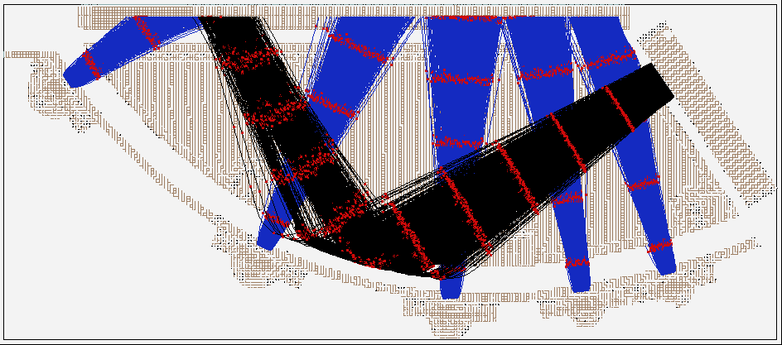
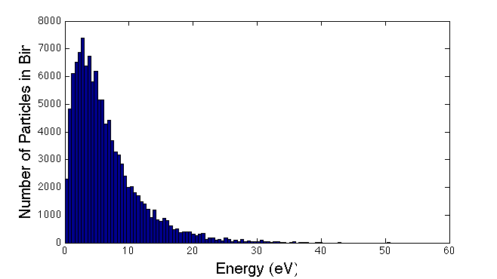
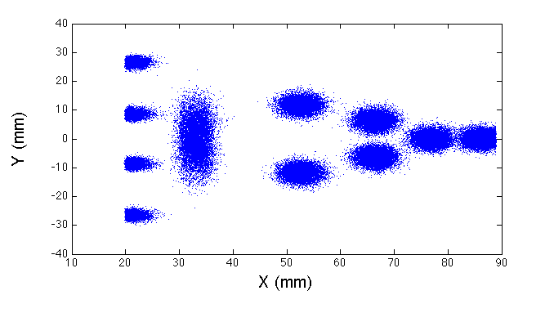
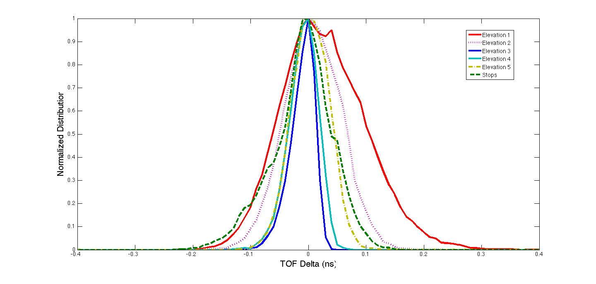
SIMION, Alegrini Energy Distribution
Sample Trajectories
Initial Energy Distribution
Hit Locations
Electron Dispersion
Elevation 3
Elevation 5
Name | Mean TOF (ns) | TOF Sigma (ns)
Elevation 1 | 1.06 | 0.19
Elevation 2 | 2.17 | 0.13
Elevation 3 | 2.35 | 0.05
Elevation 4 | 2.33 | 0.06
Elevation 5 | 2.32 | 0.12
Stops | 5.23 | 0.11
Elevation 4
Elevation 2
Elevation 1
19

Slide 20
EPI-Lo Wedge, Exploded View
APERTURE START FOILS, GROUND
WEDGE COVER, GROUND
WEDGE COVER INSULATOR, ULTEM 2300
WEDGE GRID, 1KV
SIDE WALL REMOVED FOR CLARITY
EPI-LO INDIVIDUAL SENSOR WEDGE ASSY CROSS SECTION

Slide 21
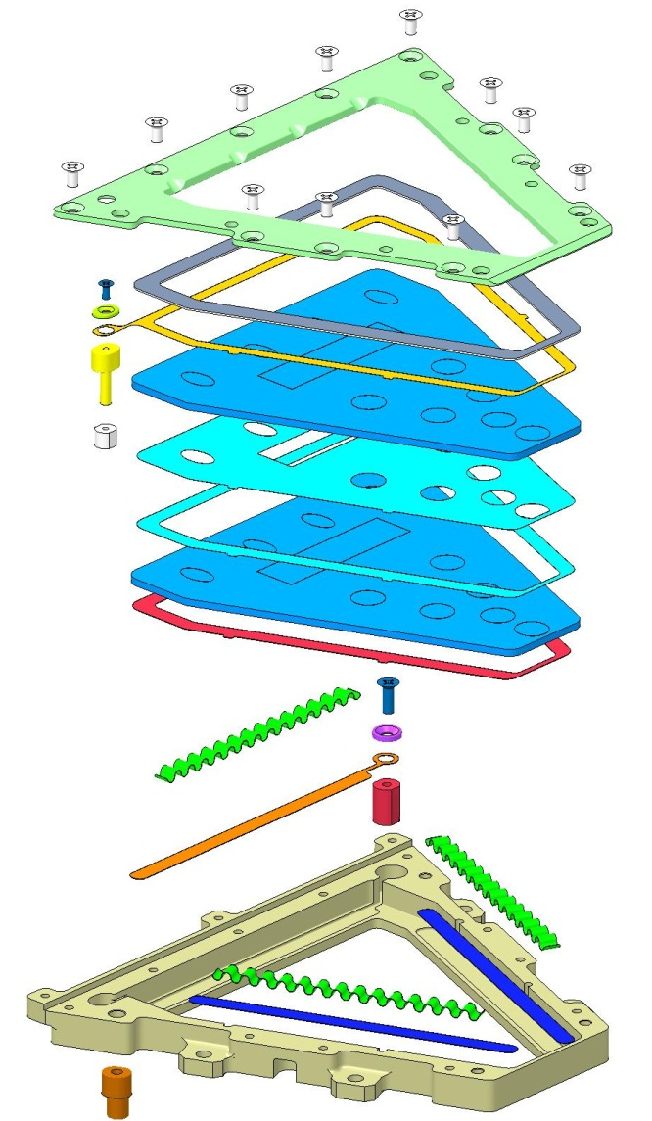
MCP Inter-Plate Spacer also a mask
COMPRESSION PLATE
SCREW
GUARD WASHER
INSULATED SHIM, ULTEM 1000
900 V LUG ASSY
900V ELECTRODE
NUT
MCP
SPACER .002
ALTERNATE SPACER
SLIDE-SPACER-ELECTRODE
MCP
LINEAR EXPANDERS, 3 PLACES
SCREW
WASHER
2.9KV ELECTRODE
2.9KV LUG ASSY
SLIDES FOR EXPANDERS, 2 PLACES
1KV LUG ASSY
EXPLODED VIEW “NEW” MCP ASSEMBLY

Slide 22
SIMION, Alegrini Energy Distribution
Sample Trajectories
Initial Energy Distribution
Hit Locations
Electron Dispersion
Elevation 3
Elevation 5
Name | Mean TOF (ns) | TOF Sigma (ns)
Elevation 1 | 1.06 | 0.19
Elevation 2 | 2.17 | 0.13
Elevation 3 | 2.35 | 0.05
Elevation 4 | 2.33 | 0.06
Elevation 5 | 2.32 | 0.12
Stops | 5.23 | 0.11
Elevation 4
Elevation 2
Elevation 1
22

Slide 23
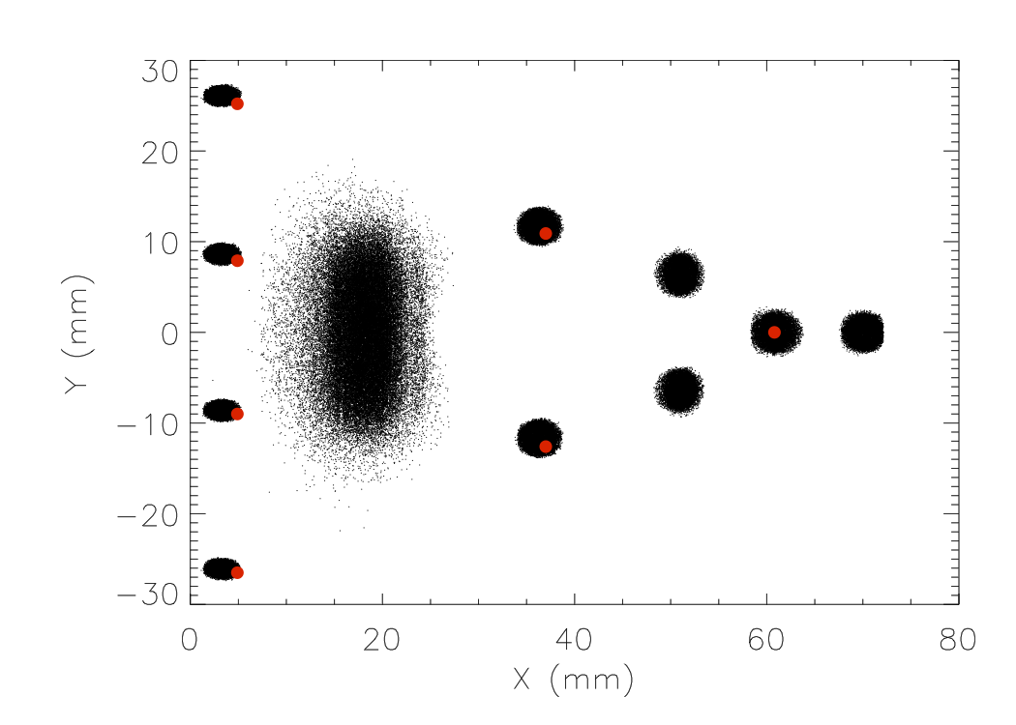
Microchannel Plate (MCP)

Slide 24
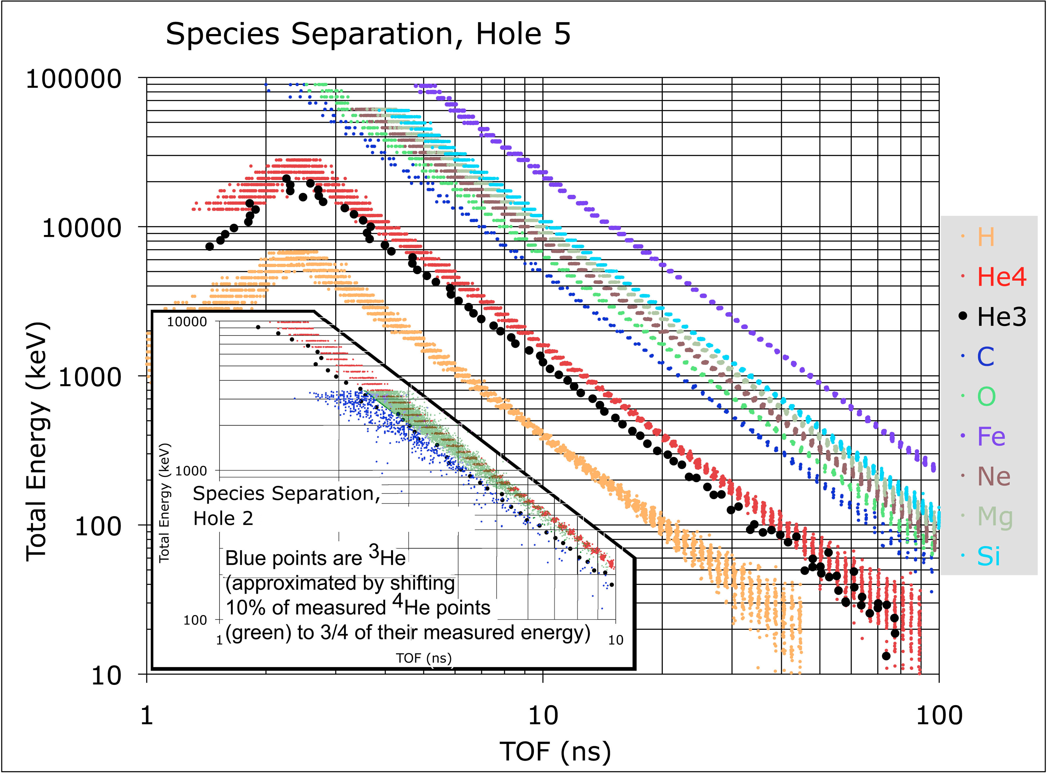
Mass Resolution

Slide 25
Mass Resolution

Slide 26
Collimators and Start Foils
Foils Mount on Apertures (red)
  Each elevation tailored for equal GF
  Second foil planned at intermediate baffle
Collimators screw-mount to outer cover, capture foils
  Each Elevation and azimuth is unique

Slide 27
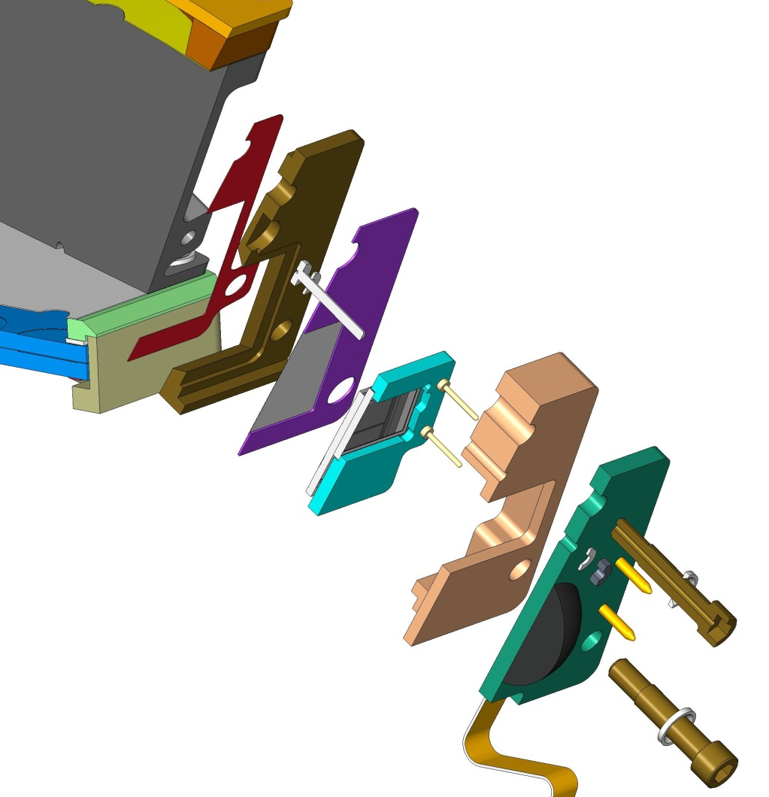
EPI-Lo SSD Assemblies (8)
SSD WEDGE GRID, 1KV
SSD STOP GRID-FOIL, GROUND
SENSOR WEDGE 1KV
GROUNDING SCREW
SSD ASSY HOUSING, ULTEM 1000
ENERGY PWB ASSY
SSD INSULATOR, ULTEM 1000
SSD ASSY
SCREWS, TORLON
SSD ASSY TO WEDGE EXPLODED CROSS SECTION

Slide 28
Anti-coincidence System
Electron SSD is backed by an anti-coincidence SSD

Slide 29
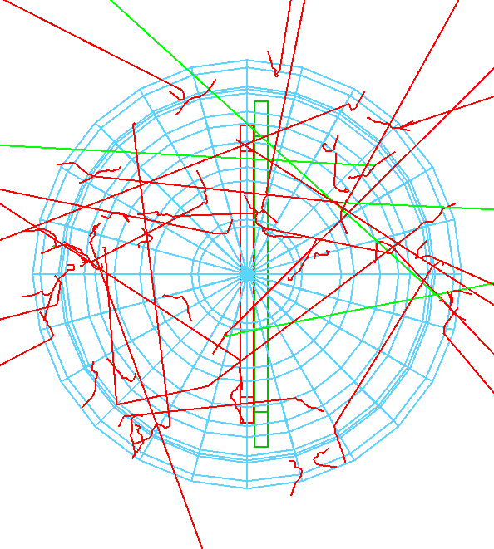
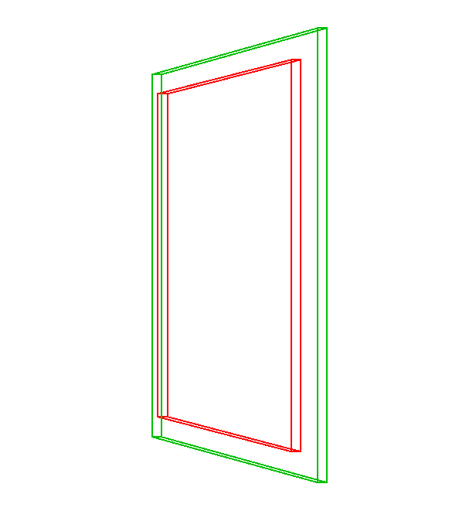
Anti-coincidence System: GEANT
Setup for GEANT4 model of electron SSD anticoincidence

Slide 30
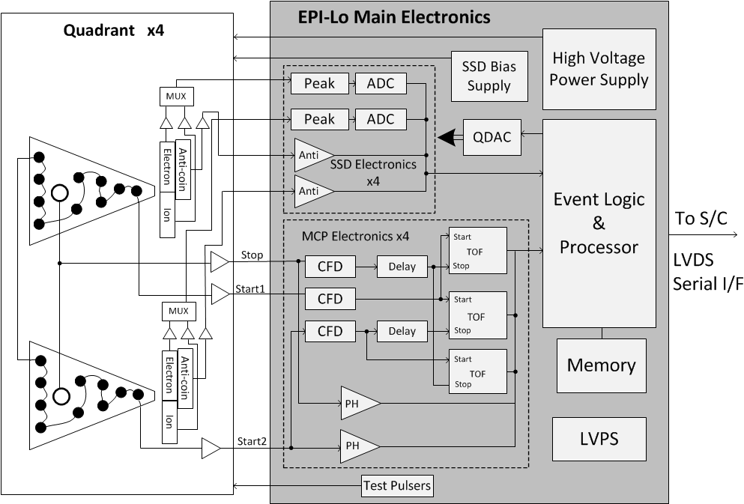
EPI-Lo Block Diagram

Slide 31
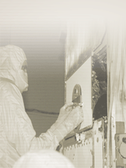
Sensor Voltages
Collimators
Grounded Foils
Tecan Grid
1000V
SSD
100V
+ 900V
MCP
MCP
+2900V
100
900V (total diode drop)
+3000V
Anode/Preamp
MCP Return is a ground reference at HVPS (allows MCP current measurement across resistor)
MCP return
Voltage Control Cartoon
HVPS Out +3000V

Slide 32
EPI-Lo Block Diagram

Slide 33
Light & Dust Mitigation
TBD

Slide 34
Dust: Simulating the Environment
elevation angle
90 deg
Impacts within the back foil angle will pass through the collimator opening and front foil and hit the back foil
Impacts within the front foil angle will pass through the collimator opening and hit the front foil
67.5 deg
45 deg
22.5 deg
0 deg
align with plane of instrument
Collimator
opening
+Z
+x-ish
+Z-ish
0 deg
315 deg
45 deg
Impacts in the hemisphere will hit the “virtual surfaces” (ignores the collimator)
azimuthal angle
Front foil
270 deg
90 deg
Virtual surface
Back foil
225 deg
135 deg
NOTE: actually only polar angle is limited, not position on surface, so foil area was adjusted to account for this and produce actual foil geometry factors,
180 deg

Slide 35
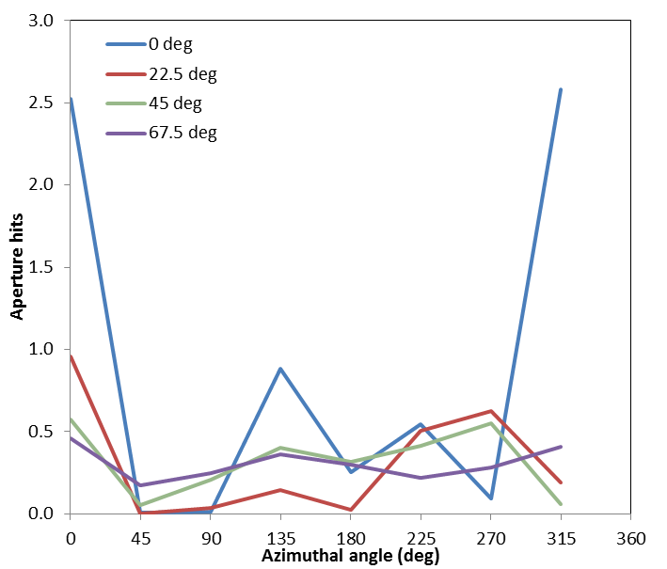
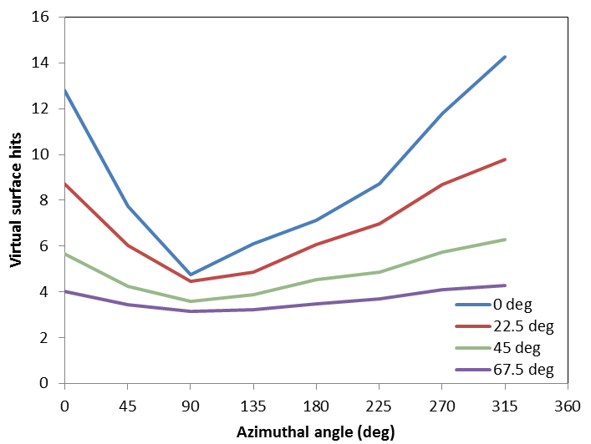
Dust: Simulating the Environment
Each unprotected foil would expect ~10 damage-inducing hits per mission. Reduced to ~1 hit per mission with collimator. Order of magnitude decrease.

Slide 36
Dust: Lab tests
TBD

Slide 37
SLIDE PREPARATION NOTES
Are we handling dust in this presentations? Assuming yes.
Should we discuss photons suppression here? Assuming yes, it’s background.
How about details like how the MCPs work (in general)? Or this could be handled when someone discusses the anode boards. Special features like the inter-plate mask (or is that handled in a mechanical section)?
Backup slides: MCPs
We are only supposed to respond to requirements, so I wasn’t going to go into any of the rate estimates from the work that I (Matt) and Rob D. did since that is for goals. Is this the right approach?

Slide 38
Follow Up from Peer Reviews
TBD

Slide 39
Summary
TBD

Slide 40
Backup

Slide 41
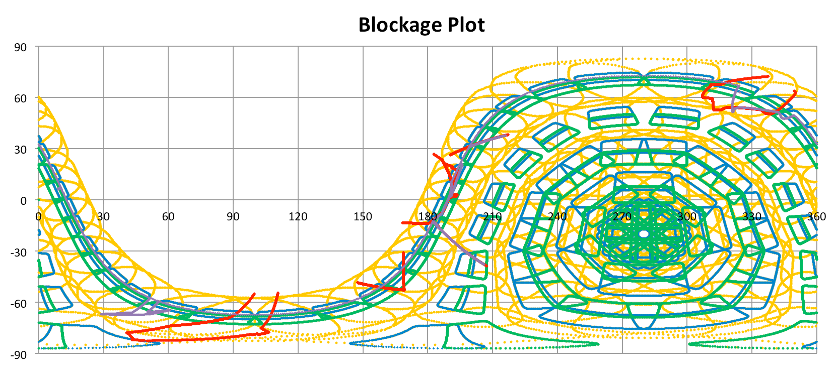
Collimator Foil FOV
Foil FOVs shown in yellow (these are not with the latest collimators).

Slide 42
EPI-Lo Instrument
Peer Review
APERTURE START FOILS, GROUND
WEDGE COVER, GROUND
WEDGE COVER INSULATOR, ULTEM 2300
WEDGE GRID, 1KV
SIDE WALL REMOVED FOR CLARITY
EPI-LO INDIVIDUAL SENSOR WEDGE ASSY CROSS SECTION

Slide 43
EPI-Lo Instrument
Peer Review
COMPRESSION PLATE
SCREW
GUARD WASHER
INSULATED SHIM, ULTEM 1000
900 V LUG ASSY
900V ELECTRODE
NUT
MCP
SPACER .002
ALTERNATE SPACER
SLIDE-SPACER-ELECTRODE
MCP
LINEAR EXPANDERS, 3 PLACES
SCREW
WASHER
2.9KV ELECTRODE
2.9KV LUG ASSY
SLIDES FOR EXPANDERS, 2 PLACES
1KV LUG ASSY
EXPLODED VIEW “NEW” MCP ASSEMBLY

Slide 44
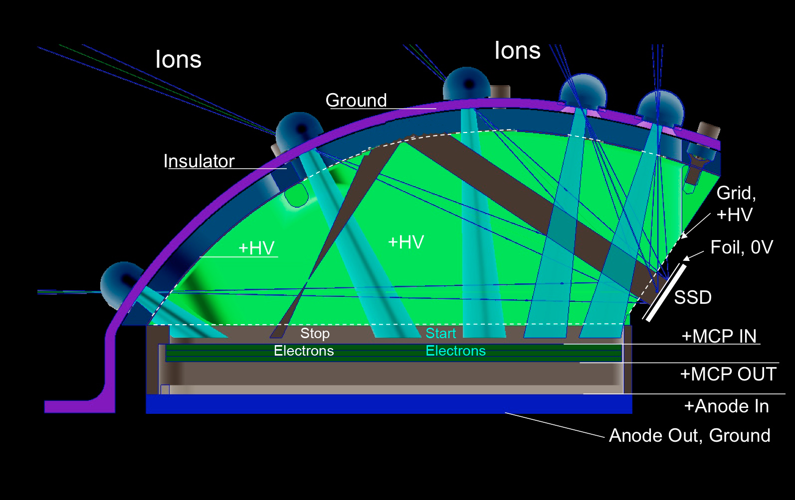
Principles of Operation

