Slide 1
EMI / EMC
Reid Gurnee
Notes:
introduction

Slide 2
EMC Design Considerations
Power supplies crystal controlled to a frequency window centered at n*50 kHz with n>=3 and 500 ppm wide over all operating conditions and time.
The LVPS is synchronized to 200kHz provided by the digital boards.
EPI-Hi has 60MHz oscillator and EPI-Lo has 40MHz oscillator. Both evenly divide to 200kHz. (crystal specifications?)
Transformers and big inductors are placed as far from Box walls as possible.
Show this / mention it in power supply slides
Stable currents to minimize changes in Magnetic Emissions
Control all current paths inside your box to minimize loop area. Cannot use a solid return plane if a trace is the source. Any circuit over 100 milliamps AC or 1 amp DC will be analyzed
All Cables outside the metal box must be twisted shielded with 360deg shields terminated to the Box with less than 20 mOhms.
EPI-Lo has no external cables. EPI-Hi ???
I will add to these slides to show how we plan to meet these

Slide 3
EMC Design Considerations
EMI Backshells not required by EME but shield must cover connector fully
I thought we had EMI backshells on all S/C connections???
Connector shell to Box resistance before mated < 5 mOhms
Any cable outside the spacecraft body attached to a device must have either 13 mils shielding or DDD first circuit protection
EPI-Lo has no external cables. EPI-Hi ??? Are S/C cables going to be shielded, or do we depend on LVDS chips to make this ok?
All use of Magnetic Materials (Nickel, 400 Series CRSS, etc) must be identified and approved by the project. High Phosphor Nickel coating is allowed because it is not magnetic.
EPI-Lo has Nickel grids. Working with project to develop magnetic mitigation plan. EPI-Hi?

Slide 4
EMC Grounding
Primary power supplies isolated by >1 MΩ
Secondary power supply returns tied to chassis with <2.5 mΩ in only the Box using the power.
Grounding Diagrams will show all chassis grounds, primary and secondary power feeds and returns, shields, and signals with returns
ID all connector pins with first circuits
Connectors unused in flight shall have a conductive cover with less that 10 mΩ from cover to Box chassis
“Conductive” Box exterior
Exterior will be MLI, and XXX white conductive paint, talk to shawn about other surfaces like kapton tape
Box design must be at least tongue and groove. EMI gaskets on flat joints is acceptable.
Talk to Carl, he said this was not needed. Use copper tape? EPI-Hi???

Slide 5
EMC Testing
Early Testing (Breadboard, Card level, Engineering Model (EM)) can identify a problem when it can still be fixed without major schedule slip.
Doing conducted emissions (CE) can find most issues.
Initial CE test on LVPS will occur in Q1 2013. EPI-Hi and EPI-Lo will test EM units for CE in Q3 2013.
Required Tests: Bonding & Isolation
Conducted Emissions: CE-01, CE-02, CE-07
Conducted Susceptibility: CS-01, CS-02, CS-06
Radiated Emissions: RE-01, RE-02, Mag Sniff
Radiated Susceptibility: RS-03, ESD

Slide 6
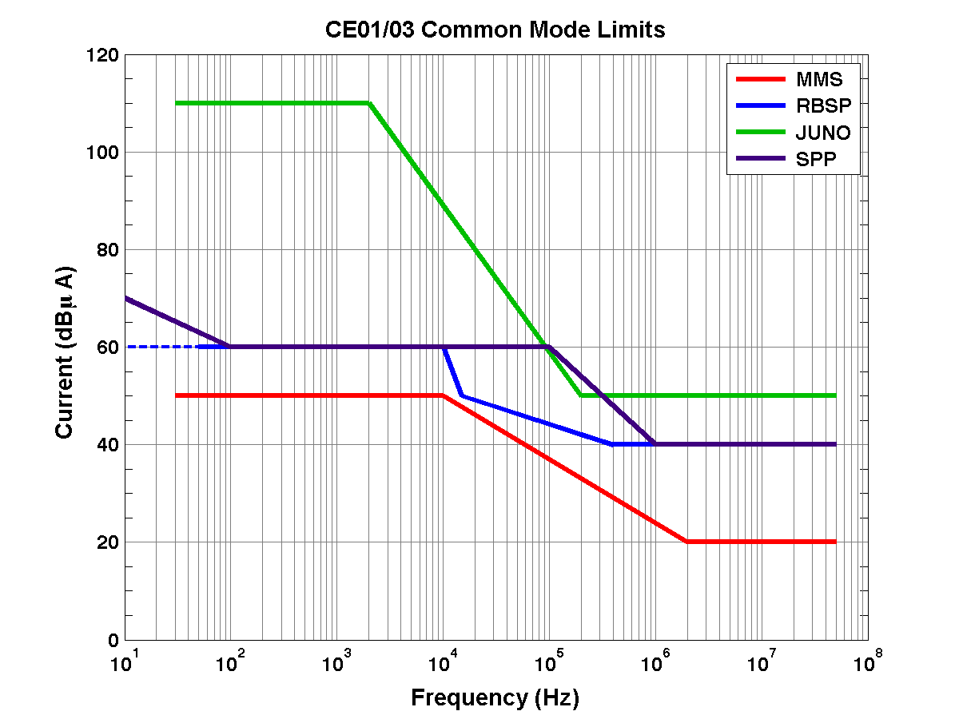
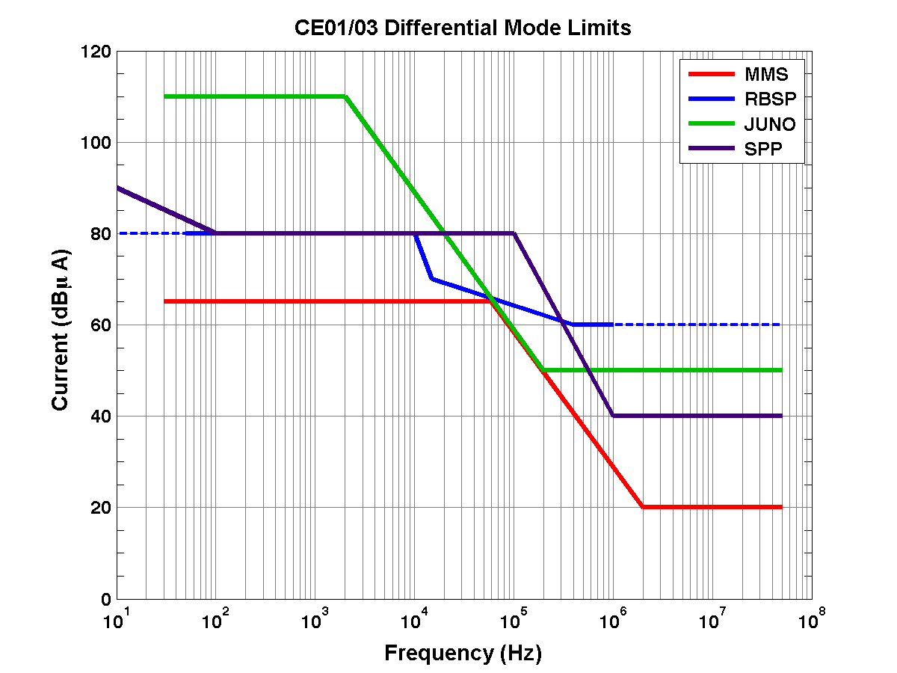
LVPS CE predicted performance
Based on heritage supply that meets MMS requirements

Slide 7
Original Outline – do not present
EMI/EMC requirements and specifications as well as descriptions of design mitigations to meet these requirements
Include the deep dielectric discharge mitigation approach
Testing to be performed to verify compliance and when the testing will take place

