Slide 1
Performance Assurance
Joerg Gerhardus
ISIS Mission Assurance Lead (SwRI)
This document contains technical data that may be controlled by the International Traffic in Arms Regulations (22 CFR 120-130) and may not be provided, disclosed or transferred in any manner to any person, whether in the U.S. or abroad, who is not 1) a citizen of the United States, 2) a lawful permanent resident of the United States, or 3) a protected individual as defined by 8 USC 1324b(a)(3), without the written permission of the United States Department of State.
Notes:
introduction

Slide 2
Outline
Requirements
Performance Assurance Implementation Plan
Organization
Quality Assurance
EEE Parts Engineering
Safety
Summary

Slide 3
SPP PA Requirements and PAIPs
Tailored SMA Requirements negotiated with the SPP project:
Solar Probe Plus (SPP) Instrument Mission Assurance Requirements Compliance Matrix
SPP document # 7434-9096 Rev. A
Iterative process between SPP and ISIS SMA teams utilizing best practices and combined knowledge of the diverse teams at all participating organizations
ISIS Implementation through plans (PAIP) and operating procedures:
ISIS: SwRI document 16105-SPP-IMAR-COMPMAT-01 Rev. 0, released 10/07/13
EPI Lo: Solar Probe Plus (SPP) Performance Assurance Implementation Plan; APL document # 7434-9001 Rev. -, released 10/14/13
EPI-Hi: Caltech document CIT-SPP-004 Rev. -, released 10/07/2013

Slide 4
Performance Assurance Implementation Plan
Deliverables
General Quality Requirements
Procurement
QA Surveillance
Training and Certification
Design and Development Review Process
Configuration Management
Non Conformance Process and Reporting
Hardware Quality Requirements
Manufacturing, Inspection, Assembly, Test, and Inspection Planning
Controlled Stores
Fabrication processes
Inspection
Acceptance Test Verification
Handling Packaging, Shipping
Software Quality Requirements
Requirements Analysis
Reviews
Verification and Validation
Safety
Reliability Assurance
EEE Parts Program

Slide 5
PA Organization Chart
SPP
Luke Becker
(APL)
SPP ISIS
Joerg Gerhardus
Eric Edlund
(SwRI)
EPI-Lo
Jim Burgum
EPI-Hi
Branislav Kecman
Mounting Bracket
Eric Edlund

Slide 6
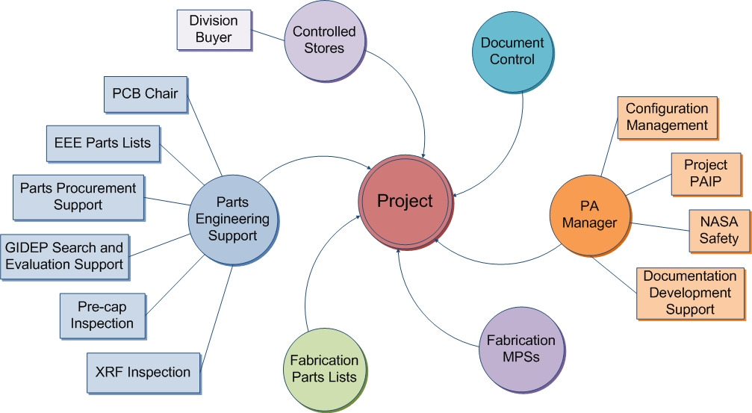
Project Quality Assurance
Project Team PA
Reliability engineering
Parts acquisition oversight
Division 15 PA Manager and Staff
Coordinate Div 15 Resources
Independent Project Quality Engineer
Oversight & Coordination
QA Engineering
QA Inspections
Partner QA
Implement local PAIP and support SwRI’s SPP ISIS PA Lead

Slide 7
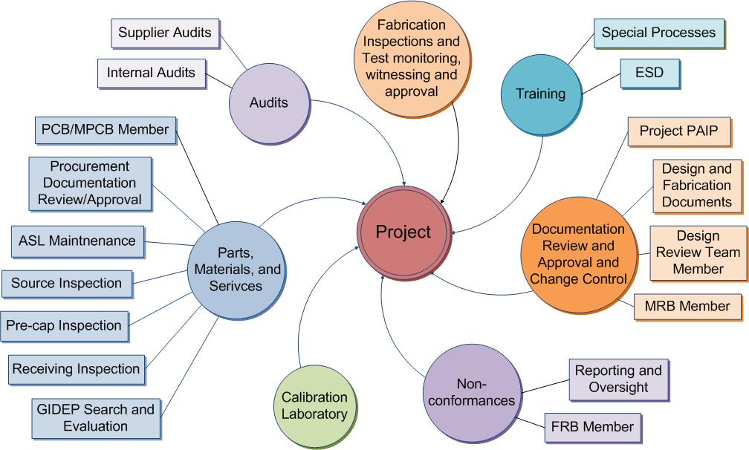
Quality Tasks

Slide 8
Design Assurance
Hardware designs governed by:
Design process and controls
Requirements definition
System engineering process
Design planning
Peer reviews and checklist
Verification and validation
Control of design changes
Software designs governed by:
Structured software development process
Contract reviews, software development folder, planning
Review of requirements, and checklist
Software design specification, design peer reviews, and checklist
Coding standards, configuration control, and code walkthroughs
Test plans, test preparations, formal testing, and reporting
Independent QA surveillance and reporting

Slide 9
Quality Assurance (1/2)
Procurements per released drawing and indentured parts list
Periodic GIDEP alert verification performed on EEE parts list
QA Receiving Inspection of EEE parts for flight hardware
Flight PWB procurement and coupon testing at GSFC
SwRI coordinates PCB effort for SPP ISIS with mission-level PCB

Slide 10
Quality Assurance (2/2)
Non-conformance control:
Per organization’s established procedures
MRB and FRB established
All non-conformances will be processed as Anomalies or Problem/Failure reports and reported through SwRI to APL as required
Workmanship
Technicians and inspectors are certified to NASA 8739 standards. Vince Ganley and Connie Ovalles are the in-house Level B certified instructors and are available to support other organizations as needed
ESD
Engineers, operators, and technicians are certified to NASA-STD-8739.7 / ANSI ESD S20.20.

Slide 11
Software Quality Assurance
ISIS SQA follows the AS9100 quality program in monitoring software activities which includes review of project documents, witnessing acceptance testing, tracking action items and defects, and performing surveillances/audits
QA has approved the ISIS Software Development Plan (SDP), which references the EPI-Hi/Lo SDPs
Software Development Plan Solar Probe Plus Project ISIS Instrument Software, Document No. 16105-ISIS-SDP-01, Rev 0 Chg 0, September 2013
Regular surveillances of EPI-Hi and EPI-Lo software activity will focus on the teams compliance to their SDP and their organization’s quality/procedural requirements.
On-site surveillances by the SwRI SQA at EPI-Lo and EPI-Hi are planned

Slide 12
EEE Parts Engineering
Primary role is to support ISIS hardware developers with meeting EEE parts requirements as called out in Solar Probe Plus Parts Control Plan, SPP document 7434-9001 Rev A
SwRI has significant experience working with APL & GSFC Parts Engineering Branch
Ensure that all parts presented to SPP Parts Control Board are compliant to the PCP
Provide procurement support where necessary
Significant stock available at SwRI
This has already been useful to aid in prototyping and EM hardware
Avoid long lead times and expensive minimum buys
Support coordination of common buy activities as requested
Allows for 1 consolidated response for the ISIS suite

Slide 13
Safety
SPP ISIS will provide Safety inputs
The NPR-8715.3A process circle summarizes the overall safety program risk management approach
Safety Hazards Analysis
Implementation of hazard controls
Verification

Slide 14
EPI Hi/Lo Hazards and Mitigations
EPI-Lo:
High Voltage
200V bias voltage to the SSDs
Fully contained inside the instrument
Only operated in high vacuum
Safe/arm limiting plug design
Ionizing Radiation Sources
Planned use of the following sources (radiation datasheets have been provided to SPP):
Am-241 foil, 100uCi, Type A2 Capsule
Bi-207, 10uCi, MF-1 Disk, 25.4mm OD x 5.08mm AD, 100-200ug/cm2 Acrylic Window
Ba-133, 10uCi, MF-1 Disk, 25.4mm OD x 5.08mm AD, 100-200ug/cm2 Acrylic Window
EPI-Hi:
High Voltage
250V bias voltage to each detector within the three telescopes
Fully contained inside the instrument
Ionizing Radiation Sources
Planned use of the following sources:
Beta / gamma sources 106Ru, 207Bi: <0.1 mCi
Alpha sources 228Th, 241Am, 244Cm : <10 mCi
alpha source for producing knock-on protons 210Po : <10 mCi
General Hazard:
Nitrogen purging
Controlled flow rates in ventilated areas
Conducted by trained personnel
Monitoring O₂ levels (where necessary)

Slide 15
Summary
SPP ISIS Performance Assurance plans and requirements are in place
PAIPs written in response to the tailored SPP MAR Matrix
SwRI QA independently verifies that we follow plans

