Slide 1
EPI-Hi Calibration
Richard Mewaldt
EPI-Hi Scientist (Caltech)
This document contains technical data that may be controlled by the International Traffic in Arms Regulations (22 CFR 120-130) and may not be provided, disclosed or transferred in any manner to any person, whether in the U.S. or abroad, who is not 1) a citizen of the United States, 2) a lawful permanent resident of the United States, or 3) a protected individual as defined by 8 USC 1324b(a)(3), without the written permission of the United States Department of State.
Notes:
introduction

Slide 2
Outline
  Introduction
  Species and Energy Ranges
  Calibration Plan
  Facilities
  Test Flow
  In-Flight Calibration
  Summary

Slide 3
Introduction
  EPI-HI Measurement Requirements:
    Composition, energy spectra, and angular distributions of ions and electrons in flare and CME-related SEP events, and at shocks
    Required Species for EPI-Hi
      H, ³He, ⁴He, C, O, Ne, Mg, Si, Fe ≤ 1 MeV/nuc (TBR) to ≥ 50 MeV/nuc
    Required Species for Mission
      Electrons with ≤ 0.5 MeV to ≥ 3 MeV
    SEP Directional Distributions
    The combined LET and HET fields of view are required to measure SEP angular distributions over ≥ p/2 sr in both the sunward and anti-sunward directions
  EPI-Hi Measurement Goals:
    SEP Ions: Composition and energy spectra of ~16 species with
    1 ≤ Z ≤ 28 and trans-Fe element groups
    SEP Electrons with ≤ 0.5 to 6 MeV

Slide 4
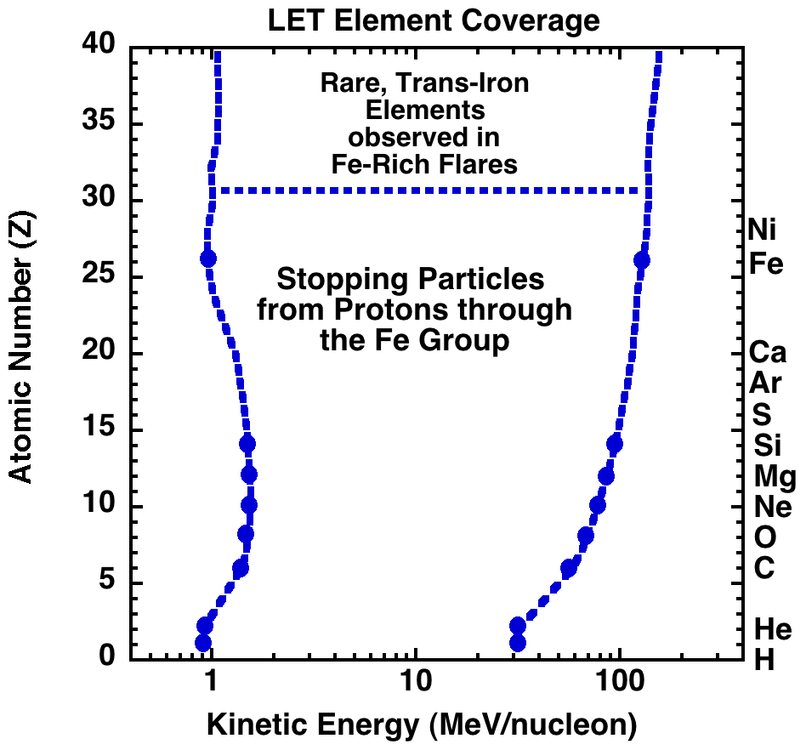
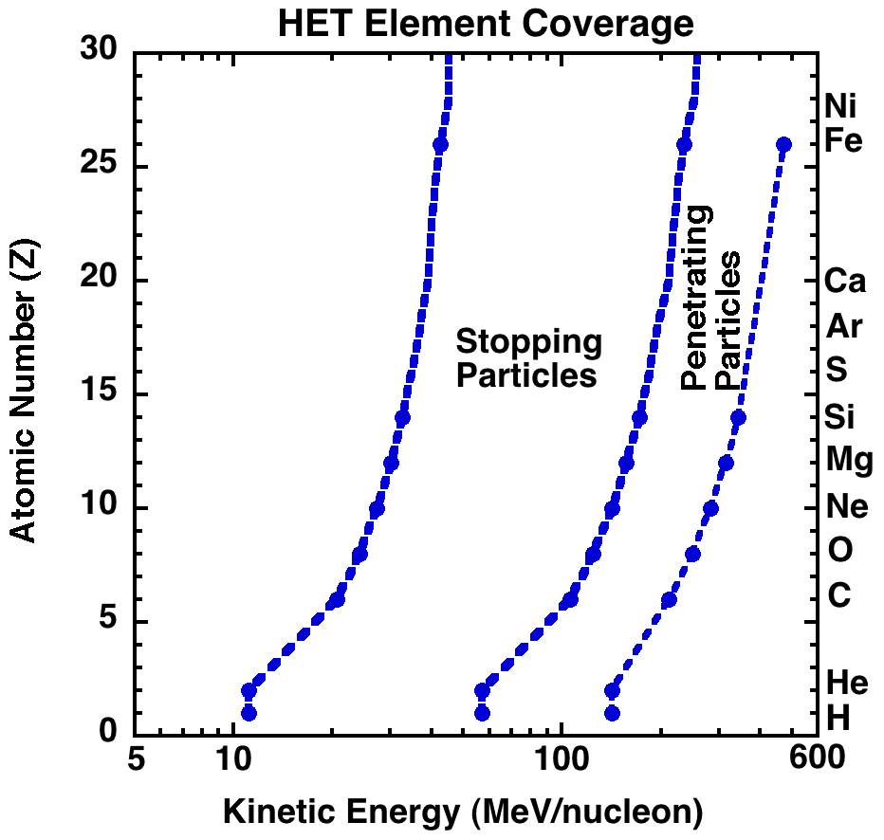
Species and Energy Ranges
LET and HET energy coverage for stopping elements is shown below. Note that LET and HET have considerable energy overlap. Also shown is the energy range over which HET can identify penetrating ions. Required species are indicated by blue dots. LET will also measure rare trans-Fe species often overabundant in ³He-rich flares.

Slide 5
Calibration Plan
  Lab measurements of electronic gains, offsets, linearity, thresholds, noise, and temperature variations
  Alpha-particle and heavy-ion measurements of detector uniformity
  Accelerator measurements of heavy-ion dE/dX-E-Range parameters, combined with modeling
  Monte-Carlo simulations of detector performance
  Monte-Carlo determinations of LET and HET geometry factors for directional sectors
  GEANT-4 calibrations of the HET and LET electron response
  Accelerator measurements of heavy-ion dE/dX–E’ “tracks” for new flight detectors and end-to-end testing/tuning of on-board particle identification algorithms
  Validate high-rate performance
  In-flight measurements that optimize/validate on-board particle identification processes

Slide 6
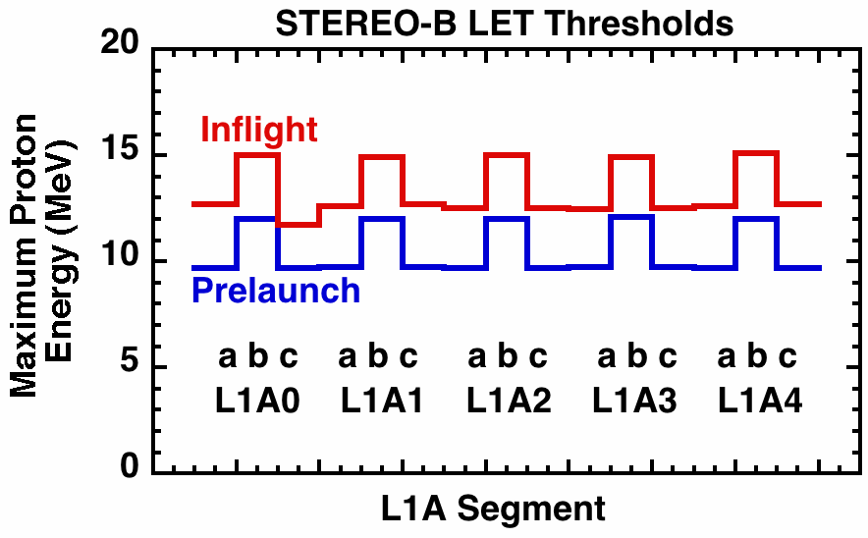
Calibrating Detector Energy Thresholds
Each dual-gain PHA chain contains a precision test pulser that will be used to measure the preflight and in-flight trigger thresholds of 88 separate detector segments in EPI-HI. The Table below shows data for STEREO LET-B sensor. The goal is to have equal proton response in all directions. Typically, in-flight thresholds can be lower than pre-flight thresholds.

Slide 7
Measuring Gains/Offsets of PHASICS
Onboard particle identification requires accurate calibrations of the flight electronics and their dependence on temperature
Onboard measurements of the nuclear charge (Z) and kinetic energy (E) of energetic particles requires accurate pre-launch and in-flight measurements of the gain and offset of each PHASIC dual-gain PHA
Since the SPP orbit may lead to temperature variations, need to also measure the temperature coefficients of each PHASIC
The LET and HET designs also provide for periodic in-flight calibration of each ADC on a grid of logarithmically-spaced points.
Fortunately, the PHASICs are relatively stable with temperature.
STEREO PHASIC Gain Temperature Coeff.: <50 ppm/deg. C
Performance: Offset Temperature Coeff.: <0.1 Channel/°C

Slide 8
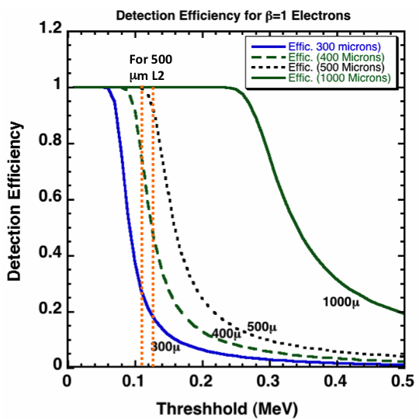
Monte Carlo Simulations
Monte Carlo simulations were used throughout the LET & HET design process to identify and optimize parameters controlling charge and energy resolution.
Such simulations continue to be important in evaluating accelerator and laboratory measurements
of detector and electronic
performance.
For example, this GEANT-4
simulation illustrates the
L2 threshold requirements
for measuring electrons with
LET. For an L2 thickness of
500 mm a trigger threshold
of 0.110 - 0.125 MeV gives
95% - 100% detection
efficiency for all electrons of
interest (0.5 – 6 MeV)
Simulation by A. Labrador

Slide 9
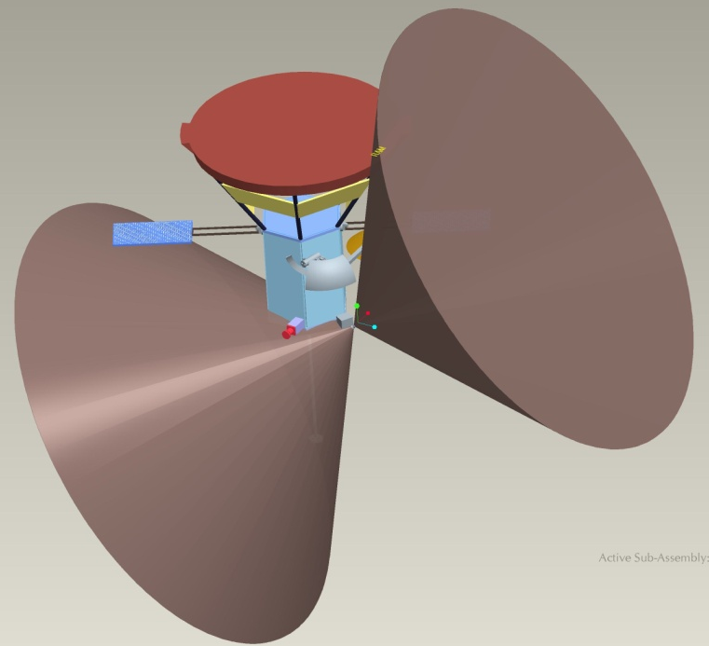
Calibrating LET/HET Fields of View
The combined LET and HET fields of view are to cover
≥ π/2 sr in both the sunward and anti-sunward directions (see LET-1 example below).
The geometry factor and directional
coverage of each of the 25 sectors
within each cone will be determined
with a Monte Carlo calculation taking
into account the pointing directions of
the three telescopes relative to the
spacecraft and Sun and any
obstructions.
The relative geometry factor of
each sector can be validated in-flight
during the decay phase of SEP
events when solar energetic particles
become nearly isotropic in the solar
wind rest frame.
LET-1 Field of View

Slide 10
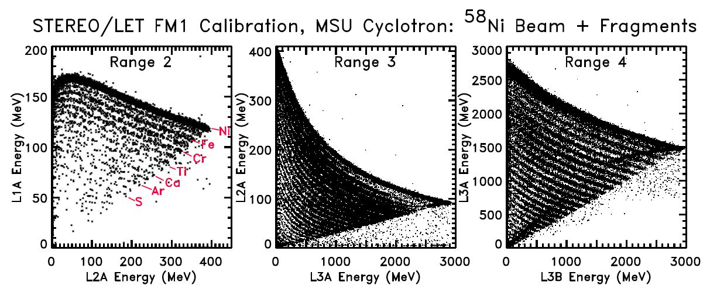
Facilities – Accelerator Calibration Data
LET & HET use ΔE vs. Residual Energy (E’) to measure SEP composition
The ΔE vs. E’ tracks for lighter species are obtained by fragmenting a
heavy-ion beam on a polyethylene target
The example below from STEREO/LET uses a ⁵⁸Ni beam at the MSU NSCL
This also provides an end-to-end test of the onboard identification system
Mewaldt et al. 2008

Slide 11
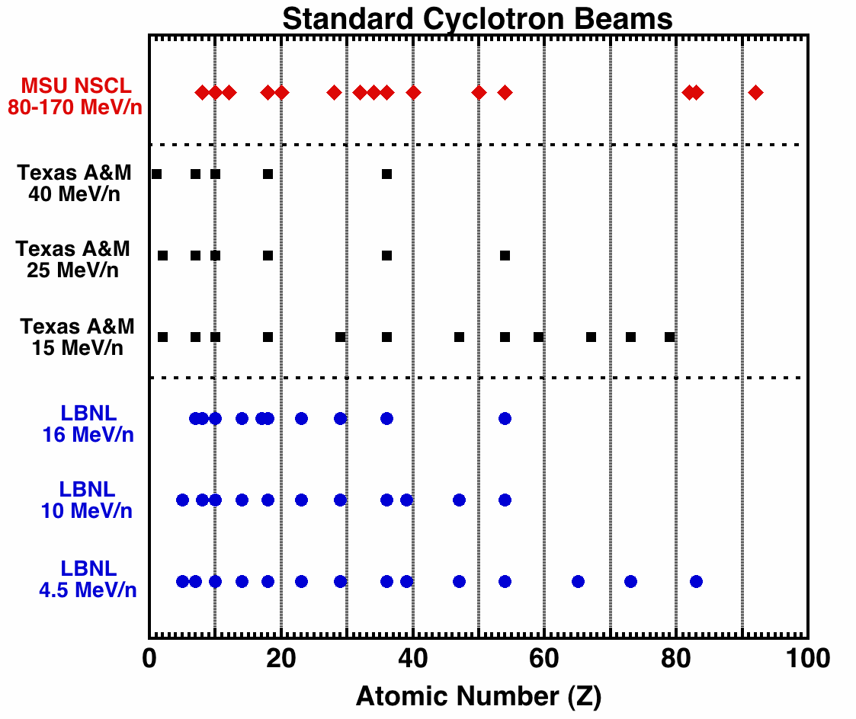
Facilities – Accelerator Calibrations
There are three appropriate heavy-ion accelerators in the U.S.
All 3 cover the key heavy-ion charge range (6≤Z≤28) and also provide for trans-iron (Z>30) calibrations.
However, only MSU covers the full energy range of EPI-Hi.
The MSU accelerator also reaches high enough energy to produce a much greater yield of lower-Z fragments.
In the past we have also used the heavy-ion accelerator in Darmstadt, Germany.
Propose an accelerator calibration of EPI-Hi (or the engineering unit) for 2016

Slide 12
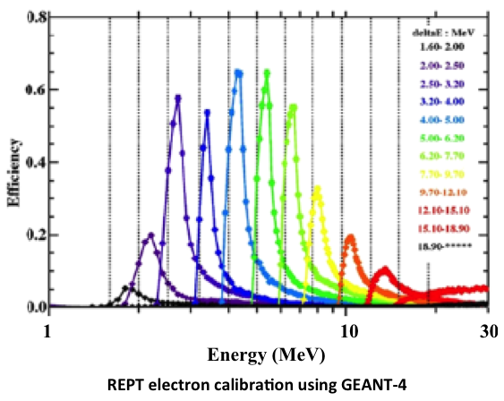
Electron Calibrations
  HET and LET will measure energetic electrons with 0.5-6 MeV
  The HET and LET electron response will be calibrated with GEANT-4, used to calibrate the REPT sensors on the Van Allen Probes (Baker et al. 2012)
  HET is 13.5 mm of Si deep compared to a 23-mm depth for REPT
  Based on REPT and
  SAMPEX/PET calibrations, a
  HET/LET energy range covering
  0.5 – 6 MeV is achievable
  The LETs will provide electron
  measurements over a more
  limited energy range
  (~0.5 – ~4 MeV)
  Routine testing of the
  HET/LET electron response
  will use ß-decay sources like
  ¹⁰⁶Ru and ⁹⁰Sr.

Slide 13
Calibration Test Flow (1/2)
Overview of Key Steps
  Determine how the Science Requirements drive detector, electronics, and software requirements (noise, resolution, dynamic range, near-Sun environment)
    (requirements on detector thickness, uniformity, noise)
    (requirements on PHASIC noise, dynamic range, radiation hardness)
  Evaluate expected instrument performance with calculations and simulations
  Develop new detector/electronic hardware; new flight software
  Test new detectors, hardware, software with real/simulated particles to determine if they meet requirements.
    (Accelerator and lab tests; simulations)
  Perform an end-to-end test of all systems at a heavy-ion accelerator
  In-flight tuning and validation of onboard analysis routines

Slide 14
Calibration Test Flow (2/2)
Calibrate New Detectors, PHASICS, and Software
Task | In Progress | Scheduled For
New, thin SSDs meet uniformity and response requirements | √
Calibrate transfer function of flight PHASICS vs. temperature |  | End of 2014
Propose for beam time at MSU Superconducting Cyclotron Lab |  | 2014
Calibrate HET and LET SEP electron response using GEANT-4 |  | mid-2016
Test SEP electron detection and ɣ-ray background with lab sources |  | mid 2016
Validate on-board analysis routines at accelerator |  | mid-2016
Determine location of element tracks at MSU accelerator |  | mid-2016
Inflight tuning and validation of on-board analysis routines |  | ≥2018

Slide 15
In-Flight Electronics Calibration
The gain, offset, and threshold of each PHASIC channel will be periodically calibrated onboard using built-in DACs that stimulate multiple detectors. The Figure shows an example of in-flight calibration data from STEREO/LET. Such calibrations are especially important if the temperatures of the LET and HET electronics vary significantly over the course of the SPP orbit.

Slide 16
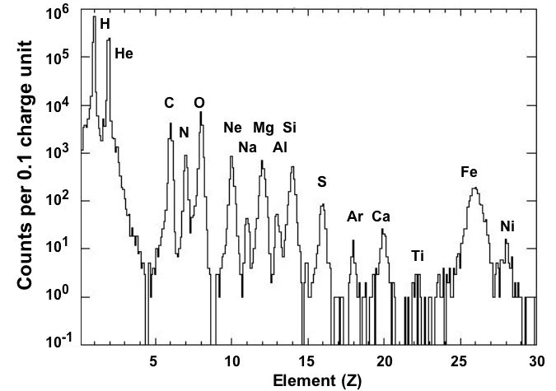
In-Flight Calibration
Pulse-height data from the EPI-Hi LET and HET sensors will provide the final calibration of the on-board particle identification system. Shown are STEREO LET data from the Dec. 2006 SEP events. Sixteen elements are resolved.
EPI-Hi should provide similar resolution extending to ~100 MeV/nuc.
STEREO/LET Data
~ 6–30 MeV/nuc
December, 2006

Slide 17
In-Flight Calibration
STEREO/LET event data from the Dec. 2006 SEP events are plotted on the L1vsL2 and L2vsL3 matrices after correction for incidence angle and individual L1 and L2 segment thicknesses
(~25 and ~50 µm thick). Colored bands show regions used for on-board particle identification. EPI-Hi detectors range from 10 µm to 2000 µm thick.

Slide 18
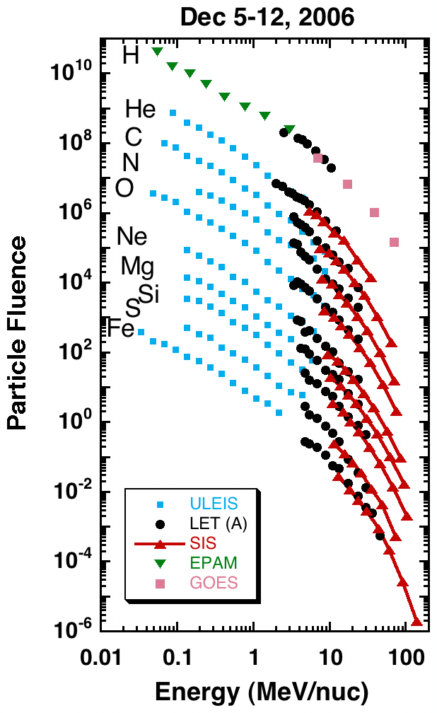
In-flight Energy Spectra
To achieve EPI-Hi science requirements the nuclear charge (Z) and kinetic energy of SEP ions must be measured to construct energy spectra.
Shown at right are energy spectra that combine ACE, GOES & STEREO data measured while the STEREOs were still near Earth. They cover the same energy range as EPI-Lo & Hi (~0.05 to >100 MeV/nuc). Measured intensities are plotted with no correction factors.
The approaches outlined here will enable EPI-Lo and EPI-Hi to produce similar energy spectra.

Slide 19
Summary
Both pre-flight and in-flight calibrations of sensors, electronics and software are essential for meeting the science and measurement requirements of EPI-Hi.
The plan for calibrating on-board analysis of SEP ions requires both accelerator and in-flight calibrations
EPI-Hi measurements of SEP electrons will rely on
GEANT-4 calibrations, using tests with radioactive sources as a cross check

