Slide 1
Verification
Nigel Angold
ISIS Systems Engineering (SwRI)
This document contains technical data that may be controlled by the International Traffic in Arms Regulations (22 CFR 120-130) and may not be provided, disclosed or transferred in any manner to any person, whether in the U.S. or abroad, who is not 1) a citizen of the United States, 2) a lawful permanent resident of the United States, or 3) a protected individual as defined by 8 USC 1324b(a)(3), without the written permission of the United States Department of State.
Notes:
introduction

Slide 2
Outline
  Documentation
  Verification Process Definition
    Verification Program Concept
    Verification Program Planning
    Verification Methods
    Requirements Verification Matrix
    Verification Process
  Performance Requirements
  Environmental Requirements
  Interface Requirements
  Assurance Requirements
  Verification Summary

Slide 3
Documentation
SPP System Verification and Validation Plan, 7434-9099
ISIS Verification and Validation Plan, 16105-ISIS_VVP-01
These documents define the Verification Process:
  Verification Program Concept
  Verification Program Planning
  Verification Methods
  Requirement Verification Matrix
  Verification Process
Notes:
NOTE: this is the outline provided by Scott

Slide 4
Verification Process Definition (1/8)
  Verification Program Concept:
    ISIS instrument requirements verification is part of the overall SPP verification campaign.
    EPI-Lo requirements will be verified by APL.
    EPI-Hi requirements will be verified by Caltech.
    Tracking of all ISIS requirements verification will be performed by the ISIS Systems Engineer, reporting to the SPP Requirements & Verification Engineer.
Notes:
NOTE: this is the outline provided by Scott

Slide 5
Verification Process Definition (2/8)
  Verification Program Planning:
  Verification and Validation Plans produced before PDR.
  Test and Calibration Plans, inputs for I&T produced before CDR.
  Test, Verification and Calibration reports generated throughout all pre-launch phases.
Notes:
NOTE: this is the outline provided by Scott

Slide 6
Verification Process Definition (3/8)
  Verification Methods:
  Test
  Most requirements should be verified by test or supported by quantitative test data.
  Analysis
  Some requirements cannot be verified by test (e.g. due to cost or physical limitations) or may not be fully verifiable by testing alone.
  Demonstration
  Applied to some qualitative requirements that cannot be easily tested or requirements that cannot be tested over a full range of relevant scenarios.
  Inspection
  Used to verify a design characteristic or method or where a requirement may be satisfied solely by the review of documentation.
  Every requirement must be verified by one or more of the above methods.
Notes:
NOTE: this is the outline provided by Scott

Slide 7
Verification Process Definition (4/8)
  Requirement Verification Matrix:
  Tracking of verification by means of matrices containing:
    Requirement Reference Number
    Requirement Description
    Verification Method: one or more of Test, Analysis, Demonstration
    and Inspection
    Verification Activity
    Closure Status: Closed, Open, Waived, Deferred, etc.
    Closure Date
    Responsible Organization
    Comments
Notes:
NOTE: this is the outline provided by Scott

Slide 8
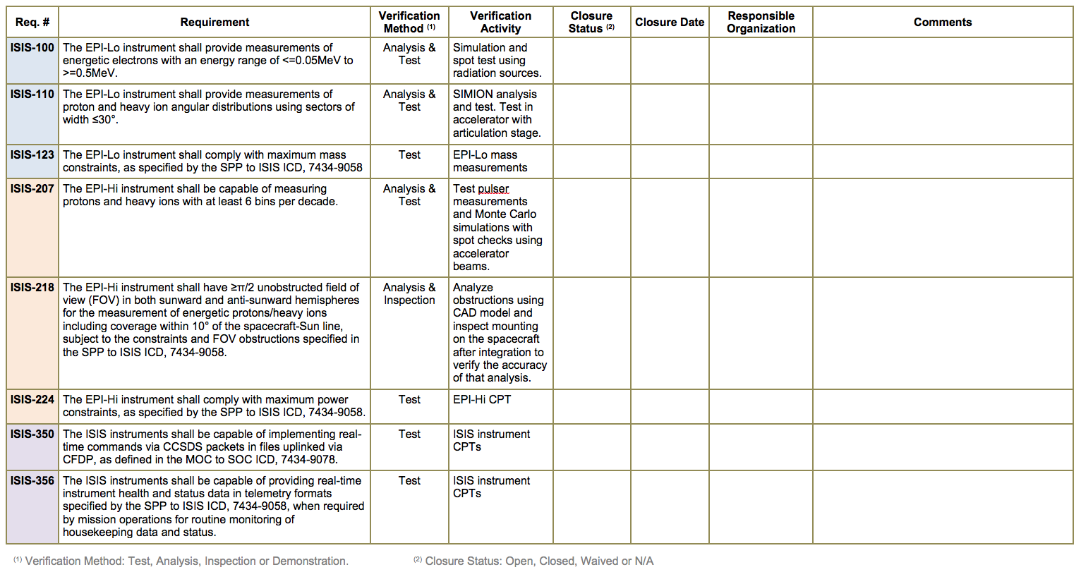
Verification Process Definition (5/8)
  Example Verification Matrix entries from ISIS IRD:
  Currently tracking 82 instrument requirements in the IRD Verification Matrix
Notes:
NOTE: this is the outline provided by Scott

Slide 9
Verification Process Definition (6/8)
  Verification Process:
  Development of Verification Procedures
    Procedures approved by the design engineer, the systems engineer, the project manager, and QA and released prior to execution.
    They will comply with the format requirements and configuration control authority of the originating agency (APL, Caltech, or SwRI).
  Performance of Test Readiness Reviews
    Required before installing flight hardware into a test environment.
  Test Execution
    Test engineer assigned
    QA participation
    Equipment calibrated before test
    Test procedures under document control
Notes:
NOTE: this is the outline provided by Scott

Slide 10
Verification Process Definition (7/8)
  Verification Process continued:
  Post-test Reviews
    Test results are reviewed and approved by the ISIS SE to ensure adequate verification of requirements.
    All hardware non-conformances or failures shall be documented.
    Any corrective actions identified shall be processed by the cognizant engineer and elevated as appropriate.
    For any test failure, the reason must be identified.
    Hardware under test / test setup must not be disturbed in any way that prohibits duplication of a test failure.
    The post-test review will result in a “pass” or “fail”.
  Completion of the Verification Matrix
    Verification is tracked by entering data into the Verification Matrix.
Notes:
NOTE: this is the outline provided by Scott

Slide 11
Verification Process Definition (8/8)
  Verification Process continued:
  Requirement Closure
    A requirement will be declared “closed” when all verification activities planned for the requirement have been completed satisfactorily.
  Waivers and Deviations
    In cases where it may be acceptable that a requirement is not met, a waiver or deviation will be filed with the JHU/APL SPP Project Office, and NASA Goddard Program Office, as appropriate.
    The SPP waivers and deviations process is documented in the SPP Configuration Management Plan, 7434-9006.
    All hardware non-conformances or failures shall be documented.
Notes:
NOTE: this is the outline provided by Scott

Slide 12
Performance Requirements
  Performance requirements are defined in:
  Level 1 Requirements for the Solar Probe Plus Mission
  SPP Mission Requirements Document (Level 2), 7434-9047
  SPP Level 3 Payload Requirements Document (Level 3), 7434-9051
  ISIS Instrument Requirements Document (Level 4), 16105-ISIS-IRD-01
  Level 2 - 4 documents:
  Each document contains a Requirement Verification Matrix.
  Level 2 and 3 verification typically inspection of documention verifying lower level requirements found in the ISIS IRD.
  ISIS Systems Engineer will flow verification data up to the appropriate document owners.
  The Requirement Verification Matrix is maintained as an Excel spreadsheet that the SPP Requirements & Verification Engineer uses to import data into the SPP System Requirements Database, DOORS.
Notes:
NOTE: this is the outline provided by Scott

Slide 13
Environmental Requirements
  Environmental requirements are defined in:
  SPP Contamination Control Plan, 7434-9011
  SPP Environmental Design and Test Requirements Document, 7434-9039
  SPP Electromagnetic Environment Control Plan, 7434-9040
  Environmental requirements documents:
  Each document contains a Requirement Verification Matrix.
  ISIS Systems Engineer will flow verification data up to the appropriate document owners.
Notes:
NOTE: this is the outline provided by Scott

Slide 14
Interface Requirements
  Interface requirements are defined in:
  SPP to ISIS ICD, 7434-9058
  SPP General Instrument to Spacecraft ICD, 7434-9066
  MOC to SOC ICD 7434-9078
  Interface requirements documents:
  Each document contains a Requirement Verification Matrix.
  ISIS Systems Engineer will flow verification data up to the appropriate document owners.
Notes:
NOTE: this is the outline provided by Scott

Slide 15
Assurance Requirements
  Assurance requirements are defined in:
  SPP Product Assurance Implementation Plan (PAIP), 7434-9003
  EPI-Lo Product Assurance Implementation Plan (PAIP), 7464-9001
  EPi-Hi Product Assurance Implementation Plan (PAIP), CIT-SPP-004
  Assurance requirements documents:
  Each document contains a Compliance Matrix
    Comply
    Do not Comply
    Comply with Caveats
    N/A
  The SPP System Assurance Manager is responsible for verification of Assurance requirements.
Notes:
NOTE: this is the outline provided by Scott

Slide 16
Verification Summary
  ISIS has a clearly defined Verification Process that is documented in the ISIS Verification and Validation Plan.
  Requirement Verification Matrices will be used to track Performance, Environmental and Interface Requirements.
  Assurance Requirements will be tracked using Compliance Matrices.
Notes:
NOTE: this is the outline provided by Scott

