Slide 1
Assembly, Integration, and Test
John Dickinson
ISIS SE (SwRI)
This document contains technical data that may be controlled by the International Traffic in Arms Regulations (22 CFR 120-130) and may not be provided, disclosed or transferred in any manner to any person, whether in the U.S. or abroad, who is not 1) a citizen of the United States, 2) a lawful permanent resident of the United States, or 3) a protected individual as defined by 8 USC 1324b(a)(3), without the written permission of the United States Department of State.
Notes:
introduction

Slide 2
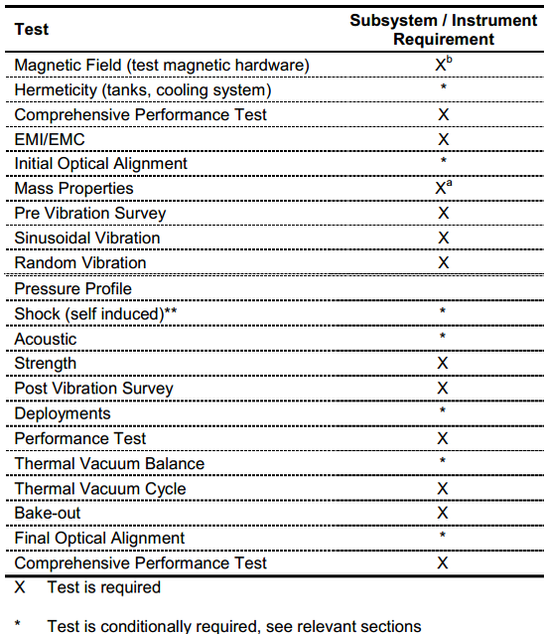
Outline
Typical Test Flow for Components and Instruments (EDTRD)
EPI-Hi Assembly, Integration, and Test Flow
EPI-Lo Assembly, Integration, and Test Flow
EDTRD Test Levels:
  Acoustic
  Vibration
  Thermal-Vacuum profile
  Observatory Environmental Testing
Summary
Not Performed on ISIS

Slide 3
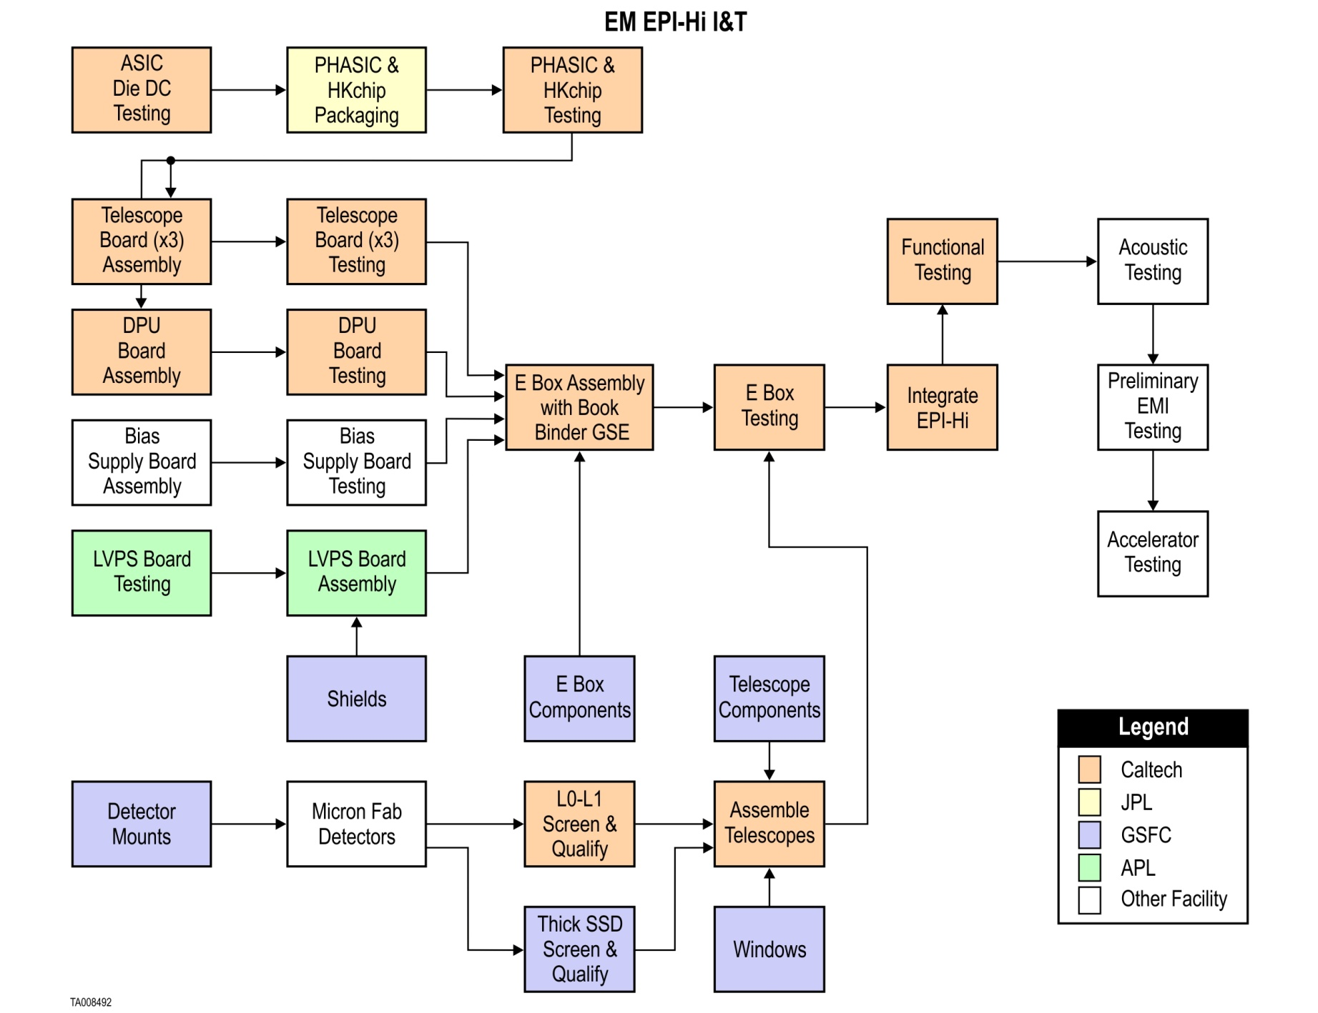
EM EPI-Hi Assembly, Integration, & Test

Slide 4
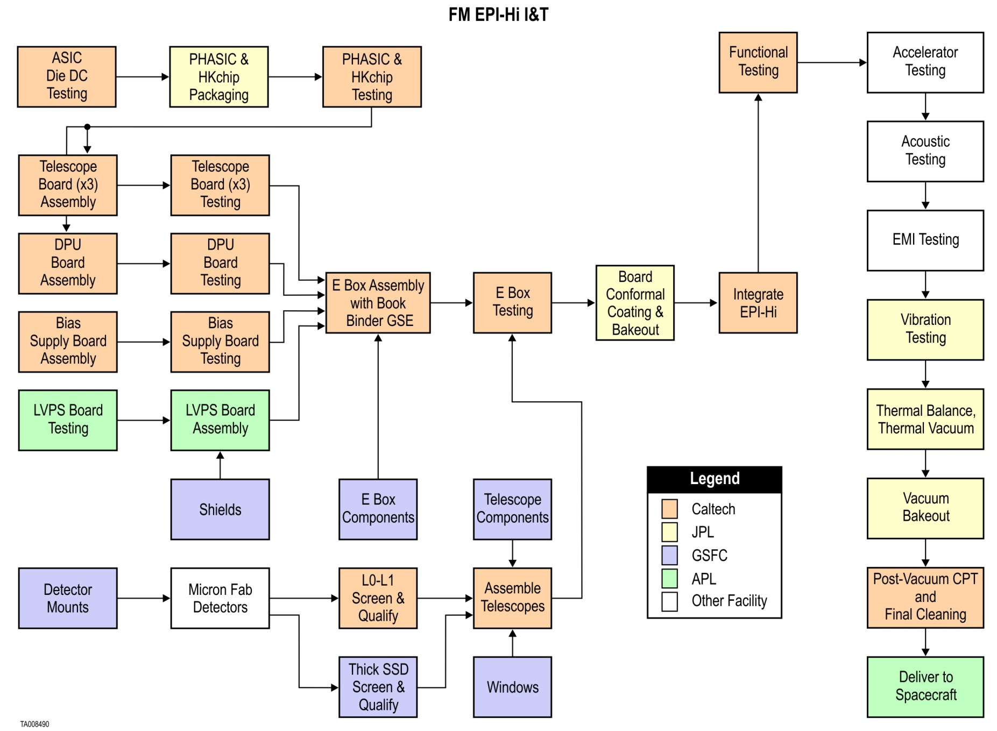
FM EPI-Hi Assembly, Integration, & Test
Performance Tests performed between Qualification Tests

Slide 5
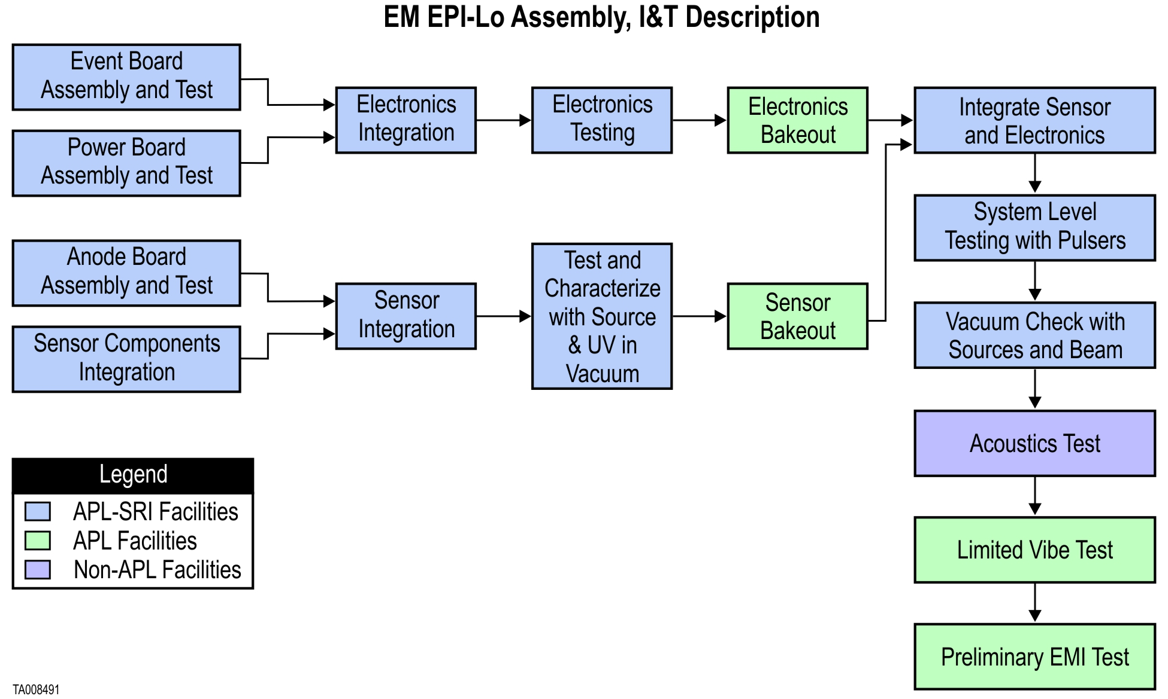
EM EPI-Lo Assembly, Integration, & Test

Slide 6
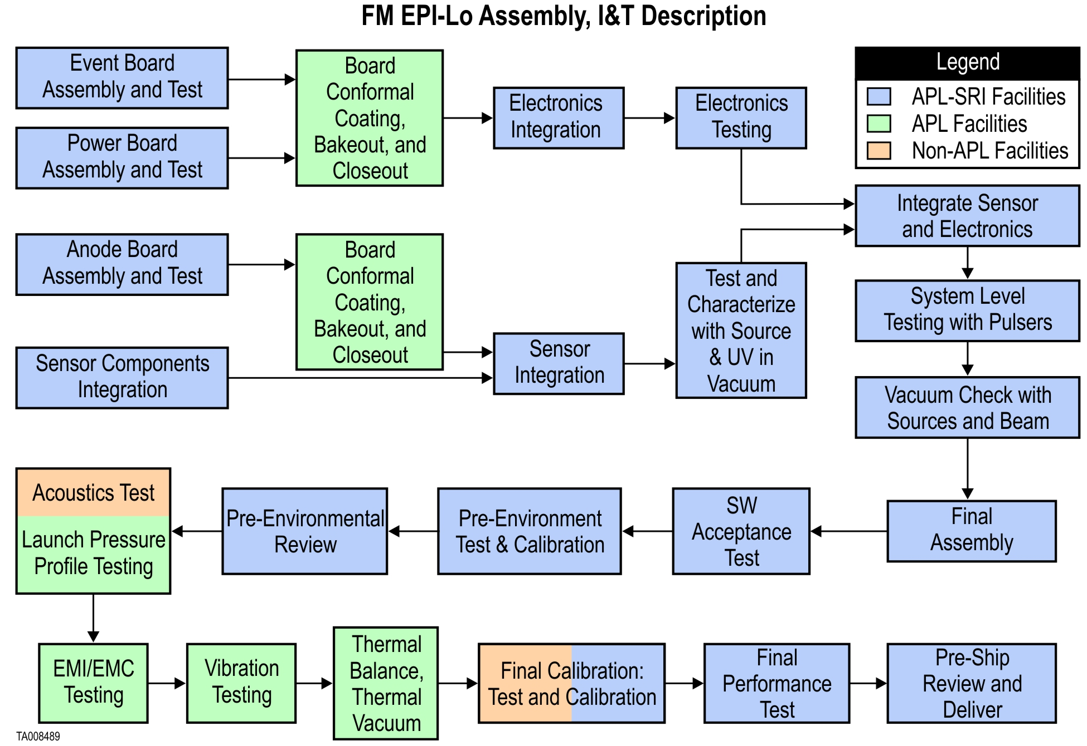
FM EPI-Lo Assembly, Integration, & Test
Performance Tests performed between Qualification Tests

Slide 7
Normal Vibration Levels
Side Panels Mounted Components & Subsystems Normal To Panel
Frequency (Hz) | Qualification (G²/Hz) | Protoflight (G²/Hz) | Acceptance (G²/Hz)
20 | 0.01 | 0.01 | 0.01
60 | 1.25 | 1.25 | 0.63
200 | 1.25 | 1.25 | 0.63
350 | 0.04 | 0.04 | 0.04
500 | 0.04 | 0.04 | 0.04
2000 | 0.01 | 0.01 | 0.01
Overall Grms | 16.4 | 16.4 | 12.6
Duration (mins) | 2 | 1 | 1
Normal
Lateral
Lateral

Slide 8
Lateral Vibration Levels
Side Panels Mounted Components & Subsystems Lateral To Panel
Frequency (Hz) | Qualification (G²/Hz) | Protoflight (G²/Hz) | Acceptance (G²/Hz)
20 | 0.01 | 0.01 | 0.01
35 | 0.04 | 0.04 | 0.04
500 | 0.04 | 0.04 | 0.04
2000 | 0.01 | 0.01 | 0.01
Overall Grms | 6.8 | 6.8 | 6.8
Duration (mins) | 2 | 1 | 1
Normal
Lateral
Lateral

Slide 9
Acoustics Levels
Table 7‑2. Acoustic Flight Levels
1/3 Oct Center Freq (Hz) | MEFL (dB) |  | 1/3 Oct Center Freq (Hz) | MEFL (dB)
32 | 123.0 |  | 630 | 120.5
40 | 124.8 |  | 800 | 119.1
50 | 126.2 |  | 1000 | 117.8
63 | 127.5 |  | 1250 | 116.4
80 | 128.3 |  | 1600 | 115.0
100 | 128.8 |  | 2000 | 113.6
125 | 129.0 |  | 2500 | 112.3
160 | 128.7 |  | 3150 | 110.9
200 | 127.5 |  | 4000 | 109.5
250 | 126.0 |  | 5000 | 108.1
315 | 124.3 |  | 6300 | 106.8
400 | 123.3 |  | 8000 | 105.4
500 | 121.9 |  | 10000 | 104.0
 |  |  | OASPL | 138.1

Slide 10
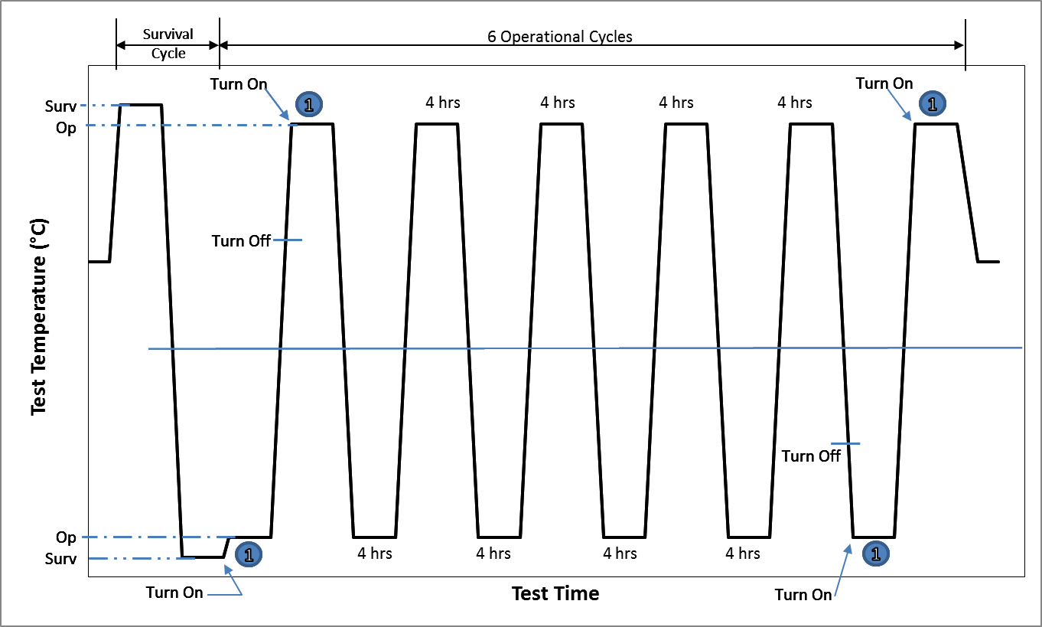
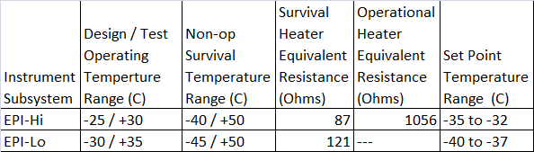
Thermal Vacuum Test Cycles
CPT
CPT
CPT
CPT

Slide 11
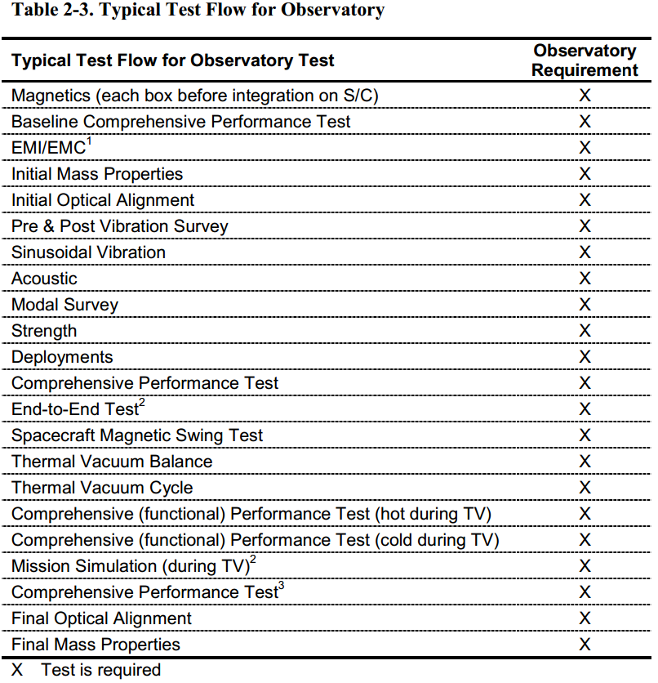
Observatory Environmental Testing
(N/A for ISIS)

Slide 12
Summary
EM is used as a pathfinder for FM integration and test
Selected EM environmental testing provide risk reduction
FM unit undergoes instrument level environmental testing to EDTRD levels
EM is used for command and procedure testing after FM delivery to spacecraft and to support commanding activities after launch

