Slide 1
ISIS Thermal
Gregory J. Dirks
ISIS Thermal Lead (SwRI)
This document contains technical data that may be controlled by the International Traffic in Arms Regulations (22 CFR 120-130) and may not be provided, disclosed or transferred in any manner to any person, whether in the U.S. or abroad, who is not 1) a citizen of the United States, 2) a lawful permanent resident of the United States, or 3) a protected individual as defined by 8 USC 1324b(a)(3), without the written permission of the United States Department of State.
Notes:
introduction

Slide 2
Outline
Driving Instrument Thermal Requirements
Thermal Design and Implementation
Thermal Management
Heaters and Sensors
MLI Design
Materials and Finishes
Predicted Performance and Margins
Thermal Model Details
Design Cases
Optical Properties and Power Dissipation
Predictions and Margins
Plans for Thermal Verification
Summary

Slide 3
Requirements (1/2)
Design Temperature Limits
EPI-Hi EPI-Lo
Margin Guidelines – Includes Test and Model Uncertainty
Hot Limits 10 C and Cold Limits 5 C (Heater Controlled)
Component | Hot Op. (°C) | Cold Op. (°C) | Cold Surv. (°C)
EPI-HI HET | 40 | -25 | -40
EPI-Hi LET1 | 40 | -25 | -40
EPI-Hi LET2 | 40 | -25 | -40
EPI-Hi DPU | 40 | -25 | -40
EPI-Hi Bias | 40 | -25 | -40
EPI-Hi LVPS | 40 | -25 | -40
EPI-Hi HET Tel | 30 | -25 | -40
EPI-Hi LET 1 Tel | 30 | -25 | -40
EPI-Hi LET 2 Tel | 30 | -25 | -40
Component | Hot Op. (°C) | Cold Op. (°C) | Cold Surv. (°C)
Detector | 35 | -30 | -45
Anode Board | 55 | -30 | -45
Event Board | 55 | -30 | -45
Power Board | 55 | -30 | -45
Dome | 35 | -30 | -45

Slide 4
Requirements (2/2)
Interface Temperatures
Operational: -25 / +65 C
Non-Operational: -30 / +70 C
Heaters
75% Maximum Duty Cycle
Resistance Determined at 26 V

Slide 5
Design (1/3)
EPI-Hi
E-box Radiator to Dissipate Internally Generated Heat
Telescopes Conductively Isolated from E-box
Operational Heaters on Telescopes
Survival Heaters on Telescopes and E-box
MLI on Surfaces Except Apertures, Radiator, and Bottom (S/C Facing)
Telescopes
Radiator Surface
E-Box
Circuit Boards

Slide 6
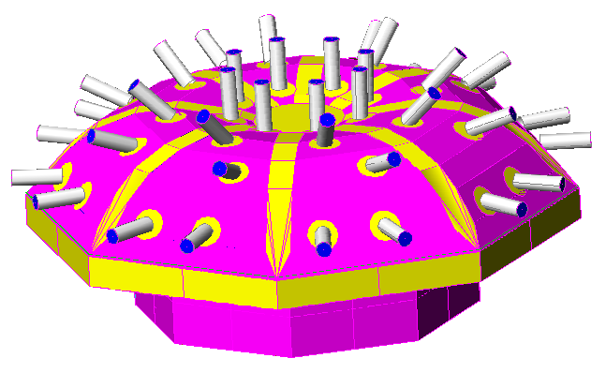
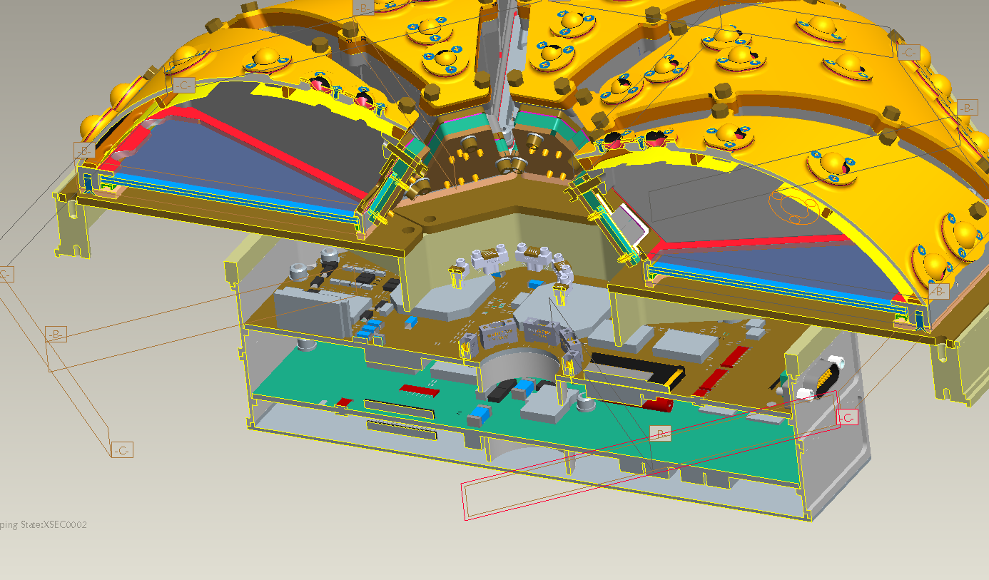
Design (2/3)
EPI-Lo
Wedge Radiators (8) to Dissipate Internally Generated Heat
Eight Survival Heaters (One on Each Wedge)
MLI on Surfaces Except Apertures and Radiators

Slide 7
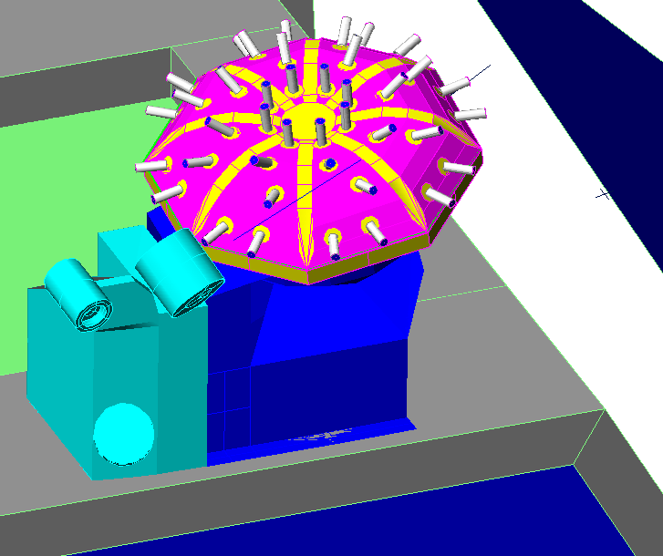
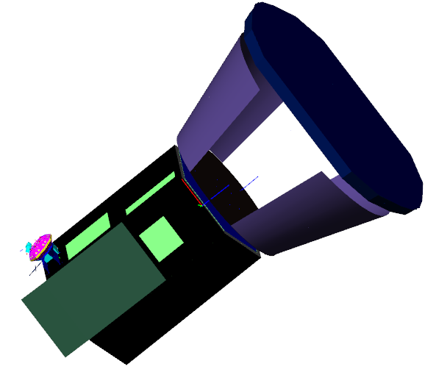
Design (3/3)
ISIS
EPI-Hi and EPI-Lo are Thermally Isolated from the Bracket
Bracket is Thermally Isolated from the S/C

Slide 8
Heaters and Sensors (1/2)
EPI-Hi Heater Operations
One S/C Thermistor on Each Telescope and Two S/C Thermistors on E-box (Primary and Redundant)
Operational Heaters on Telescopes are All on One S/C Service, but Controlled by E-box
Survival Heaters on Telescopes and the E-Box are All on One S/C Service and Controlled by S/C with Sense Location Currently Baselined as the E-box
Survival Heaters Also Used to Warm Instrument to Cold Operational Temperature for Cold Turn On by using Different Set Points

Slide 9
Heaters and Sensors (2/2)
EPI-Lo Heater Operations
Two (Primary and Redundant) S/C Thermistors on Dome for Heater Control and One More (To Be Positioned)
All Survival Heaters are on One S/C Service (Separate from EPI-Hi) Controlled by S/C with Sense Location Currently Baselined as One of the Wedges
Survival Heaters are Used to Warm Instrument to Cold Operational Temperature for Cold Turn On by Using Different Set Points
Survival Heaters are Also Used to Maintain Minimum Cold Operating Temperature During Low Power Operating Conditions

Slide 10
MLI
Coverage
Entire Instrument Other than Apertures, Radiators, and Under EPI-Hi Electronics
Specifications/Construction
Each Separate Blanket Grounded with Wire to S/C
Vented Using Edge Mesh Screens Directed away from Apertures
Edges and Seams Sealed using GBK Tape
Blankets Secured using G-10 Buttons and SS Snap Rings

Slide 11
Materials and Finishes
Radiators
Z-93 Conductive White Coating
MLI
Germanium Black Kapton (GBK)
Apertures
EPI-Hi: Metalized Polyimide
EPI-Lo: Z-93
Thermal Isolators
G-10 Fiberglass

Slide 12
Thermal Model
EPI-Hi Modeled by Vertex Aerospace
Rommel Zara and Santino Rosanova
EPI-Lo Modeled by APL
Shawn Begley
Bracket Modeled by Vertex Aerospace
ISIS Model Integrated by Vertex Aerospace
All Models Created using Thermal Desktop Software
Pre-PDR Model Delivered to S/C in June
Good Correlation between Instrument and S/C Results

Slide 13
Design Cases
Hot Operational
+65 C I/F Temperature
EOL Power and BOL Optical Properties
Low MLI e* = 0.03
Cold Operational
-25 C I/F Temperature
BOL Power and BOL Optical Properties
High MLI e* = 0.05
Cold Non-Operational
-30 I/F Temperature
BOL Optical Properties and e* = 0.05
Hot Non-Operational
1.02 AU with +70 I/F Temperature
EOL Optical Properties and e* = 0.03

Slide 14
Optical Properties
Radiator: Z-93 White Coating
BOL: a = 0.15, e = 0.91
EOL: a = 0.45, e = 0.91
MLI Exterior: GBK
BOL: a = 0.49, e = 0.81
EOL: a = 0.55, e = 0.78
EPI-Hi Apertures
HET BOL: a = 0.31, e = 0.46
LET BOL: a = 0.35, e = 0.35

Slide 15
Power Dissipation
ISIS Power Distribution
Cold Case uses CBE, Hot Case uses CBE+Cont.

Slide 16
Predictions (1/9)
EPI-Hi Hot Operational
Component | Limit (°C) | Predict (°C) | Margin (°C)
EPI-HI HET | 40 | 29.4 | 10.6
EPI-Hi LET1 | 40 | 29.5 | 10.5
EPI-Hi LET2 | 40 | 27.3 | 12.7
EPI-Hi DPU | 40 | 28.2 | 11.8
EPI-Hi Bias | 40 | 28.6 | 11.4
EPI-Hi LVPS | 40 | 29.6 | 10.4
EPI-Hi HET Tel | 30 | 3.5 | 26.5
EPI-Hi LET 1 Tel | 30 | -15.0 | 45.0
EPI-Hi LET 2 Tel | 30 | -0.5 | 30.5

Slide 17
Predictions (2/9)
EPI-Hi Cold Operational
Component | Limit (°C) | Predict (°C) | Margin (°C)
EPI-HI HET | -25 | -2.9 | 22.1
EPI-Hi LET1 | -25 | -2.9 | 22.1
EPI-Hi LET2 | -25 | -4.8 | 20.2
EPI-Hi DPU | -25 | -4.1 | 20.9
EPI-Hi Bias | -25 | -3.8 | 21.2
EPI-Hi LVPS | -25 | -2.6 | 22.4
EPI-Hi HET Tel | -25 | -20 | 5
EPI-Hi LET 1 Tel | -25 | -20 | 5
EPI-Hi LET 2 Tel | -25 | -20 | 5
Heater Location | Heater Power(W)
EPI-Hi HET TEL | 0.05
EPI-Hi LET1 TEL | 0.08
EPI-Hi LET2TEL | 0.32
TOTAL | 0.45

Slide 18
Predictions (3/9)
EPI-Lo Hot Operational
Component | Limit (°C) | Predict (°C) | Margin (°C)
Detector | 35 | 24.8 | 10.2
Event | 55 | 27.2 | 27.8
Pwr. Supply | 55 | 28.9 | 26.1
MCP | 55 | 25.2 | 29.8
Anode | 55 | 23.8 | 31.2

Slide 19
Predictions (4/9)
EPI-Lo Cold Operational
Component | Limit (°C) | Predict (°C) | Margin (°C)
Detector | -30 | -10.0 | 20.0
Event | -30 | -8.4 | 21.6
Pwr. Supply | -30 | -7.0 | 23.0
MCP | -30 | -8.8 | 21.2
Anode | -30 | -11.1 | 18.9

Slide 20
Predictions (5/9)
ISIS Heater Sizing
EPI-Lo Operational CBE Power of 4.17 W is Duty Cycled at 75% for a Heater Instantaneous Power of 5.56 W (26 V).
Temperature Setpoints of -25°C/-22°C (Operational)
Temperature Setpoints of -40°C/-37°C (Non-Operational)
EPI-Hi Operational CBE Power of 5.81 W is Duty Cycled at 75% for a Heater Instantaneous Power of 7.74 W (26 V).
HET TEL: 0.3 W
LET1 TEL: 0.8 W
LET 2 TEL: 0.5 W
EBOX: 6.15 W
Temperature Setpoints of -20°C/-17°C (Operational)
Temperature Setpoints of -35°C/-32°C (Non-Operational)

Slide 21
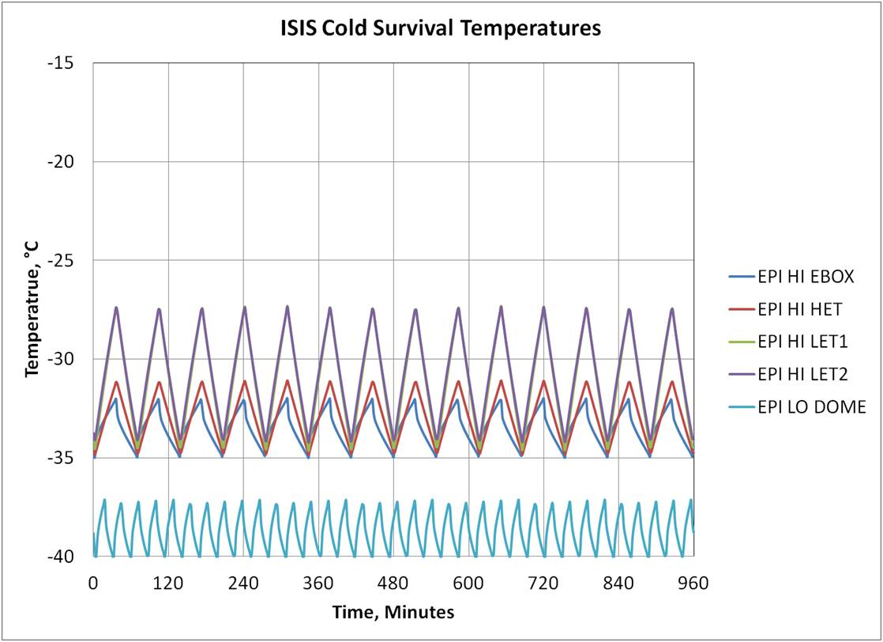
Predictions (6/9)
ISIS Cold Non-Operational Temperatures
Component | Avg.Heater Power, W
EPI LO | 2.30 (2.82 Allocation)
EPI HI Ebox | 3.09 | 3.90 (4.38)
EPI HI HET 1 | 0.25
EPI HI LET 1 | 0.15
EPI HI LET 2 | 0.40

Slide 22
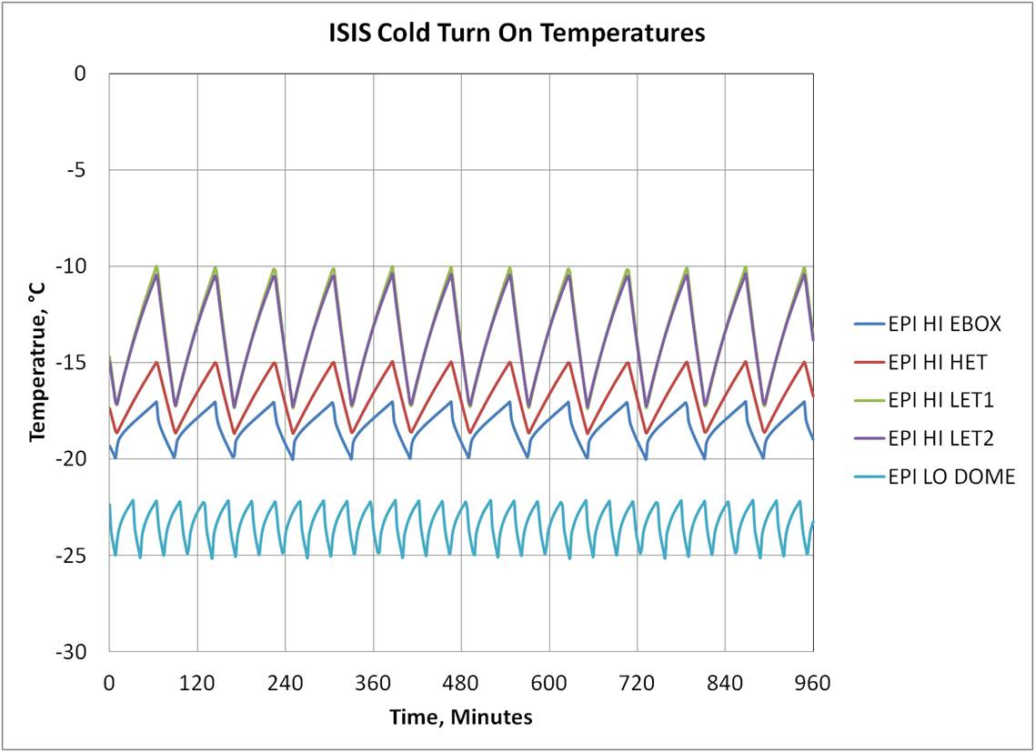
Predictions (7/9)
ISIS Warm Up Temperatures
Component | Avg. Heater Power, W
EPI LO | 3.40
EPI HI Ebox | 4.26 | 5.37
EPI HI HET 1 | 0.35
EPI HI LET 1 | 0.21
EPI HI LET 2 | 0.55

Slide 23
Predictions (8/9)
ISIS Hot Non-Operational Temperature Plot

Slide 24
Predictions (9/9)
ISIS Hot Non-Operational Temperature Table
Component | Hot Surv Predict, °C | Hot Surv Limit, °C | Margin, °C
IS_ISIS_TEL_HET | 7.0 | 55.0 | 48.0
IS_ISIS_TEL_LET1 | 26.8 | 55.0 | 28.2
IS_ISIS_TEL_LET2 | 30.8 | 55.0 | 24.2
IS_ISIS_EPI_HI_BIAS | 8.9 | 55.0 | 46.1
IS_ISIS_EPI_HI_DPU | 9.1 | 55.0 | 45.9
IS_ISIS_EPI_HI_HET | 8.9 | 55.0 | 46.1
IS_ISIS_EPI_HI_LET1 | 8.9 | 55.0 | 46.1
IS_ISIS_EPI_HI_LET2 | 9.1 | 55.0 | 45.9
IS_ISIS_EPI_HI_LVPS | 9.2 | 55.0 | 45.8
Component | Hot Surv Predict, °C | Hot Surv Limit, °C | Margin, °C
IS_ISIS_EPI_LO_DETECTOR | 42.5 | 55.0 | 12.5
IS_ISIS_EPI_LO_EVENT | 42.2 | 55.0 | 12.8
IS_ISIS_EPI_LO_PWR_SUPPLY | 42.1 | 55.0 | 12.9
IS_ISIS_EPI_LO_MCP | 42.3 | 55.0 | 12.7
IS_ISIS_EPI_LO_ANODE | 42.2 | 55.0 | 12.8
IS_ISIS_EPI_LO_DOME | 42.7 | 55.0 | 12.3

Slide 25
Verification (1/2)
ISIS Thermal Vacuum Profile
Six Operational Cycles
One Survival Cycle

Slide 26
Verification (2/2)
ISIS Thermal Balance
Three Cases: Hot Operational, Cold Operational, and Cold Survival
Temperature Controlled Baseplate to S/C I/F Temperature Limits
Radiators with View to LN2 Cooled Chamber Shroud
Verify Heater Duty Cycle
Verify Interface Conductances
Correlate Thermal Model

Slide 27
Summary
Instrument Requirements (Temperature Limits) are Defined
Thermal Environments and Interfaces are Defined
Resources (Heater Power) have been Iterated and Baselined
The Thermal Design Presented and Analyzed Meets all Requirements in the Specified Environments within the Allocated Resources

