Slide 1
ISIS Structural
Nick Alexander
ISIS Mechanical Engineer (SwRI)
This document contains technical data that may be controlled by the International Traffic in Arms Regulations (22 CFR 120-130) and may not be provided, disclosed or transferred in any manner to any person, whether in the U.S. or abroad, who is not 1) a citizen of the United States, 2) a lawful permanent resident of the United States, or 3) a protected individual as defined by 8 USC 1324b(a)(3), without the written permission of the United States Department of State.
Notes:
introduction

Slide 2
Outline
EPI-Hi Structural Analysis*
  Requirements
  FEM/Boundary Conditions
  Modal Results
  Stress Results
ISIS Bracket Structural Analysis
  Mechanical design/structural requirements
  ISIS overall mechanical configuration
  FEM/Boundary Conditions
  Modal Results
  Stress Results
  Structural design margins and plans for strength verification
  * EPI-Lo structural analysis shown in EPI-Lo mechanical presentation

Slide 3
EPI-Hi Structural Analysis Requirements
Design Requirements taken from SPP Environmental Design and Test Requirements Document (EDTRD), Document 7434-9039 Revision –
  A structural analysis shall be completed to verify the component structural integrity.
  Instrument minimum resonant frequency shall be greater than 80 Hz.
  PWAs shall be designed to have a first structural resonance frequency above 150 Hz.
  All bus-mounted components and subsystems shall be designed to the quasi-static accelerations derived from the MAC (Mass Acceleration Curve).

Slide 4
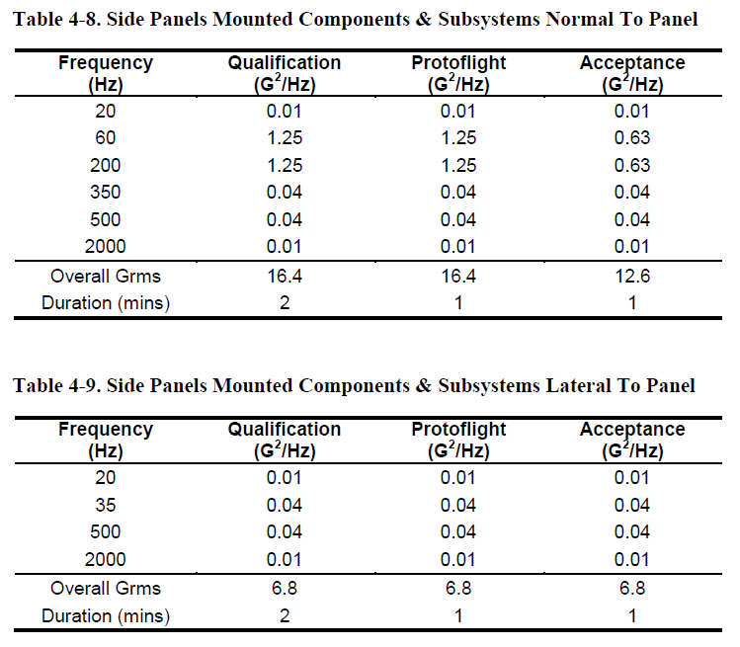
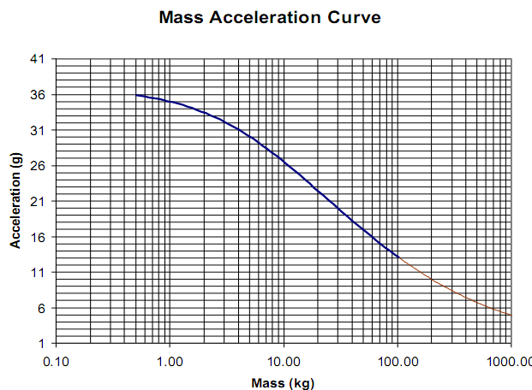
EPI-Hi Environments
Random Vibration ASD Specifications
EPI-HI: Mass with uncertainty=4.0 kg
MAC: for 4.0 kg, Acceleration=31 g
EPI-HI: Y-direction is Normal to Panel;
X & Z-directions are Lateral to Panel
Analysis Employs Qualification Level Loads

Slide 5
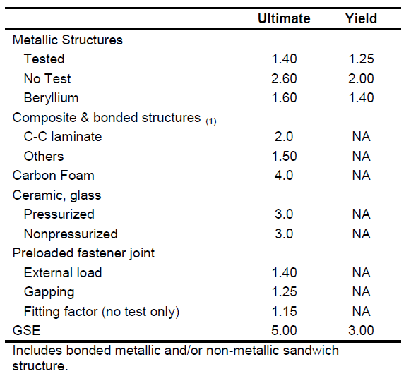
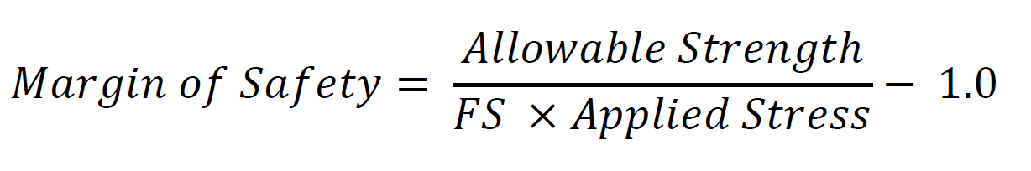
EPI-Hi Factors of Safety
The tabulated factors of safety are applied to the limit loads for quasi-static and sine vibration loads.
For random vibration, an additional factor of 1.28 is added to the factors of safety for ultimate and yield.
For random vibration analysis, the 3-sigma RMS response from the finite element analysis is employed to calculate margins.
Margins of safety calculated using equation on right:

Slide 6
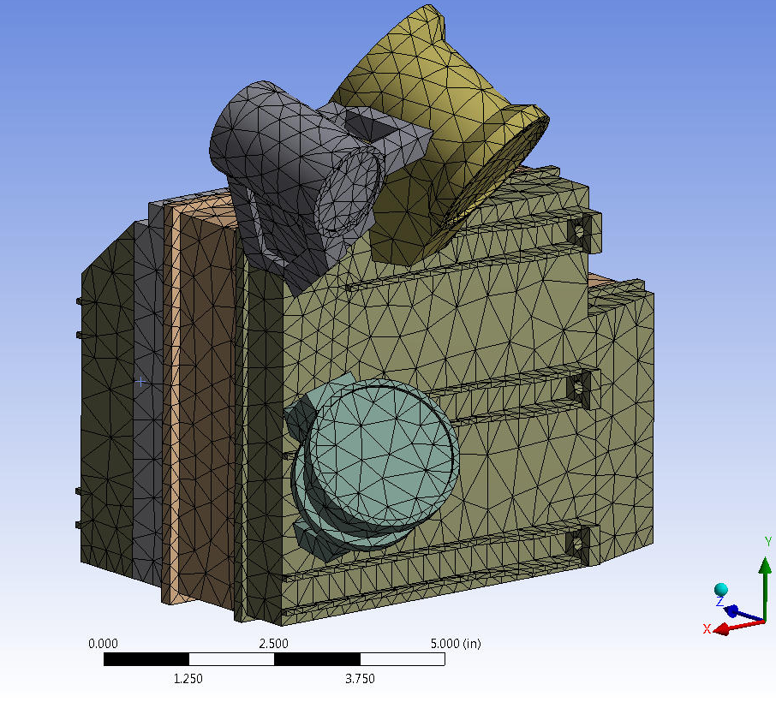
EPI-Hi FEM/Boundary Conditions
FE Model Mass = 4.026 kg (CBE mass plus uncertainty)
Fixed at mounting holes on feet (5 places)

Slide 7
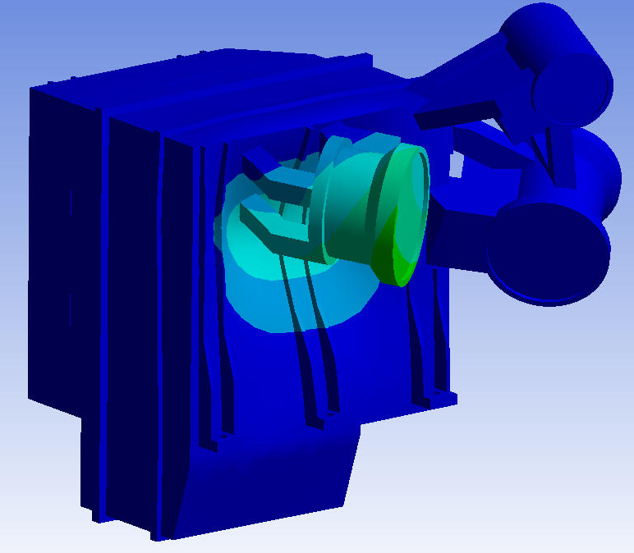
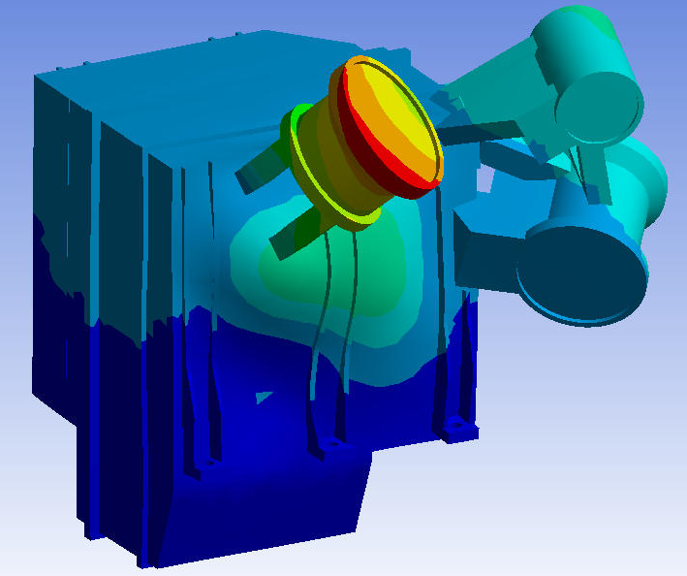
EPI-Hi Modal Frequencies (1/2)
Instrument Fundamental Frequencies
  471 Hz
  (side panel diaphragm mode coupled with internal boards)
  639 Hz
  (instrument rocking mode)

Slide 8
EPI-Hi Modal Frequencies (2/2)
PWA Modes
  All PWA Fundamental Frequencies > 150 Hz (EDTRD_0307)

Slide 9
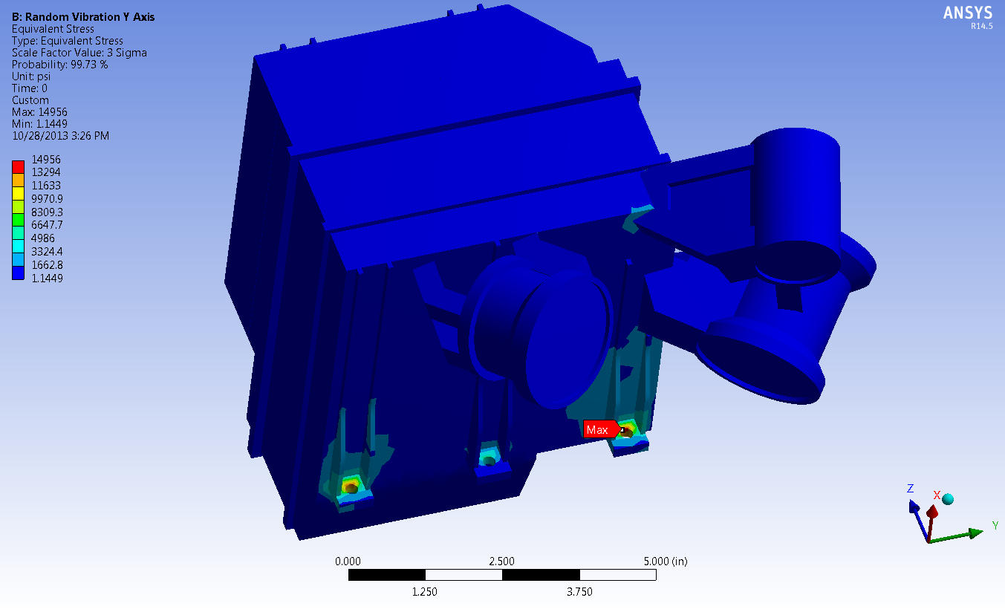
EPI-Hi Stress Results
Worst Case Stress:
14956 psi; occurs at housing foot in the Y-axis Random Vibration load case

Slide 10
ISIS Bracket
Mechanical Design Requirements
ISIS bracket must hold EPI-Hi and EPI-Lo in position on the SPP deck
ISIS bracket must be capable of independently removing EPI-Hi and EPI-Lo, in either order
ISIS bracket must survive all environments for deck mounted components
  Random vibration
  Sine vibration
  Shock
All ISIS suite testing shall be performed on the bracket, with instruments or instrument analogs as appropriate

Slide 11
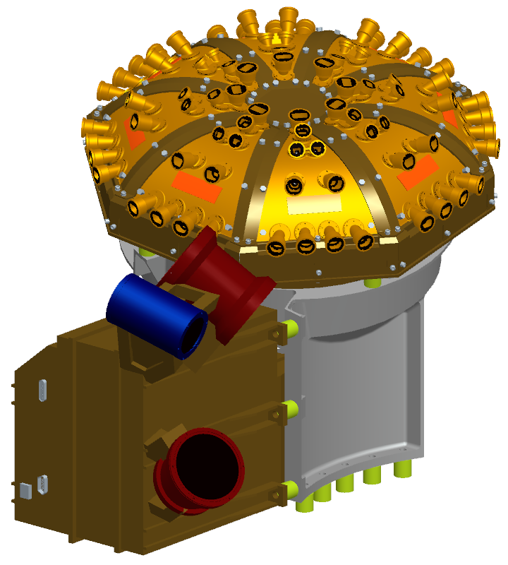
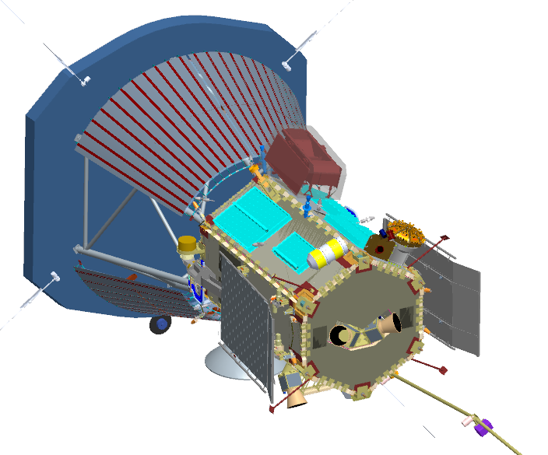
ISIS Mechanical Design Overview

Slide 12
ISIS Bracket Design Overview

Slide 13
ISIS Bracket Fabrication
The ISIS bracket can be machined using conventional machining processes
  Monolithic design, will be machined from a single block
  All operations can be performed on conventional machines (i.e. lathe, mill, etc.)
Thermal isolators and mass models will also be fabricated to be used during structural testing
  G10 isolators will be machined to flight-like quality
  Mass models to reflect instrument mass properties with flight-like mounting interfaces
Bracket height increase due to TPS shift can easily be accommodated as needed
  Working with S/C mechanical team; any shift in the TPS only requires translation normal to the deck to remain adjacent to the umbra

Slide 14
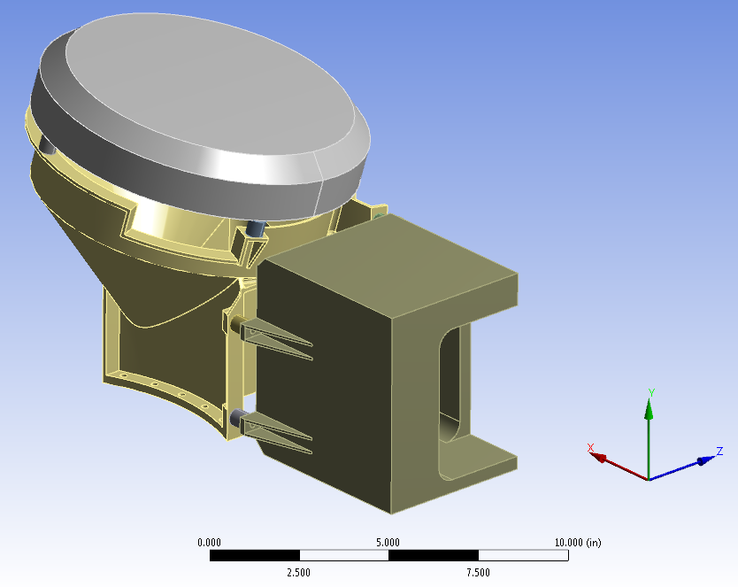
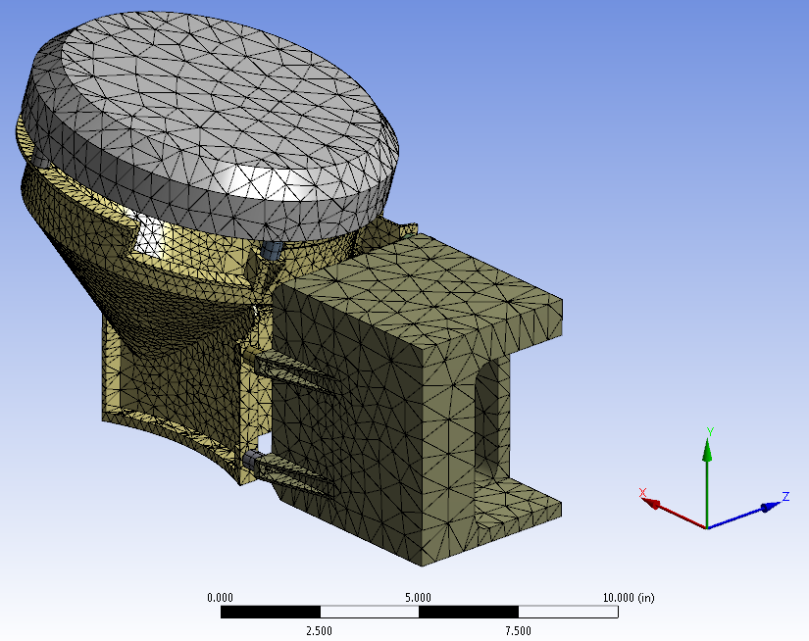
ISIS Bracket FEM/Boundary Conditions
Model includes bracket, EPI-Hi and EPI-Lo mass models (at max allocation) and thermal isolators
  Bracket: Aluminum 7075-T6 properties
  Mass models: Aluminum 6061-T6 properties
  Thermal isolators: G10 material properties
Mass models represent accurate mass and CG properties
  Test results will be easy to compare to model
  Mass models are stiff enough to not introduce modes
Edge to surface connections for all mounting interfaces
Fixed supports on 10 bracket mounting holes

Slide 15
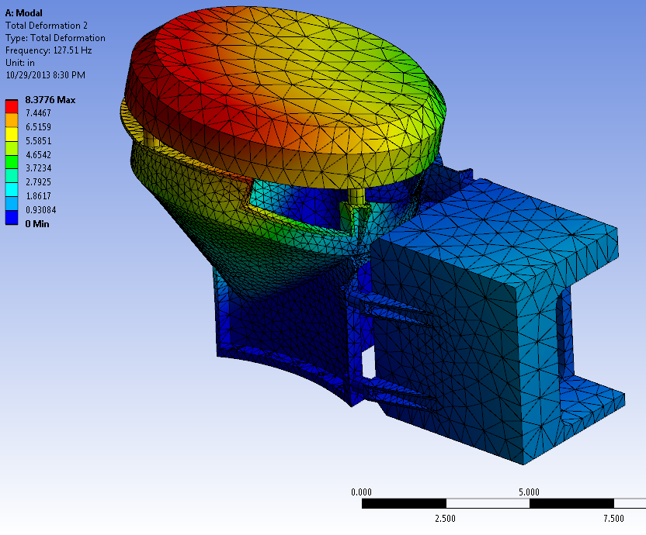
ISIS Bracket FEM - Modal Results
Primary Mode:
127.51 Hz
(rocking mode)
Requirement:
80 Hz minimum

Slide 16
ISIS Bracket FEM - Structural Setup
Random Vibration ASD Specifications
ISIS: NTE Mass=7.74 kg
MAC: for 7.74 kg, Acceleration=28 g
ISIS: Y-direction is Normal to Panel;
X & Z-directions are Lateral to Panel
Analysis Employs Qualification Level Loads with Notching

Slide 17
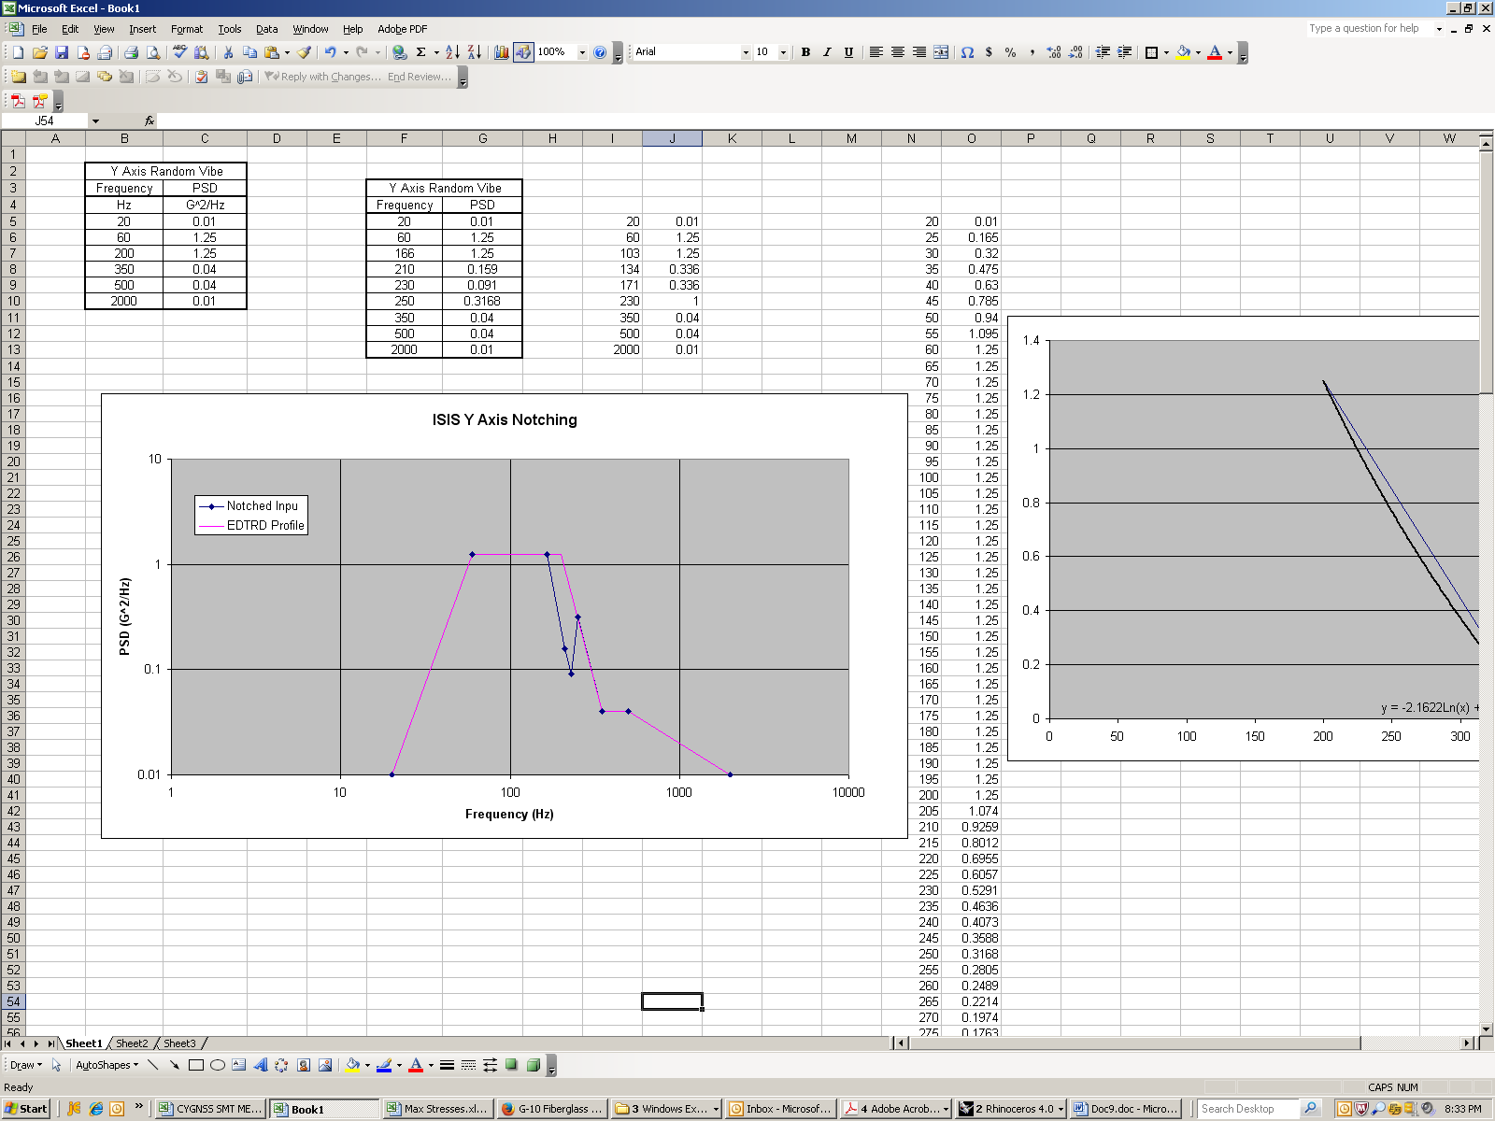
ISIS Bracket FEM - Notching
Notching performed on the Y Axis in accordance with ETDRD Section 4.4.7.4
  CBE Mass: 7.74 kg
  MAC Acceleration: 28 G
  MAC Limit Load: 1.25
  Notching Limit Load: 2657.5 N (35 G)
  Un-notched Reaction Load: 7498.8 N
  Notch Depth: 7.65dB, Notch Width: 20 Hz, Ramp: +/-15 dB/Oct
  Notched Frequency: 220 Hz
  Resulting Profile
  Resulting Reaction Load: 5588.7N

Slide 18
ISIS Bracket Structural Design Margins
The tabulated factors of safety are applied to the limit loads for quasi-static, random and sine vibration loads.
For random vibration analysis, the 3-sigma RMS response from the finite element analysis is employed to calculate margins.
Margins of safety calculated using equation on right:

Slide 19
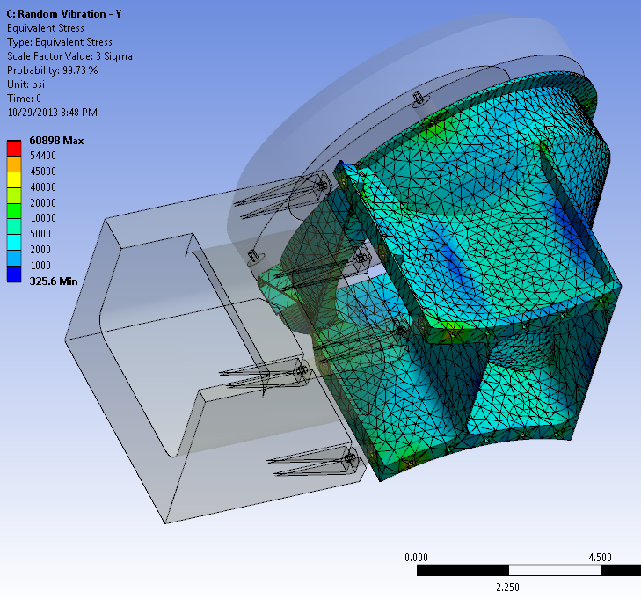
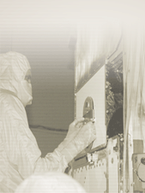
ISIS Bracket Stress Results (Preliminary)
Worst Case Stress:
49979 psi; occurs at S/C Interface Bolt in the Y-axis Random Vibration load case

Slide 20
ISIS Bracket Structural Testing
ISIS bracket will be tested at SwRI facilities with EPI-Hi and EPI-Lo mass models
  G10 thermal isolators will be included
  Mounted using flight quality mounting hardware
Tests will check natural frequency, random vibe response, sine vibe response
  Natural frequency must be >80 Hz (EDTRD_0095)
  Must survive random vibration loads (EDTRD_0111) per tables in EDTRD 4.4.3
  Must survive sine sweep loads (EDTRD_0114) per sine environment (TBD) given in EDTRD 4.4.4
  Pre & post test low-level sine sweeps used to identify any change in fundamental frequency
Once fabricated and tested at SwRI, ISIS bracket will be used in support of EPI-Hi and EPI-Lo environmental testing

Slide 21
Summary
EPI-Hi, EPI-Lo, and ISIS Bracket modeling have been completed
  Satisfies EDTRD requirements
  Have required margins of safety
Ready to begin EM Fabrication and move into Phase C

