Slide 1
EMI / EMC
Reid Gurnee
EPI-Lo SE (JHU/APL)
This document contains technical data that may be controlled by the International Traffic in Arms Regulations (22 CFR 120-130) and may not be provided, disclosed or transferred in any manner to any person, whether in the U.S. or abroad, who is not 1) a citizen of the United States, 2) a lawful permanent resident of the United States, or 3) a protected individual as defined by 8 USC 1324b(a)(3), without the written permission of the United States Department of State.
Notes:
introduction

Slide 2
Outline
EMC Design Considerations
EMC Grounding
EMC Testing
Heritage CE performance
Summary

Slide 3
EMC Design Considerations (1/3)
Power supplies crystal controlled to a frequency window centered at n*50 kHz with n>=3 and 500 ppm wide over all operating conditions and time.
The LVPS is synchronized to 200 kHz by a 400 kHz clock provided by the digital boards.
EPI-Hi has 58.8 MHz oscillator and EPI-Lo has 40 MHz oscillator. Both evenly divide to 400 kHz.
Transformers and big inductors are placed as far from Box walls as possible.
Stable currents to minimize changes in Magnetic Emissions
Control all current paths inside your box to minimize loop area. Cannot use a solid return plane if a trace is the source. Any circuit over 100 milliamps AC or 1 amp DC will be analyzed.
LVPS has AC currents on primary transformer that exceed 100 mA.
EPI-Hi op-heaters can draw only about 30 mA @ 33V.

Slide 4
EMC Design Considerations (2/3)
All Cables outside the metal box must be twisted shielded with 360° shields terminated to the Box with less than 20 mOhms.
EPI-Lo has no external cables.
EPI-Hi has an external thermal harness for thermal hardware mounted on 3 telescopes and E-box and will meet these requirements.
EMI Backshells not required by EME but shield must cover connector fully.
EPI-Lo and EPI-Hi boxes designed to accommodate backshells for S/C data and power connectors.
Connector shell to Box resistance before mated < 5 mOhms
Any cable outside the spacecraft body attached to a device must have either 13 mils shielding or DDD first circuit protection.
EPI-Lo has no external cables.
EPI-Hi’s external thermal harness will have adequate shielding.
S/C data / power cable shielding 8 mils (TBR). S/C interfaces designed to handle DDD.

Slide 5
EMC Design Considerations (3/3)
All use of Magnetic Materials (Nickel, 400 Series CRSS, etc) must be identified and approved by the project. High Phosphor Nickel coating is allowed because it is not magnetic.
EPI-Lo has Nickel grids. Working with Project to develop magnetic mitigation plan.
EPI-Hi has no major Nickel parts, only Ni-plated connectors.

Slide 6
EMC Grounding
Primary power supplies isolated by >1 MΩ.
Secondary power supply returns tied to chassis with <2.5 mΩ in only the Box using the power.
Grounding Diagrams will show all chassis grounds, primary and secondary power feeds and returns, shields, and signals with returns.
ID all connector pins with first circuits.
Connectors unused in flight shall have a conductive cover with less that 10 mΩ from cover to Box chassis.
“Conductive” Box exterior
Exterior on EPI-Lo will be MLI StaMet outer finish, and Z93C55 white conductive paint.
Exterior on EPI-Hi will be MLI and radiator surfaces.
Box design must be at least tongue and groove. EMI gaskets on flat joints is acceptable.
EPI-Lo utilizes overlap joints and copper tape as necessary to seal seams.
EPI-Hi enclosure uses overlap joints, light-tight by design, and copper tape as necessary.

Slide 7
EMC Testing
Early Testing (Breadboard, Card level, Engineering Model (EM)) can identify a problem when it can still be fixed without major schedule slip.
Doing conducted emissions (CE) can find most issues.
Initial CE test on LVPS will occur in Q1 2014. EPI-Hi and EPI-Lo will test EM units for CE in Q4 2014.
Required Tests: | Bonding & Isolation
Conducted Emissions: | CE-01, CE-02, CE-07
Conducted Susceptibility: | CS-01, CS-02, CS-06
Radiated Emissions: | RE-01, RE-02, Mag Sniff
Radiated Susceptibility: | RS-03, ESD

Slide 8
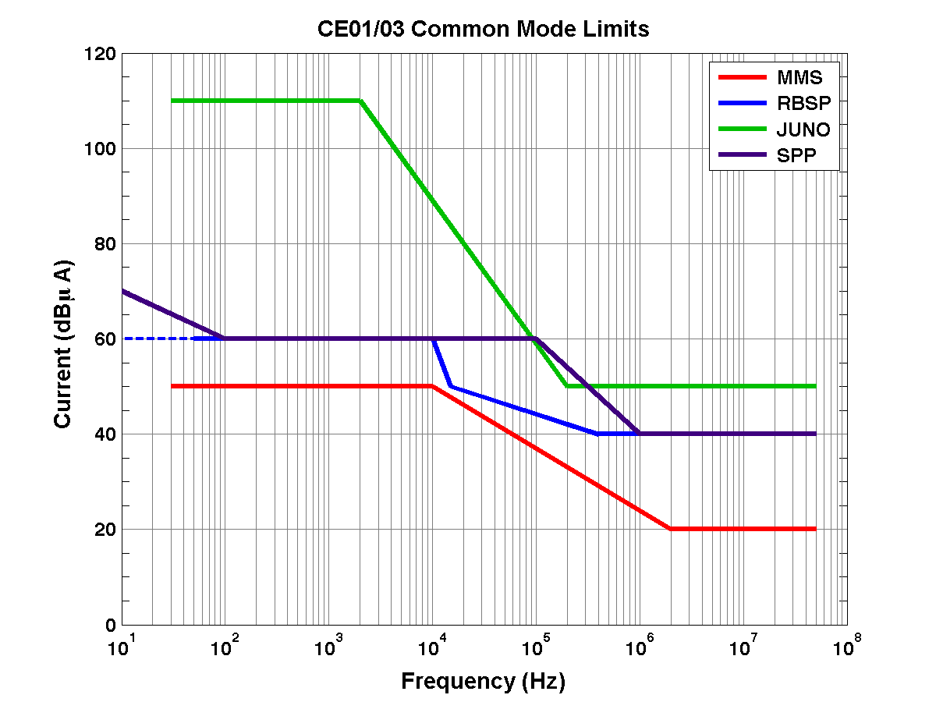
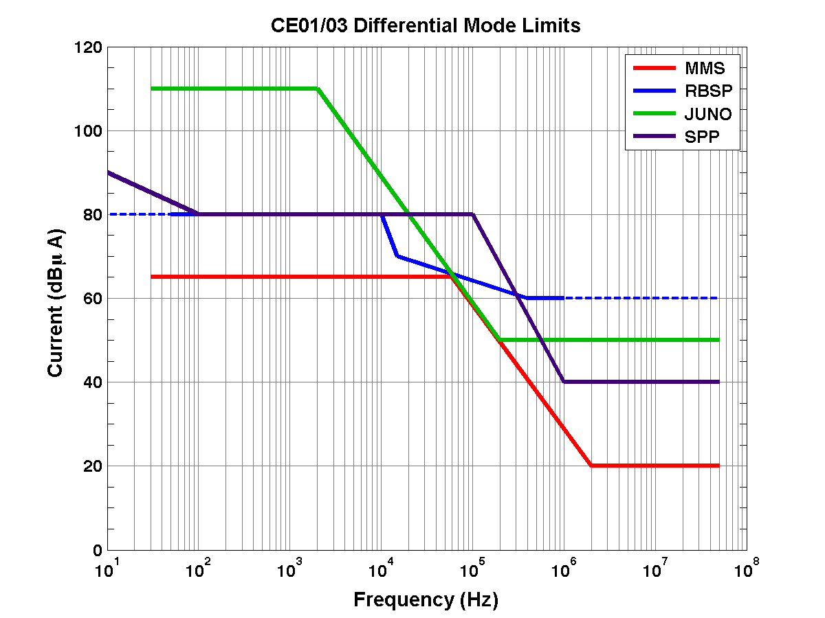
LVPS CE Predicted Performance
Based on heritage supply that meets MMS requirements

Slide 9
Summary
EMI/EMC design considerations being followed
No CE issues expected
Early testing will allow time to mitigate
EPI-Lo Ni grid concerns mitigated with careful handling, use of non-magnetic tools, and testing

