Slide 1
ISIS Power
David Do
LVPS Engineer (JHU/APL)
This document contains technical data that may be controlled by the International Traffic in Arms Regulations (22 CFR 120-130) and may not be provided, disclosed or transferred in any manner to any person, whether in the U.S. or abroad, who is not 1) a citizen of the United States, 2) a lawful permanent resident of the United States, or 3) a protected individual as defined by 8 USC 1324b(a)(3), without the written permission of the United States Department of State.
Notes:
introduction

Slide 2
Outline
Overview
Requirements
Packaging
Analysis
Parts
Testing
Status Summary
Plan Forward
Peer Reviews

Slide 3
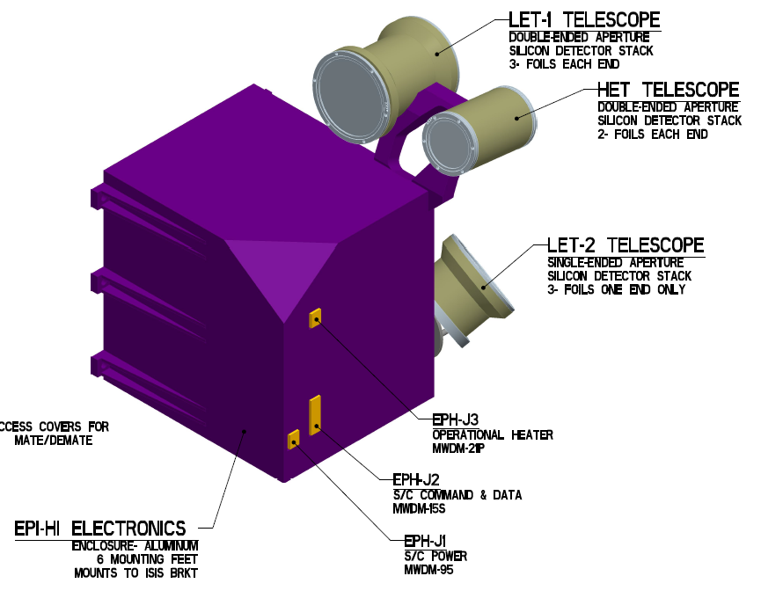
EPI-Hi Electronics Overview

Slide 4
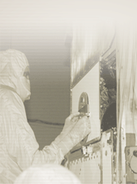
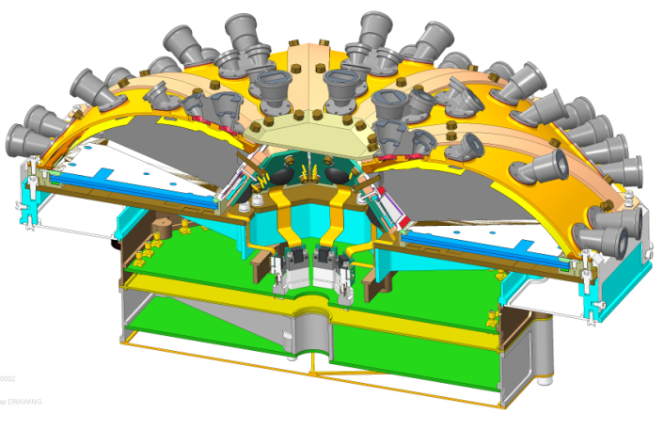
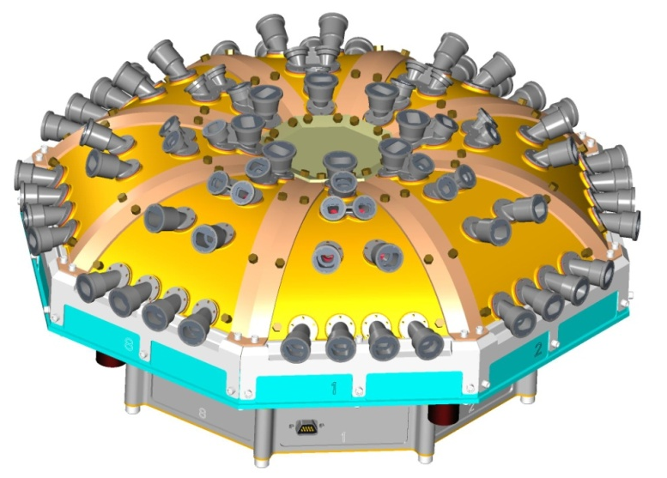
EPI-Lo Electronics Overview
Energy Boards (x8)
Anode Boards (x4)
Event Board
Power Board

Slide 5
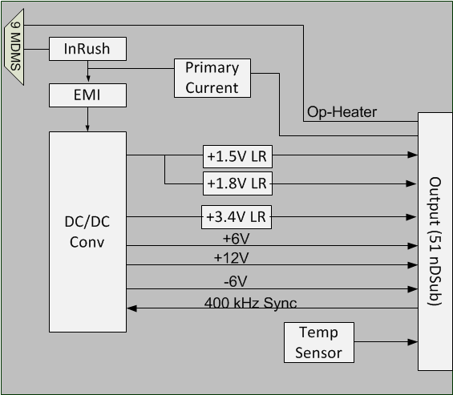
EPI-Hi Block Diagram

Slide 6
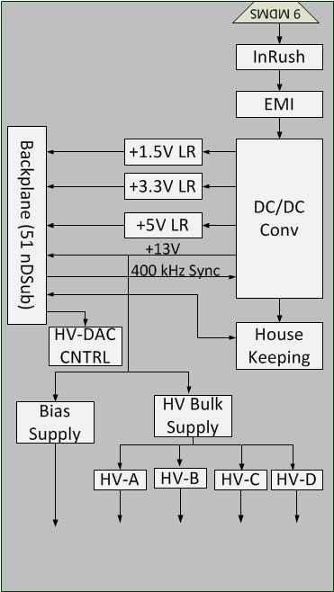
EPI-Lo Block Diagram

Slide 7
Environment Requirements
Thermal
  Survival is -55°C to +85°C
  Operational is -35°C to +65°C
Radiation
  25 krad (includes RDM=2 from FASTrad analysis)
  LET > 80 MeV*cm2/mg

Slide 8
LVPS Major Input Requirements
Requirements from Solar Probe Bus
Input Specification
  Operate over bus voltage of 22 to 35 V
  Survive any standing or fluctuating voltage from 0 to 40 V
  Meet EMI/EMC
  Transformer and power inductor far away from wall
  Power supplies crystal controlled to a frequency window centered at n*50 kHz with n>=3 and 500 ppm wide over all operating conditions and time.
  Inrush current limit
  Primary Secondary isolation >1 MOhm
  Overall efficiency > 70%

Slide 9
Input Power Requirement
  EMI/EMC
  Inrush Current
CE01& CE03 Limit
In-Rush Current Limit

Slide 10
Interface
EPI-Hi
  Input connector: MWDM2L-9SCBRR2-.110-429
  Output connector: 891-008-51PSBRT1T-429TH
EPI-Lo
  Input connector: MWDM_L-9SSMR
  Inter board connector: 891-008-51PSBRT1T-429
  Safing connector: 803-005-07M5-3EN
  Bias voltage connector: 09-9001-1
  High voltage: Pig tails

Slide 11
Power Topology
Common for EPI-Hi and EPI-Lo:
  Main converter is forward with resonant reset operating
  at 200 kHz. Efficiency is >80%.
  Digital voltages are linear regulated.
EPI-Lo HVPS:
  Bulk high voltage is set at 3.4 kV.
  High voltages of up to 3.3 kV are controlled through Opto-couplers.
  Bias voltage is up to 200 V.

Slide 12
Output Requirements
EPI-Hi:
  Generate low voltages: +12 V, +6 V, +3.3 V, +1.8 V, +1.5 V & -6 V
  Primary input current telemetry
  Temp sensor
  Provide path for Op-heater voltage
EPI-Lo:
  Generate low voltages: +13 V, +5 V, +3.3 V and +1.5 V
  House keeping through ADC for primary input current, temperature, output currents and output voltages
  Generate high voltages and bias voltages to sensors
  Hard and soft high voltage safing

Slide 13
EPI-Hi Output Requirements
 | Output Regulation | Min Load (mA) | Nom Load (mA) | Max Load (mA)
+1.53V | ±2.5% | 50 | 100 | 150
+1.82V | ±2.5% | 20 | 40 | 60
+3.41V | ±2.5% | 145 | 287 | 430
+6V | ±7% | 79 | 338 | 500
+12V | ±7% | 8 | 16 | 64
-6V | ±5% | 6 | 12.6 | 19

Slide 14
EPI-Lo Output Requirement
 | Outputs Regulation | Min Load (mA) | Nom Load (mA) | Max Load (mA)
+1.5V | ±3% | 45 | 80 | 200
+3.3V | ±3% | 150 | 200 | 460
+5V | ±5% | 115 | 135 | 160
+13V | ±5% | 10 | 63 | 90

Slide 15
Sensor Voltages
Collimators
Grounded Foils
Tecan Grid
SSD
1000V
100V
+ 900V
MCP
MCP
+2900V
+3000V
100V
Anode/Preamp
900V (total diode drop)
MCP Return is a ground reference at HVPS (allows MCP current measurement across resistor)
MCP return
HVPS Out +3300V Max

Slide 16
EPI-Lo HVPS Requirements
 | Max Output Voltage (V) | Min Load (uA) | Max Load (uA)
Bias | 200 | 0 | 20
Bulk | 3400 | 0 | 250
HVPS | 3300 | 0 | 50
Grid | 1000 | 0 | 1
MCP | 900 | 0 | 50

Slide 17
HVPS Current Limit
Control range: 0 uA to 200 uA
Control granularity: <1 uA
Response time: <1 ms
LVPS sends over-current signal to event board
Event board turns off high voltage output and resets DAC

Slide 18
LVDS Fault Mitigation
Transformer: primary and +3.3 V winding is well isolated by +13 V and +6 V windings
+3.3 V is linear regulated from +3.6 V
Linear pass transistor is rated for 100 V
Worse case fault LVPS goes to full duty cycle, which results in +7.5 V output on +3.6 V
Preliminary thermal analysis shows 33°C rise in linear regulator
DC/DC
+3.6 V
Linear
+3.3 V

Slide 19

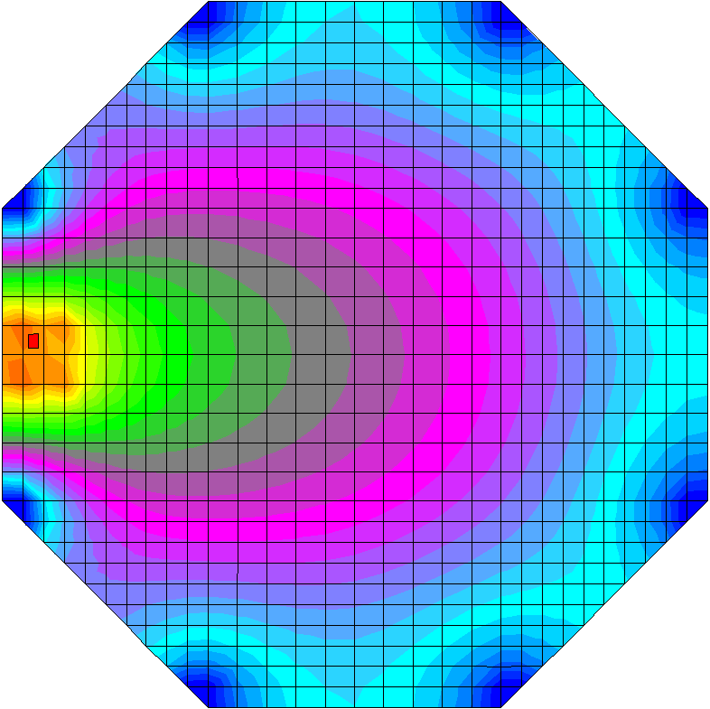
Worst Case Thermal Analysis
6 oz Cu in PWB
Thermal contours plot shown with 8 W total power dissipation
Actual power dissipation <2.5 W
TO-254 temps for 6 oz
  Junction = 32.8°C
  Case = 13.2°C

Slide 20
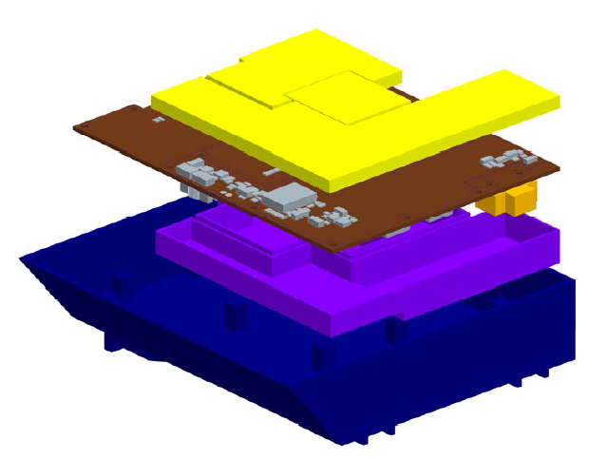
EPI-Hi Package
Top Shields
LVPS Board
Bottom Shields
Chassis

Slide 21
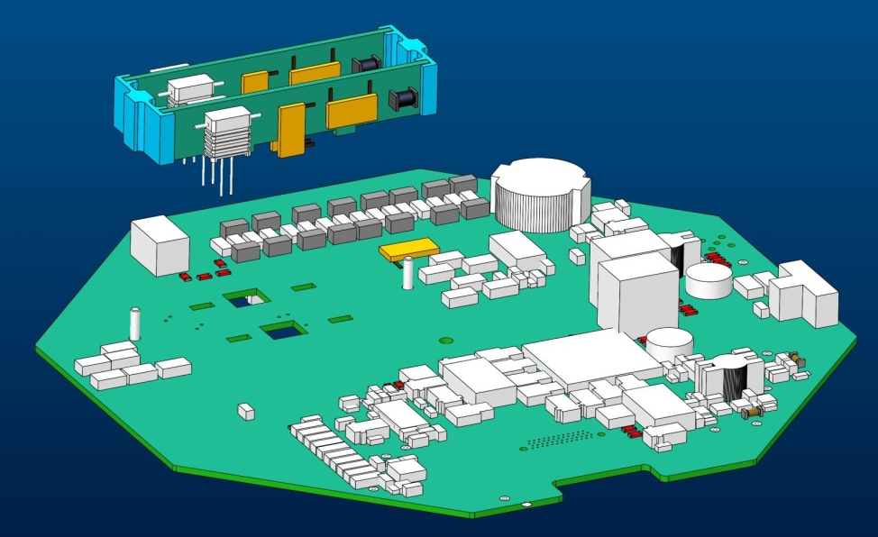
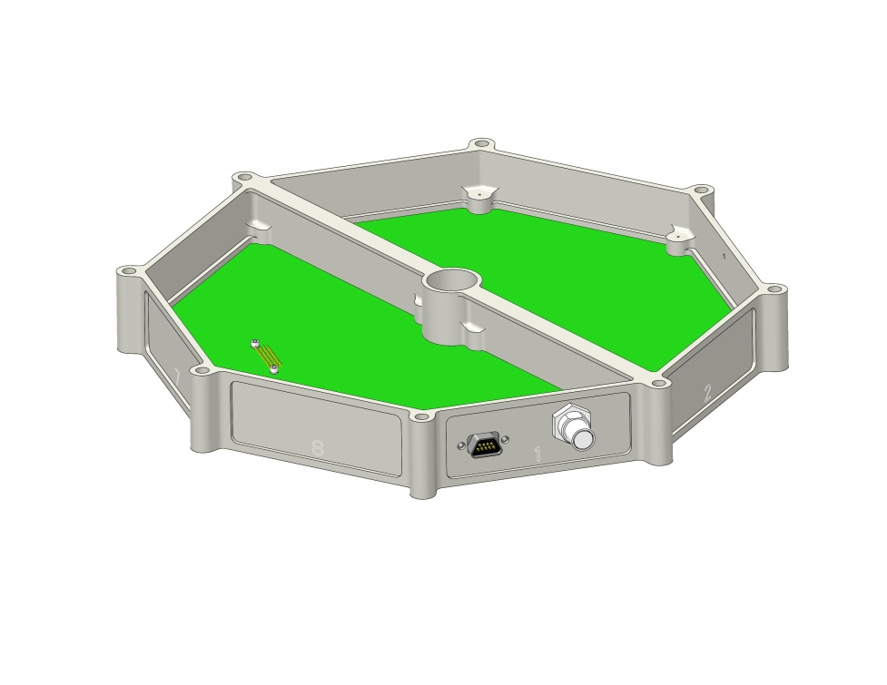
EPI-Lo Packaging
Interconnect
Packaged in octagon frame
2 daughter boards for high voltages
Stiffener goes across the board
Power dissipation is estimated <2.5 W
Input
Safing

Slide 22
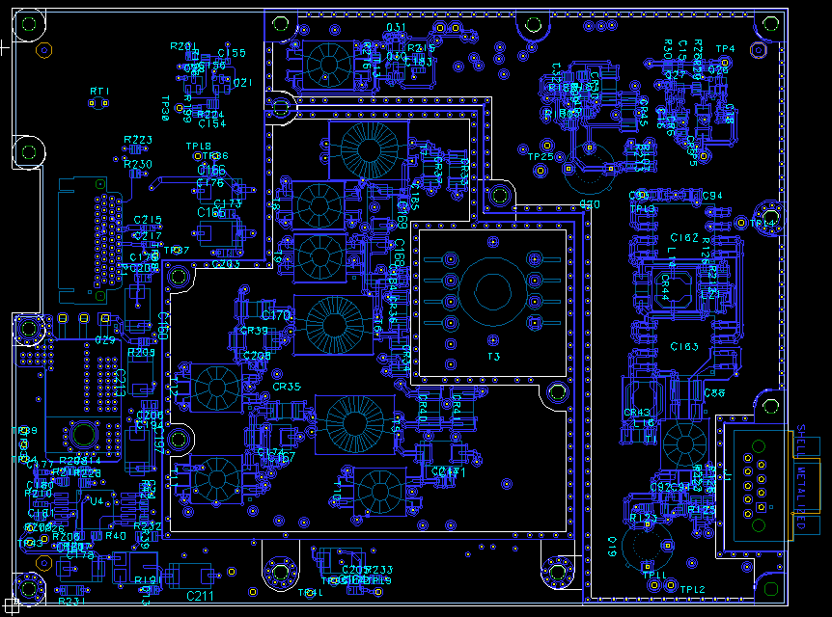
EPI-Hi Board Layout
Secondary Shield
Primary
Shield
Output
XFORMER
Input

Slide 23
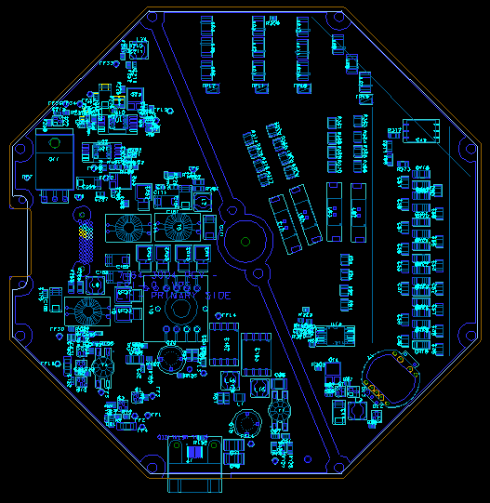
EPI-Lo Board Placement
HVPS
LVPS
XFORMER

Slide 24
Nominal Output Regulation and Efficiency
 | Load(A) | Regulation(V) | Power(W)
+1.53V | 0.14 | 1.505 | 0.2107
+3.41V | 0.287 | 3.69* | 0.9758
+6V | 0.338 | 5.97 | 2.01786
+12V | 0.016 | 11.98 | 0.19168
-6V | 0.012 | 5.95 | 0.0714
input | 0.159 | 28 | 4.452
 |  |  | 78%
*+3.41V shown pre-regulated. Efficiency is calculated using +3.4 V.
+3.41 V and +1.82V linear regulator have same design as +1.53 V.

Slide 25
Analysis
Preliminary EMI completed
WCA for digital voltages regulation = ±2.3%

Slide 26
Voltage Regulation WCA Method and Assumptions
WCA Method
  Extreme Value Analysis in Mathcad
Temperature Range
  -35°C to + 65°C operational
Resistors Variation
  K resistors are 100 ppm (0.8%) + 1% initial tolerance + 2% Aging ≈ 4%
  E resistors are 25 ppm (0.2%) + 0.1% initial tolerance + 1% Aging ≈ 1.3%
  Z resistor are 5ppm(0.04%)+ 0.01% initial tolerance 0.16% Aging ≈ 0.2%
RH1078
  100 Krad data from datasheet
PWM5302S
  100 Krad data from datasheet

Slide 27
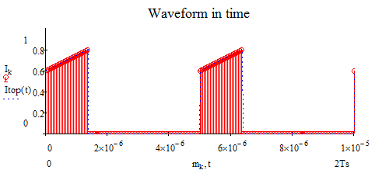
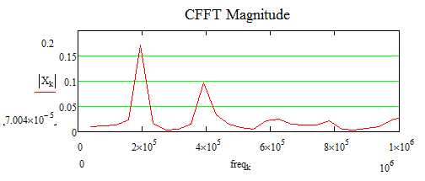
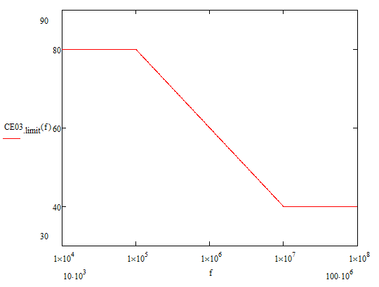
EPI-Lo EMI Analysis
Primary Current in Discrete Time
Primary Current in CFFT
CE03 Limit
EMI Filter Attenuation

Slide 28
Parts
All parts are rad-hard to >100 krad
Parts submitted to PCB. No issues expected.
Part Number | Description | Manufacture
PWM3052S | PWM IC | Aeroflex
ADC128S102QML | 12 Bit-ADC | TI
RH1009MW | 2.5V Reference | Linear Tech
RH1078MW | Low power Opamp | Linear Tech
M49470X01335KBB | Stacked 3.3uF Ceramic | Presidio
IRHNM57110 | 100V N Channel FET | IR
JANSR1N5811US | 100V Schottky Diode | Microsemi
JANSR2N2222AUB | NPN transistor | Microsemi
JANSR2N3501UB | NPN transistor | Microsemi
66353 | High voltage opto | Micropac
ADCMP600 | Comparator | Analog Devices

Slide 29
Plans for Testing
Follows APL manufacturing flow
Significant highlights:
  Populate Passive Components with Automatic Measurement.
  Populate Actives and Install Known Tailors or Tailor Flags
  Install into Flight Frame
  Execute Test Procedure to Test and Tailor Entire Board
  ESS Testing
  Execute Functional Test Procedure
  Photograph and Conformal Coat
  Execute Test Procedure to Calibrate and Characterize Board (over temperature)
  Release to Next Assembly

Slide 30
Status Summary
EPI-Hi
  EM PWB is being fabricated
EPI-Lo
  EM is in placement and layout phase

Slide 31
Plan Forward
EPI-Hi
  Complete testing EM
  Fabricate flight
EPI-Lo
  Fabricate and complete testing EM
  Fabricate flight
Finalize all documentation and procedures for flight build
Build, tailor, calibrate, and qualify flight units

Slide 32
Peer Reviews
EPI-Hi LVPS: May 2013, 27 AIs all closed SRI-13-026
EPI-Lo Power: Aug 2013, 5 AIs all closed SRI-13-029
Major Action Items:
  EPI-Hi:
    Shielding over switching circuits
    Output loads
    Output regulations
  EPI-Lo:
    MCP voltage accuracy
    LVDS fault mitigation
    Bias Voltage Zener diode protection

