Slide 1
EPI-Hi Mechanical
Sandy Shuman
EPI-Hi Mechanical (GSFC)
This document contains technical data that may be controlled by the International Traffic in Arms Regulations (22 CFR 120-130) and may not be provided, disclosed or transferred in any manner to any person, whether in the U.S. or abroad, who is not 1) a citizen of the United States, 2) a lawful permanent resident of the United States, or 3) a protected individual as defined by 8 USC 1324b(a)(3), without the written permission of the United States Department of State.

Slide 2
EPI-Hi Outline
Overview of Instrument Configuration
Location on Spacecraft
Fields of View
Mass Allocation
Mechanical Design
Assembly Process
Summary of Peer Review Results

Slide 3
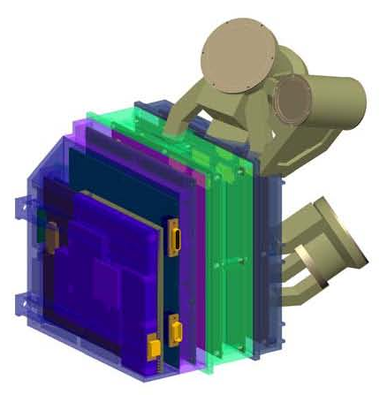
EPI-Hi Component Configuration
LET1
Low Energy Telescope 1
HET
High Energy Telescope
DPU & Bias
Supply
LET2
Low Energy Telescope 2
LVPS
LET2 Electronics
HET & LET1 Electronics

Slide 4
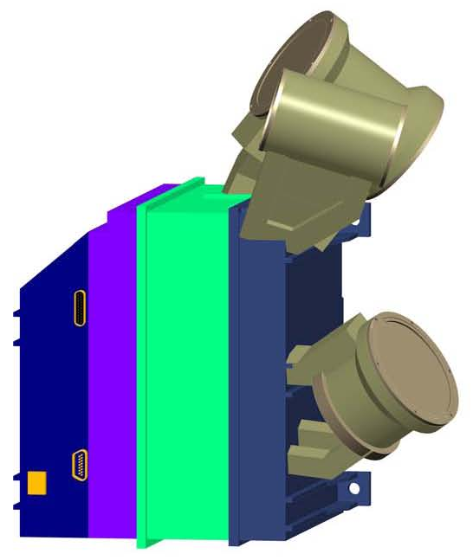
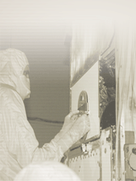
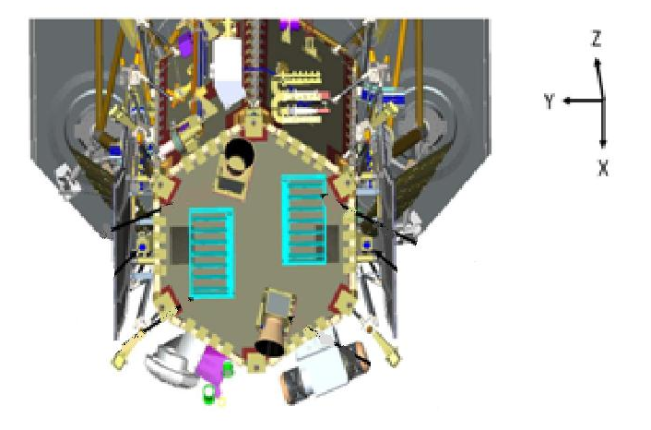
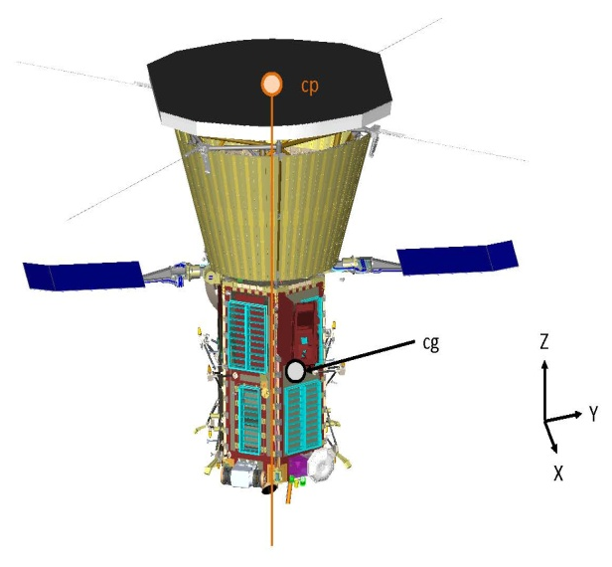
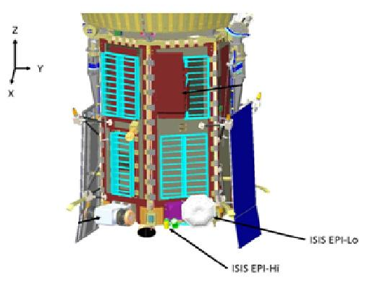




EPI-Hi Instrument
Location of instrument on spacecraft
Located on +X side (RAM side)
Lower right mounting bolt on instrument located at: X = 46,16 cm
Y = 23,39 cm
Z = 6,13 cm
S/C MOUNTING
LOCATION
REFERENCE
ISIS-EPI-HI
RAM SIDE

Slide 5
EPI-Hi Instrument FOVs
HET conical 90° FOV
  Double-ended
  20° above S/C-Sun line
LET1 conical 90° FOV
  Double-ended
  45° above the S/C-Sun line
LET2 conical 90° FOV
  Single-ended
  Orthogonal to LET1 telescope (135° from
  S/C-Sun line)

Slide 6
EPI-Hi Mass Allocation
Subsystem | Mass [ g ]
LET1 telescope LET1 board | 225 258
LET2 telescope LET2 board | 145 233
HET telescope HET board | 120 250
DPU board Bias Supply & RF shields LVPS & RF shields | 197 225 + 130 160 + 100
Elec. box, hardware & shielding Telescope brackets Thermal hardware MLI blankets | 925 + 250 +100 160 50 100
Total | 3,628

Slide 7
EPI-Hi Enclosure Requirements
Work within tight mass constraints
Design to meet S/C launch environment requirements for Vibration, Acoustics and Thermal conditions
Design for radiation dose shielding environment
Package boards maintaining adequate parts clearance board-to-board
Provide adequate RF and/or ground shielding board-to-board and through the enclosure
Provide thermal isolation between electronics box and bracket, as well as between telescopes and electronics box

Slide 8
EPI-Hi Electronics Enclosure (1/4)
Electronics box is made up of 4 major components:
  LVPS Assembly
  DPU & Bias Supply Assembly
  HET & LET1 Electronics Assembly
  LET2 Electronics Assembly
Each Electronics Assembly is mounted in a perimeter style frame
All “frames” when assembled together will provide a continuous RF shield for internal electronics
Wall thickness will be minimum 1,0 mm (~40 mils) for radiation dose shielding
Internal shielding between critical components will create separate shielded areas as necessary for proper electronics function
Board interconnect is achieved using rigid/flex boards with built-in cables terminating to individual nanonics/microstrip connectors on mating boards
Connections to the S/C will be via standard Micro-D connectors

Slide 9
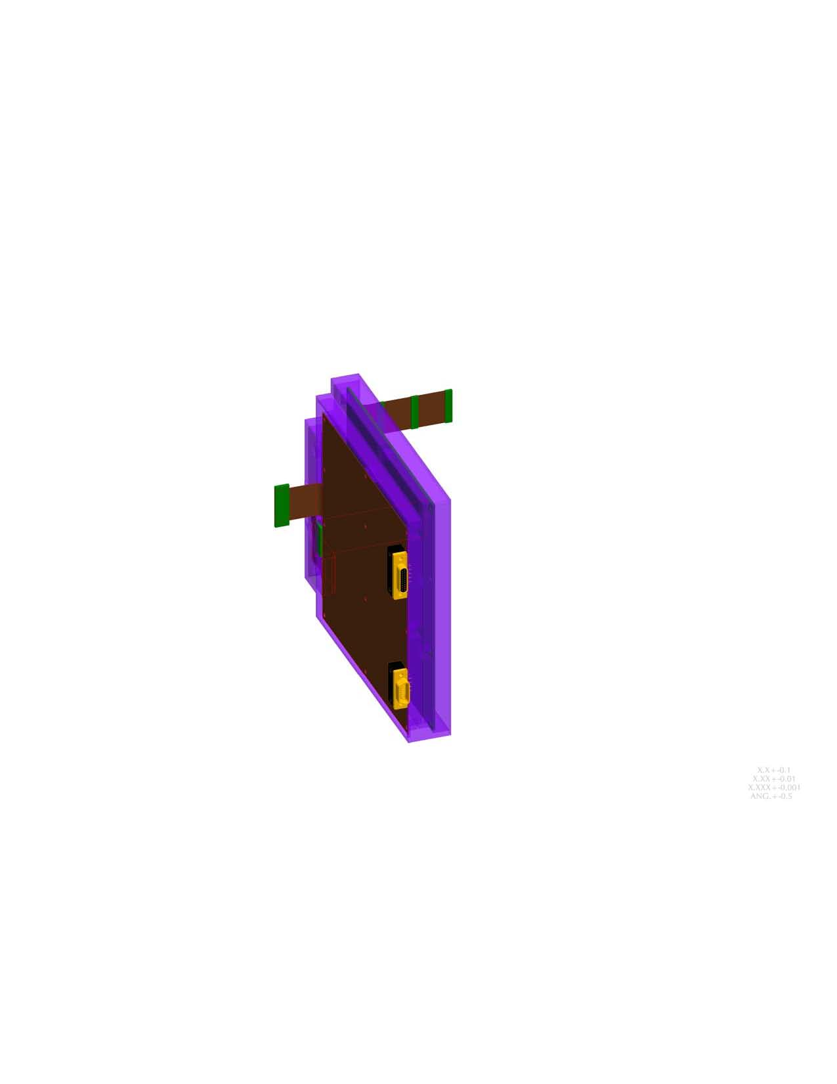
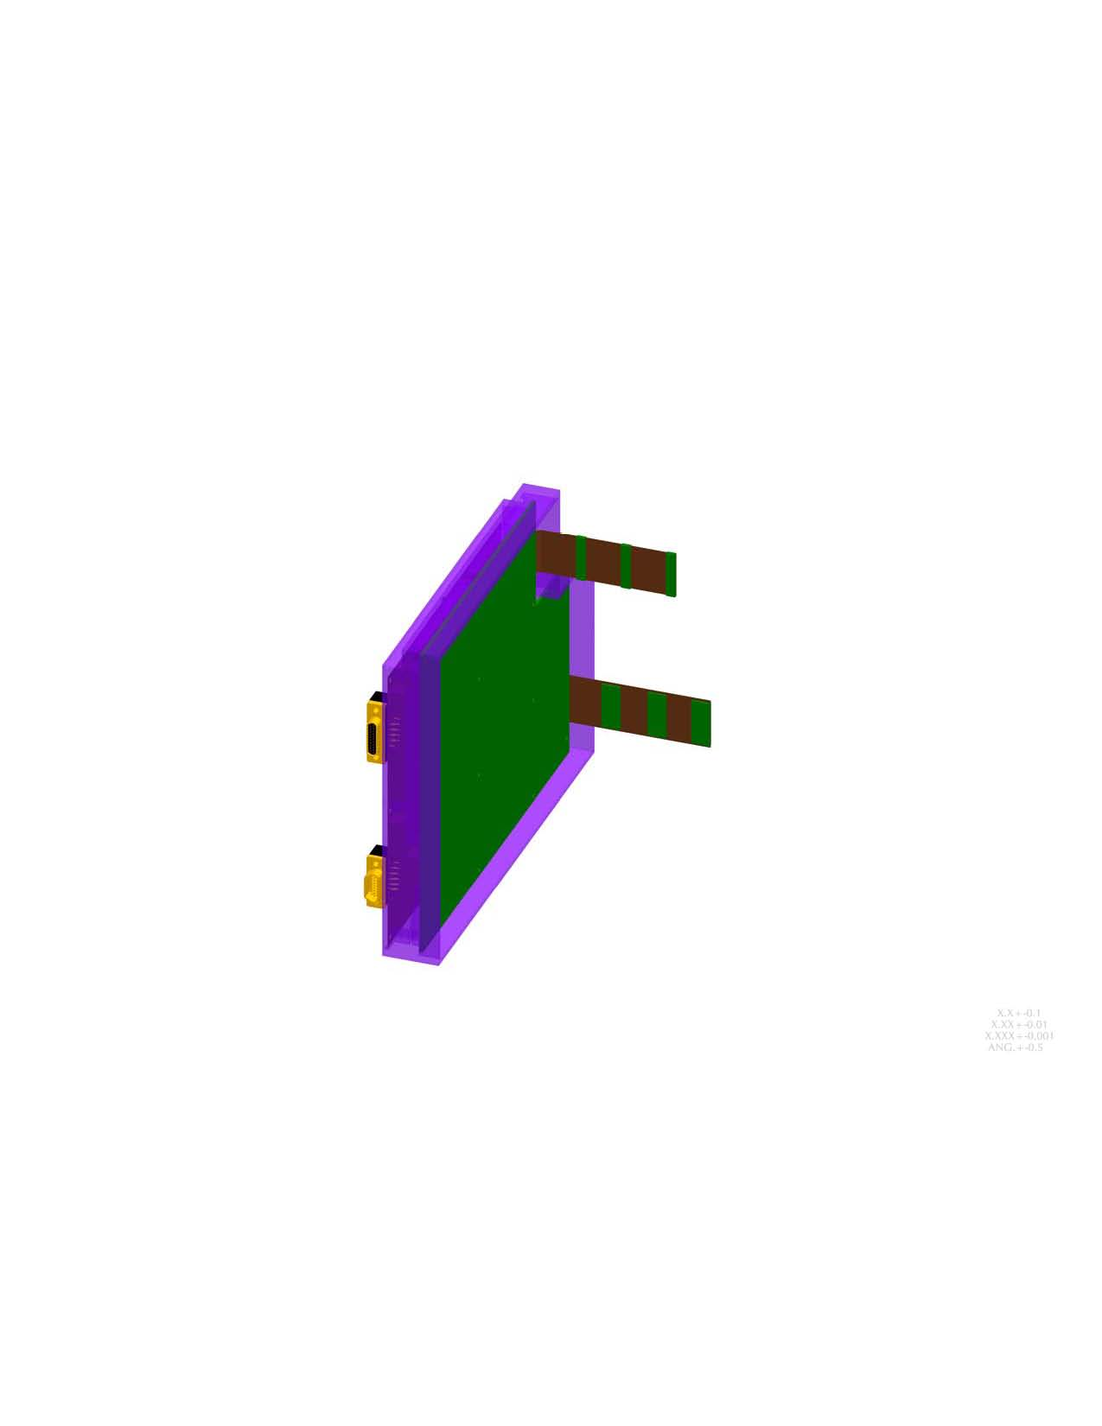
EPI-Hi Electronics Enclosure (2/4)
DPU Board (mounted in one side of frame)
  Flex connection to telescope boards
  Flex connection to LVPS
  S/C cmd&data connector (PCB mount)
  Thermal harness connector (PCB mt)
  PCB mounted to machined-in posts in chassis
Bias Supply Board (mounted in one side of frame)
  Flex connection to 3 telescope boards
  Flex connection to DPU board
  R/F shielding
  PCB mounted to machined-in posts in chassis

Slide 10
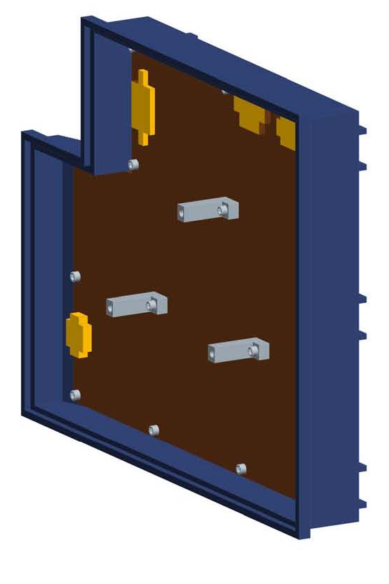
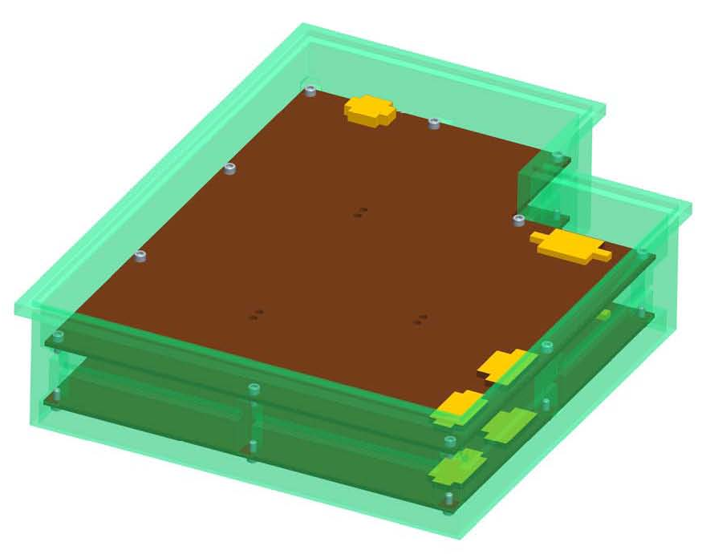
EPI-Hi Electronics Enclosure (3/4)
LET2 Telescope Electronics Assembly
  Receives flex connection from Bias Supply
  Receives flex connection from DPU Board
  Receives 2 flex connections from telescope
  Housing provides feet for Instrument to enable bracket mounting
HET & LET1 Electronics Assembly
(each board)
  Flex connection from Bias Supply Board
  Flex connection from DPU Board
  2 flex connections from its telescope
  PCB mounted to machined-in posts in chassis

Slide 11
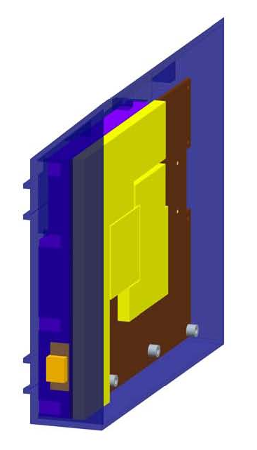
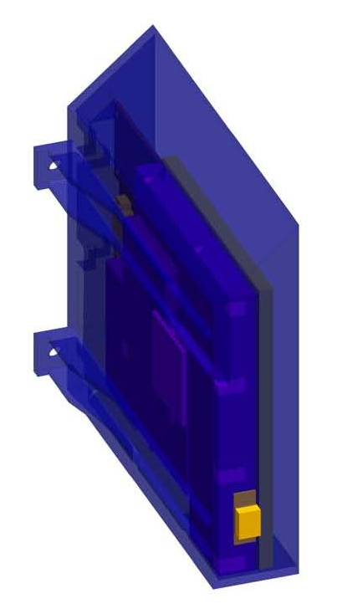
EPI-Hi Electronics Enclosure (4/4)
Low Voltage Power Supply
  Receives flex connection from DPU Board
  S/C power connector (PCB mount)
  Individually shielded primary/secondary circuits top and bottom
  Housing is tapered to avoid HET FOV
  Housing provides feet for Instrument to enable bracket mounting
  PCB mounted to machined-in posts in chassis
*LVPS Board provided by APL
*Chassis and shields designed/provided by GSFC

Slide 12
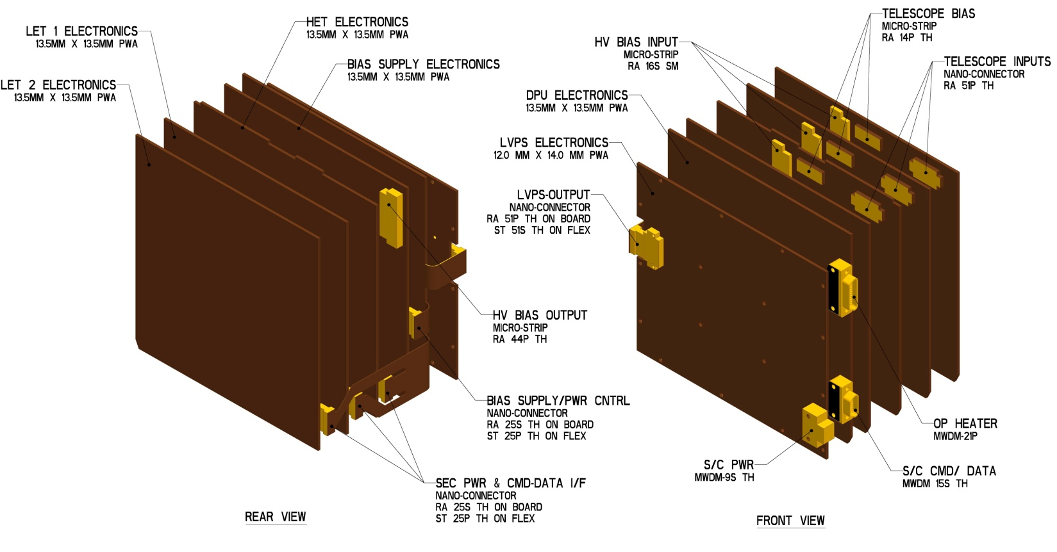
EPI-Hi Interconnect

Slide 13
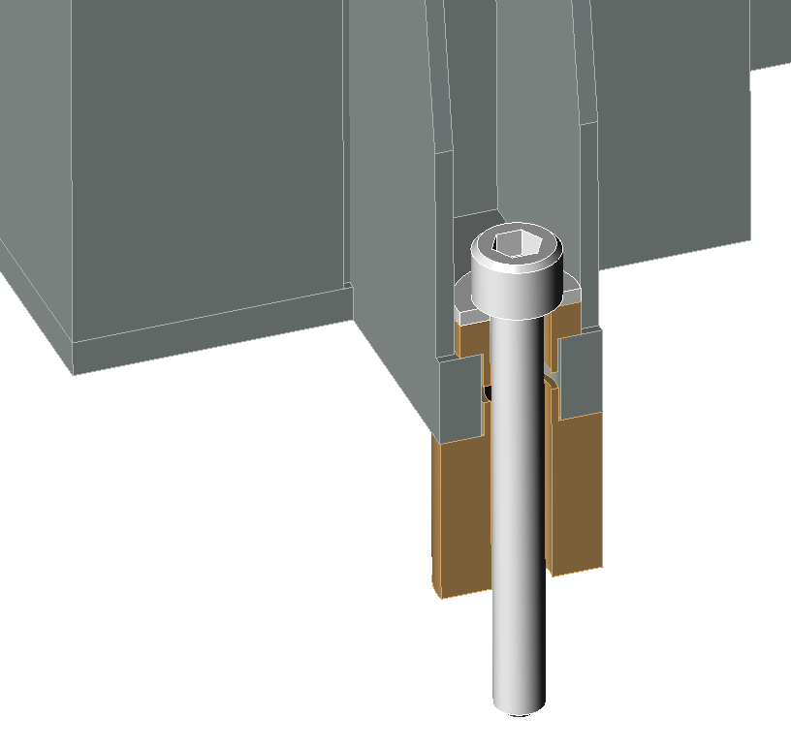

EPI-Hi Thermal Isolation
Typical Mounting Foot Showing Thermal Isolation
Mounting Bolt
Washer
G-10 Isolation Bushings

Slide 14
EPI-Hi Mount Design Requirements
Detector Mounts
  Able to transmit signals from silicon detectors, via wire bond connections to output connector
  Allows the stacking of detectors maintaining 0,5 mm spacing surface-to-surface between thickest detectors (1,0 mm)
  Allows any detector to be stacked face-up or face-down with any other detector
  Allows for the protection of wire bonds from being crushed on either side when placed on flat surface during storage and/or test
  Provides electrical breakdown protection next to detector, when stacked, of up to 200 V differential between crown of HV wire bonds to conductive surface of opposing detector

Slide 15
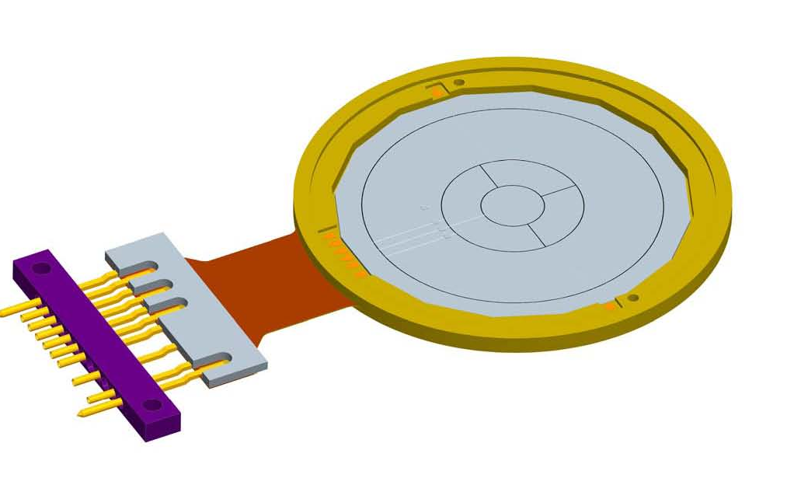
EPI-Hi Detector Mount (1/2)
Recessed detector shelf for silicon detector installation
Micro-strip connector output
Flex stiffener to rigidize the area where connector is mounted
Alignment achieved with alignment pins and concentric stacking shelves on mount and connector
Tolerancing for mounts will be tightly constrained, but within current CNC machining capabilities
Detector alignment will be verified through measurement and testing on assembled flight detectors

Slide 16
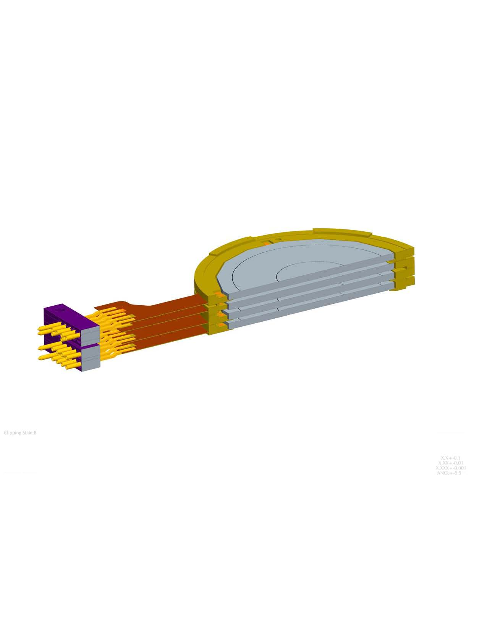
EPI-Hi Detector Mount (2/2)
Mount design allows stacking of detectors face-to-face, face-to-back and back-to-back while maintaining same spacing
Mounts are spaced 1,5 mm apart when stacked allowing for 0,5 mm separation between thickest detectors
Detector voltage ranges from
~2 V up to ~200 V
Mounts provide adequate spacing/protection for wire bond clearance

Slide 17
EPI-Hi Telescope Design (1/2)
3 telescopes comprised of silicon wafer detectors
Provides ~6,0 mm of aluminum shielding to block unwanted particles from entering through the housing body
Will have multiple foils for micro-meteorite/light protection
Mounted directly to the top of the enclosure, allowing the flex interconnect cable to be routed internally to provide proper RF shielding
Will be thermally isolated from the electronics enclosure
Will all have red-tag covers over all aperture openings

Slide 18
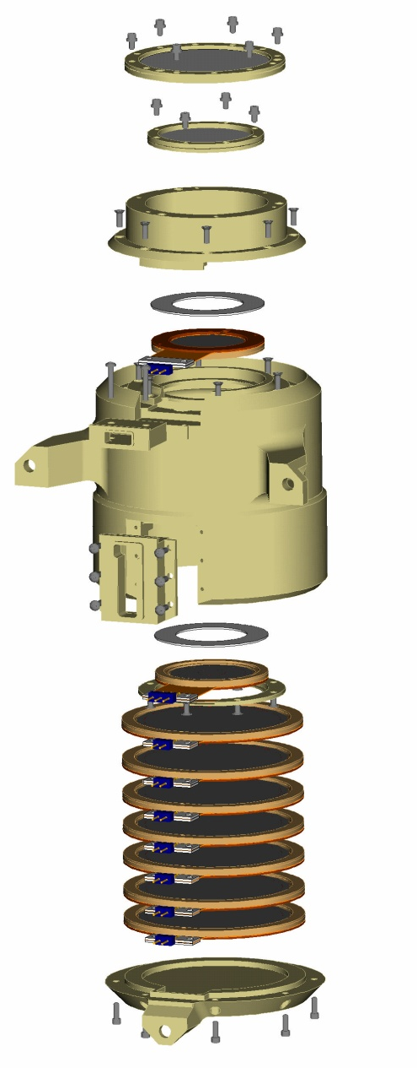
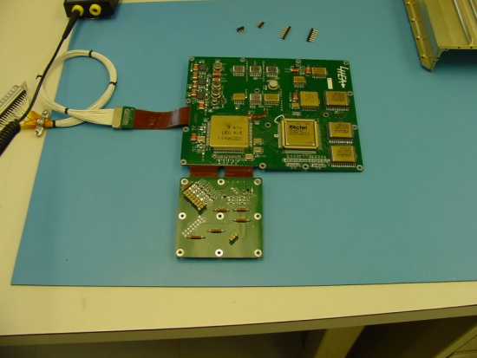
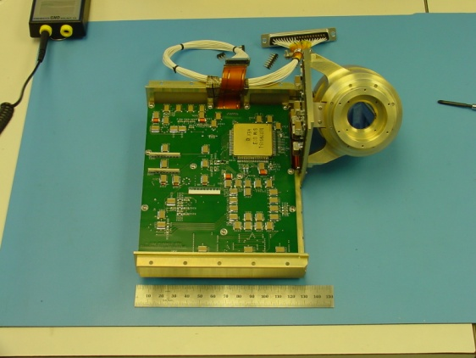
EPI-Hi Telescope Design (2/2)
Heritage design
Uses alignment pins to stack detectors in telescope body
Mounting bracket designed into telescope body
Output signal cable will be completely enclosed in assembly, providing proper shielding
Pictures shown are of STEREO\HET telescope

Slide 19
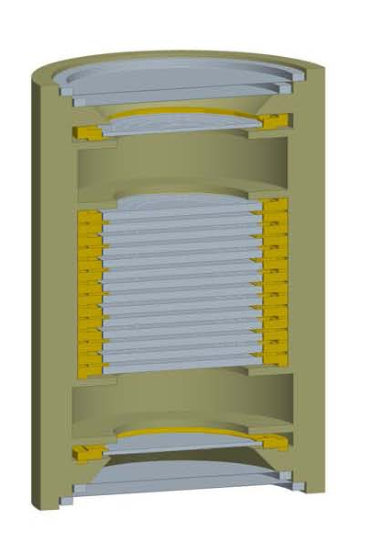
EPI-Hi High Energy Telescope
2- ~127 µm (5 mil) Foils for micro-meteorite/light protection on each end
Comprised of 16 silicon wafer detectors mounted in rigid-flex mounts
The front two detectors at each end are spaced apart in order to set a 90° FOV angle

Slide 20
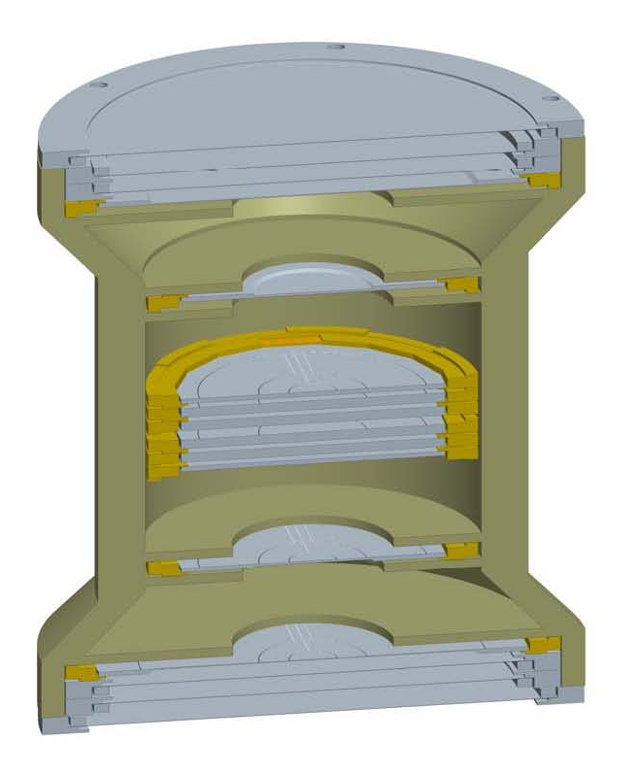
EPI-Hi Low Energy Telescopes
LET1
  Double-ended FOV
  3 foils for micro-meteorite/light protection on each end
    Outer foil to be 2 µm polyimide
    Inner 2 foils to be 1 µm polyimide
  Comprised of 10 silicon wafer detectors mounted in flex-rigid mounts
  The front 3 detectors at each end are spaced apart in order to set a 90° FOV angle
LET2
  Single-ended FOV
  Comprised of one half of an LET1 telescope
(LET1 shown)

Slide 21
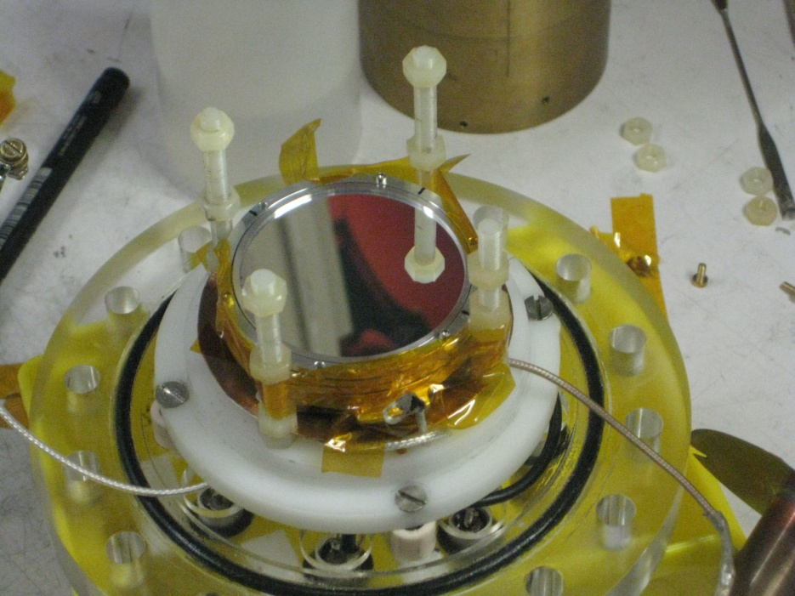
EPI-Hi LET Foils (1/2)
All foils will be aluminized polyimide manufactured by the Luxel corporation
Full sized prototype foils (1, 2, and 4 micron) have been manufactured by Luxel during Phase B
Prototype foils have been thoroughly tested, including a high-velocity dust test at the Heidelberg dust accelerator
Stack of three Luxel foils (1 micron, 2 micron and 4 micron) in dust accelerator set up

Slide 22
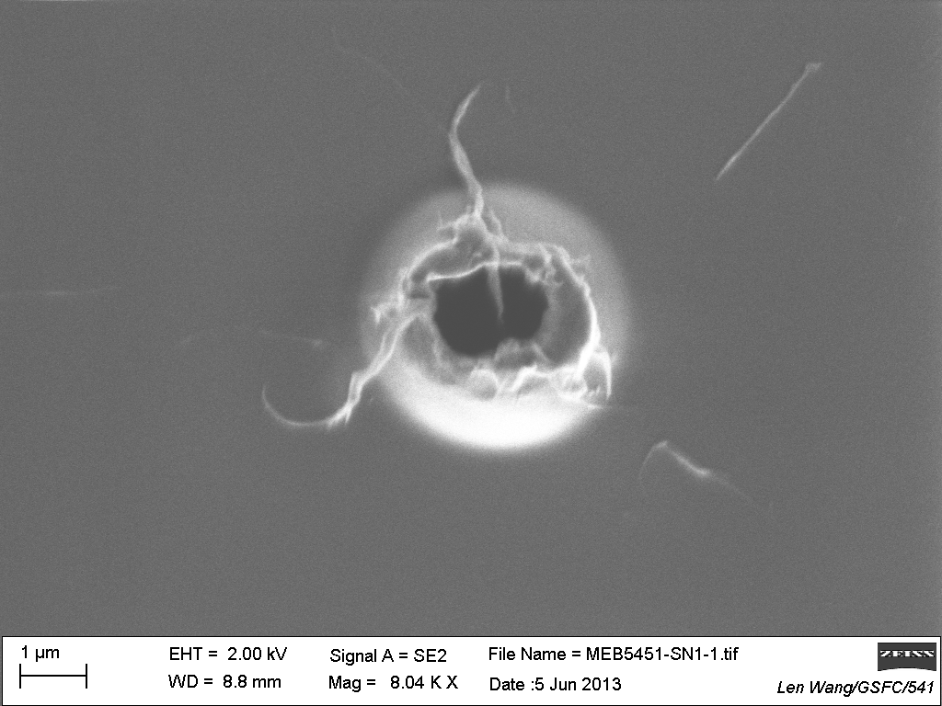
EPI-Hi LET Foils (2/2)
Dust test shows that holes do not propagate
Melted polyimide actually appears to strengthen the edge of the hole
Thermal requirements met with aluminization on the inside surface only
Atomic Force Microscope image from back (exit) side of dust impact in 1 micron thick polyimide

Slide 23
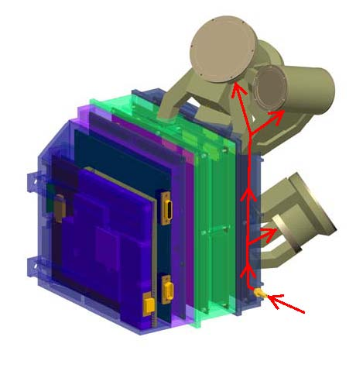
EPI-Hi Telescope Purge
Purge established to the individual telescopes with a single purge fitting on the outside of the Instrument
Purge distributed internally through a manifold that sends the purge gas into the center volume of each telescope

Slide 24
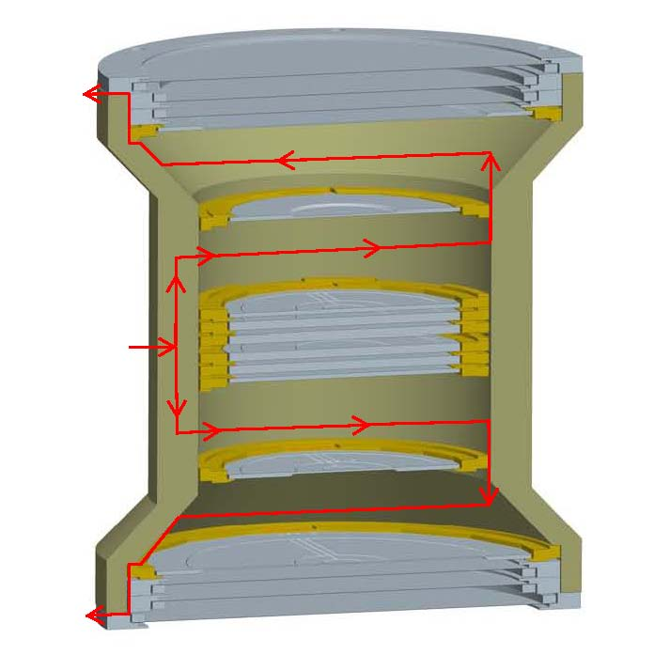
EPI-Hi Telescope Venting
Heritage venting strategy used on several prior missions
Purge gas enters thru housing into open center volumes
Gas then flows outwards thru vent slots in housing shelves, detector mounts and foil rings
Gas exits each end of the telescope thru vent slots below outer foil
PURGE GAS

Slide 25
EPI-Hi Assembly Flow (1/3)
Electronics Assembly Flow
  Assembled board put into its corresponding frame
  Electronics boards tested independently
  Boards then interconnected and fanned out like a book for troubleshooting and further testing w/ telescopes attached
  Purge hoses and fittings installed
  External RF shields added before assembly is closed up
  Frames then bolted together, and the last remaining board cabling installed/connected through access panels in frames
  Access panel covers installed
  Test, Test, Test

Slide 26
EPI-Hi Assembly Flow (2/3)
Telescope Assembly Flow
  Processed Silicon wafers placed in mounts and tested
  Detector selections made and mount thicknesses recorded
  Detectors stacked in telescope w/ proper shims, covers and spacers
  Polyimide Foils installed in collimators
  Collimators/covers installed onto telescope
  Red Tag/Protective covers installed
  Telescope tested w/ electronics and radioactive sources
  Stored for integration to box

Slide 27
EPI-Hi Assembly Flow (3/3)
  Telescope to Electronics Box Assembly
    Mating cable assembled over detector pins and secured in place
    Closeout cover installed over cable
    Telescope positioned over electronics, and cable fed through corresponding frame
    Cables connected at electronics end through access panels in frames
    Access covers installed
    Test, Test, Test
    Telescopes mapped by source testing/accelerator calibrations

Slide 28
EPI-Hi Peer Review Results
Peer Review conducted earlier this month
Only 3 issues noted:
  Thin detectors and implications of environments
    These have been considered and appropriate testing has been or will be performed
  PCB/wall-mounted connectors
    Appropriate measures will be taken to minimize stresses during installation
  Whether “bolt slip” during instrument/telescope mounting will be sufficient enough to keep telescope FOVs within spec
    This will be analyzed and verified

Slide 29
Summary
Mechanical concept verified with peer review
All issues from peer review addressed
Next step, the drawings for Engineering Model, already started

