Slide 1
EPI-Hi Electronics
Rick Cook / Branislav Kecman
EPI-Hi Electronics SE and Lead (Caltech)
This document contains technical data that may be controlled by the International Traffic in Arms Regulations (22 CFR 120-130) and may not be provided, disclosed or transferred in any manner to any person, whether in the U.S. or abroad, who is not 1) a citizen of the United States, 2) a lawful permanent resident of the United States, or 3) a protected individual as defined by 8 USC 1324b(a)(3), without the written permission of the United States Department of State.
Notes:
introduction

Slide 2
Outline
Requirements
Constraints
Block Diagram
Instrument - S/C Interfaces
Pulse Height Analysis System Integrated Circuit
Minimal Instruction Set Computer
Housekeeping Chip
Design/Assembly/Test Flow
Board Status
EEE Parts Program and Status
Resources
Harness Diagram
Summary

Slide 3
Key Requirements
Support 3 independent charged particle telescopes: LET1, LET2 and HET.
For each telescope provide for detection of coincident signals from various Si detector elements to define “events” caused by the incidence of individual nuclei, electrons and neutral particles/photons.
For each event, provide pulse height analysis of the signal amplitudes in the various stimulated detector elements. Large dynamic range is needed for measurement of electrons through Zn nuclei.
Sort and count the events according to particle type and energy.
Integrate the counts for the various particle/energy categories over time periods ranging from seconds to hours.
Format the count rate data into packets and transmit them to the S/C.
Include in data packets the raw pulse height data for a sample of events to aid in-flight calibration.
Monitor instrument health by measurement of detector leakage currents, instrument temperatures, power supply voltages and total instrument current draw, and include this “housekeeping” data in telemetry packets.
Respond to commands for altering threshold voltages, bias voltages, etc. and performing instrument self-tests and auxiliary functions.
Control instrument operational heaters.

Slide 4
Constraints and their Implications
Constraints
Both power and mass are very tightly constrained.
Design should be single string, yet reliable.
Primary data collection occurs when S/C cannot communicate with Earth.
Radiation environment is more severe than heritage missions.
Implications
Reliability through minimization of parts count and use of “natural” redundancy.
Use of custom rad-hard VLSI: PHASIC and HKCHIP.
Design should be “bullet-proof” with regard to radiation affects: no latch-up, no processor crash due to SEU, total dose tolerant > 100 krad.
Design should be capable of autonomous operation during primary data collection period (<0.25 AU from Sun).

Slide 5
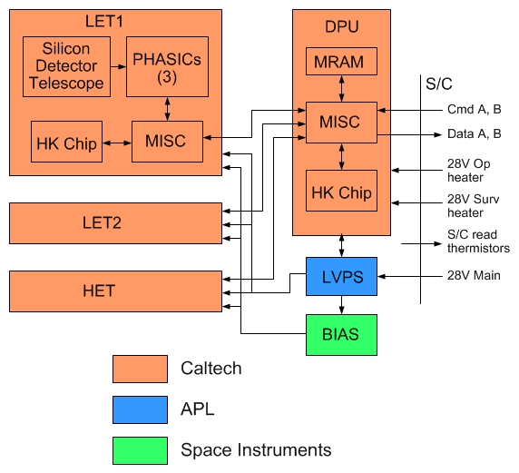
EPI-Hi Block Diagram
6 boards
All telescope boards same.
DPU formats data and provides a single point interface with S/C.
Low Voltage Power Supply (LVPS) and Bias Supply board are shared.
Bias Supply board contains a separate supply for each telescope “end”, 5 total.
Logic and MISCs are implemented in RTAX 250 FPGAs, 4 total.
Heritage from earlier projects: STEREO and NuSTAR.

Slide 6
Instrument to S/C Electrical Interfaces
Interfaces with S/C specified by ICD under APL control.
Command and data interfaces are 115.2 kbaud LVDS using rad-hard drivers/receivers specified by APL.
Redundant A and B sides.
Reset and Timing signals removed from interface by APL for simplicity. Functions included in command signal protocol.
MISC boot method has been modified to accommodate lack of Reset signal.
S/C supplies separate 28V power services for survival and operational heaters.
S/C monitors instrument temp via S/C supplied thermistors.

Slide 7
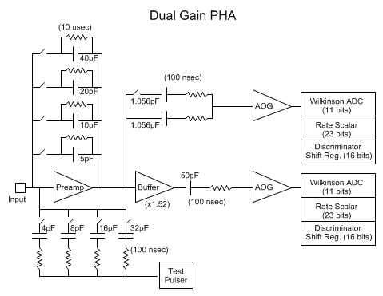
PHASIC Overview
PHASIC stands for “Pulse Height Analysis System Integrated Circuit”.
Originally developed and used in NASA’s STEREO mission.
Each PHASIC contains 16 complete dual-gain pulse height analysis (PHA) chains.
STEREO PHASICs still operational in space.
Mods for SPP include widening dynamic range, and improving total dose tolerance to >100 krad.

Slide 8
PHASIC Packaging
PHASIC die is installed in an 80-pin hermetic Kovar package along with a few passive components to form a “hybrid” circuit.
Hybrid substrate design and passives same as for STEREO.
PHASIC hybrid to be qualified and screened to class H (as on STEREO).
Passive components include a precision resistor for each PHA chain that sets the rundown current. Allows PHA channel gain to have low <50 ppm/degC temperature coefficient.

Slide 9
PHASIC Mods near Preamp
Preamp output stage changed from “follower” to “open drain” to increase output swing.
Preamp compensation method changed for lower noise.
Buffer added in high gain signal chain.
High/Low gain ratio increased from 20 to 68, with programmable option of 40.
High/Low gain boundary falls between alphas and carbon for most detectors.

Slide 10
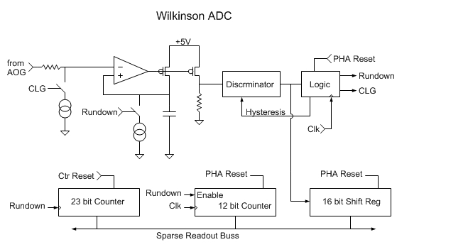
PHASIC Mods near Peak Detector (1/2)
Peak Detector
Current Mirror
STEREO Peak detector contained two differential amplifier stages at input. For Solar Probe Plus reduced to one stage but with higher current resulting in lower noise.
Size of FETs in current mirror at output increased to improve matching and threshold uniformity.

Slide 11
PHASIC Mods near Peak Detector (2/2)
16-bit shift register added to capture time history of discriminator output to aid in cross-talk identification.

Slide 12
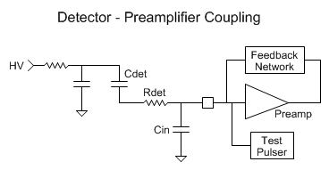
Predicted PHASIC Noise/Threshold
Cf = Nf * 5pF
Det | Cdet (pF) | Rdet (ohm) | Cin (pF) | Nf | Threshold (MeV) | Full Scale (MeV) | Zn @ 45 degrees (MeV) | Gain Crossover Freq (MHz) | Phase Margin (deg)
L0 | 208 | 0 | 30 | 1 | 0.09 | 268 | 83 | 12.3 | 98
L1 | 93 | 30 | 40 | 1 | 0.05 | 268 | 251 | 13.3 | 65
L2(H1) | 20 | 10000 | 60 | 6 | 0.12 | 2802 | 2660 | 13.4 | 60
L3(H2) | 40 | 7500 | 80 | 9 | 0.19 | 4337 | 4092 | 10.8 | 61
H3 | 30 | 15000 | 80 | 13 | 0.28 | 6155 | 6203 | 10.5 | 56

Slide 13
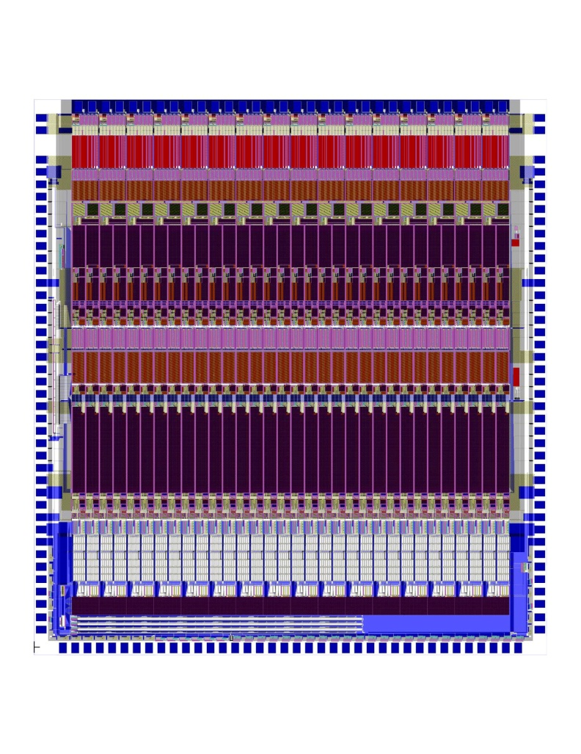
PHASIC Radiation Tolerance
Total dose tolerance improved by adding proven Aeroflex processing steps to commercial ON-Semi C5N CMOS process.
Layout modified to comply with slight Aeroflex design rule differences.
12 krad improves to >100 krad.
Latch-up threshold should still be >80 MeV/(mg-cm²) due to use of guard rings.

Slide 14
PHASIC Status
Engineering run though ON-Semi C5N commercial process was completed, yielding EM wafers and dice.
EM dice installed in STEREO hybrids and tested.
Systematic noise was issue in STEREO test fixture due to socket. (For SPP some channels need to operate at higher gain than for STEREO.)
Completed new test fixture without socket. Residual noise was eliminated, allowing full performance testing to proceed.
Initial test results indicate noise and dynamic range goals achieved and new 16-bit SRs are functional.
Linearity and threshold testing in progress (should be done by PDR).
PHASIC Manual has been updated to account for SPP mods.

Slide 15
What is a MISC?
MISC stands for “Minimal Instruction Set Computer”.
Public domain design concept by Charles Moore, inventor of FORTH.
Our implementation defined in 2002 for STEREO, with Dr. C.H. Ting.
24-bit word width; Four 6-bit instructions per word.
All instructions execute in single clock cycle.
Dedicated I/O bus and instructions.
11 prioritized interrupts.
Both MISC design and FORTH operating system stable since 2002.
Compact design fits nicely in RTAX250.
Data and Return stacks implemented using “block ram” in RTAX250, with EDAC becomes SEU tolerant.
RTAX250 implementation (flown on NuSTAR) runs @ 15 MHz.
MISC uses 36% of RTAX250 “R cells” (flip-flops) and 63% of “C cells” (logic gates), leaving 1050 R cells and 900 C cells for application specific logic.
Estimated app specific logic for telescope board: 500 Rcell, 300 Ccell based on similar STEREO design, i.e. < 50% of available resources.

Slide 16
HK Chip
Housekeeping Chip is a new ASIC design for use in EPI-Hi.
Includes most auxiliary functions needed for a small instrument in a 68-pin hermetic ceramic package.
Delta sigma modulator, for making DC voltage (0-5V) measurements to monitor power supply voltages, currents, and instrument temperatures.
35-input analog multiplexor.
12 10-bit DACs with option of rail to rail buffered output.
12 digital outputs designed to drive opto-isolated power switches for heater control.
DACs may be ganged for greater voltage setting resolution.
DAC outputs may be internally routed to modulator for precision measurement => low precision DACs can be used to generate high precision voltages and improved in-flight PHASIC calibration.

Slide 17
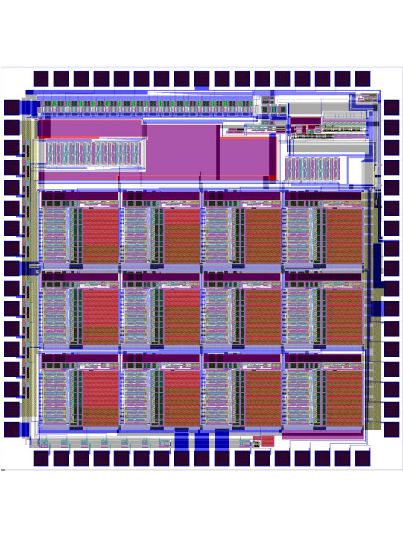
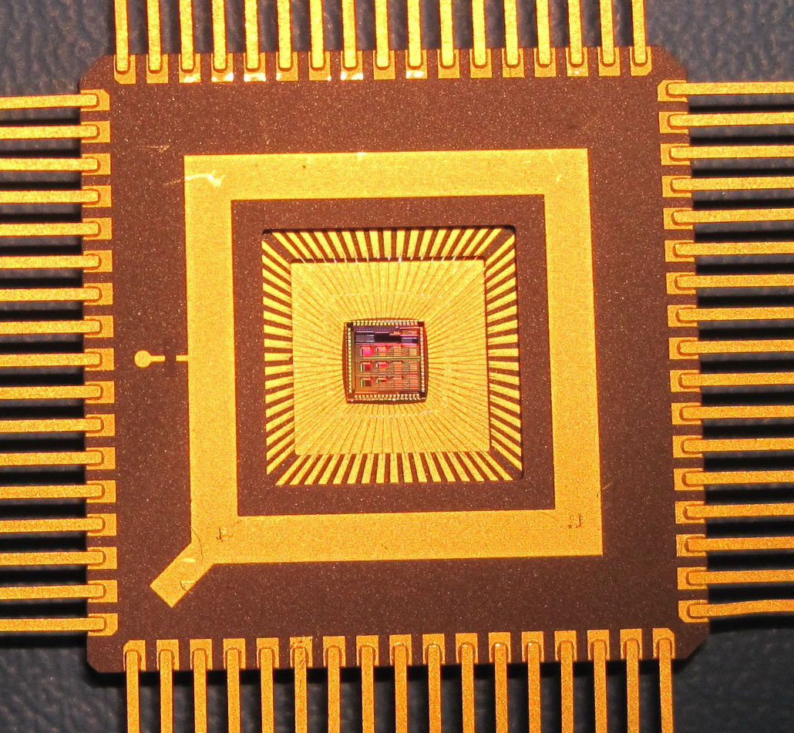
HK Chip Packaging
HK Chip packaged in hermetic 68-pin ceramic package.
HK Chip to be qualified and screened to level Q, with PIND test included.

Slide 18
HK Chip Status
HK Chip was laid out using Aeroflex design rules.
Fabrication of EM parts was done first with ON-Semi C5N process through MOSIS. The 2nd run was on shared wafers with EM PHASIC fab directly through ON-Semi.
Test results: DAC linearity limited to 8 bits; Delta sigma modulator can provide up to 18-bit performance. Buffer amps, digital outputs and power on reset circuit all perform properly.
Design judged adequate for flight re-spin with Aeroflex radiation hardening.
Flight re-spin will occur simultaneously with PHASIC flight fab on same wafers.

Slide 19
EPI-Hi Electronics
Implementation and Status

Slide 20
Design/Assembly/Test Flow
Mechanical design
S. Shuman
GSFC
Preliminary design
and schematic
R. Cook
J. Burnham
Detailed design
and schematic
J. Burnham
B. Kecman
Peer review
SwRI, JPL
EM layout
J. Burnham
B. Kecman
EM layout
review
SwRI
EM assembly
J. Burnham
B. Kecman
Test/rework/test
R. Cook
B. Kecman
J. Burnham
Parts identification, EM and flight
B. Kecman, J. Burnham
J. Tumlinson SwRI
Parts stress
analysis
J. Burnham
Parts procurement, EM and flight
B. Kecman, M. Windhausen GSFC
Flight layout mods
J. Burnham
B. Kecman
Flight layout
review
SwRI
Flight board
assembly & inspection
JPL
Flight board test
R. Cook
B. Kecman
J. Burnham
Staking,
conformal
coating
JPL

Slide 21
Board Status
Board | Spec | Schem | Peer review | EM layout | EM fab began | EM parts procured | EM test starts at Caltech
Telescope x3 | L4 | 99% | √ | 20% | No | 60% | Jan-Jun ‘14
DPU | L4 | √ | √ | √ | No | 80% | 2/28/14
LVPS | √ | √ | √ | √ | Yes | √ | 1/27/14
Bias Supply | √ | √ | √ | 60% | No | 70% | 4/7/14
Breadboard | Spec | Schem | Peer | Layout | Fab | Parts | Test
Bias Supply | √ | √ | N/A | √ | √ | 90% | In progress

Slide 22
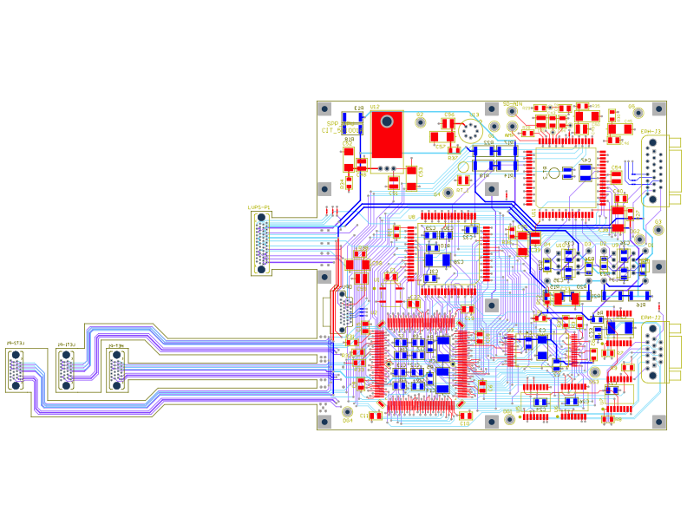
DPU Board Layout
View from sunward direction
13.50 cm, square

Slide 23
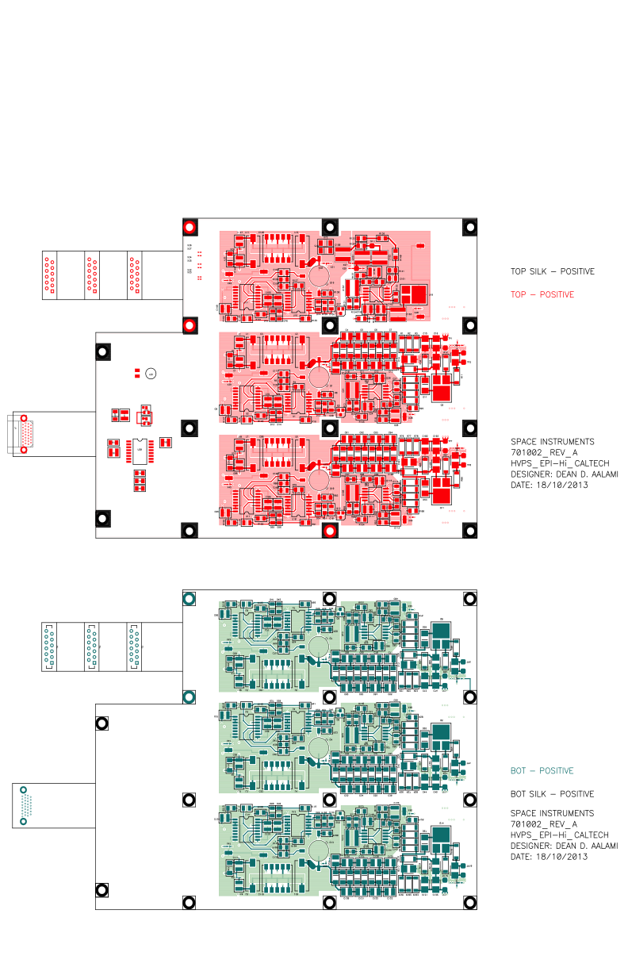
Bias Supply Board Layout
13.50 cm
View from sunward direction
14 cm
17.50 cm

Slide 24
EEE Parts Program and Status
All parts required to meet EEE-INST-002, Level 2
PCB approval required for all parts
PCB review in process for all parts
Existing Caltech custom databases used to track inventory and kit history for all parts
Procurement in process now for prototype/EM parts
Where possible, flight parts will come from Caltech, GSFC, SwRI and JPL inventory
Parts more than 5 years old will have additional testing performed as required by the PCB

Slide 25
Significant Parts
Part Number Part Type | Manufacturer | Heritage | Notes
RTAX250SL-CQ208B FPGA | Microsemi SoC (Actel) | NuSTAR | Existing stock at Caltech
5962R0323601QXC SRAM, 4Mb (128k x 32) | Aeroflex | NuSTAR | Existing stock at Caltech
5962R0422701QXC SRAM, 16Mb (512k x 32) | Aeroflex
5962R1222201VXC MRAM, 16Mb (2M x 8) | Aeroflex |  | Common buy with S/C
10229545 PHASIC, Hybrid ASIC | JPL | STEREO | Existing stock at Caltech Modification required
TBD HKchip, ASIC | JPL |  | Will follow similar process as PHASIC

Slide 26
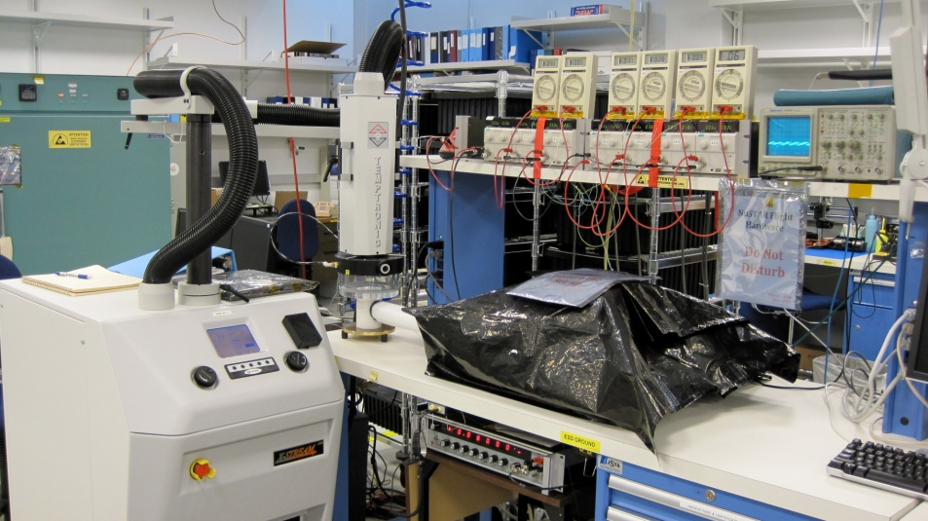
ASICs: PHASIC and HKchip
PHASIC: Hybrid ASIC developed for STEREO
Using existing stock with modifications
New rad-hard wafers will be produced
TID and SEL testing planned
Heritage die will be removed and replaced
Packaging will be performed by JPL Hybrid Lab
Assembled part will undergo full screening and qualification performed by JPL and Caltech
HKchip: New part, monolithic ASIC
Will follow the same wafer procurement, packaging and test plan as the PHASIC

Slide 27
Resources - Power
Subsystem | Power [ W ]
LET1 board | 1.06
LET2 board | 0.76
HET board | 0.95
DPU board | 0.62
Bias Supply @ Beginning Of Life | 0.12
LVPS @ BOL (70% efficiency) | 1.50
Total @ BOL | 5.0
End Of Life
Bias Supply @ End Of Life | 0.68
LVPS @ EOL (70% efficiency) | 1.74
Total @ EOL | 5.8

Slide 28
Resources - Mass
Subsystem | Mass [ g ]
LET1 telescope LET1 board | 225 258
LET2 telescope LET2 board | 145 233
HET telescope HET board | 120 250
DPU board Bias Supply & RF shields LVPS & RF shields | 197 225 + 130 160 + 100
Elec. box, hardware & shielding Telescope brackets Thermal hardware MLI blankets | 925 + 250 +100 160 50 100
Total | 3,628

Slide 29
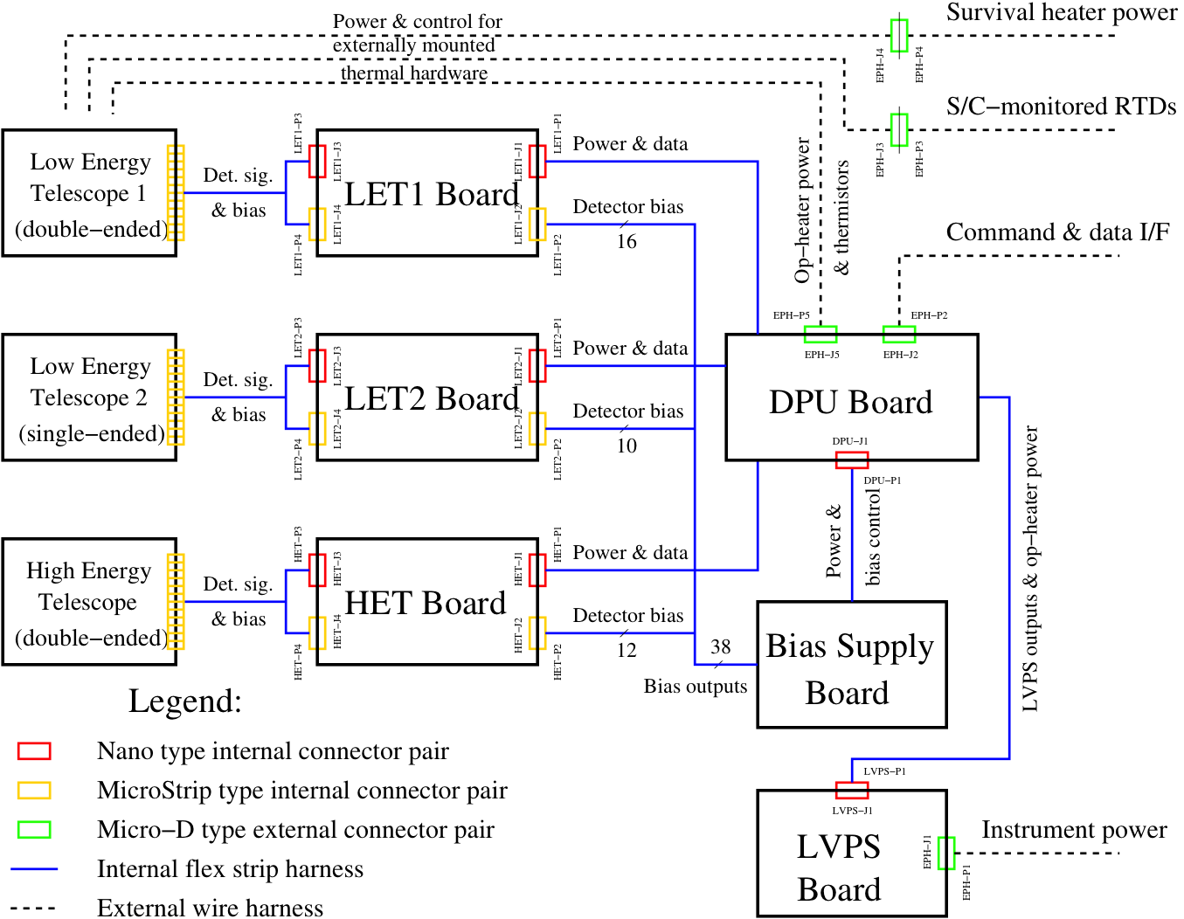
Harness Diagram

Slide 30
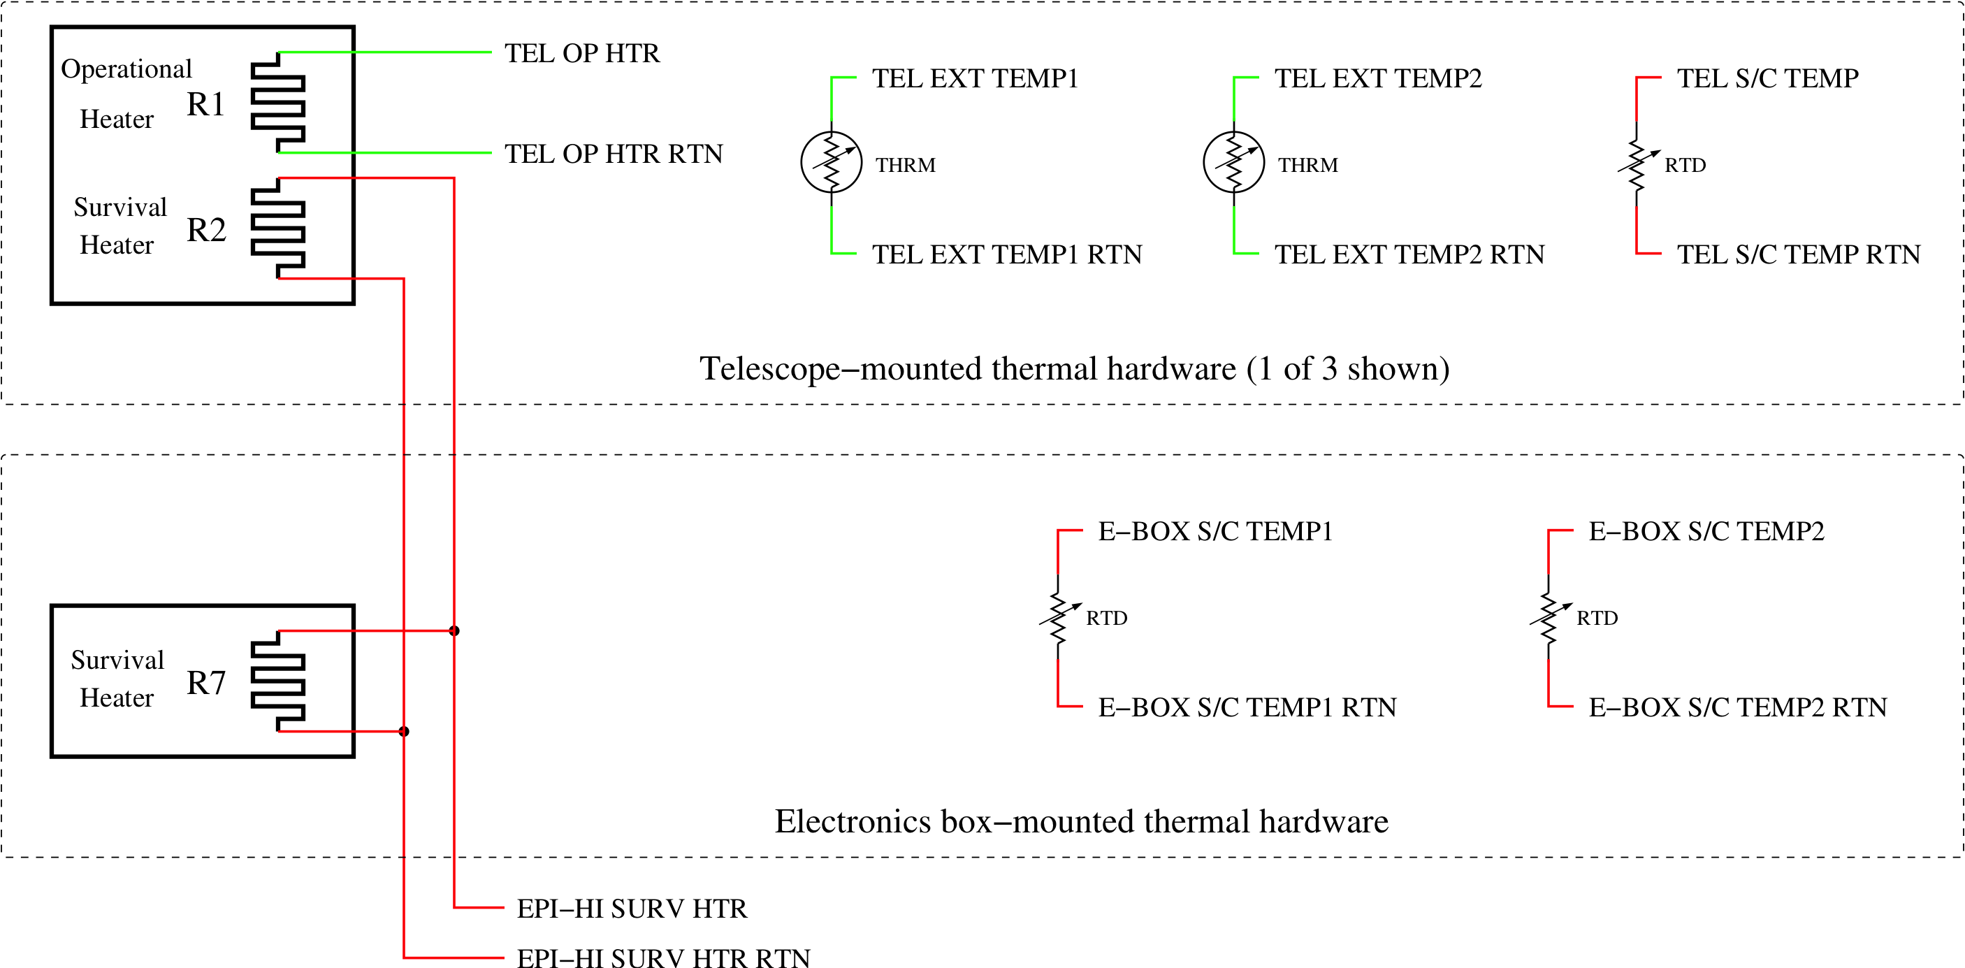
Thermal Harness Diagram

Slide 31
Summary
Peer Reviews conducted on designs
PHASIC – Dec 2012 – all Action Items closed
DPU and Telescope Boards – Sep 2013 – all Action Items closed
Schematics updated and layouts in process
Bias Supply Board – Sep 2013 – all Action Items closed
Schematic updated and layout in process
Testing of ASICs has shown good performance that will meet our requirements
No issues with Parts List
When all layouts completed and reviewed, fabrication and testing of EM begins

