Slide 1
EPI-Hi Technology Development
Mark Wiedenbeck
EPI-Hi Lead Co-I
This document contains technical data that may be controlled by the International Traffic in Arms Regulations (22 CFR 120-130) and may not be provided, disclosed or transferred in any manner to any person, whether in the U.S. or abroad, who is not 1) a citizen of the United States, 2) a lawful permanent resident of the United States, or 3) a protected individual as defined by 8 USC 1324b(a)(3), without the written permission of the United States Department of State.
Notes:
introduction

Slide 2
Outline
Objective
Thin Silicon Detector Fabrication Process Summary
Development Strategy and Status
Prototype Thin Detectors
Fidelity of the Test Article
Tests Required to Achieve TRL6
Tests Performed
Electrical Characteristics
Thermal-Vacuum Stability Test
Accelerator Test Using Heavy-Ion Beams
Tests with a Radioactive Source of Alpha Particles
Radiation Tolerance Testing
Mechanical Robustness
Transition to Flight
Summary

Slide 3
Objective
Develop a new approach to fabricating multi-element ion-implanted silicon solid-state detectors thinner than ~30 μm with the following features:
Thicknesses in the range ~10 to 30 μm
Good control of absolute thickness and detector-to-detector variation (±1 μm)
Good thickness uniformity (~0.2% or better rms variation) to allow good species resolution (e.g., He isotope separation)
Mechanical robustness to provide good manufacturing yield and to survive launch environment without breaking

Slide 4
Thin Silicon Detector Fabrication Process Summary
thin device wafer
buried oxide
thick handle wafer
silicon-on-insulator (SOI) wafer is a commercial product with excellent device layer uniformity and control
photoresist mask
ion implant to produce diode pn junctions on device layer
wet etch to remove handle layer under active area—oxide acts as etch stop and preserves the thickness uniformity of the device layer
nitride mask
etch away oxide from underneath the active area using HF, which has negligible effect on the silicon
ion implant from back to produce detector’s ohmic contact
dice wafer into individual thin detectors with thick supporting frames

Slide 5
Development Strategy and Status
Background
Prototyping studies carried out by a collaboration between LBNL (diode fabrication) and Caltech/JPL since 2003
Prior Caltech/JPL collaboration with Micron Semiconductor (Lancing, Sussex, England) allowed them to develop the capability for making thin, supported detectors from conventional silicon wafers; thickness control and uniformity did not meet specifications
Phase B Activity
Efforts to prototype EPI-Hi thin detectors from SOI wafers have been funded during phase B both at Micron and LBNL
Testing and evaluation being carried out by the manufacturers and by Caltech/JPL and GSFC
Flight Detectors
Plan to down-select to a single source for flight detectors based on test results

Slide 6
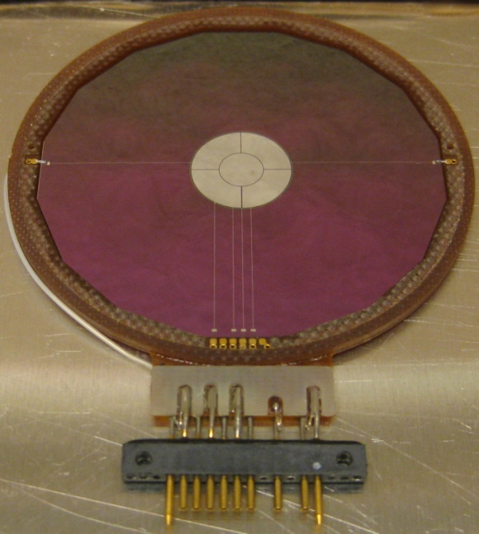
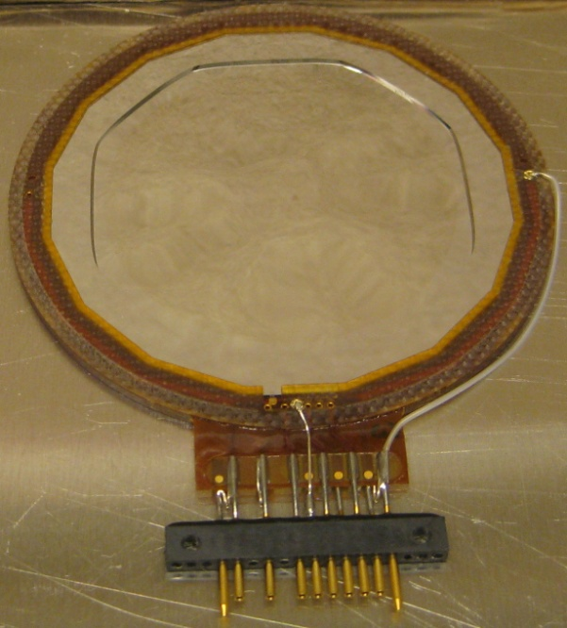
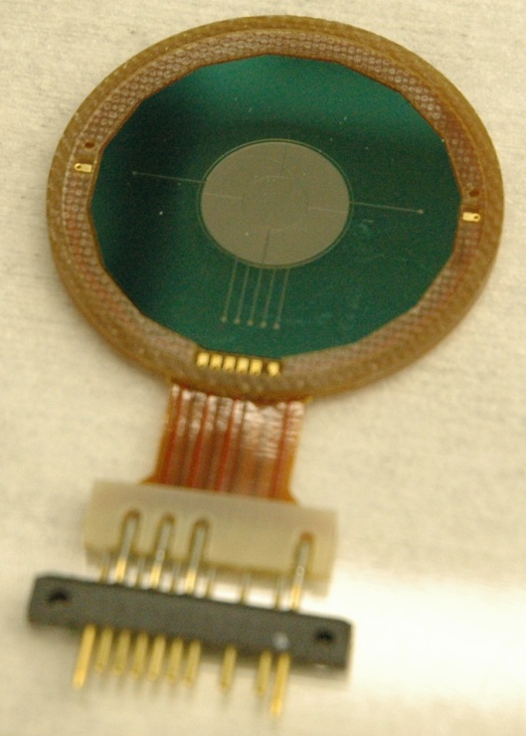
Prototype Thin Detectors
L0 Detector from Micron Semiconductor
L1 Detector from LBNL
front
back
active area (1 cm²)
12 μm membrane
thick frame
Note: thick frames on L1 detectors extend inward nearly to the edge of the active area.

Slide 7
Fidelity of the Test Article
Flight detectors are expected to be identical to the prototypes
The same photolithography masks will be used
No changes are anticipated in process parameters (ion implantation energy, annealing temperature and time, etc.)
It presently appears that a sufficient supply of SOI wafers may be left over from the phase B work to allow fabrication of all of the flight detectors and spares
No changes are anticipated in the detector mounts (provided by GSFC to both LBNL and Micron)
Possible exceptions
If LBNL is selected to make flight detectors, adhesive used for gluing detectors into mounts may be changed to that conventionally used by Micron

Slide 8
Tests Required to Achieve TRL6
Determining that this technology for fabricating thin silicon detectors has achieved TRL6 (prototype demonstration in a relevant environment) requires demonstration that:
The detectors yield the expected charge signals proportional to deposited energy that is characteristic of conventional silicon solid-state detectors when exposed to energetic ions
A detector telescope using the detectors for measuring dE/dx can resolve elements and He isotopes
The detectors have depletion and breakdown voltages acceptable for use in a solid-state detector telescope
The detector characteristics are stable over an extended period (weeks) in vacuum at a nominal maximum temperature of 40°C
The detectors can survive high radiation doses without degradation beyond that expected from displacement damage in conventional silicon detectors
The detectors are mechanically robust enough to survive the acoustic loads expected at launch

Slide 9
Tests Performed
Electrical characteristics
Leakage current versus bias (IV) ↔ maximum operating voltage
Capacitance versus bias (CV) ↔ bias required for full depletion
Particle response
Alpha particles from ²⁴⁴Cm source (5.8 MeV ↔ 1.45 MeV/nuc)
Accelerator beams of heavy ions
Thickness characteristics inferred from particle data
Stability in expected environment
Thermal-vacuum life test at GSFC—our standard test for flight qualification of all silicon detectors
Total dose testing using ⁶⁰Co gamma-ray source at JPL
Mechanical robustness
Acoustic test of mechanical model made from thinned SOI

Slide 10
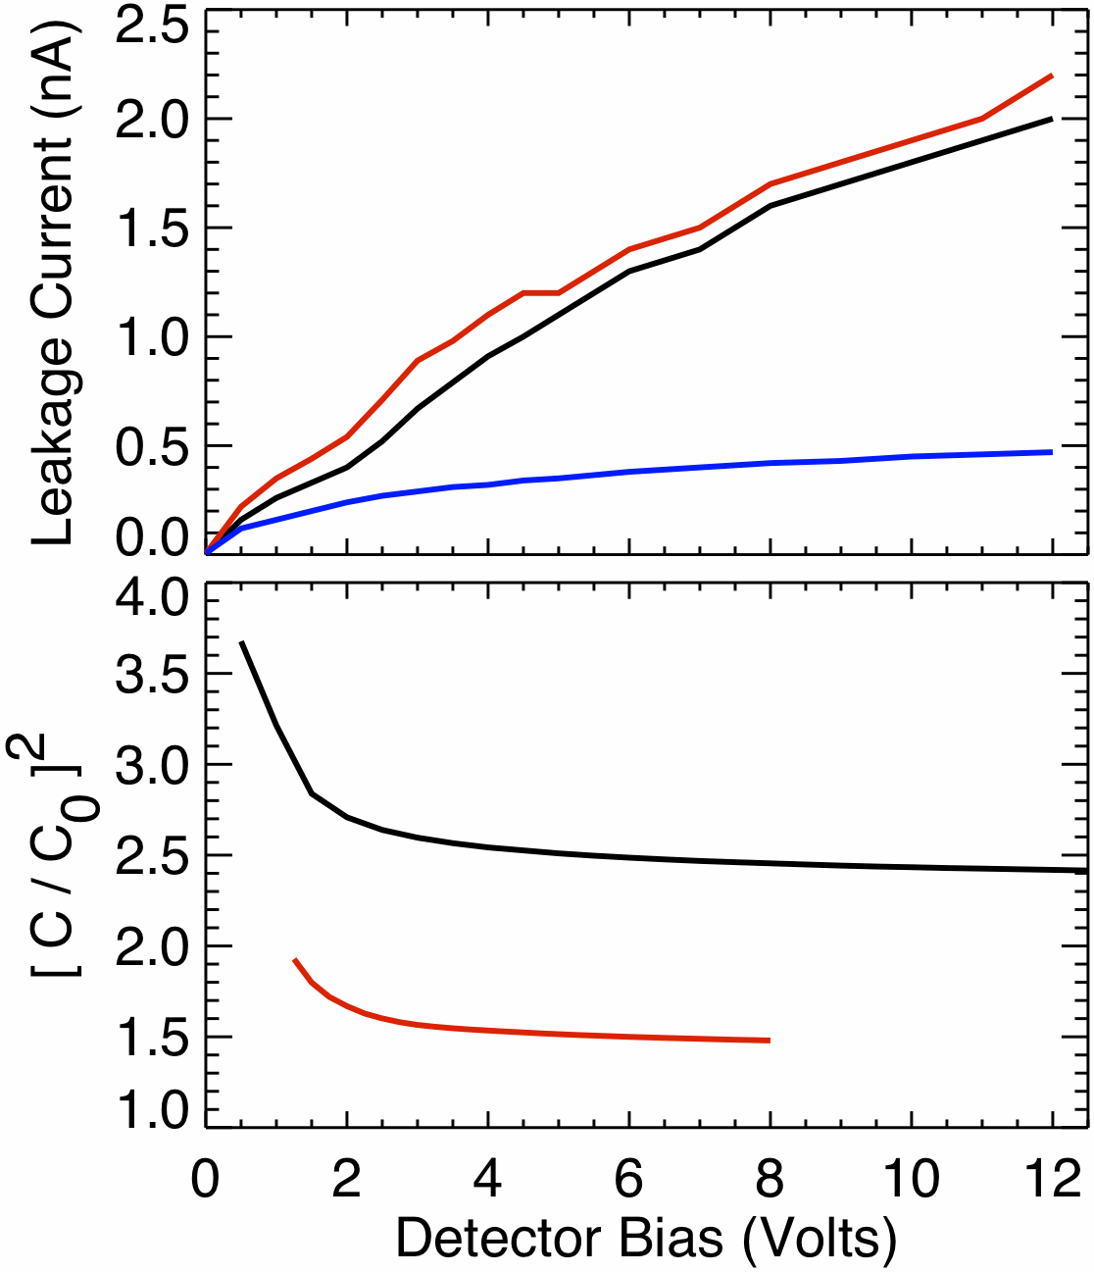
Electrical Characteristics
Measurements of leakage current versus applied bias (IV curves) are used to determine the highest allowed bias voltage before onset of electrical breakdown
breakdown voltages are found to be >25V for both the L0 and L1 detectors
Measurements of detector capacitance versus applied bias (CV curves) are used to determine the minimum bias required to totally deplete the detector
Depletion voltages are found to be ~2V for L0 detectors and ~3V for L1 detectors
Capacitances at full depletion exceed those obtained from a simple parallel plate capacitor calculation (C₀) due to dead layers and to the capacitance of traces connecting active elements to wirebond pads
CV measurements have not yet been made for the LBNL detectors, but particle data indicate that depletion voltages are similar to those obtained for the Micron detectors
Micron L1 (25 μm) detector
Micron L0 (12 μm) detector
LBNL L1 (25 μm) detector
Micron L0 (12 μm) detector
Micron L1 (25 μm) detector

Slide 11
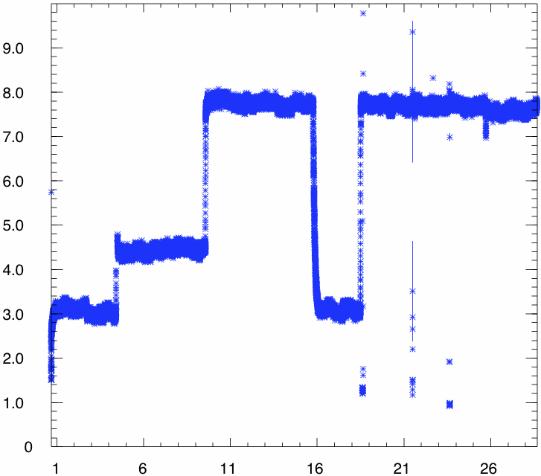
Thermal-Vacuum Stability Test
Thermal-Vacuum Life Test of 12 μm L0 Detector L0-01/M
The detector has performed stably (no indication of leakage current growth problems) for a month, including 16+ days at the maximum operating temperature of 40°C
Test at GSFC continued through the October government shutdown, but with heating turned off as a safety precaution
Typical practice on previous missions has been to test candidate flight detectors for about 3 weeks at 40°C
40°C
40°C
Leakage Current, nA
30°C
22°C
22°C
government shutdown
brief interruptions to measure response with detector disconnected
Time, Day of October 2013

Slide 12
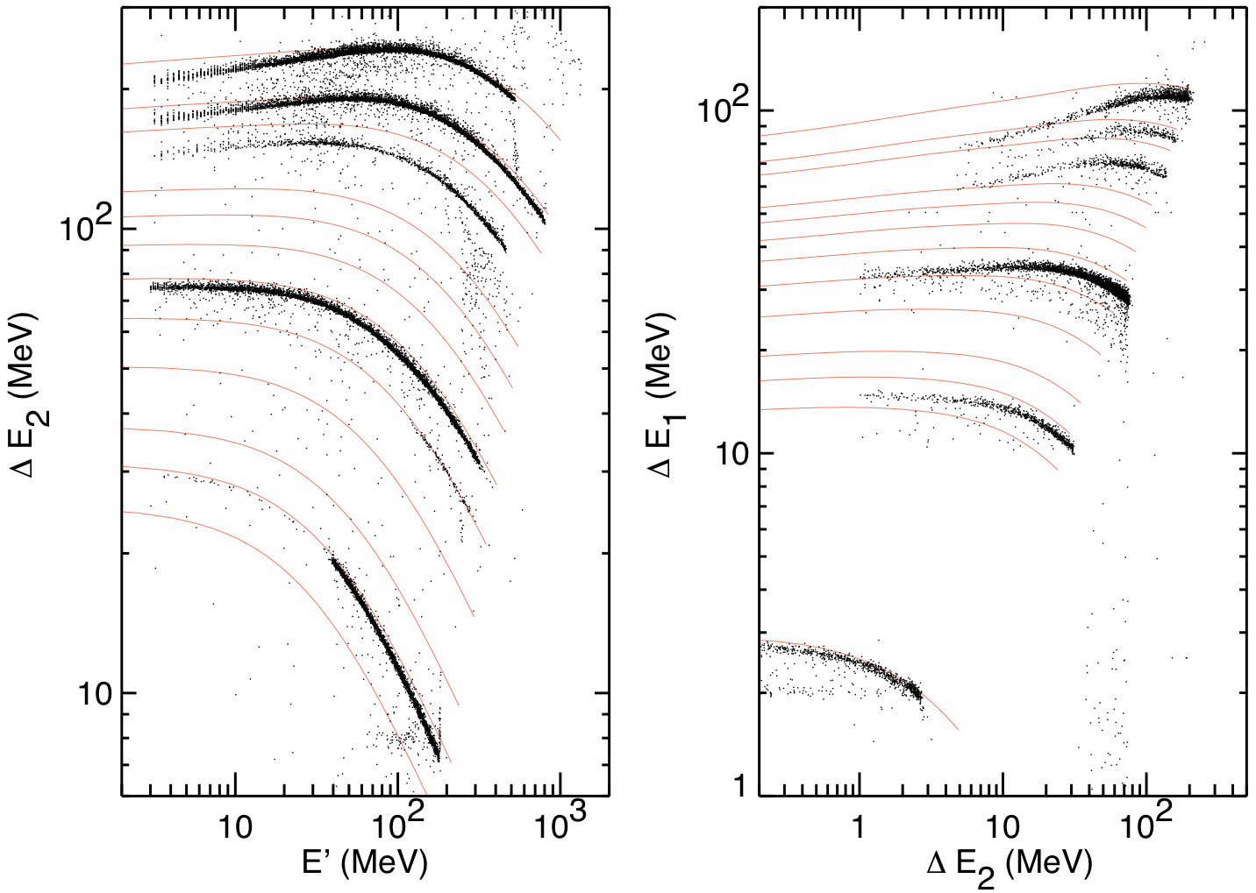
Accelerator Test Using Heavy-Ion Beams
red curves: calculated response; black points: measured events
LBNL 88-inch Cyclotron, 16 MeV/nuc Cocktail Beam, 3 Oct 2013
incident ion beam
Kr
Kr
Kr
Kr
Cu
Cu
energy spreader
Cr
Cu
Fe
Cu
Cr
Ca
Si
Ar
Fe
Si
S
ΔE₁ (12μm)
Si
Ca
Mg
ΔE₂ (25μm)
N
Ne
Mg
Ar
O
S
N
E’ (thick)
Si
C
N
Mg
Obtained similar performance using two 12 μm detectors from Micron and two 25 μm detectors from both Micron and LBNL
Ne
α particles
O
He
C
N

Slide 13
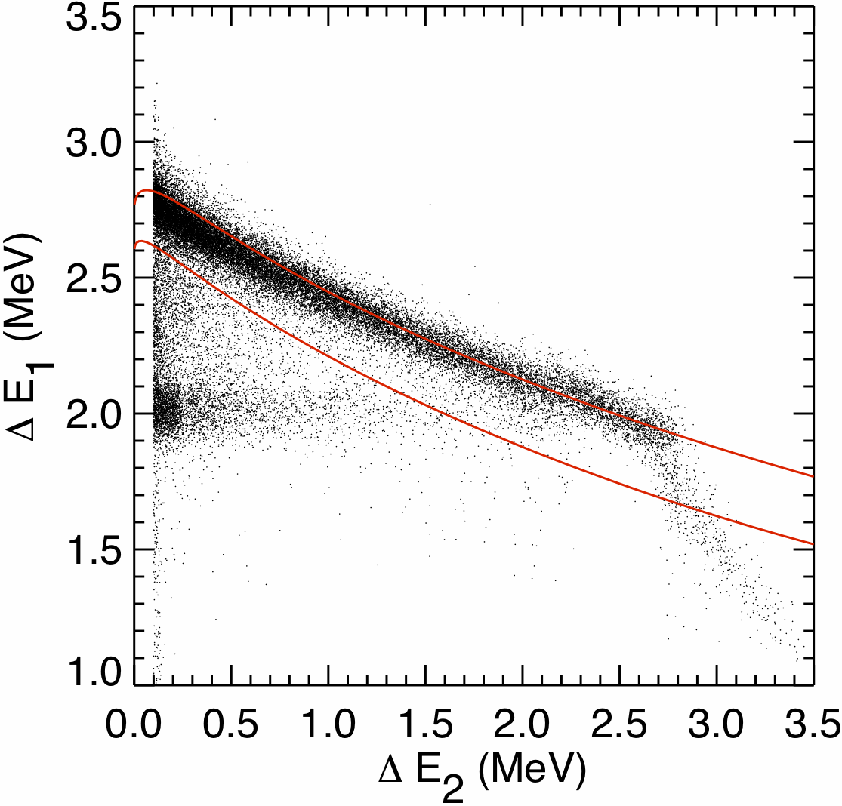
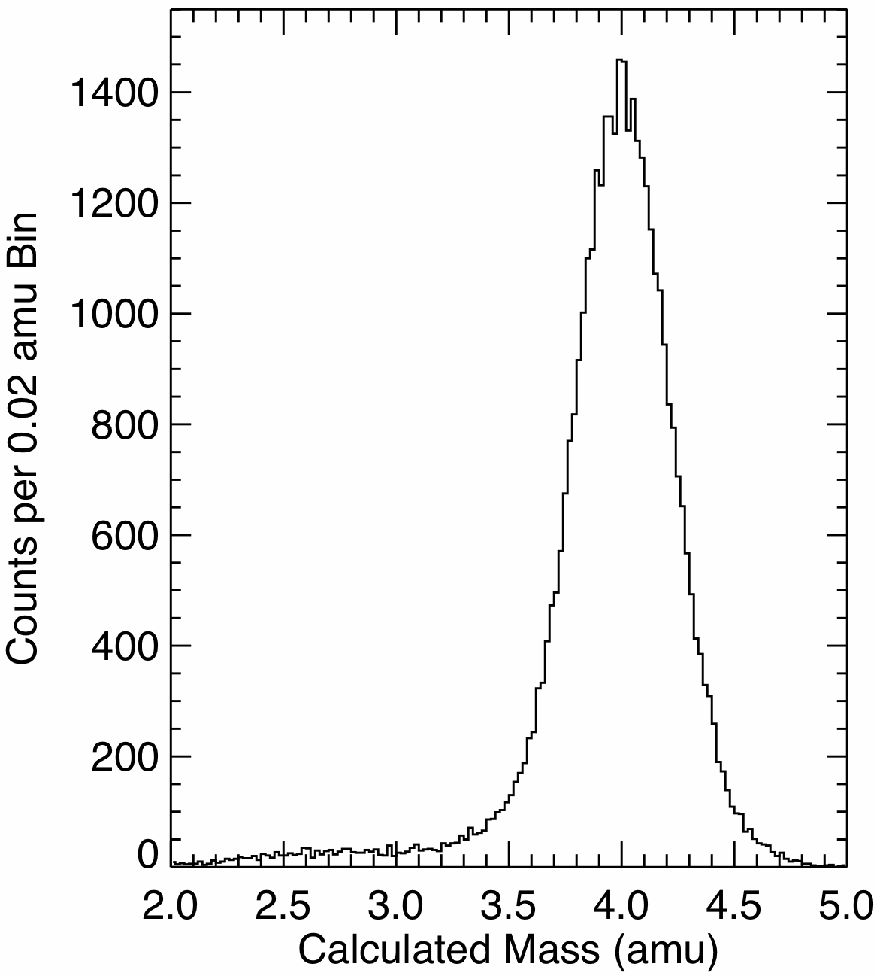
Tests with a Radioactive Source of Alpha Particles
He track obtained using a 12 μm L0 detector to measure ΔE and a 25 μm L1 detector to measure E’
Compare with calculated He isotope response tracks
Adjusted ΔE thickness to 11.8 μm and dead layer to 0.1 μm to improve agreement
Derived mass resolution demonstrates that detector has the required thickness uniformity
Thickness variation measured by SOI manufacturer <0.8 μm (wafer to wafer and across individual wafers)
⁴He
incident α beam
FWHM = 0.50 amu
energy spreader
³He
ΔE₁ (12μm)
ΔE₂ (25μm)

Slide 14
Radiation Tolerance Testing
Thin detectors will receive high radiation dose because, of necessity, there is very little shielding in front of them
Using the 95% confidence worst-case mission fluences from the EDTRD we have estimated total doses to the L0 and L1 detectors over the SPP mission of about 10 Mrad and 2 Mrad, respectively
One L1 detector from each manufacturer has been subjected to a total dose test at the JPL high-dose-rate facility (⁶⁰Co source)
Detectors irradiated in the dark with bias applied to simulate conditions in flight
Irradiations done in a series of increasing steps with measurements of characteristics after each step
step 1 (16 Oct 2013): 100 krad
step 2 (17-18 Oct 2013): 1 Mrad
one or two additional dose increments are planned
Detector leakage currents increased as a result of the irradiations but are still at acceptable levels (<10 nA at a nominal 10 volt bias)
Alpha particle tests of the detectors showed no degradation of charge collection efficiency or energy resolution

Slide 15
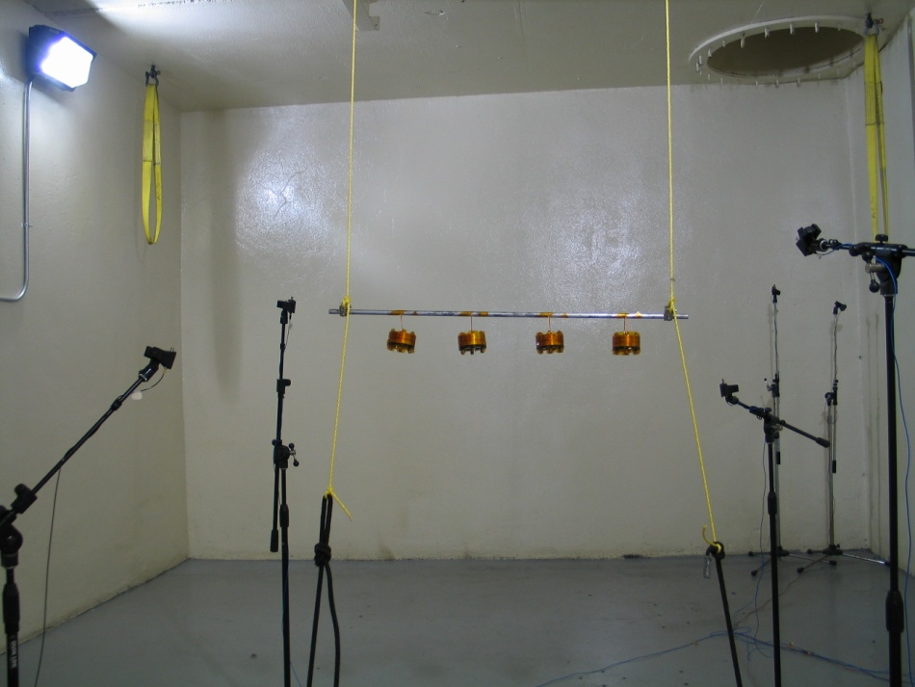
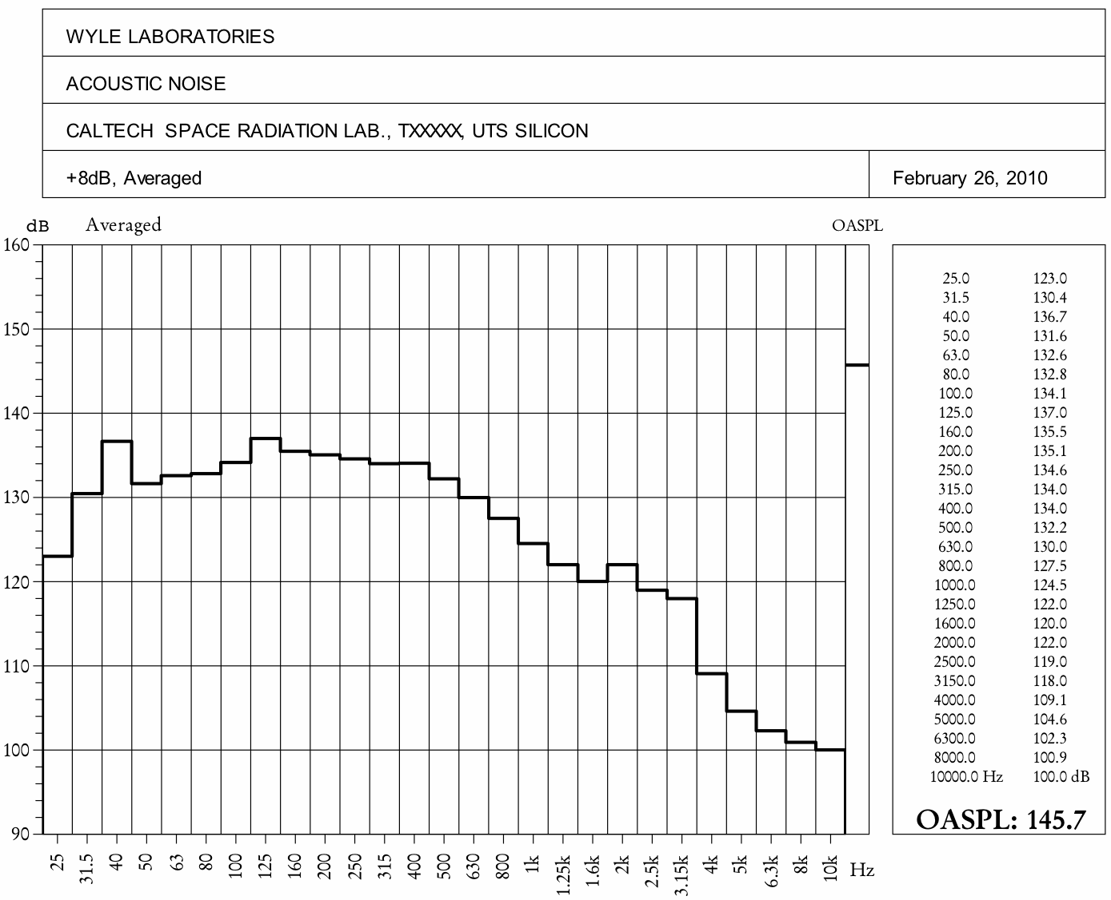
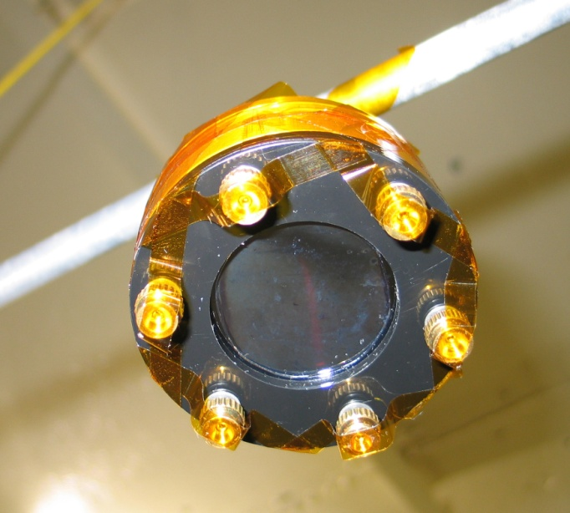
Mechanical Robustness
Silicon membrane of the diameter planned for the L0 detector was fabricated from an SOI wafer with 10 μm device layer and subjected to an Atlas V acoustic spectrum at a level significantly exceeding the SPP specification
The sample survived without any problems
silicon membrane
10 μm thick
~3.4 cm diameter
highest test level: 145 dB = SPP spec + 8 dB

Slide 16
Transition to Flight
Extend selected prototype tests to cover additional detectors that have been fabricated in phase B—determine whether there are any detector-to-detector differences that might affect
Yield
Selection of manufacturer for flight detectors
Test program needed for flight devices
Select manufacturer for flight detectors

Slide 17
Summary
New technology for fabricating silicon solid-state detectors at least as thin as 10 μm has been developed based on the use of silicon-on-insulator (SOI) wafers as the raw material
Detectors have been successfully produced by two manufacturers:
Micron Semiconductor Ltd., Lancing, Sussex, England
Lawrence Berkeley National Laboratory in collaboration with Caltech
Prototypes from both sources have been subjected to all of the tests required for achieving TRL6 without problems
Extension of a few tests is still in progress:
Additional time for the thermal-vacuum life test
Exposure to additional radiation doses
To date, the LBNL/Caltech fabrication has produced L1 detectors but L0 detectors remain to be completed. The LBNL/Caltech process has previously yielded good detectors as thin as 10 μm in sizes comparable to L1. Fabrication of L0 detectors has already passed the critical thinning step.

