Slide 1
EPI-Hi Sensor Design
Mark Wiedenbeck
EPI-Hi Lead Co-I (JPL)
This document contains technical data that may be controlled by the International Traffic in Arms Regulations (22 CFR 120-130) and may not be provided, disclosed or transferred in any manner to any person, whether in the U.S. or abroad, who is not 1) a citizen of the United States, 2) a lawful permanent resident of the United States, or 3) a protected individual as defined by 8 USC 1324b(a)(3), without the written permission of the United States Department of State.
Notes:
introduction

Slide 2
Outline
Measurement Requirements
Sensor System Overview
Low-Energy Telescopes
High-Energy Telescope
Solid-State Detectors
Species and Energy Coverage and Energy Binning
Element Resolution
Helium Isotope Identification
Electron Identification
Fields of View
Angular Sectoring
Measurement Cadences
Dynamic Range in Particle Intensities
Redundancies: Design for Graceful Degradation
Additional Capabilities: Bonus Science Opportunities
Peer Review Results
Summary

Slide 3
EPI-Hi Measurement Requirements
Protons and Heavy Ions
Energy range: 1 MeV/nuc (TBR) to ≥50 MeV/nuc
Energy binning: ≥6 bins per decade
Cadence: at least one energy bin with time resolution of 5 s or better
FoV: ≥π/2 sr in sunward and anti-sunward hemispheres (incl. 10° from S/C-Sun line)
Angular sectoring: ≤30° sector width
Composition: at least H, He, C, O, Ne, Mg, Si, Fe, ³He
Species resolution: FWHM ≤ 0.5 (TBR) × separation from nearest abundant neighbor
Max intensity: up to 10% (TBR) of upper limit proton spectrum from EDTRD
Electrons
Energy range: 0.5 MeV (TBR) to ≥3 MeV
Energy binning: ≥6 bins per decade
Cadence: at least one energy bin with time resolution of 1 s or better
FoV: ≥π/2 sr in sunward and anti-sunward hemispheres (incl. 10° from S/C-Sun line)
Angular sectoring: ≤45° sector width
Max intensity: up to 10% (TBR) of upper limit electron spectrum from EDTRD*
*Note: upper limit electron spectrum not yet specified in EDTRD

Slide 4
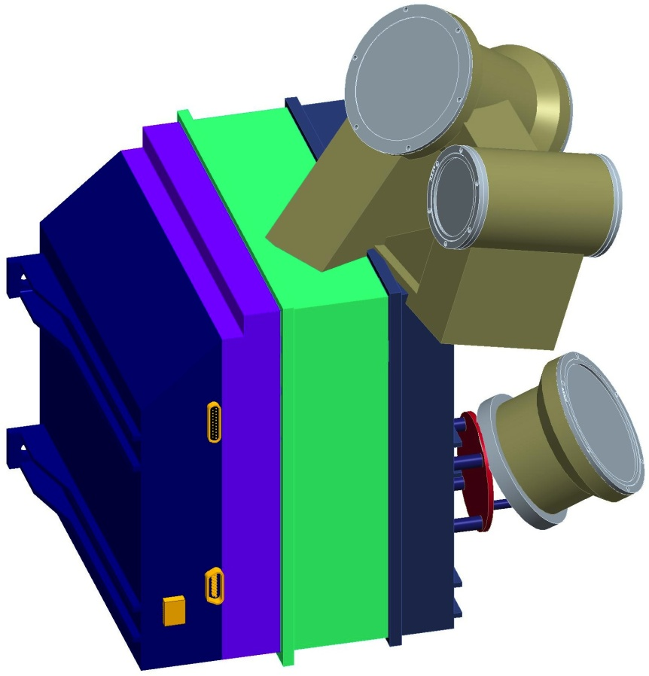
EPI-Hi Sensor System Overview (1/2)
Sensor Approach
All sensor elements are silicon solid-state detectors
Multiple detector telescopes to provide large energy range and sky coverage
Some telescopes double-ended to increase sky coverage
Detector segmentation to provide angular sectoring and adjustable geometrical factor
Heritage
Numerous energetic particle instruments over the past 40 years
Direct predecessor: STEREO/LET & HET
Key Differences
Thinner detectors and windows to reduce energy threshold
Compact telescope designs to reduce saturation at high particle intensities and backgrounds at low intensities
LET1
HET
LET2

Slide 5
EPI-Hi Sensor System Overview (2/2)
3 detector telescopes:
1 double-ended low-energy telescope (LET1)
1 single-ended low-energy telescope (LET2)
1 double-ended high-energy telescope (HET)
All sensor elements are ion-implanted silicon solid-state detectors
Signals from each telescope processed by an individual electronics board

Slide 6
Low-Energy Telescopes
LET1 (double ended)
LET2 (single ended)
windows (each end):
2 μm, 1 μm, 1 μm Kapton
color: active silicon
grey: inactive material

Slide 7
High-Energy Telescope
Conceptual Cross Section
HET (double ended)
windows (each end):
2 × 127 μm Kapton
color: active silicon
grey: inactive material

Slide 8
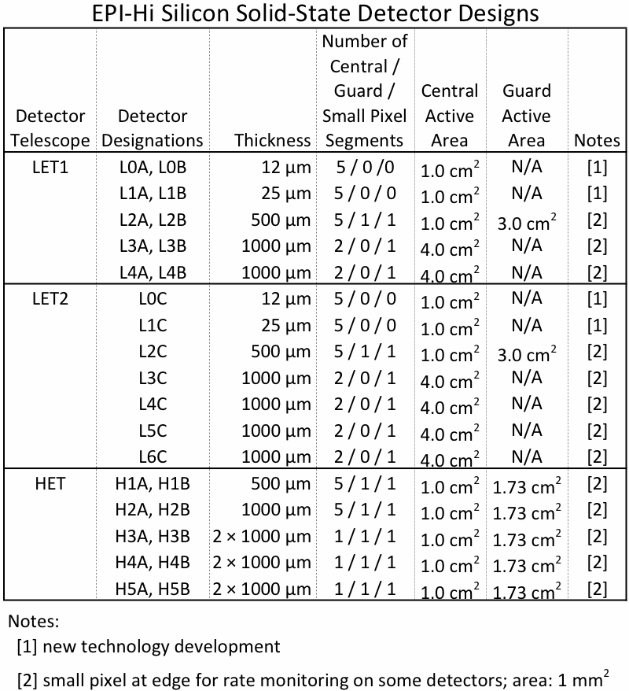
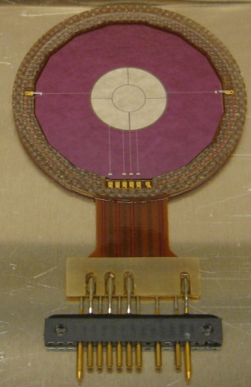
Solid-State Detectors
Segmentation of Active Areas:
center
small pixel
guard
prototype L1 detector

Slide 9
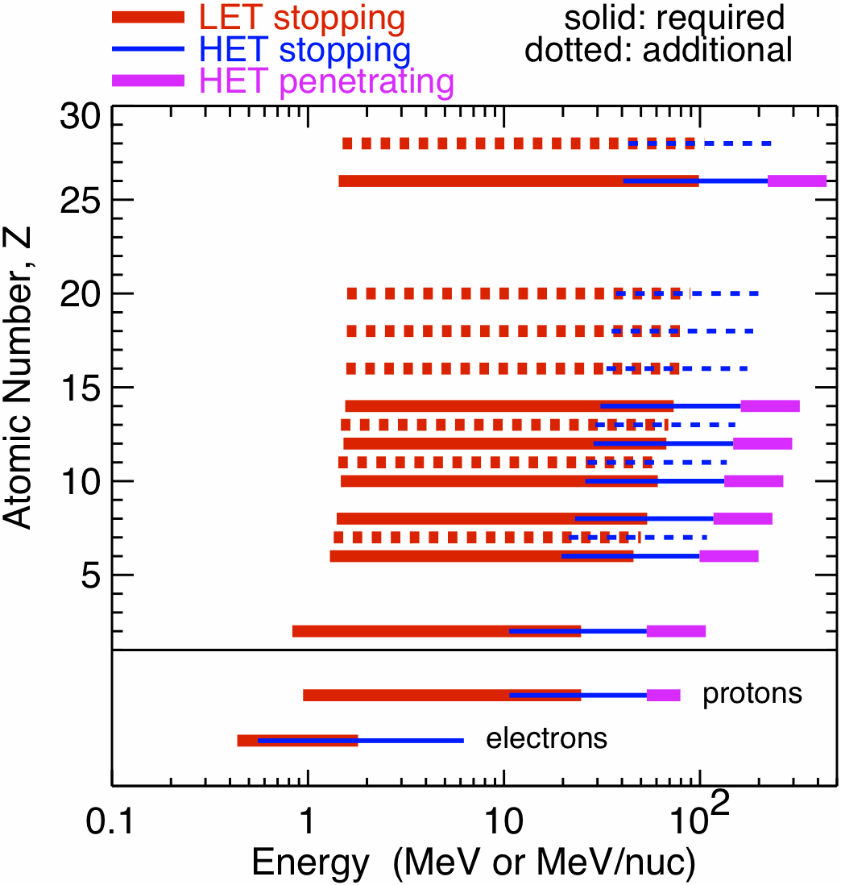
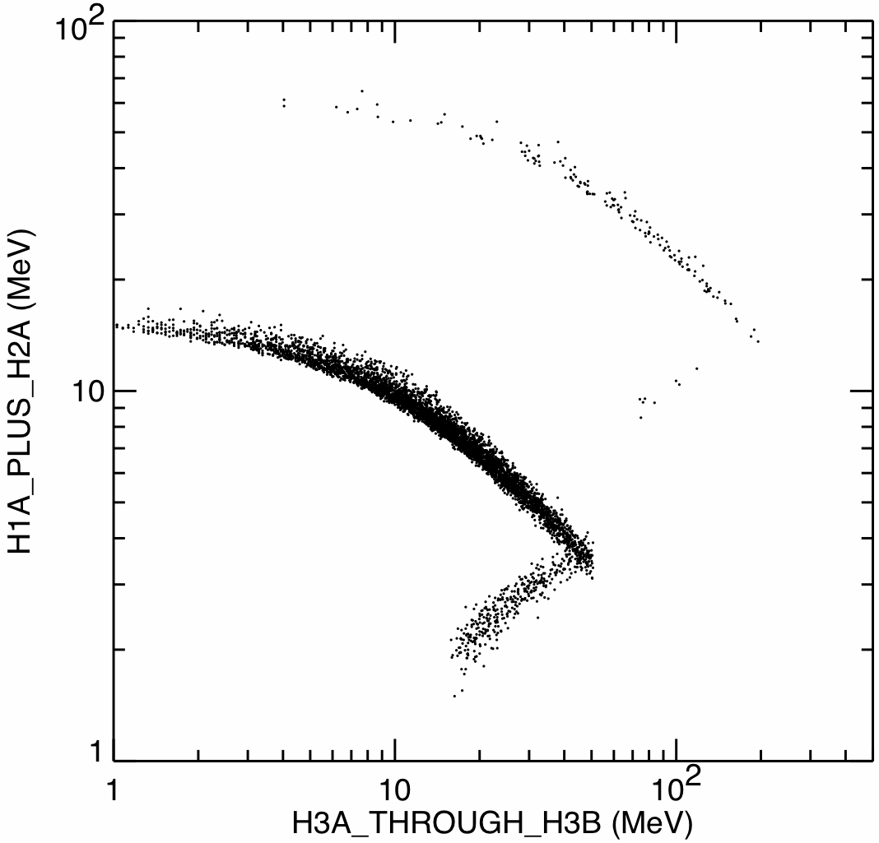
Species and Energy Coverage and Energy Binning
Rates are accumulated on-board in logarithmically spaced energy bins of width of a factor of 2^½ or 2^¼
Bin width of 2^½ corresponds to ~6.6 bins per decade
Larger bins are used for some rates accumulated at the highest cadence (1 second) in order to increase statistical accuracy
stopping He
stopping protons
penetrating protons

Slide 10
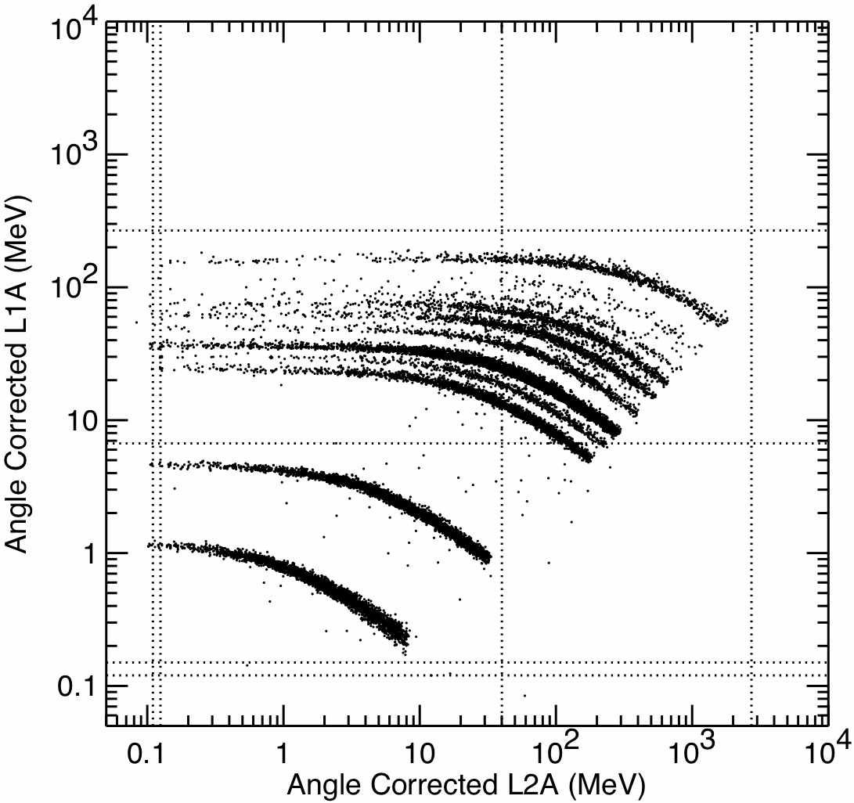
Element Resolution
Energy loss measurements from the detector in which a particle stops (E’) and the preceding detector (ΔE) organize the data into distinct tracks for the various elements.
Sector information is used to obtain mean thickness penetrated in the ΔE detector and make an on-board correction to the measured energies to optimize species resolution.
Energy assigned on-board includes energies measured in overlying detectors and calculated energy loss in windows.
Monte Carlo Simulation of Ion Response
Example:
ΔE measured in L1A (25 μm)
E’ measured in L2A (500 μm)
all incidence directions included
Fe
Si
O
Ne
C
He
H

Slide 11
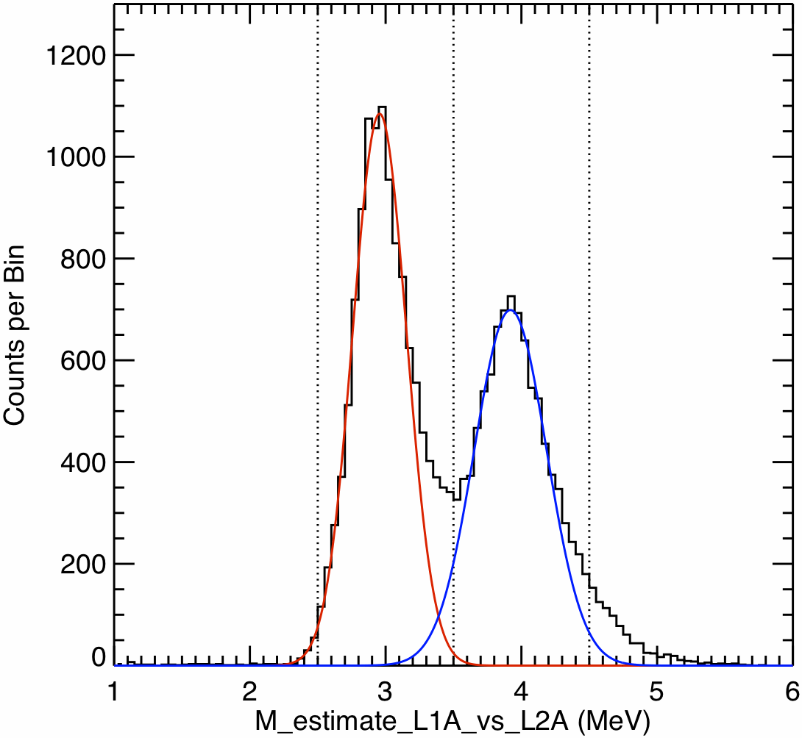
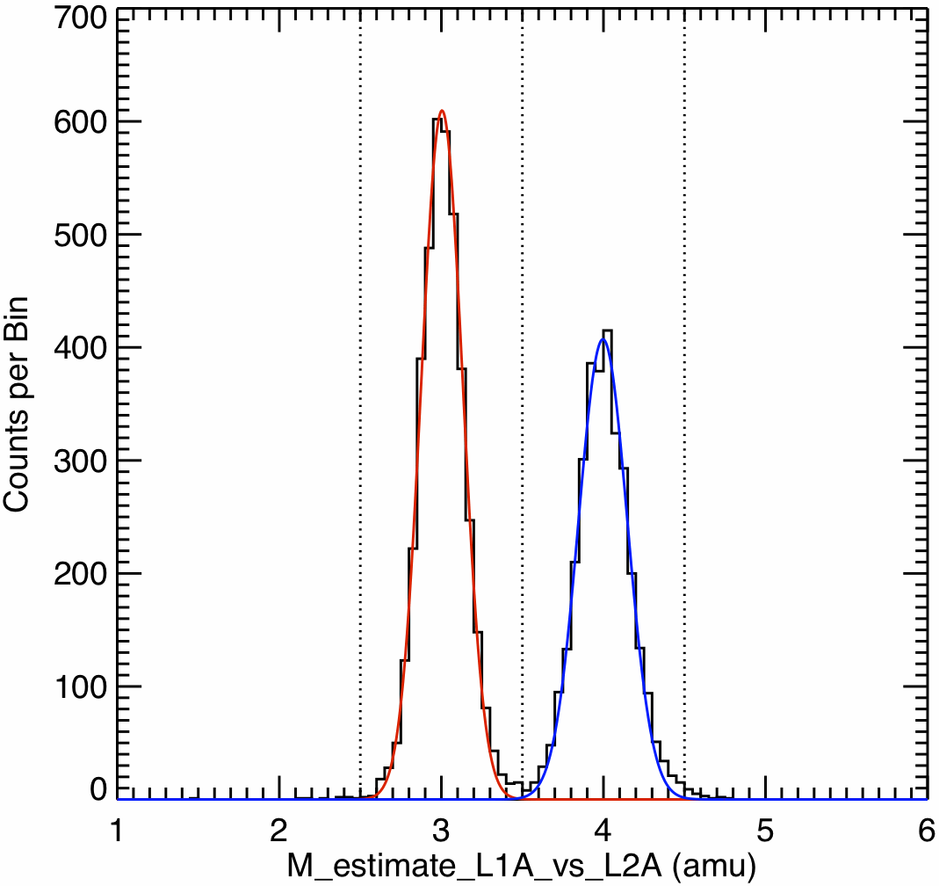
Helium Isotope Identification
Geometry Defined by L0•L1•L2 Coincidence (~1/4 of L1•L2 geometry)
Full Geometry Defined by L1•L2 Coincidence
FWHM:
³He 0.47 amu
⁴He 0.64 amu
FWHM:
³He 0.30 amu
⁴He 0.35 amu
Monte Carlo simulation of He isotope resolution: example based on L1A vs. L2A
Resolution dominated by effect of incidence angle uncertainty on ΔE thickness penetrated
Restricting analysis to narrow-angle sectors gives higher resolution dataset
Other effects (e.g., channeling) limit measurable ³He/⁴He ratio at energies of a few MeV/nuc to >~5%

Slide 12
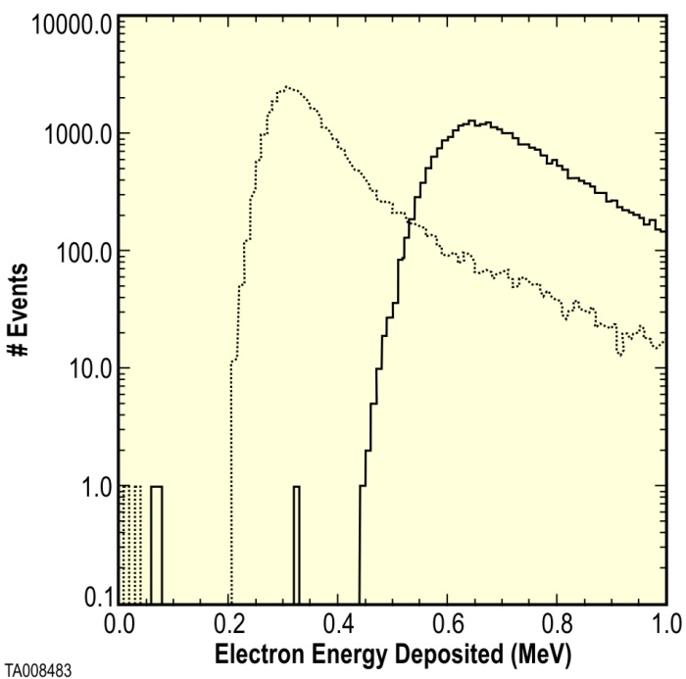
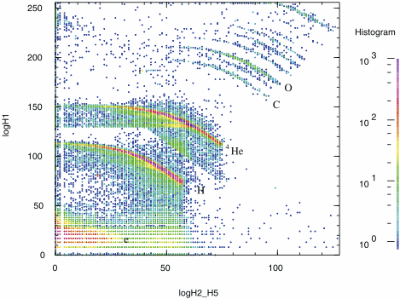
Electron Identification
STEREO/HET Electron Threshold: GEANT4 simulation
Example: measurements from the STEREO/HET telescope in the 13 Dec 2013 SEP event
1000 μm detector
2000 μm detector
von Rosenvinge et al., Space Sci. Rev., 136, 391, 2008
von Rosenvinge et al., 2008
EPI-Hi HET uses a 500 μm front detector vs. 1000 μm in STEREO/HET
High-energy electrons should deposit ~0.17 MeV in H1 and be detectable using the modeled 0.11 MeV threshold
Once electronic noise level has been measured in a realistic setup, we will assess whether a modest increase in the H1 thickness is desirable
electrons

Slide 13
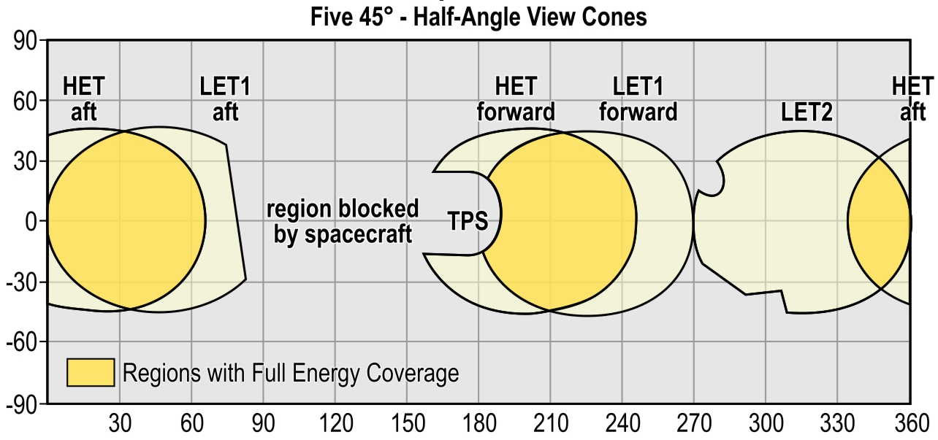
Fields of View
Azimuth

Slide 14
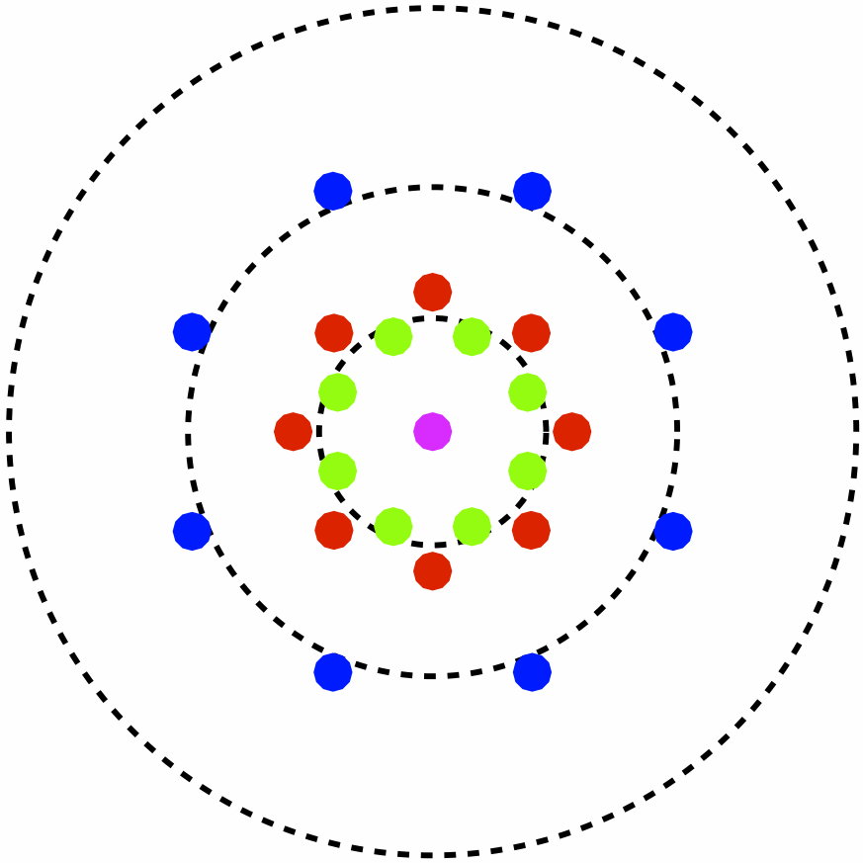
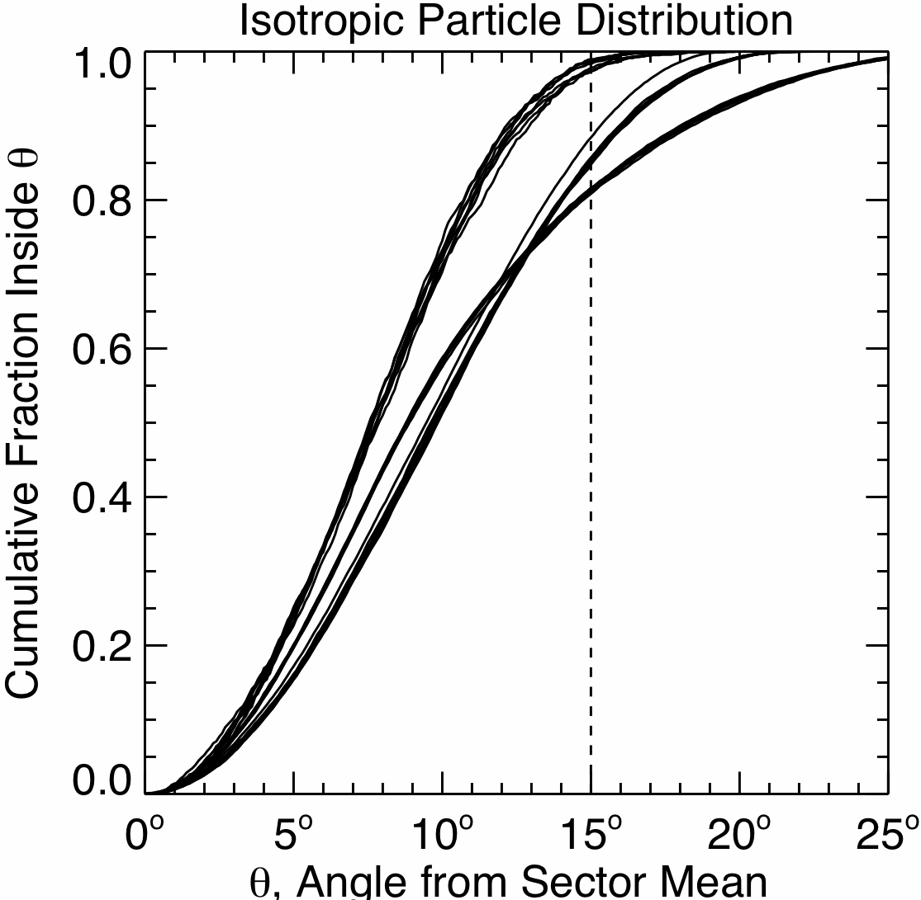
Angular Sectoring
Locations of Centers of Angular Sectors, Telescope Axis at Center of Diagram
Particle directions of incidence are determined based on active elements hit in two position-sensitive Si detectors (L0 and L1, L1 and L2, or H1 and H2)
Each of these detectors has central bull’s eye surrounded by 4 quadrants
Area of each active element is 0.2 cm²
Quadrants in the second detector rotated 45° about the telescope axis relative to those in the first detector
25 combinations of hit elements in the two detectors are used to assign event to a viewing sector
For an isotropic distribution of particles, ≥80% of the particles detected in a sector have directions of incidence within 15° of the mean viewing direction of the sector
Significant overlap among sectors allows measurements of particle distributions with angular resolution smaller than the size of a sector
HET provides sectored electron data, LET1 provides only front-back direction information for electrons
30°
15°
45°

Slide 15
Measurement Cadences
Highest cadence: 1 second
Used for one electron bin below and one above 1 MeV
Used for 4 proton bins above 1 MeV
Intermediate cadence: 10 sec
Used for narrow energy bins for e, H, He, ³He
Used for intermediate-width energy bins for element groups CNO, NeMgSi, Fe
Normal cadence: 60 sec
Used for narrow energy bins for ³He, and major elements from C through Ni
Used for wide energy bins for groups of ultraheavy elements
Low cadence: 300 sec
Used for angular distribution of e, p, He, ³He, CNO, NeMgSi, and Fe in intermediate energy bins
Very low cadence: 1 hr
All rates accumulated at cadences of 60 sec and 300 sec are also accumulated over 1 hr

Slide 16
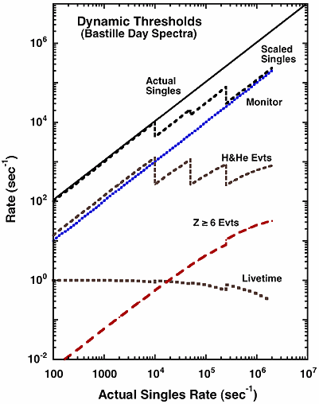
Dynamic Range in Particle Intensities (1/2)
Protons and He dominate the EPI-Hi count rates and the associated dead-time
A “dynamic threshold” system, successfully used in the LET and HET instruments on STEREO, allows the adjustment of the geometrical factor for protons and He while maintaining the full geometrical factor for Z≥6 elements
In several stages, thresholds are raised on all but one active element in detectors progressively deeper in the stack to suppress protons and He over a portion of the instrument geometrical factor
A detector element that remains sensitive to protons and He is used to monitor the actual rate so that thresholds can be returned to the lower values (with some hysteresis) when particle intensities have decreased
Count rates at which thresholds are dynamically raised and lowered are controlled by entries in the command table
Example from STEREO/LET
Mewaldt et al., Space Sci. Rev.,
136, 285, 2008

Slide 17
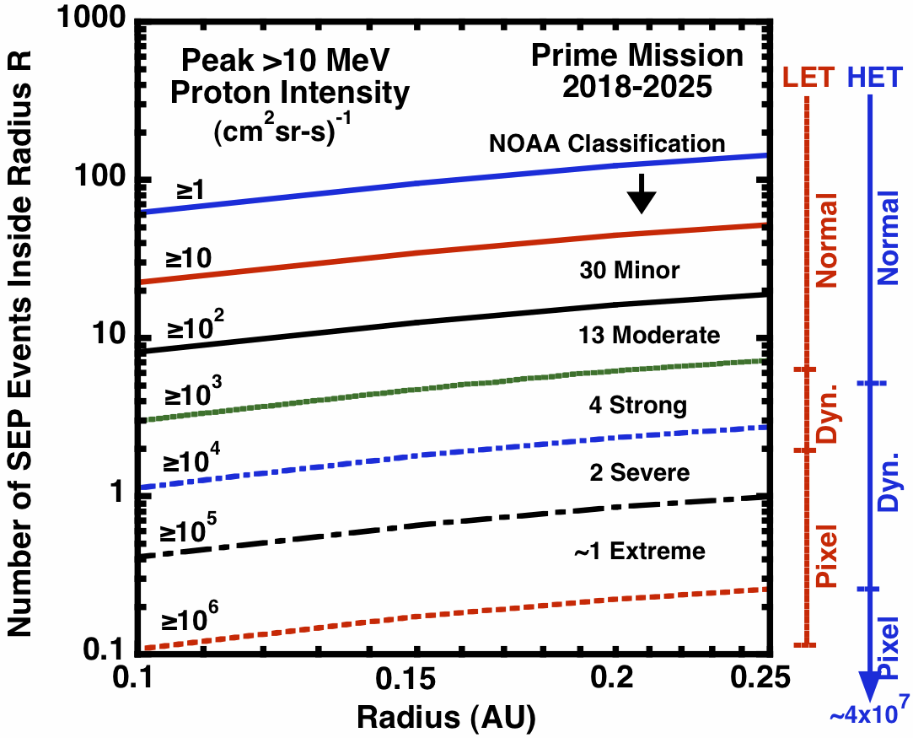
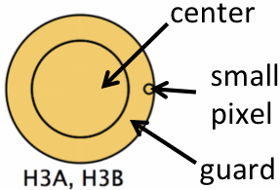
Dynamic Range in Particle Intensities (2/2)
An estimate of the distribution of SEP event sizes was obtained by combining: 1) an extensive database of SEP observations at 1 AU, 2) the radial dependence of peak intensities derived from Lario et al. (2007), and 3) the SPP orbit
~50 events are expected inside 0.25 AU over the 7-year mission, including ~2 “severe” events and possibly an “extreme” event
Both HET and LET use dynamic thresholds when intensities exceed ~2000 /cm²sr-s
There is significant uncertainty in the radial dependence of SEP intensities close to the Sun
The EDTRD includes a worst-case spectrum having a >10 MeV intensity of 3×10⁷/cm²sr-s (95% confidence)
In order to measure proton intensities in extreme events up to this level, singles count rates from several small (1 mm²) pixels are used with thresholds raised on all other detector elements

Slide 18
Redundancies: Design for Graceful Degradation
The radiation and dust environments close to the Sun are poorly known and may be severe.
The front detectors, particularly in the LETs, have minimal shielding in order to achieve a low energy threshold and are thus particularly vulnerable to damage by radiation and dust.
The normal instrument coincidence logic defines some categories of events that do not require a signal from an L0 detector, so failure of an L0 detector would increase the LET telescope threshold but otherwise not interfere with instrument operation.
The coincidence equations can be redefined in order to optimize performance in the event of other detector failures. For example, if an H1 detector were to fail, the HET coincidence could be redefined to accept events based on detectors deeper in the stack and allow measurements with poorer angular and energy resolution.
The double-ended telescopes have separate bias supplies for the two ends to preserve functionality in the event of a bias failure.
Resistors in series with detectors allow a limited number of shorted detectors without compromising the operation of an entire telescope end.

Slide 19
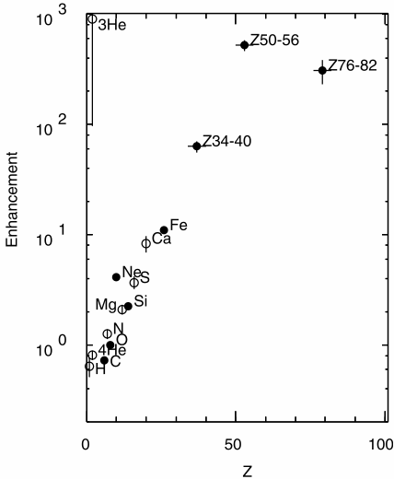
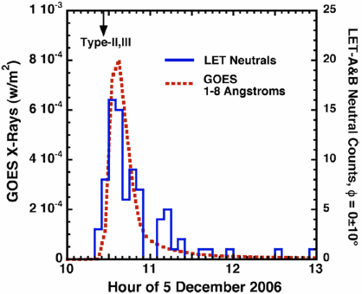
Additional Capabilities: Bonus Science Opportunities
EPI-Hi lends itself to several measurements without requiring modifications of the hardware design:
Ultraheavy (UH) elements: PHASIC dynamic range allows measurements of groups of elements with atomic numbers Z≥30. Large enhancements of UH elements are sometimes observed in impulsive SEP events.
²²Ne/²⁰Ne isotope ratio measurements: this isotope ratio has been observed to be enhanced by factors ~5 in some impulsive events.
Neutral particles including gamma-rays, neutrons, and energetic neutral atoms (ENAs): HET should be capable of measuring gammas and neutrons in some large SEP events. LET should be able to identify ENA hydrogen originating from charge exchange between SEP protons and ambient H atoms in the corona.
UH Element Enhancements
Reames et al. 2004
ENA Hydrogen from an SEP Event
Mewaldt et al. 2009

Slide 20
Peer Review Results
A combined peer review of the sensor system and front-end electronics (PHASIC) design was held on 1 March 2013 to address the suitability of this combination for making the required measurements. External (non-EPI-Hi) reviewers: Rick Leske (Caltech), Matt Hill (APL), Mihir Desai (SwRI).
Significant Issues Raised and Responses or Actions Taken:
If the instrument experiences large temperature variations, electronic thresholds, gains, and offsets could change enough to require updating parameters used for the on-board analysis during a solar encounter. Response/Action: Temperature variation over the SPP orbit has been evaluated and found to be less than the ~10°C that would require adjusting on-board analysis parameters.
Large dynamic range could lead to significant cross-talk and possibly retriggering, as experienced on STEREO/LET. Response/Action: Design improvements going from the STEREO PHASIC to the SPP PHASIC had already been implemented to reduce retriggering and to flag crosstalk. Details are given in the presentation on the EPI-Hi electronics.

Slide 21
Summary
EPI-Hi builds on heritage from the STEREO/LET and HET instruments to provide a combination of sensor system and electronics capable of meeting the requirements of Solar Probe Plus
Significant new features include:
The development of thin silicon detectors to reduce the EPI-Hi energy threshold and achieve some overlap with EPI-Lo
Compact packaging of detector stacks to reduce backgrounds and improve performance under conditions of high particle intensities
Addition of small detector segments (“small pixels”) that can be used to provide a measure of proton intensities under extreme conditions
Enhancement of capabilities for on-board analysis including He isotope identification and multiple measurement cadences to optimize the use of available telemetry

