Slide 1
EPI-Lo Technology Development
Reid Gurnee
EPI-Lo SE (JHU/APL)
This document contains technical data that may be controlled by the International Traffic in Arms Regulations (22 CFR 120-130) and may not be provided, disclosed or transferred in any manner to any person, whether in the U.S. or abroad, who is not 1) a citizen of the United States, 2) a lawful permanent resident of the United States, or 3) a protected individual as defined by 8 USC 1324b(a)(3), without the written permission of the United States Department of State.
Notes:
introduction

Slide 2
Outline
EPI-Lo Technology Developments to TRL6
Performance Requirements and Derivation
Energy System Development
  Fidelity of Test Article
  Test and Analysis Results
Sensor / Timing System Development
  Fidelity of Test Article
  Test and Analysis Results
TOF-D/CFD-D ASIC Development
  Fidelity of Test Article
  Test and Analysis Results
Transition to Flight

Slide 3
EPI-Lo Technology Developments to TRL6
Species composition driven by two systems: energy system and timing system
Energy and TOF performance to meet 3He / 4He separation
  3He, 4He: 0.5 FWHM AMU
  for incoming energies between ≤0.2 MeV and ≥2.0MeV
  Validate that one anode covering two sensors has adequate timing performance – quadrant anode design uses significantly less readout electronics than an octant design
  Validate that SSD has adequate energy performance
TOF-D and CFD-D ASIC development

Slide 4
EPI-Lo Performance Modeling
Two independent models used
  Monte-Carlo
    Inputs are timing noise, SSD noise, and path length variation
    Inputs can by any distribution (not limited to Gaussian)
  Analytical
    Inputs are timing noise, SSD noise, and path length variation
    All inputs are Gaussian
  The two models have been compared and shown to give identical results
  Does not include foil losses (not significant for >200 keV He)
Modeling shows 400 ps FWHM, 15 keV FWHM performance comfortably meets requirements

Slide 5

He Separation Requirements
At low energies the energy resolution dominates performance
At high energies the timing resolution dominates performance
Predicted performance has ample margin from requirement
He separation requirement
Predicted performance

Slide 6
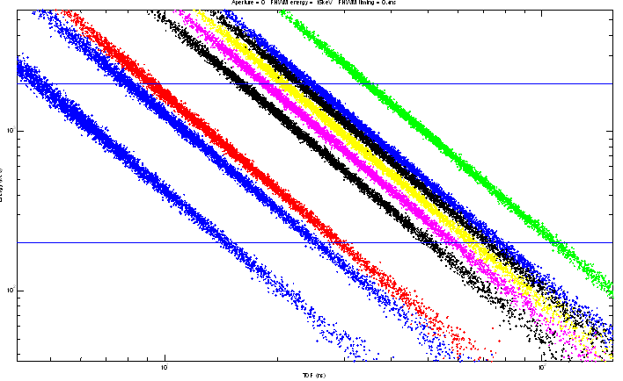
Track Simulations
Monte-Carlo model for all species with 400 ps FWHM timing and 15 keV FWHM energy resolutions
1 MeV
100 keV
10 ns
100 ns

Slide 7
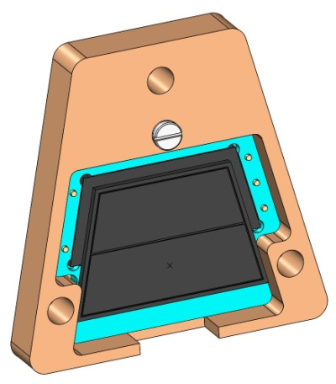
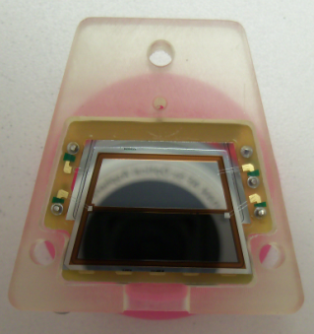
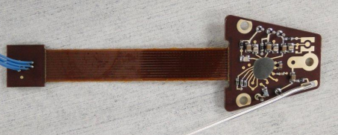
Energy System Development
Solid-State Detector is fabricated and mounted to carrier board
Energy board is fabricated and populated
All components nearly identical to flight – no design changes expected

Slide 8
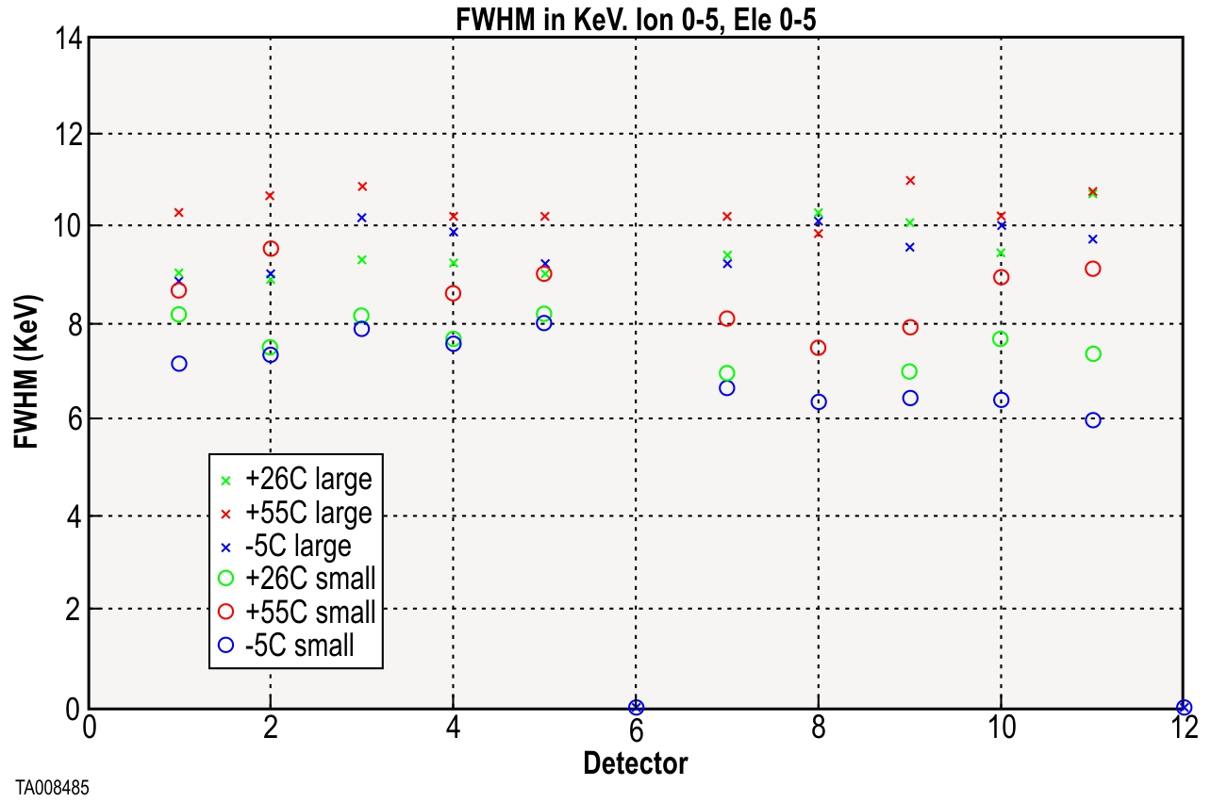
RBSPICE DATA with 60keV X-ray Source
SSD performance base-lined on RBSPICE instrument tested with 60 keV X-ray
Performance is ~11 keV FWHM over a wide temperature range
EPI-Lo SSD in testing now – preliminary results show <15 keV FWHM at 60 keV

Slide 9
Timing Performance: Timing Budget
Electron Dispersion: 200 ps
TOF-D ASIC: 200 ps
CFD-D ASIC: 200 ps
Total: 350 ps (requirement is 400 ps)

Slide 10
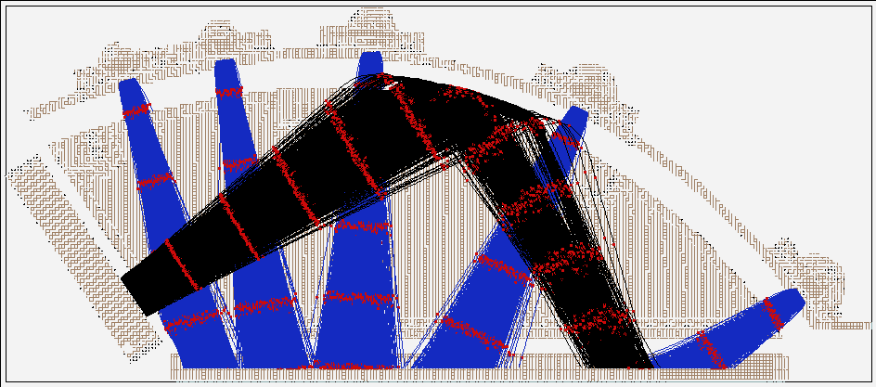
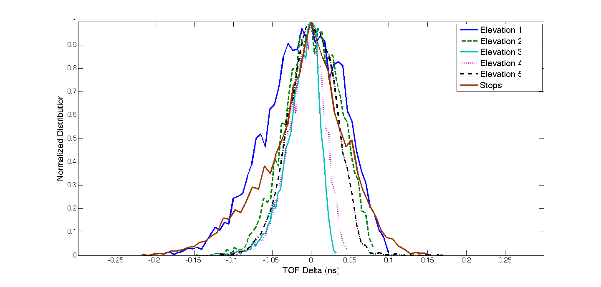
Timing budget – Secondary Electron Dispersion Simulations
250 ps Time Markers
Electron dispersion (start and stop combined) for worse case elevation 1 is 150 ps
Name | Mean TOF (ns) | FWHM (ns)
Elevation 1 | 0.93 | 0.12
Elevation 2 | 2.12 | 0.08
Elevation 3 | 2.35 | 0.04
Elevation 4 | 2.32 | 0.05
Elevation 5 | 2.26 | 0.08
Stops | 5.23 | 0.09

Slide 11
TOF-D Test Results
TOF-D performance meets requirement
INL variations compensated for with look-up tables
  Same LUTs used to normalize path length for different apertures
Jitter is less than 1 LSB FWHM
TOF range for He3/He4 separation requirement

Slide 12
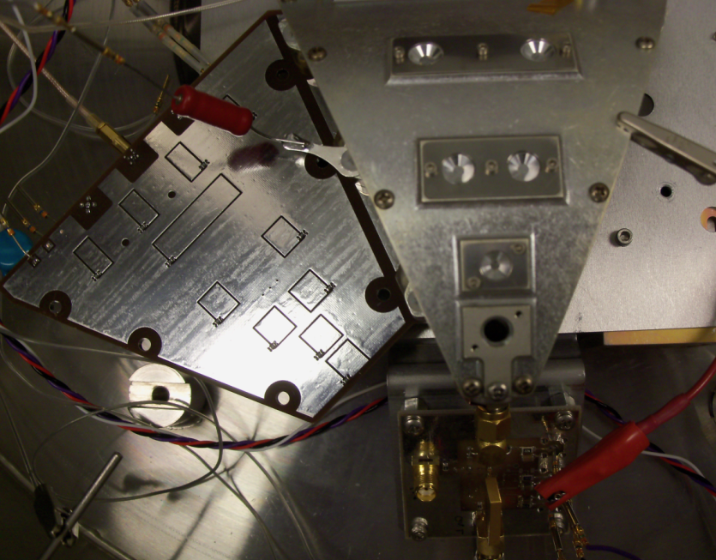
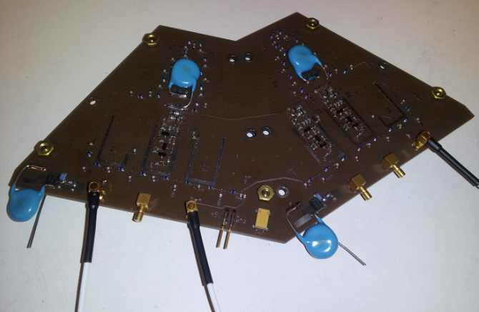
Prototype Quadrant Sensor Testing (1/2)
Timing performance testing completed on prototype sensor
End-to-end test includes variations due to electron dispersion, anode board performance, and CFD-D V0 performance
  Does not include TOF-D ASIC
Prototype anode board is close to flight configuration
  HV isolation in imbedded capacitance
  Start delay line covers two sensors
  Does not mechanically fit flight design
Prototype sensor is similar to flight sensor – key sensor geometries are the same

Slide 13
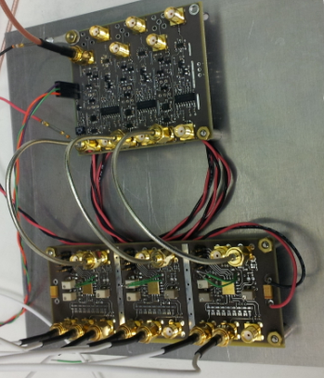
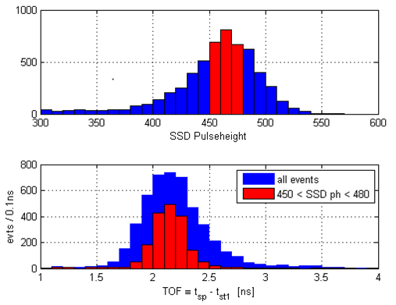
Prototype Quadrant Sensor Testing (2/2)
Initial results show about 300 ps FWHM timing performance (CFD-D and electron optics contributions), which meets our requirements
The final version of the CFD-D has lower jitter at low thresholds and reduced walk, which we expect will improve performance

Slide 14
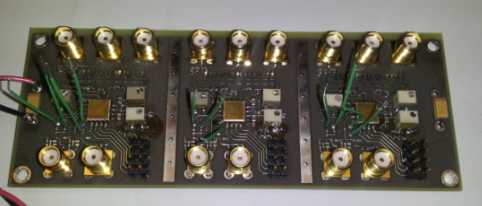
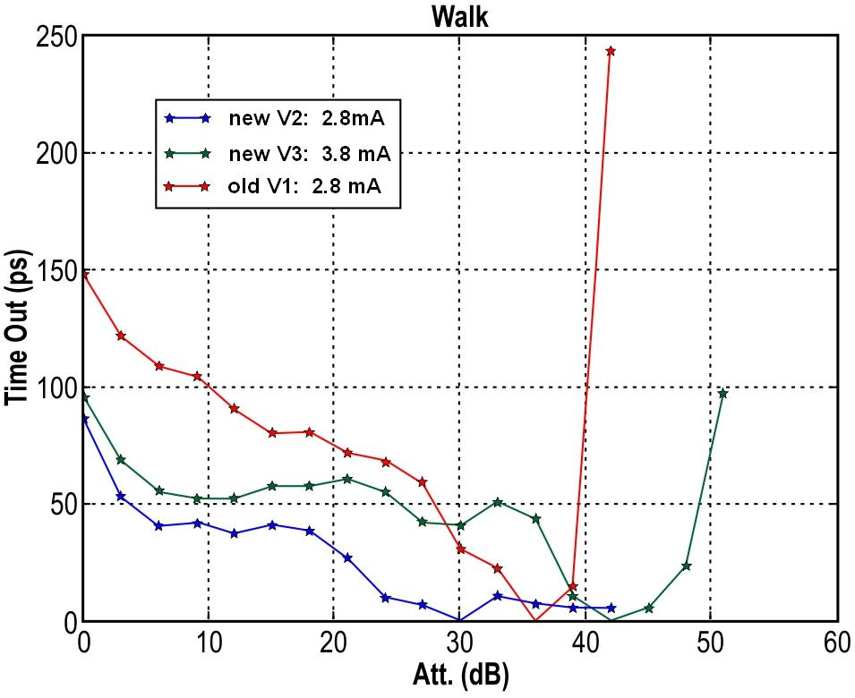
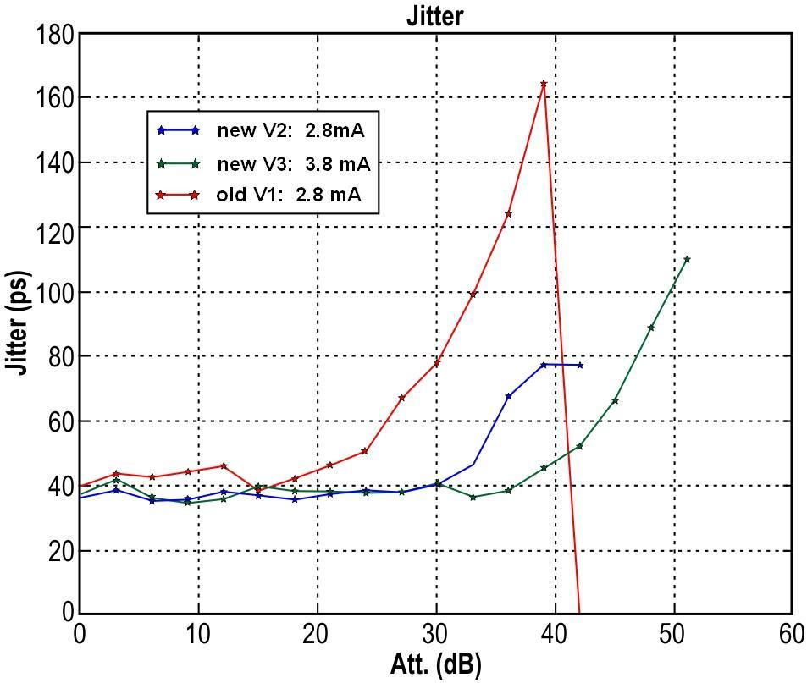
CFD-D Test Results
CFD-D extensively tested
using the CFD-D test board
CFD-D V3 has improved performance

Slide 15
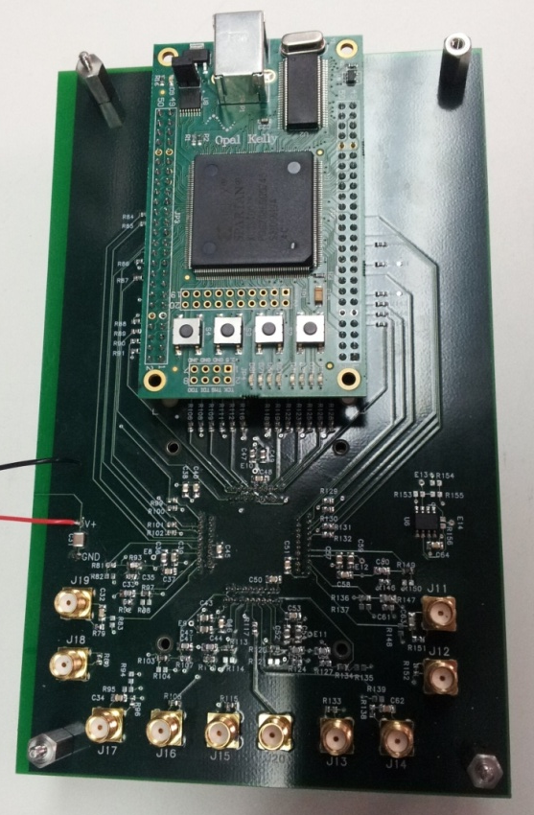
Technical Development: ASIC Progress
First version of TOF-D chip fabricated and tested
  Temperature testing from -40°C to 70°C
  Supply tested from 3.0 V to 3.6 V
  Functionality verified over 10 ps to 2 ns LSB
  Successfully completed SEE testing at Texas A&M
  Completed total dose testing
Second version of TOF-D chip and first version of CFD-D chip fabricated and tested
Flight Fabrication - third version of TOF-D chip and second version of CFD-D chip fabricated and tested
  Temperature testing from -40°C to 70°C
  Supply tested from 3.0 V to 3.6 V
  TOF-D functionality verified over 10 ps to 2 ns LSB
  Working with vendor for final qualification of both ASICs

Slide 16
Transition to Flight
TOF-D, CFD-D ASICs
  Complete qualification with external test house
  Parts are needed in early 2014 for SIS instrument – EPI-Lo not the driver
  Complete radiation testing on flight parts (prototype parts passed all radiation testing)
Sensor Development
  Build and test EM sensor
  Integrate sensor with SSD
SSD
  EM design complete
  Finish testing EM SSD
  Flight design will be identical
All critical performance metrics for quadrant anode design have been verified with prototype testing

