Slide 1
EPI-Lo Sensor Design
Ralph McNutt
EPI-Lo Lead Co-I (JHU/APL)
This document contains technical data that may be controlled by the International Traffic in Arms Regulations (22 CFR 120-130) and may not be provided, disclosed or transferred in any manner to any person, whether in the U.S. or abroad, who is not 1) a citizen of the United States, 2) a lawful permanent resident of the United States, or 3) a protected individual as defined by 8 USC 1324b(a)(3), without the written permission of the United States Department of State.
Notes:
introduction

Slide 2
Outline
Requirements
Placement
Cross-Section
Fields of View
Ions
Electrons
Energy Distribution
Microchannel Plate (MCP)
Block Diagram
Collimators and Start Foils
Anti-Coincidence System
Light and Dust Mitigation
Follow-up from Peer Reviews
Summary

Slide 3
The EPI-Lo Instrument Requirements
Parameter | Required | Goal (Capability) | Comment/Heritage
Electron Energies | 50 – 500 keV | 25 - 1000 keV | Electron capability from JEDI, RBSPICE
Ion Energies | 50 keV/nucleon – 15,000 keV Total E | 50 keV/nucleon – 15,000 keV Total E | Capability based on that of RBSPICE. Maximum energy ~250keV/nuc for Fe
Energy Resolution | 45% for required energy range | 40% for required energy range | Telemetry limited
Time sampling | 5 sec | 1 sec | Telemetry and/or statistics limited
Angle resolution | <30° x <30° | Ions, ~15°x 12°to <30° x <30° e-, 45° | Varies with elevation
Pitch Angle (PA) Coverage | 0°-90° or 90°-180°, some samples in both hemispheres | 0°-90° or 90°-180°, some samples in both hemispheres
Time for Full PA | 1 – 5 sec | 1 – 5 sec | Telemetry limited
Ion Composition | H, ³He, ⁴H4, C, O, Ne, Mg, Si, Fe | H, ³He, ⁴He, C, O, Ne, Mg, Si, Fe | ³He / ⁴He ~50 to 1000 keV/nuc
Electron Sensitivity | j = 10-10⁶ / cm²-s-sr | Sensor-G:0.144 (cm².sr) Pixel-G: ~0.02 (cm².sr) Up to 6x10⁶ 1/s counting | j=Intensity (1 / cm²-s-sr) G=Geometric factor (cm²-sr) 8 pixels/sensor
Ion Sensitivity | j = 10-10⁶ / cm²-s-sr | Sensor-G:0.16 (cm².sr) Pixel-G: ~0.002 (cm².sr) Up to 3.5x10⁶/s rate (TOF x E) | 80 pixels/sensor

Slide 4
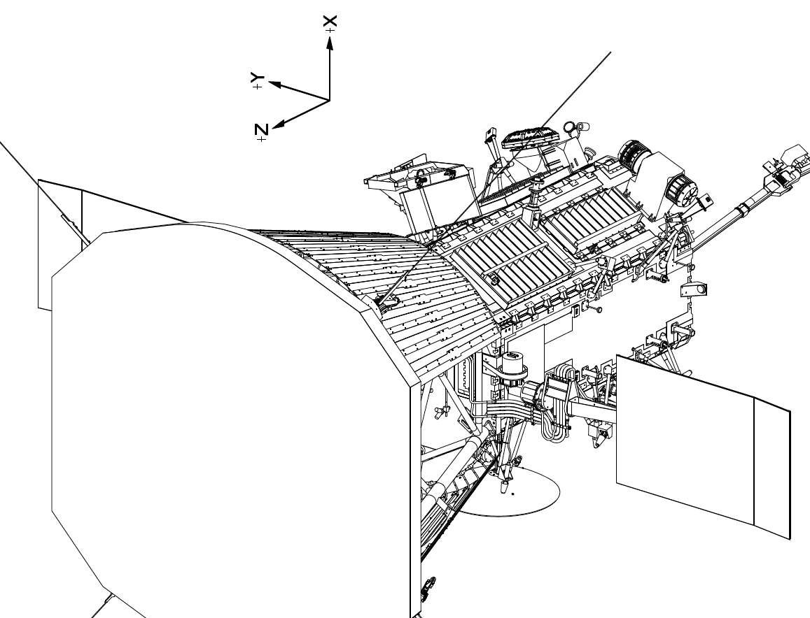
EPI-Lo Instrument Placement

Slide 5
EPI-Lo Instrument Cross Section
ANODE PWB ASSY
EVENT PWB ASSY
POWER SUPPLY ASSY
EPI-Lo Cross-Section View Isometric

Slide 6
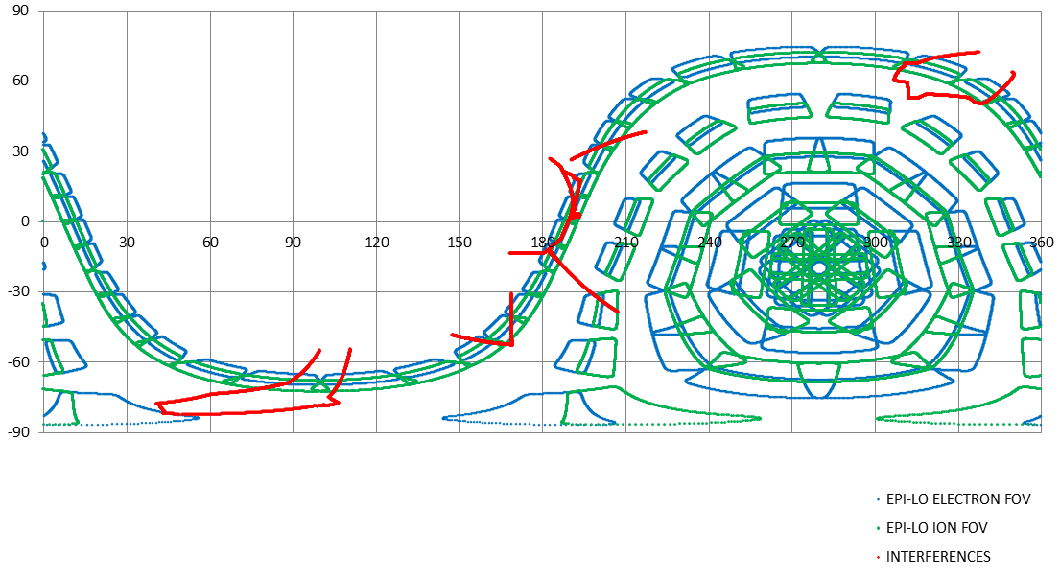
EPI-Lo Field(s) of View
SUN
RAM

Slide 7
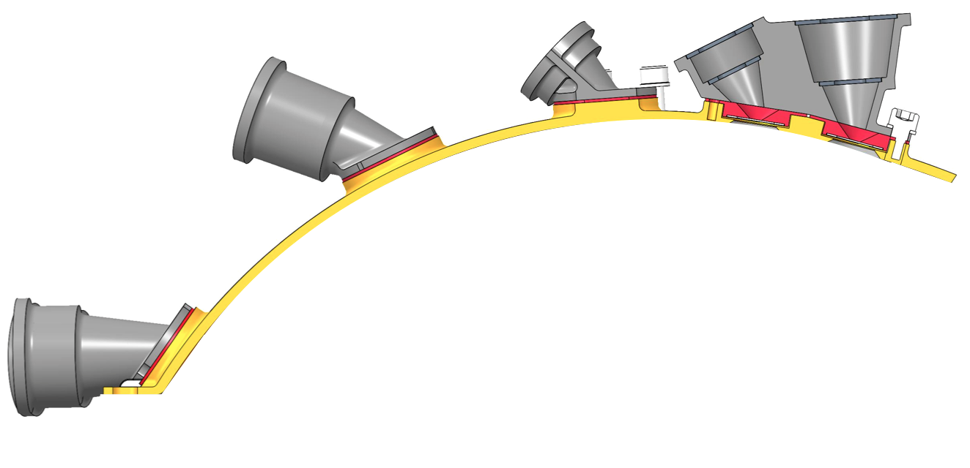
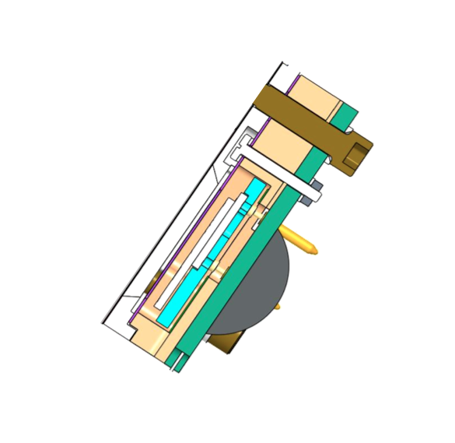
Ions (Energy, TOF, and Position)
Incident ion trajectory
Start electron trajectory
Stop electron trajectory
MCP
SSDs
Anode

Slide 8
Energetic Ion Measurements
Ion Measurement Logic can toggle TOF, but no TOF ➔ no species identification

Slide 9
Electrons: Energy (& Position)
Incident Electron
Secondary
electrons
(infrequent)
MCP
Anode
SSDs

Slide 10
Energetic Electron Measurements
Stops from secondaries not indentifiable
Secondary Electrons from Start Foils possible, but Low Probability;
Start Electron only identifies entrance aperture

Slide 11
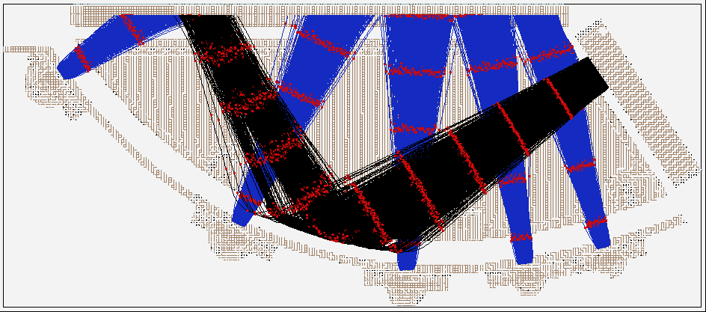
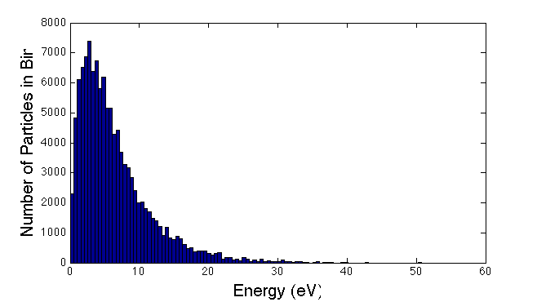
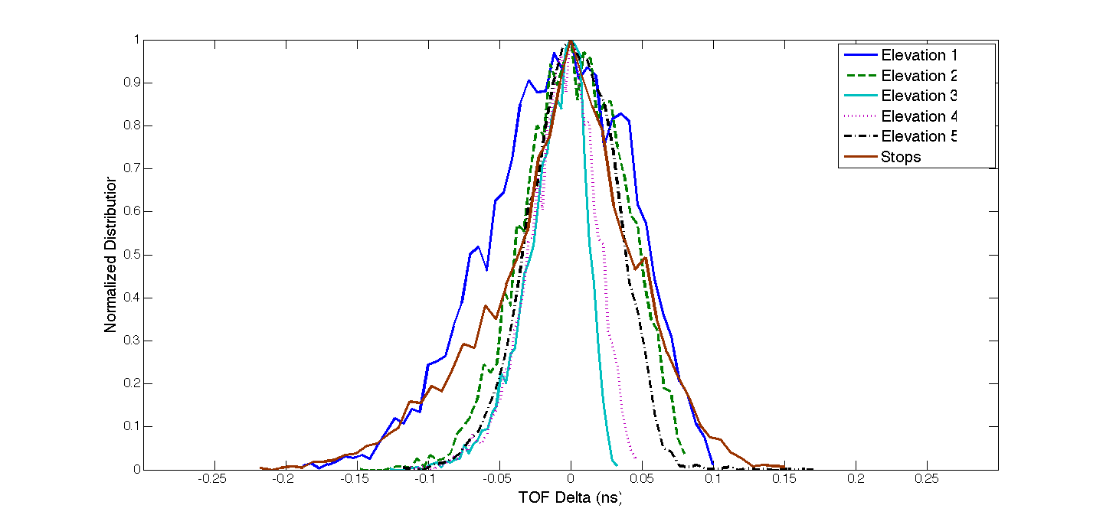
SIMION, Allegrini Energy Distribution
Sample Trajectories
Initial Energy Distribution
Hit Locations
Electron Dispersion
Elevation 3
Elevation 5
Name | Mean TOF (ns) | FWHM (ns)
Elevation 1 | 0.93 | 0.12
Elevation 2 | 2.12 | 0.08
Elevation 3 | 2.35 | 0.04
Elevation 4 | 2.32 | 0.05
Elevation 5 | 2.26 | 0.08
Stops | 5.23 | 0.09
Elevation 4
Elevation 2
Elevation 1
11

Slide 12
SIMION, Allegrini Energy Distribution
Sample Trajectories
Initial Energy Distribution
Electron Dispersion
Hit Locations
Electron Dispersion
Elevation 3
Elevation 5
Name | Mean TOF (ns) | FWHM (ns)
Elevation 1 | 0.93 | 0.12
Elevation 2 | 2.12 | 0.08
Elevation 3 | 2.35 | 0.04
Elevation 4 | 2.32 | 0.05
Elevation 5 | 2.26 | 0.08
Stops | 5.23 | 0.09
Elevation 4
Elevation 2
Elevation 1
12

Slide 13
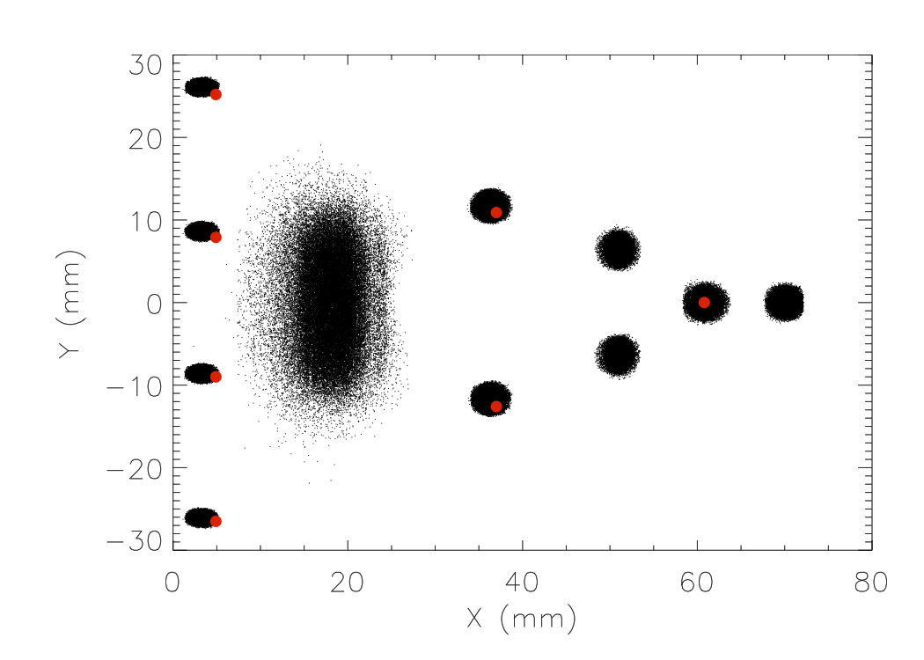
Microchannel Plate (MCP)
Simulation (black) versus measured centroids (red)
The misalignment in Y-direction was due to a registration offset in the setup
The offset in the X direction for the left-most data was caused by an obstruction at the edge of the MCP mount that has since been eliminated

Slide 14
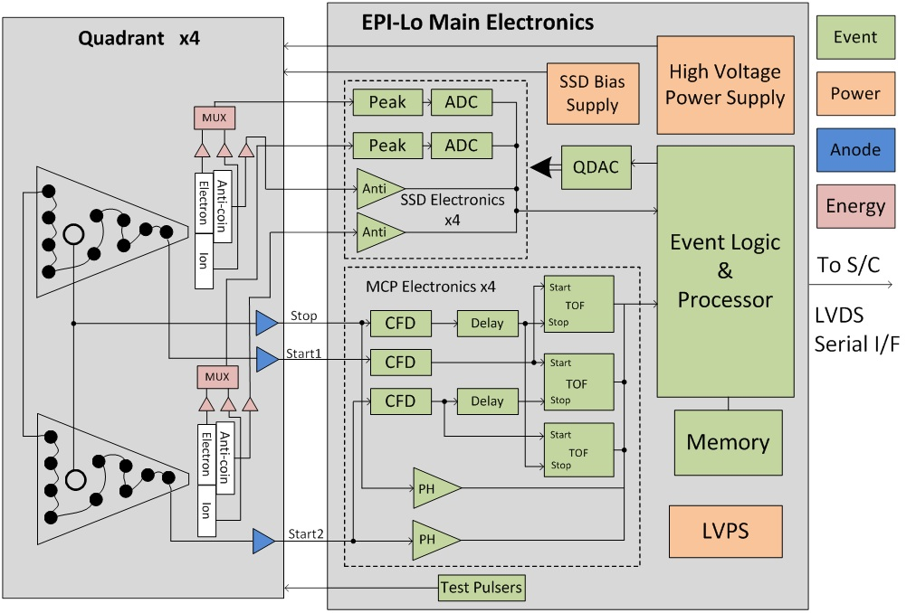
EPI-Lo Block Diagram

Slide 15
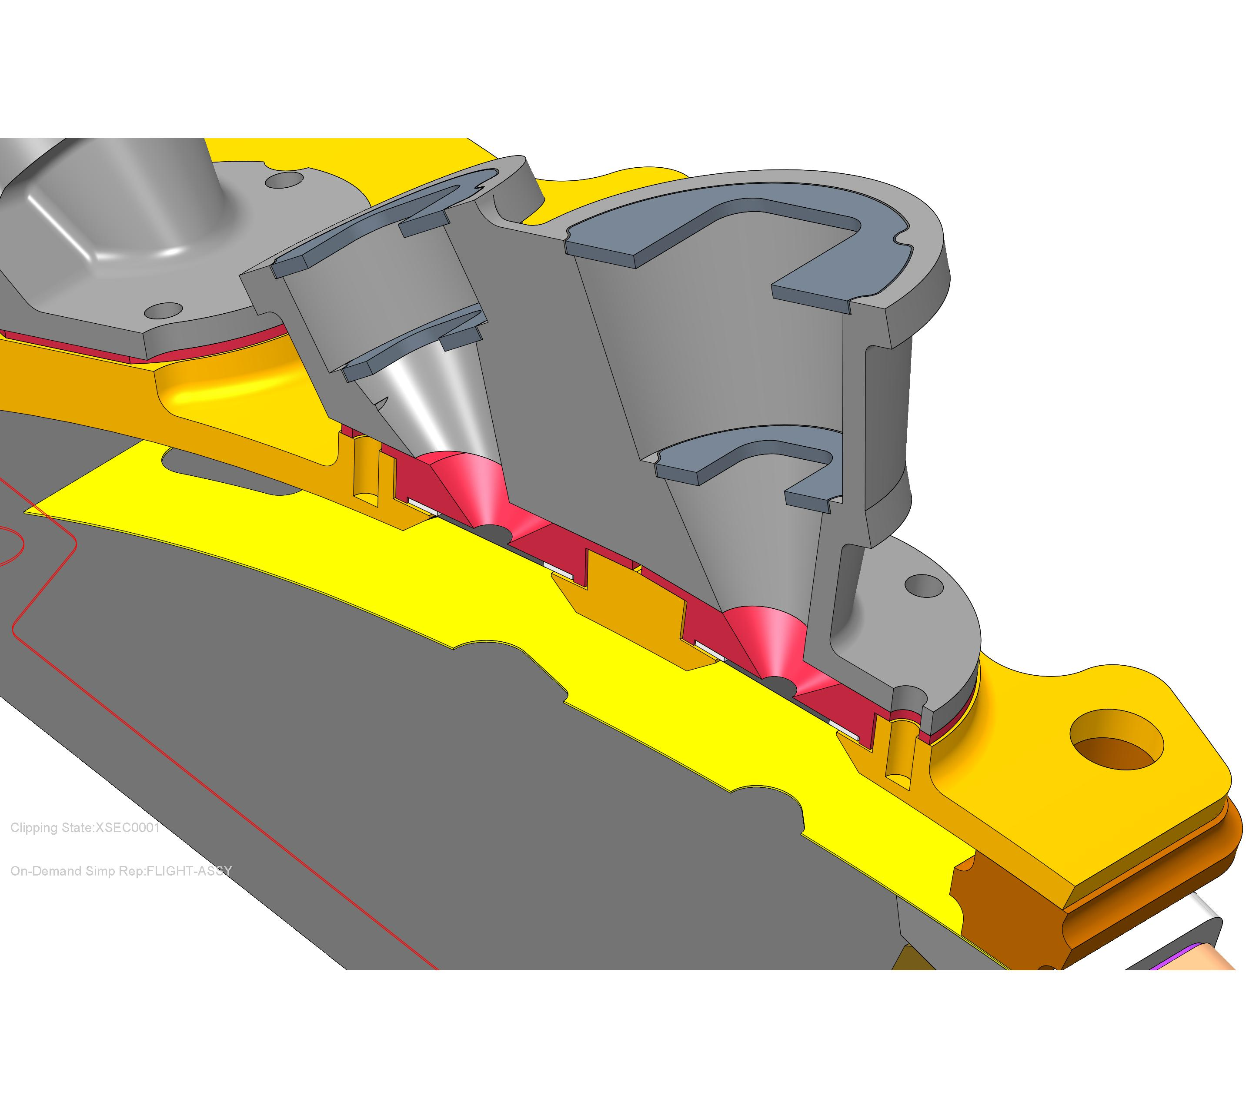
Collimators and Start Foils
Foils Mount on Apertures (red)
Each elevation tailored for equal geometric factors
Second foil at intermediate baffle (vented)
Collimators screw-mount to outer cover, capture foils
Each elevation and azimuth is unique

Slide 16
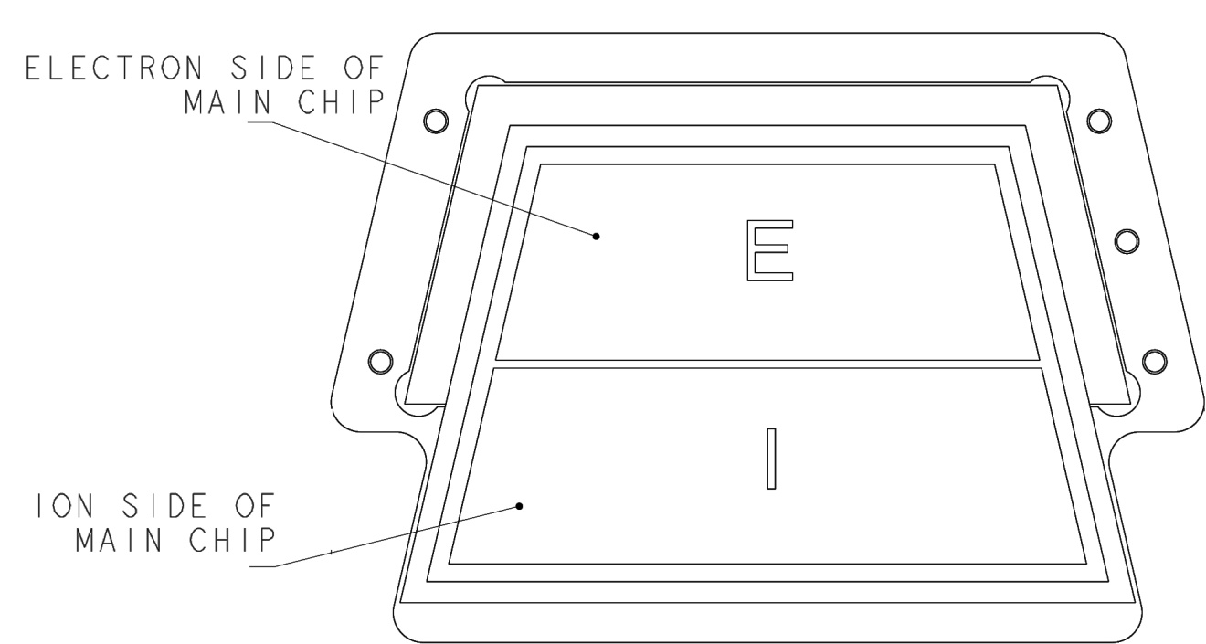
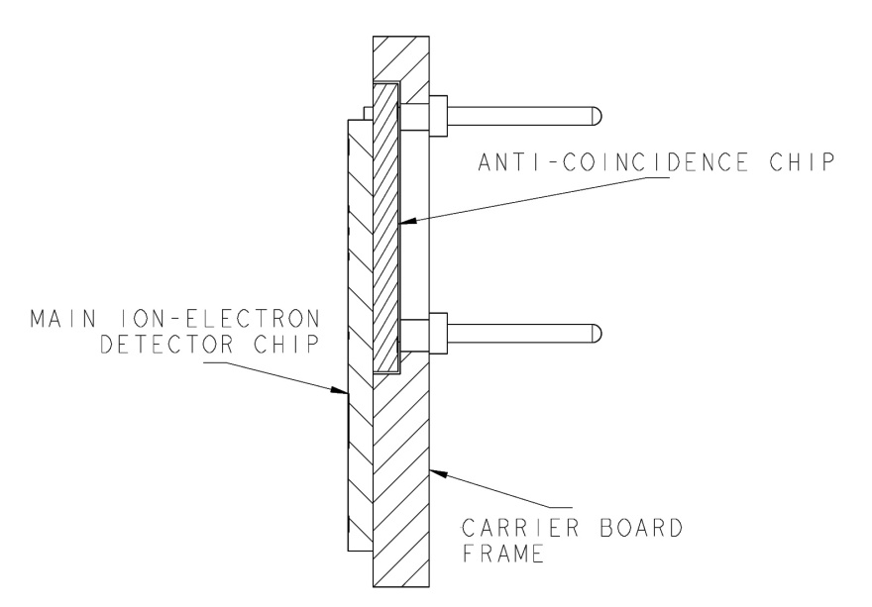
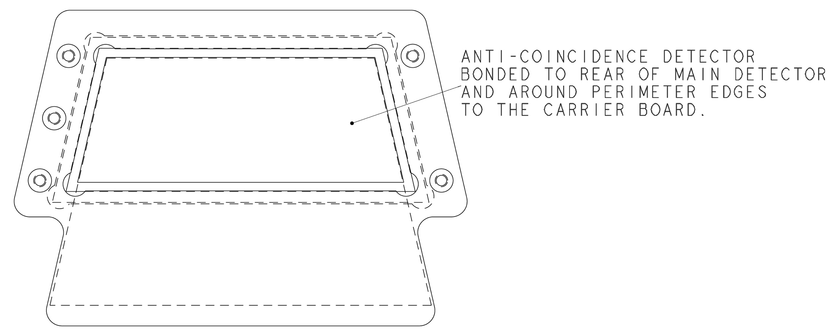
Anti-coincidence System
Electron SSD is backed by an anti-coincidence SSD
Improves S/N for electrons by a factor ~25 (from ~0.4 to ~10)

Slide 17
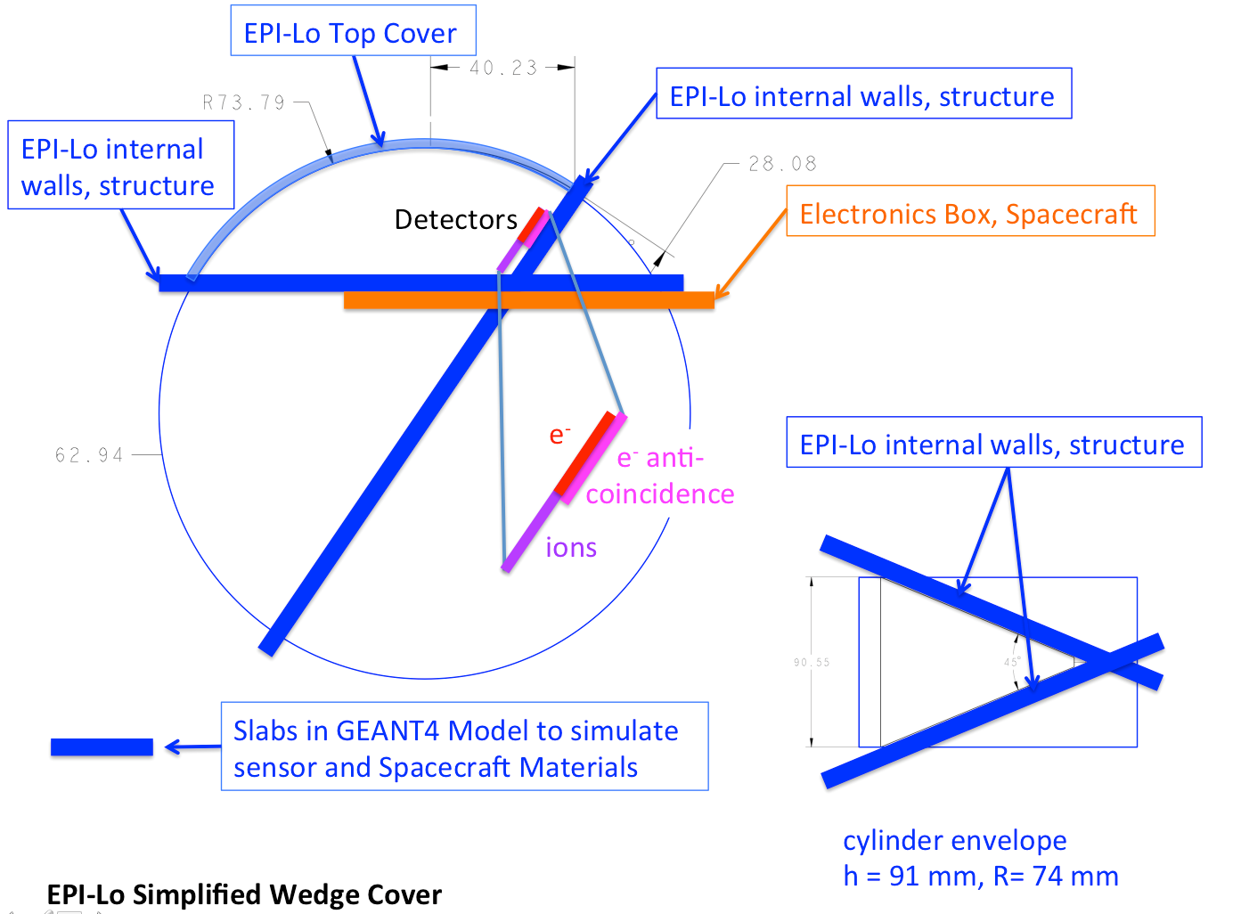
Anti-coincidence System: GEANT Setup
Improved setup for GEANT4 model of electron SSD anticoincidence

Slide 18
Anti-coincidence System: GEANT Results
Assumed electron flux of j(E) ~ E^{– 2.65} from ~10 keV to ~5 MeV
Penetrator rejection efficiency range from 83% to 95% from 1 MeV up to 10 MeV incident electron energy
Following peer review result of S/N of ~3 for foreground electrons with anti-coincidence, higher fidelity sensor model yields S/N ~10
New GEANT model accounts for more realistic geometry and extra shielding by structure
Only ~1% of electrons below 2 MeV penetrate to detectors in this model

Slide 19
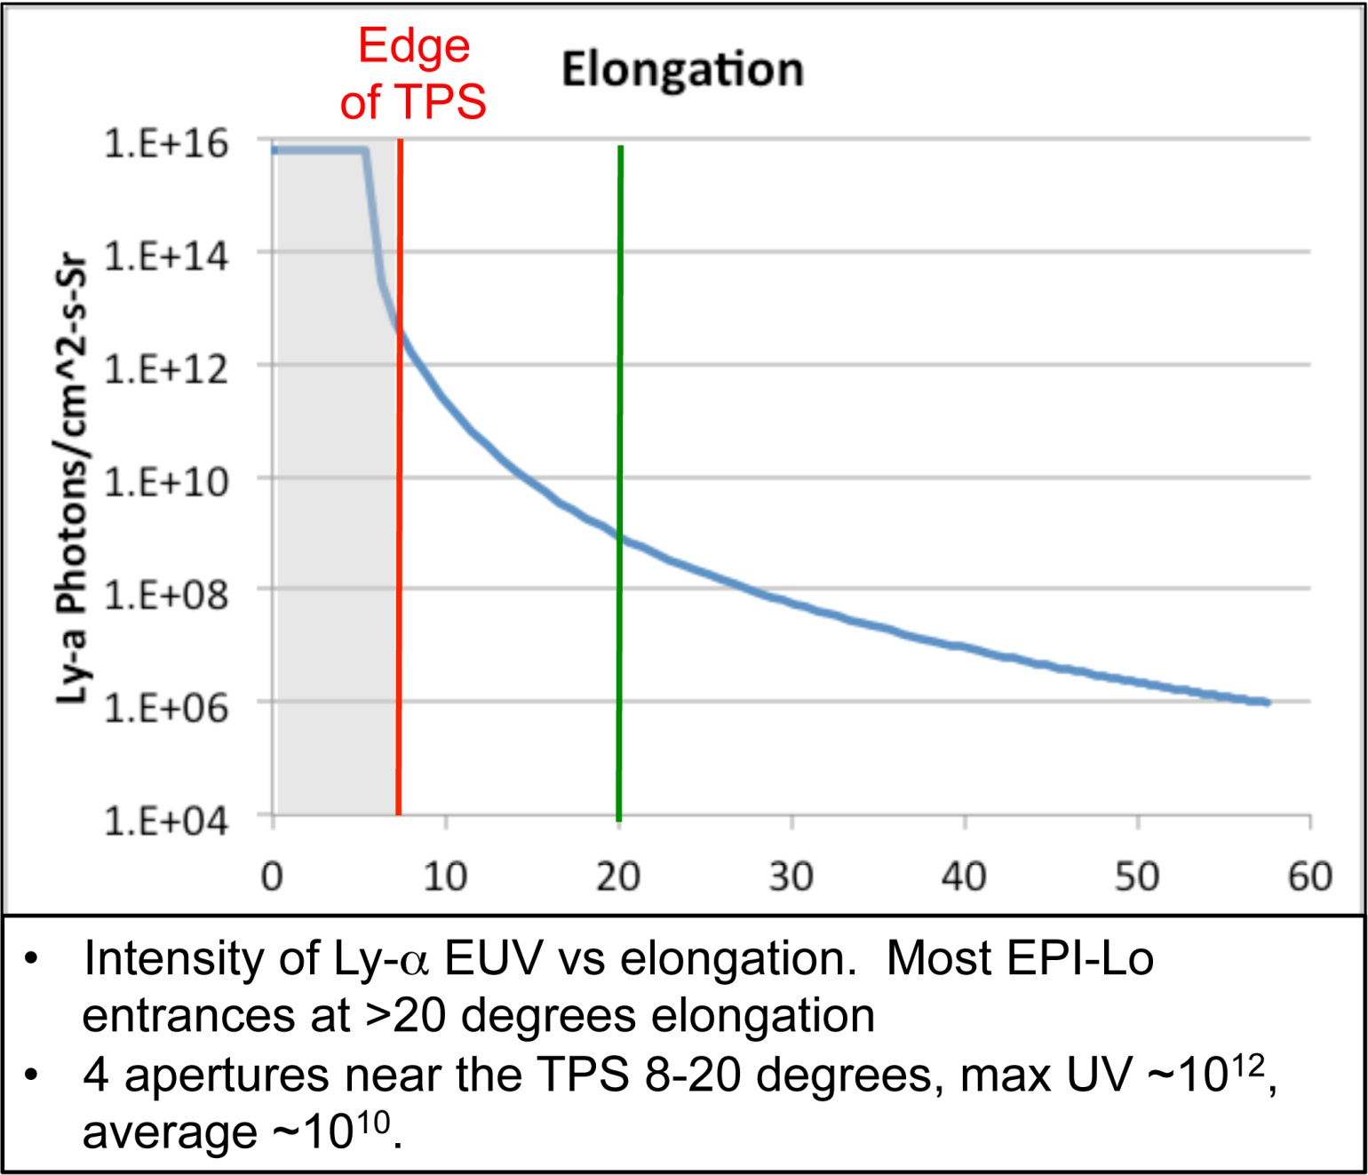
Light and Dust Mitigation (1/2)
Dust may produce pinholes in the Start and collimator foils.
Foils are designed to reduce UV by ~3 orders of magnitude.
Pinholes may account for as much as ~0.4% of a foil area.
For the 4 foils closest to the TPS edge, the suppression factor must be ~4 orders of magnitude. For these, pinholes are important to UV suppression.

Slide 20
Light and Dust Mitigation (2/2)
Dust may produce pairs of pinholes in the Start and collimator foils
Foils are designed to stop solar-wind-energy electrons
Pinhole pairs allow will still allow access to solar-wind electrons
Solar wind electrons have an energy of ~100 eV or less
Electrons that “leak in” through apertures are indistinguishable from Start secondary electrons
Solar wind electron flux ~2 x 10¹²/cm²-s-sr
Estimate foil pinhole as size of a support grid element is ~4.9 x 10⁻⁵ cm²
Geometric factor of a pair of pinholes separated by ~0.5cm is ~1.3 x 10⁻⁸
The flux through a pinhole pair can be estimated as ~2.6 x 10⁴/s
If every aperture had 1 grid-element pinhole, the total for a quadrant would be ~5.0 x 10⁵/s
This rate would be well tolerated by the electronics processing
Such a pinhole pair would result in UV induced counting rates ~10/s

Slide 21
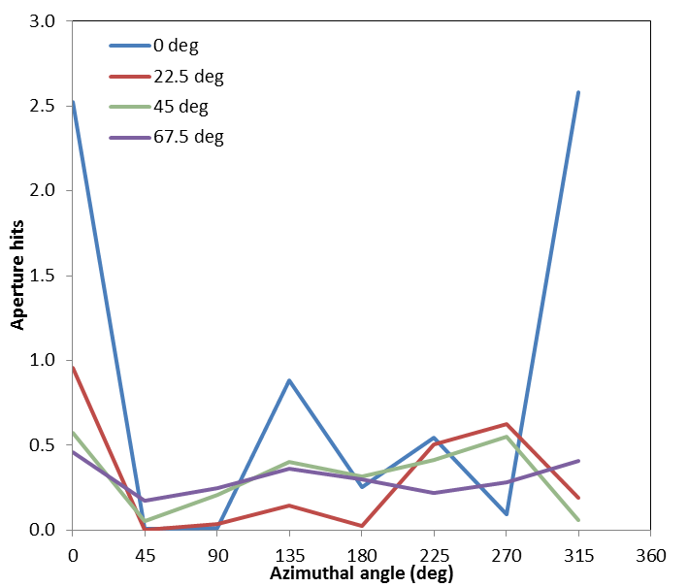
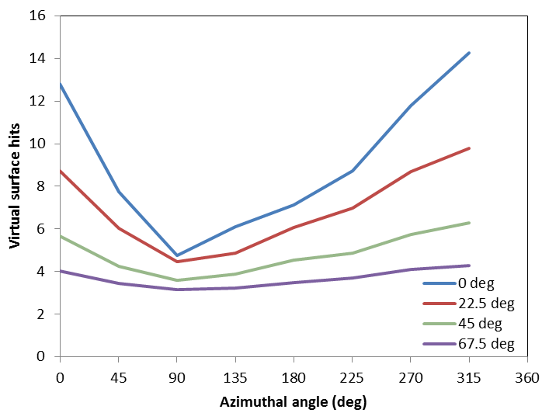
Dust: Simulating the Environment
Expect ~10 damage-inducing hits on each unprotected foil during entire mission
Reduced to ~1 hit per mission with collimator
Can lower further with pairs of pinholes
Start Foil Behind Collimator
Bare Start Foil

Slide 22
Follow Up from Peer Review
Area of Concern/Action | Resolution/Comment | Status
1. Photoelectron flux false starts. | Second start foil reduces flux of e- accelerated. | Closed
2. MCP count rate density > 1 MHz/cm2 | Simulations show density below this. | Closed
3. Rates, S/N, efficiency compilation. | Draft closure memorandum complete 10/25/2013 | Closed
4. Electron measurement poor S/N. | Higher resolution GEANT runs completed | Closed
5. Incorrect plug power co-ax. | Use labeling and/or color-coding. | Closed
6. Alternate internal e- noise sources. | In equipotential 100 V retarding potential rejects e- | Closed
7. Reject false signals w/ redundant info. | Consistency checks will be done b/w 3 TOF chains. | Closed
8. In-flight pulser for rate correction. | Mewaldt et al, Space Sci Rev (2008) 136:285-362. | Closed
9. HV discharge secondary effects. | Addressed by design and testing | Closed
10. Fasteners w/o locking features. | Locking inserts, Bellville washers, etc. added. | Closed
11. Wishbone webbing field deformation. | Webs removed, extra 0-1kV surface length added. | Closed
12. Bonded external baffles allowed? | Preliminary answer is yes; final requires thermal specs | Closed
13. EPI-Lo/Hi electron energy gap. | Additional GEANT simulations complete | Closed
14. Thicker foil effect on lookup tables. | Not a problem on board, just science interpretation. | Closed
15. Dual foils near sun handle pinholes. | Second foil is under consideration. | Closed
16. Neutrals/photoelectrons/plasma bkg. | Solar wind electron fluxes cut-down by dual foil. | Closed
17. Auto use of extra data allocation. | Too complicated to implement. | Closed
18. Spare MCP assembly plans. | Spares plan held at ISIS level. | Closed
19. Vent back cover of SSD assembly. | Vent is added. | Closed
20. Mounting structure for tags/handling. | Plan is in place. | Closed
21. How are foils marked/serialized? | Labels laser etched prior to assembly. | Closed
22. Sensor purging plan. | Purge IN in center and vent OUT in each octant. | Closed

Slide 23
Summary
EPI-Lo Sensor development is on schedule and on budget
Peer review held and action items have been responded to
22 items
All closed
Sensor design and approach are matured through Technical Readiness Level 6:
System/subsystem model or prototyping demonstration in a relevant end-to-end environment (ground or space): Prototyping implementations on full-scale realistic problems. Partially integrated with existing systems. Limited documentation available. Engineering feasibility fully demonstrated in actual system application.
Ready to proceed to Phase C

