Slide 1
Systems Engineering
John Dickinson
ISIS SE (SwRI)
This document contains technical data that may be controlled by the International Traffic in Arms Regulations (22 CFR 120-130) and may not be provided, disclosed or transferred in any manner to any person, whether in the U.S. or abroad, who is not 1) a citizen of the United States, 2) a lawful permanent resident of the United States, or 3) a protected individual as defined by 8 USC 1324b(a)(3), without the written permission of the United States Department of State.
Notes:
introduction

Slide 2
Outline
ISIS SE Approach
SPP Requirements
ISIS Requirements and Flowdown
Interfaces and Accommodation
Resources
Instrument Command and Autonomy
Environmental Design and Test Requirements
Trade Studies
Summary

Slide 3
ISIS Systems Engineering Approach
Distributed Systems Engineering
  Both EPI-Hi and EPI-Lo engage fully in the SE process
ISIS SE role is to:
  Coordinate interactions with the project
  Maximize use of shared resources
  Provide oversight of technical tasks
Requirements development process:
  ISIS has actively worked with the Project to make sure the correct requirements are being developed at all levels
  ISIS has ownership of its requirements at all levels

Slide 4
SPP Req’s Doc. Architecture and Status
Level 1
L1 Requirements For The SPP Mission
Appendix E to Living With a Star Program Plan
Status Key:
Started
Draft: Key Driving
Draft: Complete
Preliminary
Baseline
Solar Probe Plus (SPP) Level 2 Mission
Requirements Document (MRD)
Level 2
SPP Level 3 Payload
Requirements Document (PAY)
Level 3
EDTRD
EMECP
CCP
MPCP
PCP
SPP-ISIS ICD
GI ICD
MOC/SOC ICD
Due PDR+60
SPP ISIS Level 4 Instrument Requirements Document (IRD)
Level 4
Notes:
Instrument Requirements are derived directly from Project L1->L2->L3 Requirements and environmental, materials, and parts plans
Dual instrument ICDs guide spacecraft interfaces (electrical, command and data, mechanical, thermal, and ground)
All documents have been reviewed and signed off by SPP
Environmental Design and Test Requirements Document
Electromagnetic Environment Control Plan
Contamination Control Plan
Materials and Processes Control Plan

Slide 5
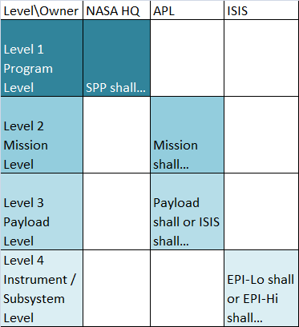
Level Definitions
L1 requirements are defined by NASA as advised by the SPP Science Working Group
  This document belongs to NASA
  “SPP mission shall”
  Program Level Requirements
L2s are APLs response to the L1s
  This document belongs to APL/Project Office
  “Mission shall”
  Mission Requirements Document
L3s are performance and functional requirements on individual mission elements
  This document belongs to APL/Project Office
  “Payload shall" or "ISIS suite shall“
  Payload Requirements Document
L4s are the payload response to L3s
  This document belongs to ISIS
  “EPI-Lo shall” or “EPI-Hi shall”
  Instrument Requirements Document
Notes:
Different levels of requirements apply to different levels of implementation.
Documents are owned by different institutions.
ISIS team is involved and performs reviews at all levels – direct signature on L2-L4 (Does Dave sign L1s?).

Slide 6
SPP Requirements Documents
Project Requirements Document | Version | Date
NASA L1 Requirements For The SPP Mission Appendix E to Living With a Star Program Plan | Rev. - | 9/6/2011
APL 7434-9047, Solar Probe Plus (SPP) Level 2 Mission Requirements Document (MRD) | Rev. C | 8/30/2013
APL 7434-9051, SPP Level 3 Payload Requirements Document (PAY) | Rev. - | 6/27/2013
APL 7434-9066, SPP General Instrument to Spacecraft ICD | Rev. - | 10/3/2013
APL 7434-9058, SPP to ISIS ICD | Rev. - | 10/30/2013
APL 7434-9078, SPP MOC to SOC ICD | Draft | PDR+60d
APL 7434-9039, SPP Environmental Design and Test Requirements Document | Rev. - | 6/18/2013
APL 7434-9040, Electromagnetic Environment Control Plan (EMECP) | Rev. - | 4/23/2013
APL 7434-9011, SPP Contamination Control Plan (CCP) | Rev. - | 6/17/2013
APL 7434-9009, SPP Materials and Processes Control Plan (MPCP) | Rev - | 6/11/2013
APL 7434-9001, SPP EEE Part Control Plan (PCP) | Rev. A | 4/11/2013
JPL D-8545, JPL Derating guidelines | Rev. E | 8/4/2006
Plus other Mission Assurance Documents
Notes:
Specific Requirements Document Names and Numbers
Also shows current revision level for APL documents
ISIS reviews and signs off on all documents

Slide 7
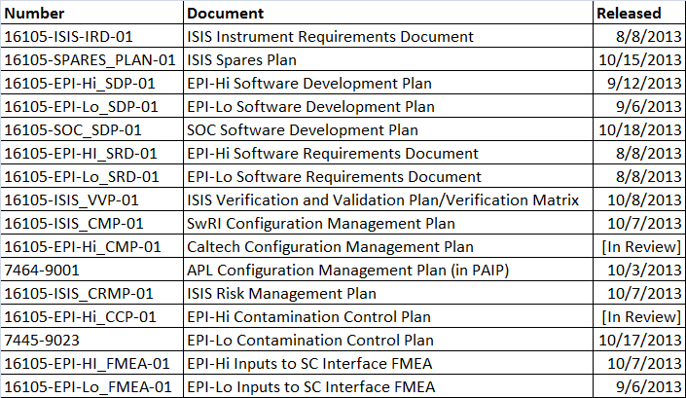
ISIS Response Documentation
Notes:
ISIS has provided all deliverable documents required for PDR to the Project
Instrument designs are well under way in the form of board schematics
SW NOTES: Delete documents, expand out Documents (EPI-Hi /Lo get their own line)
Hi CCP will be “final release”
Add list of planned reviews

Slide 8
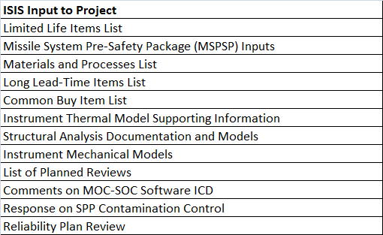
Reviewed Supporting Documents
In addition to the Requirements documents, ISIS has provided feedback on the following documents/topics:
ISIS has been responsive to inputs required by Project
Notes:
ISIS has been responsive to inputs required by Project
ISIS has been involved with requirements documents at all levels

Slide 9
Driving Requirements at L1/L2
The Mission shall measure energetic protons and heavy ions, as follows:
  Energy range: ≤ 0.05 to ≥ 50 MeV/nucleon
  Highest cadence: ≤ 5s for selected rates
  FOV: ≥ π/2 sr in sunward and anti-sunward hemispheres
  Angular sectoring: ≤ 30 degree sectors
  Composition: at least H, He, 3He, C, O, Ne, Mg, Si, Fe
The Mission shall measure energetic electrons, as follows:
  Energy range: ≤ 0.05 to ≥ 3 MeV
  Highest cadence: ≤ 1s for selected rates
  FOV: ≥ π/2 sr in sunward and anti-sunward hemispheres
  Angular sectoring: ≤ 45 degree sectors
  Composition: n/a
Requirement above in blue is traced to lower levels in subsequent slides

Slide 10
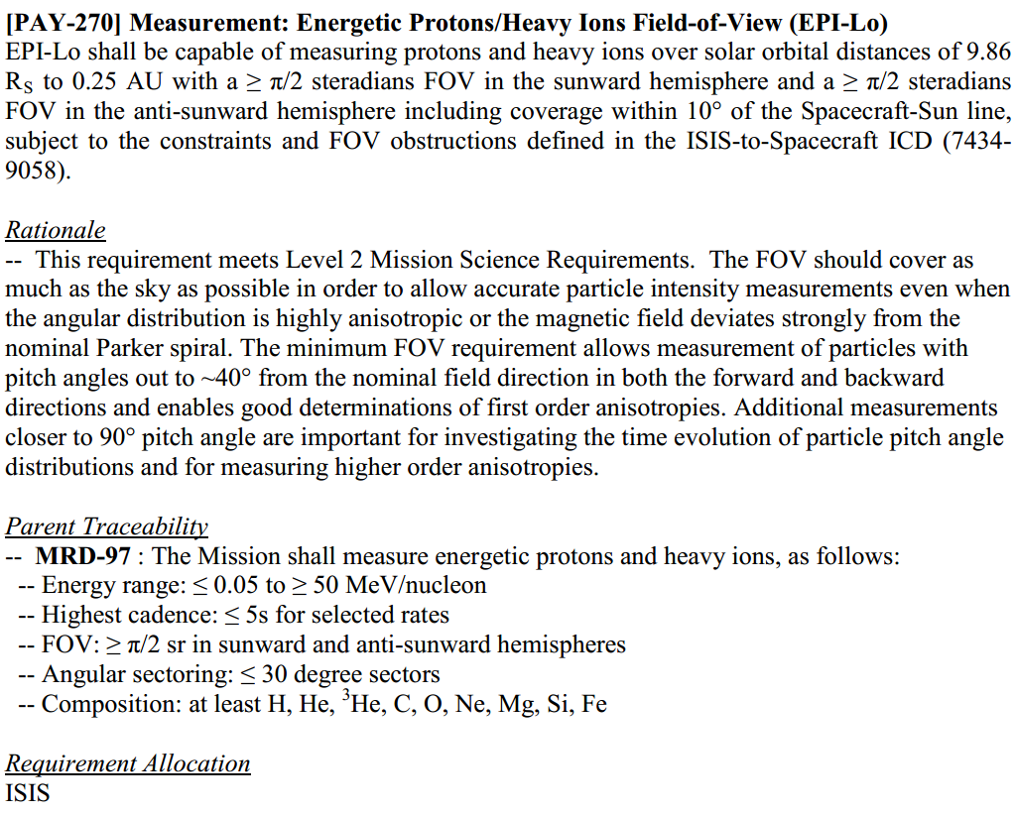

Requirements Flowdown to L3
L2: The Mission shall measure energetic protons and heavy ions, as follows:
  FOV: ≥ π/2 sr in sunward and anti-sunward hemispheres
L3:
Traceability to L2 as well as more detail captured at L3
  Description/Clarification, Spacecraft Rationale, Parent Traceability, Requirement Allocation
Notes:
Each driving requirement flows to at least 1 L3 requirement
A description/clarification is captured at the S/C level
Further, S/C rationale is captured at L3

Slide 11
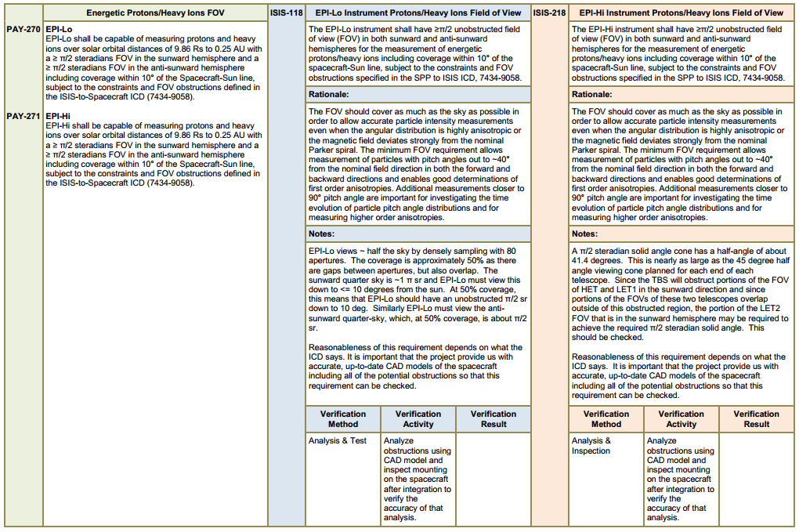
Requirements Flowdown to L4
Notes:
Illustration of science requirements flowdown
L3 requirements flow down to at least 1 L4 requirement
Flow down is captured in the requirements document itself (show a picture)
Every L4 requirement is verifiable either directly or via several activities
L3 requirements are verified directly by roll-up of L4 requirement verification

Slide 12
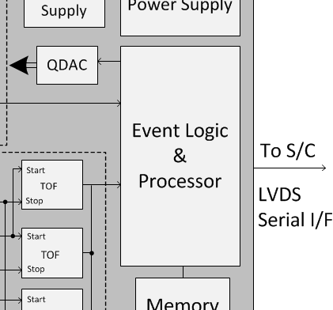
EPI-Lo Spacecraft Interfaces
Unique EPI-Lo-to-spacecraft Interfaces include:
  Spacecraft power
  Command/Telemetry
  Survival Heaters
  Spacecraft Temperature Sensors
EPI-Lo mounted to shared ISIS Bracket
Notes:
Individual Instrument Block Diagrams
Both instruments are entirely separate
Each instrument has it’s own individual connections to the S/C, including: power, command and telemetry, heaters, temperature sense

Slide 13
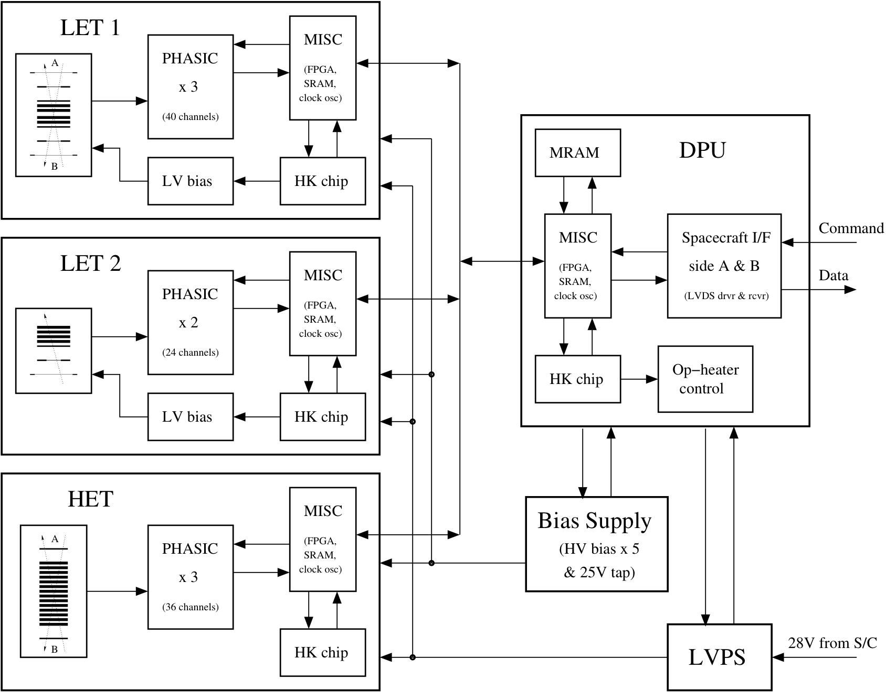
EPI-Hi Spacecraft Interfaces
Unique EPI-Hi-to-spacecraft Interfaces include:
  Spacecraft power
  Command/Telemetry
  Survival Heaters
  Spacecraft Temperature Sensors
EPI-Hi mounted to shared ISIS Bracket
Notes:
Each instrument has it’s own individual connections to the S/C, including: power, command and telemetry, heaters, temperature sense

Slide 14
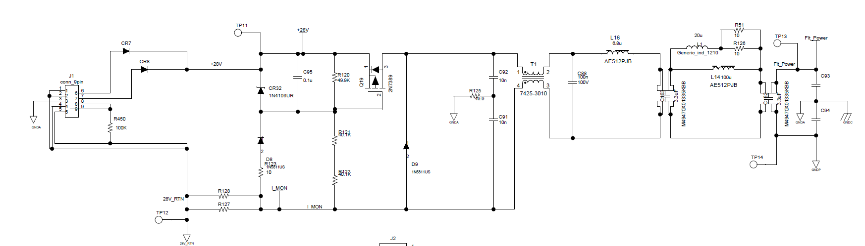
Spacecraft Electrical Interfaces
Power
  Main Instrument Power
  Survival Heaters
  Operational Heaters (EPI-Hi)
Command & Telemetry
  Side A/B LVDS UART
Grounding
  Chassis Ground to Bracket, thermally isolated
Thermal
  Heaters
  Temperature Sensors
Captured in GI and SPP-ISIS ICDs
Instrument Interface Circuit from ICD
Notes:
Spacecraft interfaces to the instrument
They are captured in the ICDs
Specifically, main power has a S/C fuse, high side FET, and low side current monitor
Instrument interface has filtering and primary isolation

Slide 15
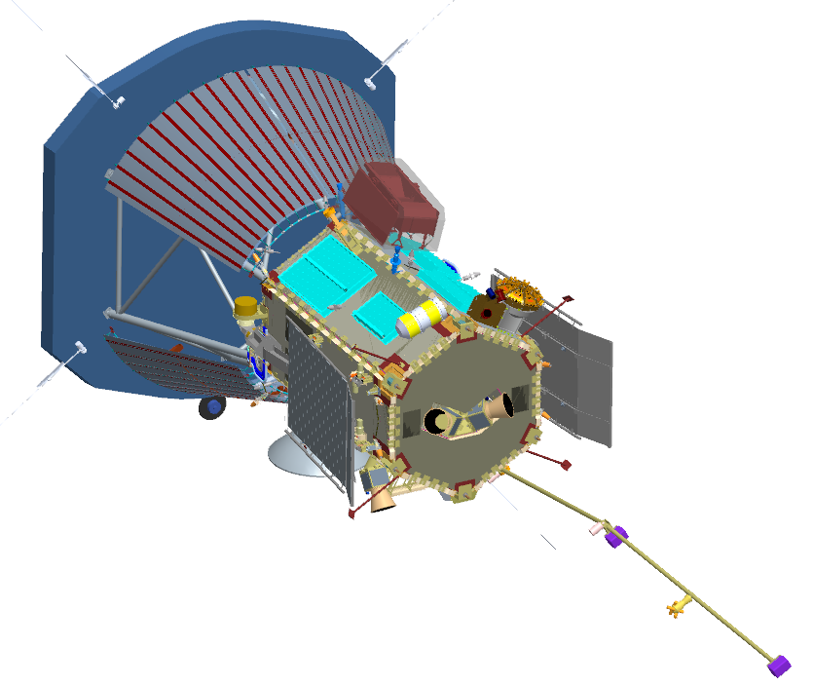
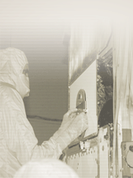


ISIS Spacecraft Accommodations
WISPR
TPS
Limb Sensor
Star Cameras
+X (RAM)
+Z (SUN)
+Y
Mag Boom
Notes:
ISIS is mounted on S/C in RAM direction to maximize science return
The major impacts on our fields-of-view are the TPS, WISPR, Limb Sensors, and Mag Booms
We are most sensitive to FOV in the +Z (sunward direction)

Slide 16
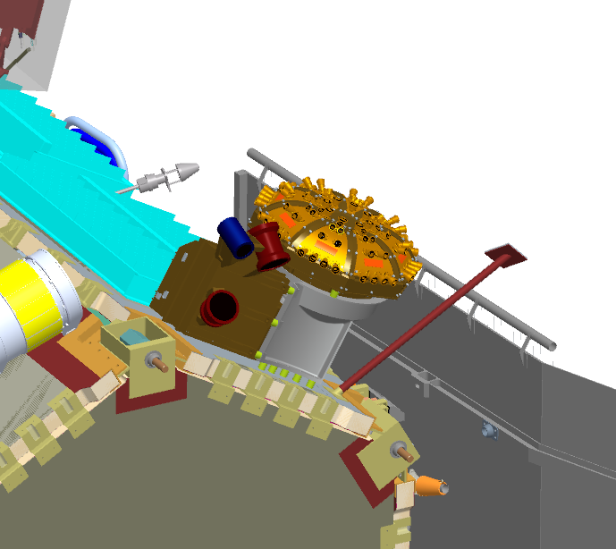

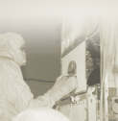
Mechanical Interfaces
  ISIS suite mounted as a single unit on the spacecraft deck
  EPI-Hi & EPI-Lo are thermally isolated from ISIS bracket; ISIS bracket is thermally isolated from the spacecraft deck
  ISIS is mounted in order to keep both EPI-Hi and EPI-Lo adjacent to the umbra
  Harness, Purge, Grounding, MLI all still being developed, but can easily be accommodated into existing design
EPI-Hi
EPI-Lo

Slide 17
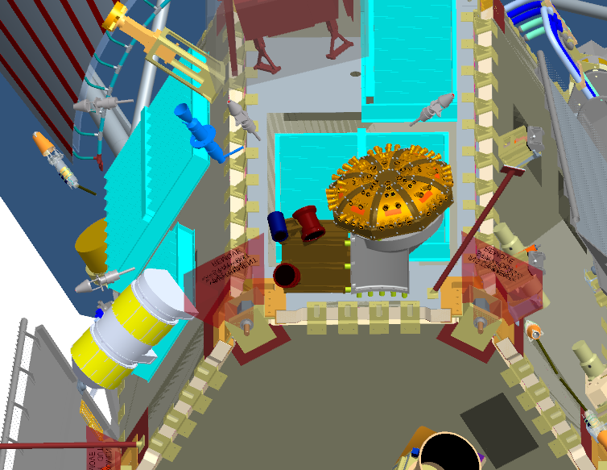
Spacecraft Sep Plane Keep Out Zone
Ample clearance between EPI-Lo and S/C
EPI-Hi to S/C Sep Conn. is ~2 cm
Notes:
Other KOZ’s that will likely be clarified later: purge/harness routing
Not shown: minimize shadowing of the louvers, will work with S/C when developing harness/purge/MLI

Slide 18
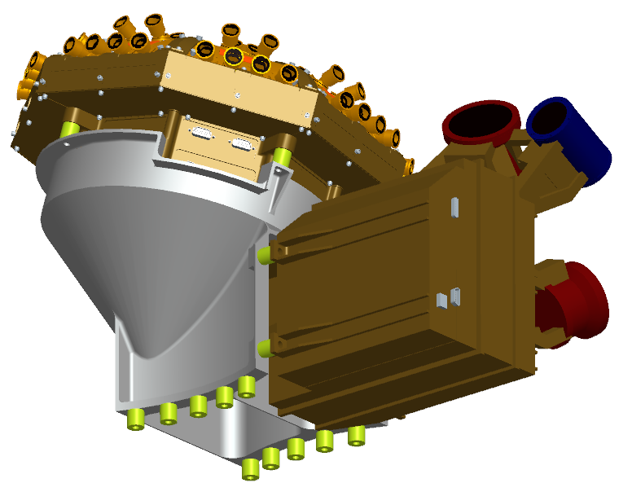
ISIS Instrument Mounting to Bracket
ISIS mounting bracket provides common mounting for both EPI-Hi and EPI-Lo
Bracket keeps instruments close to umbra with a minimal footprint on the spacecraft deck
EPI-Hi and EPI-Lo can each be attached independently to the bracket, in either order, before or after the bracket is mounted to the spacecraft deck
EPI-Lo
EPI-Hi
Bracket
Thermal Isolators used between: Bracket & EPI-Hi Bracket & EPI-Lo

Slide 19
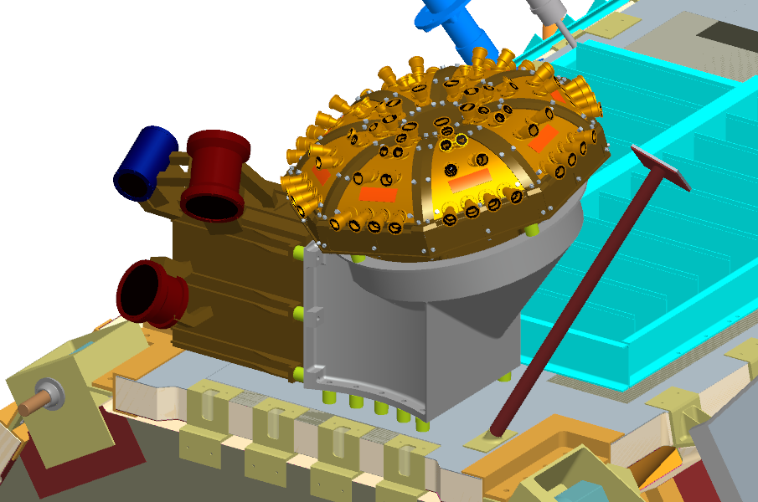
ISIS Mounting to Spacecraft Deck
ISIS bracket mounts on a very small footprint, keeping away from spacecraft structural elements and other deck-mounted components
ISIS bracket allows for flexibility in mounting order of EPI-Hi and EPI-Lo, and accommodates easy access to EPI-Hi and EPI-Lo mounting interfaces and spacecraft interfaces (i.e. harnesses)
Bracket can be easily moved to accommodate TPS growth to keep EPI-Hi and EPI-Lo close to the umbra
Limb Sensor (minor EPI-Lo FOV obstruction)
Thermal Isolators
Louver

Slide 20
Relationship of ISIS to TPS Umbra
Bracket height can increase in the event of a late TPS shift (Direction of motion shown)

Slide 21
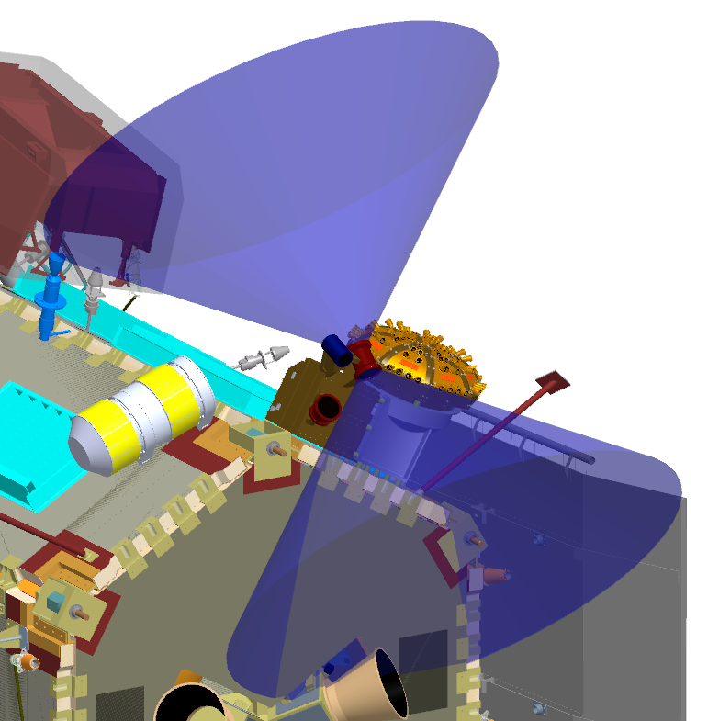
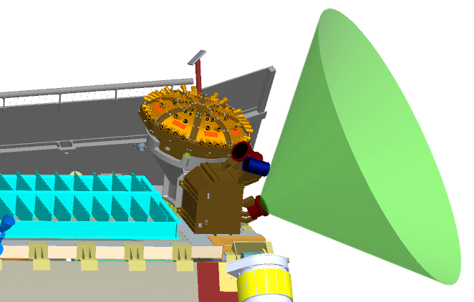
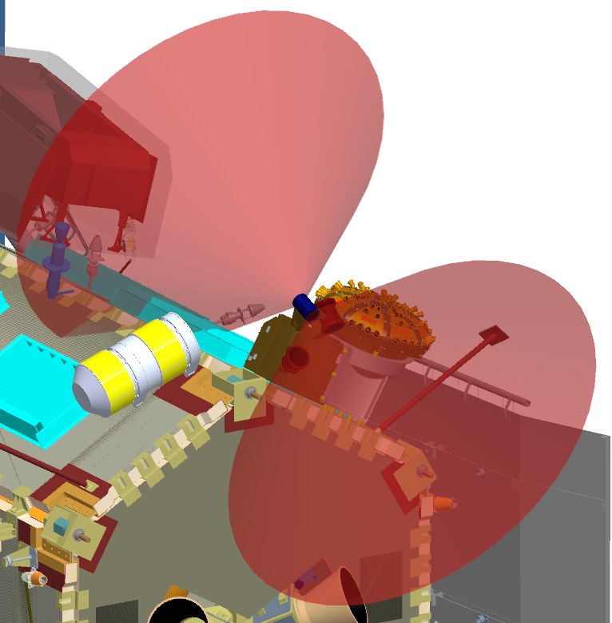
EPI-Hi Field Of View
All EPI-Hi telescopes have the same FOV shape as dimensioned in LET-2
LET-2
LET-1
45°
90°
HET

Slide 22
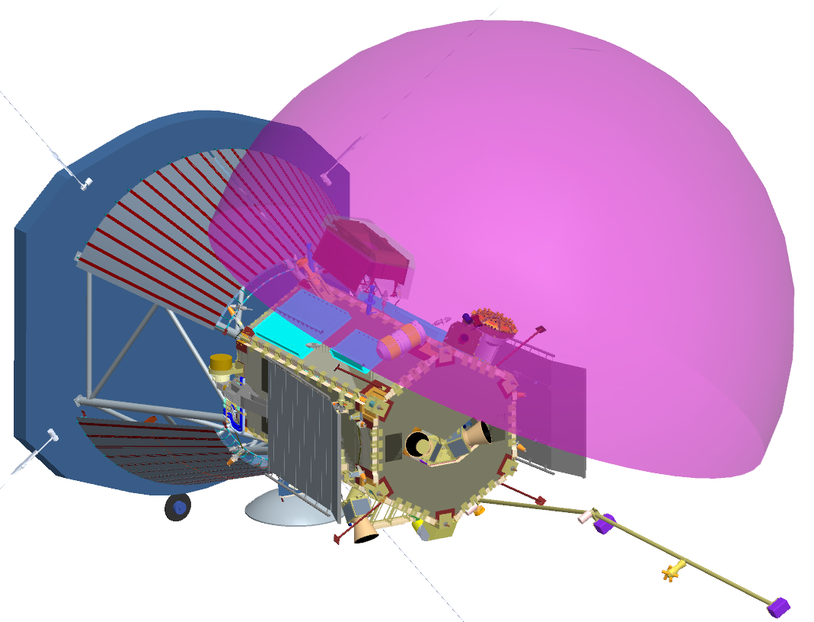
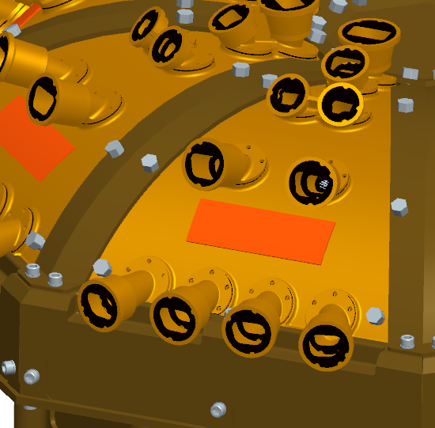
EPI-Lo Field Of View
EPI-Lo FOV is comprised of 80 individual apertures, which together approximate a half-dome
189°

Slide 23
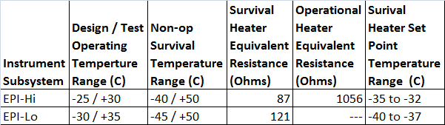
Thermal Interfaces
EPI-Hi:
  Both survival and operational heater services from the spacecraft
  Instrument controls operational heater
  Spacecraft controls survival heater
  Has 5 temp sensors monitored by spacecraft
EPI-Lo:
  Has a dual use survival/operational heater, used during survival conditions, instrument pre-on warm-up, and in low power modes
  EPI-Lo has 2 temp sensors
Ground strap is thermally isolated
Notes:
EPI-Hi has both survival and operational heater services from the S/C
EPI-Hi controls operational heater, S/C controls survival heater
EPI-Lo has a dual use survival/operational heater, used during survival conditions, instrument pre-on warm-up, and in low power modes
EPI-Lo has 2 temp sensors
EPI-Hi has 5 temp sensors monitored by S/C

Slide 24
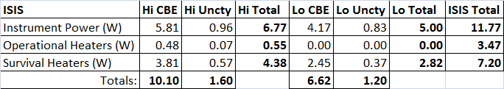
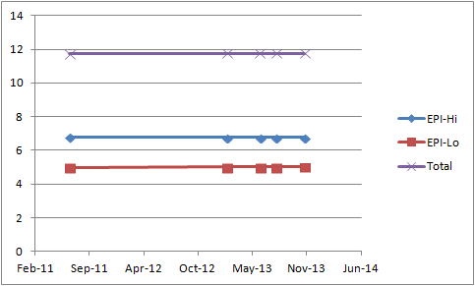
Resources - Power
ISIS Current Best Estimates and Uncertainties
During Survival, heater power is duty cycled to ensure instrument stays above survival temperature
During Warm-up, heater has a 100% duty cycle to warm the instrument prior to normal operations (Encounter Mode)
Because all resources on SPP are tightly constrained, mass and power estimates have been rigorously maintained based on heritage instruments from the beginning
As a result of this attention to rigorous estimation, there has been no change in instrument power allocation over time
Notes:
ISIS maintains individual Current Best Estimate values on each instrument
An Uncertainty on these estimates is suggested by the cognizant engineer and carried at the ISIS project level
The total CBE + Uncertainty remains within the S/C allocation for the instruments
For power, individual modes and power services are broken out for different phases in the mission
SW COMMENTS: Break this up into 2 slides (maybe)

Slide 25
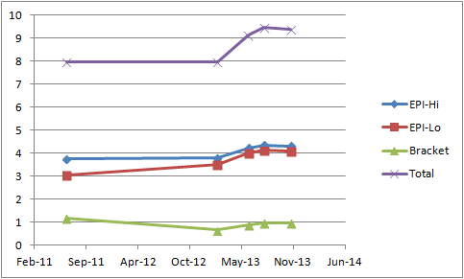
Resources - Mass
ISIS Current Best Estimates and Uncertainties
With the spacecraft orbit change, the Instruments were asked to propose key areas to increase mass to reduce risk (in June 2013)
This increased instrument allocation by 1.5 kg.
Three Selected Requests | Risk Addressed
ISIS Bracket Change to Follow Umbra at TPS Shift | APL to hold additional 0.100 kg as lien.
Increase Size of Four EPI-HI Boards | Mitigate board area allocation risk.
Heavier Than Expected MCPs | Realized mass growth.
Total: | 1.536 kg
Notes:
ISIS Mass estimates have also been very stable.
With the S/C orbit change, the Instruments were asked to choose key areas to increase mass to reduce risk (in June, 2013)
This enabled ISIS to reduce the following risks: ISIS bracket change to follow late TPS shift, size increase of the four EPI-Hi boards to alleviate layout anxiety, and MCP mass that was heavier than expected.

Slide 26
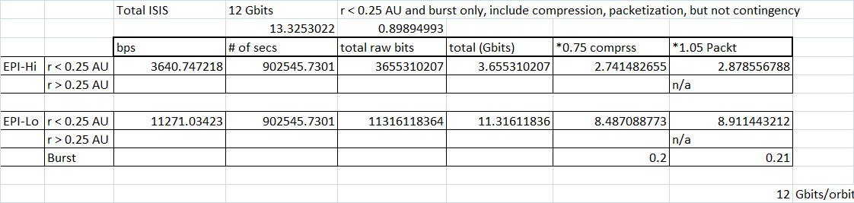
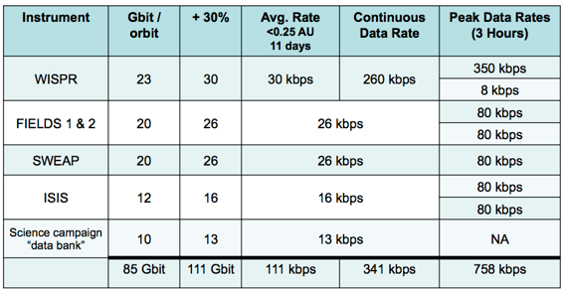
Resource - Telemetry
ISIS Telemetry request is unchanged since Phase A
Notes:
ISIS telemetry is unchanged since Phase A
S/C can accommodate our needs

Slide 27
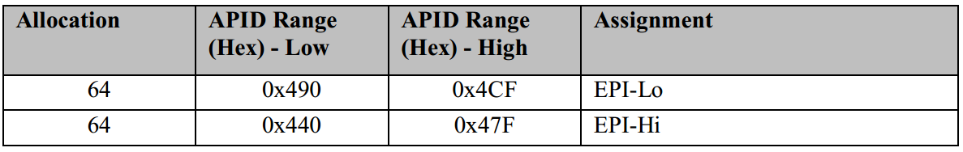
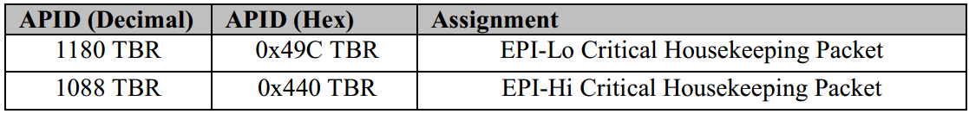
CCSDS APIDs
CCSDS APIDs assigned in SPP-ISIS ICD
EPI-Lo and EPI-Hi have each been allocated a contiguous range of 64 APIDs for CCSDS telecommand and telemetry packets.

Slide 28
Autonomy Summary
The spacecraft will monitor and respond to:
ISIS Power requests instrument critical housekeeping telemetry packet:
  instrument power-down (response = power-down)
  instrument power-cycle (response when < 0.25 AU = power-cycle; response when >= 0.25 AU = power-down)
ISIS Stale aliveness status as determined from the sequence count in the ITF (response when < 0.25 AU = power-cycle;
response when >= 0.25 AU = power-down)
Excessive ISIS power levels as determined from spacecraft Power Distribution Unit (PDU) telemetry (response = power-down)
Excessive ISIS temperature as determined from spacecraft Remote Interface Units (RIUs) (response = power-down)
ISIS is still working with the Project to flesh out all operational scenarios to ensure a comprehensive and feasible approach to ISIS autonomy.

Slide 29
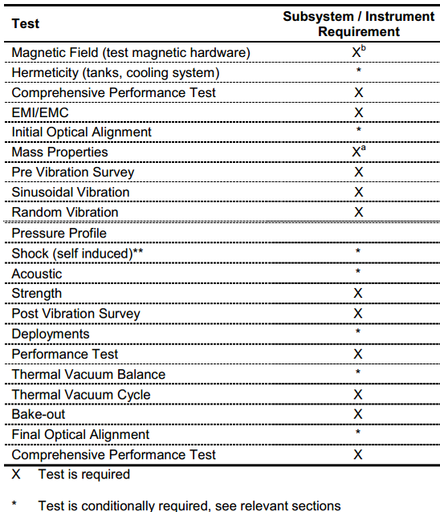
Environmental Requirements & Tests
Typical Test Flow for Components and Instruments (EDTRD)
Key Environmental Requirements set in EDTRD:
  Duration: 7 years
  Orbits: 24
  Solar Illumination: 1 sun on any aperture
  TID: 80 kRad behind 60 mils Al
  SEL: >80 MeV-cm2/mg
  Dust: Probability of no impact >95%
    EPI-Lo: >124.3 um particle diameter
    EPI-Hi: >68.5 um particle diameter
  Stiffness: >80 Hz Res. Freq.
  Shock: 40G @ 100 Hz at separation interface
Not Performed on ISIS
Notes:
ISIS is prepared for all Environmental testing levied by EDTRD
As will be shown in the AI&T presentation, ISIS undergoes all prescribed environmental testing.

Slide 30
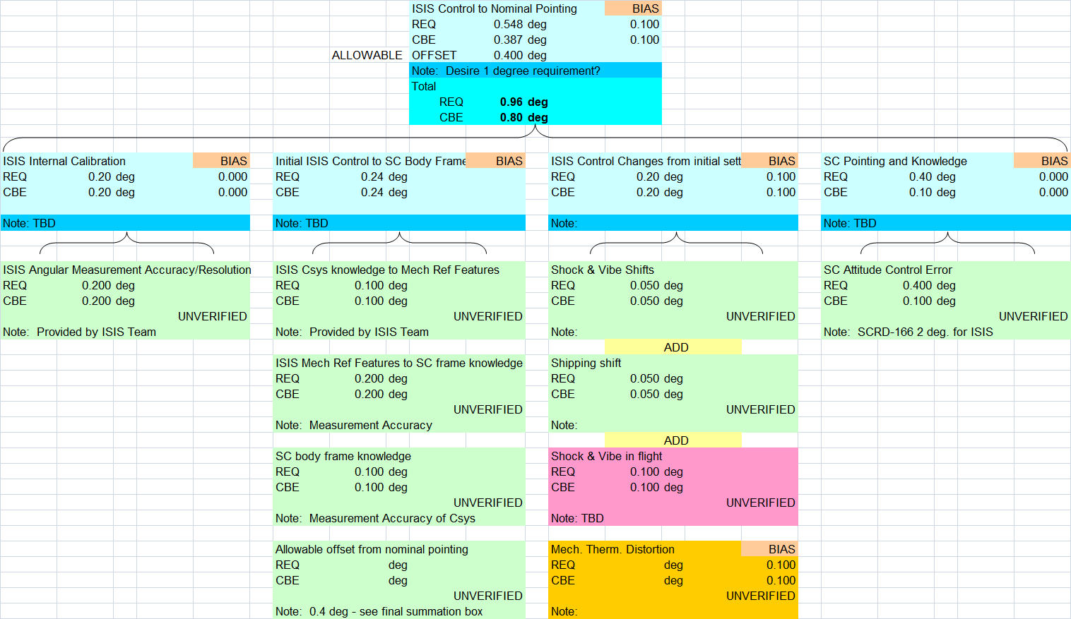
Pointing Requirements
ISIS Pointing Requirement: 1 deg accuracy, 0.25 deg knowledge
ISIS is not driving spacecraft pointing requirements
ISIS is working with the Project to define Pointing Budget
Notes:
ISIS requirements are within S/C capabilities
Flowdown and tolerances are well understood

Slide 31
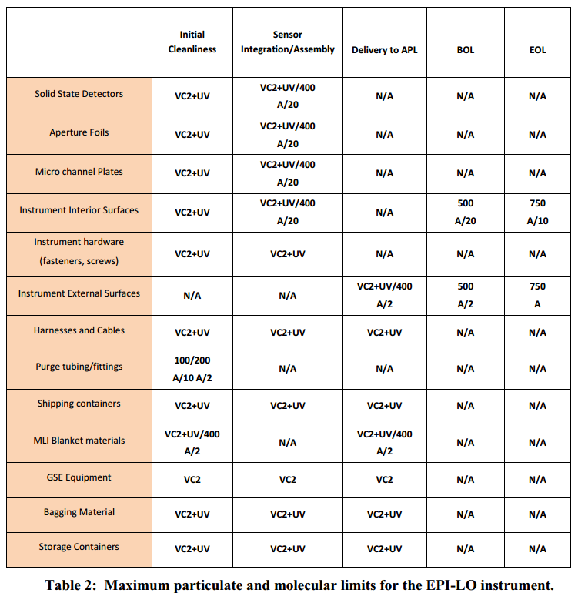
Contamination Requirements
Contamination requirements are defined in the Instrument Contamination Control Plans
The plans define the criteria for implementing contamination control during the manufacture, assembly, and test ISIS instruments
EPI-Lo has MCPs that drive ISIS contamination control requirements
Notes:
Contamination requirements are based on heritage missions, documented in EPI-Lo and EPI-Hi individual CCPs
Concerns include EPI-Hi detectors and EPI-Lo MCPs
Ground purge requirements are established w/S/C in SPP-ISIS ICD

Slide 32
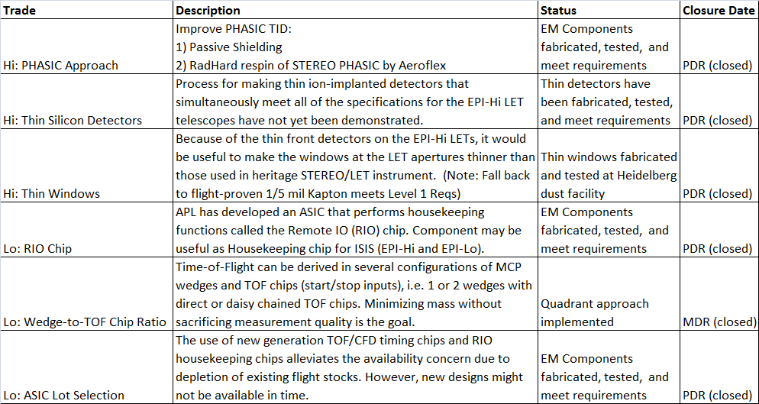
Trade Studies

Slide 33
Summary
ISIS takes a comprehensive and distributed approach to systems engineering
ISIS requirements are approached with flowdown and verification in mind
  ISIS has been involved at all levels of requirement generation
  Requirements flowdown is easily traceable and well understood
  ISIS design meets or exceeds all Level 3 requirements
ISIS to Spacecraft electrical, mechanical, and thermal interfaces are well described in the ICDs
ISIS Resource estimates are within spacecraft allocations
  ISIS has cultivated a reputation as a good steward of mission resources
Plans are in place for Environmental Testing and AI&T
ISIS has demonstrated tremendous design and definition maturation throughout Phase B

Slide 34
Backup

Slide 35
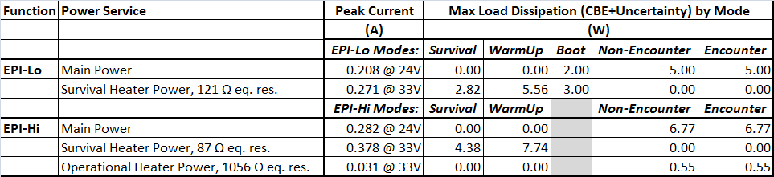
Power by Mode
ISIS Current Best Estimates and Uncertainties
ISIS Power by Mode and service
EPI-Lo has a low-power Boot safe-hold mode in which survival heaters are used as operational heaters to maintain instrument above Cold Op. temps
EPI-Hi is either on or off
During Survival, heater power is duty cycled to ensure instrument stays above survival temperature
During Warm-up, heater has a 100% duty cycle to warm the instrument prior to normal operations (Encounter Mode)
Notes:
ISIS maintains individual Current Best Estimate values on each instrument
An Uncertainty on these estimates is suggested by the cognizant engineer and carried at the ISIS project level
The total CBE + Uncertainty remains within the S/C allocation for the instruments
For power, individual modes and power services are broken out for different phases in the mission
SW COMMENTS: Break this up into 2 slides (maybe)

