Slide 1
ISIS Overview
Scott Weidner
ISIS PM (SwRI)
This document contains technical data that may be controlled by the International Traffic in Arms Regulations (22 CFR 120-130) and may not be provided, disclosed or transferred in any manner to any person, whether in the U.S. or abroad, who is not 1) a citizen of the United States, 2) a lawful permanent resident of the United States, or 3) a protected individual as defined by 8 USC 1324b(a)(3), without the written permission of the United States Department of State.
Notes:
introduction

Slide 2
Outline
ISIS Organization Chart
ISIS Suite
Spacecraft Accommodation
Changes since MDR
Development Status
Summary

Slide 3
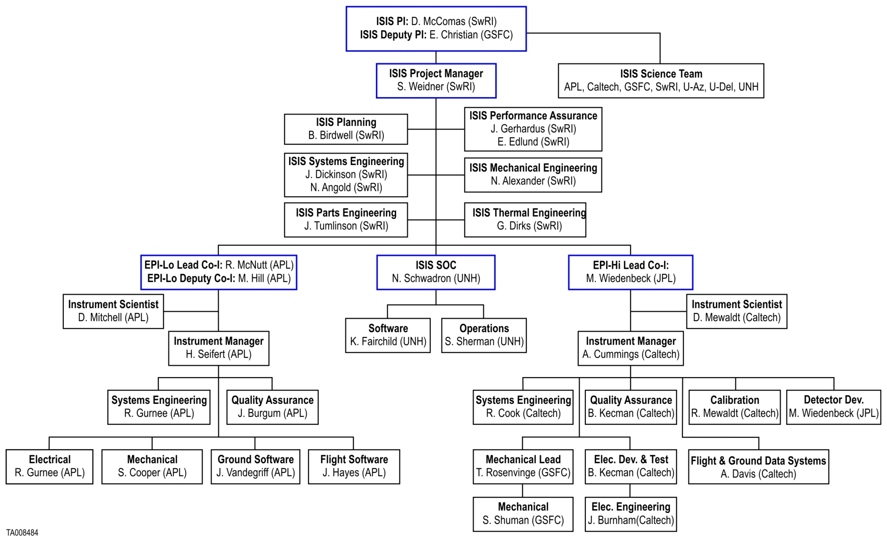
ISIS Team

Slide 4
ISIS Suite
EPI-Lo
ISIS Energetic Particle Suite
Measures energetic particles, including electrons, protons, and heavy ions
Two instruments for wide energy coverage
EPI-Hi (Caltech, JPL, & GSFC)
EPI-Lo (JHU/APL)
ISIS Allocations
Mass: 9.383 kg
Power: 11.768 W
Telemetry: 12 Gbit/orbit
ISIS
Bracket
EPI-Hi

Slide 5
ISIS EPI-Hi
Three Telescopes
HET – High energy
LET1 – Low energy
LET2 – Low energy, single-ended
Energy Range
Ions:
1 MeV/nucleon – 50 MeV/nucleon
Electrons:
0.5 MeV – 3 MeV
FOV: ≥π/2 sr in sunward and anti-sunward hemispheres (incl. 10°from S/C-Sun line)
LET1
HET
LET2
Electronics
Box

Slide 6
ISIS EPI-Lo
8 Wedges configured in 4 independent quadrants
Energy Range
Ions:
50 keV/nucleon –
15,000 keV Total E
Electrons:
50 – 500 keV
Nearly 2-π FOV
Sensor
Wedges
Electronics
Housing

Slide 7
Spacecraft Accommodation

Slide 8
Late-Breaking Trade with the S/C
New Solar Limb sensor appeared in S/C model near ISIS
Analysis of the effect on our FOV is on-going
No “show stoppers” expected but analysis and accommodation needs to be completed
Working the process-issues with the Spacecraft team

Slide 9
Changes Since MDR
No changes to Science
EPI-Lo electronics box reduced in diameter and fits inside the ISIS bracket
Updated design for EPI-Hi electronics box
ISIS bracket modified to accommodate the Ebox changes
Mass increased as part of risk-reduction process run by the SPP spacecraft when the nominal orbit was modified
Power and telemetry have held steady with some reductions in uncertainty
Two small additions
EPI-Hi added a background pixel
EPI-Lo added an anti-coincidence detector
Both of these use spare resources of existing electronics and provide large payoff for dynamic range

Slide 10
Development Status
Successfully completed TRL6 Technology Developments
Developed requirements flow-down with SPP Spacecraft
ICDs with the Spacecraft are signed-off
Preliminary analyses completed
Prototypes of new circuits have been built and tested
Completed preliminary designs
In most areas we are right on track
In some areas we are beyond a PDR-level and EM fabrication is underway
Five different ASICs within ISIS
All have completed EM build or FM build
We’ve brought in coast-to-coast teams to help Peer Review details of each subsystem

Slide 11
Summary
In Phase B, the ISIS team has completed definition, preliminary design, and analysis work for the suite
The presentations ahead will be taking you through all of the details
We look forward to your feedback on our plans and preliminary designs

