Slide 1
Instrument Development Status
Scott Weidner
Notes:
introduction

Slide 2
Outline
Key Dates
EPI-Hi EM Schedule
EPI-Lo EM Schedule
EPI-Hi FM Schedule
EPI-Lo EM Schedule
Critical Path, Reserves, and Slack
Schedule Threats and Mitigations
Summary

Slide 3
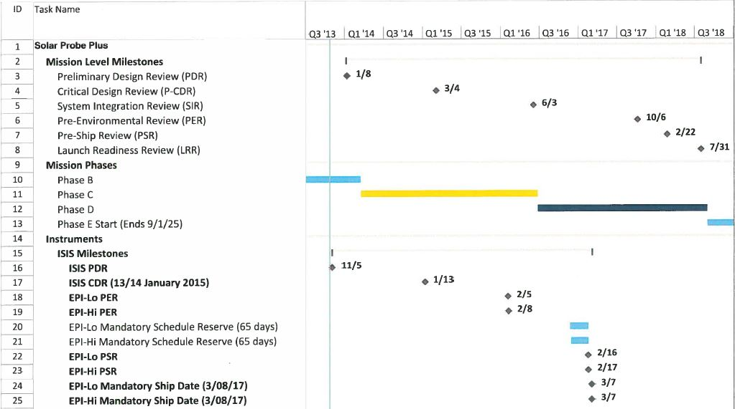
ISIS Schedule Key Dates

Slide 4
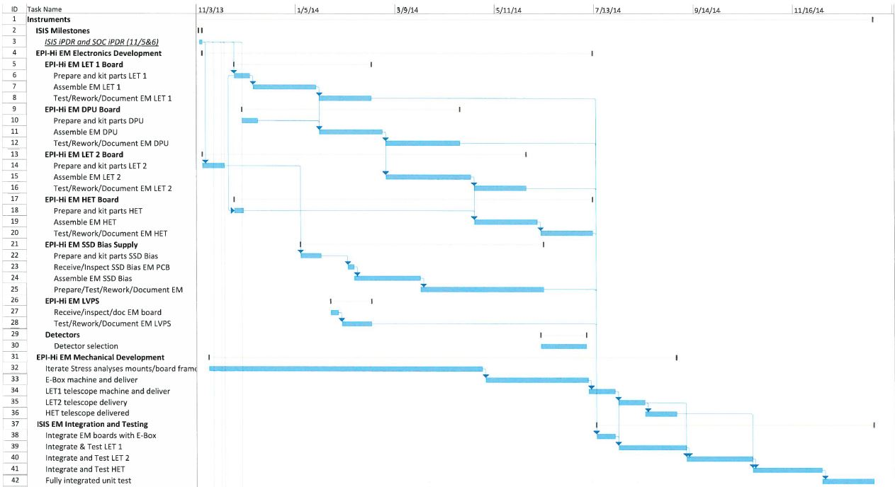
ISIS Schedule: EPI-Hi EM
<= Should Say EPI-Hi EM

Slide 5
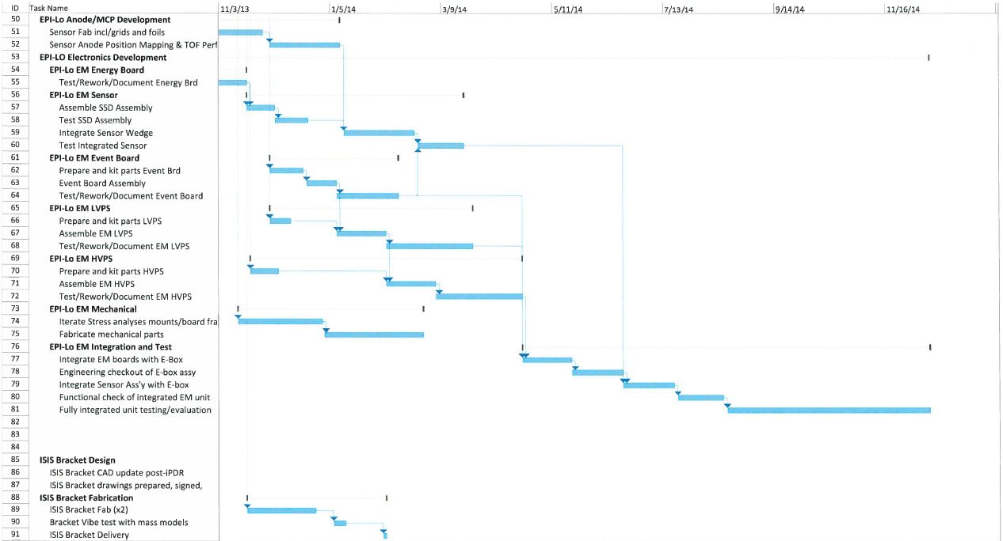
ISIS Schedule: EPI-Lo EM and Bracket

Slide 6
ISIS Schedule: EPI-Hi FM
Insert FM Flow

Slide 7
ISIS Schedule: EPI-Lo FM and Bracket
Insert FM Flow

Slide 8
Critical Path, Reserves, and Slack
The ISIS Critical Path goes through [barry insert]
65 days of Reserves in-line with month/year reserves to delivery
Within the schedule, there is slack between tasks to keep schedule pushed to the left even beyond the Reserves
Earned Value already in use during Phase B to help keep a realistic picture of progress being made and provide early warning

Slide 9
Schedule Threats and Mitigations
Schedule Threats
TRL6 development and other Phase B work eliminated the most serious schedule threats
New detectors, new ASIC designs
Long-lead parts always need to be watched
So far we’ve had excellent performance from Micron Semiconductor
Interfaces between institutions require extra attention
GSFC to Caltech with Mechanical and Detector Deliveries
JHU/APL to Caltech with LVPS Deliveries
Mitigations
Planner provides weekly Look-Ahead List to the ISIS team
Weekly coordination meetings with all institutions
EM testing used to mitigate FM schedule risks
Earned Value Management provides early warning
Planner provides detailed analysis and coordinates with SPP

Slide 10
Summary
ISIS Team has performed well during Phase B
TRL 6 Achieved for all of the ISIS Technology Development
New design elements have been prototyped and tested
Requirements Defined
Baseline of ICDs and Requirements Documents
Detailed Preliminary Design completed
Schematics and mechanical designs Peer Reviewed
Early Analyses show good margins
Trade studies in Phase B have reduced risk
ISIS is on track to proceed into Phase C on schedule

